Slide 1


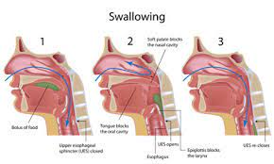
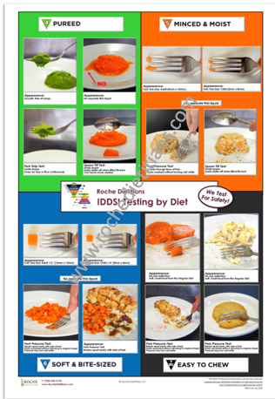
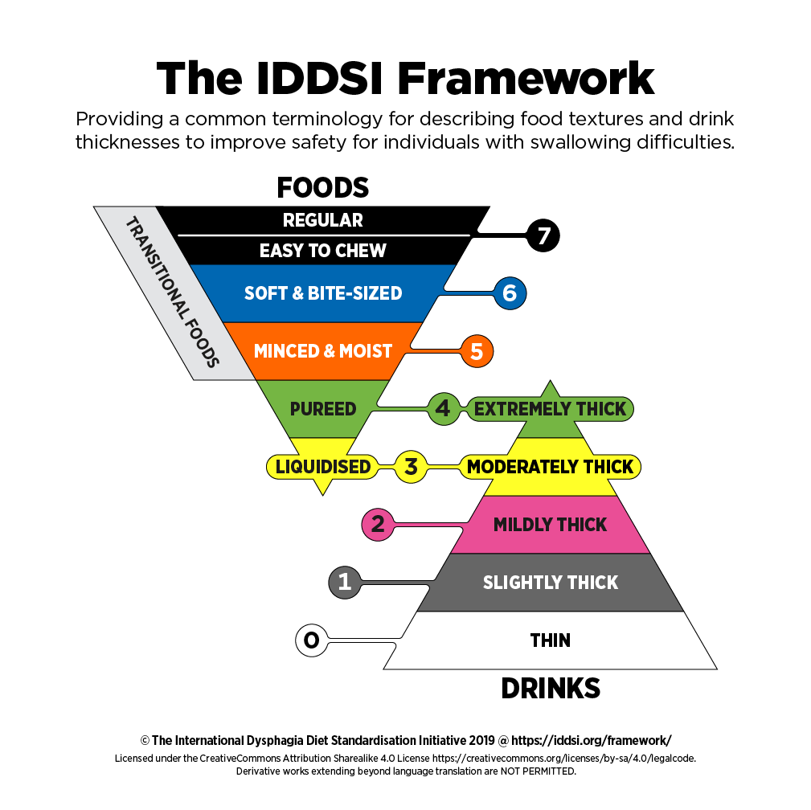
Factors of adherence to modified diets in individuals with dysphagia
Abigail Klemm, & Sharyl Samargia-Grivette, Ph.D., CCC-SLP
Introduction
Purpose and Hypotheses
Results
Dysphagia is the term used to describe difficulty swallowing. Individuals with dysphagia are at high risk for respiratory illness including pneumonia leading to increased hospitalizations and even death due to laryngeal aspiration of foods and liquids (Figure 1). Speech-language pathologists provide assessment and intervention services for this population. One compensatory strategy often recommended is the implementation of a modified diet.
The International Dysphagia Diet Standardization Initiative (IDDSI) developed a framework for the levels of modified diets (Figure 1). Past studies report adherence to modified diet range from 0% to 80%, all of which were conducted in residential facilities in which meals were prepared for the individuals. One study reported reasons for nonadherence to include: 1) denial of a swallowing problem 2) dislike of dietary modifications 3) limited education about the problem and plan, and 4) impact the new diet has on social and mental wellbeing.
Purpose: The purpose of this research is to identify the rate of and reasons for non-adherence to modified diets in individuals with dysphagia living in private residences in the community. A secondary purpose is to and examine the relationship between diet level and adherence.
Hypotheses:
1. Individuals living at home will report factors to non-adherence will
include environment, convenience, access to products and recipes and lack of training in the process of modification of food and liquids.
2. There will be a statistically significantly different rate of adherence between groups with groups requiring more modification having poorer adherence.
3. There will be a large, positive, statistically significant relationship between diet level and adherence level; as the diet level decreases (requires more modification), the poorer the adherence.
Participants: Thirty adults over the age of 18 years that have been diagnosed with dysphagia and are on a modified diet are being recruited. As part of the survey, participants are assigned to groups based on the level of modified diet they have been prescribed. Exclusion criteria include individuals who 1) are living in a residential facility, 2) have dementia or Alzheimer’s disease, or any other neurologic condition negatively impacting their ability to provide consent and/or respond reliably to survey questions.
Recruitment: Participants are being recruited through emailing local speech-language pathologists, posting in dysphagia support group pages on Facebook, and posting on the National Foundation of Swallowing Disorder’s social medias and support group.
Study Design: After eligibility is confirmed and consent is obtained, participants are directed to a 46-item online survey (Table 1).
Seven people have consented to the survey but have not yet completed the survey. Recruitment and enrollment is ongoing. Upon completion of data collection, an ANOVA will be conducted to compare differences in adherence between diet level groups. A linear regression will be conducted to identify predictors for adherence and non-adherence to modified diets.
This research is significant because there is currently no research that has been done on this specific population: adults living in their private residences in the community that fill out the survey themselves. All research in adherence has targeted individuals in residential care facilities and/or caregivers and healthcare workers. There is a large population of individuals with dysphagia living in private homes in the community who have the responsibility of preparing their meals. Awareness of adherence in this population will inform the field of speech-language pathology regarding factors of non-adherence and will lead to plans to improve adherence in this population.
Centers of Excellence for Relapse Prevention. (n.d.). Adherence rating scales. https://easacommunity.org/files/Medication%20Adherence%20Scale.pdf
International Dysphagia Diet Standardization Initiative. (2019, July 31). Complete IDDSI Framework and Detailed Definitions 2. https://iddsi.org/IDDSI/media/images/Complete_IDDSI_Framework_Final_31July2019.pdf
King, J. M., & Ligman, K. (2011). Patient Noncompliance With Swallowing Recommendations: Reports From Speech-Language Pathologists. Contemporary Issues In Communication Science and Disorders, 38, 53-60. https://doi.org/10.1044/cicsd_38_S_53
Krekeler, B. N., Broadfoot, C. K., Johnson, S., Connor, N. P., & Rogus-Pulia, N. (2018). Patient Adherence to Dysphagia Recommendations: A Systematic Review. Dysphagia, 33, 173-184. https://doi.org/10.1007/s00455-017-9852-9
Leiter A, Windsor J. (1996). Compliance of geriatric dysphagic patients with safe-swallowing instructions. Journal of Medical Speech Language Pathology, 4, 289-299.
Low, J., Wyles, C., Wilkinson, T., & Sainsbury, R. (2001). The effect of compliance on clinical outcomes for patients with dysphagia on videofluoroscopy. Dysphagia, 16(2), 123-127.10.1007/s004550011002.
Rogus-Pulia, N., & Hind, Jacqueline. (2015). Patient-Centered Dysphagia Therapy -The Critical Impact of Self-Efficacy. Perspectives on Swallowing and Swallowing Disorders (Dysphagia), 24, 146-154. https://doi.org/10.1044/sasd24.4.146
Rosenvinge, S. K., & Starke, I. D. (2005). Improving care for patients with dysphagia. Age and Aging, 34(6), 587-593. https://doi.org/10.1093/ageing/afi187
Shim, J. S., Oh, BM., & Han, T. R. (2013). Factors Associated With Compliance With Viscosity-Modified Diet Among Dysphagic Patients. Annals of Rehabilitation Medicine, 37(5), 628-632. 10.5535/arm.2013.37.5.628.
Shune, S. E., Resnick, B., Zarit, S. H., & Namasivayam-MacDonald, A. M. (2020) Creation and Initial Validation of the Caregiver Analysis of Reported Experiences with Swallowing Disorders (CARES) Screening Tool. American Journal of Speech-Language Pathology, 29(4), 1-14. https://doi.org/10.1044/2020_AJSLP-20-00148
Vesey, S. (2013). Dysphagia and quality of life. British Journal of Community Nursing, 18(5),14-19. https://doi.org/10.12968/bjcn.2013.18.Sup5.S14
Clinical Significance
Figure 1: Midsagittal image of oral cavity, pharynx and larynx during swallowing and aspiration.
Methods
References
Acknowledgements
Figure 2: International Dysphagia Diet Standardization Initiative (IDDSI) framework
Figure 3: Food examples using the IDDSI framework. Copyright, Roch Dietitians.
Thank you to the University of Minnesota Duluth Undergraduate Research Opportunity Program for this opportunity.

