Slide 1
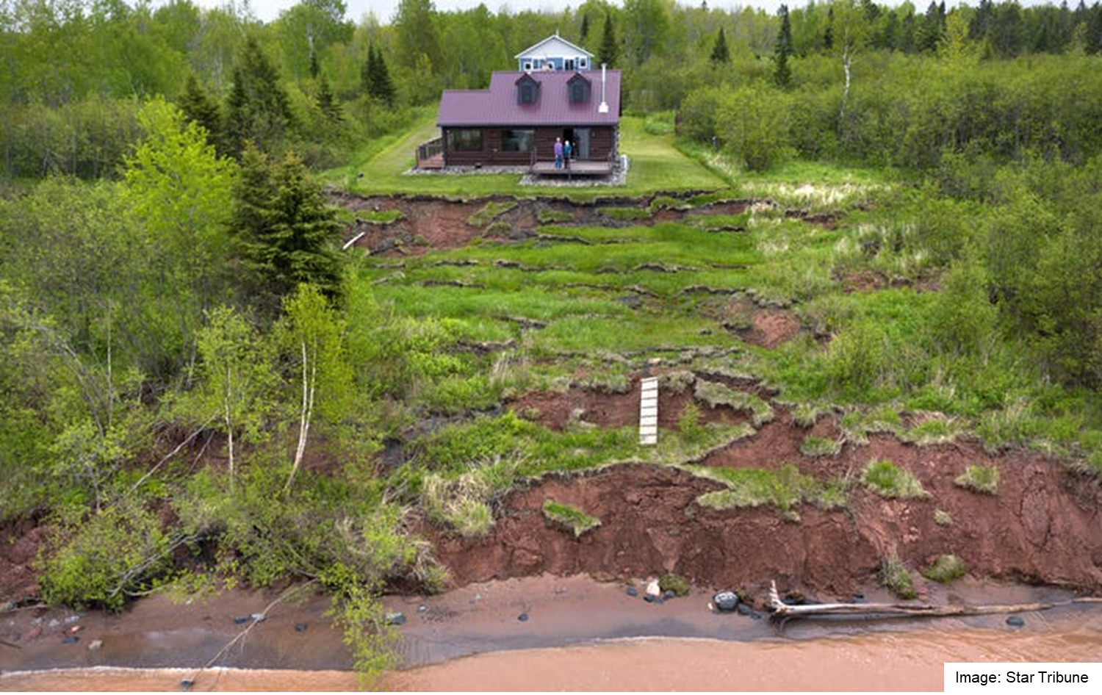

Bluff to Beach: Sand sources, sinks, and pathways in far western Lake Superior – implications for the genesis and evolution of Minnesota Point
Lake Superior bluff, Douglas County, WI
John B. Swenson
Department of Earth and Environmental Sciences
University of Minnesota Duluth
218-726-6844
jswenso2@d.umn.edu

Slide 2
Goals:
Present a source-to-sink framework for erosion, transport, and deposition of sand in the Duluth coastal region
Provide scientific insight—on geologic timescales—to guide long-term (human timescale) strategic planning
Expenditure of tens of millions of taxpayer dollars for mitigation of coastal erosion necessitates sound understanding of sediment pathways and rates
Acknowledgments:
Nigel Wattrus (UMD / LLO faculty)
Todd Kremmin (UMD grad student)
Andrew Dennison (UMD grad student)
Crystal Lambert (UMD undergraduate)
Andrew Breckenridge (UWS faculty)
Coastal Erosion Hazard Mapping (CEHM) Task Force colleagues

Slide 3
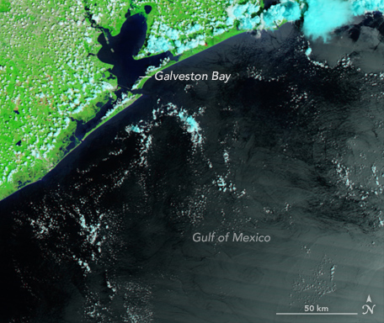
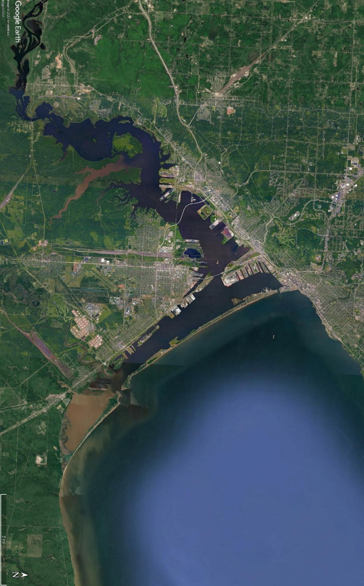
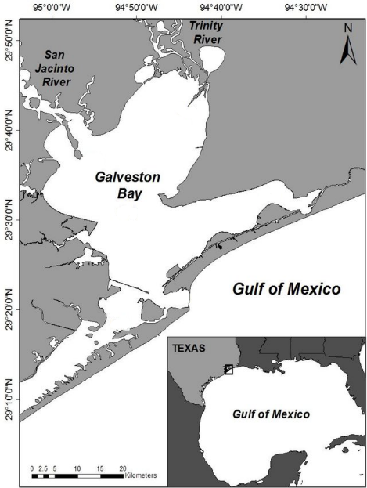
Comparing apples to apples: What is Minnesota Point?
Sand bar?
Spit?
Baymouth bar?
Does it matter?
Key point: Barrier island formation linked to sea-level RISE (simple reason = must drown river to form estuary)
Barrier island separating estuary (drowned river) from open ‘sea’

Slide 4
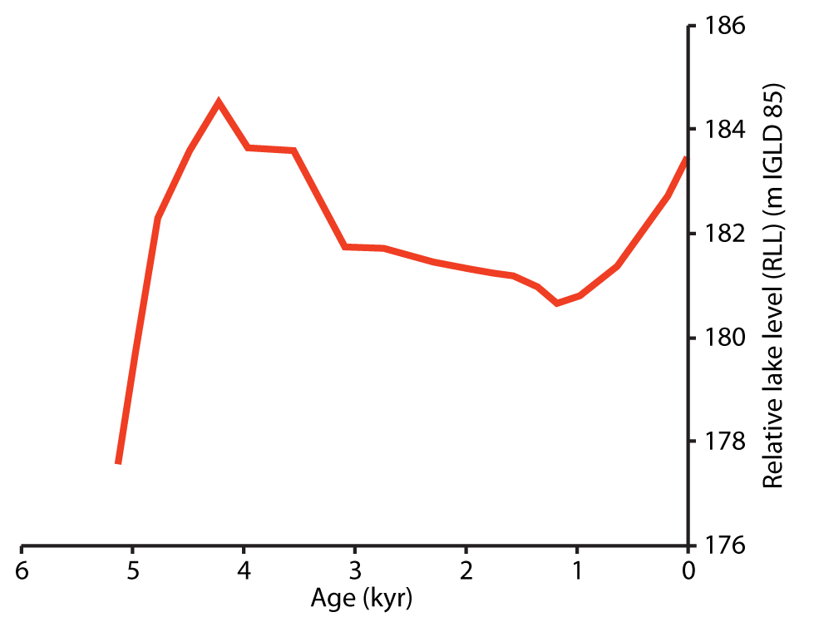
Long-term lake level change in Duluth area
Lake-level curve from Breckenridge et al. (2016), based in part on earlier work by Johnston et al. (2012), Yu et al. (2013), and Mainville and Craymer (2005)
Birth of Minnesota Point
Slowly falling lake level from about 4500 yr BP – 1200 yr BP
Change in outlet of Lake Superior @ ~ 1200 yr BP triggers rise in lake level
‘slow’ fall
Rise rate ~ 2.5 – 3.0 mm/a in Duluth = FAST (geologically speaking)
Birth of Connor’s & Rice’s Points
~ 1200 yr BP (+/- geologic slop)

Slide 5
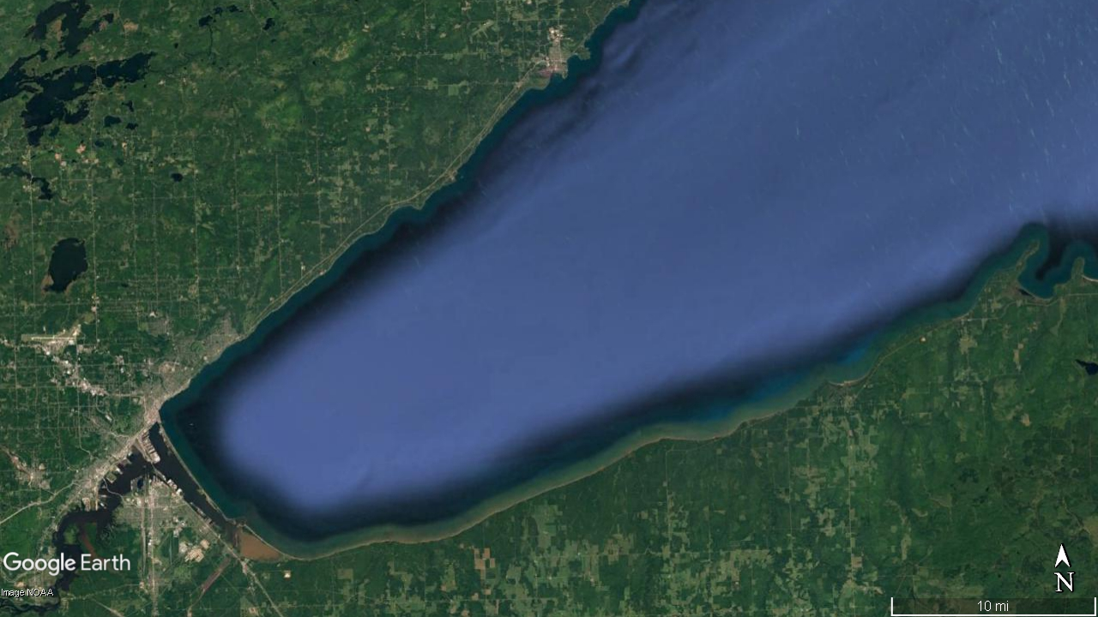
Sand sources: Riverine (fluvial) input
For all sediment sources:
Mud : Sand ratio ~ 10 : 1
N. Shore: Small catchments, low sediment yield
Riverine input trends (big picture):
No significant change in sediment yield for last 4500 years
  Except last 150 years ↔ land-use changes
From 1200 years BP – present, St. Louis & Nemadji progressively disconnected from coastal waters
St. Louis: Large catchment, very low sediment yield
From where else might we source sand?
Sand input (rivers)
S. Shore: Small & medium catchments, modest sediment yield
Nemadji: Medium catchment, high sediment yield

Slide 6
Sand sources: Bluff erosion
For all sediment sources:
Mud : Sand ratio ~ 10 : 1
Trends in bluff erosion (big picture):
Minor bluff erosion from 4500 - 1200 years BP
Profound INCREASE in bluff erosion @ 1200 years BP
1200 years BP – present: Bluff erosion driven by long-term lake-level rise
N. Shore: Bedrock cored; veneer of till (‘butter’)
Sand input (bluff erosion)
4500 – 1200 yrs BP
1200 yrs BP – present
S. Shore: Thick till (~ all ‘butter’)

Slide 7
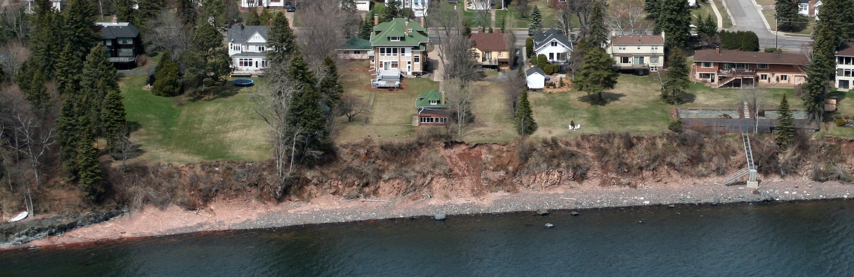
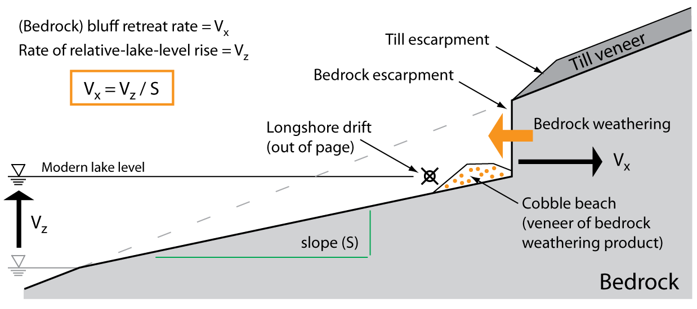
Rapid lake-level rise drives bluff erosion
Key Point: Nearshore lake-floor geometry holds information about long-term bluff-retreat rates
Contact between glacial till and underlying volcanic flow (bedrock)
Thin veneer of active beach cobbles
Diabase dike (intrusive rock): More resistant to weathering
(Lambert and Swenson, 2016)

Slide 8
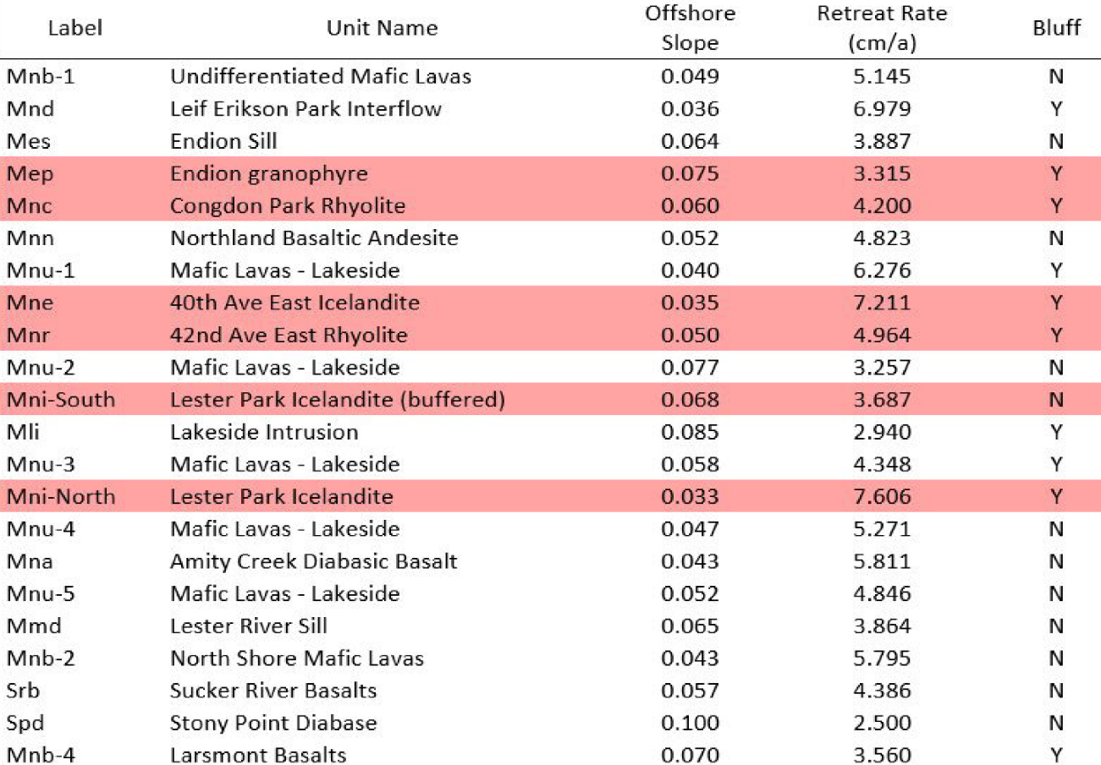
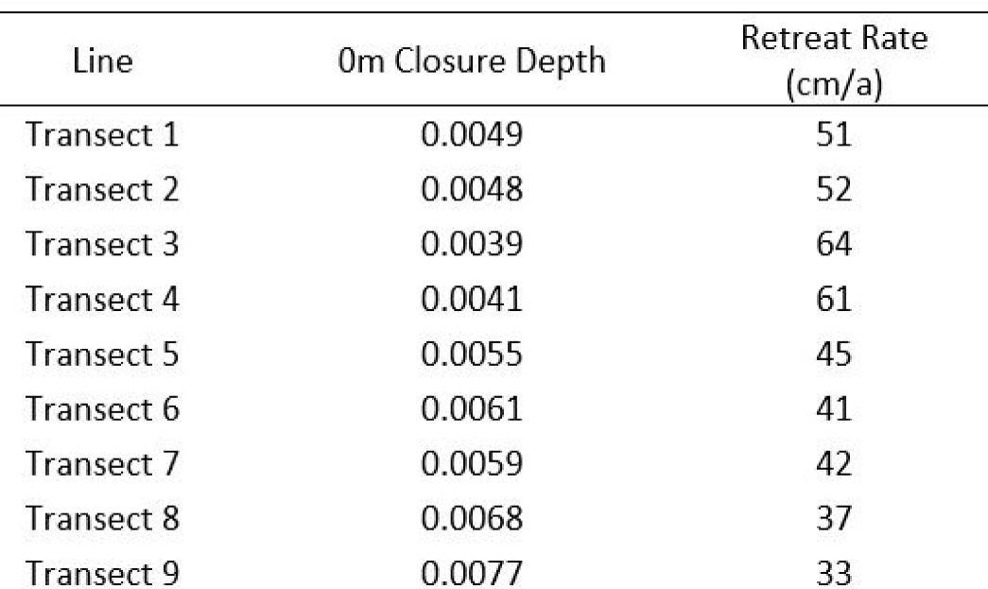
Long-term (multi-century) bluff erosion rates
Bedrock-cored north-shore bluff retreat rate ~ 5 cm/yr
Large variability because of mixed lithology, e.g. rhyolite vs. basalt vs. diabase
Offshore slope
Lambert and Swenson (2016)
South-shore bluff retreat rate ~ 50 cm/yr
Mechanically weak, unconsolidated till
Less variability -> homogenous till

Slide 9
Bluff retreat is driven by rise in lake level from ~1200 yr BP - present
North shore retreat rate ~ cms / year
Large variability (tied to lithology)
~ 5 cm/yr
South shore retreat rate ~ TENS of cms / year
Less variability (~homogeneous material)
~ 50+ cm/yr

Slide 10
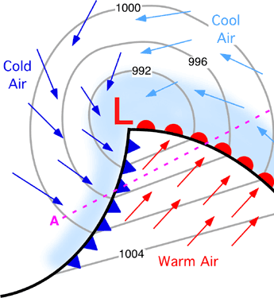
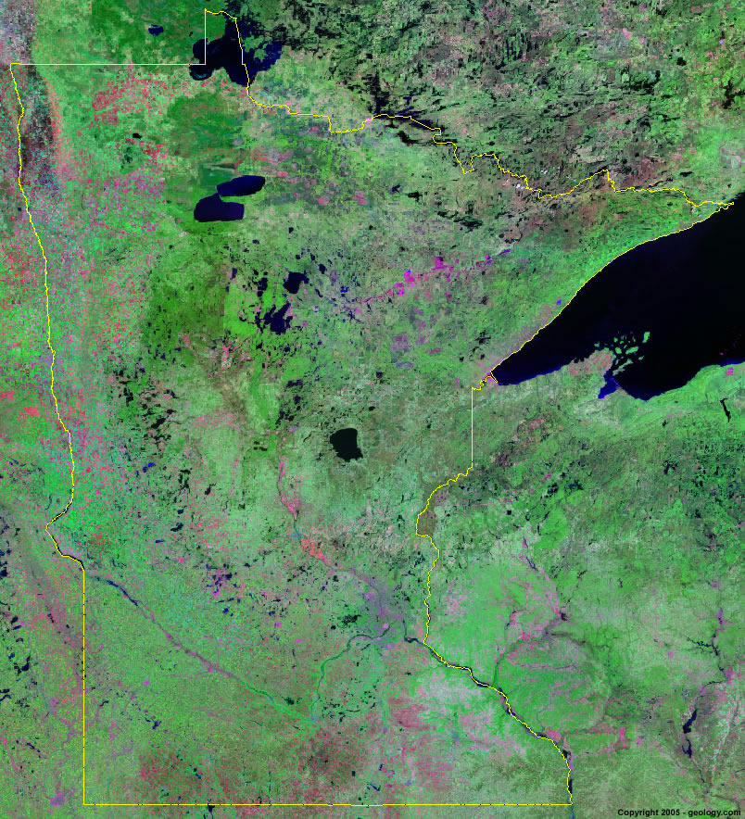
Transport pathways: Sand transported during ‘storms’ (cyclones)
Alberta Clipper
Nearly all extratropical cyclone tracks generate period of E – NE flow in the western arm of Lake Superior
Colorado Low / Texas Hook

Slide 11
Transport pathways: Net longshore transport of sand near Duluth
convergence = deposition (SINK)
Net erosional coastline
E- NE wind
wave crests
wave crests
Longshore sand transport
Net depositional
coastline
Net erosional coastline
St. Louis & Nemadji Rivers (potentially) add to net sediment convergence

Slide 12
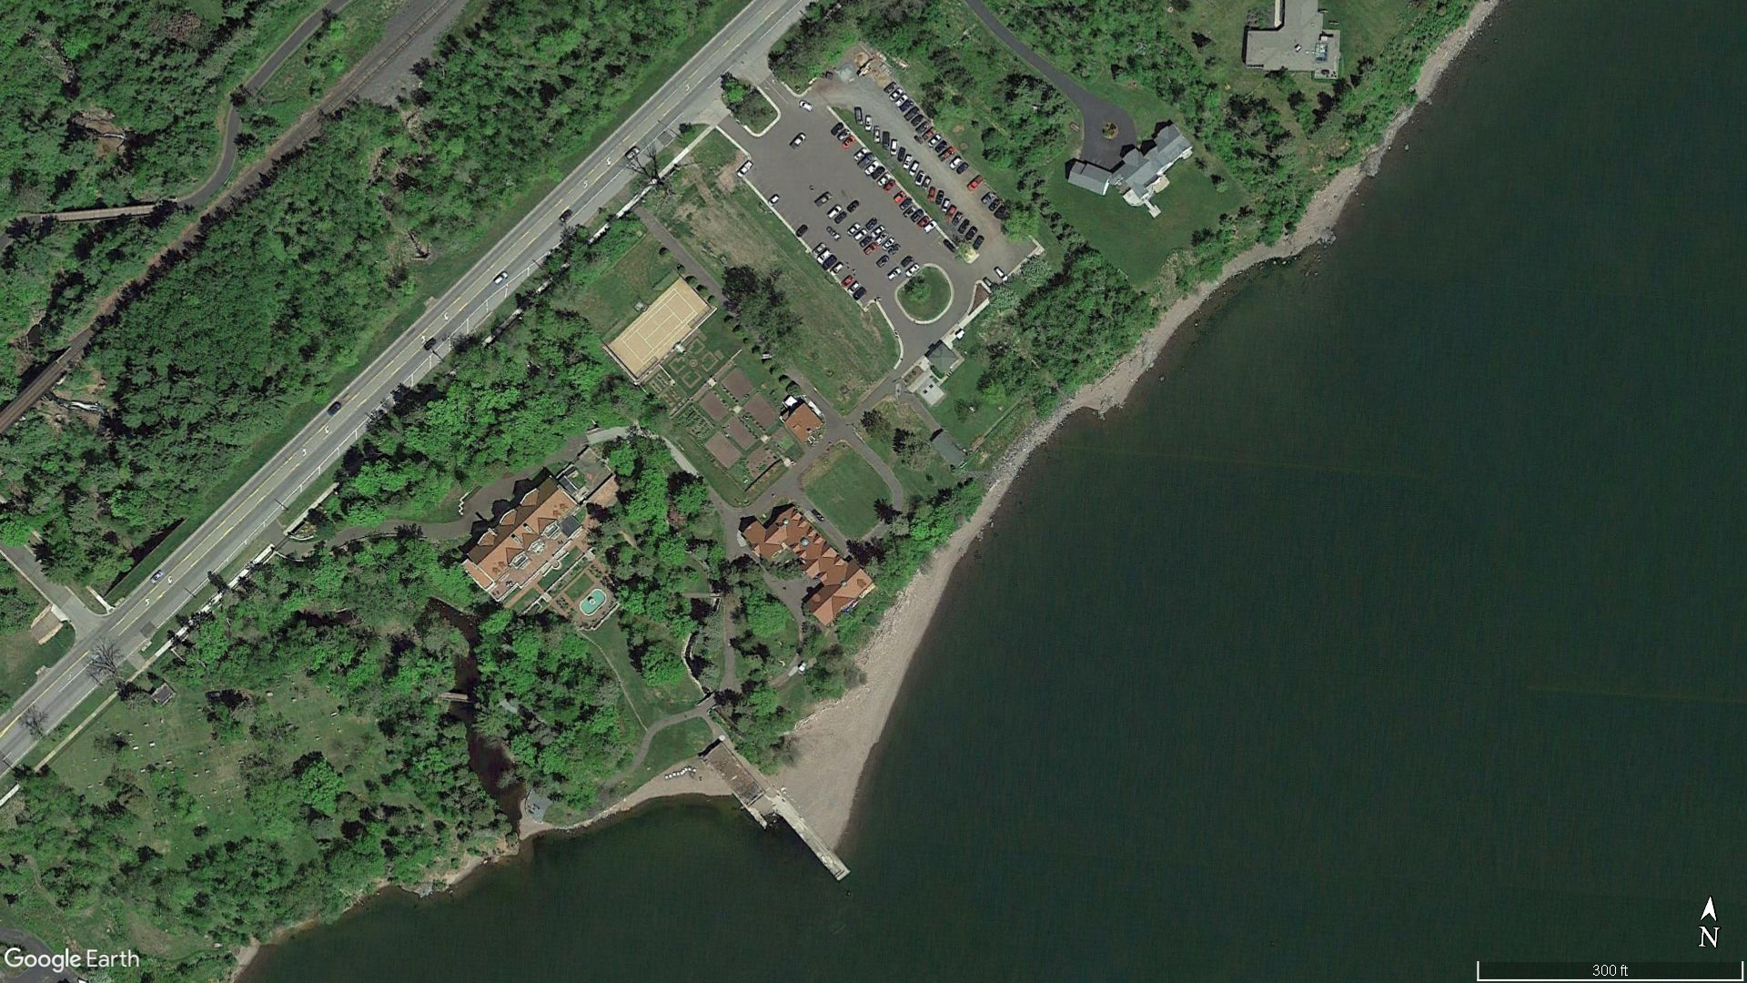
Net longshore transport near Duluth
Glensheen Mansion
wave crests
NET longshore transport
concrete dock: ‘dams’ river of sand
Transport pathways converge in the Duluth Harbor area. What type of depositional landform results?

Slide 13
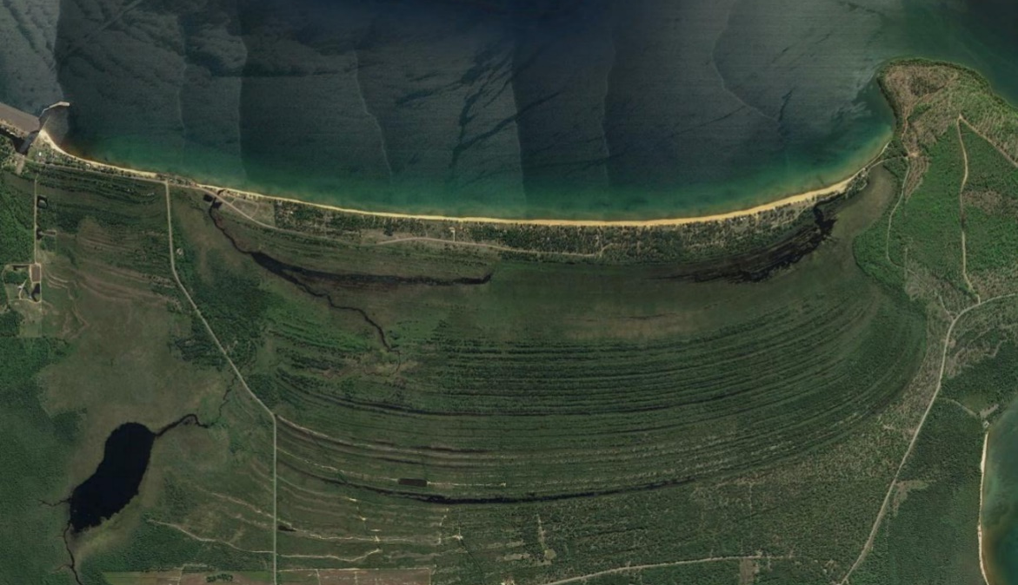
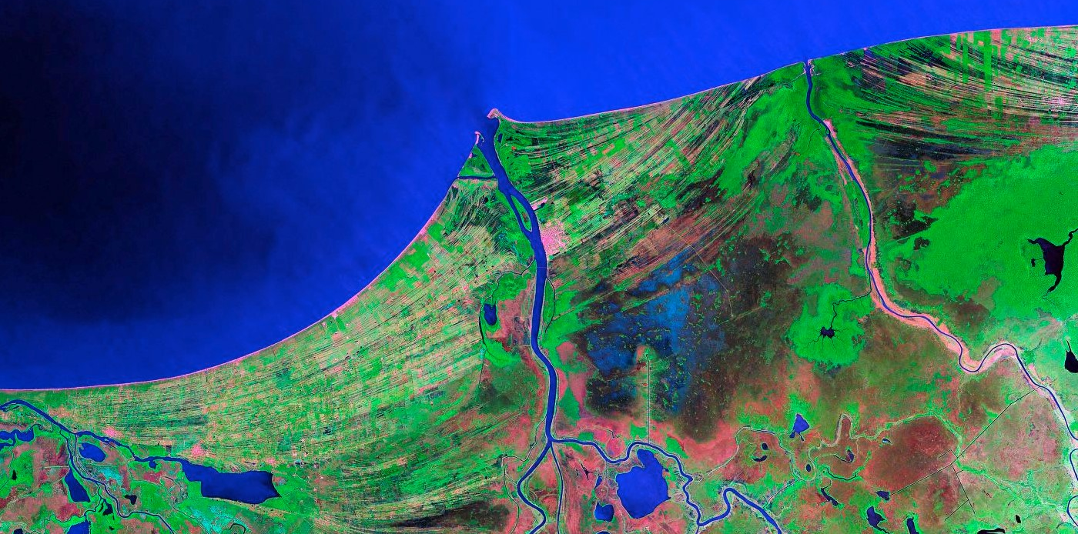
+
Sand sink: Depositional landform flavor depends on lake-level trend
Grand Traverse Bay, east coast Keweenaw Peninsula
modern
lake level
younger ridge
N
oldest ridge
-
N
Bay of Campeche
all ridges ~ same elevation
Stable or slowly falling lake level = strandplains
Strandplain = collection of beach ridges reflecting lakeward growth
Ridges are a bit like tree rings—but not annual

Slide 14
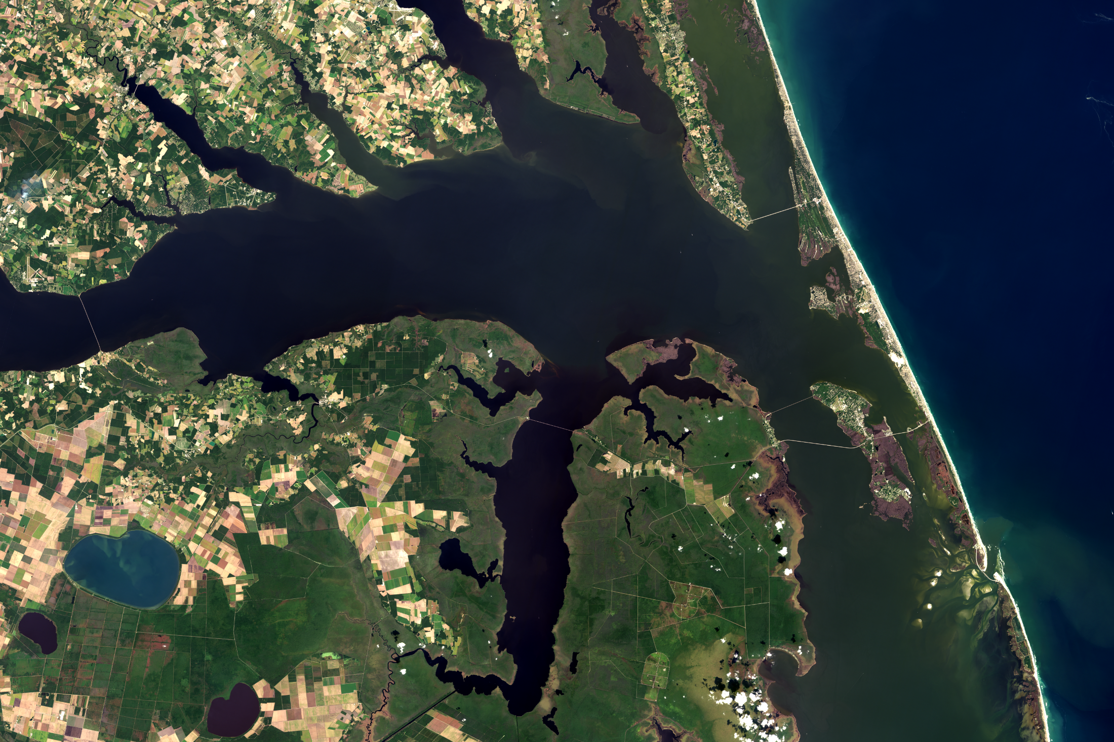
+
Depositional landform flavor depends on lake-level trend
Outer Banks
N
lake level
Albermarle Sound
barrier island
estuary (drowned river)
-
Rapidly rising lake level = estuaries and barrier islands

Slide 15
Genesis of Duluth Harbor and Minnesota Point

Slide 16
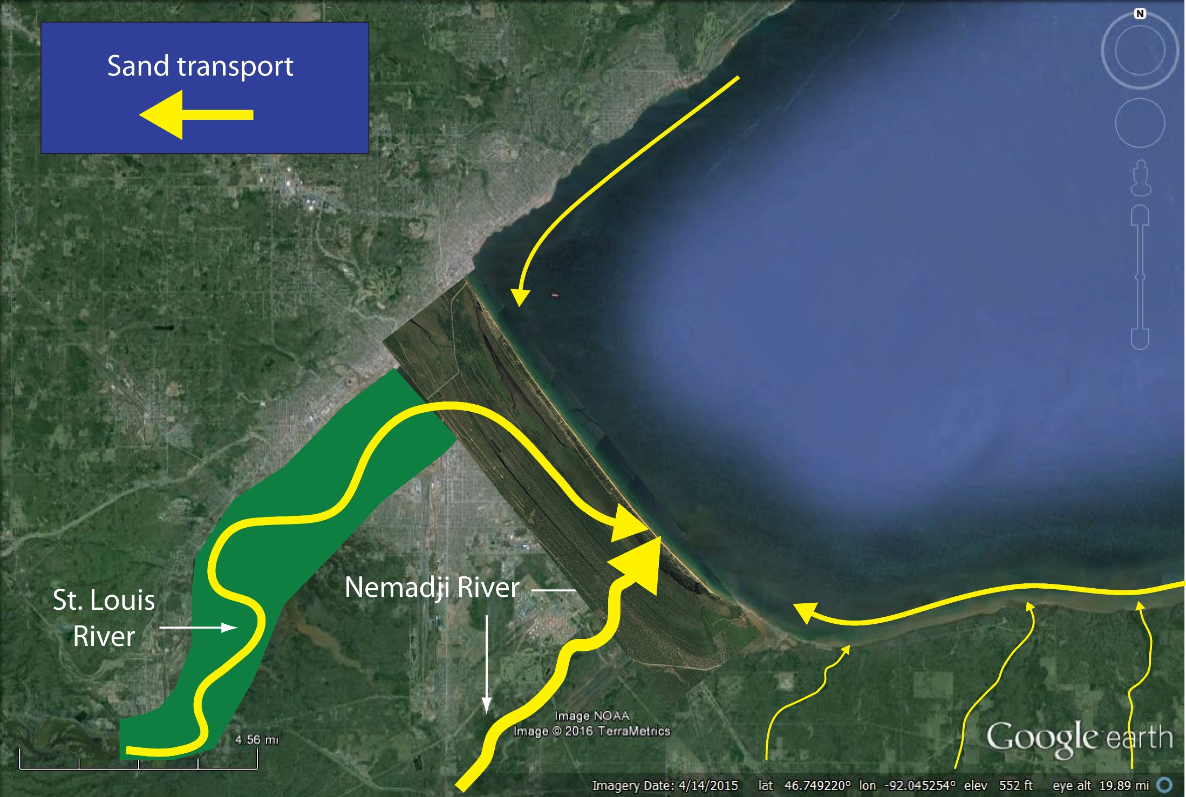
(Genetic model) 4500 – 1200 years BP: Slow lake-level fall
Sand supply mostly from St. Louis and Nemadji Rivers (connected to lake)
Some longshore transport of sand from north- and south-shore rivers
Minor bluff erosion
slow fall
Construction of strandplain (now drowned)
No harbor
No estuary
Sand budget ~ 50,000 – 70,000 m³/yr

Slide 17
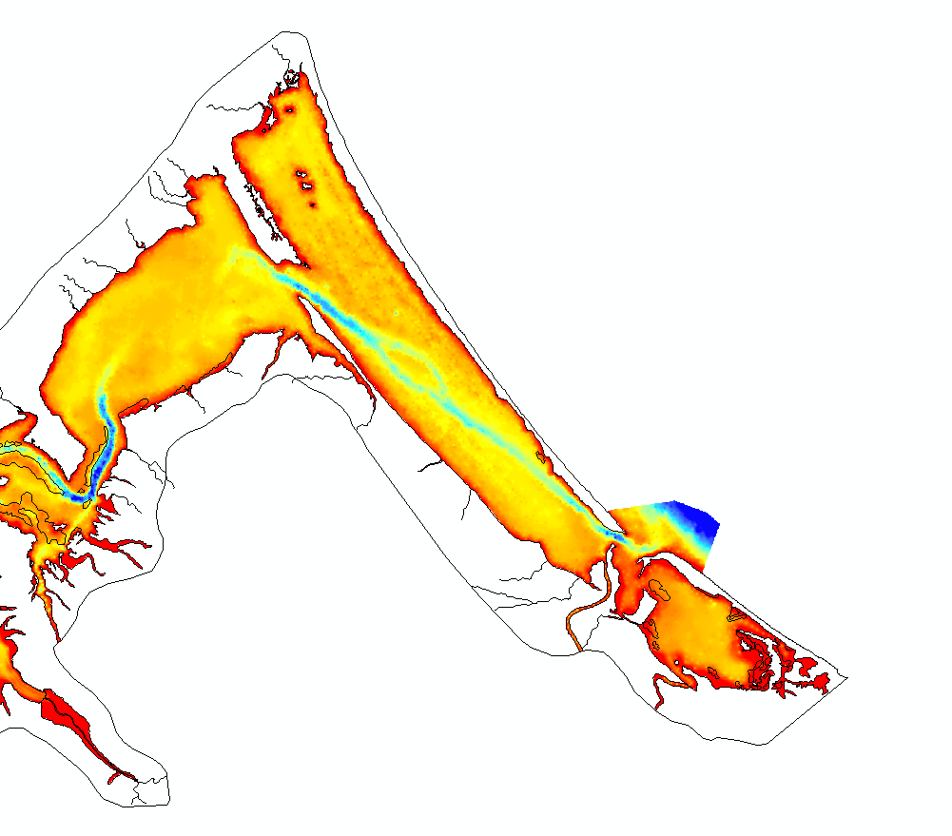
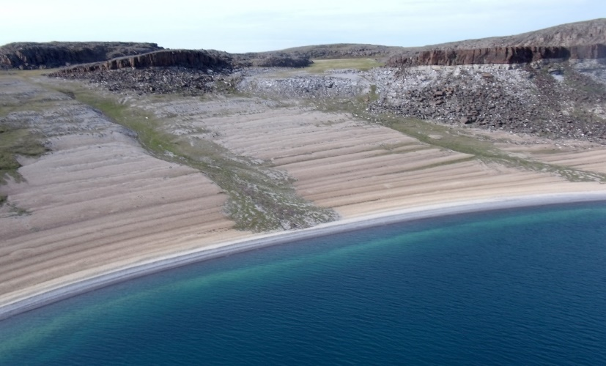
Supporting evidence for strandplain beneath harbor
Note curvilinear (arcuate) features in mapped 1863 bathymetry = beach ridges (drowned)
An (elusive) feature like this underlies the muddy bottom of the Duluth / Superior harbor
Wiki image of Bathhurst Inlet, Nunavut
Digitization of 1863 Hearding map by Andy Breckenridge and students
slow fall

Slide 18
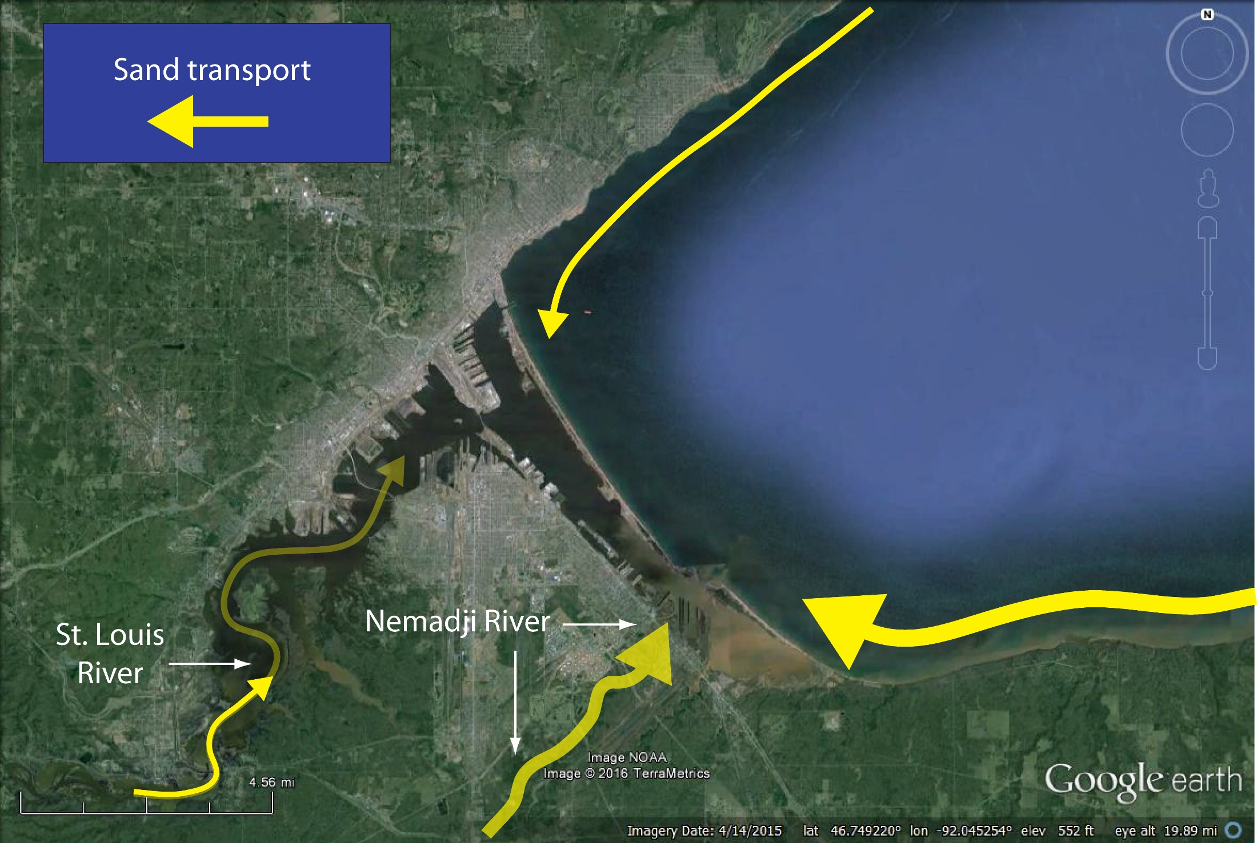
(Genetic model) 1200 years BP - present: Rapid lake-level RISE
Erosion of south-shore bluffs dominates sand budget
Order of magnitude less from north shore bluffs
St. Louis and Nemadji Rivers contribute relatively little due to progressive drowning and trapping in estuary
rapid rise
Abandonment (?) and drowning of strandplain
Northwestward growth of Minnesota Point (?)
Harbor and estuary formation
Today: Dominant sand source

Slide 19
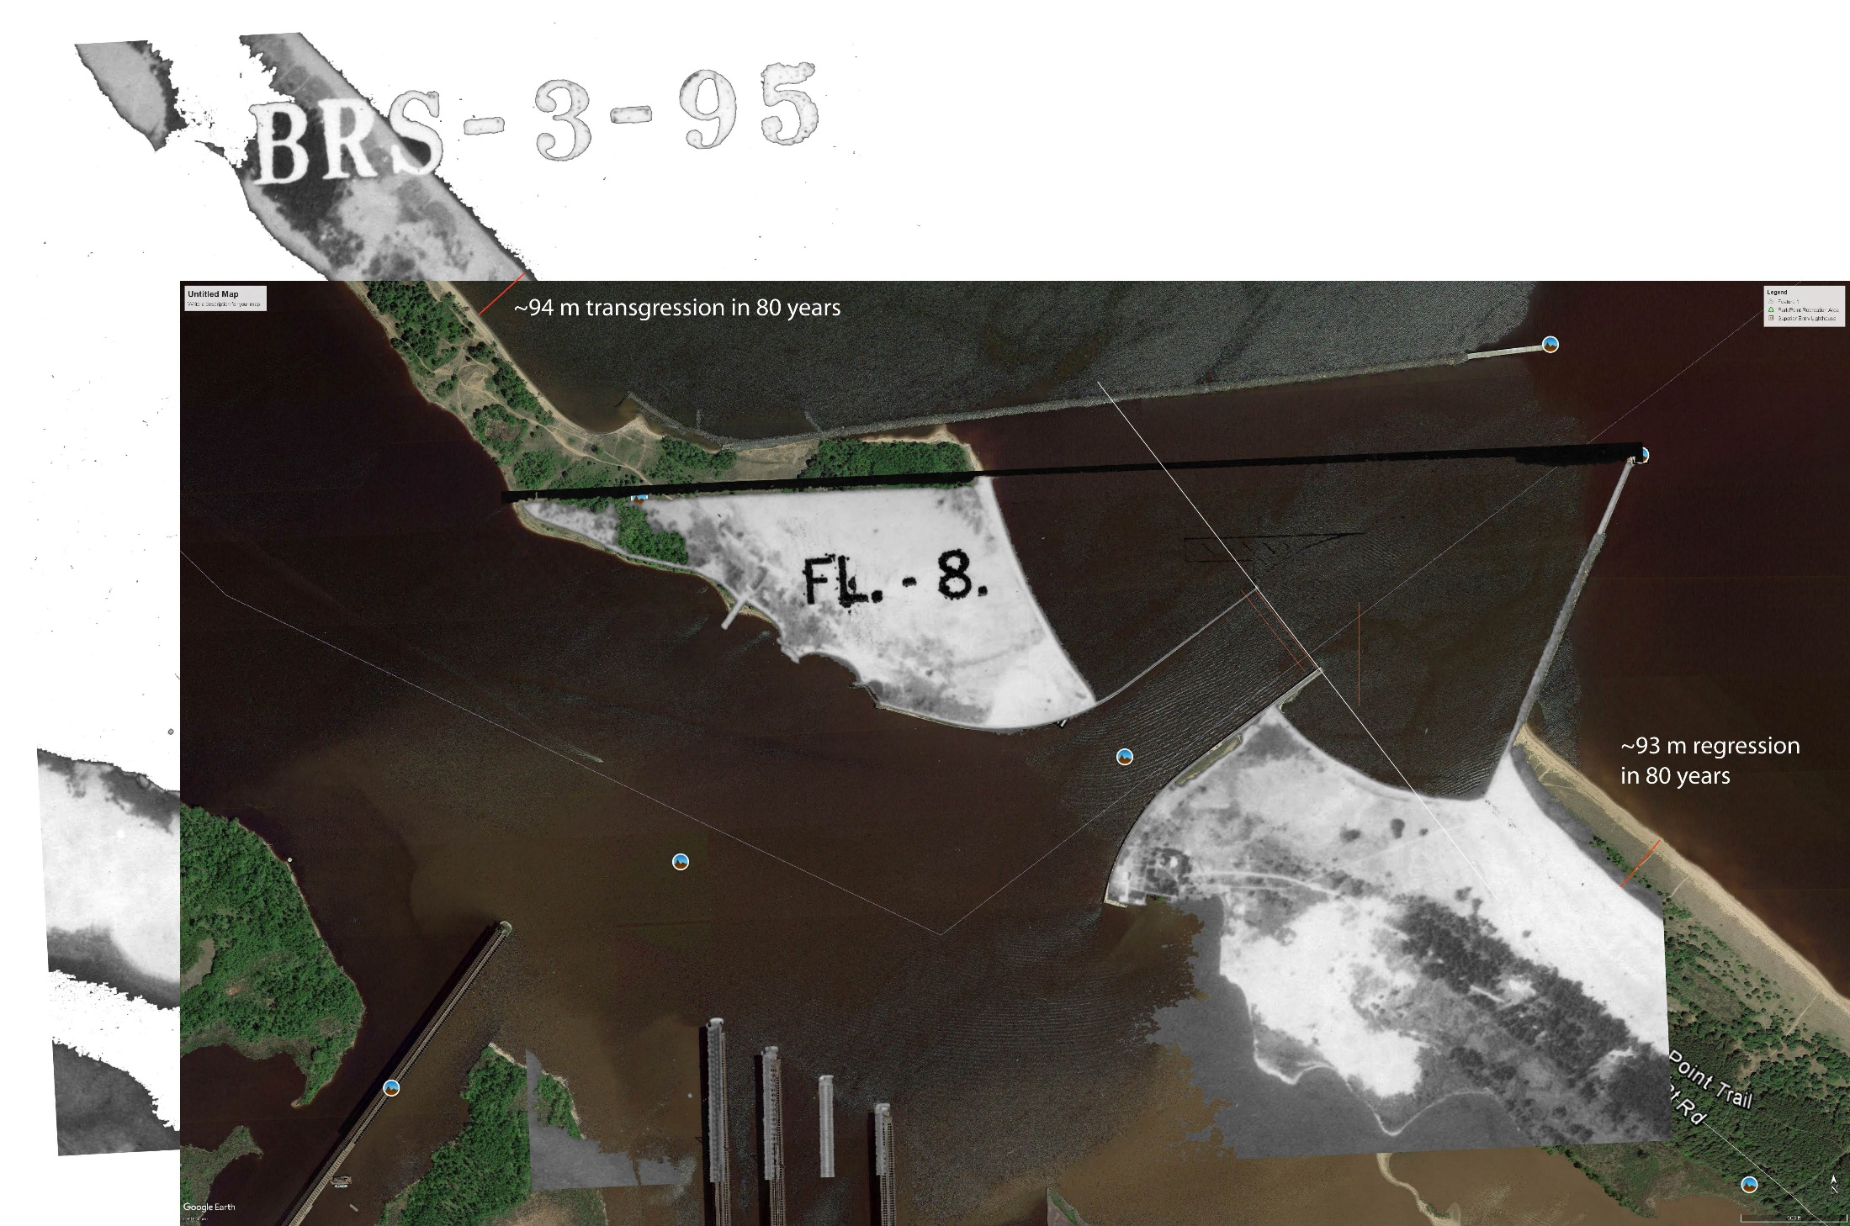
The ‘infrastructure’ problem: Starvation
Superior entry forms nearly perfect ‘dam’ in the ‘river of sand’ from south shore
~ 90 m erosion in 80 years
~ 90 m growth in 80 years
Overlay of 2017 (color) satellite image and 1938 aerial photo.

Slide 20
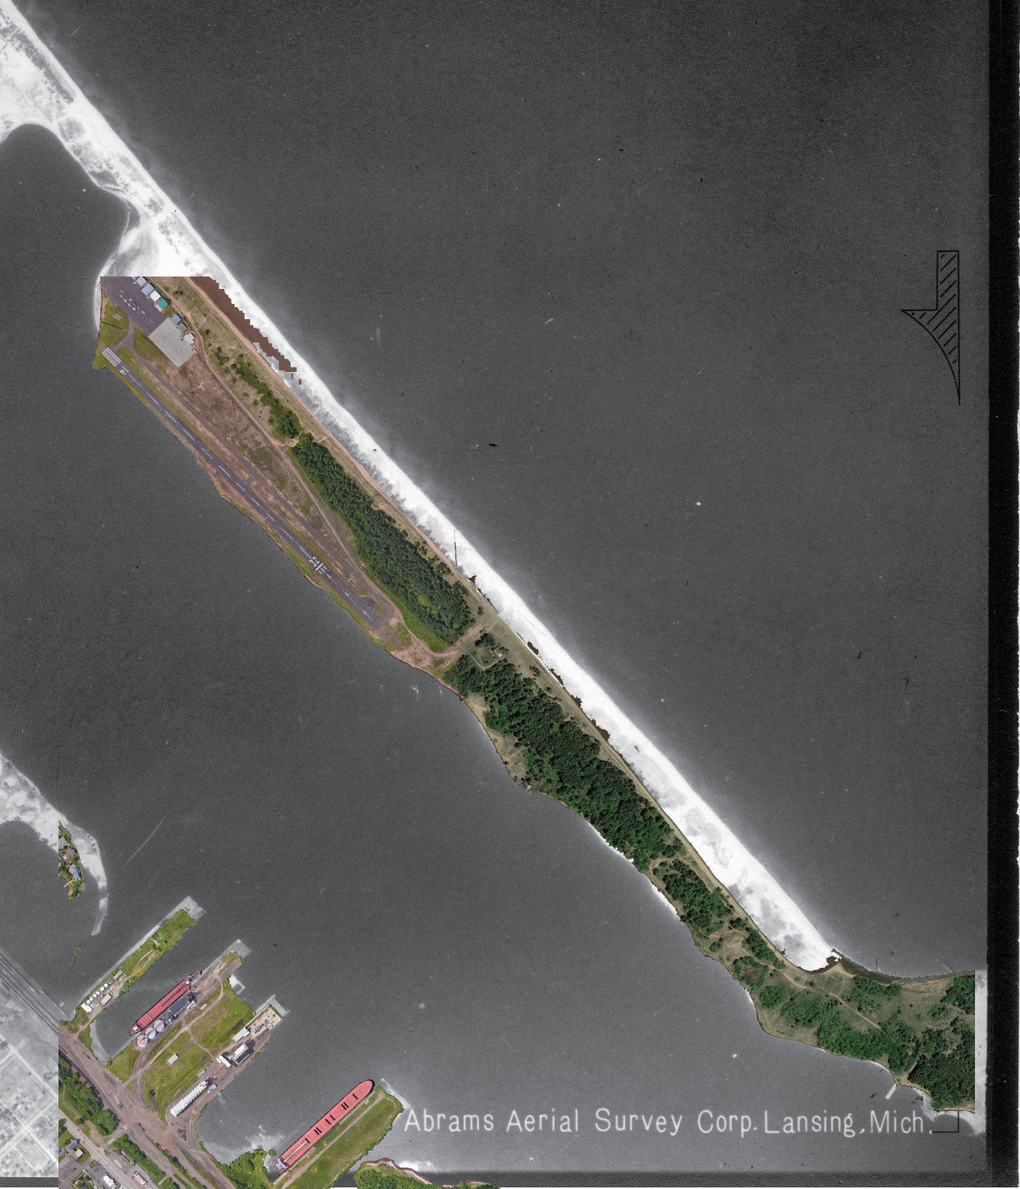
The ‘infrastructure’ problem: Starvation
Eroded sand moving ‘downstream’
Similar story with the Duluth breakwater
Blocks sediment supply from north-shore bluff erosion
But sediment supply from north shore is significantly smaller

Slide 21
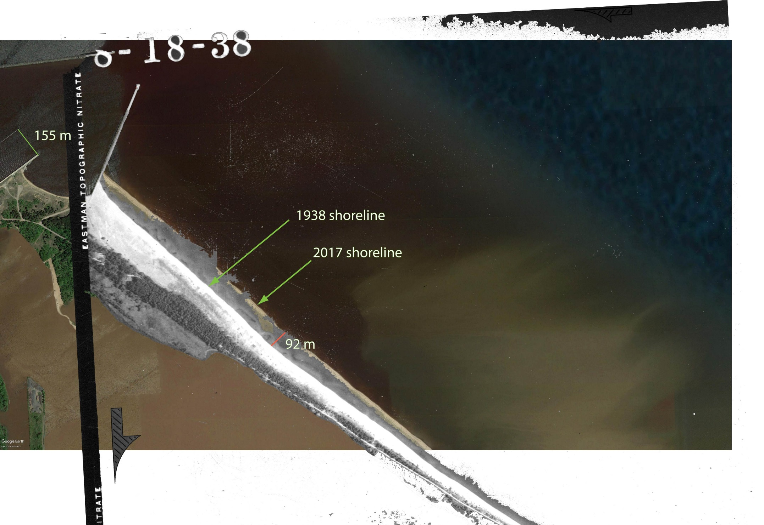
The ‘infrastructure’ problem: Starvation
Sand budget:
40,000 m³/yr sand
(2001 ACOE estimate ~ 50,000 m³/yr)
Bluff erosion alone can close sand budget (little river input):
35 km of bluff x 10% sand x 40 cm/yr retreat rate x 30 m total bluff height = 40,000 m³/yr sand
This is the ‘south end’ deficit

Slide 22
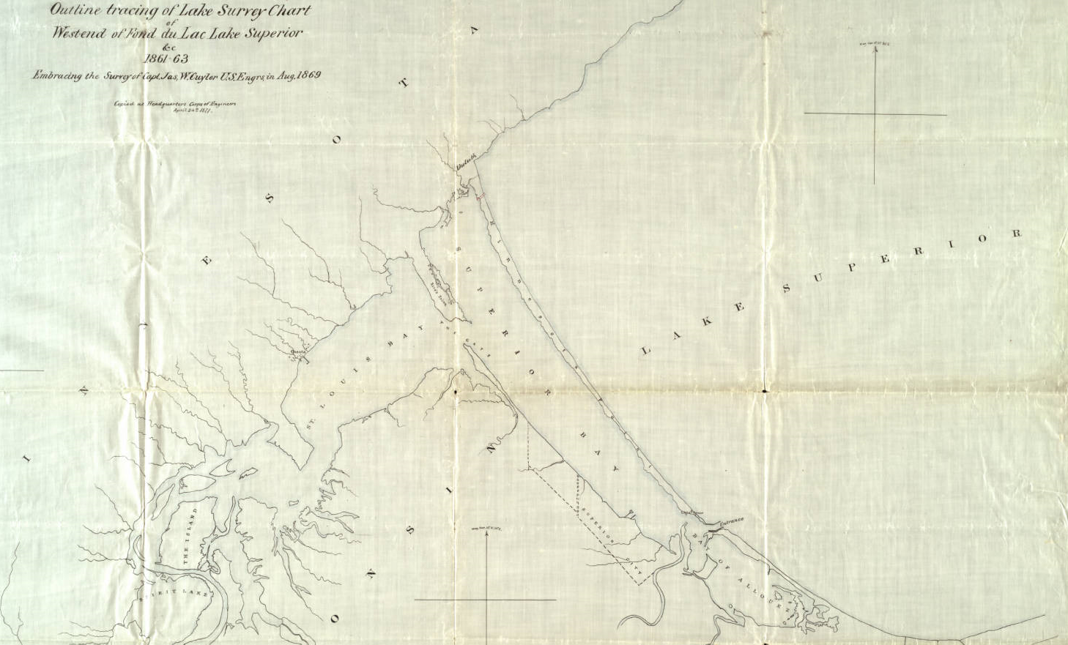
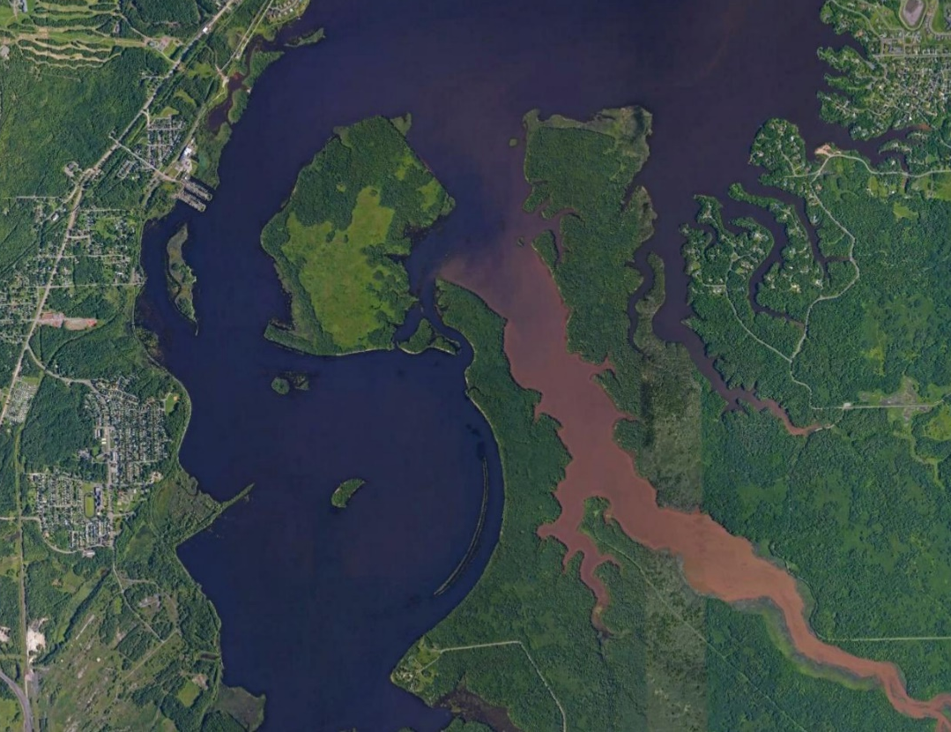
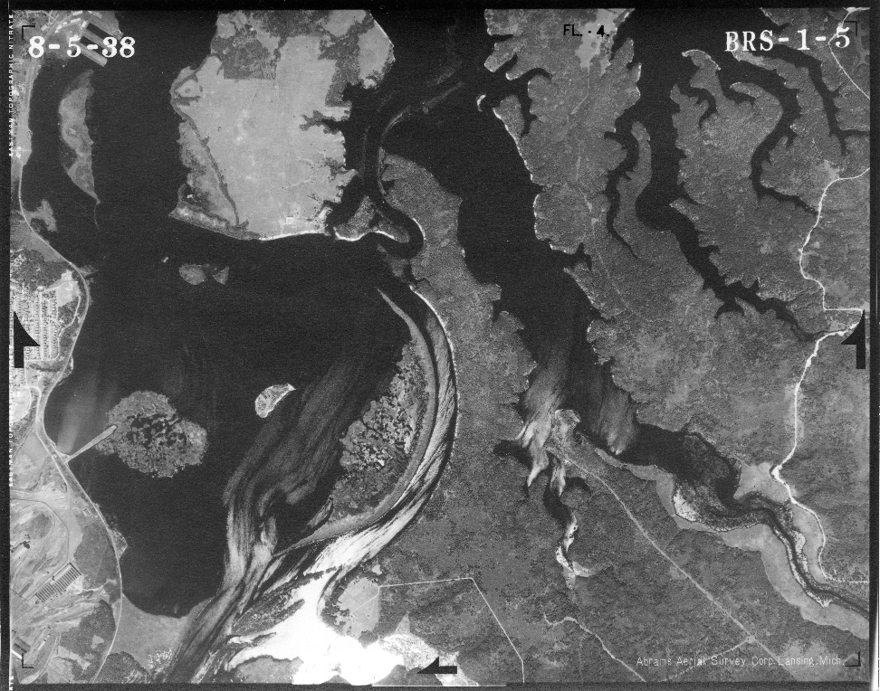
Modern sand sources: What about the St. Louis River?
1861
2017
1938
Note progressive drowning of RELICT (inactive) SAND levees over 160-year timespan
Little sand was reaching Spirit Lake in 1860 (pre-dam era)
Where was it deposited?

Slide 23
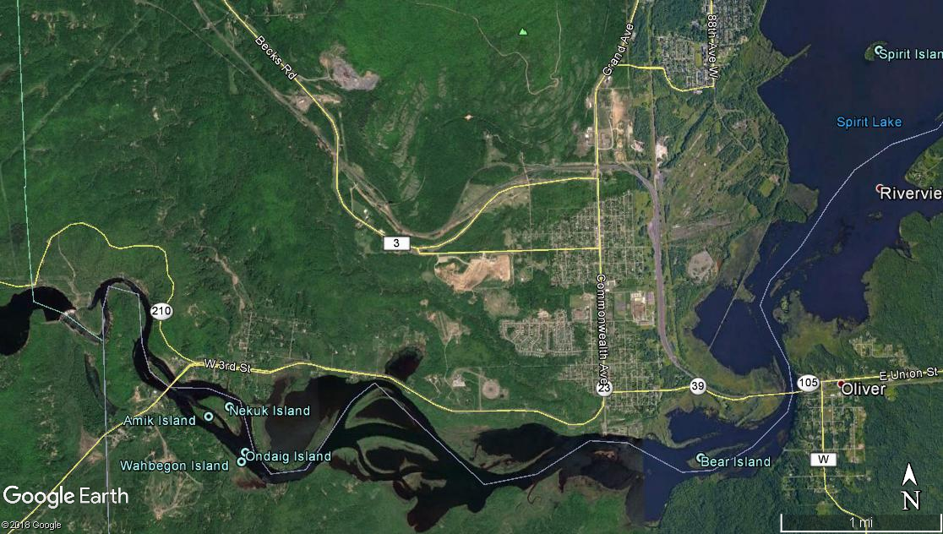
St. Louis could deliver sand to lake (strandplain) during 4.5 – 1.2 kyr BP RLL fall
Onset of RLL rise at 1.2 kyr BP drowned river mouth and drove depocenter ‘upstream’
Last position (pre-dam) was Fond du Lac
progressive
disconnection
St. Louis sand supply connected to lake
Modern bayhead delta (pre-dam sand depocenter)
progressive ‘back-stepping’ of sand depocenter

Slide 24
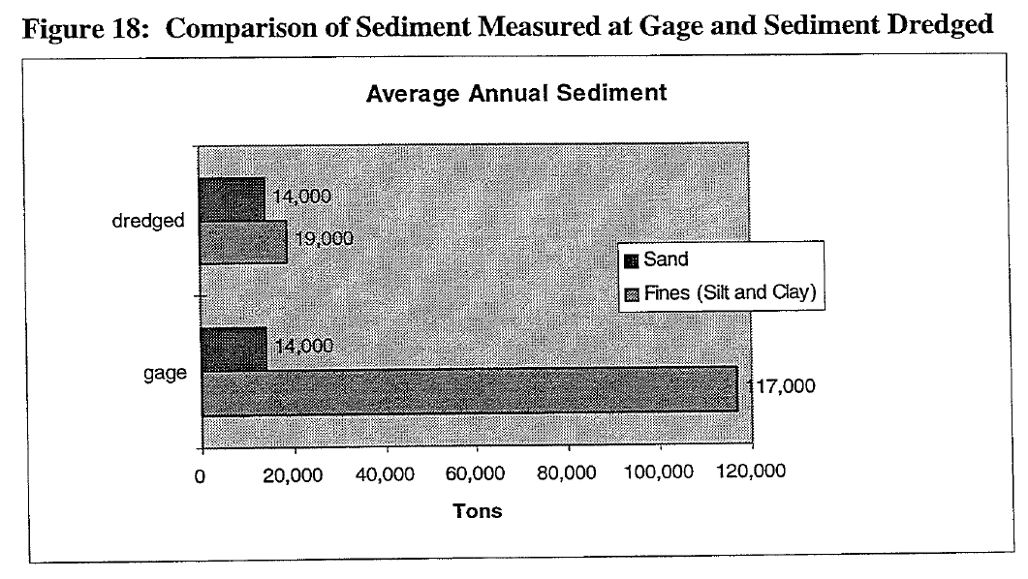
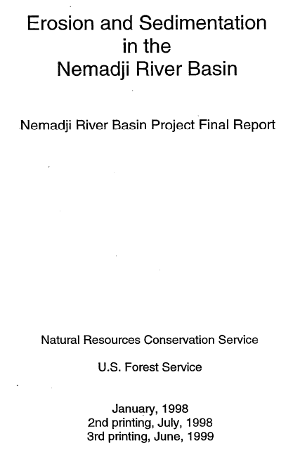
Modern sand sources: What about the Nemadji River?
gage = dredged ⬄ no Nemadji sand leaves harbor
Take-home message:
All Nemadji sand trapped in harbor (and then dredged)
Significant mud transfer to lake (visual confirmation)
14,000 tons/yr ~ 6300 m³/yr
Small fraction of 35,000 – 50,000 m³/yr needed

Slide 25
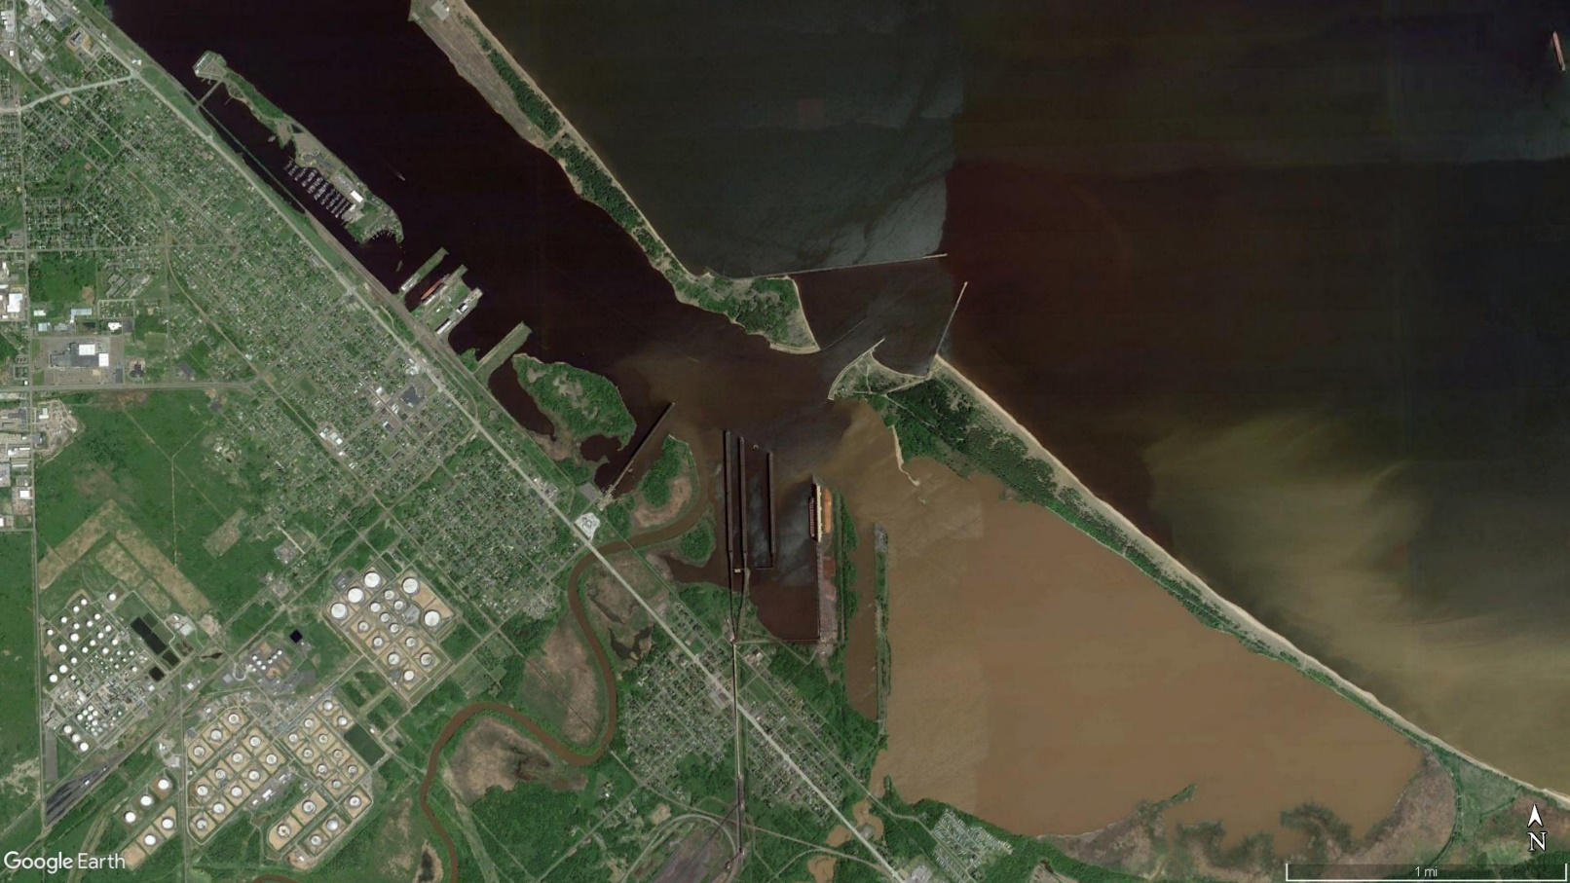
Modern sand sources: What about the Nemadji River?
Modern sand contribution from Nemadji is minimal
Dredging ‘pinches off the bud’ of the Nemadji
Dredging prevents Nemadji from maintaining weak connection to the lake side of the barrier
Note: Nemadji outlet would drown naturally, regardless of dredging activity, albeit at a reduced rate

Slide 26
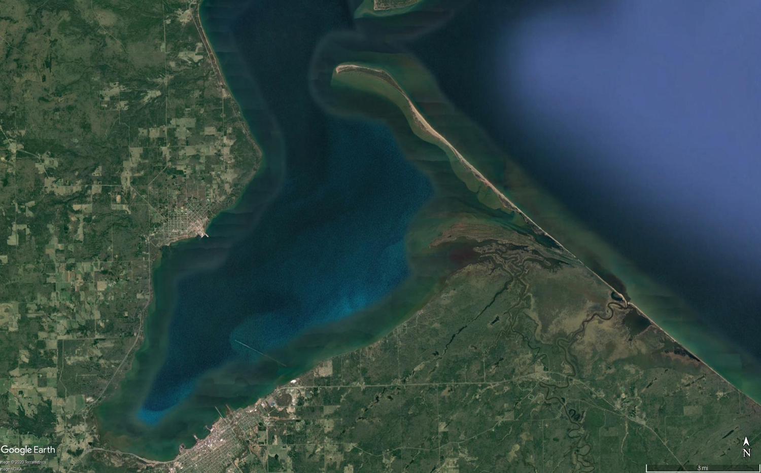
Summary / conclusions
Minnesota Point (barrier island) ~ 1000 years in age (+/-)
  ¹⁴C dates (Kremmin et al.) do not refute (oldest age ~ 800 yrs BP)
Dominant sand source = south-shore bluff erosion
St. Louis & Nemadji rivers contribute minimal sand to the lake side of barrier
Breakwaters trap sand flux and starve the barrier
(partial) armoring strategies will simply shift locus of erosion towards center of barrier

Slide 27
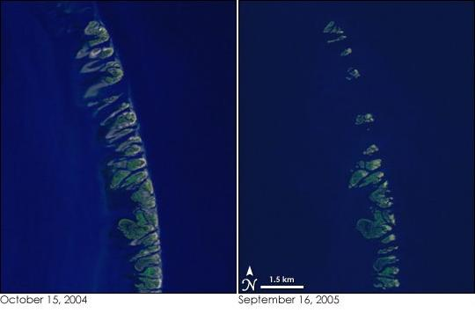

Final thoughts
For their size, barrier islands are the most dynamic / ephemeral landforms on Earth
Chandeleur Islands (Mississippi delta)
Drowned:
Sea level rise & sediment compaction (subsidence)
Starved:
Trapping of sand supply behind upstream dams
Battered:
Increasing frequency and magnitude of tropical cyclones
Katrina
NASA Earth Observatory
Geologic literature replete with examples of barrier systems reaching ‘tipping point’ from which there is no recovery

Slide 28
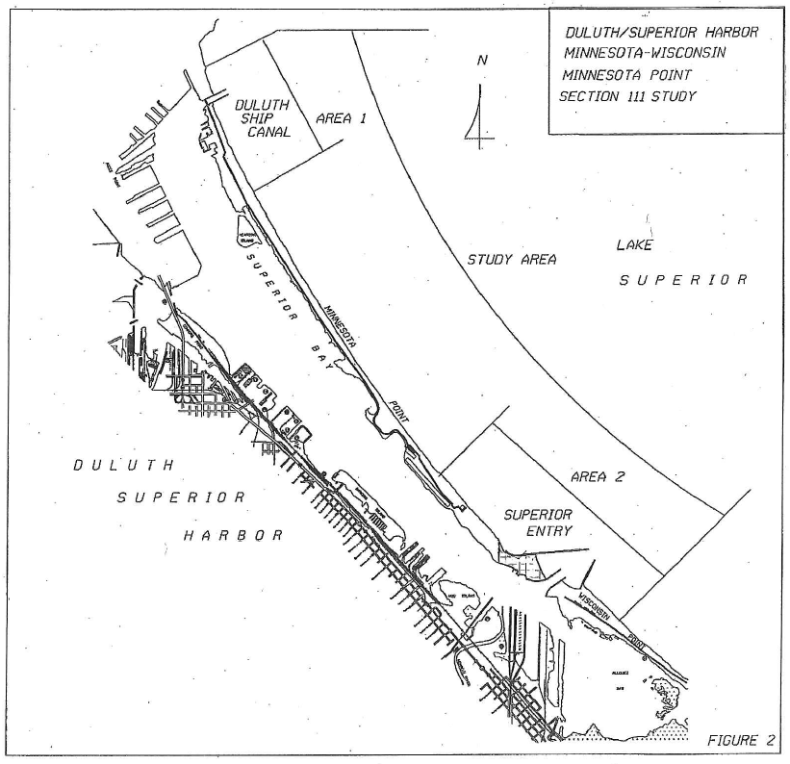
Final thoughts
For their size, barrier islands are the most dynamic / ephemeral landforms on Earth
X
Drowned:
Long-term lake level rise
Starved:
Trapping of sand supply behind breakwaters
Battered:
Increasing frequency and magnitude of mid-latitude cyclones
X
Drawing: ACOE (2001)

Slide 29
Thanks!
Questions?
218-726-6844
jswenso2@d.umn.edu

