Slide 1
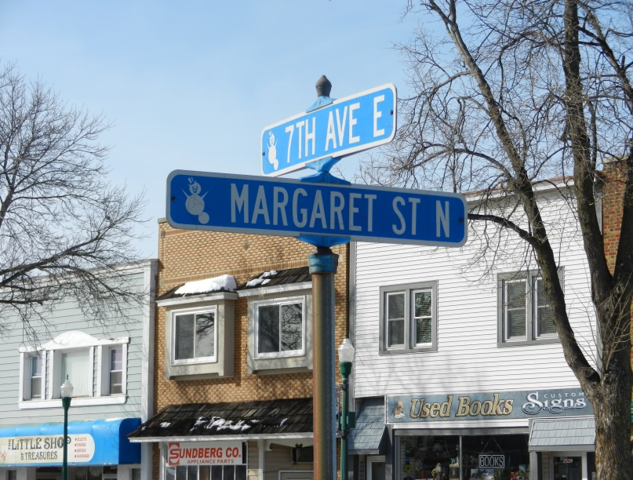
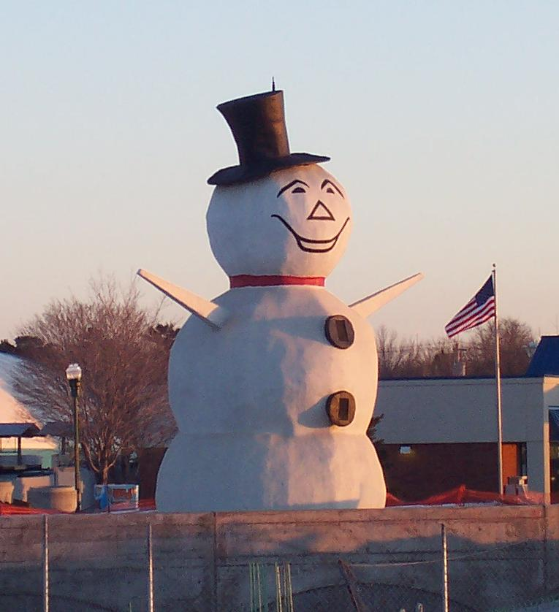
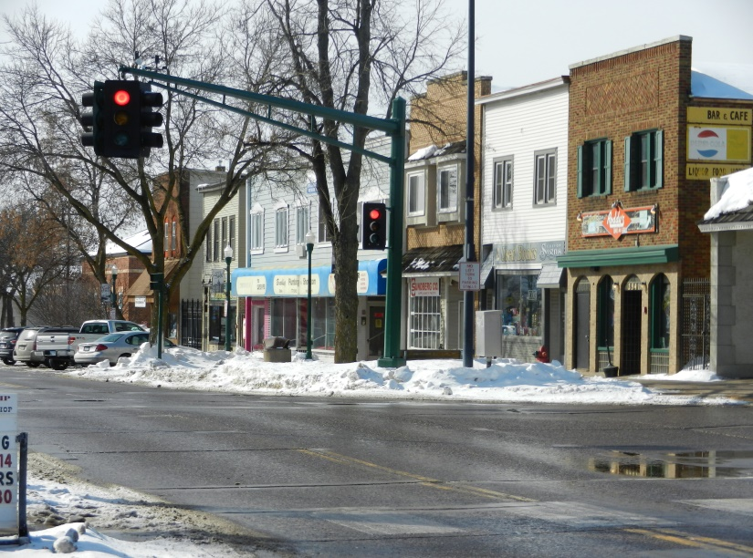


Assessing the Viability of a Business Improvement District in North St. Paul
William Boulay
Robert Clarksen
Charles Darnell
PA 8081 Capstone Workshop Spring 2014
Notes:
Intro and title
This study is part of Resilient Communities project
Who knows where North. St Paul is? (how do you get there?)
Ok, can you tell me anything about it?
We are limited for time so if we don’t cover something that interests you please ask a question during or after the presentation

Slide 2
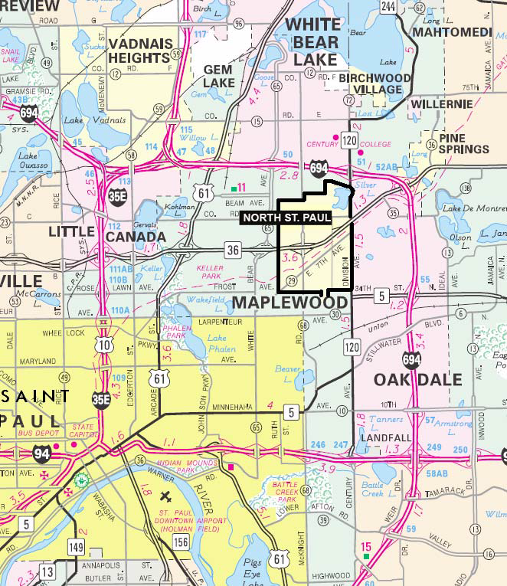
The City of North St. Paul
3.1 square mile inner-ring suburb established in 1887
Population of 11,460
Contains a six-block long historic mainstreet downtown
Notes:
Transportation access is Hwy 36
Makes it unique– downtown is focus of project

Slide 3
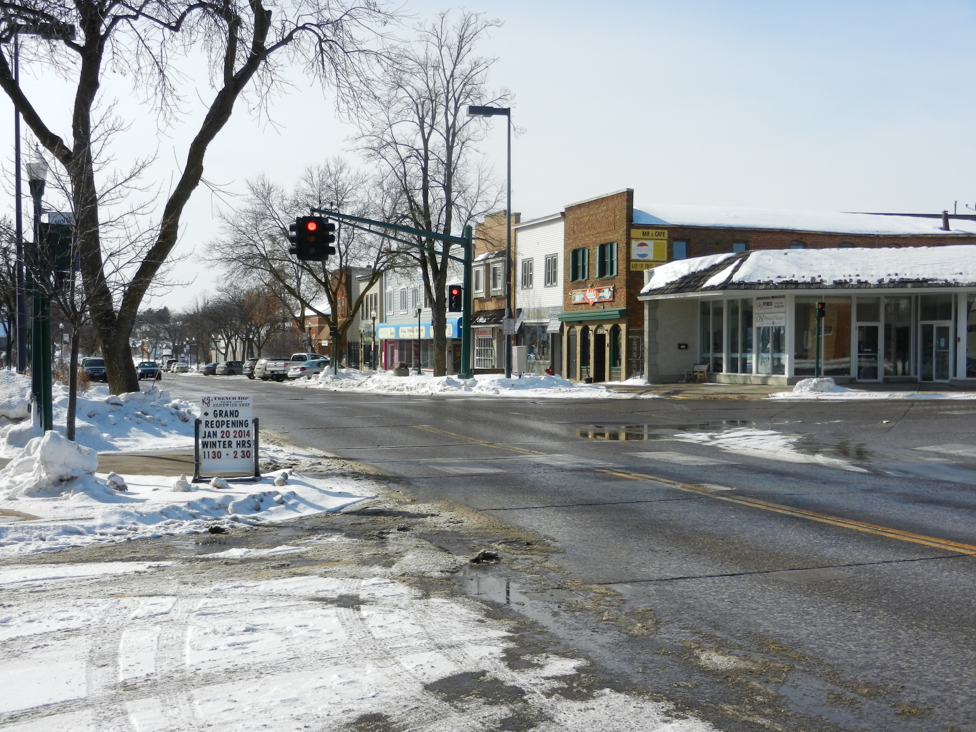
Diagnosis
Notes:
What we did to conduct our research

Slide 4
What is the study’s purpose?
Identify the needs and desires of businesses and property owners
Assess the existing level of service
Determine whether a Business Improvement District (BID) would be the appropriate tool
Notes:
But first we had to identify what the purpose and goals of the study were
If not a bid, what alternatives?
This project intends to identify the needs and desires of businesses and property owners in downtown North St. Paul, including the existing level of service, additional services paid for not provided by the city or other level of government, and any ideas for future improvements. Information gathered will be used to determine whether a Business Improvement District (BID) would be the appropriate tool to address these needs and desires, and if so, define the boundary, provide a potential structure, assessment levels, and possible services provided. If it is determined a BID is not the appropriate tool, alternatives to ad-dress the needs and desires of the business community will be explored.

Slide 5
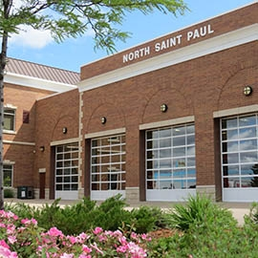
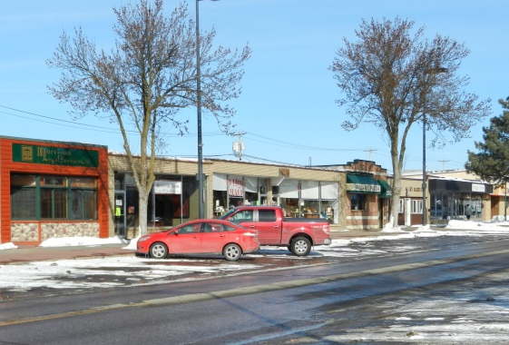
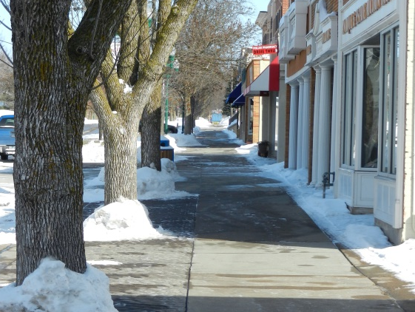
North St. Paul Today
Angled, on street parking (top)
Wide, pedestrian friendly sidewalks (bottom)
Public & Institutional Investment
Library
City Hall/fire station
Public works garage
Wind turbine
Recent New Development
3-story mixed use development at 7th Avenue and Charles
Reflex Medical
Senior Housing development currently under construction

Slide 6
North St. Paul Today
Mix of uses north of 7th Avenue, including several industrial uses along the back of the commercial area
Vacant parcels and unimproved parking lots
Notes:
Mix of uses and parking good, but can block views and inhibit small town feel.
Vacant parcels bad for tax base bad for pedestrians bad for environmental feel
All this happens through main access to downtown and in center of business district
Basically– room for improvement
Some things that turn away visitors or inhibit accelerated development

Slide 7
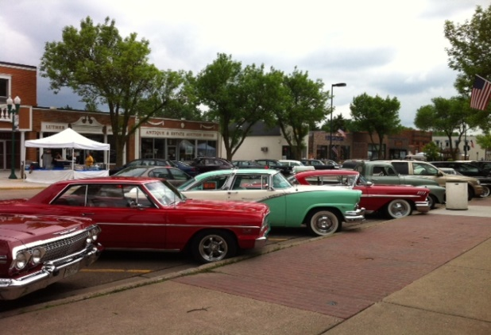
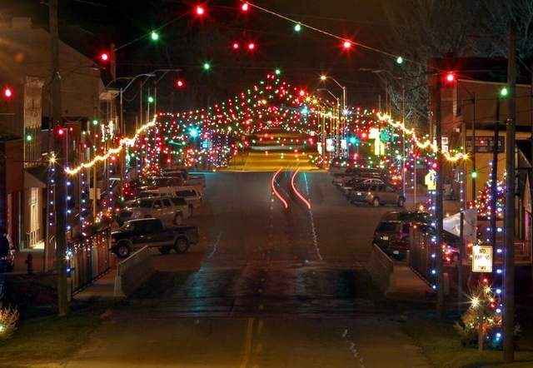
What is a BID?
A tool to…
  Enhance infrastructure
  Provide supplemental services
  …Leading to improved conditions and perceptions of the local business environment
  Self-managed; relies on special assessments on a district-wide basis
Notes:
Maintains a vibrant community, keeps it clean, keeps it safe
Not an appropriate tool for infrastructure development necessarily
A Business Improvement District (BID) is one tool which can be deployed to enhance the basic infrastructure and provide supplemental services that lead to improved perceptions of local business environments. BIDs rely on special assessments which fund high grade services on a district-wide basis within a sub-region defined by the BID members. The level of the assessment and the range of services addressed by the funds are fluidly determined by participants in the district. Also, any services that are provided through a BID are supplemental, meaning that they build on the services already supplied by the City. Services provided through BIDs do not serve as a replacement to any existing City-provided services.

Slide 8
Diagnosis Activities
Stakeholder Engagement
  Individual Interviews and Business Association Meeting
Literature Review
Zoning Code Analysis
City Walking Tour
Review of relevant Resilient Communities Project studies
Notes:
Guided discussion/q&a at business association meeting, like a workshop, full time, good representation

Slide 9
vision
Notes:
Building on the principles of the Diagnosis Willy just described, we generated a simplistic vision for what a thriving North St Paul Business district would look like in 20 years.
North Saint Paul has been described as an “Extroardinary Small Town”. We believe the City has an opportunity to employ partnerships that embrace its potential, and we think the following slides describe what could be implemented in the City by 2034.

Slide 10
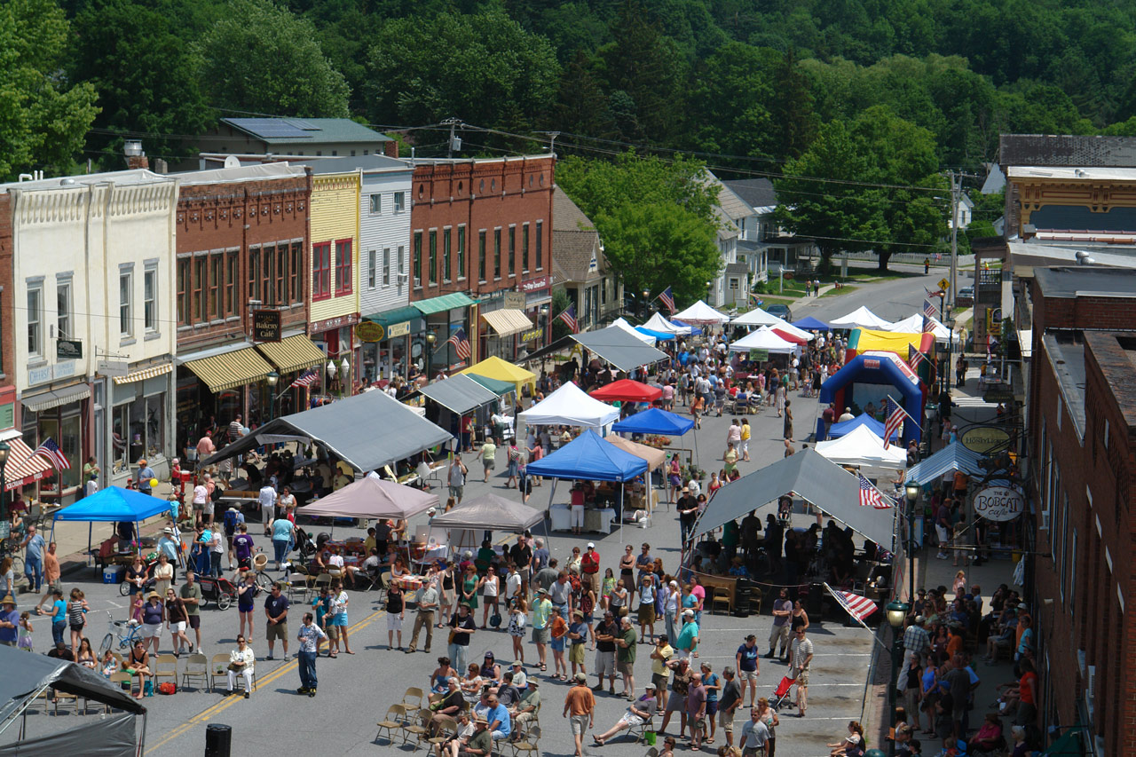
North St. Paul in 2034
“North St. Paul’s revitalized main street bustles with travelers, shoppers, and families who have reclaimed the space as a uniquely historic regional destination. Greeted by the infamous Snowman, walkers, cyclists and drivers visit the city’s acclaimed restaurants and busy shops to reflect on the comforting connection to the past enjoyed by residents and visitors alike.”
Notes:
Read the slide….
We think this simple description reflects how the North St Paul of the future capitalizes on its positive attributes.

Slide 11
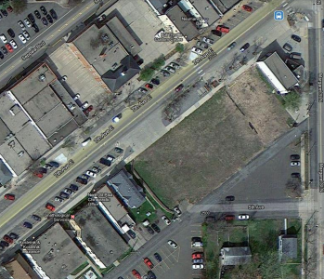
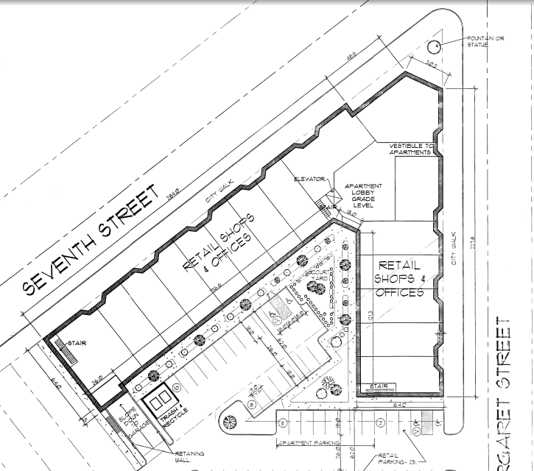
A Vision for North St. Paul in 2034
Old City Hall Site
Vacant lot/Dentist
3-4 Story Development Potential
Notes:
In our report, we stress the importance of the efficient use of buildable land on infill sites.
An example of this is the former location of City Hall - just a stones throw from the most prominent intersection in town.
The site is a vacant ½ acre parcel of land in the center of the “diversified district”
Left: Aerial photo of the property. Right: The potential for development – the “Landings”
A 4 story structure for 30 apartments over 15K SF commercial space.
Amenities: A mix of surface and underground parking and a public plaza orienting the development to the intersection.
Members of the business community commented that this project did not come to fruition due to a challenging environment to do business.

Slide 12
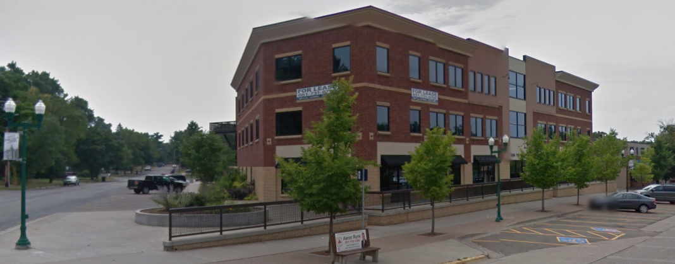
A Vision for North St. Paul in 2034
Get a pic of the new 3 story development at 7th and Charles
The goal of implementing a BID is to strengthen the business climate and attract additional development.
Notes:
So what are we talking about?
This slide shows the new 3 story development at the East end of the Diversified District - which brings elements of the vision to life in the built environment:
Updated public infrastructure
The building reinforces the street
Attractive facades – fresh paint the ironwork
Festive banners on street lights
Freshly striped angled street parking – You can see how it continues around on the side street (Charles, left)
Inviting sidewalks and street furniture
Landscaping and other amenities activate the intersection and contribute to a sense of place.
A connection with public transportation

Slide 13
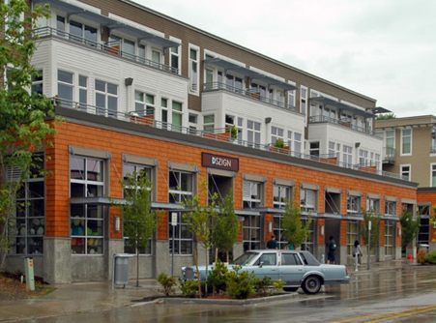
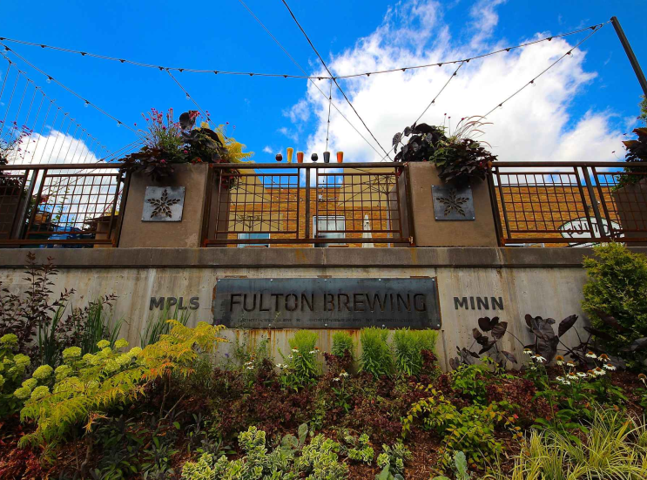
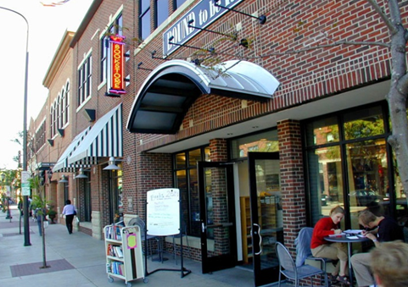
North St. Paul in 2034
Mixed-use development
Brewpubs and local food
Cafes, activated streets, gathering places
Notes:
In summary, the North Saint Paul of 2034 is an atmosphere that appeals to the casual urban adventurer
NSP 2034 is a hub of events and festivals that celebrate the unique attributes of a small town.
A “downtown neighborhood” that people choose to spend time (and money) in.
North St Paul becomes a destination – with a variety of options for local food and fun
Key is that the merchant environment must serve the immediate community – A locally oriented brewpub or a family pizza place would be a great fit in this blue collar area.
And with that Chuck is going to go into our Action Plan and recommendation

Slide 14
ACTION Plan

Slide 15
Recommendation
Phased approach
  Relationship building
  Brand awareness
  Infrastructure investment
Business Improvement District:
Why not now?
Notes:
BID: Not the appropriate downtown revitalization strategy at this time, because:
Lingering effects of strained relations between the City and business community. Many community stakeholders, including current city employees, admitted that previous leadership did not engage the business community cooperatively or consistently.
With a small assessment area, the undeveloped and/or vacant properties in North St. Paul dramatically reduce the BID’s potential revenue and would be a barrier to development for some private developers.
A BID functions best at maintaining new or like-new infrastructure, meaning areas that need significant rehabilitation or reconstruction (or have yet to be constructed) need more funding than a BID can provide.

Slide 16
Short Term Strategies (1-3 years)
Develop formal and informal relationships
Gather data
Comprehensive marketing strategy
Façade improvement program
Aggressively pursue redevelopment
Speed up downtown city infrastructure projects

Slide 17
Medium Term Strategies (4-7 years)
Expand and ‘institutionalize’ additional community events
Continue to speed up downtown city infrastructure projects
Plan and build a public gathering space
Diligently maintain the downtown area

Slide 18
Long Term Strategies (7-10 years)
Re-evaluate the feasibility of a Business Improvement District (BID)
Form a BID Steering Committee, which would:
  Establish Vision for Downtown North St. Paul
  Determine BID Boundary
  Determine Method and Level of Assessment

Slide 19
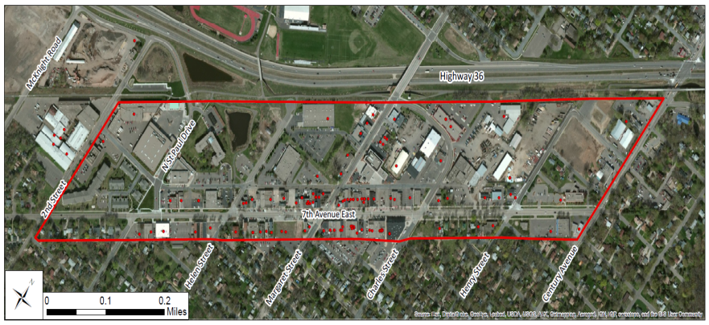
North St. Paul BID Example
Potential North St. Paul BID Activities
  Promotions
  Advertising
  Website Outreach
  Landscaping/Beautification
  Wayfinding
  Holiday Lighting
  Events

Slide 20
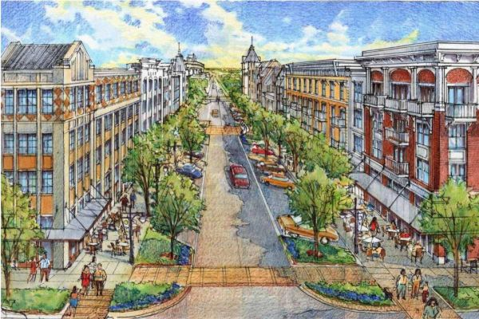
Conclusion
Notes:
Information gathering and formal analysis led to a set of recommendations that will take large amounts of STAFF TIME, EFFORT AND MONEY. We acknowledge that it won’t be easy. But do not let these things deter the city.
Need to be proactive, aggressive and persistent!!!
The opportunity for north st paul is there. It has the foundation and uniqueness to become a regional destination
BUT it needs to work hard over many years! It does not have the advantages some other larger, newer communities do.
Not going for the same thing.
But, work hard, be honest, and follow through and the vision for north st paul will become reality.

Slide 21
Thank You!
Photo credits
  North St. Paul Logo: Laura Nygren, University of Minnesota 2013
  North St. Paul photos: Chuck Darnell, Spring 2014
  Other photos
    Resilient Communities Project
    City of North St. Paul
    Google Maps 2014
    http://www.garryinsurance.com/files/2013/06/car1.jpg
    http://cmsimg.desmoinesregister.com/apps/pbcsi.dll/bilde?Site=D2&Date=20121216&Category=NEWS03&ArtNo=312160056&Ref=AR&MaxW=640&Border=0&Munson-Iowa-s-Christmas-Town-title-up-grabs-again
    http://www.discoverbristolvt.com/wp/wp-content/uploads/2011/08/Pocock-Rocks-201131.jpg
    http://www.thrillist.com/drink/minneapolis/downtown/fulton-brewerys-taproom-patio-this-is-the-twin-cities-best-brewery-patio#slide=2
    http://cdn.newsday.com/polopoly_fs/1.2802866.1345046931!/httpImage/image.JPG_gen/derivatives/display_600/image.JPG

