Slide 1
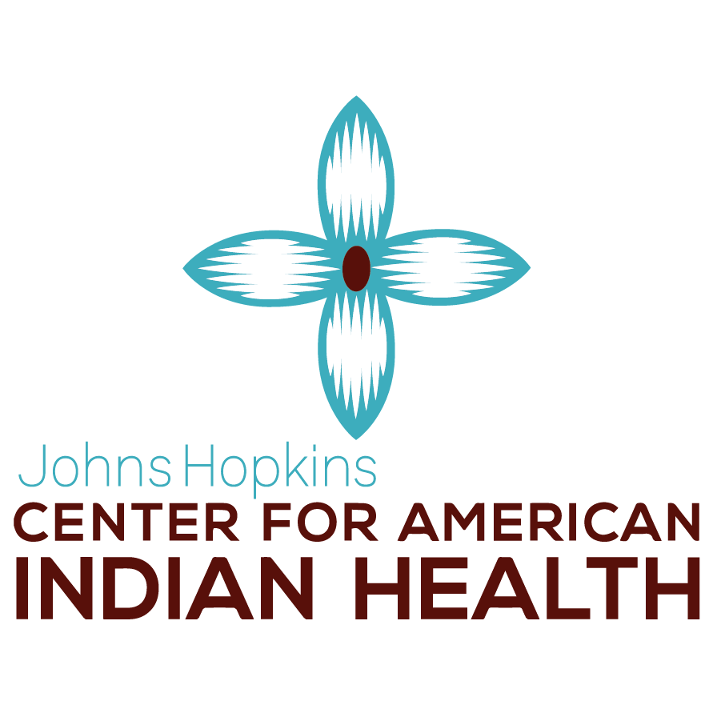
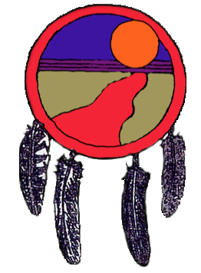
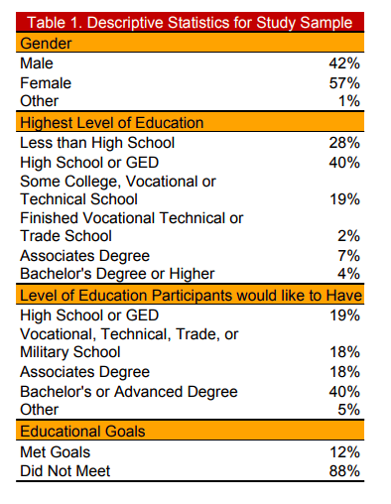
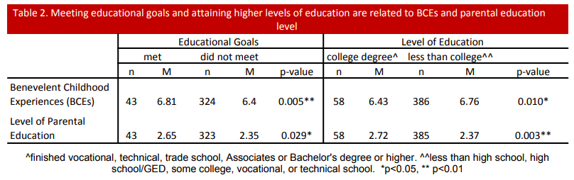
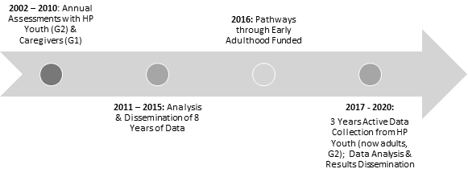
Facilitators of Educational Attainment in American Indian Young Adults
Brynn M. Bohanª, Melissa L. Walls^{b}, Dane S. Hautala^{b}, Healing Pathways Team*
ªUniversity of Minnesota- Duluth,
^{b}Johns Hopkins Bloomberg School of Public Health, Center for American Indian Health
Introduction
Results
Discussion
American Indian (AI) students experience major inequities in educational attainment compared to non-Native people
  In Minnesota, the high school graduation rate for AI students was 50.7% in 2017. The graduation rate of the total student population was 82.7% (4).
Most research focuses on barriers to educational attainment, which have been shown to include:
  Being male, negative personal experiences at school, characteristics of the school itself, having a parent that dropped out, and socioeconomic status (1,2,3,7)
There are also known facilitators to educational attainment:
  Enculturation, parental support, parental level of education, and engagement (1,5,6)
Benevolent Childhood Experiences(BCEs) measure the positive aspects of the participant’s childhood support, but have not been investigated in terms of influences on educational attainment.
Research Questions:
What is the educational attainment status of early adult AIs?
How does early adult educational attainment compare to adolescent educational goals for AI participants?
What are persistence factors to attaining educational goals among AIs over the early life course?
By understanding the facilitators of educational attainment we can identify intervention opportunities
  Tribes, Public Health Programs, Schools and Head Start programs could implement strategies and policies that promote BCEs. Specifically, programs should encourage student exposure to:
    A caretaker the student feels safe with, a good friend, comforting beliefs, a teacher that cares about them, good neighbors, opportunities to have a good time, building self identity, implementing the importance of routine
Most of the young adults had at least a high school diploma or GED (72%, Table 1)
Highest level of education attained by participants was most commonly high school or GED (40%, Table 1)
89% of participants stated that they would like to obtain higher levels of education than they currently have.
40% of participants would like to have a Bachelor’s or Advanced degree (Table 1).
Overall, 12% of the sample had met their educational goals (Table 1.)
Future Directions
Understand the role of enculturation in relation to educational attainment and achievement.
Look at social support systems (family support, community support)
Understand how the barriers to educational attainment interact with the facilitators in order to get the full story
Limitations
  Surveys were self reported which could lead to social desirability bias of reporting higher educational goals
  Results are simplistic bivariate associations
    In the future we will need to control for various demographic factors that could influence findings
Methods
Participants are from the Healing Pathways Project, a longitudinal community-based participatory research (CBPR) project involving eight reservations and reserves and a university research team. The goals of the study are to understand and determine various health risk and protective factors among AIs in the upper-Midwest of the US and Canada. .
Among the 12% of people that met their educational goals, two factors were found to facilitate meeting educational goals (high levels of BCEs, and high levels of parental/caretaker education. Table 2).
References and Acknowledgements
Figure 1. Healing Pathways Project Interview Timeline
References
Guillory, R. M., & Wolverton, M. (2008). It's about family: Native American student persistence in higher education. The Journal of Higher Education, 79(1), 58-87.
Kao, G., & Tienda, M. (1998). Educational Aspirations of Minority Youth. American Journal of Education,106(3), 349-384. doi:10.1086/44418.
Machamer, A. M., & Gruber, E. (1998). Secondary School, Family, and Educational Risk: Comparing American Indian Adolescents and Their Peers. The Journal of Educational Research,91(6), 357-369. doi:10.1080/00220679809597565
Minnesota Report Card. (2018). Minnesota Department of Education. Retrieved from https://rc.education.state.mn.us/#graduation/orgId--999999000000__groupType--state__graduationYearRate--4__categories--amIndian__p--7
Nitardy, C. M., Duke, N. N., Pettingell, S. L., & Borowsky, I. W. (2014). Racial and Ethnic Disparities in Educational Achievement and Aspirations: Findings from a Statewide Survey from 1998 to 2010. Maternal and Child Health Journal,19(1), 58-66. doi:10.1007/s10995-014-1495-y
Runner-Rioux, A. H., O’Reilly, F. L., & Matt, J. (2018). The Influence of Persistence Factors on American Indian Graduate Students. Journal of Education and Learning,7(4), 32. doi:10.5539/jel.v7n4p32.
Stout, K. E., & Christenson, S. L. (2009). Staying on track for high school graduation: Promoting student engagement. The prevention researcher, 16(3), 17-21.
The authors would like to thank the Community Research Council members and Interviewers of the Healing Pathways team*: David Bruyere, Laura Bruyere, Annabelle Jourdain, Priscilla Simard, Trisha Bruyere, Jake Becker, Laureen Bruyere, Frances Whitfield, GayeAnn Allen, Tina Handeland, Victoria Soulier, Bagwajikwe Madosh, Betty Jo Graveen, Clinton Isham, Carol Jenkins, Bill Butcher Jr., Delores Fairbanks, Devin Fineday, Bernadette Gotchie, Gloria Mellado, Christina Howard, Marilyn Bowstring, Gary Charwood, Gina Stender, Roberta Roybal, Jim Bedeau, Kathy Dudley, Geraldine Brun, June Holstein, Frances Miller, Brenna Pemberton, Ed Strong, Barbara Thomas, Charity Prentice-Pemberton, FaLeisha Jourdain, Penny King, Valerie King, Linda Perkins, Christie Prentice, Gabe Henry, Howard Kabestra, Dallas Medicine, Glenn Cameron, Jackie Cameron, Gerilyn Fisher, Virginia Pateman, Irene Scott, Cindy McDougall, Whitney Accobee, Celeste Cloud, Pat Moran, Stephanie Williams, Natalie Bergstrom, Bonnie Badboy, Elizabeth Kent, Sue Trnka, and Laurie Vilas. Research reported in this presentation is supported by the National Institute on Drug Abuse of the National Institutes of Health under award number DA039912 (M. Walls, PI). The content is solely the responsibility of the authors and does not necessarily represent the official views of the National Institutes of Health.
Measures were taken from the survey and coded using SPSS
Highest level of education participants hoped to receive from W1-W8
Educational attainment at W9
Meeting educational goals at W9
Parent/ caregiver education level was coded from the highest level parents reported at all the waves that they were asked
BCEs were summed with a larger values meaning higher number of BCEs (range 0-7)
Participants were more likely to meet their educational goals when they had higher levels of BCEs (p=0.005) and when their caretakers had higher levels of education (p=0.029, Table 2).
Participants were more likely to have higher levels of education when they had higher levels of BCEs (p=0.010) and when their caretakers had higher levels of education (p=0.003, Table 2).

