Slide 1
How to build a data access program at a major funder
Data Curation Network Webinar

Slide 2
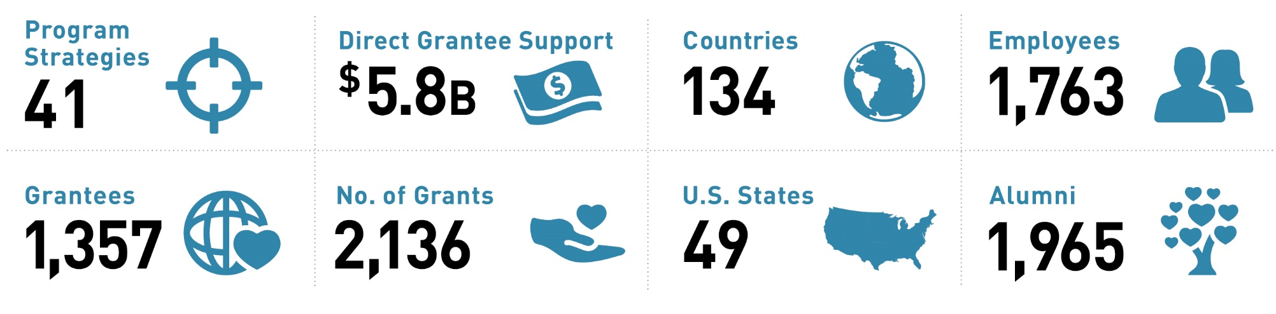
THE SCOPE OF OUR WORK
We work with partner organizations around the world to reduce inequity
For the Year ended December 31, 2020.
Notes:
We work across a broad range of issues, but all of them focus on removing the barriers that prevent people from living healthy, productive lives.
For more than 20 years we have learned several valuable lessons about how to tackle inequity as a foundation, and our approach continues to evolve, based on new evidence and changing circumstances facing the world.
For the year ended December 31, 2020 (left to right, top to bottom):
Program Strategies = 41
The current number of co-chair approved strategies as of 12/31 that the foundation is pursuing (Source: Foundation Strategy Office)
In 2020: Institute for Disease Modeling (IDM) and USP Data were added.
Direct Grantee Support= $5.8 billion
The value of grant payments made in the fiscal year (Source: 2020 Annual Report)
Countries served = 134
Number of countries we have awarded grants to by Location of Work or Geography Served in the fiscal year (Source: Investments By Geography Tool – Committed Investment Detail)
9 New in 2020 (compared to 2019): Djibouti, Seychelles, Timor-Leste, Puerto Rico, Iceland, Kazakhstan, Maldives, Tajikistan, Tunisia.
10 Countries in 2019 and not in 2020: Bahrain, Cuba, Fiji, Greece, Paraguay, Qatar, Russian Federation, Samoa, Trinidad and Tobago, Venezuela, Bolivarian Republic of.
Number of full-time employees worldwide = 1,763
Active headcount as of 12/31
Number of grantees = 1,357
The count of grantees awarded to in the fiscal year (Source: Data & Reporting)
Number of grants awarded = 2,136
Total number of new grants awarded in the fiscal year (Source: Data & Reporting)
U.S. states served = 49
Number of states in the US we have awarded grants to by Location of Work or Geography Served in the fiscal year (Source: Data & Reporting)
No specific grants were awarded for work to performed directly in or to serve the people of Maine in 2020.
Number of employee alumni = 1,814
Alumni Network as of 12/31 (Source: Alumni Network/Andrea Voytko)

Slide 3
Data Types at BMGF
Data is critical decision-making asset at BMGF, and its generation and use is increasing across our organization and partner network.
At BMGF we talk about data as either operational (internal) or programmatic (external). To make enterprise progress through policies, process and systems towards impact, we define data according to how it comes to be and its role.
Data Categories
Operational
Programmatic
Data Flow Use Cases
Generated
Acquired/Accessed
Funded
Influenced
Data with cross-cutting implications
Sensitive
Notes:
Generated : Data generated through our internal systems and projects as part of doing the business of the foundation. Most generated data is operational data. Some of it, esp. HR data can be sensitive. (e.g., INVEST data powering EBI and KM)
Acquired/Accessed: Data acquired from external sources providing core information into our systems or as an input to PST data science. (e.g., CANDID partner data into INVEST, USP loads public data into GDx, QS external access to Optum RWD)
Funded: Data that is an investment output and that has value to the field and/or the foundation as an input to analysis, evidence generation, and/or digital tools. (e.g., data from research grants)
Influenced: Data that is critical to the success of a program strategy or investment but is not the output of the grant. These usually have complex strategic challenges related to governance, business model, incentives and equity. They also more frequently involve global tech capabilities (big tech) and/or emerging technologies.
Sensitive Data: data that has specific access and use restrictions, regulatory compliance requirements, and/or ethical implications. This can be due to privacy, proprietary issues, and others. (e.g., subject level data in USP and GH, confidential biotech financial information)

Slide 4







Po data discovery pain points – Pre Grant
Today, making data accessible after the grant is costly and time-consuming, and the discoverability of this data is often highly limited
2 weeks later…
1 month later…
The PO emails the PST team to track down a grantee contact
The PO meets with the grantee who hesitates to share data due to level of effort to curate data and IP rights concerns
GRANTMAKING PROCESS (PRE-GRANT)
PO leverage to access funded data drops sharply after the grant is made
A PO exploring a grant problem space calls 2-5 contacts for relevant data from past grants
One contact knows of a PO who funded this problem space but has since left the foundation
6 weeks later…
The PO emails Legal for help with developing a data sharing agreement
DSA
A PO’s access to funded data is limited to their personal network
Output discoverability is limited to those familiar with it and is lost if they leave BMGF
Negotiating data access agreements and resolving data sharing challenges is significantly more time-consuming and less effective post-grant than upfront
10 weeks later…
REPOSITORY
Legal connects the FAIR Data WG with the PO by email to advise on sustainable repository options for the grantee
5-6 months later…
The PO and grantee come to an agreement for the PO to access the data; data is still not available to future POs exploring a similar space
After a lengthy process, the funded data is still only accessible to 1 PO (and their network)
© Bill & Melinda Gates Foundation |
Notes:
Notes on Pain Points:
A PO’s access to funded data is limited to their personal network
Output discoverability is limited to those familiar with it and is lost if they leave BMGF
PO leverage to access funded data drops sharply after the grant is made
Negotiating data access agreements and resolving data sharing challenges is significantly more time-consuming and less effective post-grant than upfront
After a lengthy process, the funded data is still only accessible to 1 PO (and their network)

Slide 5











Po data discovery pain points – Post Grant
Today, making data accessible after the grant is costly and time-consuming, and the discoverability of this data is often highly limited
PO Data Discovery Use Case (small fraction of funded data)
Vision for Enterprise Data Access
A grant final report reviewed by the grant PO references data
The grant PO reaches out to the grantee for data
Datasets are captured and tracked in INVEST through Data Management and Sharing Plans
The grantee says individuals can email the PI to get access to data
Grantees link planned output with actual output repository UIDs
Primary PO connects interested PO with the grantee (PI)
At a team meeting, the PO gives an update on the grant; a PO on their team is interested in the data
GDx indexes the datasets, using INVEST data, to link to datasets in their repository locations
GDx makes datasets discoverable through its search interface, to all foundation stakeholders and some partners; GDx can generate notifications when new datasets of relevance to an individual are indexed (based on past browsing, saved searches, etc.)
6-12 Months Later…
After an arduous 6+ month data access process, the interested PO reviews the data and realizes a $3.5M grant she was about to make is redundant with data she accessed, cancelling her grant and avoiding duplicate investment
POs can access not just one-off datasets, but the majority of funded data, to make a multiplier effect of improved investment decisions like Laura’s at scale
© Bill & Melinda Gates Foundation |

Slide 6
A COMMON SET OF DATA SHARING FRICTION POINTS HAMPER PROGRAMMATIC IMPACT
In 2017, the FAIR Data Working Group - comprised of programmatic and operational stakeholders - surfaced friction points that limit data sharing critical to advancing program strategies.
Teams sought to tackle these challenges, but often lacked time and expertise to progress their efforts. Stakeholders voiced a desire to identify issues that would be best addressed through enterprise policies or voice and advocacy.
Legal
Data ownership is unclear or undocumented; requirements for complying with governmental regulations are unclear or onerous.
Technical
Data producers lack data stewardship expertise and data custodians face challenges in preserving / cataloging resources.
Ethical
Data owners disagree with users about risks and benefits of data use and its potential to impact research.
Friction Points
Economic
Resources needed to share data are lacking or potential financial risks posed if data is shared publicly.
Political
Public sector agencies may adopt overly restrictive, blanket policies or guidelines that are unclear or inconsistent.
Motivational
Data producers lack incentives to prioritize data sharing or risk criticism if errors are uncovered.
Source: Panhuis, et al. (2014). A systematic review of barriers to data sharing in public health. BMC Public Health, 14(1). doi: 10.1186/1471-2458-14-1144
Notes:
Improve Implementation of the Open Access Policy (Underlying Data): Support design and review of policy language, guidance and grantee & Program Officer supports to improve discoverability and reuse of underlying data.
Establish a Data Sharing Community of Practice:
Identify common data sharing challenges and share current approaches and solutions to address them among peers (e.g. implementing data sharing plans as part of the grantmaking process).
Adapt, apply, and scale data sharing solutions that are currently being designed or implemented by specific PSTs (e.g. data privacy protection technologies).
Recommend Opportunities for Organizational Improvement: Influence data sharing behaviors and outcomes at scale by:
Proposing key changes to enterprise data policies and related business processes & data systems, and
Recommending the use of ELT voice and advocacy power to move the field and strategic partners.

Slide 7
COMMON DATA SHARING CHALLENGES INCREASE ORGANIZATIONAL RISK AND HAMPER STRATEGY EXECUTION
PRINCIPLES, POLICIES, AND VOICE
GRANT MAKING PROCESS AND SUPPORTS
“What data should come back to the foundation from investments? Typically, an individual PO is making decisions, and this increases risk.” -Legal
“We need guidance related to PII and privacy protection to support data access guidelines and controls for GDx (especially for external users).” -IT
“I recently had to forgo a landmark longitudinal student data study with Stanford because they wanted to be the sole owner of the research outputs. We have to get to a place where data access is a table stakes issues in getting money from the foundation.” -K12
“We need a standard data access clause and a boiler plate data sharing agreement.” -Multiple Teams
“Grantees lack the knowledge and resources to comply with complex data protection issues, and it creates barriers to data impact.” -AgDev
“I struggle to partner with Oxford, Johns Hopkins and others on important data science work because of their restrictive data policies.” -GH
“We don’t have the support and voice needed from the Co-chairs, CEO, and Country leadership on the importance of data as a public good to buffer us from sensitivities with government partners and regulators.” -India Country Office
EXTERNAL DATA ECOSYSTEM
“Our team collectively needs to understand what privacy protecting technologies are out there to secure human data, how to apply them, and if we wanted to, know who to talk to get started.” -K12
“I need to be able to speak to Central Bankers about data privacy. What are the right standards, requirements, and solutions for GDPR grade de-identification and where are there differences by discipline? Payments data is different than health data, but there are similarities.” -FSP
“We need to mitigate the reputational risk associated with Big Tech partnerships given growing skepticism of partners’ responsible handline and use of data.” -Communications
Notes:
Through our engagement with program teams around the foundation we heard three key themes:
BMGF lacks a clear position on data sharing (values, principles and policies). This is particularly challenging when interacting with partners.
Grantmaking is a key lever for achieving desired data sharing and access outcomes, yet these are often missed opportunities. Definition of data assets and related curation, hosting and licensing are often an afterthought and discussed late in the grant lifecycle, when there is little will, budget and ability to achieve key outcomes.
And we’re seeing a lot of change in the external data ecosystem - new regulations, new technologies, new partners that our POs are struggling to navigate.
Together these limit programmatic impact and increase reputational and legal risk to the foundation

Slide 8
Desirable Characteristics of Repositories
In 2018, the foundation built the Gates Data Exchange (GDx) to catalogue and internally house data resulting from investments. However, it was quickly known that GDx could not scale to meet needs. Especially, the need of the Open Access Policy for sharing underlying data to publications.
Now the question is what is next…
Desirable Characteristic | Gates Data Exchange Has?
Free & Easy Access | No, internal only
Clear Use Guidance | Yes, full documentation & metadata
Risk Management | Yes but sensitive data not allowed
Retention Policy | No
Sustainability | Little contingency plan
Persistent Identifiers | Yes, but internal only
Metadata | Yes, but limited & often not required
Curation & Quality Assurance | Yes
Broad & Measured Reuse | No
Common Format | Mixed
Storing Human Data | None as internal use only

Slide 9
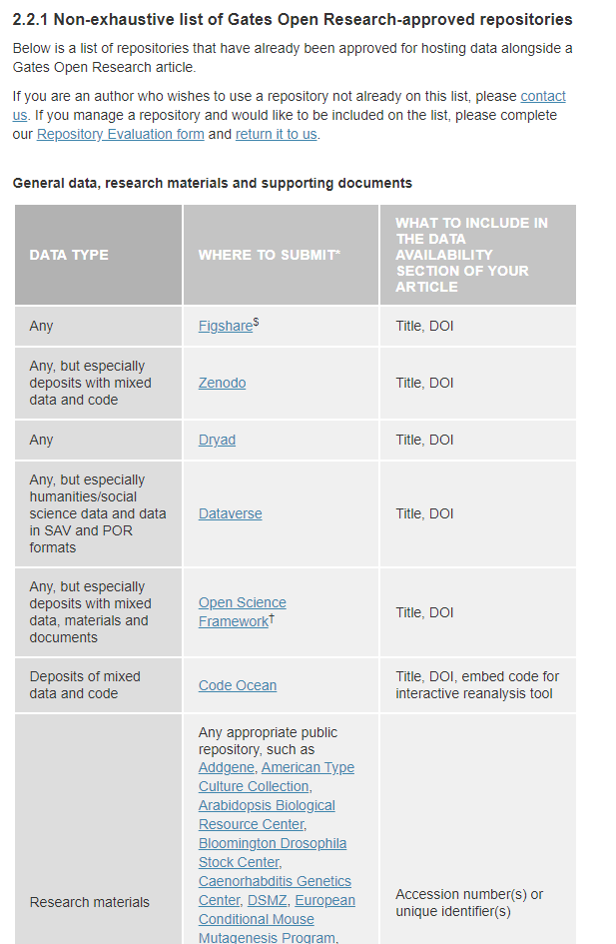
Gates Open Research
We leverage the repository vetting of F1000 Research who hosts the services underlying Gates Open Research.

Slide 10







The FAIR Data Working Group seeks to advance enterprise solutions to Common data sharing and access challenges across divisions
Enterprise
Division / PST
Principles, Policy
& Voice
Enterprise Processes
& Systems
Program-Specific
Data Sharing Strategies
Define principles and adjustments to existing data policies to treat data like an asset and use foundation “voice” to promote policy implementation and signal our values to partners
Guided by our principles and data policies, identify improvements to enterprise grantmaking processes and systems that provide a basis for FAIR and responsible investments
Facilitate knowledge sharing between divisions and PSTs developing program-specific data sharing strategies and investments to accelerate impact.
ELT Voice
& Advocacy
Legal Agreements
Ecosystem Capabilities
Data Sharing Requirements
Standard Data Access Clauses
Data
Communities
Data
Governance & Sovereignty
Data Mgmt. & Sharing Plans
Compliance & Reporting
Incentive & Business Models
ROI for
Data Sharing
Standards & Interoperability
Shared Digital Infrastructure
Data
Sharing
Values and Principles
Data
Policies
Data
Systems
Guidance & Supports
INVEST
PO & Grantee Communication
Data Stewardship
& Preservation
Privacy & Consent
Ethical
Global Access
Gates Data Exchange
Lawful
PO Capacity & Tools
…
…
Equitable
Open Access
Knowledge Management
FAIR

Slide 11
Opportunity: make it possible and easy for program officers to make funded data available for valuable use (internally & externally)
  How To Treat Funded Data As an Asset
Use Our Policies and Voice to Communicate Data Sharing Expectations Early On
Define High Value Data Use Scenarios
Design Grants with Clear and Specific Data Management & Sharing Requirements
Make Guidance and Supports Available to Partners
Link Grants to Data Assets for Tracking and Discoverability
Encourage or Require Partners to Preserve Data in Trusted Repositories
Catalog Data Assets Once Transferred to Repositories to Enable Discoverability and Access
© Bill & Melinda Gates Foundation |
11
Notes:
How To Treat Funded Data As an Asset
Define High Value Data Use Scenarios: Data to be generated through an investment should be identified at the onset of the investment lifecycle. Program Officers should work with peers and partners to determine the potential value of data use / reuse and plan accordingly.
Develop Data Management & Sharing Plans: When data generation is a primary outcome, Program Officers will often structure a grant accordingly, with clear and specific objectives and requirements related to data curation, access, transfer and licensing, etc. When data generation and use is a secondary outcome or data-related activities are not yet clear, Program Officers may benefit from data management and sharing advisory services and planning tools to define data sharing goals, use cases and grantee requirements, as well as specific implementation approach. This process provides an opportunity for issues, risks and resource needs to be identified and incorporated into grant activities and budget.
Link Data Assets to Grants: Data should be treated and categorized as an investment output or deliverable, linked to an investment, and tracked through completion (typically transferred to external data repositories). In some cases, Program Officers may tie grant payments to successful production and transfer of data to repositories.
Make Guidance and Supports Available to Partners: Often, LMIC partners lack access to trustworthy and affordable resources that would make data sharing easier. The foundation can help to bridge this gap by connecting grantees to strategic partners offering data curation, anonymization and preservation services or funding institutional memberships for such services (to further reduce friction of data sharing).
Preserve Data in Trusted Repositories: Data outputs and deliverables should be preserved in discipline-specific or generalist repositories to maximize discoverability and reuse by others over time.
Catalogue Data Assets: The foundation should have the capability to catalogue its data outputs and deliverables to enable efficient discoverability by internal teams (e.g. MLE) to inform investment decision-making. Over time, the foundation may expose this information to partners to enable research and data science activities that accelerate program strategies.

Slide 12



What we’ve learned: the fair data working group effort has identified three key pillars for making data accessible consistently for in-strategy uses
Driving What Works
Driving it At Scale
  Help POs Drive Data Access in Grantmaking
Enable POs to plan for in-strategy data uses, set grantee expectations on making data accessible, and capture as legal grant commitments
  Make it Easy for Grantees to Unlock Data
Help grantees meet Data Access commitments with guidance and direct funding to address capacity and capability gaps around Data Access
  Drive Internal and External Scale
Scale approach to making data accessible across BMGF and in the field to accelerate speed to data fueling in-strategy uses
1
2
3
Specify data, its granularity, and timing for being made accessible in the grant
Set deliverables or payment milestones for data
Align grantee incentives to making data accessible
Fund activities to make data accessible directly
Fund technical supports (e.g., data anonymization)
Fund repositories commonly needed by grantees
Establish treating data as an asset as a cultural norm in BMGF
Work with like funders and partners to shift the ecosystem to scale access to data assets
Address cross-divisional barriers like privacy and equity at scale

Slide 13



What it takes: advancing a body of work that is resourced to build, implement, and grow to get to a future where data is treated as an asset
Today: FAIR Data Working Group
2024+: Data Access Body of Work
Dedicated Team
Stand up a dedicated team to design, orchestrate and deliver guidance and supports to program teams while overseeing enterprise data policy and prioritized data initiatives.
Partial Resourcing
Two people in two divisions are driving the work of this volunteer group with partial time allocation.
Inconsistent Funding
Program funding spans funding through one division and passing of the hat.
Enterprise Tools Funded through Grants
Some Data Access tools and institutions are funded but embedded in (and often siloed in) grants.
Program Funding and Accountability
Ensure team has resourcing and accountability for services design and delivery, along with authority to make investments in partners to scale our ability – and the ability of our partners – to treat data as an asset.
Internal Resources and Alignment
Drive program vision through our adjacent services, processes and systems to operationalize Data Access in partnership with Operations team members.
Notes:
Today this work is driven with partial resourcing, inconsistent funding and too often is funded and siloed in individual grants. The FDWG has filled a void within the organization but is unable to meet growing demand for driving data access at scale without a mandate from leadership; a dedicated team and resources to organize a reliable set of service offerings, and; stronger alignment between data policies and supports for investment owners and foundation partners.

