Slide 1
ENVISION NEW FUTURES
What do we mean by innovation in higher education?
Mario Martinez and Nichole L. Sorenson

Slide 2
Presentation outline
Literature Takeaways
Environments and Ecosystems
Invention, Innovation, Adoption
Application to Jandris Center

Slide 3
TAKEAWAYS BASED ON LITERATURE
Work on one big idea (breakthrough innovation) and several small ideas (incremental innovation). This is a “diversified” approach to innovation and a realistic approach
Collaboration across organizations (inter-organizational collaboration) is the product of time, investment and resources—there are no shortcuts—but the payoff can be big.
New inventions in higher education will require that we draw on perspectives inside and outside of higher education—we need knowledgeable insiders and outsiders who bring new questions.
Innovations in higher education that have any chance of scaling will have to purposefully consider both the technical/functional aspects of the innovation and the emotion/meaning that users and adopters associate with it.
Innovations do not diffuse in a vacuum. It is necessary to consider the higher education environment and ecosystem in which these innovations are attempting to diffuse.

Slide 4


THE LITERATURE AS A GUIDE TO INNOVATION WORK

Slide 5
What is Innovation?
Commercializing or distributing an invention
Radical breakthroughs in performance or efficiency
Novel or Disruptive technology applied to an industry
Tapping New Markets (Blue Oceans)
Transforming function and meaning
Creative destruction
An idea, practice, or object that is perceived as new by individuals or groups
Mass Distribution Solutions

Slide 6
THE STAGES OF INNOVATION FRAMEWORK
Political, Economic, Social and Technological Forces
Inter-Organiza- tional
Organiza- tional
Group
Individual
ADOPTION
INNOVATION
Initial
Adoption
Diffusion
and
Scale
INVENTION
Localized or Cult Adoption Mass Adoption
Industry Ecosystem
Prior and Existing Innovations

Slide 7
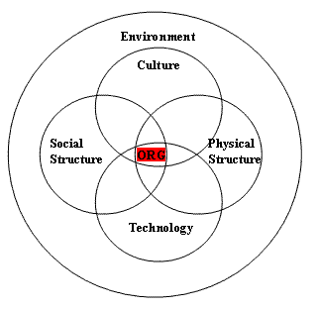
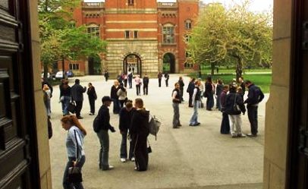
environments and ecosystems in higher education

Slide 8
The macro Ecosystem
Traditional
Higher Education
Mass Higher
Postsecondary
Global Postsecondary
Education
Education
Education &
Training
Comprehensive
Traditional
Mass Higher
Four
-
Year
Institutions
Higher
Education
Postsecondary
Colleges
Education
Education
Public
And
Private
Two Year
Proprietary
Doctoral
Colleges
Institutions
For
Profits,
Professional
Corporations,
And Specialized
Granting
Institutions
Institutions
Training
Corp,
Online Providers
1940
1950
1960
1970
1980
1990
2000

Slide 9
A PUBLIC INSTITUTION’S ECOSYSTEM
State Policy Level
State Policy Level Actors
Structures and Processes
Postsecondary System
Level
Postsecondary System Actors
Structures and Processes
Institutional
Level
Institutional Actors
Structures and Processes

Slide 10




Environmental Forces Influence Higher Education
Political
Economic
PEST Analysis
Social
Technological

Slide 11
INVENTION
THE STAGES OF INNOVATION FRAMEWORK
Political, Economic, Social and Technological Forces
Inter-Organiza- tional
Organiza- tional
Group
Individual
ADOPTION
INNOVATION
Initial
Adoption
Diffusion
and
Scale
INVENTION
Localized or Cult Adoption Mass Adoption
Industry Ecosystem
Prior and Existing Innovations

Slide 12

Invention/Innovation CAN BE Internal OR External
Externally
Driven
Internally
Driven

Slide 13
Examples of inventions/innovations
MOOCs
New engagement processes for students, alumni
Competency based credits
Social Media technologies
Hybrid courses that integrate online with face-to-face
New units (e.g. continuing education; corporate training)
Inter-institutional collaborations on student pathways

Slide 14
INVENTION AT THE GROUP LEVEL
Context
Group
Process
Notes:
PREVIOUS SLIDE
Invention at the group level is influenced by both contexts and group processes.
Contexts include organizational culture, social norms and value congruence between individuals, the organization and group.
Group processes, such as reinforcing positive operational norms, also effect a group’s ability to operate effectively and the possibility for invention.

Slide 15
VIRTUAL TEAMS AND INVENTION
Maximizing Effectiveness
Structuring tasks
Training
Strategy and goal setting
Developing shared language
Building team cohesiveness
Challenges
Less conformity
Polarized decisions
Less individual opinion change over time
Notes:
As technology enables important work and conversations to happen across vast distances, this creates new opportunities as well as new challenges.
These challenges include less conformity, polarized decisions, and less opinion change over time.
So the ability of teams to work well through virtual spaces becomes increasingly important.
There are important strategies for maximizing virtual team effectiveness so as to allow for invention at this group level, such as developing shared language.

Slide 16
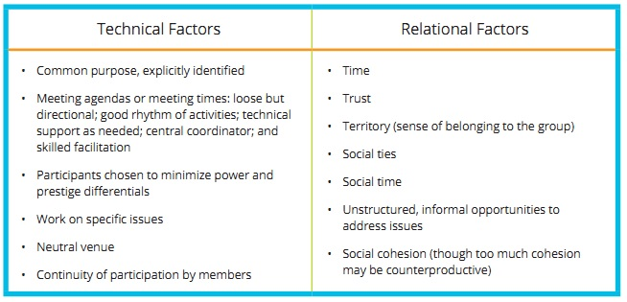
INTER-ORGANIZATIONAL Invention REQUIRES COMMITMENT
Notes:
RELATE TO PREVIOUS SLIDE
It is important to recognize that there may be additional challenges when trying to create inter-organizational collaborations for the purposes of creation, invention, and innovation.

Slide 17
INVENTION TO INNOVATION: INCORPORATE MULTIPLE PERSPECTIVES
Cultural Production (Emotion/Meaning)
Cultural Organizations
Media
Social Critics, Observers, Artists,
Social Scientists
Educational and Research Institutions; Associations
Sticky Educational
Innovation
Governments
People, Leaders
Businesses, Technology Suppliers
Marketing, Advertising
Designers and Developers
Pioneering Projects
Technological Development and Distribution (technical/functional)
Notes:
This image is from Roberto Verganti’s book Design-Driven Innovation, and it highlights the importance of a variety of perspectives, particularly in the design phase of any innovation.
Incorporating stakeholders who prioritize culture, meaning, and emotion as well as those more focused on technical and functional aspects of development creates a very useful/essential diversity of perspective.

Slide 18
INNOVATION
THE STAGES OF INNOVATION FRAMEWORK
Political, Economic, Social and Technological Forces
Inter-Organiza- tional
Organiza- tional
Group
Individual
ADOPTION
INNOVATION
Initial
Adoption
Diffusion
and
Scale
INVENTION
Localized or Cult Adoption Mass Adoption
Industry Ecosystem
Prior and Existing Innovations

Slide 19
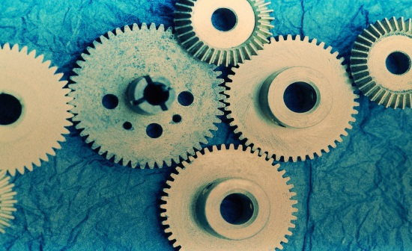

Features of Innovation
Functional/Technical
Emotional/Meaning

Slide 20
A General Innovation Framework
Types of Innovation
 | Product/Service | Process | Business Model

Slide 21
A General Innovation Framework
Types of Innovation
 | Product/Service | Process | Business Model
Incremental
Substantial
Breakthrough
Impact of Innovation

Slide 22
A General Innovation Framework
Types of Innovation
 | Product/Service | Process | Business Model
Incremental | ● ● ● ● ● ● ● ● ●
Substantial
Breakthrough |  |  | ●
Impact of Innovation

Slide 23
Examples of Higher Education Innovation
Types of Innovation
 | Product/Service | Process | Business Model
Incremental | E-advising Online courses
Substantial |  | Online Registration Engagement Processes
Breakthrough |  |  | Community Colleges
Impact of Innovation

Slide 24
ADOPTION
THE STAGES OF INNOVATION FRAMEWORK
Political, Economic, Social and Technological Forces
Inter-Organiza- tional
Organiza- tional
Group
Individual
ADOPTION
INNOVATION
Initial
Adoption
Diffusion
and
Scale
INVENTION
Localized or Cult Adoption Mass Adoption
Industry Ecosystem
Prior and Existing Innovations

Slide 25
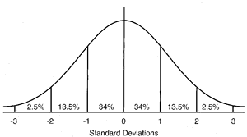
Innovation Adoption and Diffusion
Early Majority
Late Majority
Early
Adopters
Laggards
Innovators

Slide 26
Adoption is Dependent on Many Factors
Relative Advantage (how is this better than what currently exists, in the mind of the user?)
Compatibility (with previous innovations, practices, and processes)
Complexity (the more complex, the harder to diffuse)
Trialability (do people have a chance to try it?)
Observability (is there proof of the outcomes?)
Attributes of “social contagion” such as visibility and image

Slide 27
DEVELOPERS, ADOPTERS AND USERS OFTEN MISALIGN
Innovation Focus
 | Technical/Functional | Emotional/Meaning
State Policymakers | X
Administrators | X
Business, Technology Suppliers | X
Faculty/Staff |  | X
Students |  | X
Developers, Adopters, Users

Slide 28
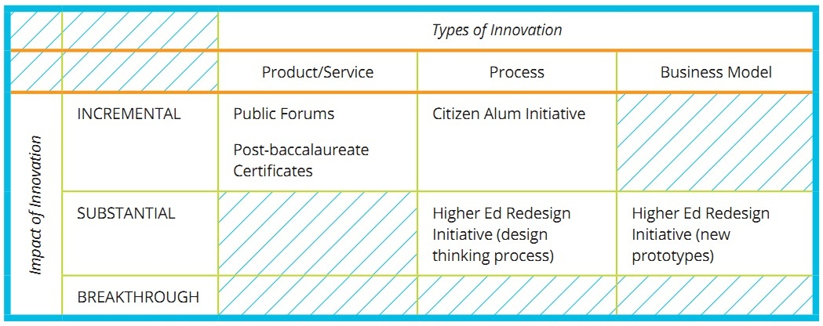
JANDRIS CENTER INITIATIVES
by Potential Innovation Type and Impact
Notes:
Here we have applied Mario’s framework of types and impact of innovation to Jandris Center initiatives.
Public forums such as this and the certificates could be incremental service innovations.
Citizen Alum Initiative may be an incremental process innovation.
The Higher Ed Redesign Initiative has the potential to both process and business model innovations.

Slide 29
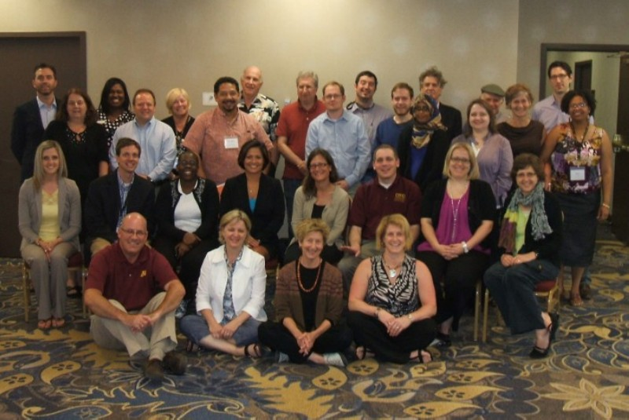
CITIZEN ALUM INITIATIVE
Citizen Alum Summer Institute, June 11-12, 2013
Jandris Center, University of Minnesota
Notes:
Jandris Center’s ongoing support for the Citizen Alum initiative represents its focus on process innovation.
Led by Professor Julie Ellison at the University of Michigan, the philosophy of Citizen Alum reconceptualizes alumni as “doers” rather than simply “donors” and aims to build multigenerational communities of active citizenship and learning.
This past year, the Jandris Center hosted the first Citizen Alum Summer Institute.
Participants came from around the US and from as far as Hawaii. Their professional backgrounds included a variety of sectors and fields.
connect to recombination concept –
“Citizen Alum combines traditional alumni relations practices with initiatives around democratic engagement in higher education.”

Slide 30

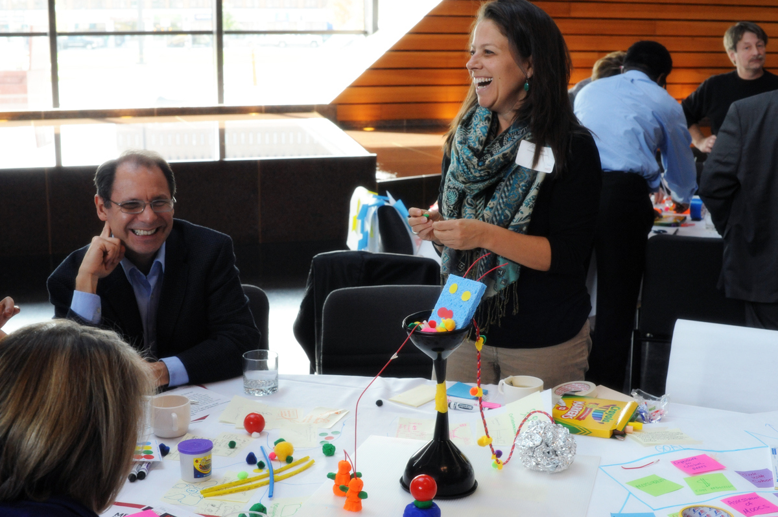


HIGHER ED REDESIGN INITIATIVE
Notes:
The Higher Ed Redesign Initiative is a collaboration of the Jandris Center, Midwestern Higher Education Compact, and the College of Design.
This initiative has the potential to provide substantial innovation in the areas of process and business models.
The process employed by the Initiative – applying a new set of problem solving tools to address persistent challenges – may be scaled to address higher education problems at various levels.
Additionally, the prototypes created through redesign programs have the potential to unearth business model innovations.
We just completed the first weekend of Higher Ed Redesign Associates Program. The design challenge that our associates are beginning to grapple with is:
How might we help post secondary educational institutions utilize open educational resources to:
Address achievement gaps and advance equity in higher education participation and outcomes
Reduce cost for students and families
Improve the overall quality of learning.

Slide 31
Thank You!
Mario Martinez
mario.martinez@unlv.edu
Nichole L. Sorenson
soren604@umn.edu

Slide 32
ENVISION NEW FUTURES
What do we mean by innovation in higher education?

