Slide 1
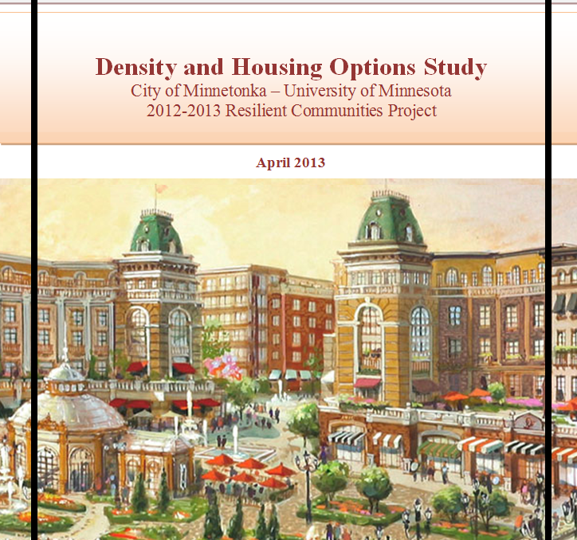

Slide 2

Project Overview & Existing Conditions
Project Goals: Increase density and diversify housing options
  Identify current exclusionary policies
  How to make housing denser and more inclusive
Why Smart Growth?

Slide 3
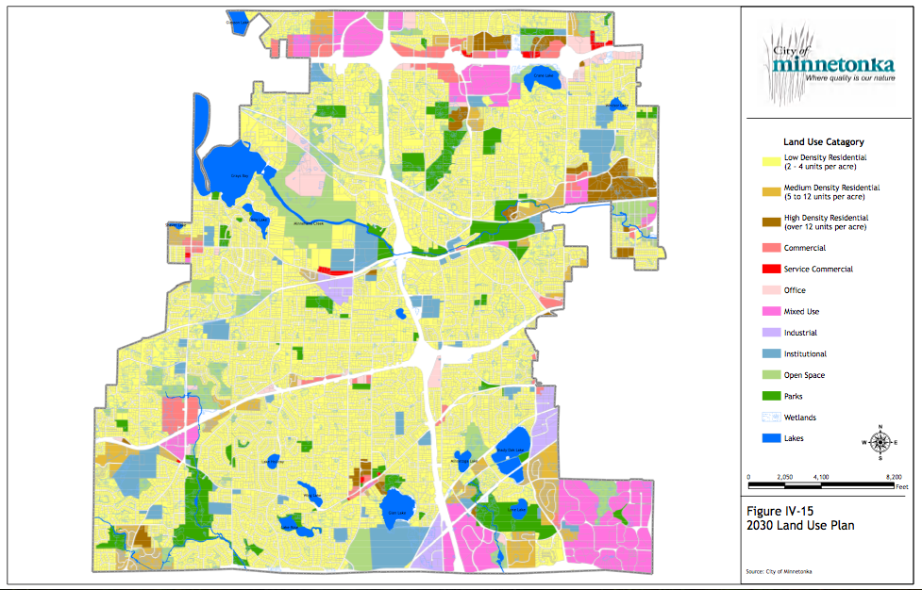
Project Overview & Existing Conditions
Existing Conditions/Challenges
  Low Density
  Single Family
  Older Housing stock
  Aging Population
  Low Population Growth

Slide 4
Smart Growth Audit
Smart Growth Category | Score | Percentage
Water, Sewer, Infrastructure | 3/3 | 100%
Regionalism | 3/3 | 100%
Efficient Land Consumption | 3/4 | 75%
Water Quality | 3/4 | 75%
Land Use | 5/7 | 71%
Urban Form | 1/2 | 50%
Open Space/Green Space | 3/6 | 50%
Energy Conservation | 2/4 | 50%
Permitting Processes | 1/2 | 50%
Housing | 5/11 | 45%
Inward Direction of Growth | 2/5 | 40%
Jobs-Housing Balance | 1/3 | 33%
Parking | 1/5 | 20%
Transportation | 2/12 | 17%
Density | 0/5 | 0%
Air Quality | 0/2 | 0%
TOTAL | 40/78 | 51%

Slide 5
Smart Growth Recommendations
Urban Form and Efficient Land Consumption
  Maintain Inward Direction of Growth
  Analyze Redevelopment and Infill Potential
  Mixed Use by Right
Housing, Density, and Affordability
  Clarify affordability targets
  Quantify bonuses and incentives
  Density Minimums
  Reduce Single Family Lot sizes
  Utilize some element of form based code
Jobs-Housing Balance
  Create specific targets
Transportation and Pedestrian Orientation
  Interconnected Streets
  Put land use on a diet
  Require sidewalks in mixed use areas
  Parking!

Slide 6
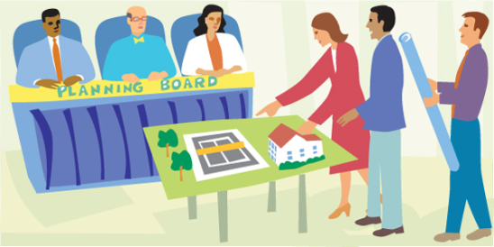
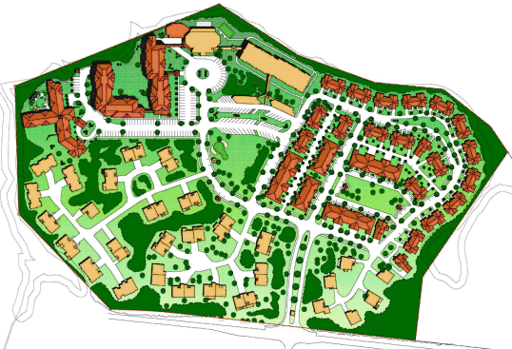
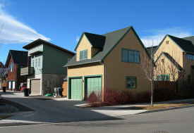
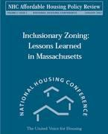
Zoning Variances
Encouraging Housing Diversity
INCLUSIONARY POLICIES
PUD
Expedited Zoning & Approval
Adjusted Fees
Accessory Apartments
Set Asides
Set Asides
Accessory Apartments
Adjusted Lot Sizes

Slide 7
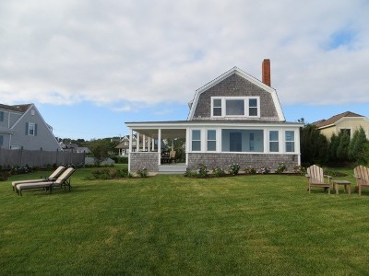

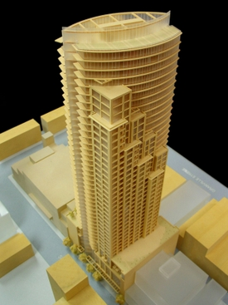
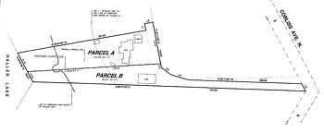
Zoning Variances
Encouraging Housing Diversity
INCLUSIONARY POLICIES
Adjusted Lot Sizes
Zoning Variances
Density Bonuses
Manufactured Homes
Incentive for New Construction Technologies
Set Asides
Accessory Apartments
Adjusted Lot Sizes

Slide 8
Senior Housing
Problems
    Baby Boomers
    Differing senior needs (“go-go” vs “no-go”)
    Community opposition & resistance to change
    Limited resources
    Aging-In-Place preference
    Aging housing stock
    Low housing turnover
Recommendations
    Accessory Apartments
    Reduce Stigmas
    Additional senior income
    Meet A-I-P preference
    Universally designed
    Increase housing options for younger families
    Infill development
    Reduce reliance on H.O.M.E. Program
Notes:
Minnetonka has a large, rapidly aging Baby Boomer population, which includes people aged 65 years and older. However, these seniors have differing needs and can be described as “go-go” seniors, “slow-go” seniors, and “no-go” seniors, who are frail and require assisted living facilities. Although there is a huge demand for a variety of senior housing options, there are zero senior rental units and zero owner-occupied units in the city. Further compounding this supply problem is community opposition to large development projects and even the expansion of smaller senior home facilities. Additionally, seniors want to age-in-place in their communities, despite the need to downsize form single-family homes that aren’t designed with elderly needs in mind. Also, this aging-in-place phenomenon contributes to a low housing turnover rate for younger families and fewer affordable housing options, which could potentially destabilize school enrollment levels. So, we advocate for accessory apartments,
Since there are several supply and demand issues regarding the feasibility of creating additional senior housing, so we recommend a greater reliance on accessory apartments. We believe that accessory apartments adequately address most of these issues, including the efficient utilization of limited, undeveloped space while respecting both senior and community needs. Accessory apartments used as senior housing could employ Universal Design elements while allowing residents to age-in-place on their property surrounded by their familiar communities. At the same time, the larger single-family structure could be leased out to younger families while senior residents would gain additional income and the added benefit of having younger neighbors to help maintain the property. This mutually beneficial relationship would also reduce reliance on the House and Outdoor Maintenance for the Elderly program, which is funded through CDBGs and may become unsustainable in the near future.

Slide 9
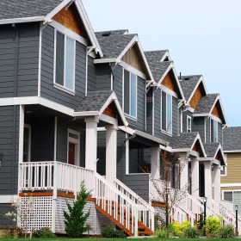
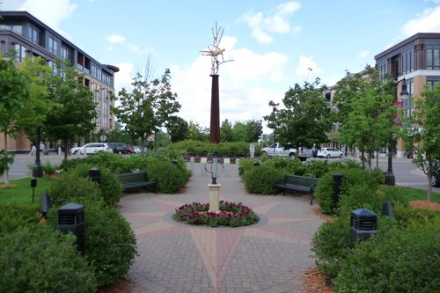
Encouraging Housing Diversity
MIXED-USE DEVELOPMENTS
Good for affordable housing
  Better access to jobs and amenities
  More incentives for developers
    Less Parking
    Commercial rental income
Good for housing diversity
  Appeals to target demographic
  Least intrusive on existing developments
  Creates community asset

Slide 10
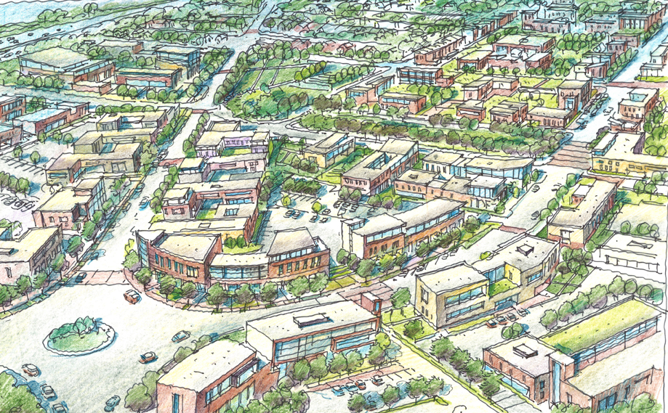
Encouraging Housing Diversity
ACHIEVING MIXED-USE
Recommendations
Rewrite PUD to be mixed-use friendly
Write mixed-use ordinance with design specifications
Provide regulatory incentives to developers

Slide 11
Conclusion
Minnetonka facing demographic “Pig in a python” with an aging population and aging housing stock
Connect Comprehensive Plan goals to housing policies
  Smaller lot sizes
  Make inclusionary housing a priority
  Allow senior housing by right in high density residential and commercial districts
  Actively pursue mixed-use within growth areas

