Slide 1
An Exercise in Building a Meaningful Life:
Game Design for Young Philosophers
An exercise by David Beard with Sarah LaChance Adams

Slide 2
Overview
Touching Base on Tuesday’s Readings: Sartre, Self-Deception, Motivation and Games
Introducing Your Assignment
Key Decisions in Game Design
Examples and Analyses of Games You Might Know
Walking You Through the Steps of the Assignment.

Slide 3
Self-Deception
and Game Design

Slide 4
The Assignment
Your objective is to design a game with the goal that a player will live a meaningful life by avoiding self-deception.
Self-deception entails thinking that one either completely lacks choices (totally determined) or that one is completely free from any cause (total free will).

Slide 5
The Assignment
Each group will create a game based on one of the sections of the course:
play/childhood
home/values
meaningful work
and parenthood.

Slide 6
Key Decisions
in Game Design

Slide 7
Number of Players
Solitaire
Head-to-head
Free-for-all
One-against-many
Team competition
Cooperative

Slide 8
Number of Players
Solitaire (Example: Solitaire)
Head-to-head (Magic)
Free-for-all (Monopoly)
One-against-many (Last Night on Earth; Piling onto Grandpa)
Team competition (Bridge)
Cooperative (Pandemic)

Slide 9
Player Interaction
None
Trading
Co-operation
Cutthroat
Traitor

Slide 10
Player Interaction
None (Solitaire; Bananagrams)
Trading (Catan)
Co-operation (Pandemic)
Cutthroat (Munchkin)
Traitor (Werewolf)

Slide 11
Narrative, Theme or Story
Be creative!
Survive a zombie apocalypse!
Raise a child!
Catch a werewolf
Tell a story.

Slide 12
Win (Victory) Condition
Last Player Standing
Capture/destroy
Territorial control
Collection
Race
Point Threshold
Solve

Slide 13
Win (Victory) Condition
Last Player Standing (Monopoly)
Capture/destroy (Chess)
Territorial control (Catan)
Collection (Rummy)
Race (Parcheesi; Super Mario-kart)
Point Threshold (Yahtzee)
Solve (Clue; Escape Rooms)

Slide 14
Examples and Analyses
of Games You Might Know

Slide 15
Play/Childhood

Slide 16
Play/Childhood
Play is a project of ascending meaning (we impose our schemes on the environment) and descending meaning, adjusting to one’s environment. (Henricks)
“Play is an activity that helps people recognize their general character and capabilities. eople must discover their capabilities through interaction with a wide range of forms of forces”
“It is in playing and only in playing that the individual child or adult is able to be creative and to use the whole personality, and it is only in being creative that the individual discovers the self”

Slide 17
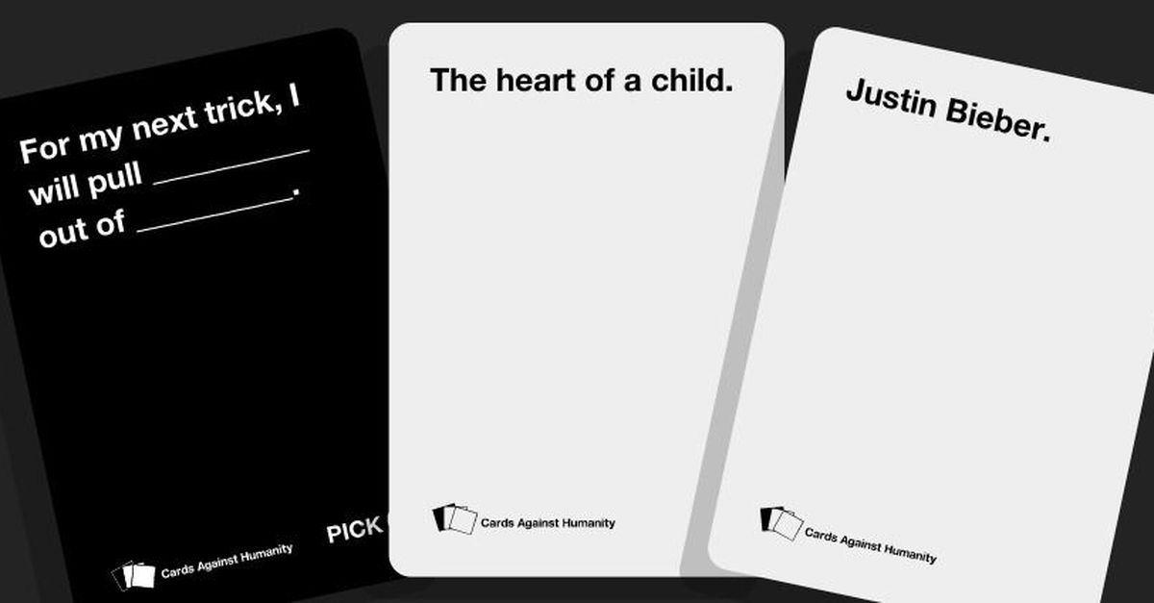

Example of
Play/Childhood Games:
Apples to Apples, Cards against Humanity, and Dixit

Slide 18
Home/Values

Slide 19
Home/Values
“The material of home constitutes an investment in our identity.” We can think of home as a place to preserve connections between our past and present.”
“Our homes reflect our values, but sometimes also contradict them (Consider the log cabin style home that is ecologically inefficient).”

Slide 20

Example of Home/Values Games:
Dream Home is a family game about building and furnishing your new house. Over twelve rounds, players collect pairs of cards consisting of a room card and an accessory card (roof, helper, furnishing or tool) and place them on their personal boards, creating their dream homes.

Slide 21
Meaningful Work

Slide 22
Meaningful Work
Meaningful work includes the following:
Connection to what one creates
Progress from novice to master
Participating in a shared sense of the good with other human beings

Slide 23
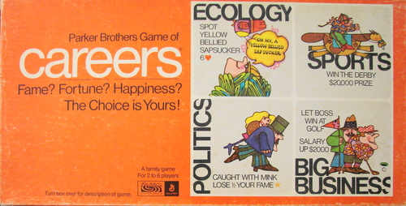
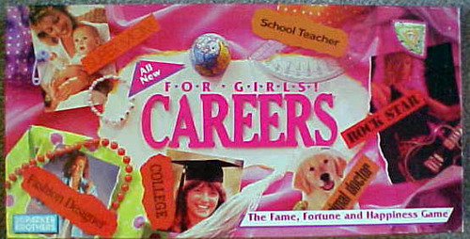

Example of Meaningful Work Games:
Swordsmithing Quest in WoW

Slide 24

Negative Example
of Meaningful Work Games:
Monopoly
and the Universal Basic Income

Slide 25
Parenthood

Slide 26
Parenthood
In parenthood…
the decision to have children or not, is not simply about one’s personal happiness.
unconditional love is rarely desirable.
not having children is the “less risky path.”

Slide 27
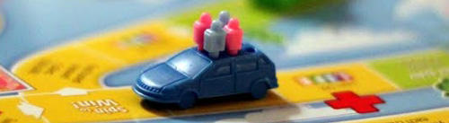
Example of
Parenthood Games:
Life and its Various Editions
Get educated, get a job, buy insurance, buy a home, raise a family…
Or collect an entourage…
Or accumulate pets instead of kids

Slide 28
The Steps: Determine Your Area
Each group will create a game based on one of the sections of the course:
play/childhood
home/values
meaningful work
and parenthood.
Choose the course material you feel you understand best. No group should be be larger than six students, without “checking in “ with Dr. LaChance Adams.

Slide 29
The Steps: Determine the Best Style of Game
How is this aspect of a meaningful life best achieved?
Alone? (Solitaire)
In competition with one? (Head-to-head)
In competition with many (Free-for-all or One-against-many)
On a team in competition with a team? (Team competition)
Working together as a community (Cooperative)

Slide 30
The Steps:
Determine the Game Narrative

Slide 31
The Steps:
Determine the Win Conditions
Last Player Standing
Capture/destroy
Territorial control
Collection
Race
Point Threshold
Solve

Slide 32
The Steps:
Creating the Board
(for board games)
Creating the Card Types
(for card games)

Slide 33
The Steps:
Creating the Turns
How Much Chance is in your game?
Monopoly’s Roll and Move: Lots of Chance in Life
Chess: Almost No Chance
Cards Against Humanity: Draw Two, Play One?

Slide 34
The Steps:
How Do We Know When the Game is Over?
Someone wins.
We run out of cards.
Time runs out.

Slide 35
The Steps:
Design the Rules
An Overview Text
Information about Players, Ages, and Game Time
The Objective of the Game
Set-Up Information
The Rules
Sample Turns
Concluding the Game (How do you know when it’s over and who won?)

Slide 36
The Steps:
Have Fun.

