Slide 1
Sust 4004: RCP Project
Nathaniel Baeumler, Jenna Yanish, Paige Brunn, Cornelia Joensson

Slide 2
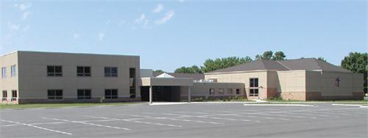
Project Objectives
Reach out to United Methodist Church
Understand current awareness of issues
Assess community capacity for engagement
Provide UMC with best management practices
Develop best outreach practices
http://ducatelliandschultz.ourwedding.com/view/7689979050527050/34655574

Slide 3
Project Accomplishments
Created positive relationship with UMC
  interested in learning more
  interested in involvement with community solar project
  provided BMP for reducing power consumption
Developed Outreach Practice Guide

Slide 4
Community Assessment UMC
Bridges:
connecting with the younger generation
want to be a more active community role
financial incentives

Slide 5
Community Assessment UMC
Barriers:
lack of volunteer time
lack of funding
lack of communication and consensus
congregation funded church

Slide 6
Other Perspectives- Enerchange
The congregation members want change
Suspicion about the free service
Frustration about change of contact person
Insufficient ways of informing about energy audit
Hard to keep interest up
Too much change is needed
They don’t use funding opportunities

Slide 7
Best Outreach Practices
Have a booth at events
Make information more understandable
Economic Localization
Host a 5K or Fun Run

Slide 8
Have A Booth At Events
Have a Booth at Events
Make it a Game
Give Away Prizes
Have Informational Pamphlets
Give them a Goal

Slide 9
Make Information More Understandable
Have a semi-annual report, or e-newsletter
  Promote your improvements in energy efficiency
Provide a visual display
  Show in a quantitative way just how many resources are used
Promote programs that aid Rosemount in their end goal
  Work with Xcel to promote their efficiency goals to benefit your goals

Slide 10
Economic Localization
Less transportation
Generates more money
Placemaking
  Generates knowledge about the local area
Health
Local businesses create engagement

Slide 11
Host a 5K or a Fun Run
1.Promote the 5K run
2.Have local sponsors such as community based businesses
3.Have Informational Pamphlets that are Relevant to the Event/Audience
4.Set a goal for the community and their future goals for the 5k run

Slide 12
Questions or Comments?

