Slide 1
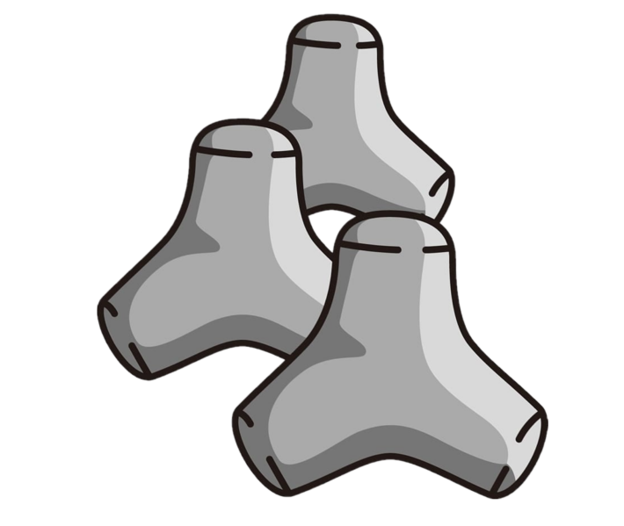
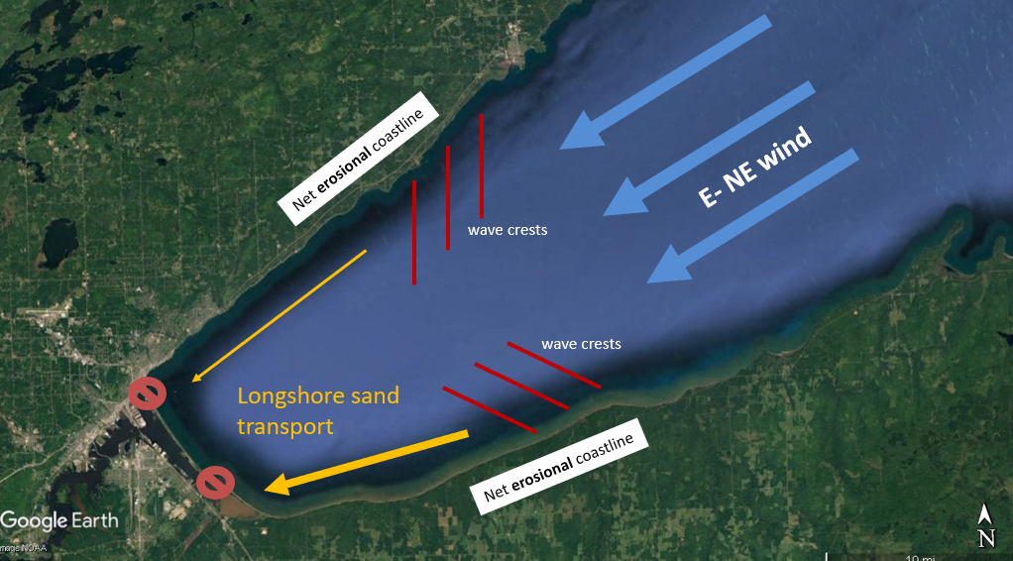
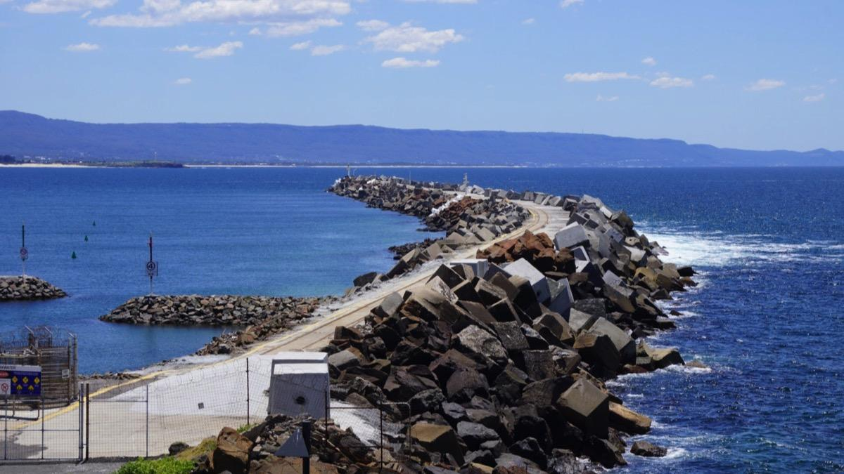
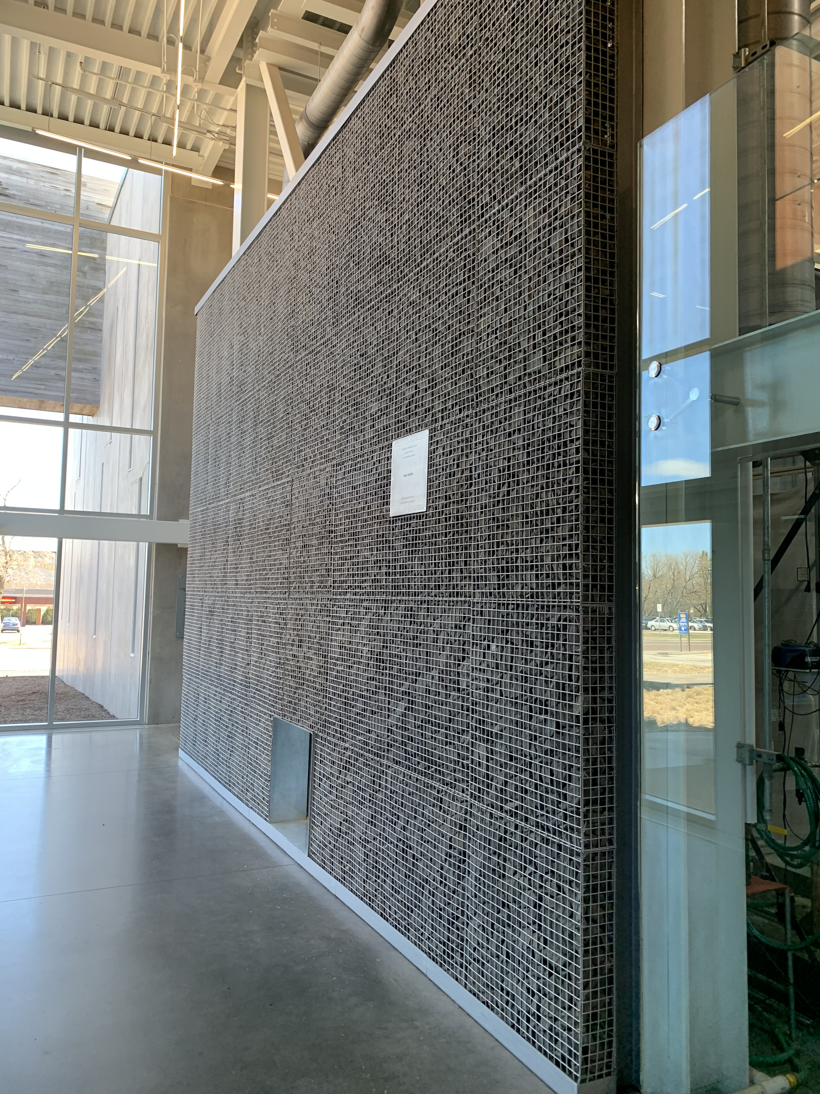
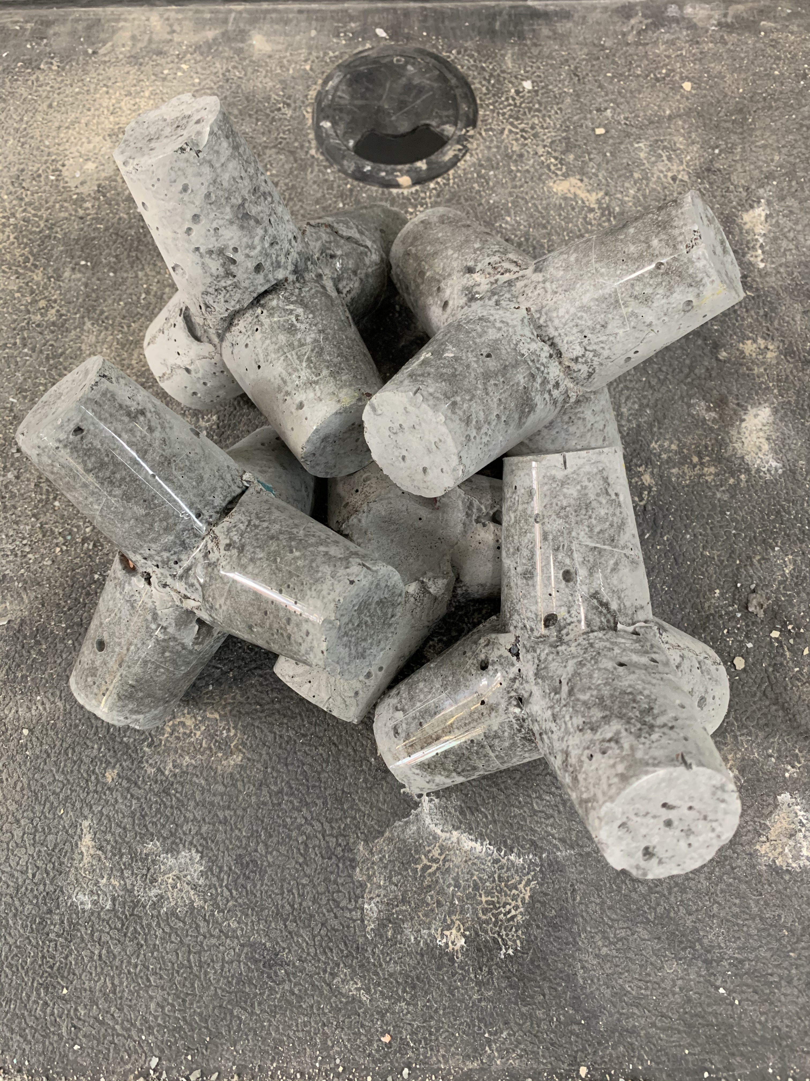
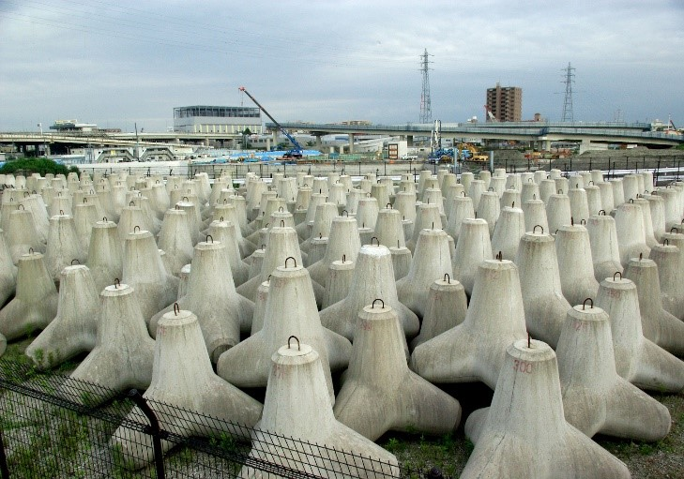
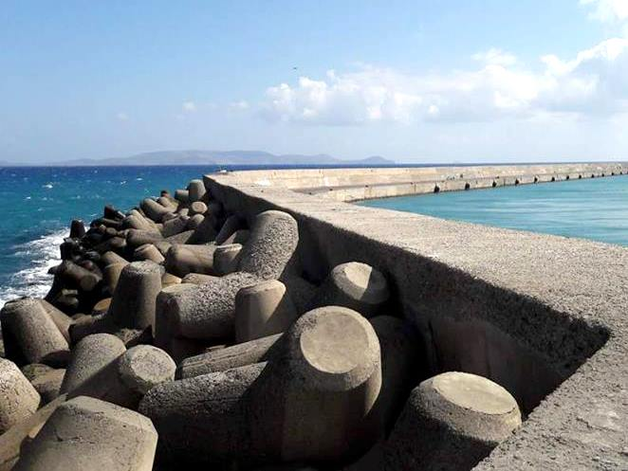
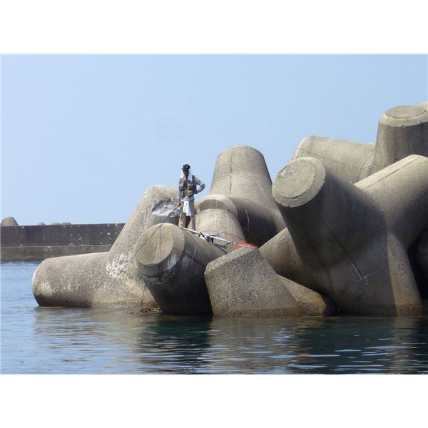

Feasibility of Implementing Concrete Tetrapods into Duluth’s Coastal Environment
By: Chase Ernste
Dr. Mary Christiansen, Department of Civil Engineering, University of MN-Duluth
What’s the Issue?
Short-term Erosion
  Wave energy from storm events
Long-term Erosion
  Soil transport from wave energy displacing shoreline soil, known as “Longshore Transport”
Implementation: Minnesota Point
Why Minnesota Point?
Soil depravation from man-made dams
Eventually will lead to Minnesota Point breaching
What’s the Best Way Forward?
Preliminary Field Study with High-Density Concrete
  GPC vs natural rock
What are Concrete Tetrapods?
Structure used to dissipate wave energy
Multiple units conveniently interlock
Easy field installation
Easily accessible material
Expected Outcomes
Reduce Short-term erosion with Tetrapods
Counter Long-term erosion with Replenishment Program
    What will it Cost?
    Plant Budget: Approx. $150,000
    Tetrapod Structure cost depends on size & quantity
Preliminary Field Study using GPC units in Sydney, Australia [2]
Concrete Mix Consideration:
Portland Cement Concrete (PCC)
Geopolymer Cement Concrete (GPC)
  Taconite Base -> High-density concrete
References
[1] Tetrapod (Structure). (n.d.). Wikipedia [Photos], The Free Encyclopedia.
[2] Mahmood, A. H., Foster, S. J., & Castel, A. (2020). Development of high-density geopolymer concrete for breakwater armour units for Port Kembla harbour. Concrete in Australia, 44(4).
[3] Swenson, J. B. (2020, March 17). Twin Ports Climate Conversation: Long view of Minnesota Point: Minnesota Sea Grant News. From http://www.seagrant.umn.edu/news/2020/03/17
Taconite Tailings in the CE Building
Acknowledgments
Dr. Mary Christiansen
Dr. John Swenson
UMD Honors Program
UROP Program
Concrete Tetrapod Structures [1]
Crete, Greece By: Lusinemarg [1]
Large Concrete Tetrapods [1]
Notes:
Copyright Colin Purrington (http://colinpurrington.com/tips/academic/posterdesign).

