Slide 1


Design Thinking for Higher Education Policy Innovation
David Weerts, Virajita Singh, Aaron Horn & Leonard Taylor
Association for the Study of Higher Education, Policy Pre-Conf, November 4, 2015

Slide 2
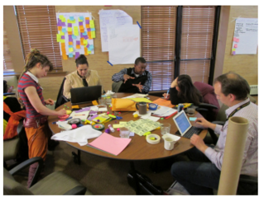
What happens when you bring together artists, designers, engineers, students, non-profit leaders, and policy makers to address persistent higher education challenges?
Promoting policy innovation

Slide 3



Streams of opportunity
Could we build on the legacy of the National Center for Public Policy in Higher Education Associates Program?
University of Minnesota’s growing niche’ in applying design methodology to social problems
Desire to draw on interdisciplinary, cross-sector perspectives to address persistent challenges in higher education.
“Our College makes stuff.” -Tom Fisher, Dean, U of Minnesota College of Design
Notes:
--Thank you for the opportunity to be here.
-- Introduce panel
In 25 minutes we will share some key lessons learned from a Minnesota-based pilot program called, “The Higher Ed Redesign Inisitiave.” In doing so we will
Give a brief history of our collaboration between MHEC, CDes, and jCENTER (DW)
Provide a brief overview about what design thinking is and how it relates to the policy arena (VS)
Share lessons learned from the project (LT)
Reflections on its application to policy challenges in higher education

Slide 4
Design Thinking is an emerging field, rooted in the tools and processes used traditionally by design disciplines (architecture, landscape architecture, graphic design, interior design, web design, interactive design and others).
Design-Thinking

Slide 5
The process involves problem definition, field research, idea generating, story boarding, frequent prototyping and narrative as a mode for engaging participants and motivating action.
Design-Thinking

Slide 6
Design-Thinking
Change by Design Tim Brown
Massive Change Bruce Mau
A Whole New Mind Daniel Pink
In the Scheme of Things Thomas Fisher
“In a world with little respect for traditional structures, almost everything – from the operation of a company to the organization of a community – can be approached as a design problem.”
- Fisher, ‘Design in the World of Flows.’ In the Scheme of Things

Slide 7
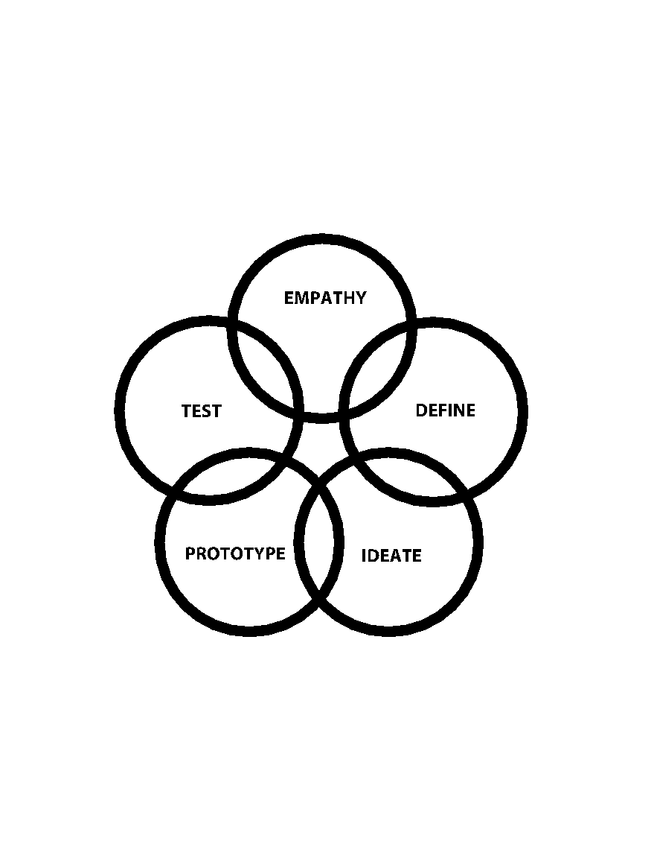
Design-Thinking
Notes:
Toby: 9:00-9:15
quick intro….so you have a conceptual understanding of the steps
Empathy
Problem definition
Ideation
Prototyping and testing
Introduce the concept and explain
Discuss
Practice activity
discuss

Slide 8
Step 1: Empathy empathize with ‘users’ in the system
Design-Thinking
Notes:
Speaking Truth to Policy - 2014 conference theme
could be incorporated by highlighting the empathic interviews in the process, user perspective as ‘truth’

Slide 9
Step 2: Define problem deepen your understanding of the problem
Design-Thinking

Slide 10
Step 3: Ideate generate an abundance of ideas. Tweak & Leap!
Design-Thinking

Slide 11
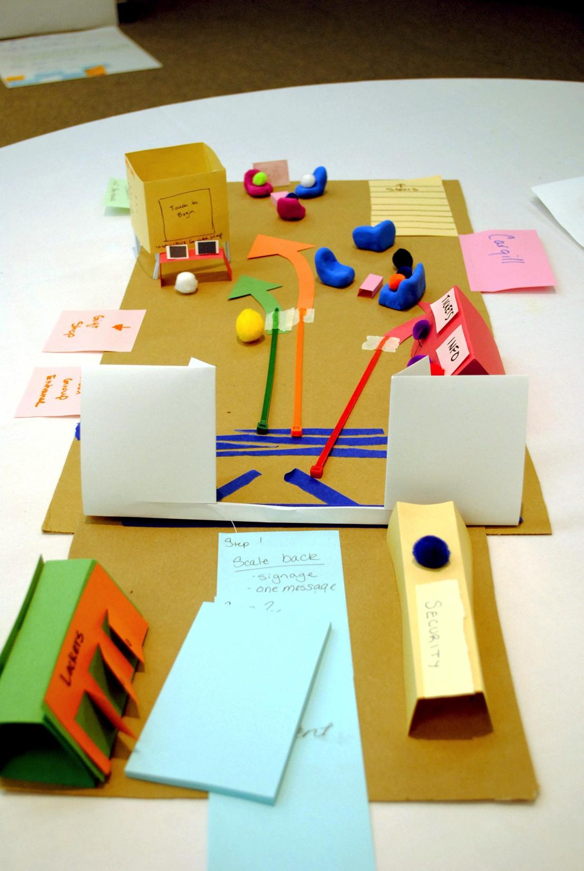
Step 4: Prototype
Think with your hands
Design-Thinking

Slide 12
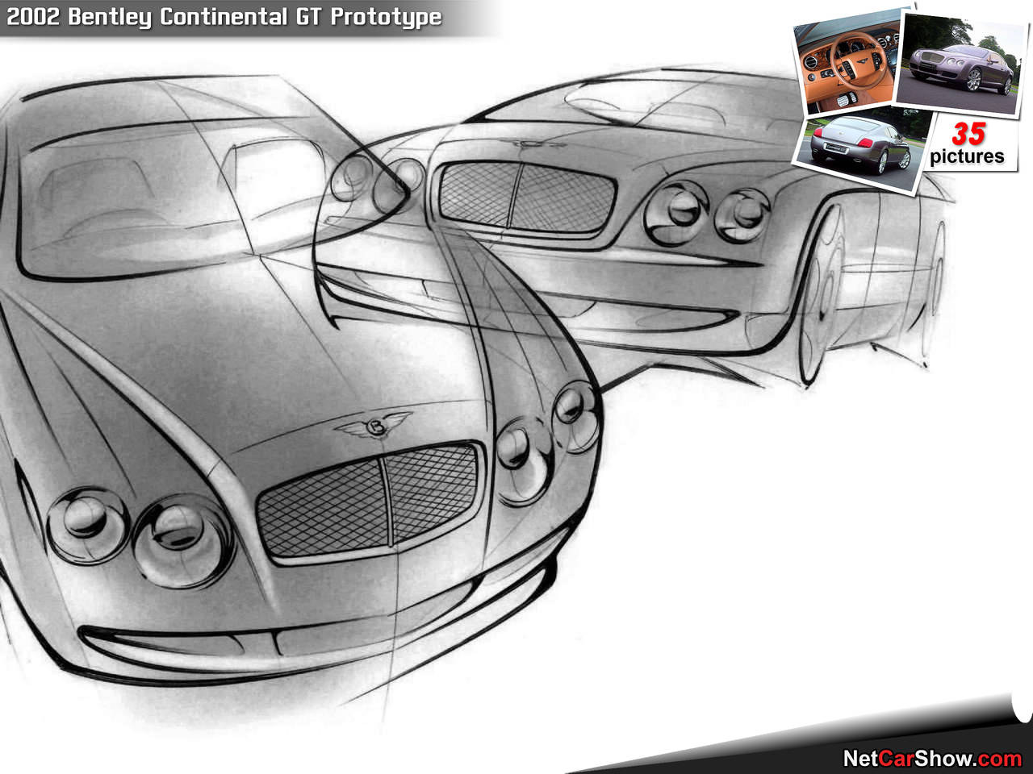
Step 5: Test
Where the rubber meets the road
Design-Thinking

Slide 13
Step 6: Apply 5-step process again & again, anytime
Design-Thinking

Slide 14
Design-Thinking
1. Embracing diversity in all forms
2. Radical collaboration
3. Making things visible
4. Having empathy for the user

Slide 15
Design-Thinking
5. Having creative confidence
6. Having a bias for action
7. Being open to failing forward
8. Committing to iterative action

Slide 16
1. Focus on the user, not only the system
2. Bring much needed change/redesign to the system
3. Help transform higher ed institutions into hubs of relevant creativity
4. Make real on-the-ground impact
Design-Thinking

Slide 17
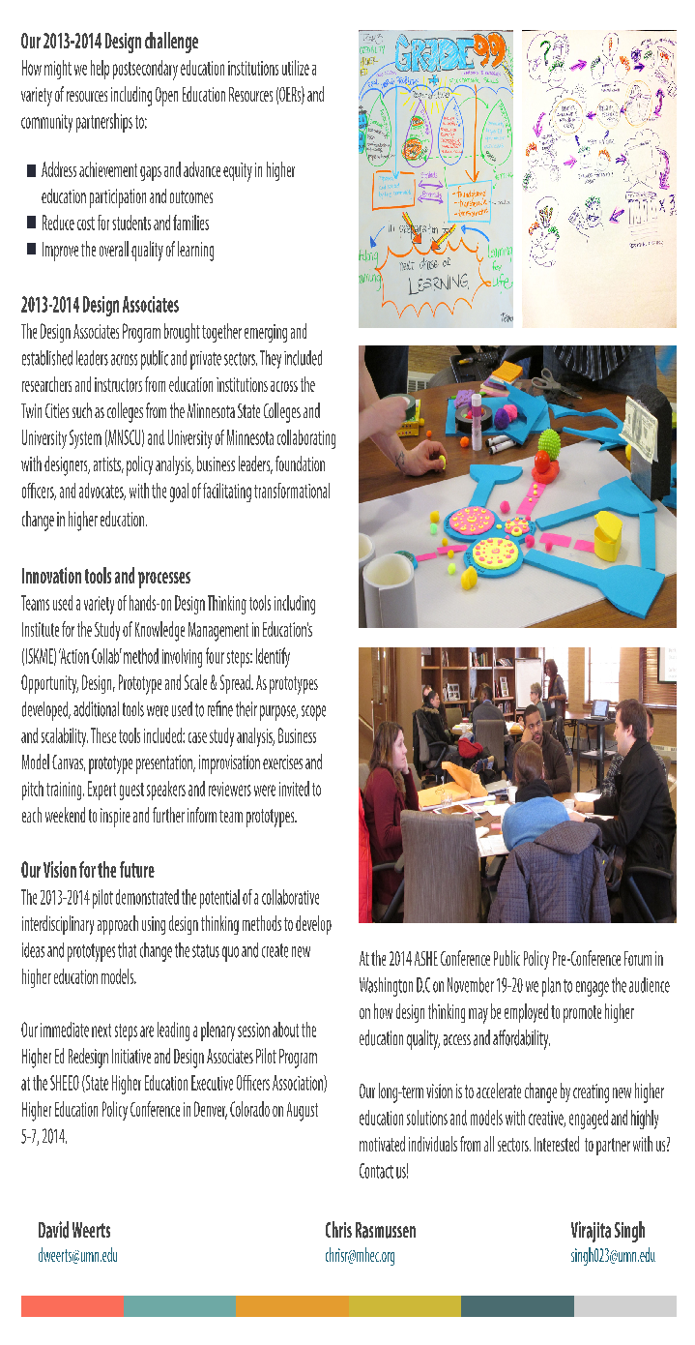
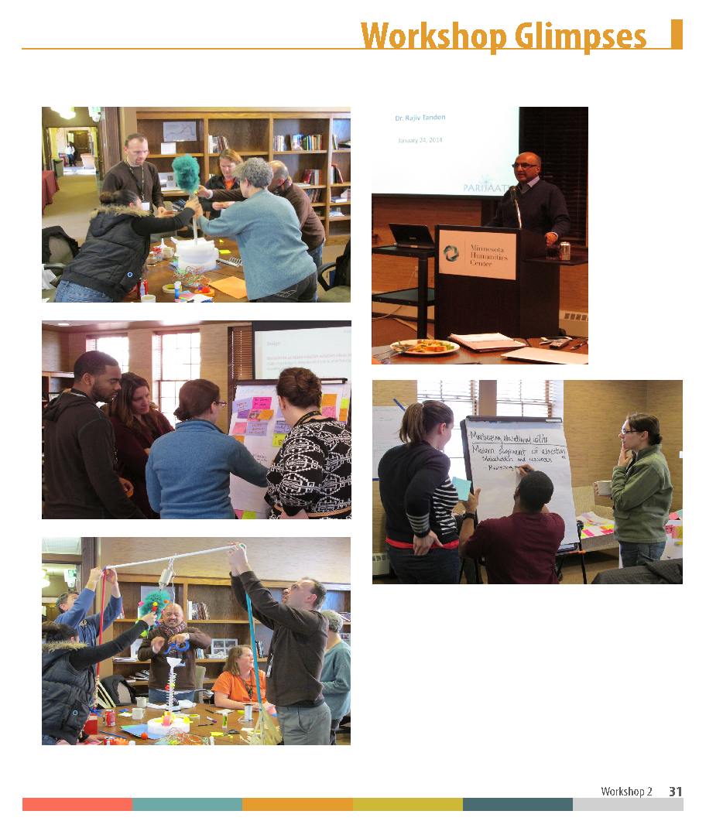
The Higher Ed Redesign Initiative

Slide 18
Design Associates Pilot: Design Challenge
How can we use open educational resources (OERs)
  to address achievement gaps and advance equity in higher education participation and outcomes,
  to reduce cost for students and families, and
  to improve the overall quality of learning?

Slide 19
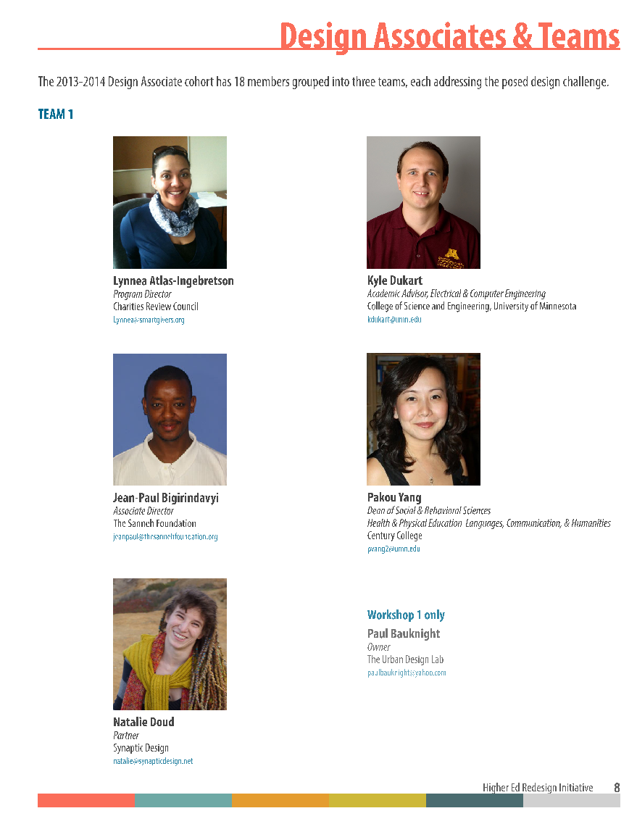
Teams and format
18 Design Associates across sectors
3 design weekends: Fall, Winter, Spring (2013-2014)
“Shark Tank” pitch of final prototype at MHEC Summer Meeting (2014)

Slide 20
Results
Prototype 3
Focus on foundational, transferable, and transformative skills
Increased synchronization of stakeholders
User-centered
Interest from Minnesota Legislators
“Earn as you learn” program in development phase
Possible contributions to the application of the program
Themes across prototypes
Identified a need for synchronization across stakeholders

Slide 21
Lessons Learned
Key strengths
Iterative in the design phase
Interdisciplinary (teams & approach)
Enhanced contextual understanding
Complements policy analysis & empirical approaches (see handout)
Key challenges
Limited time to develop team dynamics
Scalability limited by resources
Improvisation is new and uncomfortable for some
Solutions challenge cultural norms
Notes:
--Thank you for the opportunity to be here.
-- Introduce panel
In 25 minutes we will share some key lessons learned from a Minnesota-based pilot program called, “The Higher Ed Redesign Inisitiave.” In doing so we will
Give a brief history of our collaboration between MHEC, CDes, and jCENTER (DW)
Provide a brief overview about what design thinking is and how it relates to the policy arena (VS)
Share lessons learned from the project (LT)
Reflections on its application to policy challenges in higher education

Slide 22
Perspectives from a Regional Compact
Opportunities
  Potentially enhances effectiveness of action-research networks
  Diversifies social capital for professionals from disparate fields
  Incorporation within undergrad, grad, and professional development programs

Slide 23
Perspectives from a Regional Compact
Challenges
  Managing and accounting for conflicting values when evaluating solutions: cultural, political, tradition/change
  Innovation diffusion: design solutions for human systems are context-dependent
  Obtaining support of necessary parties for implementation: institutional leaders, policymakers, businesses, ngo's, and others

Slide 24

RE:FINE
Custom Design Challenge
Design-thinking workshop
Preliminary Assessment
RE:TREAT
Organizational Analysis
Custom Design Challenge
Two-Day Design-thinking Retreat
Custom Design Challenge
RE:INVENT
Organizational Analysis
Custom Design Challenge
Two-Day Design-thinking retreat
Leadership Coaching
Comprehensive Report

