Slide 1
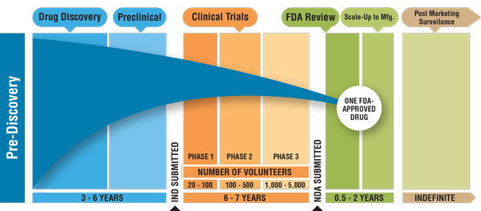
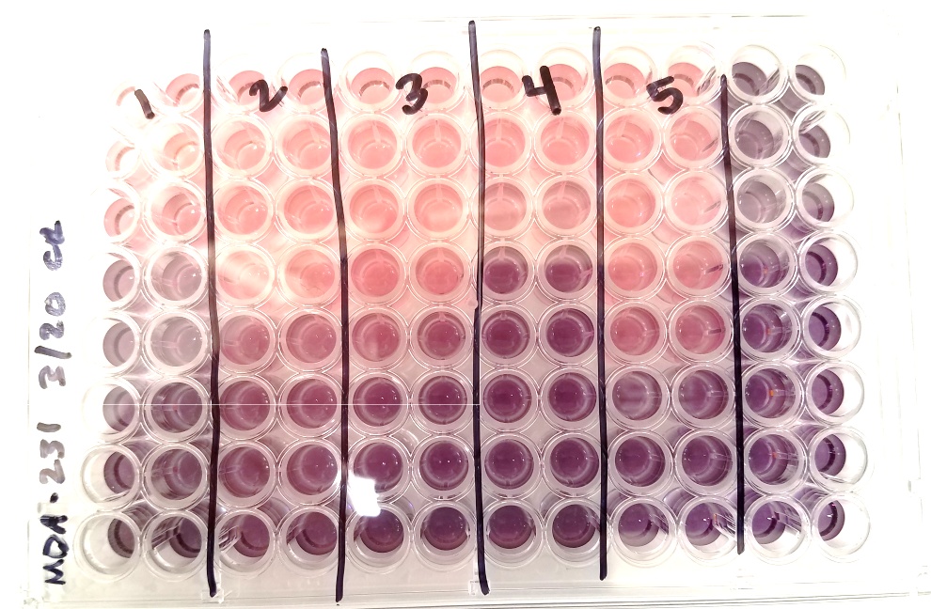
Anticancer Activity of Mycophenolic Acid
Amy Bowman
Mentors: Tanner Schumacher, Zachary Gardner, and Venkatram Mereddy
Department of Chemistry and Biochemistry, University of Minnesota Duluth
INTRODUCTION
1.8 million new cancer cases predicted to emerge across the U.S. during 2020¹
Chemotherapy is one of the current leading treatments where it acts as a ”genomic insult” that uses different drugs to kill cancerous cells²
A low survival prognosis following chemotherapy has been recognized in recent studies
To get a new drug FDA approved and, on the market,, it can take up to 15 years³
A new approach to minimize this timeline so new cancer treatments can be available to patients faster is the repurposing of previously FDA drugs
SYNTHESIS
CELL LINES FOR MTT ASSAYS
MIA PaCa-2:
Pancreatic carcinoma, human epithelial
2. WiDr:
Colorectal adenocarcinoma, human epithelial
3. MCF7:
ER+/PR+/HER2- Breast Cancer, derived from metastatic site, human epithelial
4. 4T1:
Triple-Negative Stage IV Breast Cancer (highly aggressive), derived from metastatic site, mouse mammary epithelial
5. MDA-MB-231:
Triple-Negative Breast Cancer, ER-/PR-/HER-, derived from metastatic site, human epithelial
1
Figure 3. Coupling synthesis of various amines to MPA to create highly water-soluble amides.
MTT ASSAY PROCEDURE
Treat confluent adherent cells with trypsin and suspend them at 5 x10⁴
100 uL of these cells are plated on a 96 well plate
5,000 cells/well
Compounds are added in a serial dilution fashion after cells have been plated for 24 hours
Cells are treated for 3 days and then treated with MTT (5mg/mL) for 4 hours
Figure 1. FDA Approval Process Timeline³.
BACKGROUND
Figure 5. Example of cell line plated and lysed for IC₅₀ values to be collected.
FUTURE WORK
Perform MTT assays using all 4 synthesized MPA-amide compounds on all 6 cells lines
Determine IC₅₀ values of each compound at various concentrations to determine cytotoxicity and efficacy
Synthesize and purify more MPA-amide compounds
Perform MTT assays using newly-synthesized compounds
Figure 2. Mycophenolic Acid Chemical Structure.
Mitochondrial Reductases
Mycophenolic acid (MPA) is a noncompetitive inhibitor of the rate-limiting step in the eukaryotic de novo synthesis of inosine monophosphate dehydrogenase (IMPDH)⁴
Mycophenolate mofetil (MMF) is an ester prodrug of MPA that was FDA approved for preventing graft infections following organ transplants⁴
Tumors have experimentally demonstrated a sensitivity to MPA which has been correlated to the activities of β-glucuronidase and hypoxanthine-guanine phosphoribosyltransferase⁵
One major drawback is that MPA has low oral bioavailability → synthesizing highly water-soluble amides to overcome this
MTT
Formazan
Figure 4. MTT addition is used to determine whether cells can reduce MTT to formazan.
REFERENCES
1. Table, S. Tobacco Use 44 Sources of Statistics 68 American Cancer Society Recommendations for the Early Detection of Cancer in Average-Risk Asymptomatic People 71; 2009.
2. Somasagara, R. R.; Spencer, S. M.; Tripathi, K.; Clark, D. W.; Mani, C.; Silva, L. M. Da; Scalici, J.; Kothayer, H.; Westwell, A. D.; Rocconi, R. P.; Palle, K. RAD6 Promotes DNA Repair and Stem Cell Signaling in Ovarian Cancer and Is a Promising Therapeutic Target to Prevent and Treat Acquired Chemoresistance. Oncogene 2017, 36 (48), 6680–6690. https://doi.org/10.1038/onc.2017.279.
3. Hoang, H. (n.d.). An NDA at the FDA Understanding the Drug Approval Process.
4.. Domhan, S., Muschal, S., Schwager, C., Morath, C., Wirkner, U., Ansorge, W., Maercker, C., Zeier, M., Huber, P. E., & Abdollahi, A. (2008). Molecular mechanisms of the antiangiogenic and antitumor effects of mycophenolic acid. Molecular Cancer Therapeutics, 7(6), 1656–1668. https://doi.org/10.1158/1535-7163.MCT-08-0193
5. Sweeney, M. J., Hoffman, D. H., & Esterman, M. A. (1972). Metabolism and Biochemistry of Mycophenolic Acid. Cancer Research, 32(9).
Following the addition of MTT, cells are then lysed with SDS and incubated for 4 more hours
Absorbance values are taken at 570 nm to obtain IC₅₀ values
IC₅₀ = Inhibitory concentration where 50% of the cells proliferate

