Slide 1
Best Practices for Community Gardens in North Saint Paul
Resilient Communities Project (RCP) presented by graduate students from University of Minnesota

Slide 2
Introduction
Why North Saint Paul
RCP
Four categories of best practices:
Initial organization of the garden
Selecting an appropriate location
Management and maintenance
Supporting a community garden network through ongoing partnerships and programs

Slide 3
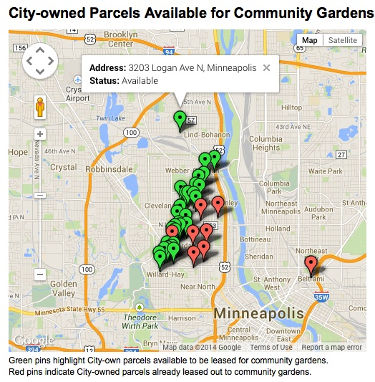
Initial organization of the garden
Create an informational website
Description- website provides information for residents to get involved
Context- City of Minneapolis website provides information on existing gardens and available vacant lots
Applicability- North St. Paul can provide information on application process, fees, and links to other community organizations
Notes:
Leila

Slide 4
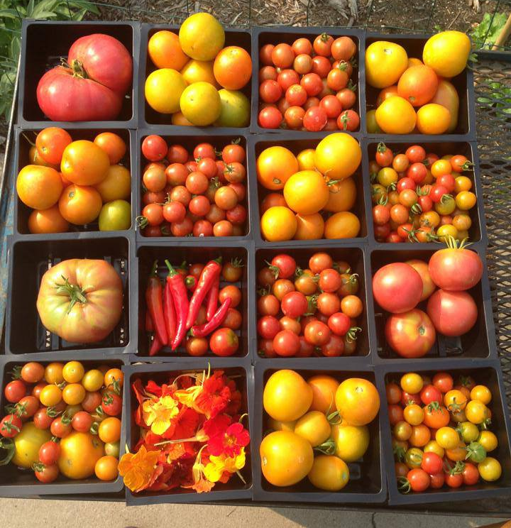
Initial organization of the garden
2. Create an urban agriculture plan
Description- created an urban agriculture plan within a comprehensive plan or as a stand alone document
Context- City of Baltimore, MD
Applicability- North St. Paul could designate community gardens on vacant lots/park space or the plan could allow for food to be grown for commercial purposes (urban farms)
Notes:
Leila

Slide 5
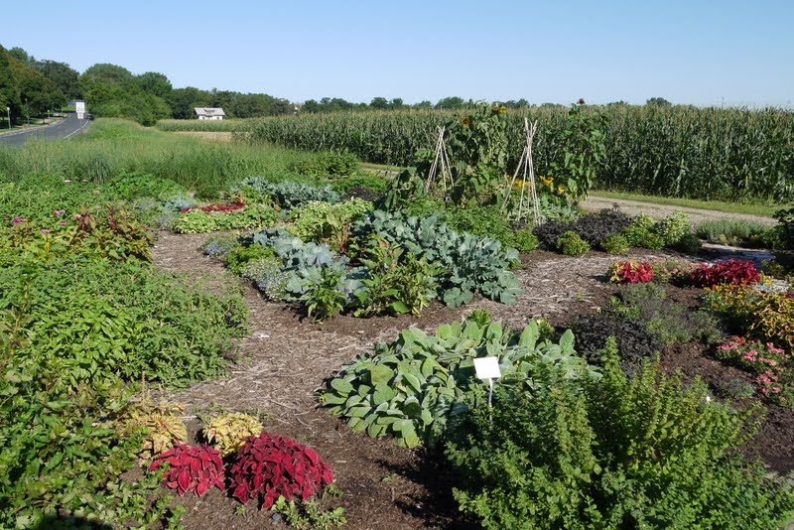
Initial organization of the garden
Regulate community gardens in the Zoning Ordinance
Description – Use the Zoning Ordinance to regulate community gardens
Context – The City of Minneapolis allows community gardens as either a principal or accessory use in all residential and business districts.
Applicability – North St. Paul can use zoning to identify where community gardening can occur and regulate parking, livestock, and permanent structures.
Notes:
Cady

Slide 6
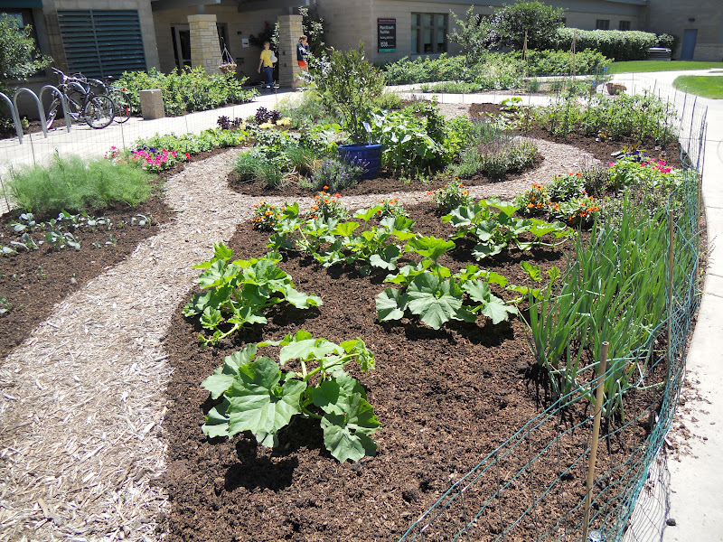
Selecting an appropriate location
Create program highlighting vacant lots based on environmental factors
Description – Identify lots suitable for community gardening
Context – City of Savannah, Georgia
Applicability – In North St. Paul this will be based on soil quality and characteristics of surrounding environment
Notes:
Cady

Slide 7
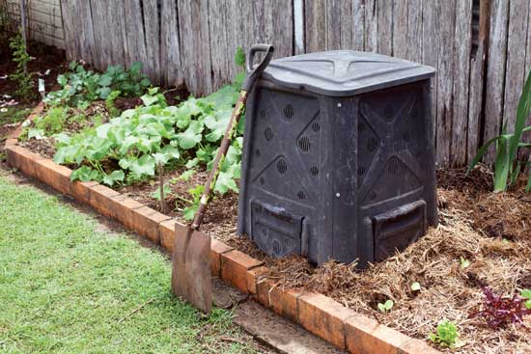
Selecting an appropriate location
Establish standards for on-site composting
Description – Provide spaces for gardeners to compost and dispose of excess material
Context – City of Bellingham, WA
Applicability – North St. Paul could provide enclosed plastic bins to allow gardeners to compost on-site without creating a nuisance
Source: ‪www.motherearthnews.com
Notes:
Leila

Slide 8
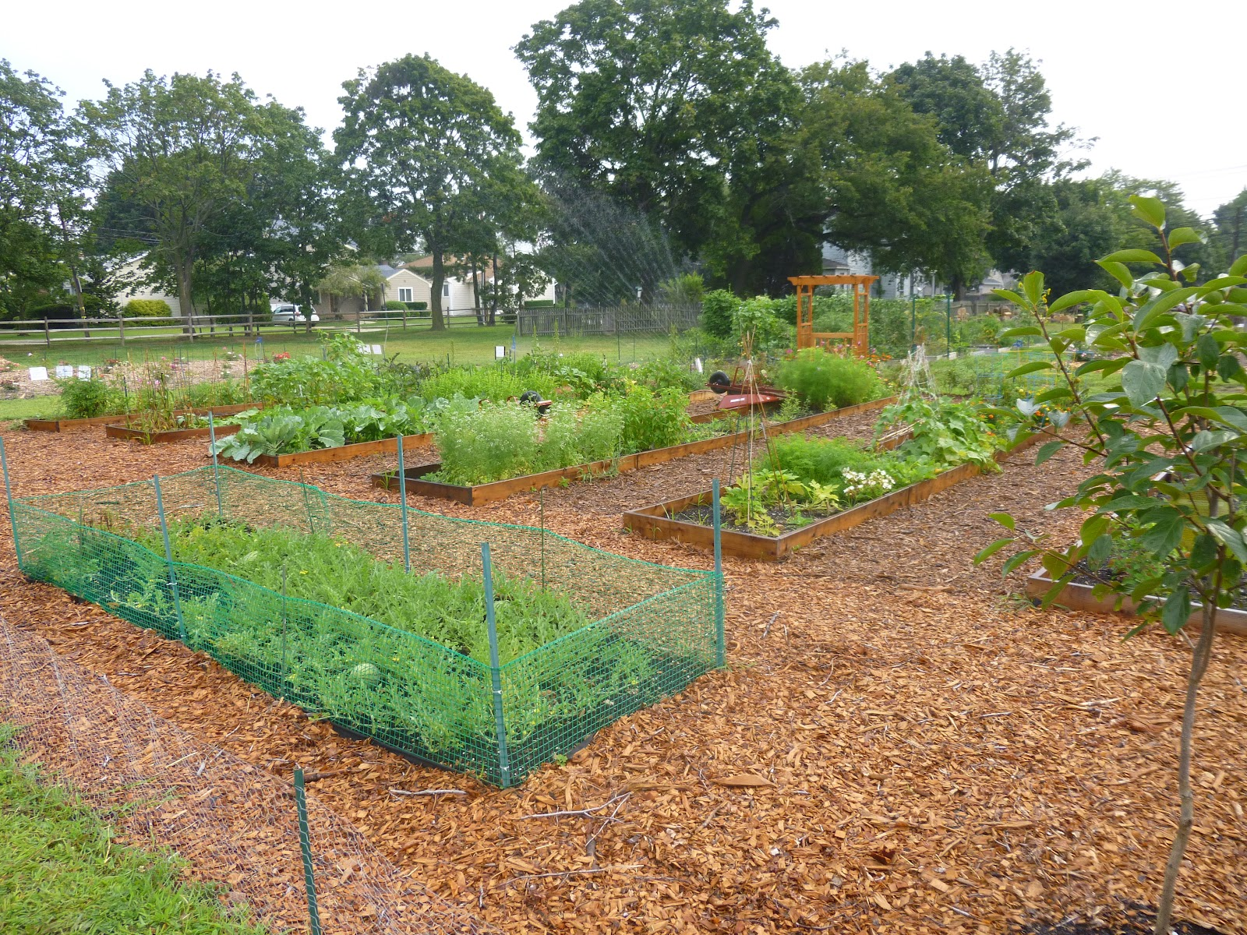
Management & Maintenance
Establish maintenance practices for common areas and individual plots
Description – Create a management plan for participants to help with upkeep of common garden space
Context – Montgomery County, MD
Applicability – Ensures that common areas and individual plots will not become overgrown, unproductive, and inconvenient to the surrounding neighborhood
Source: ‪bobbrinkmann.blogspot.com
Notes:
Leila

Slide 9
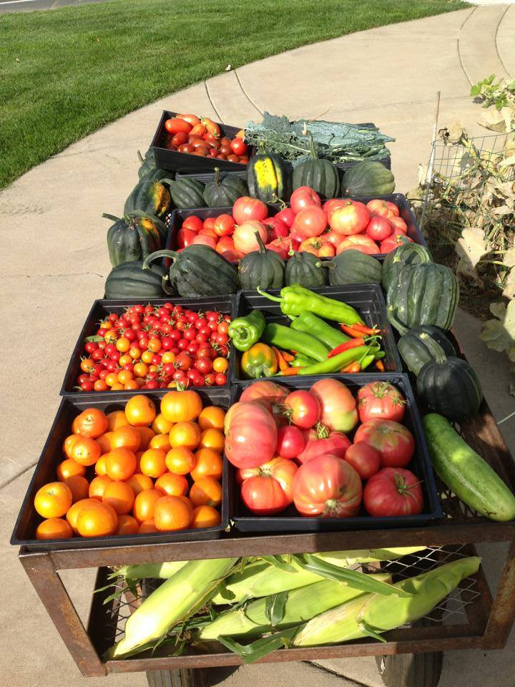
Ongoing support for community garden
Donate food to local food shelf
Description – establish a donation program to a local food shelf to maintain support of the community garden
Context – Fridley church partnered with Anoka County
Applicability – Once the community garden is established, one plot or a portion of the garden could go to donations to the North Saint Paul Area Food Shelf
Notes:
Leila

Slide 10
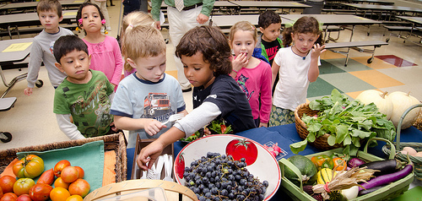
Ongoing support for community garden
Participate in a farm to school program
Description – farm to school program offers support for incorporating local food into the school lunch program
Context – Hopkins, MN
Applicability – farm to school program is a good way to offer healthy, local food from the community garden to children in North St. Paul
Source: ‪www.letsmove.gov
Notes:
Cady

Slide 11
Thank you!
Notes:
Leila

