Slide 1

ALTR Your Experience
Brittany Trangsrud
Strategic Communication M.A. Program, University of Minnesota

Slide 2
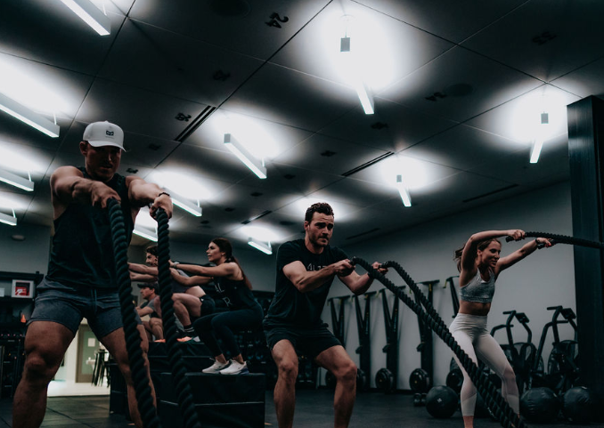

Today’s Agenda
Warmup
– ALTR Overview
– Research Insights
– The Problem
Circuit
The Goal
Objectives & Tactics
Implementation
Evaluation
Cool Down
- Q&A

Slide 3
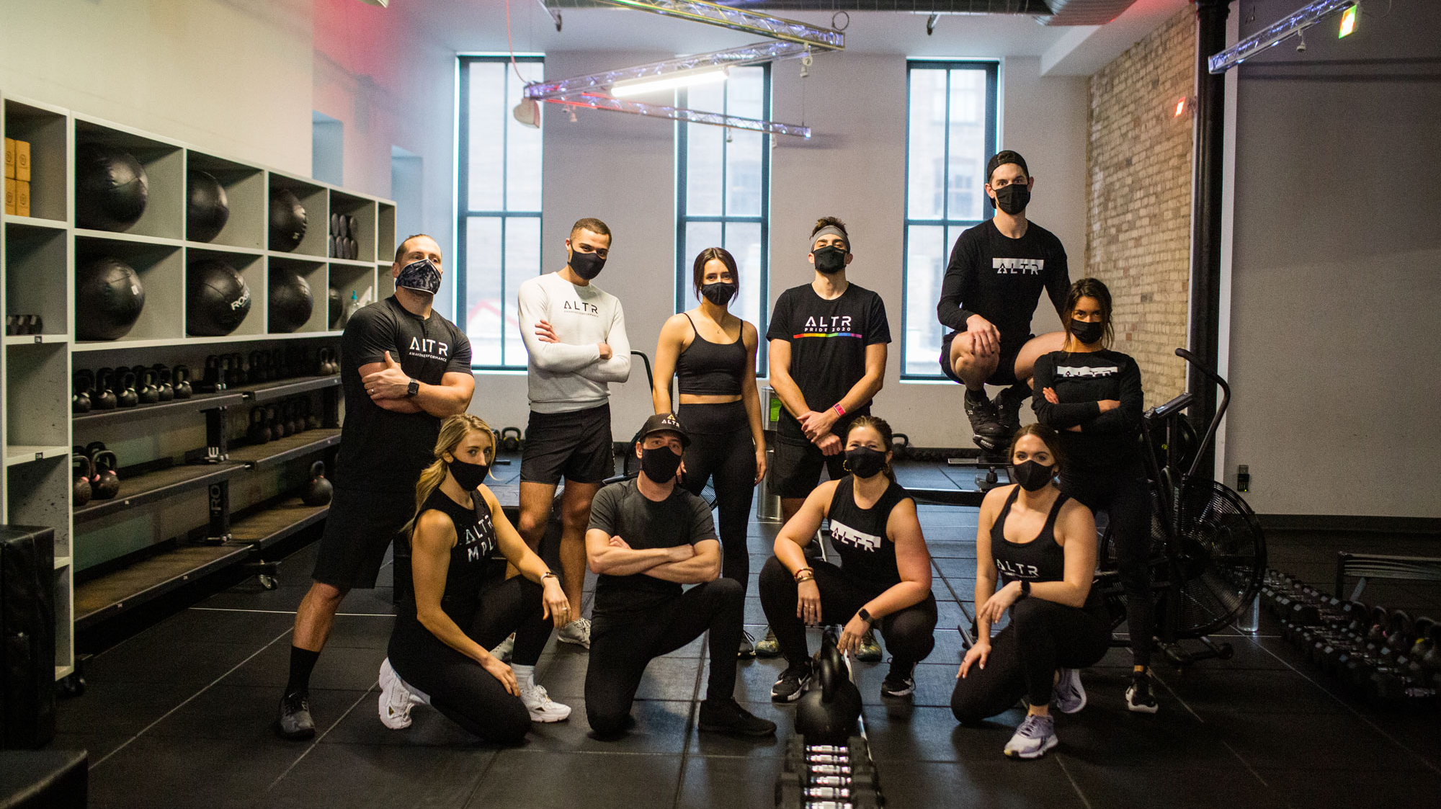

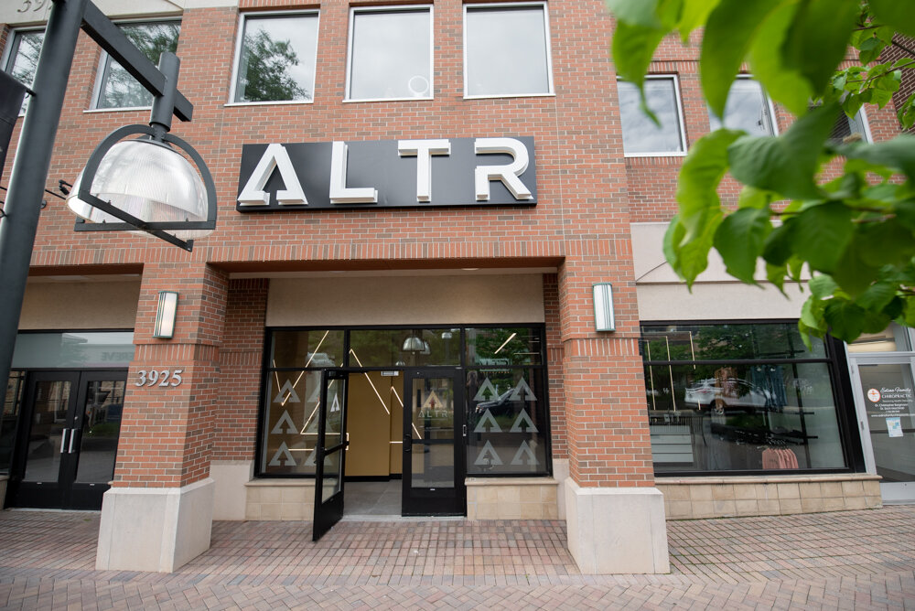
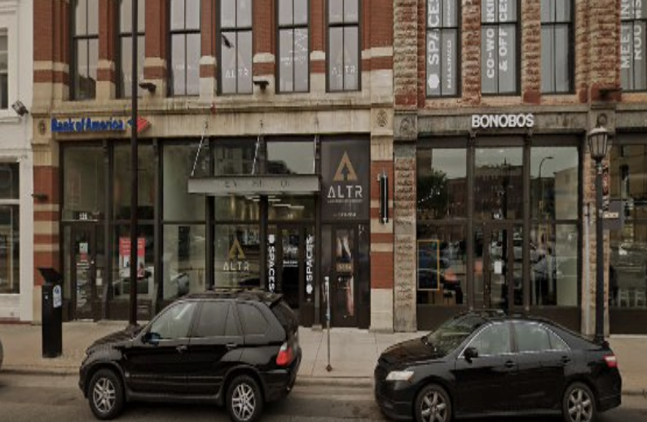
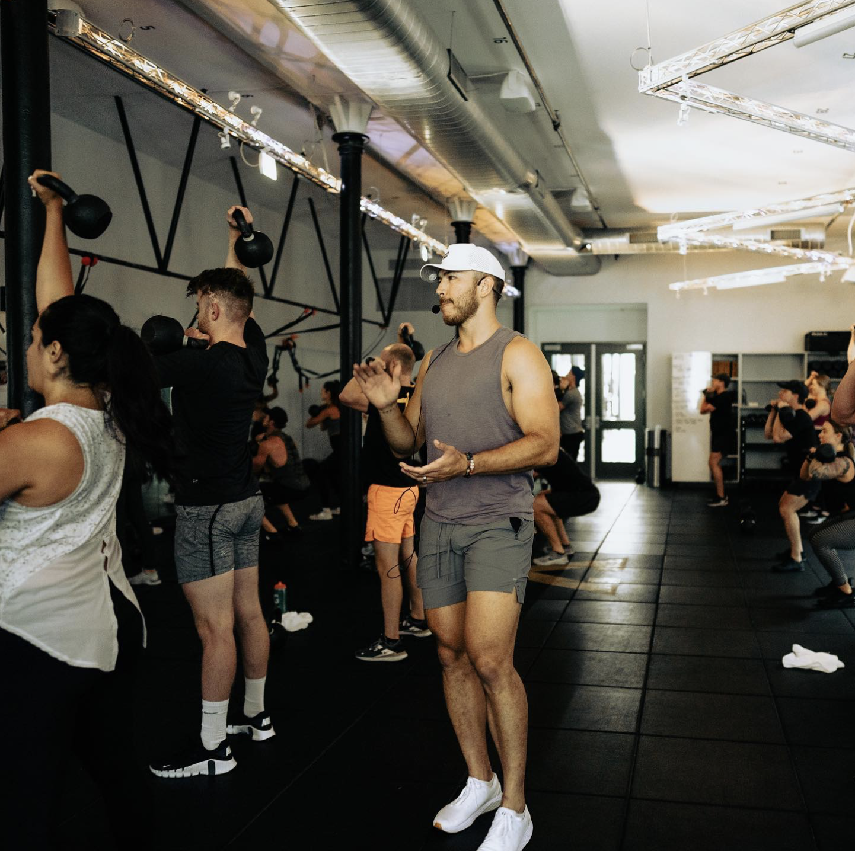
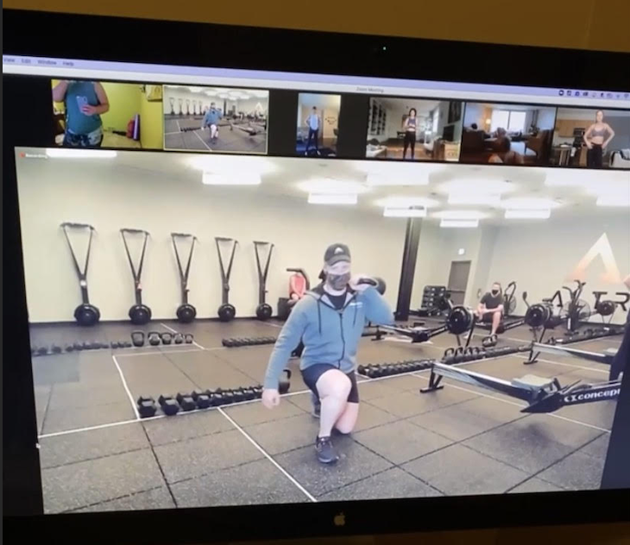
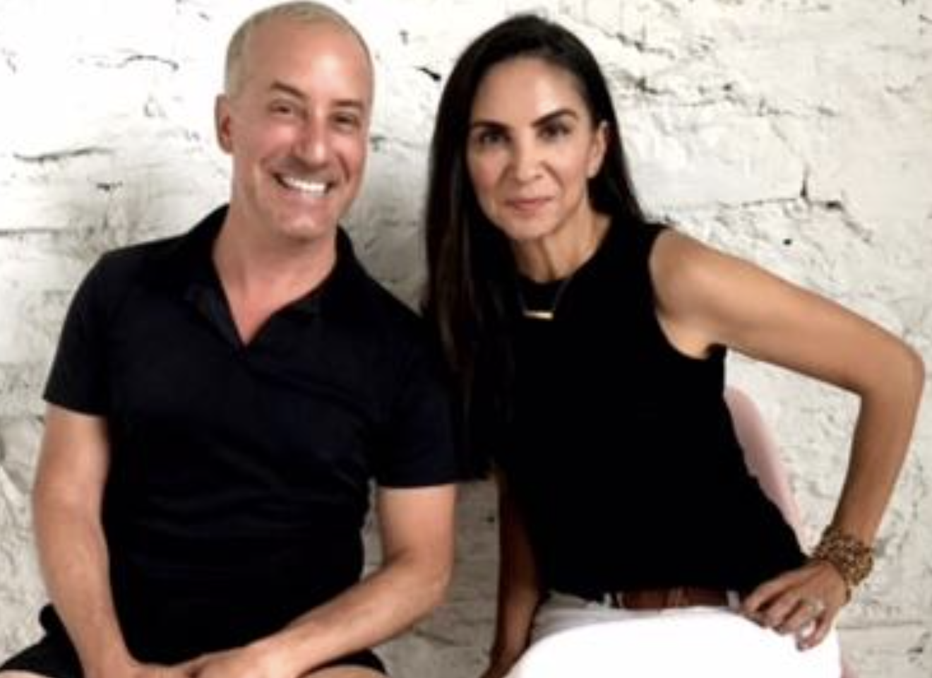
ALTR Then & Now
March 2020 – Feb. 2022: Capacity restrictions & mask mandates affect class size and attendance
2020: Edina Studio Opens
in 50th & France District
2017: First Studio Opens in
North Loop
March – June 2020 & Nov. – Dec. 2020 : ALTR starts livestream classes due to COVID-19 closures
Present Day 2022: Operating at full capacity & working to build back business

Slide 4
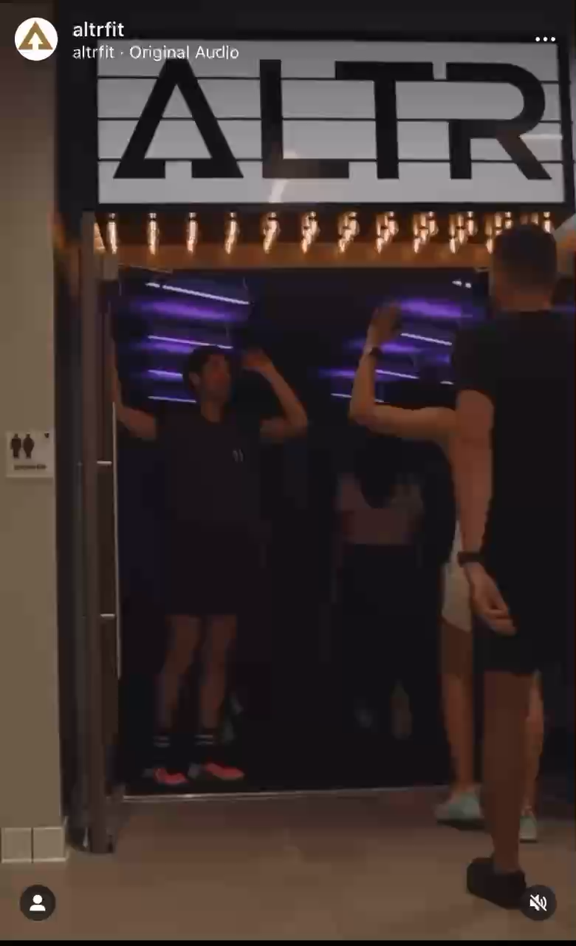
Let’s Get ALTR’d
It’s More Than a Gym Membership
The Science of HIIIT
What’s Trending
Community First

Slide 5
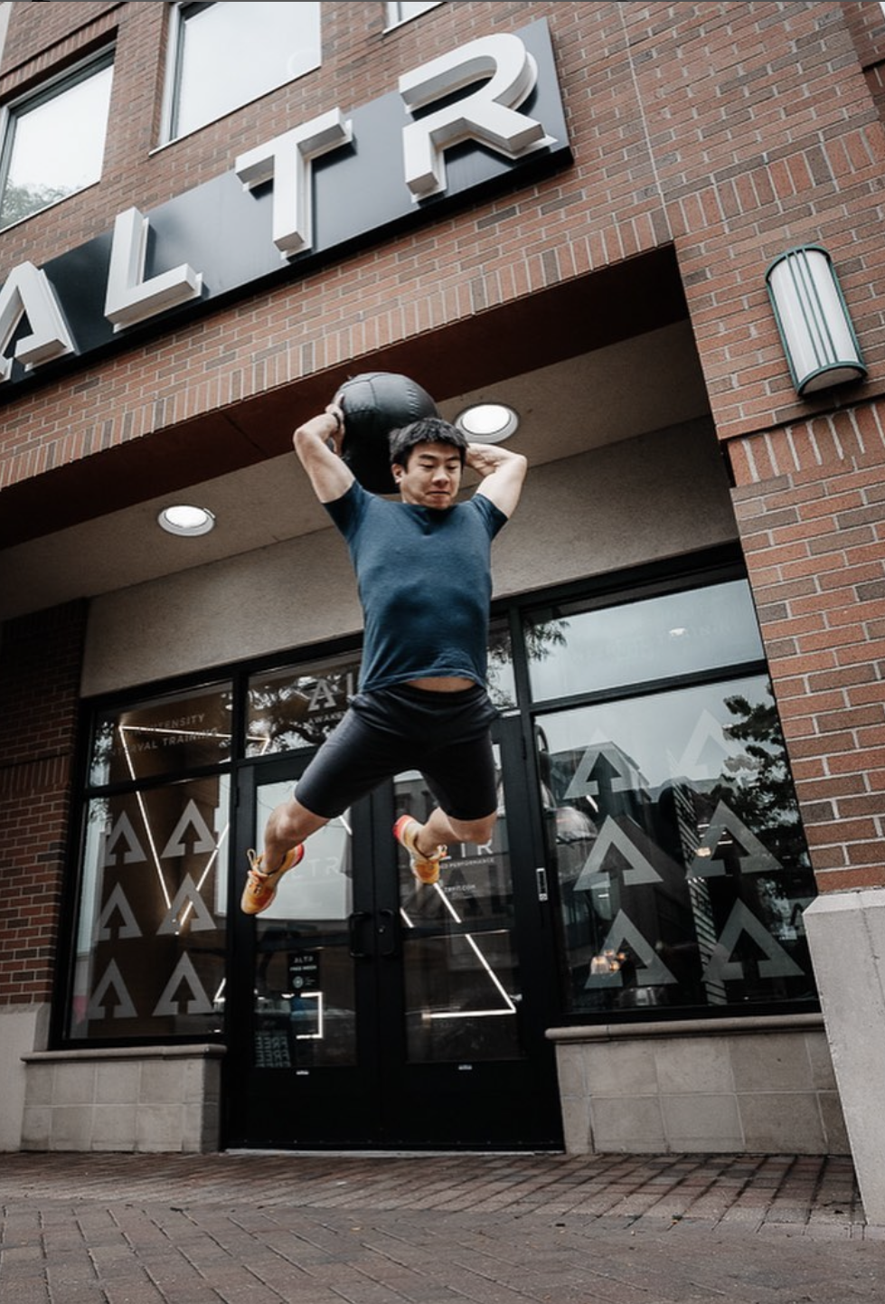
The Problem
Inconsistent membership and studio session purchases
Disconnect of its marcom efforts from its service and values
The Intimidation factor

Slide 6
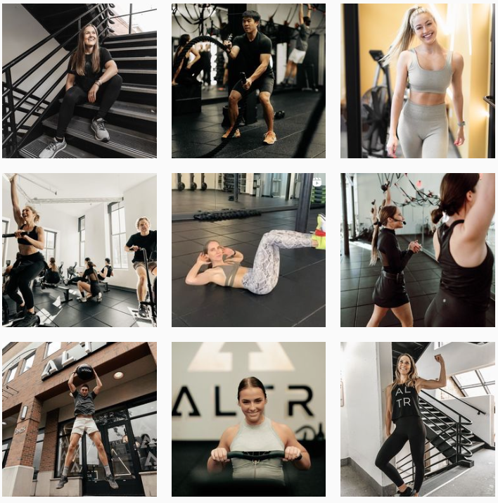

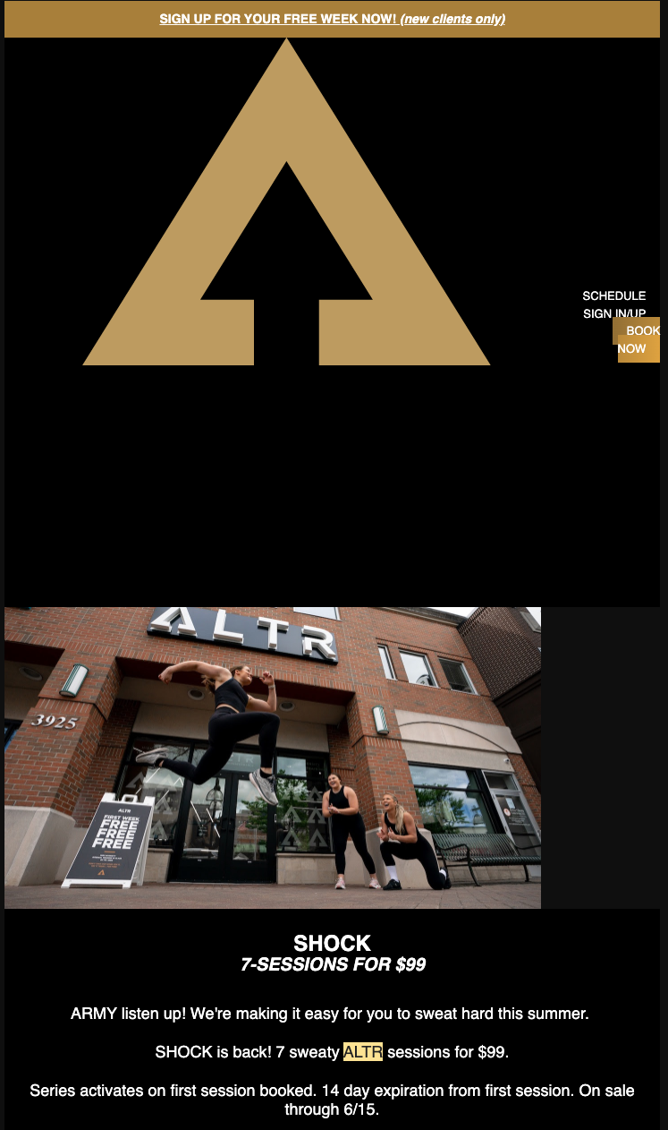






Disconnect & Intimidation

Slide 7
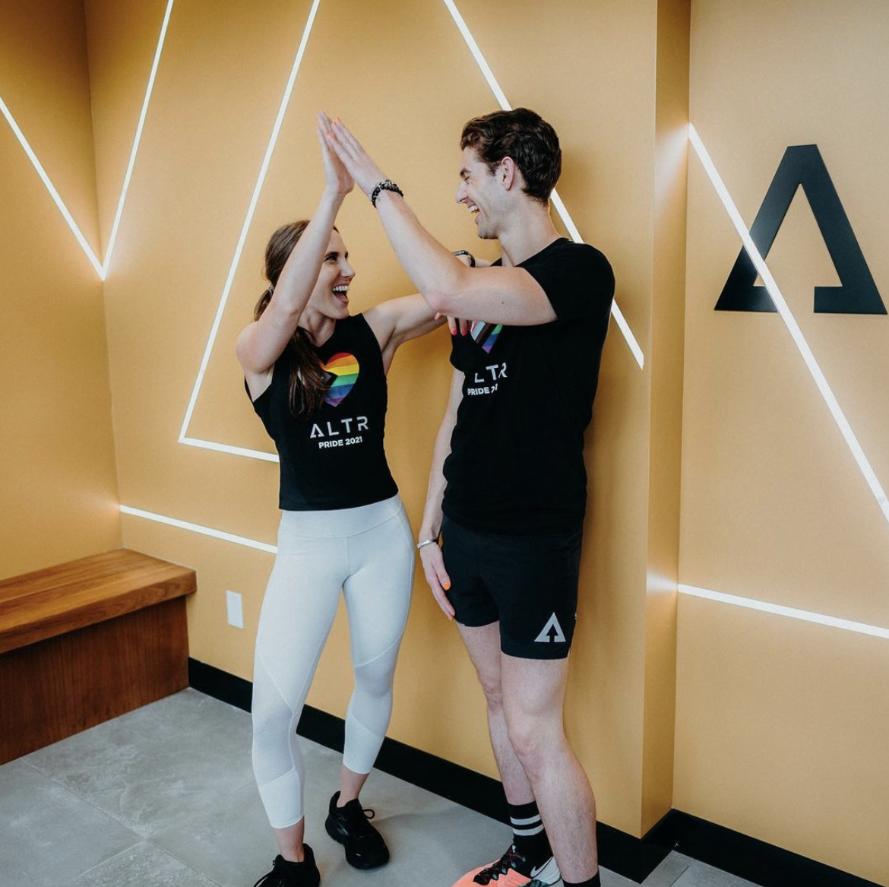
Communications Goal
Value Proposition
Welcoming and supportive experiences that ALTR for awakened performance, mindset and lifestyle.
Align the values of ALTR with its marcom efforts to drive its business goal of doubling revenue through membership and package sales by the end of the year.

Slide 8
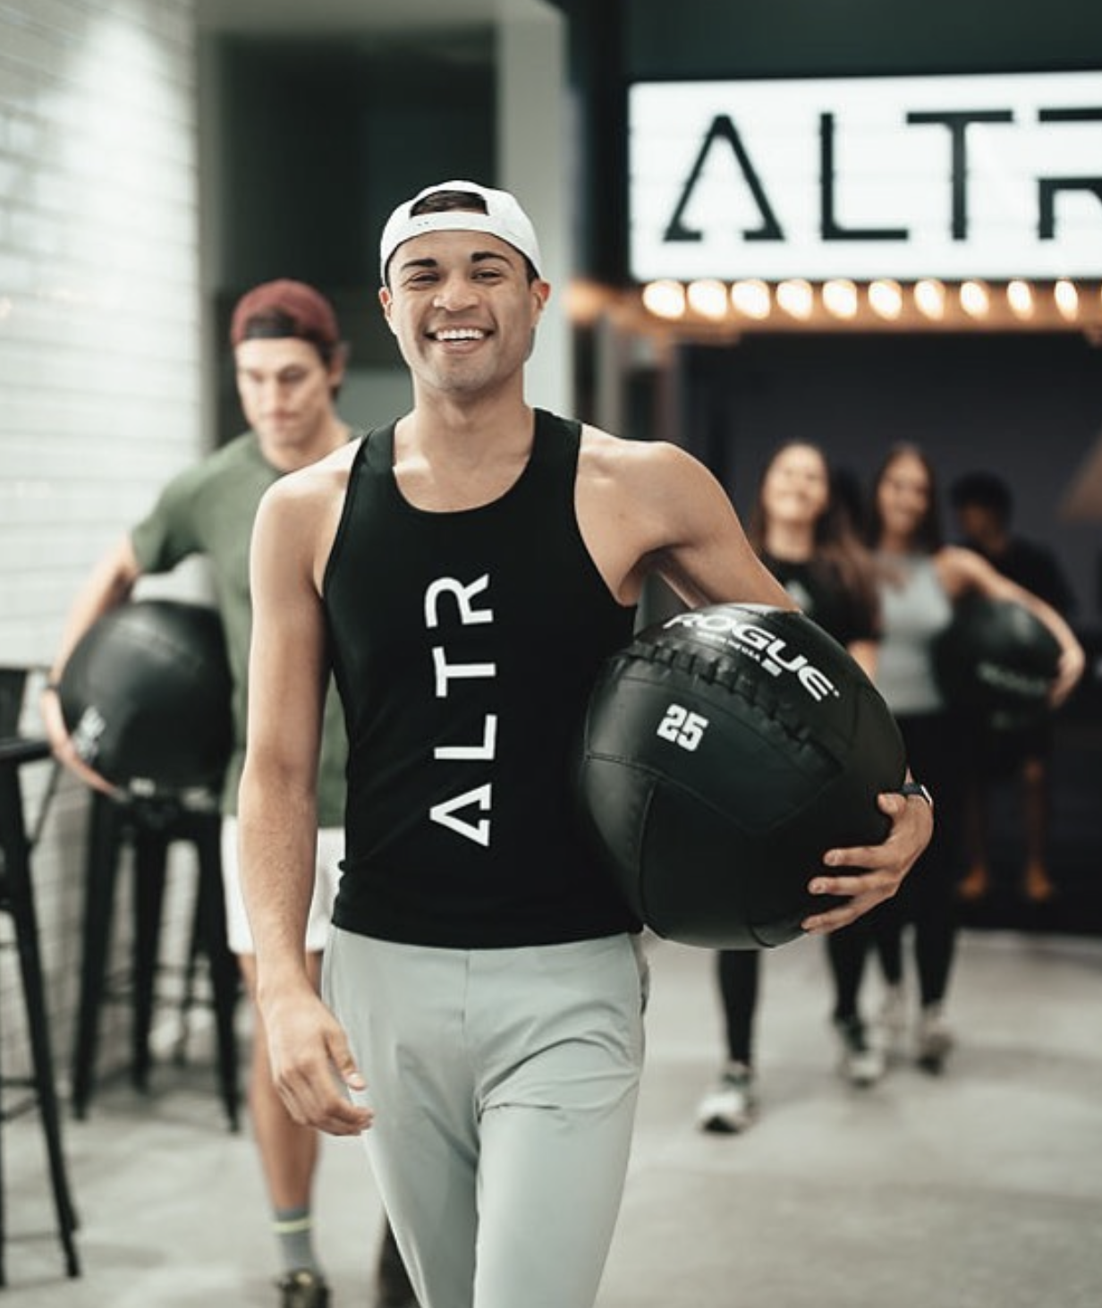
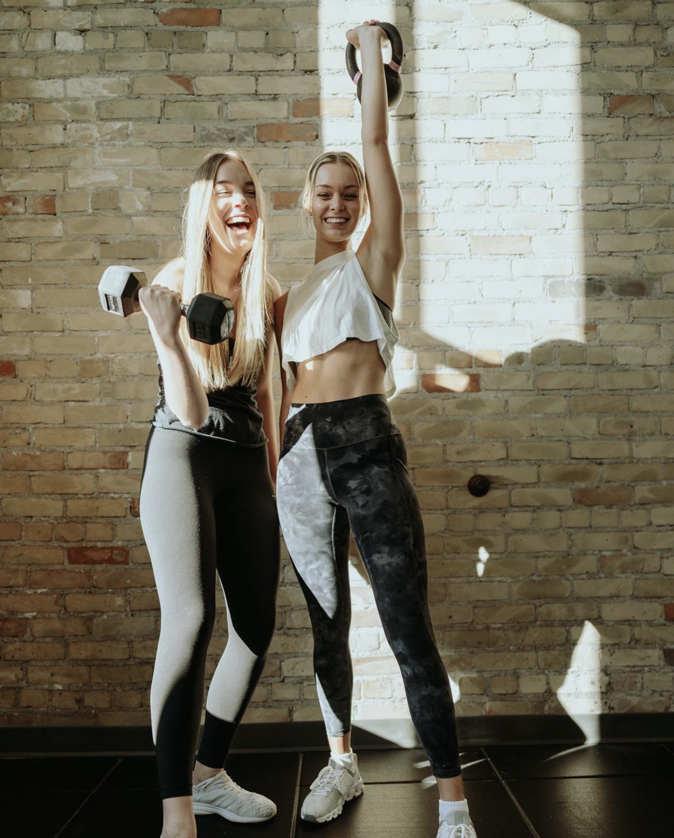
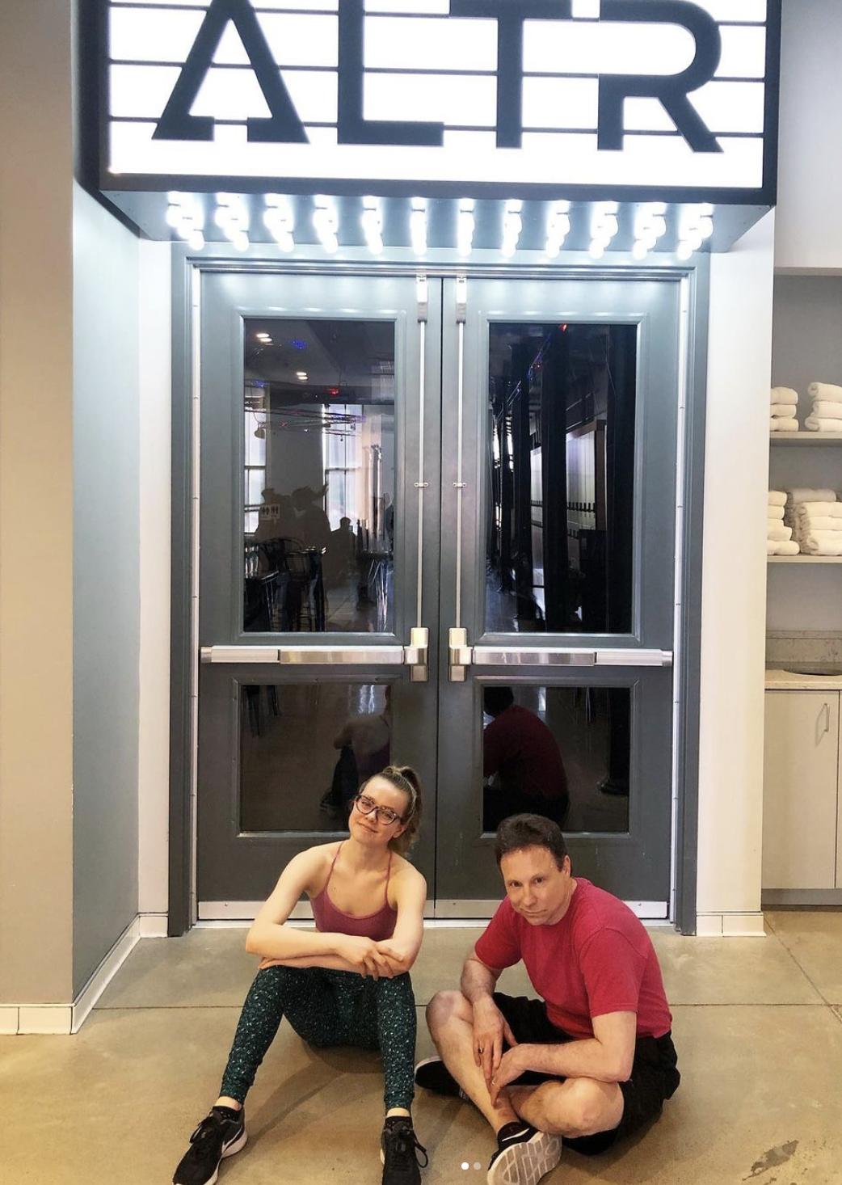
Target Audiences
ALTR Army
The Boomerangs
The Recruits

Slide 9
Communications Objectives
Develop an authentic voice and viewpoint for ALTR that establishes the studio as a source of authority within the local and regional fitness industry.
01
Develop a content strategy to ensure ALTR’s external communication is consistent and engaging to both current and potential members.
02
Decrease ALTR’s intimidation factor by working to position the studio as an inviting third place where individuals can relax and hang out before or after a workout.
03

Slide 10
Objective One: Implementation
Tactic 1: Engage in brand storytelling across owned channels about how ALTR offers a unique experiential membership to attract new members.
Tactic 2: Increase founder visibility by identifying relevant stories and creating thought leadership platforms for earned media coverage.
Tactic 3: Leverage the expertise the studio has with their ALTR Pro coaching staff and amplify their voices across owned channels through a “Pro Tip” content series.
Staff: Freelance Writer
Budget: $375 a month
Timing: Planning in July, Live in August with ongoing efforts
Staff: PR Consultant
Budget: $375 a month
Timing: Planning in July, Live in August with ongoing efforts
Staff: ALTR Pros
Budget: $0
Timing: Planning in July, Live in August with ongoing efforts

Slide 11
Objective Two: Implementation
Tactic 1: Develop content pillars and a monthly editorial calendar for consistent and engaging communication across channels.
Tactic 2: Create an Awakened Performance newsletter that will be distributed when news and discounts are available.
Tactic 3: Allow members to enjoy the music in or out of the studio with custom Spotify playlists.
Tactic 4: Partner with local influencers that have diverse backgrounds, interests and body types.
Staff: Founders
Budget: $0
Timing: Planning in July, Live in August with ongoing efforts
Staff: Director of Client Relations
Budget: $0
Timing: Planning in July, Live in August
Staff: Studio Staff
Budget: $0
Timing: Planning in July, Live in August
Staff: PR Consultant
Budget: $3,750
Timing: Q4 start and continued on a quarterly basis

Slide 12
Objective Three: Implementation
Tactic 1: Bring back the studio’s on tap cold brew and kombucha offerings.
Tactic 2: Partner with local organizations to host pop up events that feature local makers and service providers.
Tactic 3: Give members the power to personalize their workouts.
Staff: Studio Attendants
Budget: $350 initial investment
Timing: Start in July with ongoing service
Staff: Studio Staff
Budget: $200 per event
Timing: Q4 start and continued on a quarterly basis
Staff: Director of Client Relations
Budget: $0
Timing: Planning in July, Live in August

Slide 13

Program Evaluation

Slide 14
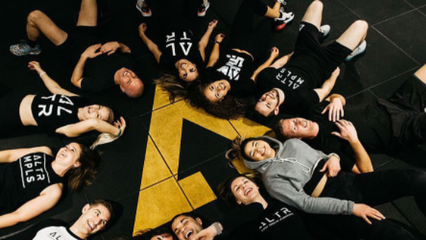
“Do I recommend ALTR? Definitely YES! That’s even an understatement! BEST GYM YET! FOUND MY FAMILY AND THE ONE GYM IM STAYING AT!” - Five-star Google review

