Slide 1


Electric Vehicle Share Feasibility Study
August 2021
Lily Johnson
Notes:
Welcome, this presentation is meant to introduce you to an electric vehicle car sharing research program that took place over the course of this summer. I worked with the regional sustainable development partnerships through the university of Minnesota and the headwaters regional development commission who are located in Bemidji, MN. I conducted this research remotely. The project was to conduct feasibility study for a potential electric vehicle car sharing program which would be made affordable to low income communities and students, and offered to the general public as well in north central MN.

Slide 2
This Study
About Me
I am a graduate student at the Humphrey School of Public Affairs at the University of Minnesota.
My professional and educational background is in environmental policy, science, and education.
About Regional Sustainable Development Partnership (RSDP)
Supports localized sustainability projects through partnerships of communities and the University of Minnesota.
Notes:
This project took place from June 1 to August 29 2021.

Slide 3
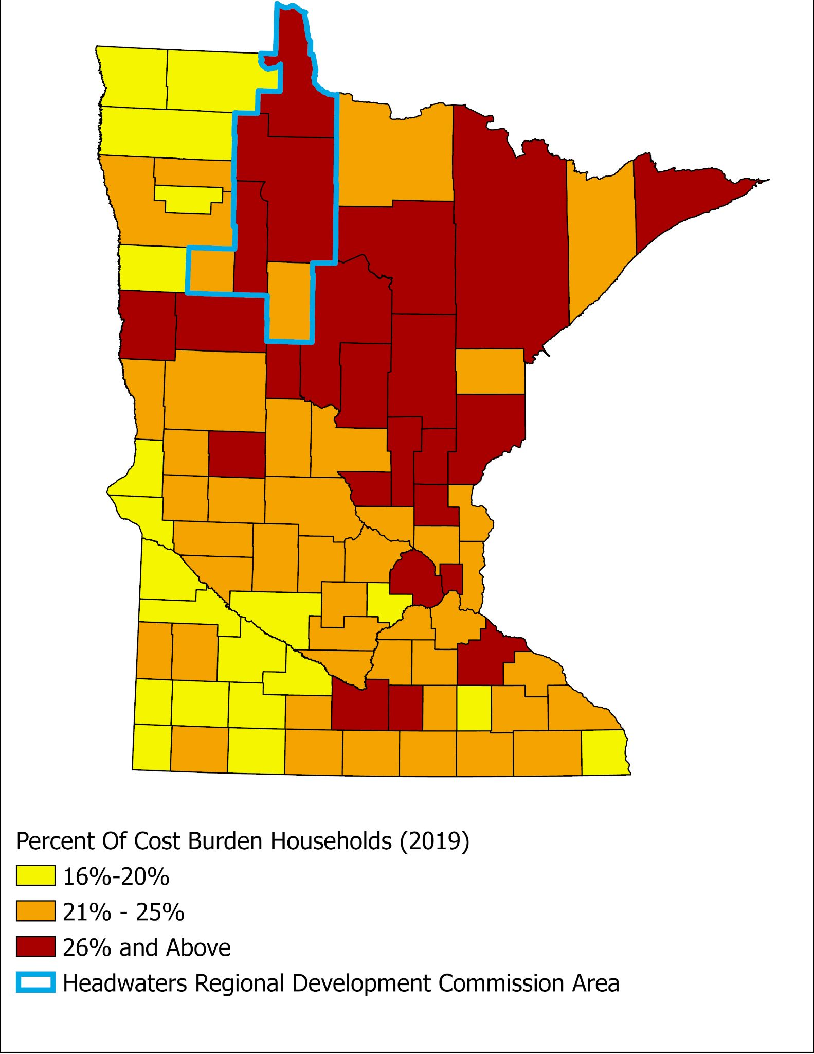
Purpose
Nearly 35% of the region has either one or zero vehicle access
Nearly 35% of the population is a cost-burden household (30% of income goes toward rent/housing payment)Including over 50% of renters
13% of Beltrami County are considered severe cost burden households (50% or more of income goes toward rent/housing payment)
43% of Bemidji, last of the 99 largest MN cities, in cost burden households
Data Available by Zip/School District/Tract Upon Request

Slide 4
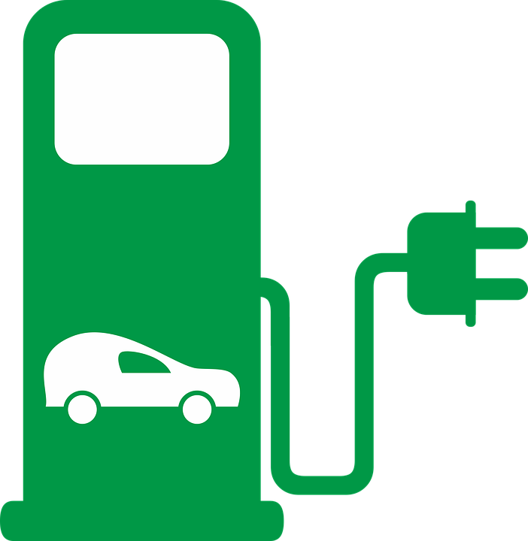
What is Carsharing?
Carsharing is defined as a model of car rental where cars are rented for short periods of time, often by the hour or per day.

Slide 5
Why is a Carshare Program Needed Here?
35% of north-central Minnesota have access to zero or one reliable vehicle per family
Eliminate expensive fuel prices & create a reliable transportation option
Rural areas <2,500 people
Notes:
Rural communities have a need for public transportation, however due to long commutes and fuel prices, public transportation is not common. Lack of public transportation infrastructure and programming greatly reduces transportation options.
An affordable solution is to implement an electric carsharing program at little or no cost to citizens. This act would cut out expensive fuel prices and create a reliable transportation option for those with little access to vehicles.
New York, through replacing routine personal car trips with use of a carshare program, families saved an average of $154 to $435 per month

Slide 6
Carsharing Offers Affordable Transportation Solution
Few affordable solutions to bridge rural transportation gaps
Carsharing is a model of car rental where users rent cars for short periods of time, often by the hour or per day
Carshare programs are often designed through collaboration, support local users and meet community goals
Notes:
There are few solutions to bridge the gap from lack of cars to the supply of cars to citizens at little or no cost have been introduced in most states. Carsharing is one such solution that cities can feasibly introduce. Carsharing is a model of car rental where users rent cars for short periods of time, often by the hour or per day. Carshare programs are often designed through collaboration, support local users and meet community goals

Slide 7
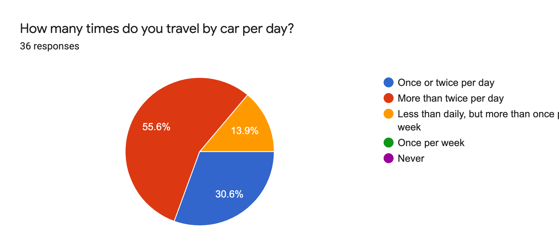
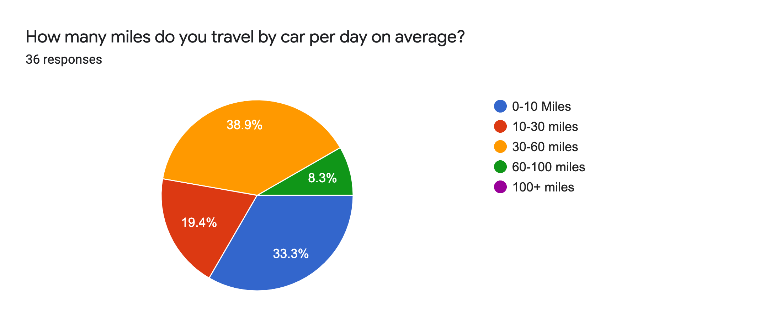
Survey Results: Car Use
Notes:
Based on survey results, community members often travel by car more than twice per day and often more than 30 miles per trip. The majority of responses came from the 55601 zip code with 50% of respondents in the 35-60 year old age category. 80% of respondents were white and 31.4% of respondents were from the Native American demographic category. Most respondents were employed for wages in full-time positions and were college educated in some capacity.

Slide 8
Survey Results: Public Transportation
Cost and lack of public transportation most common transportation barriers
64.7% of respondents rely on vehicles other than their own at least once per week
77.1% of respondents had never used a carsharing service due to lack of availability
Notes:
Cost and lack of public transportation were the most commonly reported transportation barriers. 64.7% of respondents rely on vehicles other than their own at least once per week. 77.1% of respondents had never used a carsharing service due to lack of availability.

Slide 9
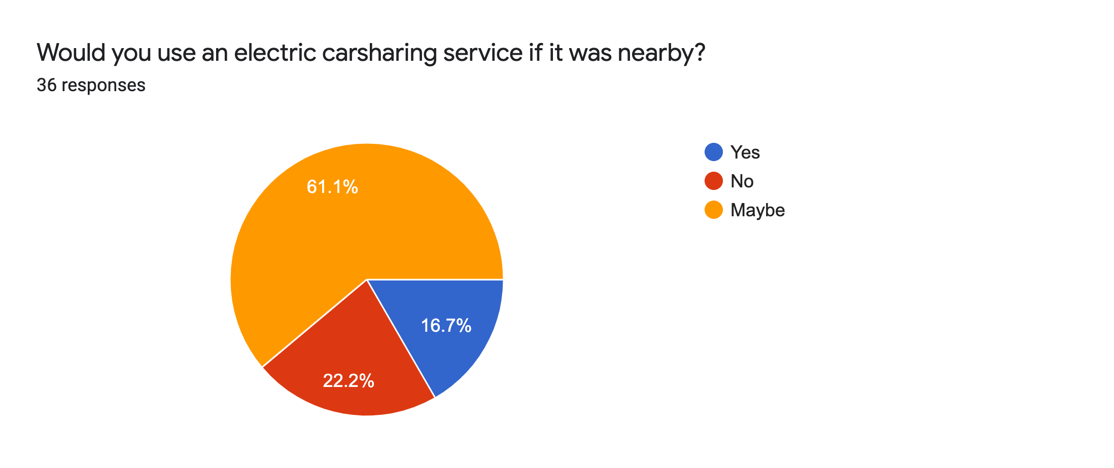
Survey Results: Likelihood to use Program
Notes:
77.8% of responses would either ‘maybe’ or definitely use an electric vehicle carsharing program if it existed in their area.

Slide 10
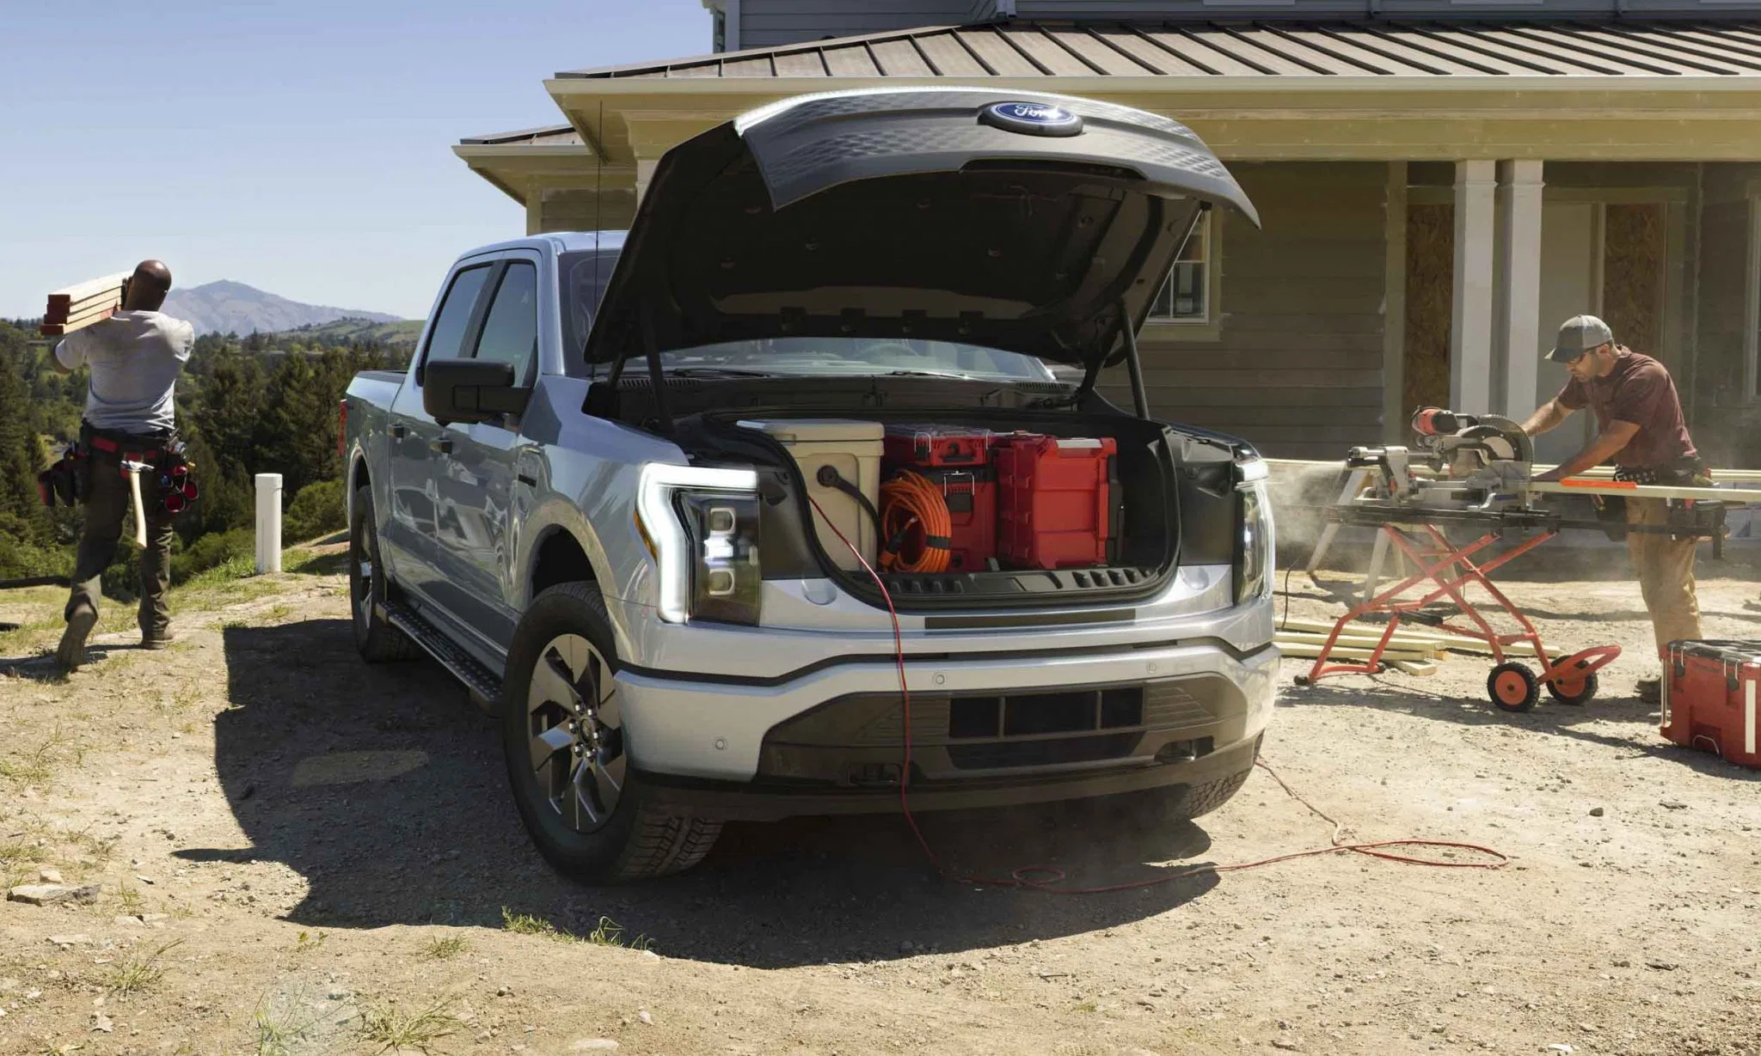
What are Electric Vehicles?
Electric Hybrid and Electric Plug-in
Hybrid vehicles: 40 miles on electric
Electric Plug-in avg. 250 miles per charge
Variety of Vehicle Types
https://kfor.com/wp-content/uploads/sites/3/2021/05/2022-Ford-F-150-Lightning8-2048x1229-1.jpg?strip=1
Notes:
When considering creating an EV carsharing program, it would be vital to thoroughly consider size, model, and type of vehicle. There are two types of electric vehicles, thoroughly consider size, model, and type of vehicle. Hybrid vehicles can generally drive forty miles before requiring use of gasoline fuel. Fully electric vehicles only utilize electricity for power and drive 250 miles per charge on average.

Slide 11
Some of my Favorite Car Types
Brand | Model | Consumer Price (2021) | Miles per Charge | Max Ground Clearance | Seats
Ford | F150 Lightning | $39,974 | 300 mi | 8.9” | 5
Tesla | Model X Long-Range | $86,190 | 351 mi | 9.0” | 5
Chevrolet | Bolt EV | $35,590 | 259 mi | 5.5” | 5
Hybrids
Toyota | RAV4 hybrid | $28,500 | 42 mi | 8.4” | 5
Honda | Insight | $22,930 | 89 mi | 5.9” | 5
Honda | CR-V hybrid | $30,560 | 38 mi | 8.2” | 5
Notes:
There are many different types and combinations of electric vehicles, hybrid vehicles, and program models

Slide 12
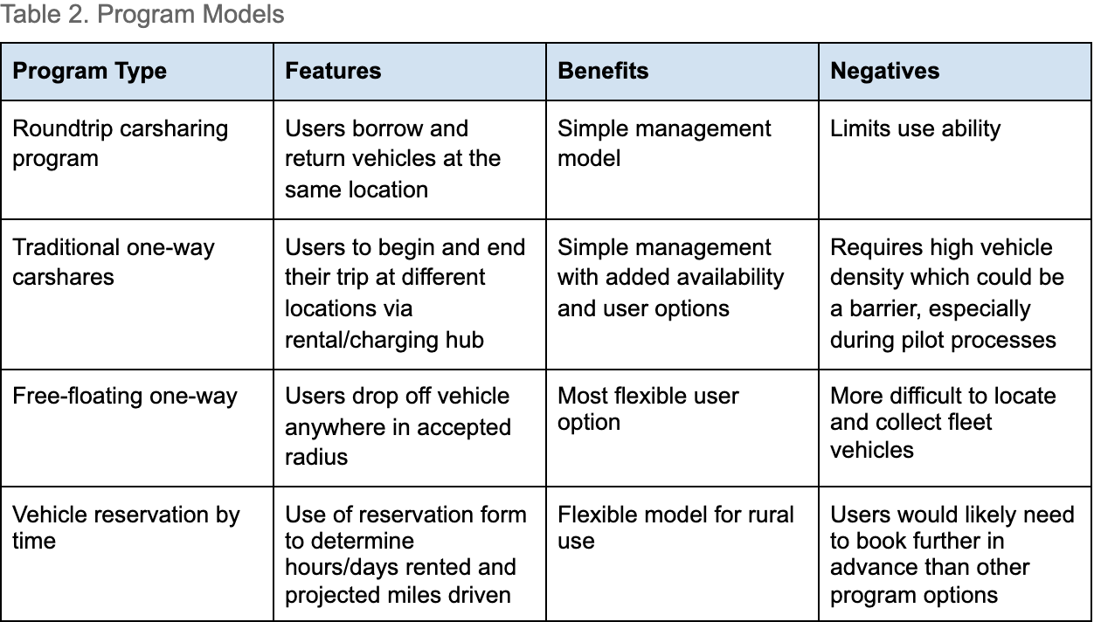
Program Options
Notes:
Cities often aid or run the decision making process regarding charging hub or ‘community mobility hub’ placement.
Central locations in each county will be important for hub placement. City halls, libraries, shopping centers, and neighborhoods will be good options.

Slide 13
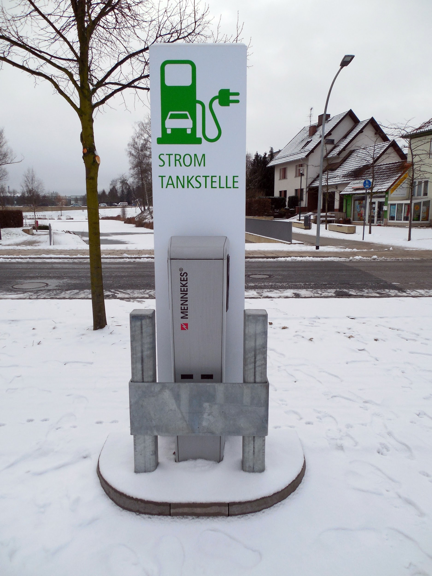
Unique Challenge: Winter
Reduced range will occur, but severity will depend on car models.
Most EVs have heated seats and steering wheels, so heating cars should not take as much energy as with gasoline vehicles.
Notes:
Stock image of electric vehicle charger in Germany

Slide 14
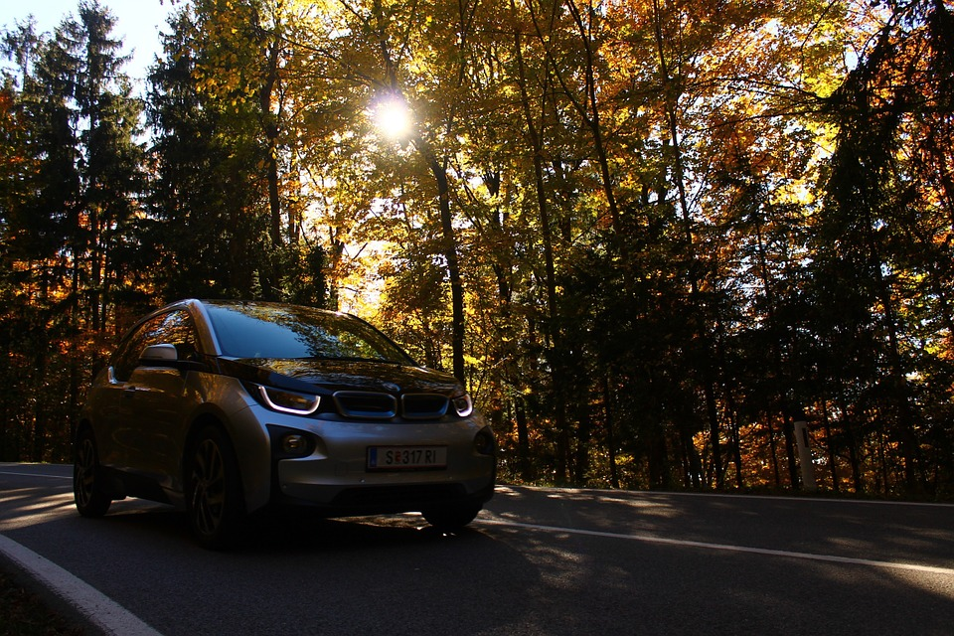
Unique Challenge: Rural Use
Average EV charge is 250 miles
Average gasoline vehicle mpg is 24.2 miles
Approximately $9 per full charge using fast-charger
Average Fuel Economy by Major Vehicle Categoryhttps://afdc.energy.gov › data
Notes:
Rural locations pose challenge to electric vehicles, though not as much as one may think. Especially since EVs can be charged using any outlet, though slowly, it is actually difficult to end up stranded if a charge runs out.
My personal car is a 2013 Subaru with a 16.9 gallon tank. This means that I get approximately 405 miles per tank. An EV would be about half of the milage, however I could charge it for much less money...and I rarely need to use 405 miles in one trip. An ev can be charged just as frequently as a gasoline vehicle but for cheaper.

Slide 15
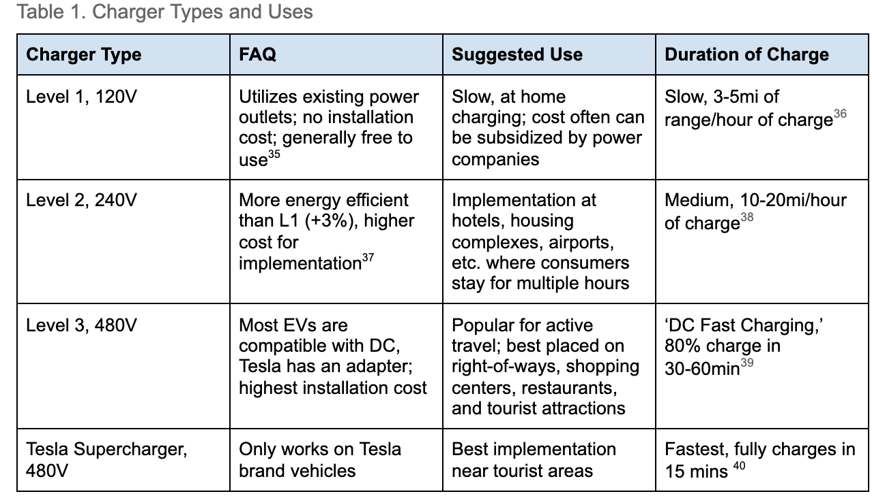
Charger Information
Notes:
L1 and L2 can easily be utilized in personal homes or businesses, L2 and L3 would be utilized in hubs

Slide 16
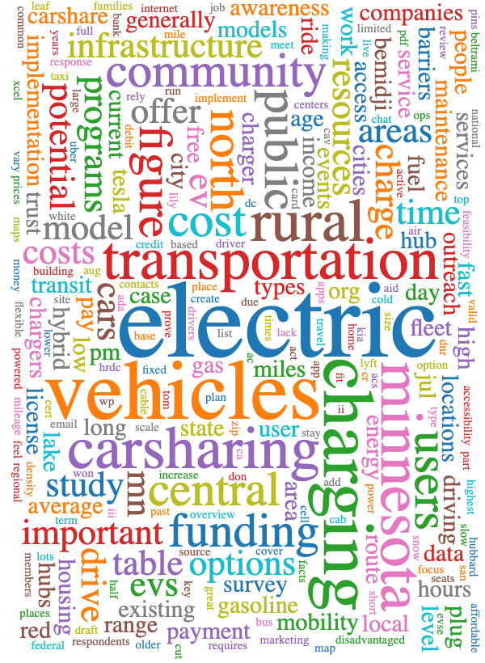
Program Recommendations
Sliding-scale payment model with many payment options
Free-floating one-way model
Offer subsidies for at-home charging
Include multiple types of cars in fleet
Focus on community needs and program outreach

Slide 17
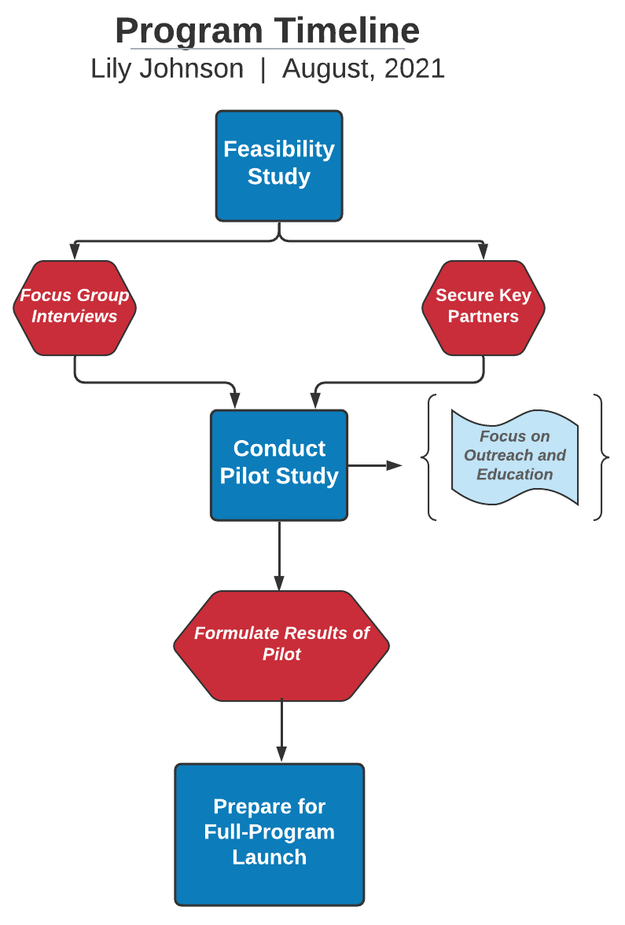
Next Steps
Identify Key Partners
Hold focus groups and interviews with community members
Create and Launch Pilot Programs

