Slide 1
Progress Report
November 23, 2015

Slide 2
OUR GOAL IS TO: Build a self-sustaining center focused on higher education innovation
IN A WAY THAT: addresses unmet needs in the field, is interdisciplinary, promotes scholarship on innovation and change in higher education, and engages alumni, friends, and key constituents;
SO THAT: we create rich experiences for OLPD faculty and students, enhance the national visibility of our higher education program, drive enrollment to OLPD MA/PhD programs, and make a lasting contribution to the field.

Slide 3
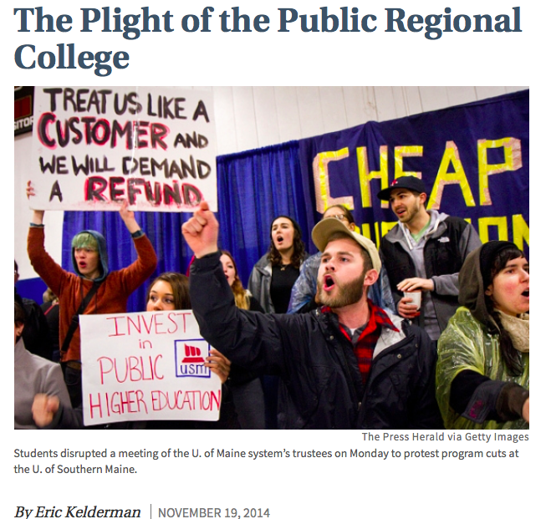
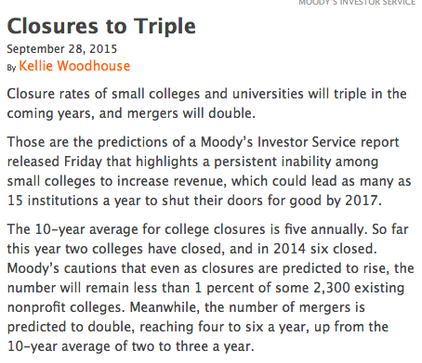
Key target audience: small to mid-size institutions

Slide 4

EMERGING LEADERS IN PRIVATE COLLEGES (12 cr. Graduate Certificate)
BETHEL UNIVERSITY: 10 students with completed
applications to begin in January 2016. ($50K+ net revenue)
CONCORDIA-CHICAGO: pending Spring 2016
Discussions with two other institutions in progress (East and Southwest)

Slide 5
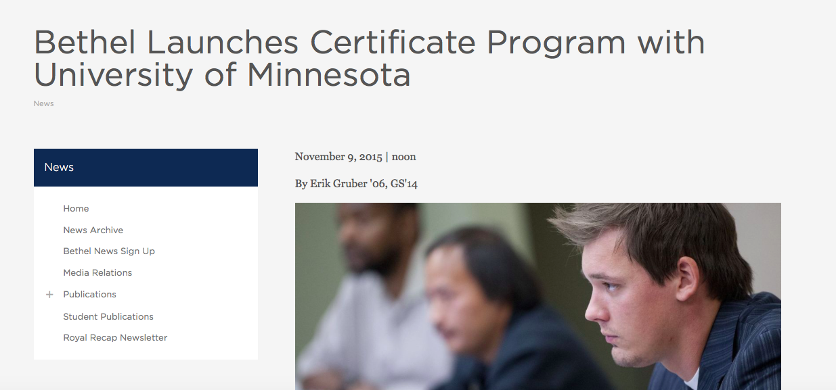
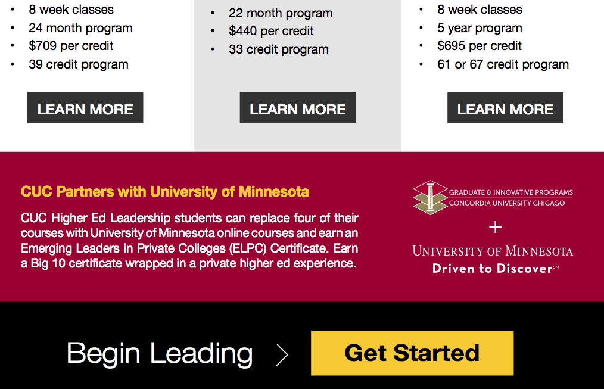

Slide 6
Small Private College Advisory Board
Mary Dana Hinton, President, College of St. Benedict
Dan Carey, President Emeritus, Edgewood College
Tom Crady, Vice President for Enrollment, Gustavus Adolphus College
Cassandra Herring, Dean, School of Education and Human Development, Hampton University
Paul Pribbenow, President, Augsburg College
Scott Morrell, President, Stone Arch Organizational Development
Ann Hill Duin, Project DAVID, University of Minnesota
Randy Bergen, Executive Assistant to the President, Bethel University
Tom Ries, President, Concordia- St. Paul (pending)

Slide 7
Innovation Scholarship Awards
Awards program to bolster scholarship on innovation and change in higher education (2016: focus on private colleges)
  Winter/Spring Awards pending ($2500 per award)
  Awardees selected by advisory board
  Publication/public forum for awardee
  Drive visibility to jCENTER and program

Slide 8


PILOT/CONSULTATIONS COMPLETED
  Design Thinking Twin Cities Pilot (2013-2014)
  University of Nebraska, Johnny Carson School of Film ($30K revenue)
SCHOLARSHIP
  Weerts, D. J., Rasmussen, C., & Singh, V., (2015). Using design thinking to drive collective impact in higher education. In, Lane, J. E., (Ed). Higher Education Reconsidered: Executing Change to Drive Collective Impact. SUNY Critical Issues Series, 3, Albany, NY: State University System of New York (SUNY).
  Konkle, E., Sommers, J., Sorenson, N. L., & Weerts, D. J., (under review). The nature of innovation and change at public research universities. In, A. F. Furco, R. Bruininks, R. Jones, & K. Kent (Eds.) Re-envisioning the Public Research University for the 21st Century.
CONFERENCE PRESENTATIONS
  SHEEO (August 2014)
  ASHE (November 2016)
  NASPA (March 2016)
  ACPA (March 2016)
PENDING PROPOSALS:
  GRIP (Graduate School)
  Florida Consortium
  Others in progress

Slide 9
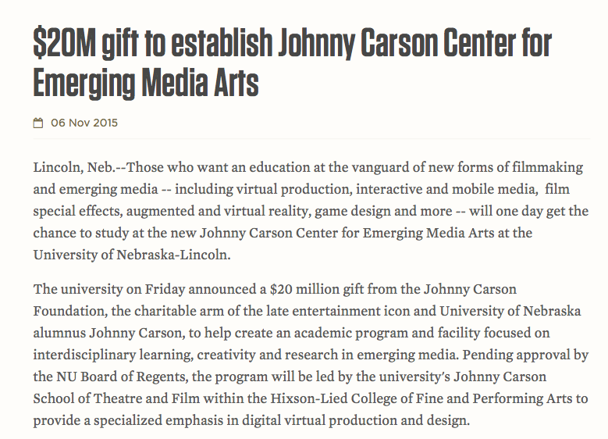
“The Center will incorporate a lot of the ideas we developed in our design thinking sessions last year. The Carson Foundation was especially impressed with the feedback you got from our students.”
Charles O'Connor
Endowed Dean
Hixson-Lied College of Fine and Performing Arts

Slide 10
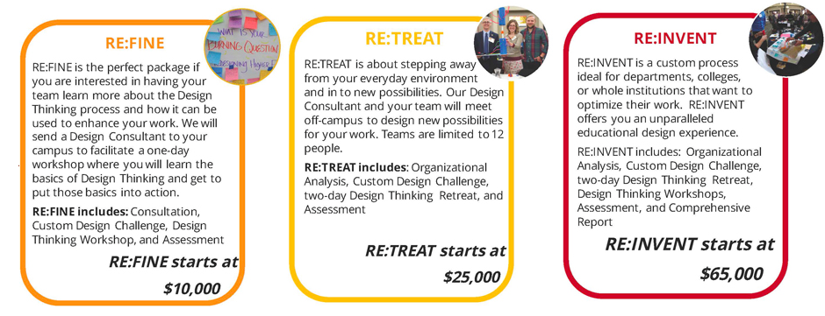

Slide 11
NEW OPPORTUNITIES
INNOVATIVE PRACTICE CERTIFICATE (NON-CREDIT)
WEBINAR SERIES: five 1-hour webinars highlighting themes in Emerging Leaders courses offered in Spring 2016.
MULTI-SECTOR FOCUS
  Four 4-week courses on change management, organization and structure, assessment, and choice of entrepreneurship, advancement, or public engagement
2016 Twin Cities Startup Weekend Education

Slide 12
Our Team
Erin Konkle, Managing Director
Gary Engstrand, Sr. Fellow (Board development)
Leonard Taylor, Director, Redesign (.50)
Bill Woodson, GA (.50)
David Weerts, Faculty Director

Slide 13

Gaining financial stability before launching into public programs/other opportunities

Slide 14
CHALLENGES, OPPORTUNITIES,
AND DISCUSSION
Thank you for your support!

