Slide 1
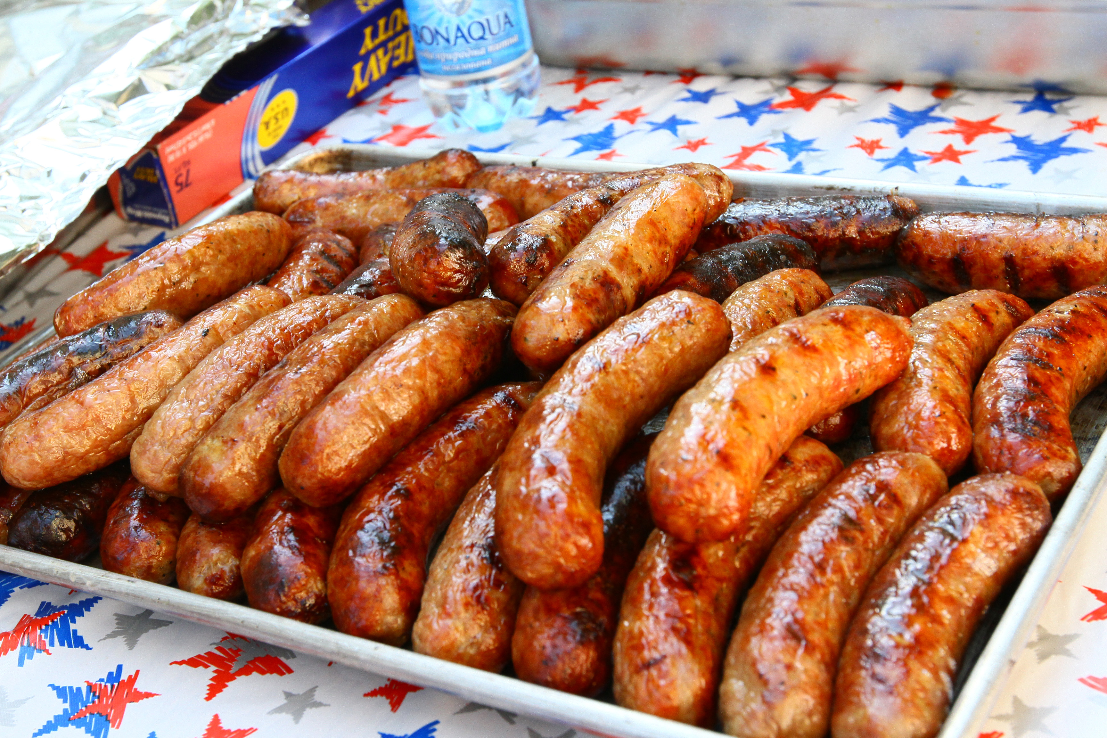
How to Setup a Temporary Booth
Part 5:
Food Safety
Notes:
How to setup a temporary booth: Part 5 food safety
This segment has a lot of important information and temperatures, please pause the video when needed.

Slide 2
Approved Food Source
Food provided must be prepared:
In the temporary food stand
At a commercial facility
Home-prepared foods are NOT acceptable
Notes:
All food and food preparation must be approved by the Health Department. The Health Department may limit and/or modify the nature of the food service operation and/or the type of food served to protect the health and safety of the general public. Home-prepared foods are not acceptable. Food must be prepared in the temporary food stand or at a commercial facility approved by the Health Department. To eliminate the potential for contamination or temperature abuse avoid preparing large quantities of food.

Slide 3
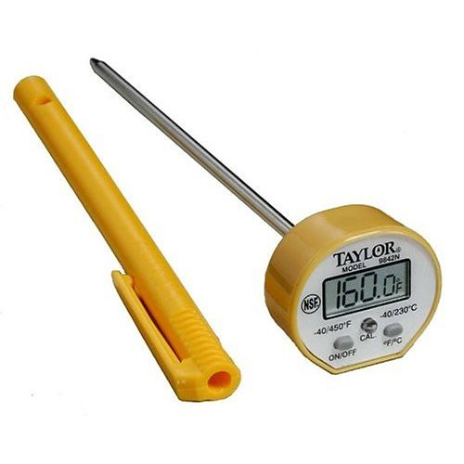
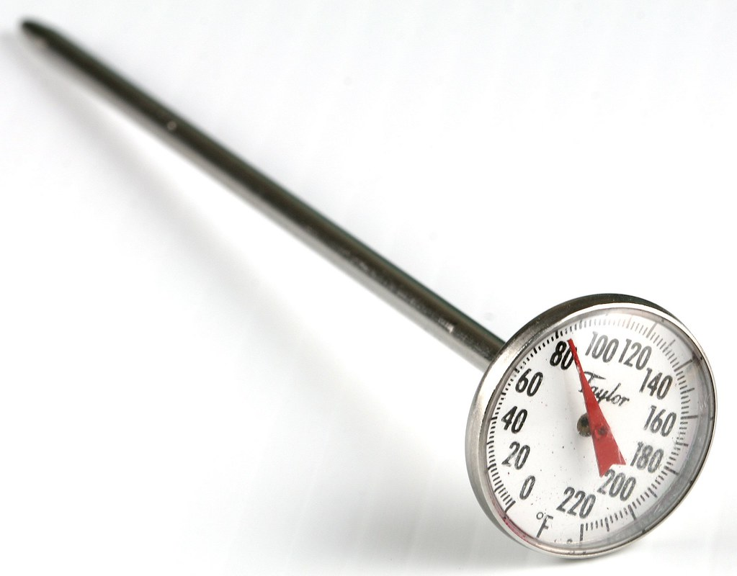
Temperature Control
An approved digital or metal stem food thermometer should be used:
Metal Stem
Digital
Both can be calibrated!
Notes:
Temperature control. An approved digital or metal stem food thermometer should be used to determine internal food temperatures. Always check temperatures when cooking, cooling, hot holding or cold holding foods. Both thermometers shown here can be calibrated in ice water or boiling water bath.

Slide 4
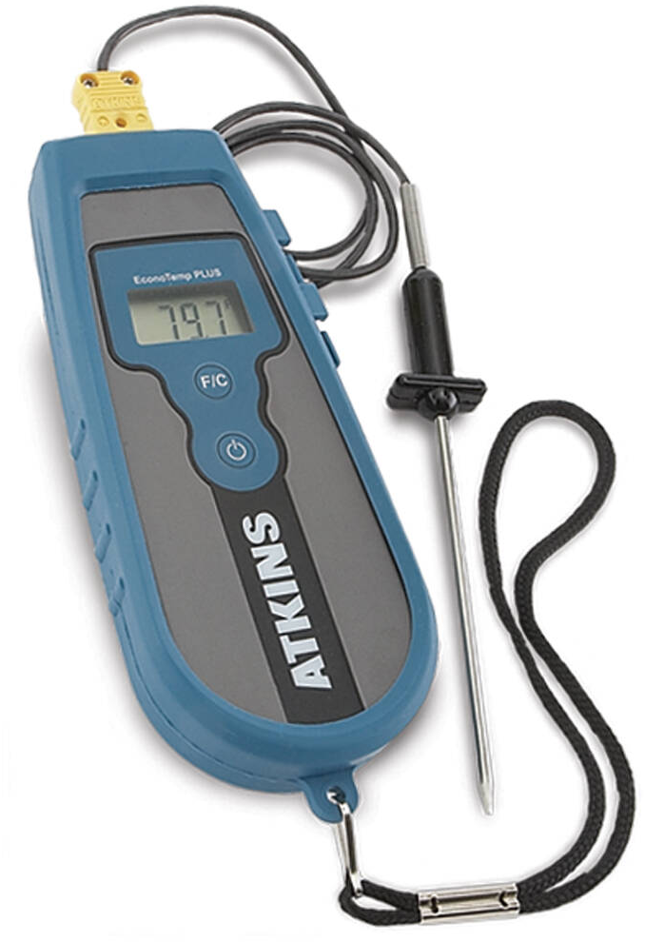
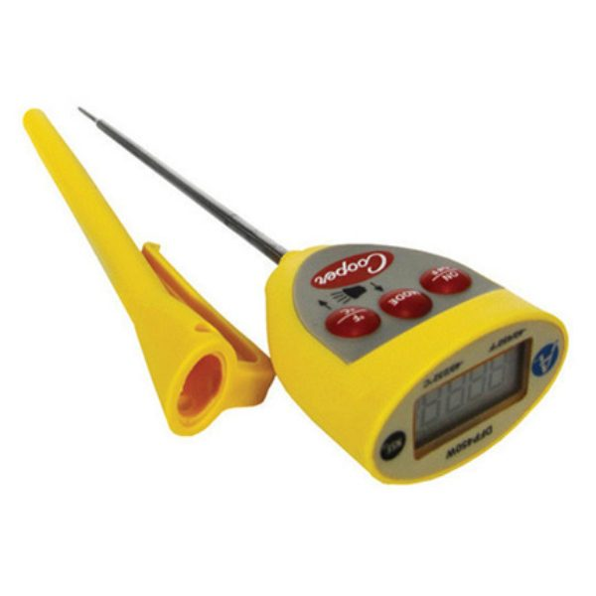
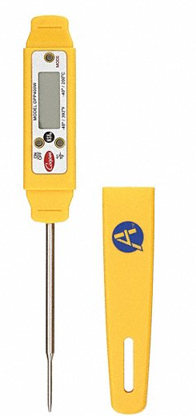
Temperature Control
Not all monitoring devices require calibration
Notes:
Not all monitoring devices require calibration. Several common devices, as shown on the screen, are not able to be calibrated and require replacement if not accurate.

Slide 5
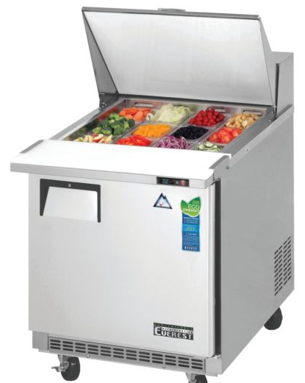
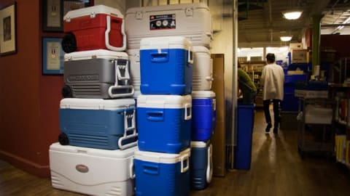
Food Temperature Control- Cold Holding
Keep cold foods at or below 41°F
Notes:
Food temperature control: Provide mechanical refrigeration when holding potentially hazardous foods more than two hours. Keep cold foods at 41°F or below. Ice may be used for the transportation, storage, display, cooling and service of potentially hazardous food if it can be demonstrated that food product temperature remains at 41°F or below.
All ice served to the general public must be from an approved source acceptable to the department.

Slide 6
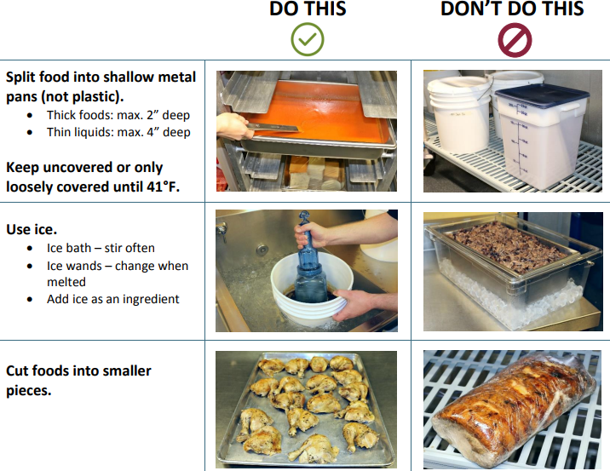
https://www.publichealthmdc.com/documents/Cooling%20Methods.pdf
Notes:
Cooling should be limited at temporary events. If cooling must be done at event: COOL potentially hazardous cooked foods: • Within 2 hours, from 135°F to 70°F • Within 4 hours, from 70°F to 41°F or below To speed cooling: • Use ice bath with frequent stirring or add ice as an ingredient • Use frozen paddle • Separate food into shallow pans and refrigerate

Slide 7
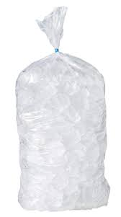
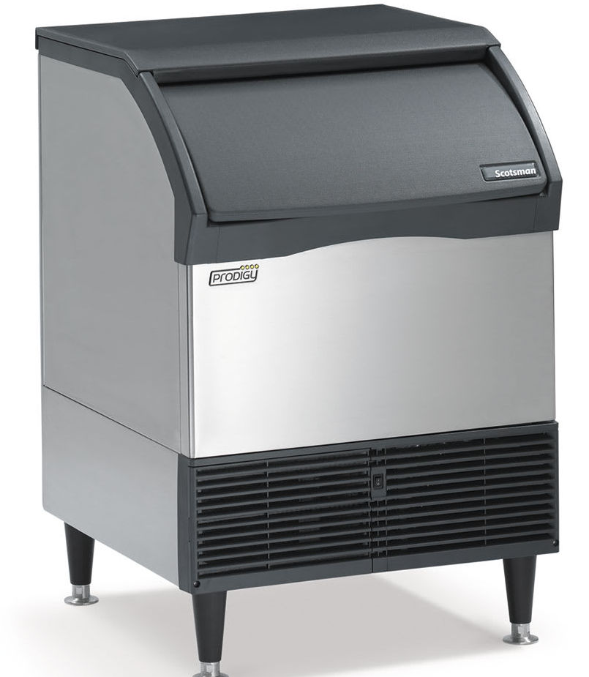
Ice
Notes:
ICE: All ice intended for human consumption must not be used for any other purpose. Keep drink ice separate from ice used to cool cans or bottles. Do not allow cans and bottle tops to become submerged in water. Continuously drain ice water from the storage unit.

Slide 8
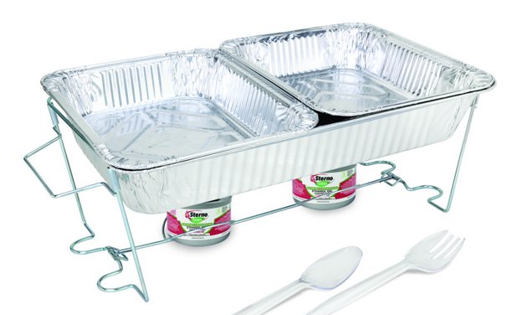
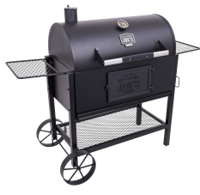
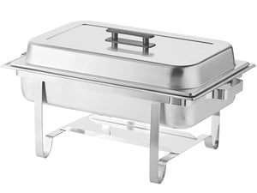
Food Temperatures- Hot Holding
Keep Hot foods at 135°F or above
Notes:
Food Temperatures- hot holding: keep hot foods at 135°F or above. Keeping items hot in a covered grill or in a metal container on a flat top grill are both ideal. Chaffing pans with sternos are allowed, but please note that the wind may burn out the heat source, so always monitor. Hot holding can be dangerous, cooking to order is always safer.

Slide 9
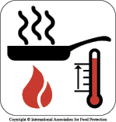
Reheating
Reheat rapidly within 2 hours to 165°F for 15 seconds
Commercially processed and packaged food for hot holding, cooking vegetables for hot holding at 135°F for 15 seconds
This Photo by Unknown Author is licensed under CC BY-SA-NC
Notes:
REHEAT rapidly (within 2 hours): • To 165°F for 15 seconds • To 135°F for ready-to-eat foods taken from a commercially processed sealed package (e.g. frozen soup or hotdogs). Cooked vegetables should also be hot held at 135*F and remeber AND ALWAYS Stir food while reheating

Slide 10
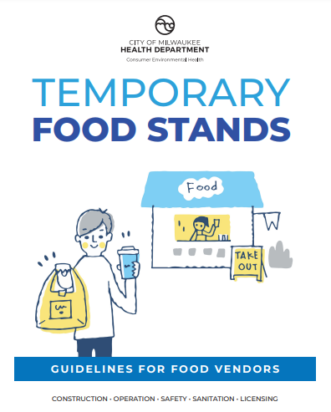
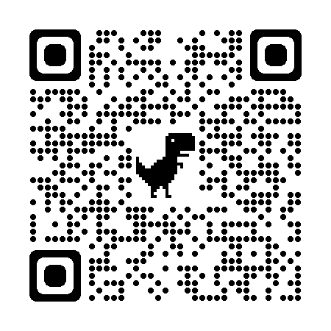
www.milwaukee.gov/health/tempfood
Notes:
Additional information, including printable guidance documents in English and Spanish can be found on the City of Milwaukee Health Department website, or by scanning the QR code located on the screen.

