Slide 1


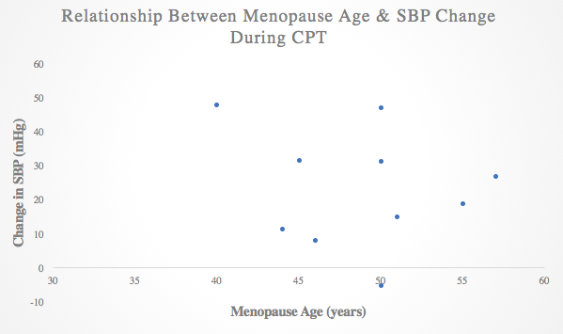
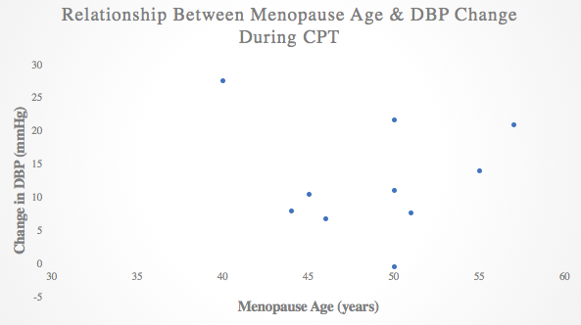
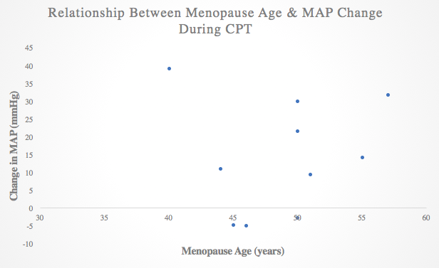
Blood Pressure Reactivity During a Cold Pressor Test in Post-Menopausal Women
Aline Glazos¹, Emma Lee, PhD¹, Marnie Vanden Noven, PhD, DPT, ATC², and Manda L. Keller-Ross, PhD, DPT¹.
¹Divisions of Physical Therapy and Rehabilitation Science, Medical School, University of Minnesota, Minneapolis, MN
²Department of Exercise Science, Belmont University, Nashville, TN
Logo
Logo
Background
Experimental Protocol
Discussion
r= -0.21
p= 0.57
The risk of hypertension (HTN) increases in women after menopause².
The onset of natural menopause at an early age is associated with a greater risk for HTN³.
Blood pressure (BP) response to a cold pressor test (CPT) can be predictive of HTN¹.
It is unknown whether the age of menopause has an influence on the BP response to the CPT.
SBP, DBP, and MAP increased during CPT from baseline (23.23±16.92mmHg, p=0.002; 12.65±8.39 mmHg, p=0.001; 14.51±15.92mmHg, p=0.02, respectively).
Participants rested on a bed in a supine position.
Participants rested for 3 minutes for a baseline (BL) data collection.
      Participants completed a two-minute CPT at ~1℃.
BP was measured with continuous finger plethysmography (Figure 1).
Mean arterial pressure (MAP) was calculated from collected BP.
Figure 2. The relationship between menopause age and SBP during the CPT. The correlation was not found to be statistically significant (p>0.05).
Menopause age was not significantly correlated with the change in SBP, DBP, or MAP during CPT (r =-0.21, p=0.57; r=-0.07, p=0.86; and r=0.08, p=0.82, respectively).
Purpose & Hypothesis
Results
r= -0.07
p= 0.86
Conclusion
Table 1. Participant Demographics
Purpose: To determine the association between menopause age and the change in BP during the CPT in post-menopausal women.
Hypothesis: Women who experienced premature or early menopause will have a heightened BP response to the CPT, predicting a higher risk of developing HTN in this population.
 | Mean ± Standard Deviation
Age (yrs.) | 63±3
Menopause Age (yrs.) | 49±5
BMI (kg/m² ) | 23.4 ± 4.3
Although the CPT induced an increase in BP in all participants on average, we found that menopause age was not associated with BP reactivity to this stressor.
Figure 3. The relationship between menopause age and DBP during the CPT. The correlation was not found to be statistically significant (p>0.05).
Table 1: Ten post-menopausal women participated: seven who experienced menopause at a typical age and three who experienced premature or early menopause.
Methodology
r= 0.08
p= 0.82
References
Two groups of women were recruited for participation:
  Women who experienced menopause at a typical age (age≥46yrs).
  Women who experienced premature or early menopause (age≤45yrs).
Hines, EA, Brown, GE. The cold pressor test for measuring the reactibility of the blood pressure: Data concerning 571 normal and hypertensive subject. Am Heart J 11: 1-9, 1936.
Lima R, Wofford M, and Reckelhoff JF. Hypertension in postmenopausal women. Curr Hypertens Rep 14: 254-260, 2012.
Shuster LT, Rhodes DJ, Gostout BS, Grossardt BR, and Rocca WA. Premature menopause or early menopause: long-term health consequences. Maturitas 65: 161-166, 2010.
Figure 4. The relationship between menopause age and MAP during the CPT. The correlation was not found to be statistically significant (p>0.05).
Figure 1. Average changes in systolic blood pressure (SBP), diastolic blood pressure (DBP), and mean arterial pressure (MAP) during the CPT from baseline. The changes found were statistically significant (p=0.002, p=0.001, p=0.02, respectively).
Acknowledgments: This project was supported by the University of Minnesota’s Undergraduate Research Opportunities Program.

