Slide 1

Importance of Food Safety
Part 7:
Food Safety Data
Notes:
The importance of Food safety Part 7: Food safety data

Slide 2

We have learned:
How to obtain a temporary event license
Construction of your booth
Employee health & hygiene
Cleaning & sanitation
Food safety
Cooking temperatures
But why is this
Important?
Notes:
Over the course of this mini series, we have explored: how to obtain a temporary event license, booth construction, important information regarding employee health & hygiene, proper cleaning & sanitation methods, general food safety, and cooking temperatures. But why is it important to have all of all of this properly in place for each of your events?

Slide 3
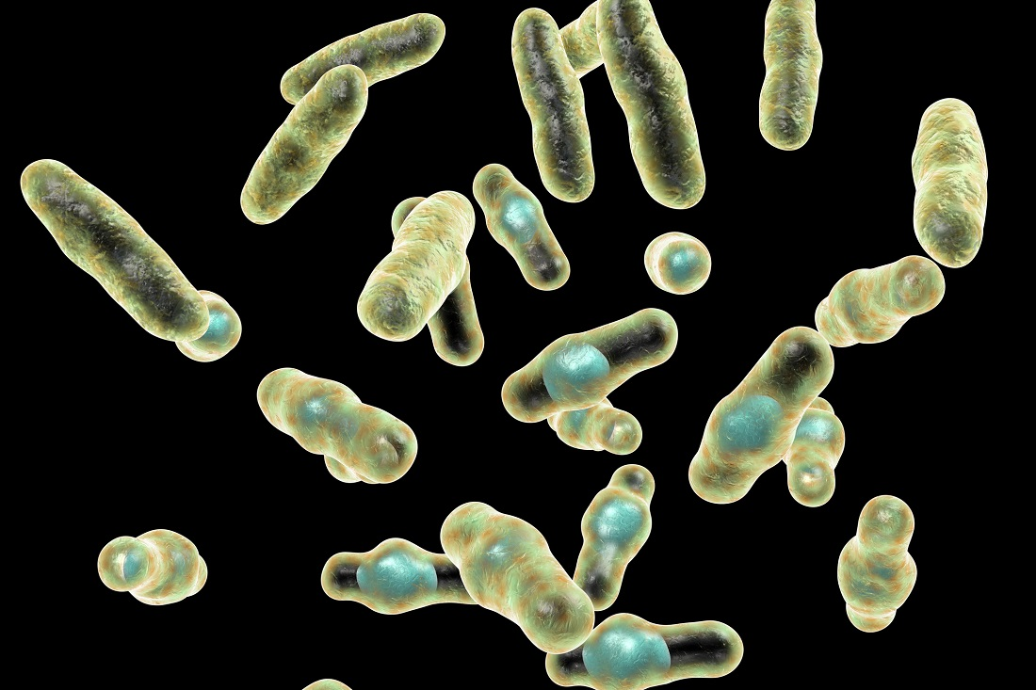
FOODBORNE
ILLNESS
Notes:
Foodborne Illness!

Slide 4
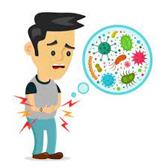
According to the CDC:
48 mil people
1 in 6 Americans
128,000 hospitalized
3,000 die
https://www.cdc.gov/foodborneburden/2011-foodborne-estimates.html
Notes:
The CDC estimates that each year roughly 48 million people, that’s roughly 1 in 6 Americans get sick from foodborne illness. Of those 48 million Americans, 128 thousand are hospitalized, and sadly, 3,000 Americans die each year. The cause? Foodborne diseases.

Slide 5

Pathogen
A bacterium, virus, or other microorganism that can cause disease
https://stacks.cdc.gov/view/cdc/47884
Notes:
The cause of foodborne diseases is usually due to a pathogen. A pathogen is a bacterium, virus, or other microorganisms that can cause disease. According to the CDC, researchers have identified over 250 foodborne pathogens.

Slide 6

Foodborne Illness
Occurs when people eat or drink contaminated food or beverages
https://www.fda.gov/food/outbreaks-foodborne-illness/foodborne-pathogens
Notes:
Foodborne illness, which is commonly called food poisoning, happens when a person consumes food or beverages that have been contaminated by bacteria, bacterial toxins, viruses, parasites or chemicals.

Slide 7
https://www.cdc.gov/foodborneburden/2011-foodborne-estimates.html
Notes:
The top 5 pathogens contributing to foodborne illness in the US each year, can be seen here. In this graph. On the Y axis, we see the top 5 pathogens: Staphylococcus aureus, Campylobacter, Closterium perfringens, Salmonella, and Norovirus. On the X axis, we see the number of cases occurring from each organism. Norovirus stands out significantly!
The US Department of Agriculture estimates that foodborne illness cost the United States more than $15.6 billion each year!

Slide 8
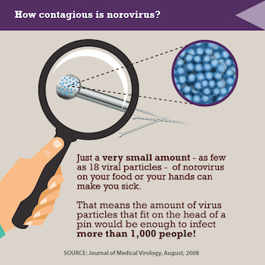
What is Norovirus?
Contagious virus
Causes vomiting & diarrhea
“Stomach flu” or “stomach bug”
Highly Transmissible
https://www.cdc.gov/vitalsigns/norovirus/index.html
Notes:
What is norovirus? Norovirus is a very contagious virus that causes vomiting and diarrhea. Norovirus is commonly referred as the stomach flu or stomach bug, Norovirus It highly transmissible. 18 virial particles is enough to make you sick. Looking to the image on the screen, that means that there is enough virial particles on a pin head to infect over a thousand people!

Slide 9

Infected food workers cause 70% of reported outbreaks from food
This Photo by Unknown Author is licensed under CC BY
Notes:
Infected food workers, those experiencing vomiting and diarrhea are the cause of 70% of reported norovirus outbreaks from contaminated food.

Slide 10
How can we prevent Norovirus?
Wash your hands
Avoid touching food with bare hands
Clean & sanitize surfaces and utensils
Stay home when sick
Cook shellfish thoroughly
Rinse fruits and vegetables
https://www.cdc.gov/vitalsigns/norovirus/infographic.html#infographic
Notes:
We can prevent norovirus infections when we wash our hands, stay home when sick, cook shellfish thoroughly, do not touch ready to eat foods with bare hands, clean & sanitize surface and utensils, and rinse our fruits and vegetables.

Slide 11
Top 5 Contributing Factors
Foodborne Illness
Poor Personal Hygiene
Food from Unsafe Sources
Contaminated Equipment/Cross Contamination
Improper Cooking Temperatures
Improper Holding Temperatures
https://www.cdc.gov/nceh/ehs/nears/factors-contribute-to-outbreaks.htm
Notes:
The Center for Disease Control, (CDC), Identified 5 contributing factors that contribute to foodborne illness: Poor Personal Hygiene, Improper Holding Temperatures, Improper Cooking Temperatures, Food from Unsafe Sources, Contaminated Equipment/Cross-Contamination. Sound familiar?

Slide 12

A Closer Look at the Data
Notes:
The remaining slides will consist of a closer look at the temporary event inspection data as observed in the City of Milwaukee.

Slide 13
Temporary Inspections Conducted
in Milwaukee, Wisconsin
Notes:
The number of temporary events conducted in the City of Milwaukee Wisconsin can be seen in this graph. In 2018, there was 534 temporary event inspections conducted. In 2019, 448 inspections. And in 2021, 113. I have omitted 2020 as safer at home orders were in place.

Slide 14

Contributing Factors 2018
Notes:
Using the 5 contributing factors, we can categorize observations from the temporary event inspection reports. On the left pie graph, we see the in’s for temporary events in Milwaukee in 2018, this means there were no violations of these 5 factors at the time of inspection. On the right, we can see the out’s or non-compliance. All though all 5 factors are seen in this graph: Holding temperatures, cross contamination and poor personal hygiene are the dominating violations.

Slide 15
Contributing Factors 2019
Notes:
2019 temp event data, was similar to 2018. Again, the left pie chart is no violations, the right is out of compliance. Holding temperatures, cross contamination and poor personal hygiene remain the dominating violations observed.

Slide 16
Contributing Factors 2021
Notes:
In 2021, the inspection data shifted, this could be due to limited inspections (remember we had 534 inspections in 2018 and only 113 in 2021). When we look at the non compliance factors on the right pie chart, we can see there are only 3 contributing factors: Holding temperatures, cross contamination and poor personal hygiene are the dominating. Food from unsafe sources and improper cooking temperatures had been removed.

Slide 17
Themes We Can See
Notes:
Improper Holding temperatures remain the largest contributing violations we see at temporary events. Poor personal hygiene, which include handwashing, the orange color was relatively the same in 2018 and 2019, but when we compare personal hygiene violations in 2021, in the midst of a pandemic, strangely enough we see MORE violations.

Slide 18
Top 5 Contributing Factors
5 Key Intervention Strategies
Foodborne Illness
Poor Personal Hygiene
Food from Unsafe Sources
Contaminated Equipment/Cross Contamination
Improper Cooking Temperatures
Improper Holding Temperatures
Safe food
Demonstration of knowledge
Employee health controls
Time and temperature parameters for pathogens
Controlling hands as a vehicle of contamination
Consumer advisory
https://www.cdc.gov/nceh/ehs/nears/factors-contribute-to-outbreaks.htm
Notes:
So what can we do? Remembering the 5 contributing factors is an important step. But the CDC also developed 5 key intervention strategies which are: Demonstration of knowledge, employee health controls, controlling hands as a vehicle of contamination, consumer advisory, and time and temperature parameters for pathogens. Using these interventions, the risk of providing contaminated food is significantly reduced.

Slide 19
We ALL Play a Role in Safe Food
Notes:
Using contributing factors and interventions, we reduce the number of foodborne illnesses each year. Remember, we ALL play a role in providing safe food. I encourage you to share these videos with staff prior to your event.

Slide 20
Thank You!
Any questions?
You can find me at
schul864@umn.edu & sschuldt@milwaukee.gov
Notes:
I would like to thank you for watching this mini series. If you have any questions regarding any of the content, I can be reached at my university email or at my Milwaukee Health department email, both located on the screen.

Slide 21
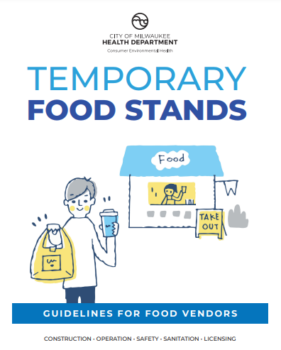

www.milwaukee.gov/health/tempfood
Notes:
And finally, Additional information, including printable guidance documents in English and Spanish can be found on the City of Milwaukee Health Department website, or by scanning the QR code located on the screen.

