Slide 1
A Recovery System for SUAV
Operations in GPS-Denied Environments Using Timing Advance Measurements
Jordan Larson
Trevor Layh
John Jackson
Brian Taylor
Demoz Gebre-Egziabher
Department of Aerospace Engineering and Mechanics
University of Minnesota, Twin Cities
Institute of Navigation – International Technical Meeting
January 27th 2015
Notes:
Today I will be discussing a recovery system that we at University of Minnesota implemented on a small UAV that utilizes a cell phone based measurement called a Timing Advance when GPS is denied to the SUAV.
This system is not meant to replace GPS, but is meant to describe a system that helps the SUAV to “limp back home.”
We use the phrase “limp back home” in a special sense for this work.
In what follows I will describe exactly what that means and provide the motivation for this work.

Slide 2
Part 1: Background
Notes:
First I will present the problem that we addressed and the logic that we used to design our recovery system using the Timing Advance measurement from a Cell Phone network.

Slide 3

Motivation: “Limp Back Home” Capability
Many envisioned law enforcement missions in remote, border areas.
Dependence on GPS for navigation can be disrupted.
Design recovery system for
  Small UAV (SUAV)
  We need this system YESTERDAY! (i.e., use current COTS)
Photo courtesy of http://www.cops.usdoj.gov/
Notes:
In 2013, the DHS approached us with the following problem.
There are many law enforcement concepts of operation (CONOPS) where UAV deployment would be of tremendous value.
The model application they had in mind was border patrol where there are not a lot of airspace users nor obstacles for the UAV so it is an ideal environment.
However, with the current heavy reliance of SUAVs on GPS for navigation, there is a danger that if GPS is jammed, spoofed, or otherwise lost, then the SUAV would be unable to complete the mission.
Even more so, it can be lost completely and this is costly for many law enforcement agencies that don’t have surplus budgets (the term used by some is “negative budgets”).
The DHS tasked us with designing a system for a small UAV (hand-launched) using current technology that would allow the safe recovery of such SUAVs.
And by safe recovery I mean that the SUAV would be able to return near enough to its home base that the SUAV could be located and another system or pilot could take over operation.
(Photo at http://www.cops.usdoj.gov/html/dispatch/08-2014/UAS_Guidebook_in_Development.asp)

Slide 4
Generic SUAV Navigation System Architectures (Current)
Many off-the-shelf SUAV autopilots feature this architecture.
GPS outage implies loss of all three navigation, guidance and control functions.
Can we replace the GPS functionality by a system (of low quality of course) which will allow recovery?
INS/GPS
INS
Blended
State
Estimate
GPS
?
AHRS+airspeed/DR
AHRS
DR
Blended
State
Estimate
?
GPS
Notes:
Today’s SUAVs are usually designed with one of two different navigation system architectures.
The first and most common is an Inertial Navigation System and Global Positioning System combination.
This architecture uses the INS for fast updates to the angular rates and acceleration which can be integrated for the attitude, velocity, and position and uses GPS for slower updates to the velocity and position as a correction to the increasing state errors introduced by integrating the INS over time.
The second architecture uses an Attitude, Heading, and Reference System to estimate the orientation of the SUAV and resolve the airspeed vector to the navigation frame. Using an estimate of wind speed, it can then form velocity over ground and integrate that to get position. We call this an AHRS Dead Reckoning system. This system is LESS accurate than the traditional INS/GPS but has the positive feature of smaller complexity and slower error growth since the integration to position is only done once.
However, since there still is error growth GPS is needed for correction of the state.
Therefore, if a GPS outage occurs, the system will begin to accumulate large errors in its position estimate and navigation will become impossible.
What we wanted to do was design a system that could easily be integrated into these architectures and replace the GPS measurements insofar as to bound the position estimate errors.
I want to point out, however, that we were not looking for a replacement for GPS in terms of position accuracy, but for a system that would bound the position estimate errors enough so that rough navigation could be done by the SUAV for the recovery of the SUAV.

Slide 5
Candidate Replacements for GPS/GNSS
Here are a few current systems that have been put forth as GPS/GNSS replacements
  Vision-Based Navigation
    (L. Lemay, et al, 2011)
    (V. Indelman, et al, 2009)
    (N. Trawny, et al, 2007)
  Signals of Opportunity (SOP)
    HDTV/TV signals (M. Rabinowitz and J. J. Spilker, 2005)
    Radio signals (J. K. Kuchar, 2006)
    Cell-phone
We picked the cell-phone SOP
  Why? Less than 1 year to get a working prototype running
Notes:
Here we list some current technologies that were potential candidates for our system.
One largely pursued technology is vision-based solutions.
However, this requires a new suite of tools that were not easily integrated into our current SUAV.
This was the case with other technologies as well which led us to examining Signals of Opportunity as potential signals that we could sense and use as positioning signals.
Such signals with large geographical coverage included TV, Radio, and Cell Phone signals.
Of these we selected Cell Phone signals because of its inherent 2-way communication scheme, and, as I’ll show next, it already had potential measurements available to us using a Cell Phone Modem.
This last characteristic was important to us since we had a limited time frame for this project.

Slide 6
Cell Phone Navigation Approaches
  Radio Frequency Fingerprinting
  Received Signal Strength Indicator (RSSI)
Custom designed hardware
  GPS-like Multi-lateration
  Potentially High Accuracy
  High Investment (Time & Resources)
Our Approach: Commercial Off-the-Shelf (COTS) hardware
  Low Investment (Time & Resources)
  Time-of-Arrival Signal: Timing Advance (TA)
Notes:
When it comes to Cell Phone navigation, there are several approaches.
The first approach we looked at was RF fingerprinting.
This has been a successful approach to location problems.
For example, Polaris Wireless uses this sort of scheme for its emergency locating services.
However with the simple hardware we had available to us we did not see enough regularity in our measurements to use this approach.
Secondly we could have pursued designing our own hardware to sample a cell phone signal.
This scheme has the potential to act very similarly to GPS, but we didn’t have the time or resources to seriously pursue this method.
So finally we landed on Commercial Off-the-Shelf technology that is already built into the cell phone network, specifically we looked at a time-of-arrival signal, called a Timing Advance, that is used by cell phone networks to predict the signal time of travel between a user and its service tower for the purposes of scheduling data transfer from different users at different times in order to service multiple users.

Slide 7
Part 2: Multi-lateration Using Cell-Phone Signals
(“Out-of-the-box” not modified cell-phone signals)
Notes:
So if we have access to a time-of-arrival signal, then we can implement a multilateration approach to position estimation, very similarly to GPS.

Slide 8
Cell-Signal Multi-lateration: Basic Theory
Line of Position (LOP) #1
LOP #2
Cell Tower #2
(x₂,y₂)
r₂
r₁ = c*t
(x₁,y₁)
(X_{uav} ,Y_{uav})
Cell Tower
#1
r₃
(x₃,y₃)
Cell Tower
#3
LOP #3
Notes:
Multi-lateration is nothing new to most of the audience here.
After all it is the way GPS/GNSS work.
Just as a review, let us look at what is required to make mulit-lateration work.
First, we must know where the cell towers are.
Second, we can get ranging measurements from these cell towers using the speed of light multiplied by the signal time of travel (either two way such as DME or one way such as GPS).
Third, if we have enough measurements from other towers we can get a location for our SUAV.

Slide 9
Challenge #1: Discrete Measurements
TA = 3 ~1650m
TA = 2 ~1100m
Cell Tower #2
(x₂,y₂)
TA = 1 ~550m
Region of possible positions
(x₁,y₁)
Cell Tower
#1
(x₃,y₃)
Cell Tower
#3
TA = Timing Advance (Cell-phone observable)
Notes:
So how does this play out when you want to use cell-phone signals to do multi-lateration?
Without any modification (out of the box) cell-phone networks provide a range measurement called Timing Advance or (TA).
This is not a continuous range measurement.
Rather it is range measurement discretized in approximately 550 m steps.
In essence a timing advance is a measure of what time slot a cell signal reaches a tower after the tower contacts the cell phone.
Therefore if we have a Timing Advance of 1 we can infer that the range from the cell tower to the SUAV is somewhere between 550 meters to 1100 meters.
The TA measurement can vary anywhere from 0 to 63 or about 0 to 35 km.
As shown here if we have multiple measurements from different towers, we no longer get an estimate of the SUAV’s position, but we get a region of equally likely positions.
How we dealt with this obstacle I will in depth later on in the talk.
Here I want to make it abundantly clear that with this highly discrete measurement we are not expecting position estimates within a few meters like GPS.
We would expect errors on the order of hundreds of meters.
However, in our application all we are looking for are adequate bounds on our position estimate for the recovery of our SUAV.

Slide 10
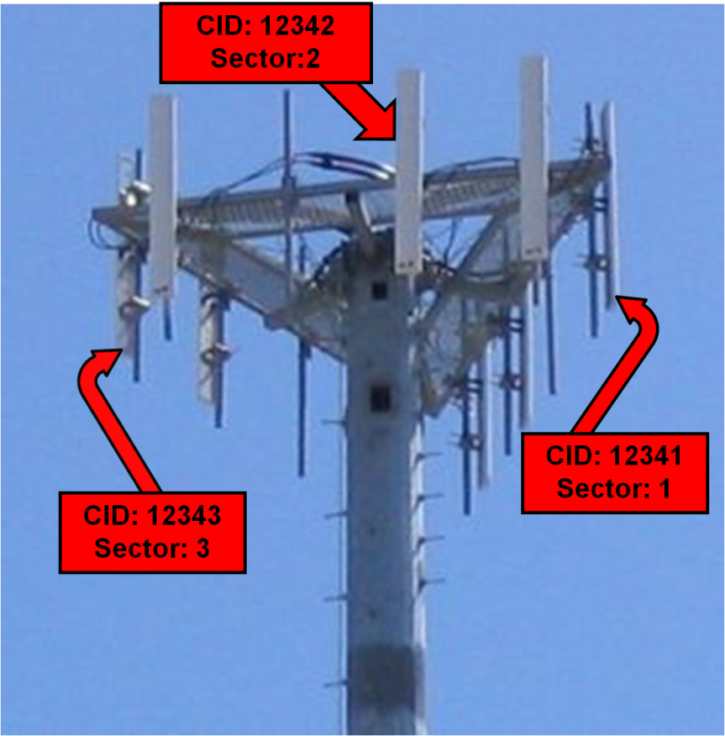
Challenge #2: Transmitter Locations
Cell networks do not provide tower locations.
Public cell tower databases provide poor accuracy.
Possible solution: reverse problem (M. Raitoharju, et al, 2011)
Our solution: Locations surveyed via drive test
Notes:
The second obstacle that we had to overcome was finding the cell tower locations.
With GPS we are sent the ephemeris positions of the satellite in the GPS signal itself.
However, cell networks do not provide their tower locations either in the signal nor in a database.
Furthermore, public databases established by communities of cell phone users do not provide enough accuracy for our application
We did consider reversing our problem around for finding the cell tower locations.
By that I mean, we could have used an SUAV with GPS as our “true” position for the SUAV and then use Timing Advance measurements to locate the cell towers.
But for the lack of time, we decided to survey the cell tower latitude, longitude, and altitude ourselves by driving our equipment around in a car and honing in on each tower near our testing location.
To the right is a typical cell tower with its three directional antenna arrays with different Cell IDs.

Slide 11
Part 3: Navigation System Design
Notes:
So, now that we have an observable, we will look at the way that we designed our new navigation system to handle it.

Slide 12
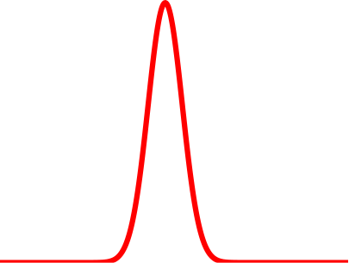


TA Measurement Model
Extended Kalman Filter (EKF)
  Assumes Gaussian noise
  TA: noisy uniform distribution
Approach
  Use midpoint of range for estimate
  Fit a Gaussian
  Reduced rate on updates
550 1100 1650 2300
1375
True Range (meters)
Notes:
In our case, we wanted to use the Timing Advance Measurement in an Extended Kalman Filter.
However, the EKF requires the uncertainty on the measurement to be Gaussian whereas the Timing Advance is loosely a uniform distribution across the region between consecutive Timing Advances along with some probability of an erroneous measurement.
Therefore our approach was to use the midpoint of the implicit range given by the timing advance measurement.
We also fit a Gaussian distribution to field data taken for timing advances and we reduced the update rate for these measurements in comparison to GPS, reducing from 1 Hz to 0.2 Hz.

Slide 13
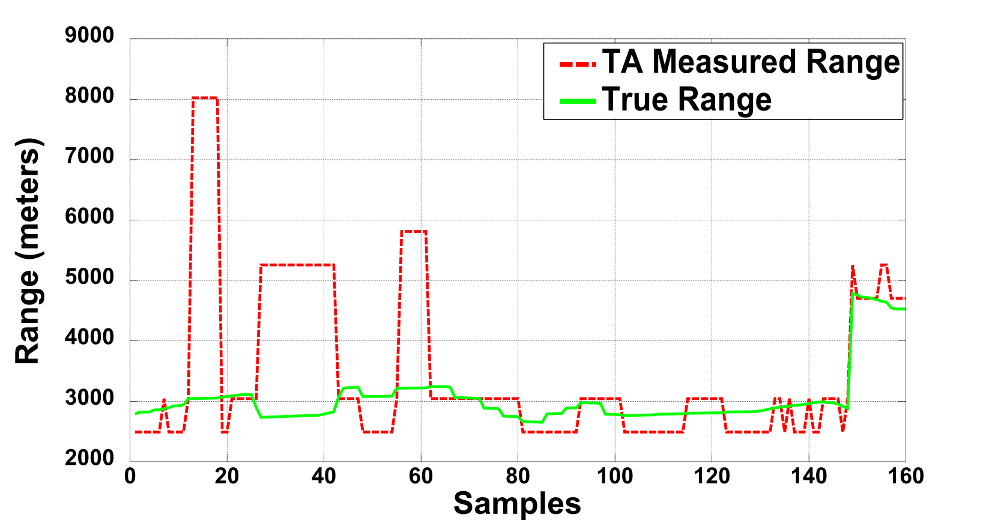
Erroneous TA Measurements
Notes:
Secondly we found that the Timing Advance measurement can easily be corrupted by various causes, including multipath, propagation delays by obstacles (specifically trees in our case), and by electrical noise.
This leads to large excursions in the reported ranges from the Timing Advance measurements as shown here.

Slide 14
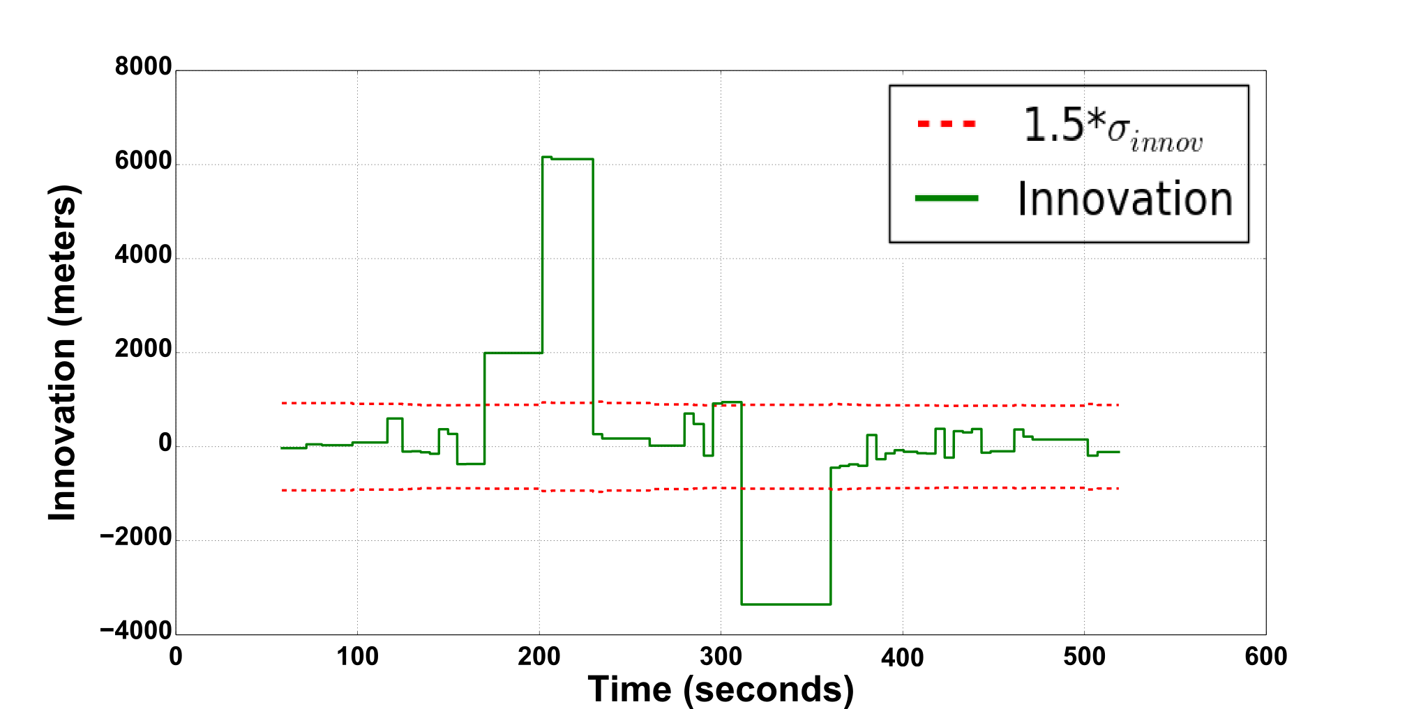
Innovation Check
Notes:
In order to handle this behavior we used a simple innovation check for each measurement.
Here the innovation is the amount of change that the EKF calculates for the current position estimate.
Because this process should be approximately Gaussian in our case, we can use a tolerance measure of 1.5 times the modeled standard deviation of the innovations process.
We decided to use 1.5 after empirically testing the performance of our filter with various gains.
Notice that using this approach can remove the timing advance measurement from the filter for an extended amount of time.
However, with the discrete nature of the Timing Advance we are expecting only rough corrections to the position solution and this period of time is not an issue for the position errors that we are concerned with.

Slide 15
Filter Implementation
AHRS
DR
Blended
Navigation Solution
GPS
Detect GPS Outage
AHRS
DR
Blended
Navigation Solution
Cell Phone
Notes:
Here I’ll demonstrate the simple procedure that we took in our filter design.
At first our SUAV will be running an AHRS/DR system augmented with GPS.
We would then turn off GPS simulating a GPS outage.
Our filter would detect that GPS had been out for a certain period of time and then it would switch over to using the Timing Advance measurements from our Cell Phone Modem inside our SUAV.

Slide 16
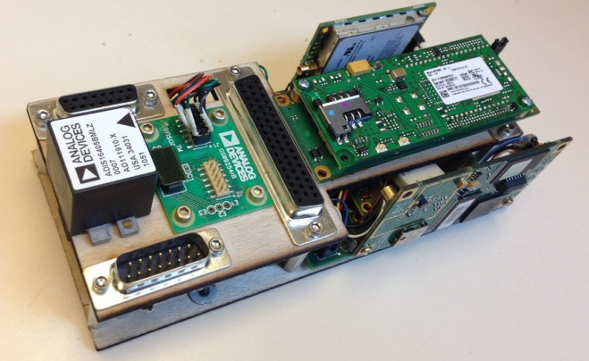
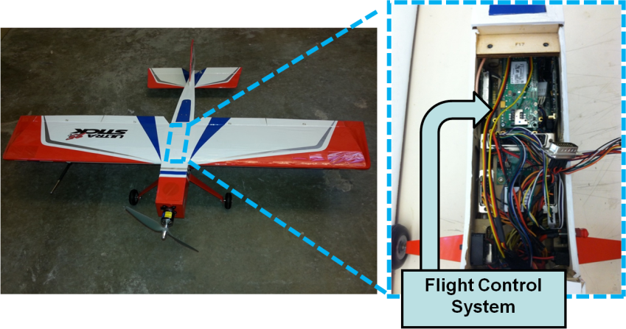
Hardware Implementation
Maintain low-cost COTS hardware of SUAVs
Leverage legacy sensors & flight computer
Integrate MultiTech Systems cell phone receiver
Datalink Radio
Cell Phone Modem
IMU
GPS
Microprocessor and Control System
Legacy Hardware
New Hardware
http://www.uav.aem.umn.edu
Notes:
With this filter design, we used Commericial Off-the-Shelf products that the University of Minnesota UAV lab uses in its ongoing UAV research.
Here we have the Goldy flight computer developed there with its traditional sensors for a SUAV.
To this flight computer we added a Cell Phone Modem along with its dedicated antenna to supply our system with the Timing Advance measurement.
This hardware was flown in an UltraStick 25e.
This UAV weighs about 5 lbs and has a 4 ft wingspan.

Slide 17
Part 4: Flight Tests
Notes:
Next we took the UltraStick and performed flight tests with this system.

Slide 18
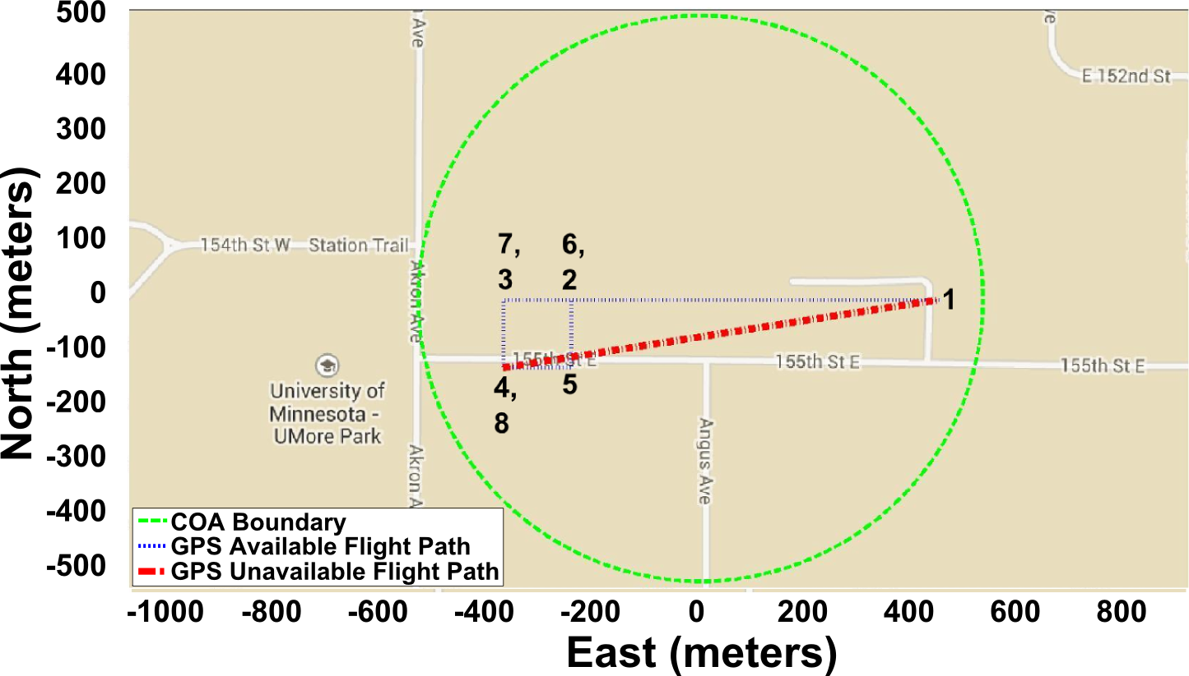
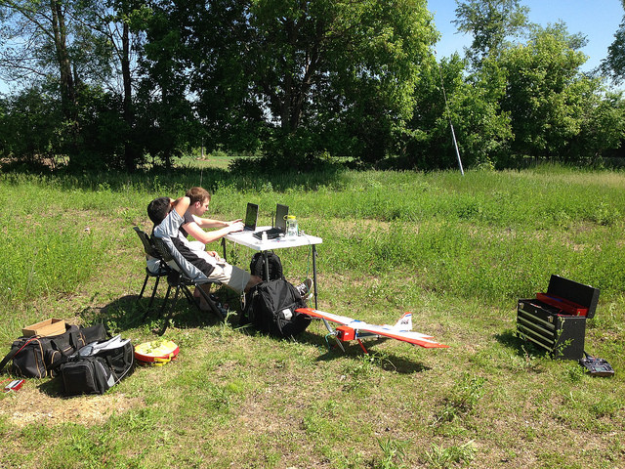

Flight Test Plan
Notes:
At the University of Minnesota we have a Certificate of Authorization from the FAA that allows us to perform flights test in a “small” area on University owned property.
Shown here by this green line.
The flight test path presented here demonstrates the scenario where a SUAV departs from a home base, waypoint 1, flys to an area and conducts its mission.
Here the flight path is a rectangle described by waypoints 2-8.
At this point GPS is cut off from the SUAV and it is programmed to return back to waypoint 1.

Slide 19
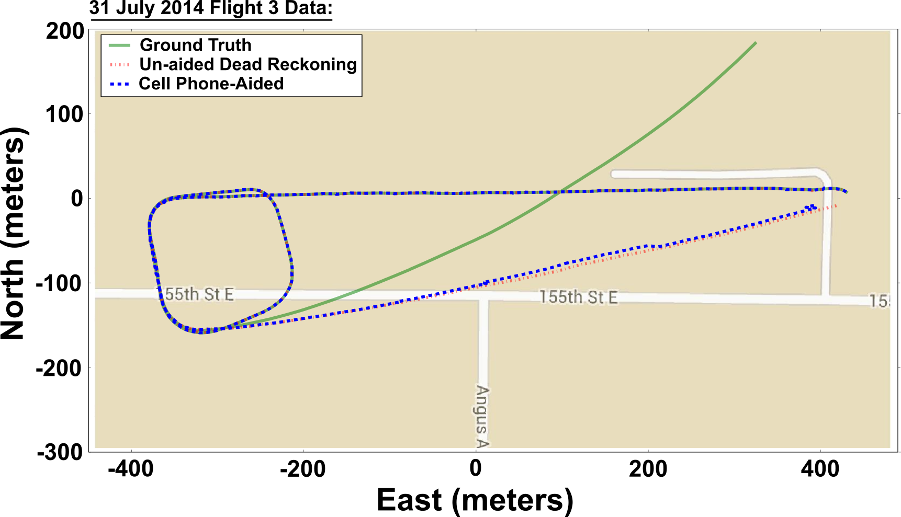
Flight Test Results
Notes:
Here is one of the flight tests that were performed with this setup.
The green line represents the ground truth obtained by an separate onboard INS/GPS filter.
The red line represents the AHRS/DR navigation solution without Cell Phone assistance from waypoint 8 to waypoint 1 while the blue is that same system with Cell Phone assistance.
Here we see that once GPS goes away the AHRS/DR system performs marginally better with the Cell Phone Timing Advance measurement as shown by the small position corrections from the unaided position estimate in red to the actual position in green.
The takeaway from these flight tests is the fact that our cell phone assistance does not show any real advantage for such a short flight (approximately 800 meters).
The length of this flight is very short since we are only allowed to fly within our COA.
Therefore an alternative to actual flight tests was needed to show that our system can bound the position errors inherent in a AHRS/DR or INS system.

Slide 20
Part 5: Hardware-in-the-Loop (HIL) Monte Carlo Simulations
Notes:
Hence, we appeal to doing Hardware in the Loop simulations.

Slide 21
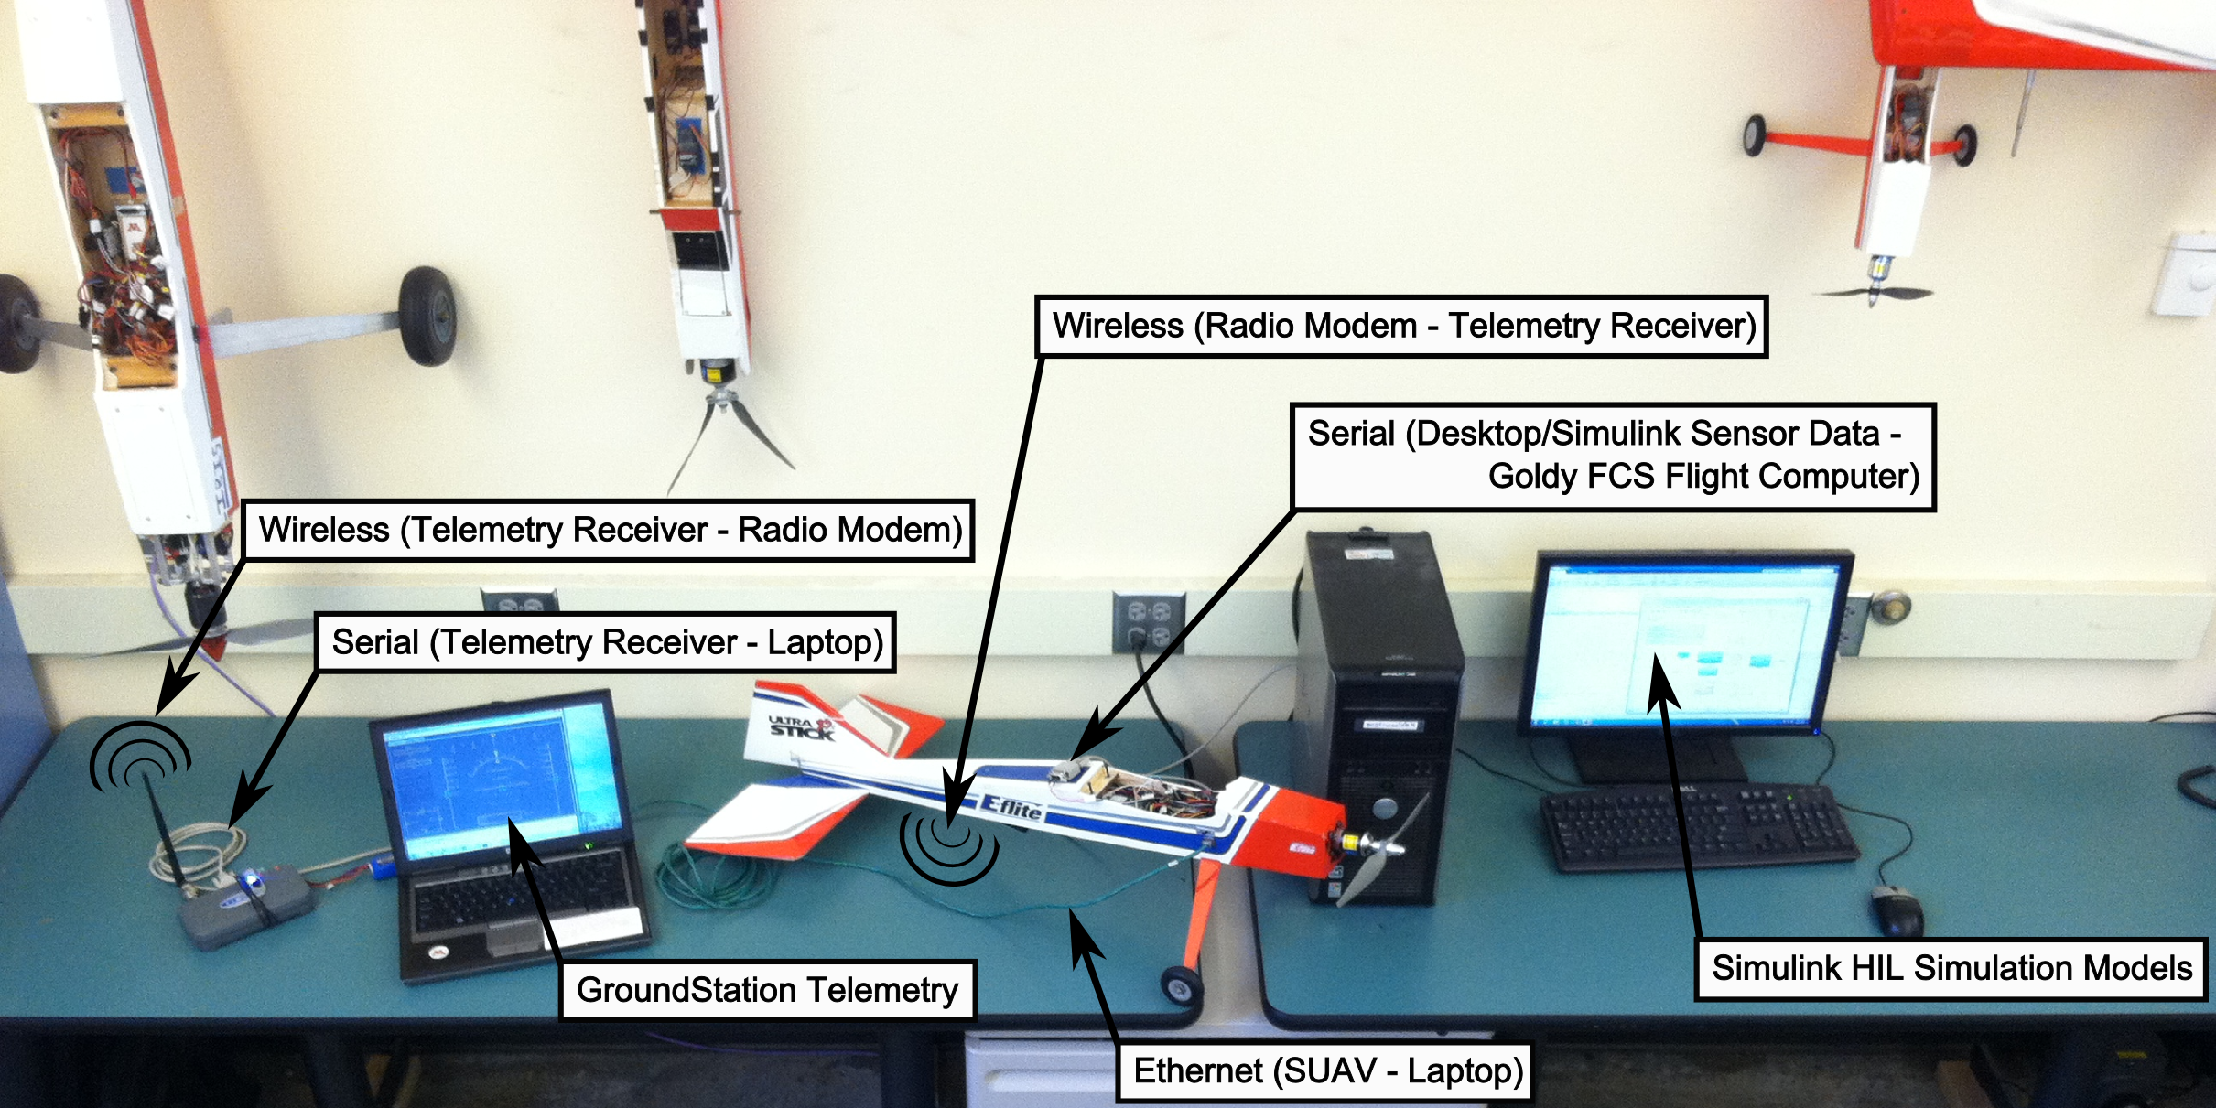
Hardware-In-the-Loop (HIL)
Lab Setting
Notes:
Now hardware in the loop simulations are done with the some of the same equipment as in the field. We have our ground station and our flight computer.
However, instead of sending signals to real actuators and receiving real data from our environment we simulate this using a computer.

Slide 22
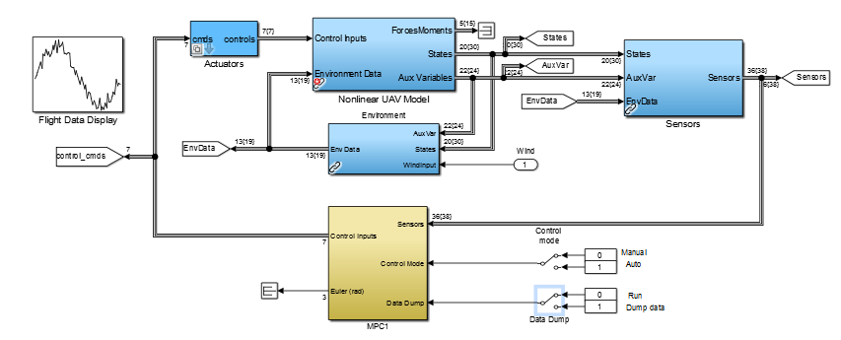
Hardware-In-the-Loop (HIL)
Simulink Model
High Fidelity Model
I\O to Flight Computer
Notes:
This is the Simulink model that is used by the computer to simulate flight conditions for our SUAV flight computer.
The blue boxes contain our high fidelity model that includes actuators, sensors, and environmental conditions.
It also features a nonlinear model for the UltraStick that was developed using flight and wind tunnel data.
Here you can see the subsystem where the flight computer ties into this simulation.

Slide 23
Hardware-In-the-Loop (HIL) Setup
Initialization with GPS
  Allows AHRS/DR to obtain decent estimates
Extended GPS outage
  30 minute outage
  14 miles flight distance
Verification & Validation of HIL
  TA ranging errors
    Real data probability modeling
  Steady winds of 4 m/s, Turbulence of 0.5 m/s
    Dryden Wind Model
Notes:
For our Hardware-In-the-Loop simulation we wanted to demonstrate an extended GPS outage over a flight trajectory of about 14 miles.
In order to use the validate the results from the HIL we needed to design a good model for the Timing Advance measurements.
This was done by looking at real data and modeling a probability distribution from the data.
Secondly, we knew that one of the driving factors for the performance of the AHRS/DR system was the ability to simulate winds during flight.
The details are in the paper, but essentially we used the Dryden Wind Model from the Aerospace Blockset.

Slide 24
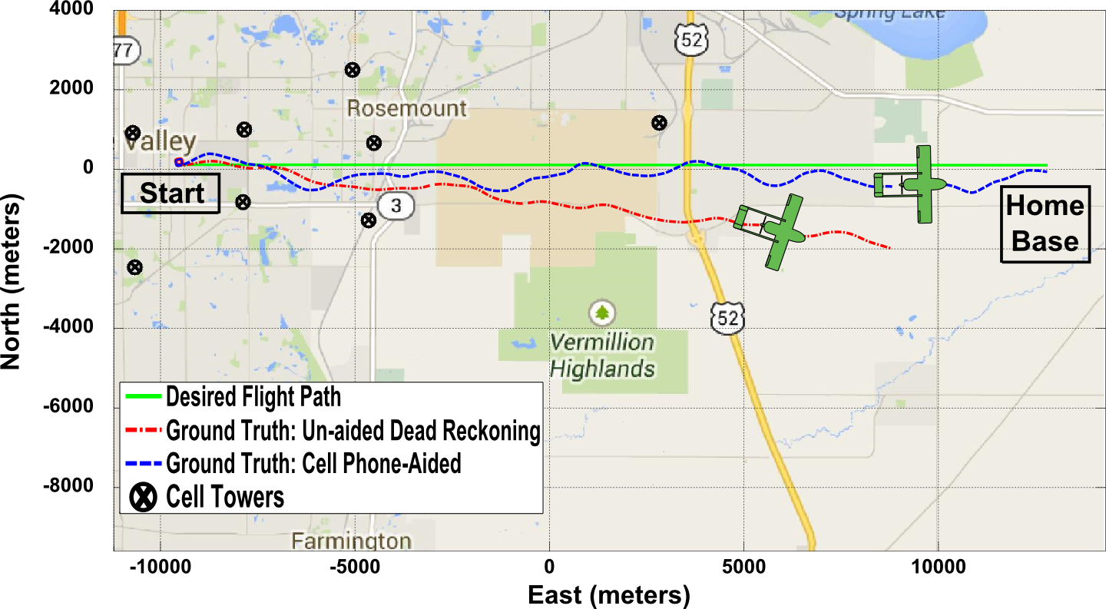
HIL Flight Trajectories
Notes:
Here is one instance of the Hardware-In-the-Loop simulations.
The green line is the desired flight path from our starting point to our desired destination.
The black points show the real cell tower locations.
These were kept the same for the simulation because we believed that this displayed some different geographical distributions that might be seen in real life
The red line shows the trajectory of the Un-aided AHRS/DR system whose position error grows over time whereas the cell phone aided trajectory, indicated by the blue line, meanders around the desired flight path.

Slide 25
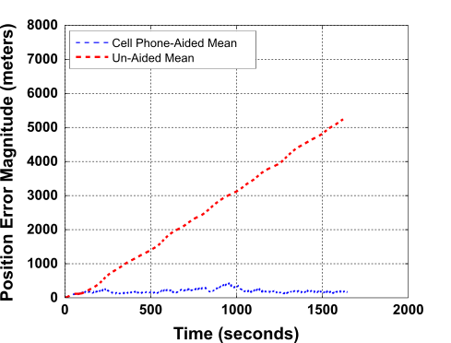
Monte Carlo Results
Notes:
This shows the average magnitude of the position errors over the flight time for 25 Hardware-In-the-Loop simulations.
Here the red line shows the perpetual error growth inherent in the AHRS/DR system.
By the end of the flight, the position error has grown to an average of 5000 meters.
While the blue line shows that the position errors for the cell phone are bounded to about 200 meters, which does not change over time.
This demonstrates the improvement that the cell phone provides.
It DOES NOT replace a traditional navigation system used for SUAV operations.
However, it can be used for a recovery navigation system.

Slide 26
Summary
Developed a Recovery Navigation System
  Operated in real-time
  Utilizes COTS technology
Errors of approximately 200 meters
  Discretized TA measurements
Survey required for cell tower locations
Validated performance
  Flight tests (limited airspace)
  HIL Monte Carlo simulations
Notes:
In summary, we developed a navigation system that can be used by SUAVs for rough navigation and the safe recovery of the SUAV.
It is unobtrusive to the current navigation architectures by using Off-The-Shelf sensors and easy integration into an existing system.
The system exhibits position errors of about 200 meters which results from discretized Timing Advance measurements.
This is a large positional error, but it should be good enough for rough navigation required to safely recover an SUAV should it lose GPS.
Please note that to use this system there was a need to survey the cell tower locations and to store them on the flight computer.
Also, this system was only verified via Monte Carlo simulations due to limited airspace.

Slide 27



Acknowledgements
United States Department of Homeland Security
MultiTech Systems
Polaris Wireless
A
  Dr. David De Lorenzo
The contents of this presentation reflect the views of the authors, who are responsible for the facts and the accuracy of the information presented herein. The authors acknowledge the United States Department of Homeland Security for supporting the work reported here through the National Center for Border Security and Immigration under grant number 2008-ST-061-BS0002. However, any opinions, findings, conclusions or recommendations in this paper are those of the authors and do not necessarily reflect views of the United States Department of Homeland Security.
Notes:
First off, I would like to thank the DHS for their financial support of this research.
Secondly, I would like to thank MultiTech Systems for their Cell Phone Modem and technical support.
Lastly, I would like to thank the people at Polaris Wireless, particularly David De Lorenzo, for their useful advice.

Slide 28
Questions
Notes:
Are there any questions?

Slide 29
Backups

Slide 30
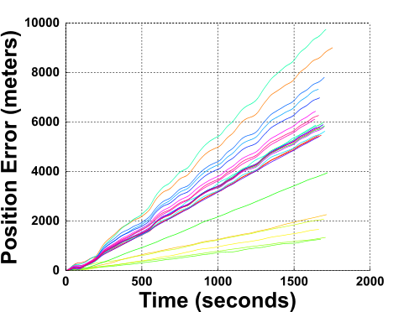
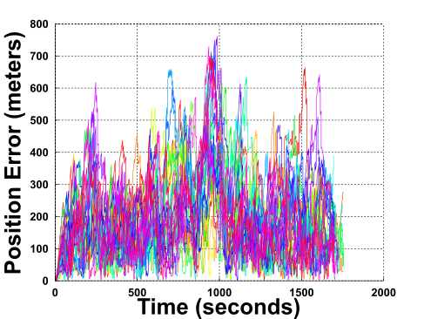
Hardware-in-the-Loop Simulations

Slide 31
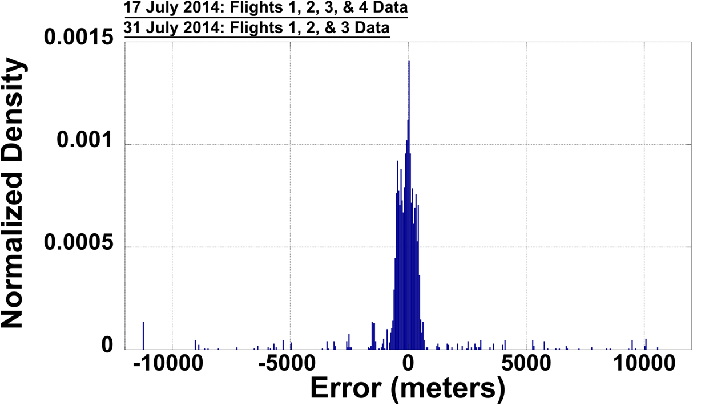
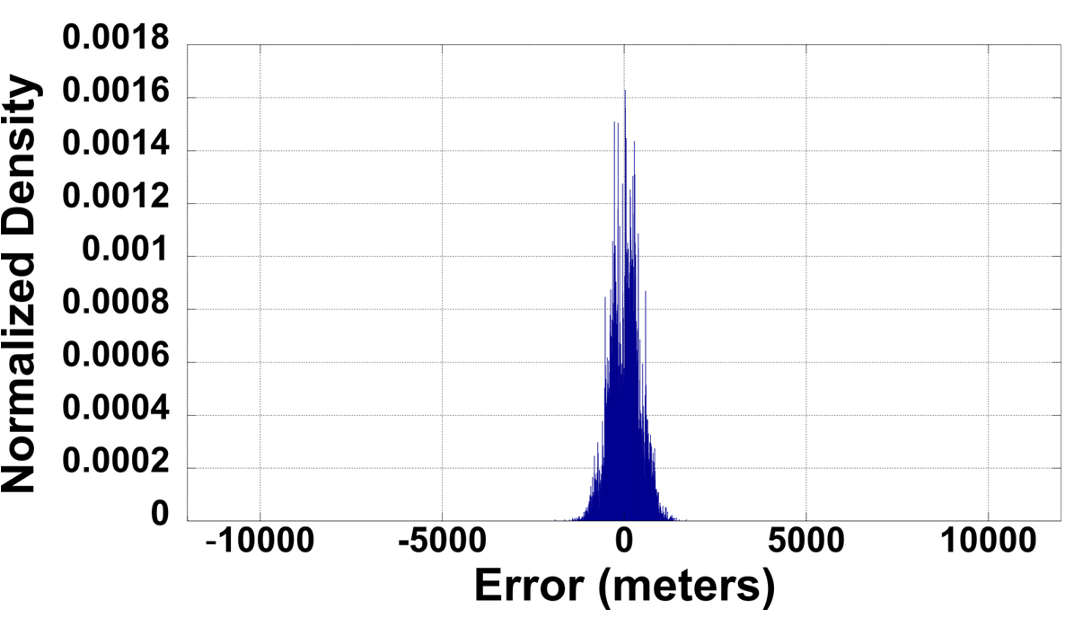
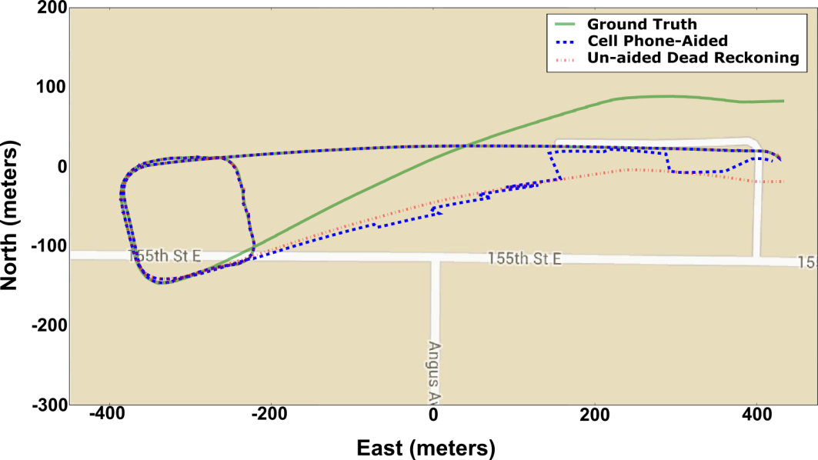
Hardware-in-the-Loop Simulations
Flight Data
HIL Simulation

