Slide 1
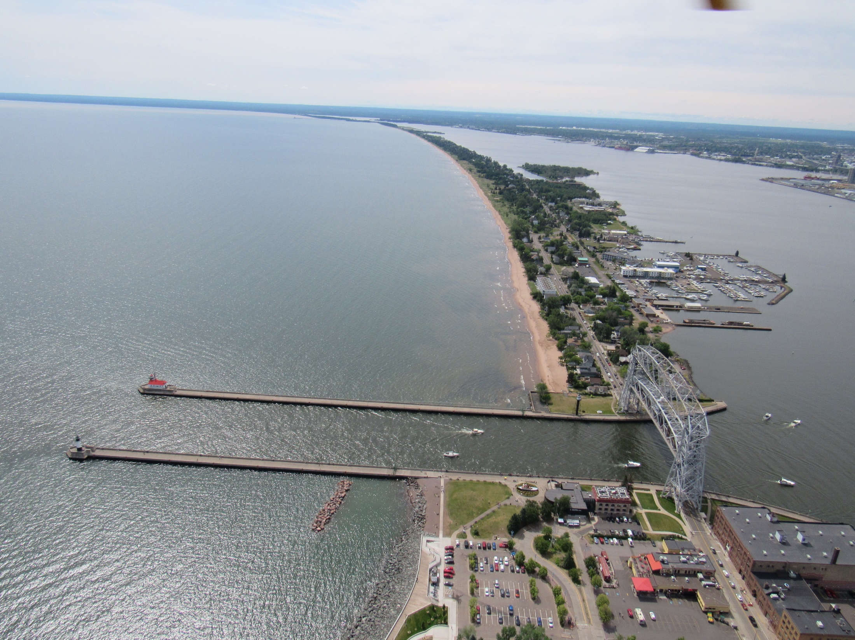
Sediment transport, shipping, and the seemingly intractable situation on Minnesota Point
Sand & gravel SINK
John Swenson
UMD Dept. Earth & Env. Sciences
Net depositional landform on interglacial (10+ ky) timescales
Photo: USACE (2021)

Slide 2
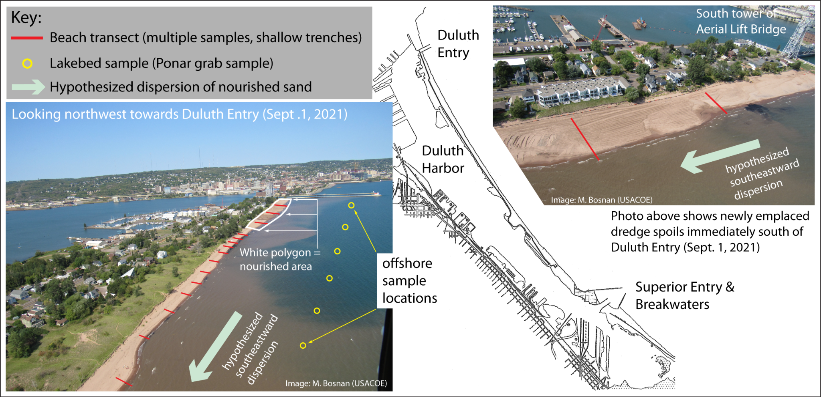
Acknowledgments:
Perennial Collaborators:
Andy Breckenridge (UW Superior)
Harry Jol (UW Eau Claire)
Karen Gran (UMD DEES)
Nigel Wattrus (UMD DEES / LLO)
Students:
Madison Rian
Sarah Nesheim
Crystal Lambert

Slide 3
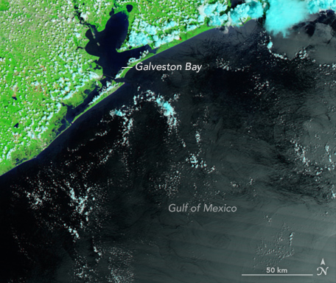
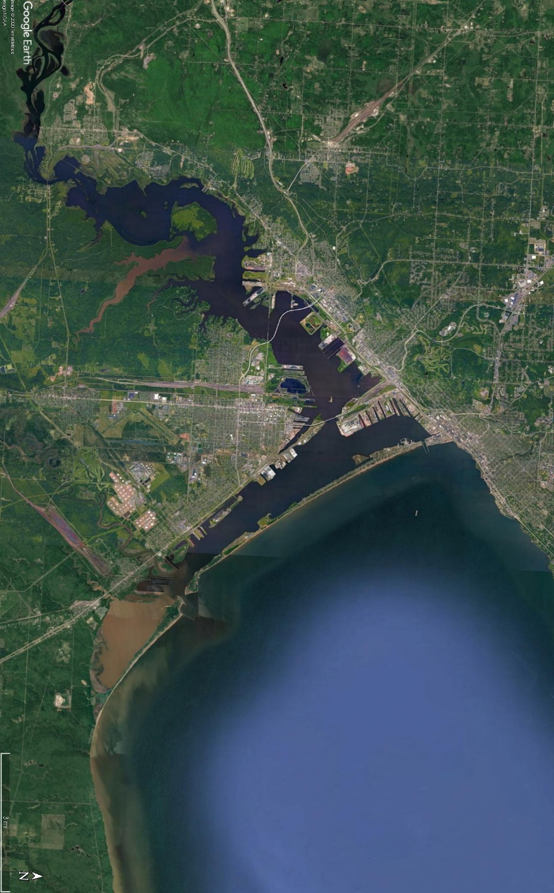
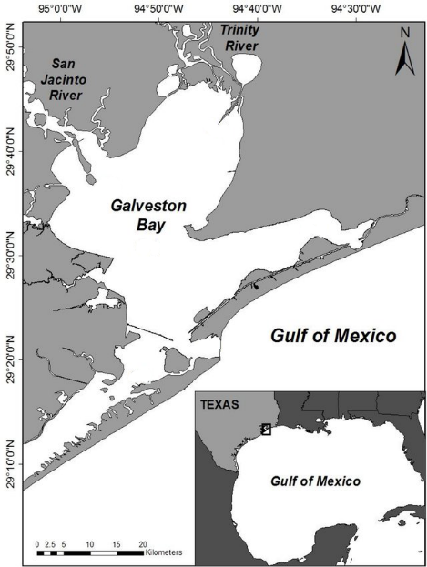
Terminology: What is Minnesota Point?
Sand bar?
Spit?
Baymouth bar?
Does it matter?
Key point 1: Barrier formation linked to sea-level RISE (simple reason = must drown river to form estuary)
Key point 2: We need a supply of sand
Barrier (complex, island) separating estuary (drowned river) from open ‘sea’

Slide 4
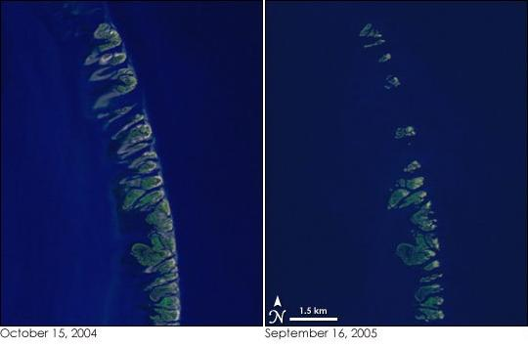
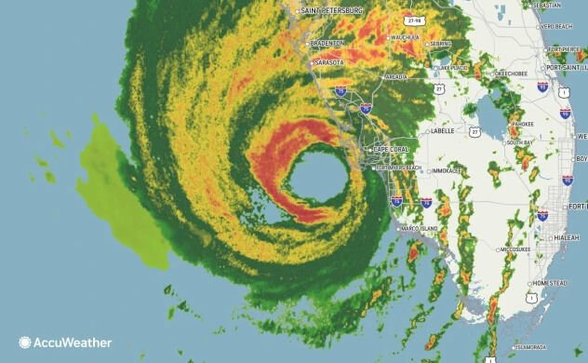

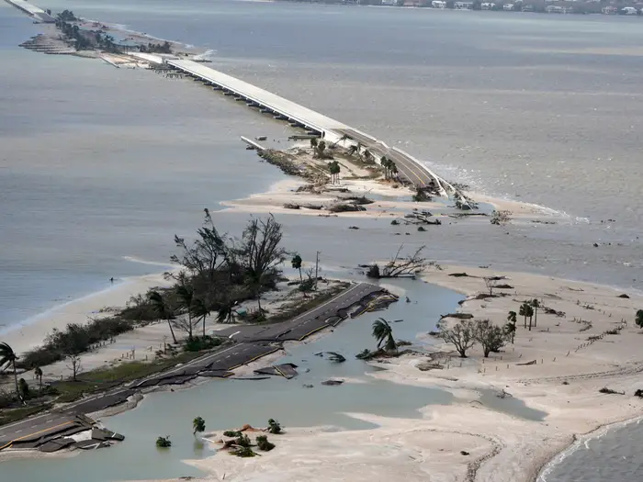
For their size, barrier islands are the most dynamic / ephemeral landforms on Earth (very delicate creatures…)
Chandeleur Islands (Mississippi delta)
Hurricane Ian (Cat 4/5); September 28, 2022
Katrina
NASA Earth Observatory
Breach of North Captiva Island

Slide 5
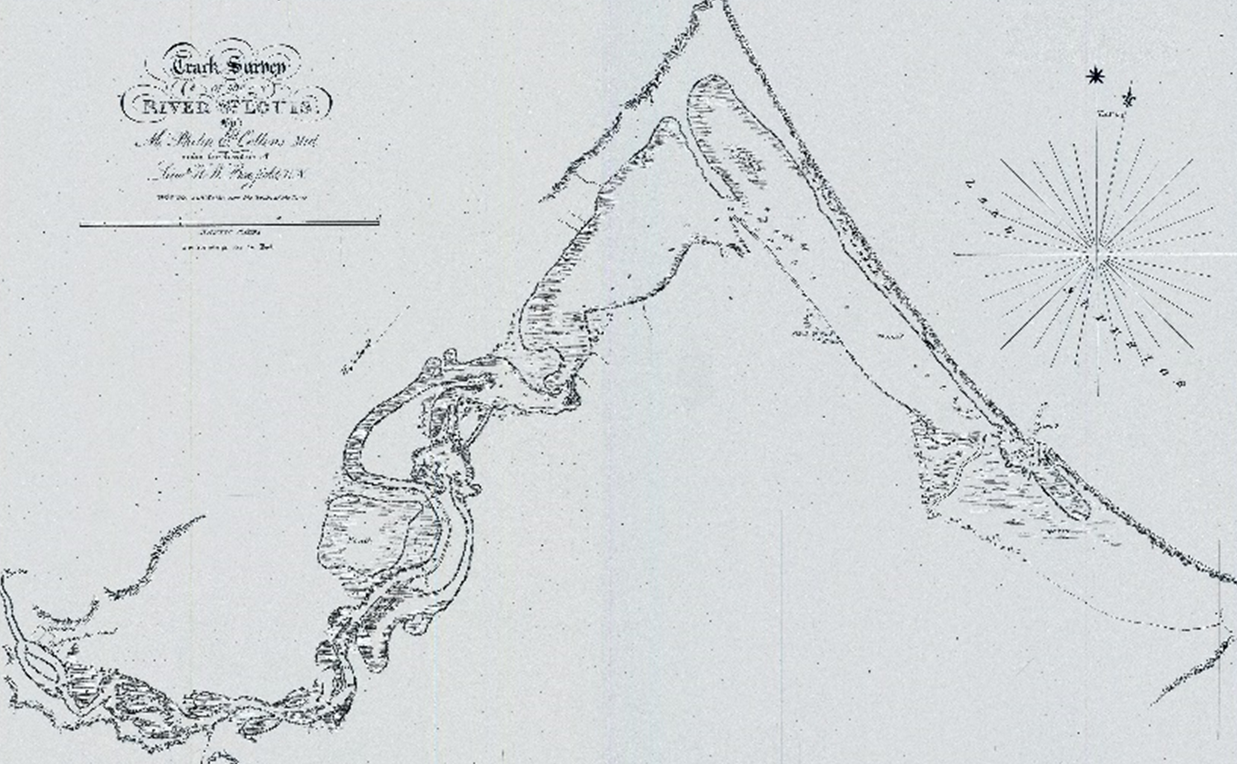
Goals / objectives:
Discuss / critique Section 111 studies (historical and current)
Provide overview of modern interplay of sediment supply and lake-level rise and causes of erosion / deposition
Minimal discussion of MN / WI Point genesis
Propose a long-term solution to the intractable situation
Map: Collins & Bayfield (1825)

Slide 6
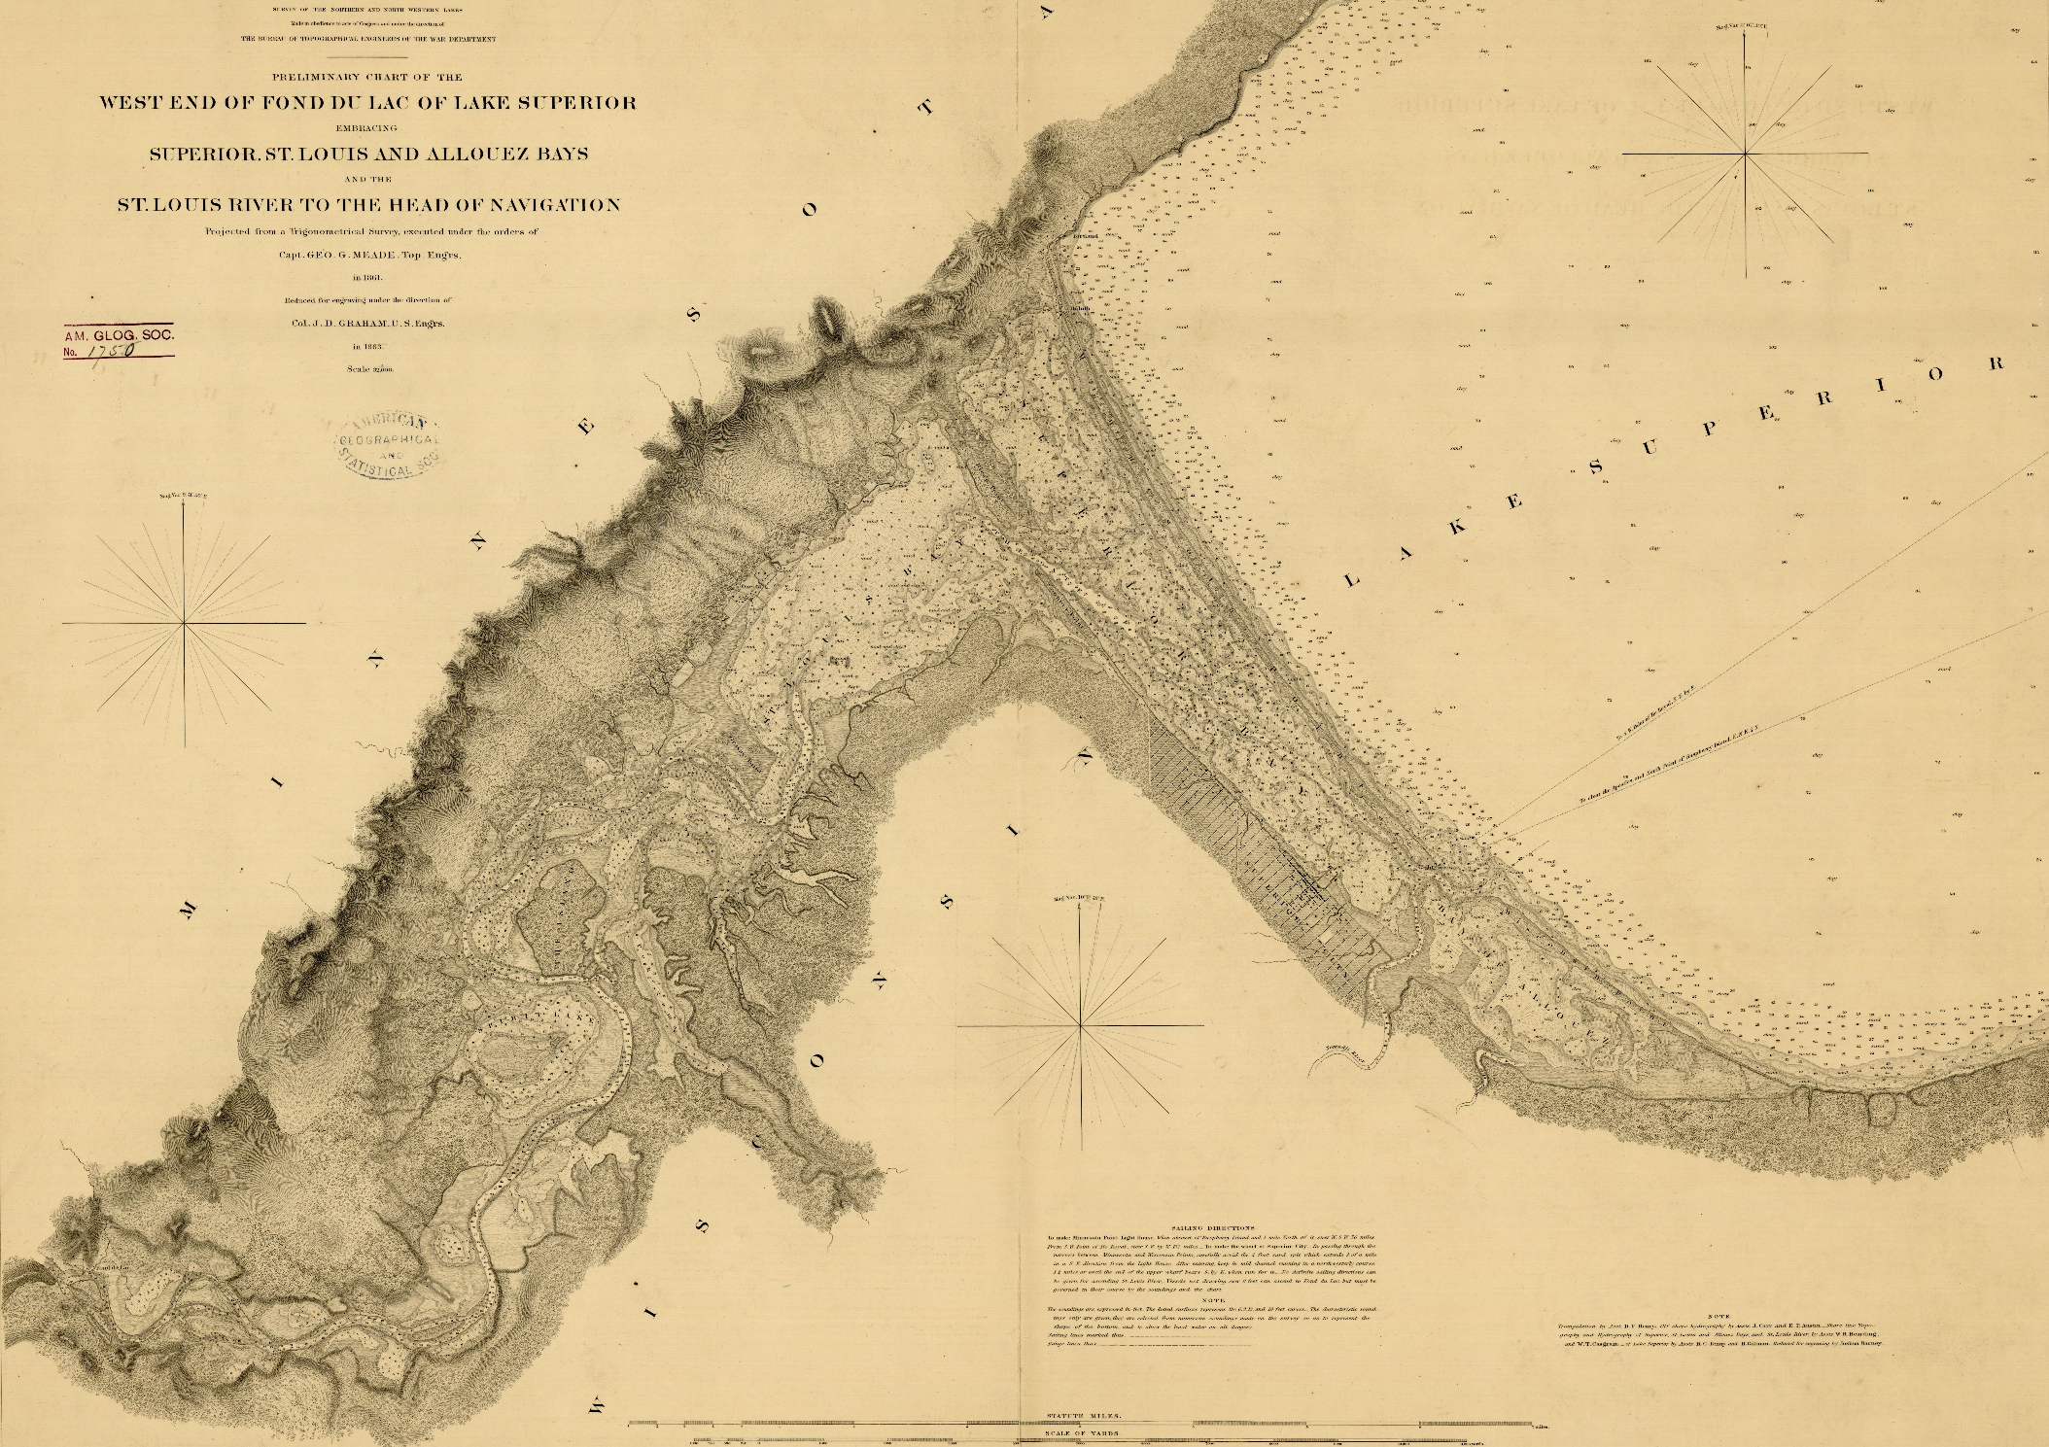
A (very) brief history of MN/WI Points
1861 Meade map

Slide 7
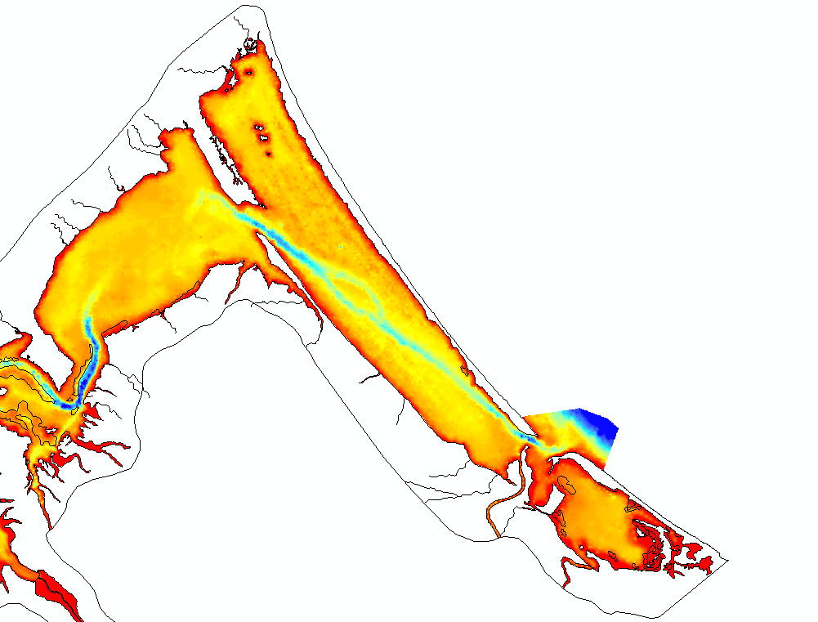
A (very) brief history of MN/WI Points: 1861 Bathymetry
Digitization of 1861 Meade map by Andy Breckenridge and students
Older beach ridges (drowning strandplain)
Trace of St. Louis River in (sand) strandplain beneath estuary
Natural inlet in 1861
Nemadji River and its sad, drowning delta

Slide 8
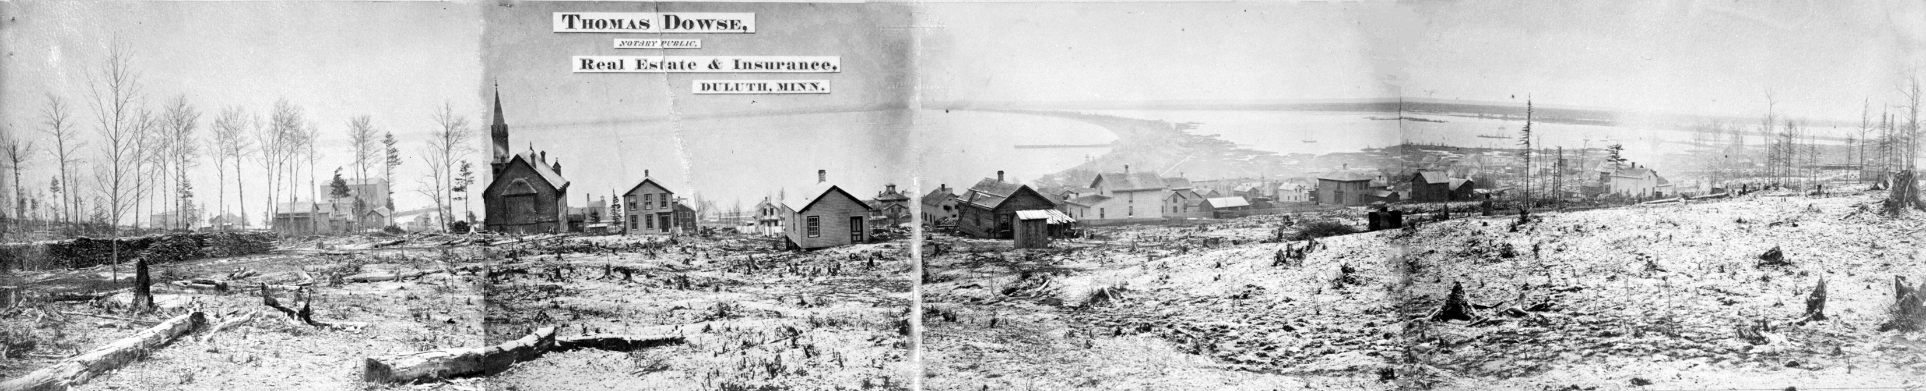
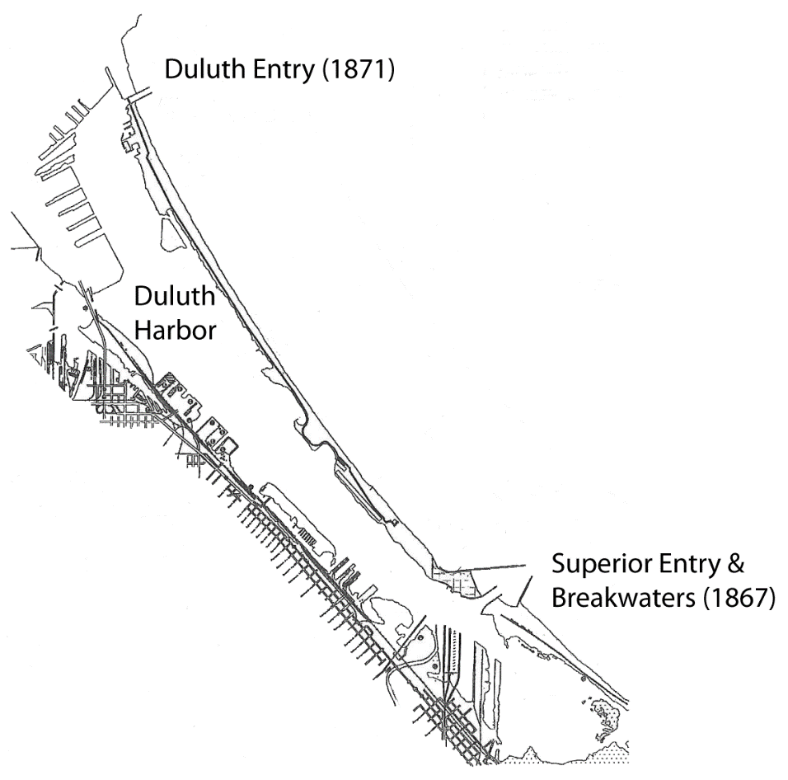
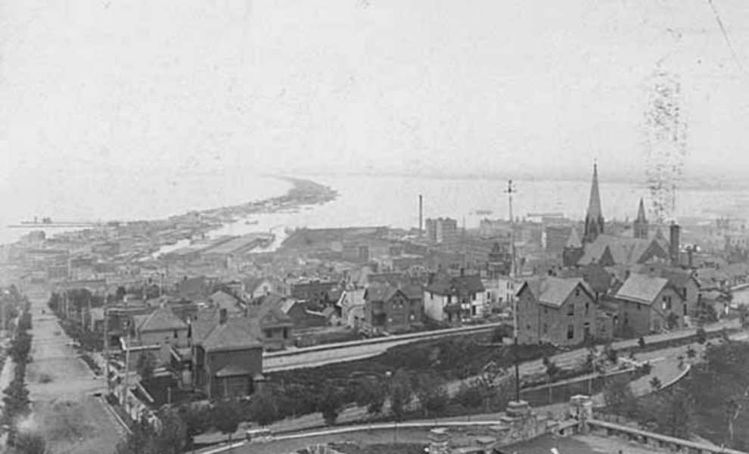
1867: Superior Entry jetties + later expansion to include breakwaters
1871: Duluth Entry jetties
Worst possible arrangement of jetties…
Photos: US Library of Congress
Drawing: USACE (2001)

Slide 9

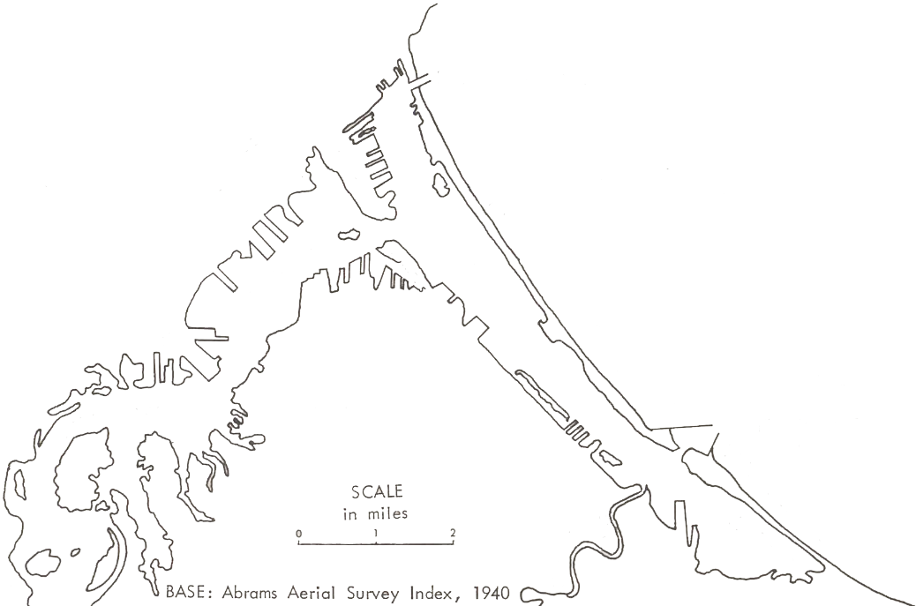
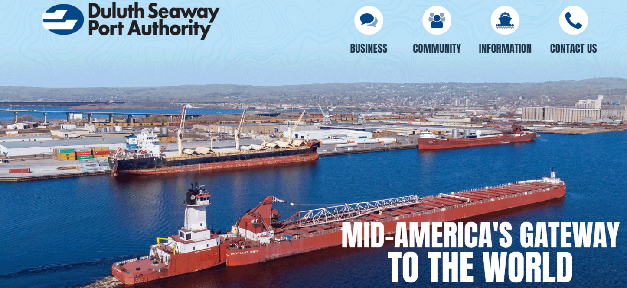
Intractable situation: 1st ingredient: Shipping
Jetties provided access to the estuary (harbor)
Economic importance of harbor cannot be overstated

Slide 10
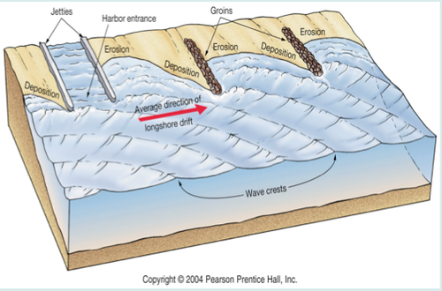
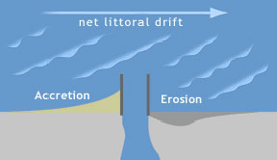
Intractable situation: 2nd ingredient: Sediment transport
Open any introductory Earth science textbook and you will find some variation on these:
‘Littoral drift’ = ‘longshore transport’
= F^{nc} (wave direction; wave height) during large wind events (storms)
“Updrift” deposition ~ “downdrift” erosion

Slide 11
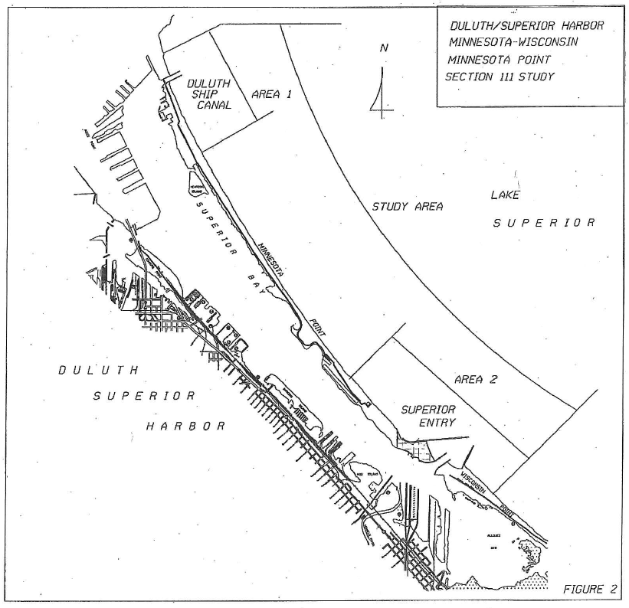
The intractable situation
Moderate deposition
Moderate erosion
Construction of federal structures coincided with observations of focused erosion / deposition proximal to structures
Patterns have persisted for entire history of structures
Public awareness peaks during periods of high lake level
Intense erosion (~ 1 m/yr)
Intense deposition (~ 1 m/yr)
Drawing: USACE (2001)

Slide 12
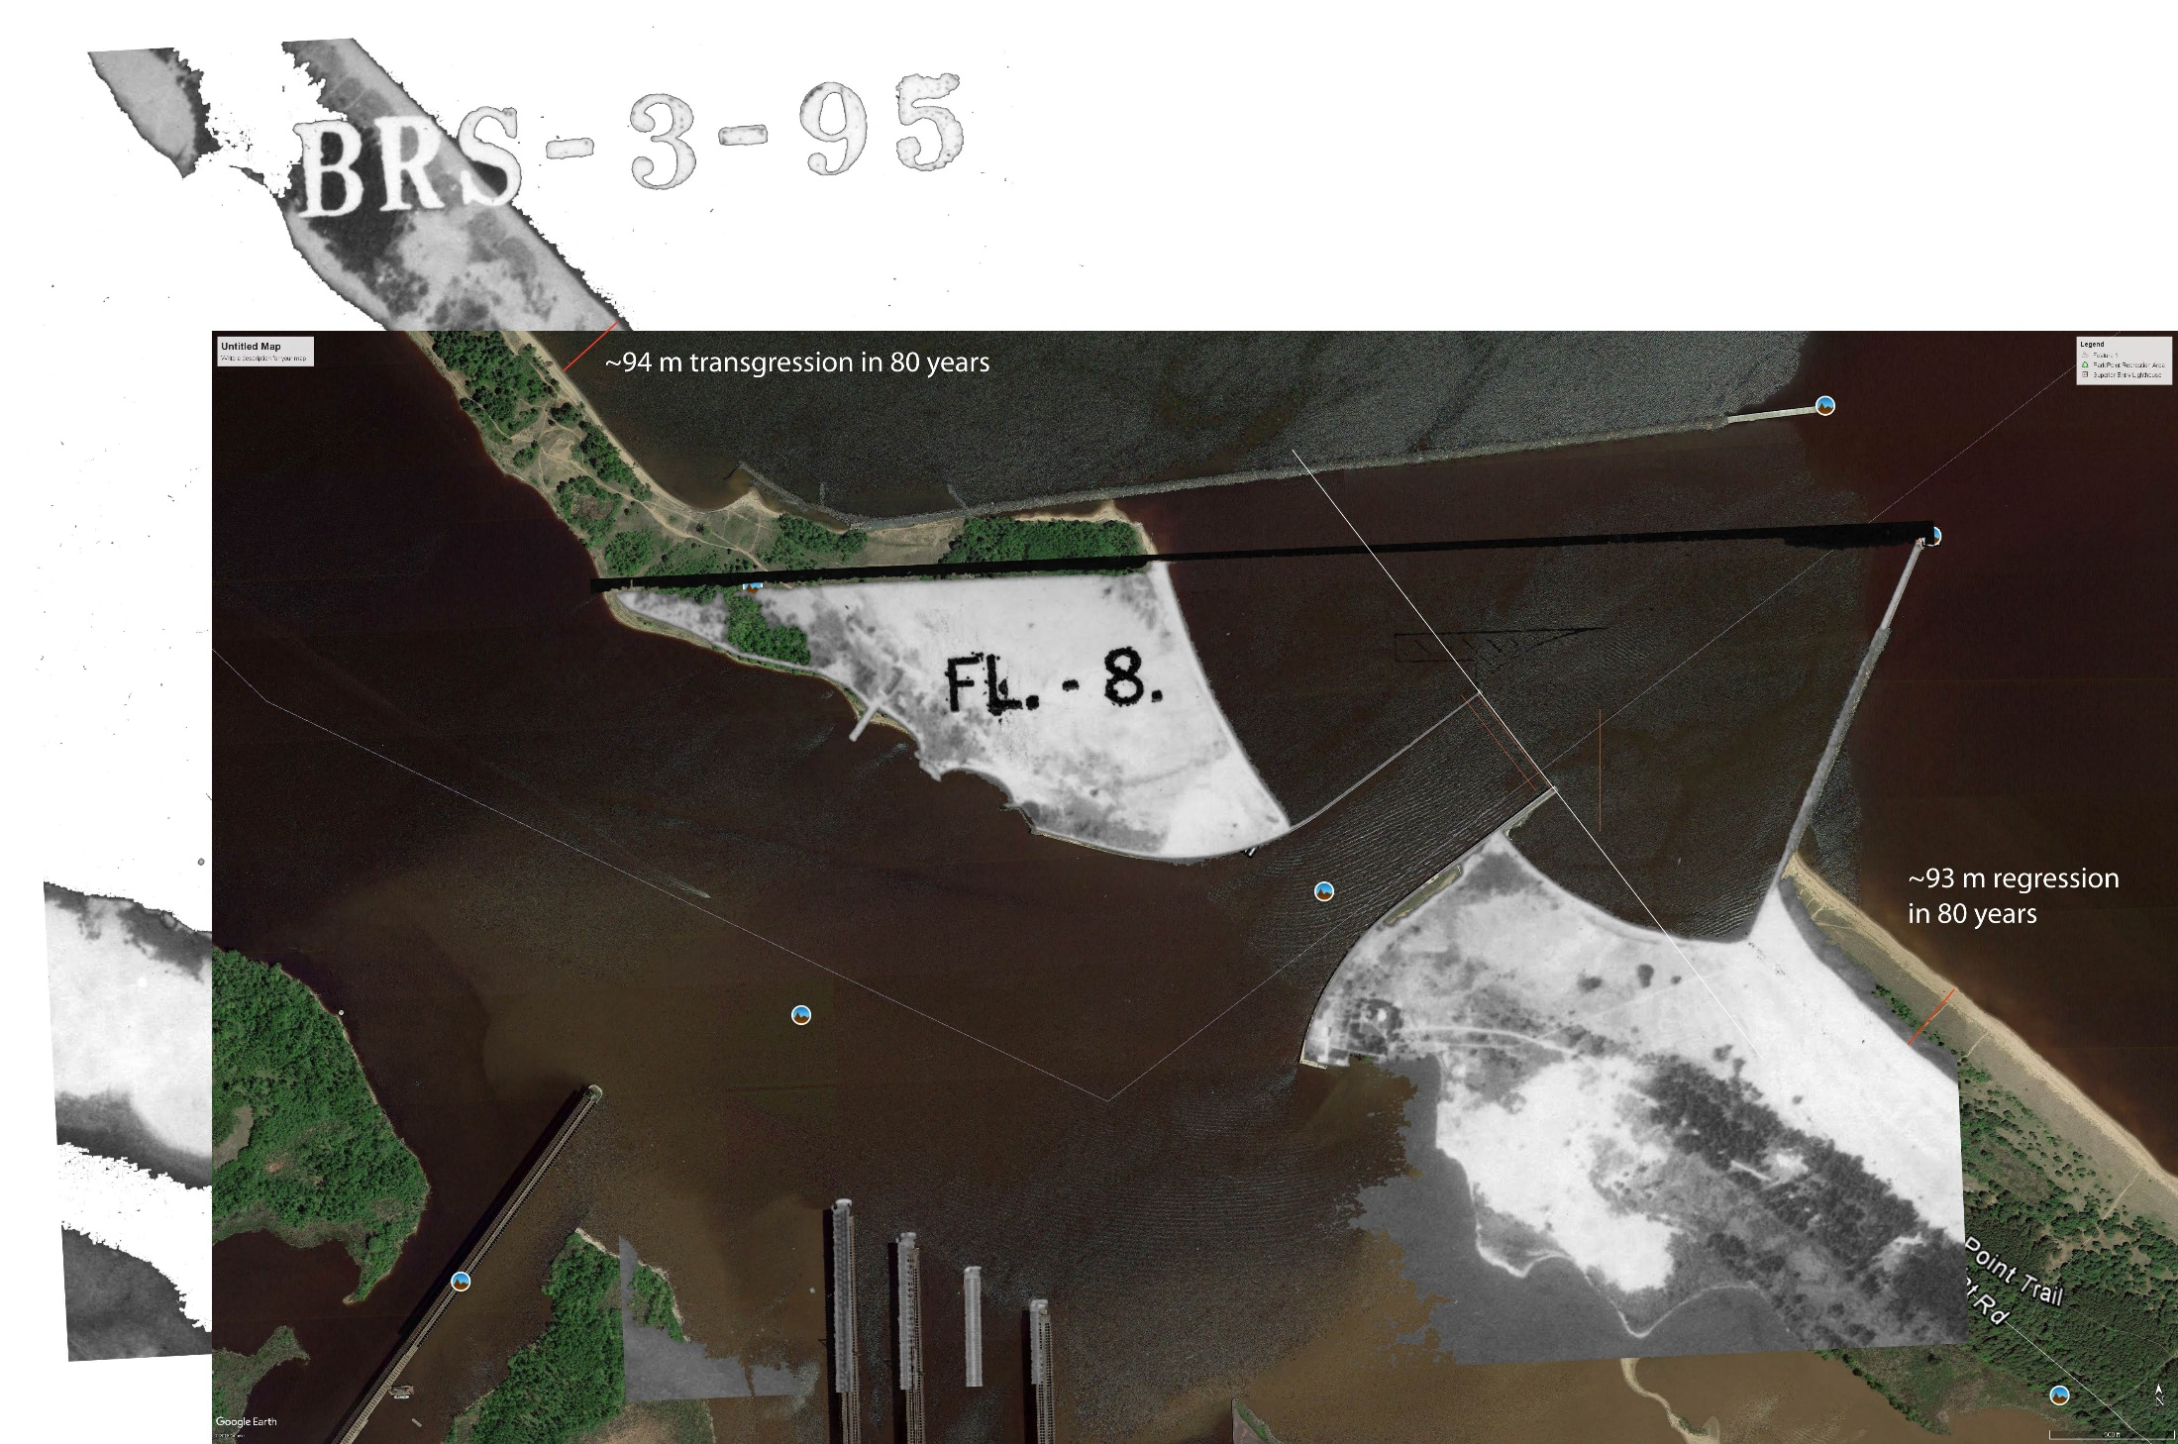
Superior entry (jetties, breakwaters) forms nearly perfect ‘dam’ in the ‘river of sand’ from south shore
~ 90 m erosion in 80 years
~ 90 m growth in 80 years
Overlay of 2017 (color) satellite image and 1938 aerial photo.

Slide 13
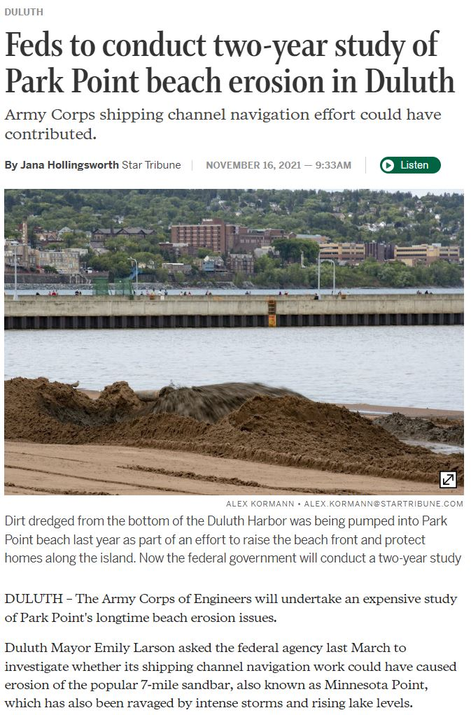

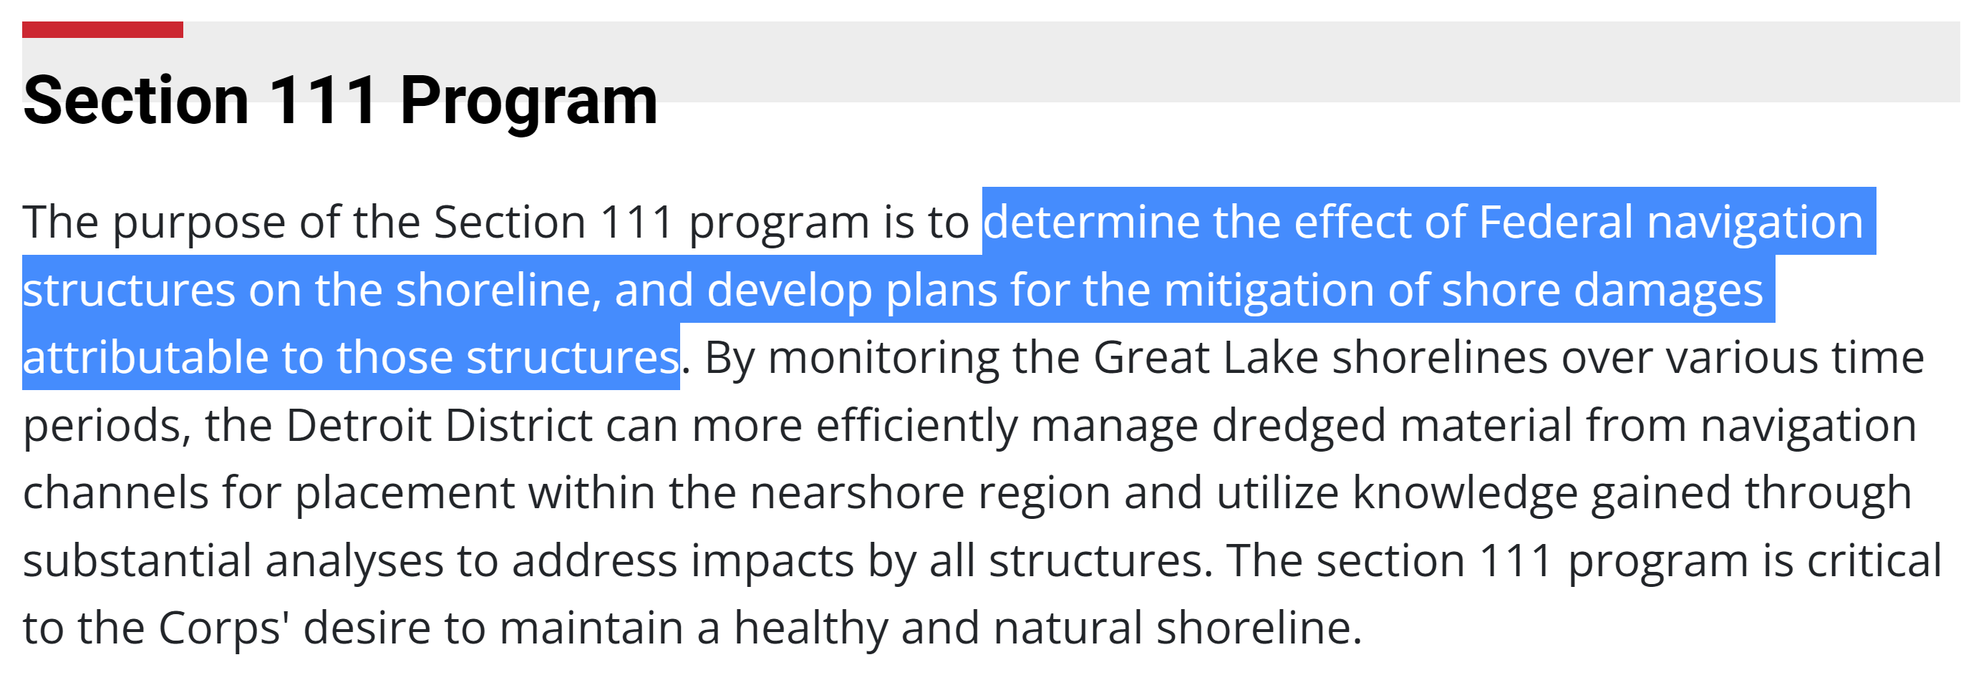
Determining culpability
USACE conducts the Sec 111 study and—based on its conclusions—determines their culpability, if any.
2024 marks the golden anniversary of the first Sec 111 study, published in 1974.
Second study in 1998 – 2001.
Will the third time be the charm?
March 2021

Slide 14
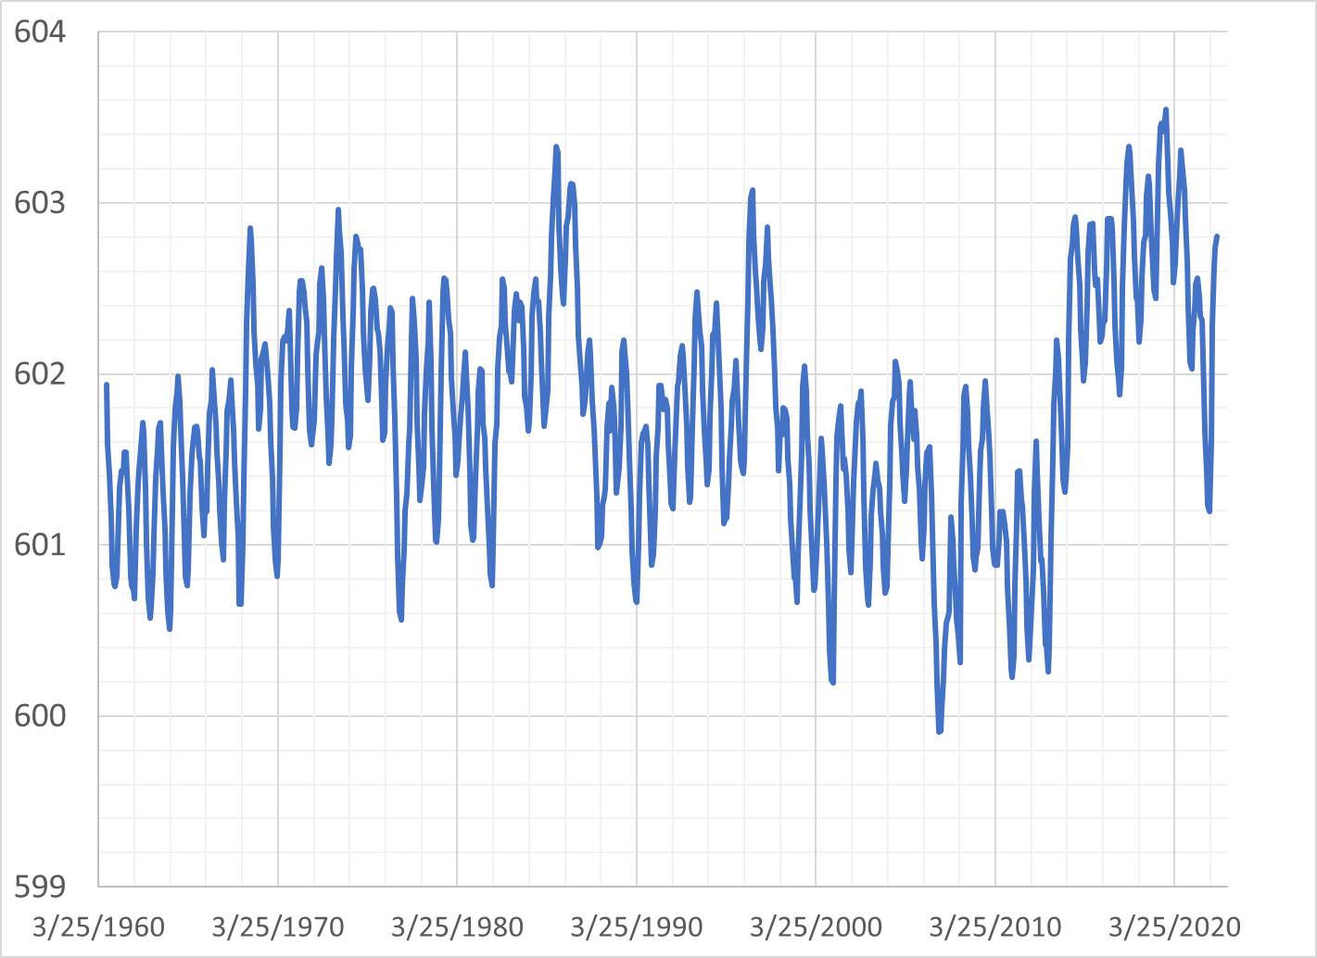
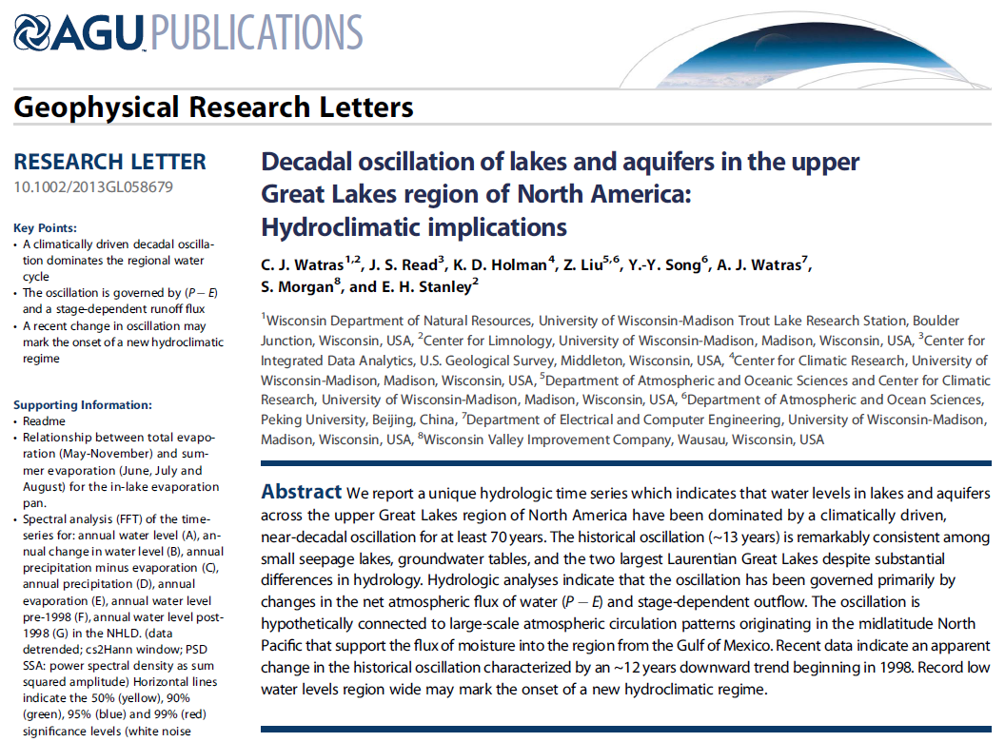

Lake level
60-year hydrograph at DLH
603
602
601
600
1974 Sec 111
2001 Sec 111
2022 Sec 111
1960
1970
1980
1990
2000
2010
2020
These climate-driven fluctuations are superimposed on a long-term (millennial scale) lake-level rise driven by lithospheric dynamics, i.e. differential post-glacial rebound, and shifting drainage outlets.
More on this later…
Short-term fluctuations (rises)—driven by changes in basin hydrology—get our attention, particularly on ‘soft’ coasts like MN / WI Points.
No coincidence that previous (and current) Section 111 studies follow lake-level highstands.

Slide 15

In the meantime, …
Beach nourishment…
…with dredge spoils from harbor
Spoils = Fine sand, silt, organics, and other things (!)
Native coastal sources = coarse sand & gravel

Slide 16
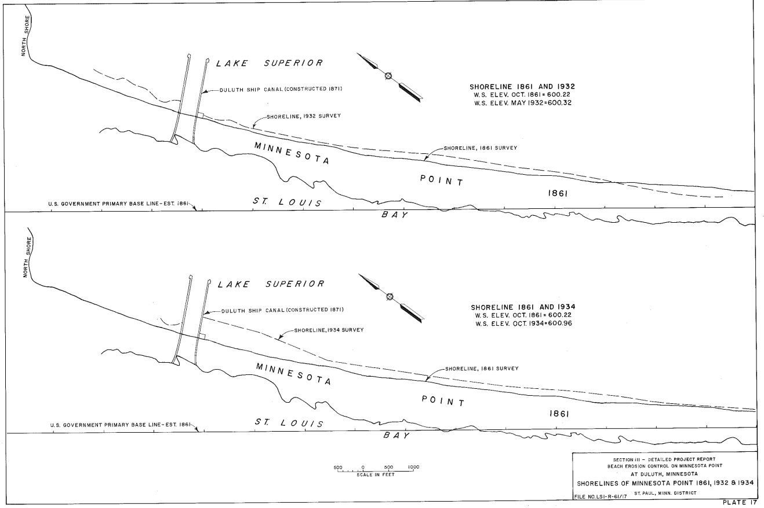
Erosion mitigation via periodic beach nourishment
1934 nourishment
USACE (1974; Sec 111)

Slide 17
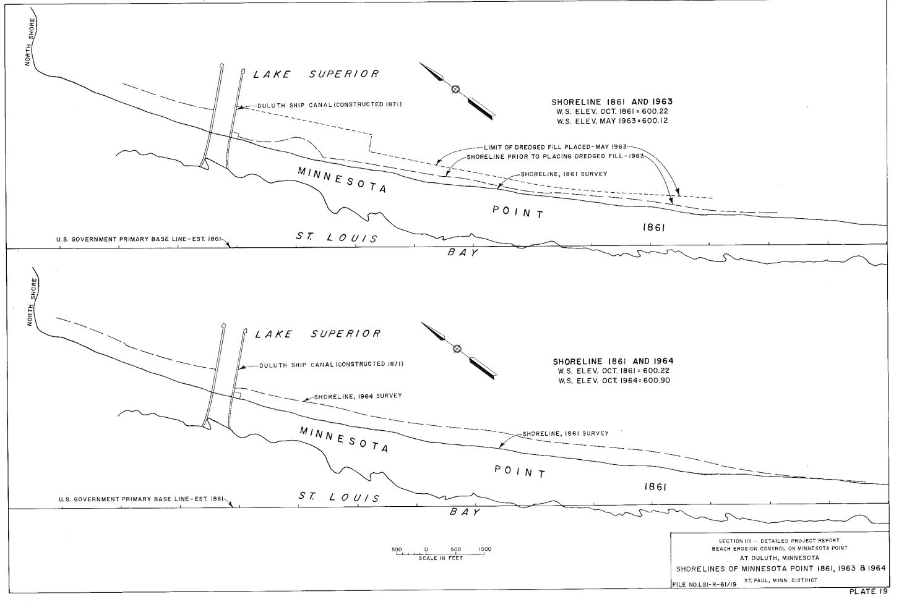
Erosion mitigation via periodic beach nourishment
1963 nourishment
USACE (1974; Sec 111)

Slide 18
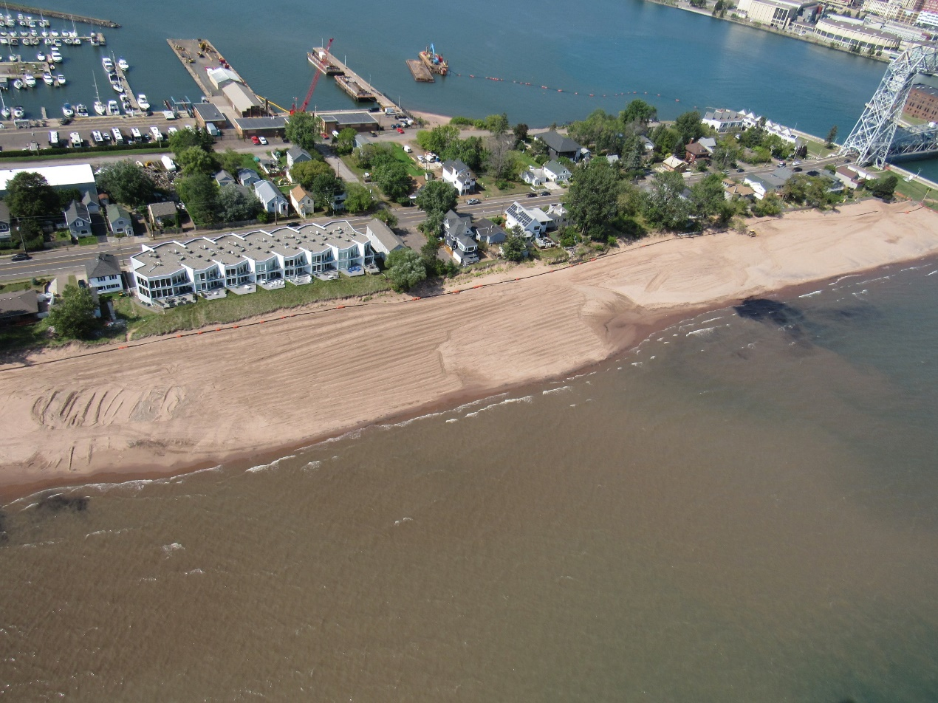
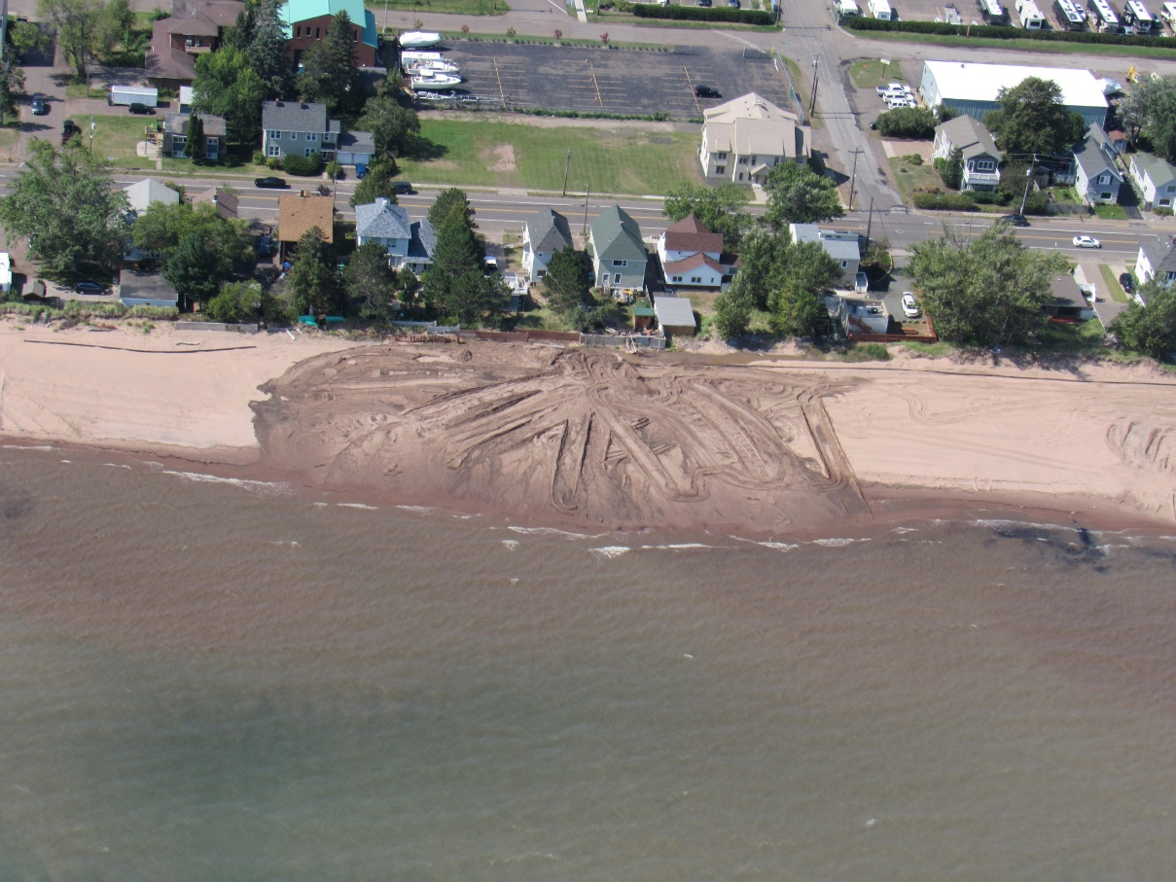
Erosion mitigation via periodic beach nourishment
2020 - 2021 nourishment
Photos: M. Bosnan (USACE; 2021)

Slide 19
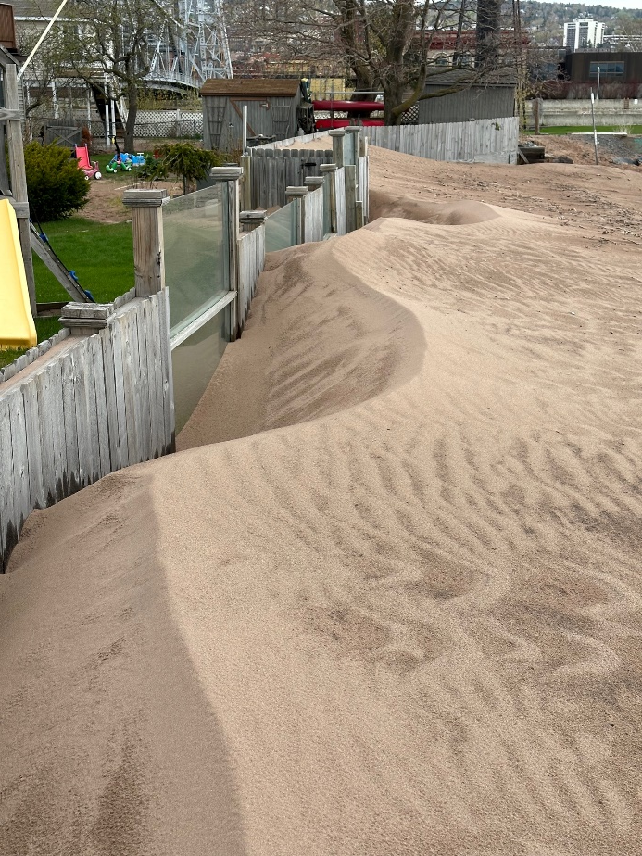
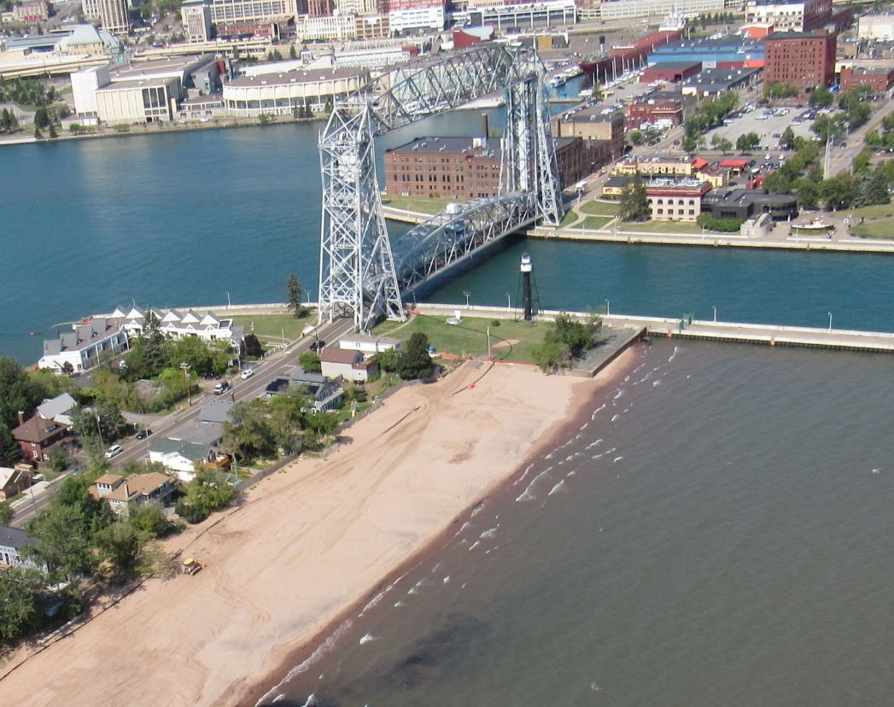
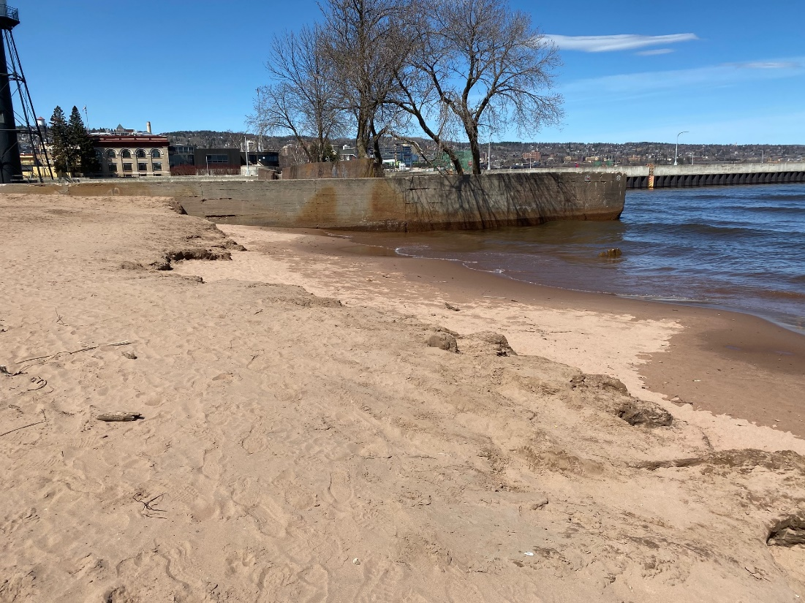
Challenges with beach nourishment
Dredge spoils significantly finer-grained than ‘native’ (original) material
Highly mobile
Onshore transport by wind (dunes / ripples)
Longshore transport
Eolian transport
Photo: Gale Kerns
Autumn 2020
Photo: Gale Kerns
Spring 2021

Slide 20
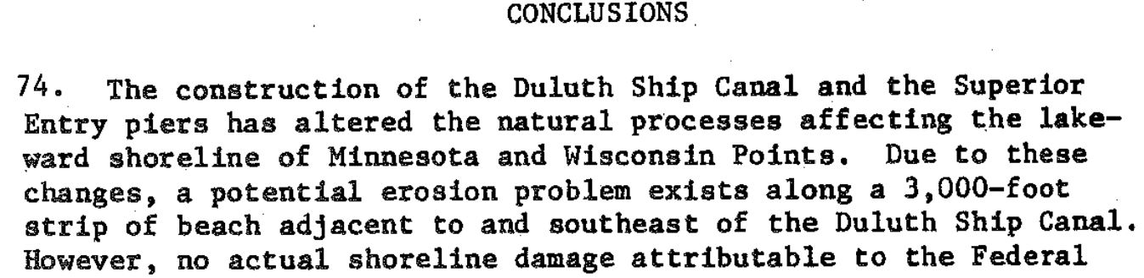
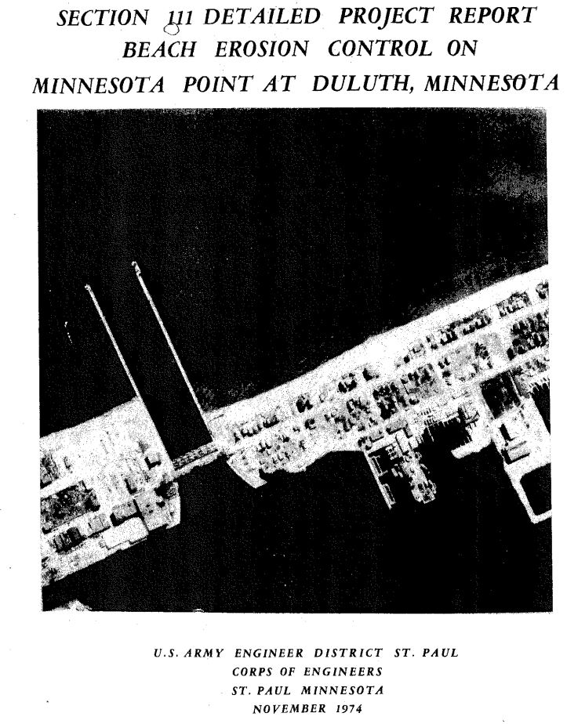
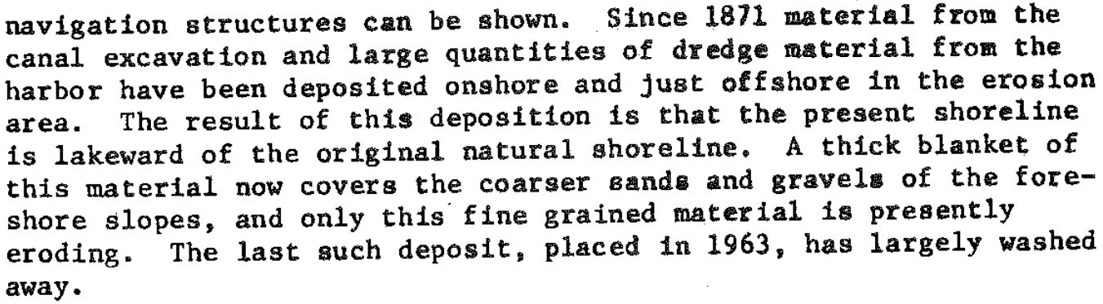
1974 Section 111 study
1974 conclusions:
Federal structures have created a “potential” erosion problem downstream of Duluth Ship Canal
No actual damage can be attributed to the Federal structures
Recommendation: No action

Slide 21

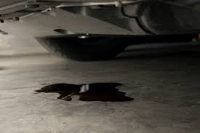
USACE (1974; Sec 111)
1964 shoreline
USACE Rationale: 1964 shoreline is lakeward of 1861 shoreline. Therefore, no loss of shoreline.
1861 shoreline
Thought problem:
My car’s oil sump holds 4 quarts;
Bob borrows my car and damages the oil sump;
Sump now leaks;
Without frequent monitoring / maintenance, sump will run dry, damaging engine;
Before returning my car, Bob fills the sump to 5 quarts volume.
Is Bob culpable for damage to my car?

Slide 22
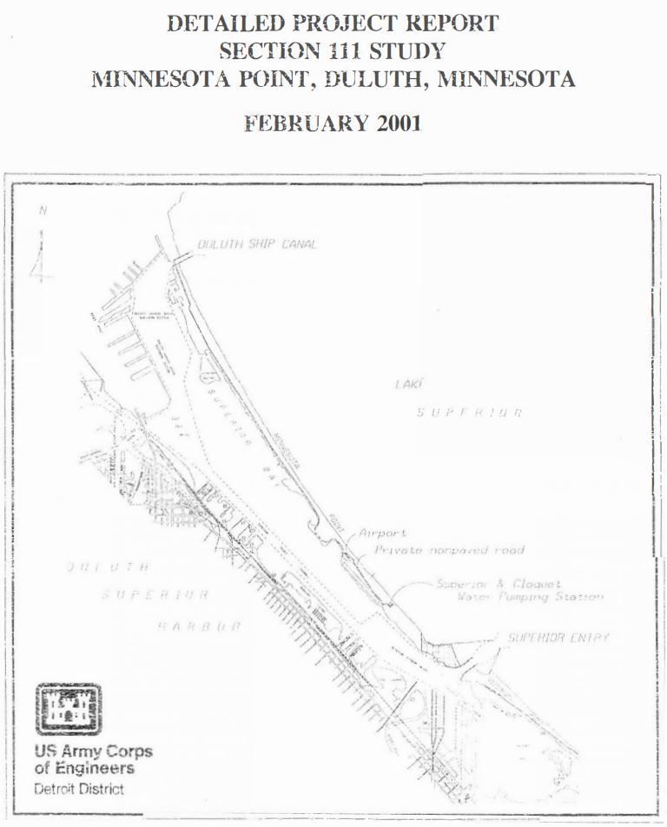
2001 Section 111 study
2001 conclusions:
Superior Entry is responsible for ‘south end’ shoreline damage
No ‘north end’ damage can be attributed to the Duluth Ship Canal
Cost of proposed ‘south end’ solution exceeded $12M cap
No action taken
Results of 2001 study ‘frame the problem’ for the current Section 111 study.
Important to identify any knowledge gaps and / or inconsistencies with observations.

Slide 23
Conclusions of 2001 Section 111 study relied heavily upon conceptual and quantitative models developed by W.F. Baird (1998)
Relevant aspects of the Baird (1998) study:
Estimated sand supply of 50,000 m³/yr from south-shore sources
Predicted net northwestward transport of ~ 50,000 m³/yr of sand along entirety of MN Point between Federal structures
Predicted offshore transfer of ~ 50,000 m³/yr of sand in the northern portion of MN Point, south of—and proximal to—Duluth entry
Ignored effects of long-term (multi-century scale) lake-level rise attributable to differential post-glacial crustal rebound
Assumed negligible input of barrier-building sediment (gravel / sand) from north-shore sources

Slide 24
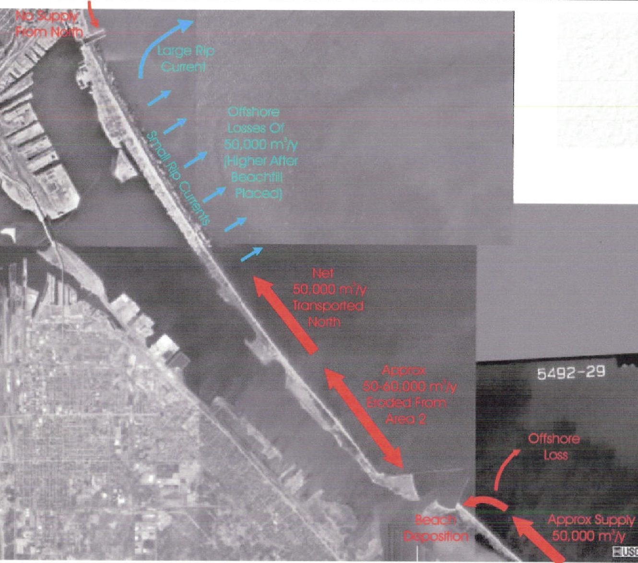
Fig 4.1 (Baird, 1998, in USACE, 2001)

Slide 25
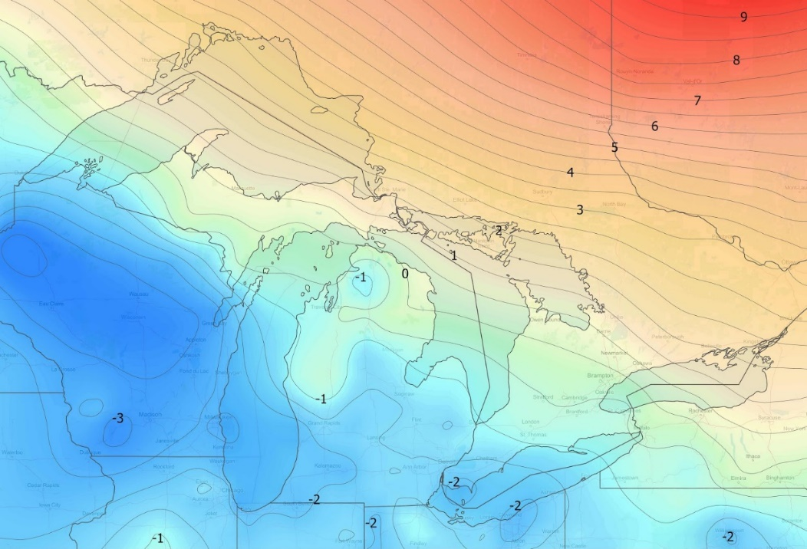
5
Assumed negligible north-shore sediment input
Crustal uplift (mm/a)
X
3
Predicted offshore sand transport of 50,000 m³/yr
No consideration of millennial-scale lake-level rise
New IGLD data (Craymer and Wisotzsky, 2021)
2
4
Predicted northward sand transport of 50,000 m³/yr
Twin Ports hydrograph (Breckenridge et al., 2016)
Five relevant aspects of Baird (1998) model, as reported in USACE (2001)
1
Estimated sand supply of 50,000 m³/yr
Drawing: ACOE (2001)

Slide 26
Relevant sediment dynamics

Slide 27
Barriers = delicate balance between rate of lake-level rise (‘accommodation space’) and sediment supply
Long-term lake-level in Twin Ports region
Long-term sediment (sand & gravel) sources for MN Point and their dependence on lake level
For the last millennium (~1100 BP – present), lake level has been rising rapidly (2.5 – 3.0 mm/yr)
Earlier (~4200 BP – 1100 BP) lake level was falling or quasi-stable
The barrier (MN / WI Point) likely emerged in response to rising lake level (Loy, 1962; Breckenridge et al., 2016; Swenson, 2020) ca. 1200 BP

Slide 28
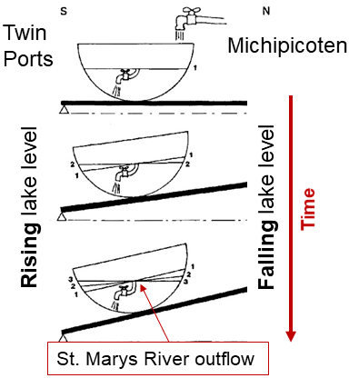

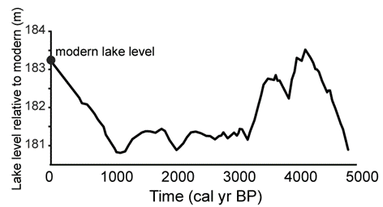
Crustal rebound (mm/a)
New IGLD data (Craymer and Wisotzsky, 2021)
Larsen (1987); extension of ideas in Goldthwait (1908)
Breckenridge et al. (2016)
1200 BP – present:
Rapid rise (2.5 – 3.0 mm/yr)
4200 BP – 1100 BP:
Generally falling to stable
Some uncertainty in timing and magnitude; trends certain

Slide 29
Barrier Islands = delicate balance between rate of lake-level rise (‘accommodation space’) and sediment supply
Long-term lake-level in Twin Ports region
Long-term sediment (sand & gravel) sources for MN Point and their dependence on lake level
Two sources: River input & bluff erosion
In the last millennium—with rapidly rising lake level—bluff erosion may be the dominant source of sand / gravel to MN Point
River-sourced sand / gravel may be comparable in importance
Crude estimates for sediment supply from bluff erosion alone on the north shore (Q_{NS}) and south shore (Q_{SS}) are:
Q_{NS} ~ 8,000 m³/yr
Q_{SS} ~ 25,000 m³/yr

Slide 30
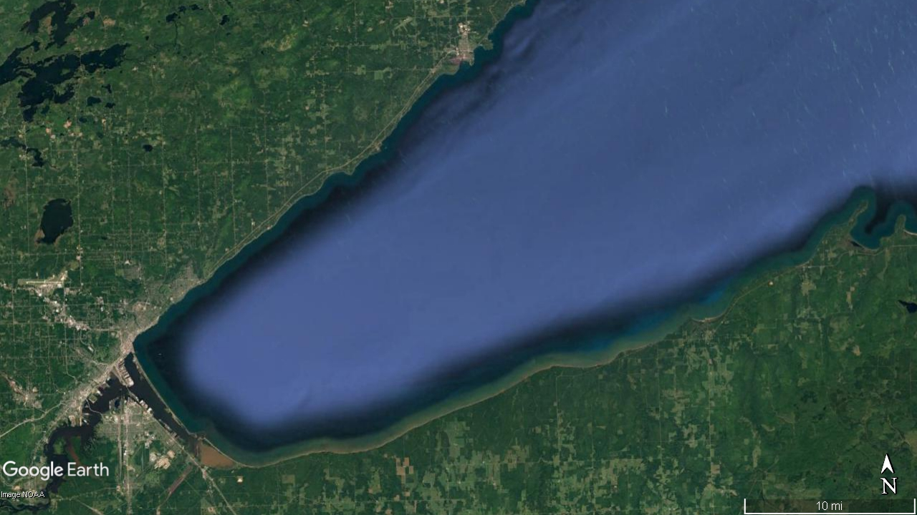
Sand sources: River (fluvial) input
Riverine input trends (big picture):
Little reason to expect significant change in sediment yield for last few millennia
(except last 150 years ↔ land-use changes)
From 1100 years BP – present, river mouths flooded (in part) by rapidly rising lake level
Progressive disconnection of St. Louis and Nemadji rivers from coastal waters
Degree of disconnection less clear on north- and south-shore rivers
North Shore: Small catchments, relatively low sediment yield
St. Louis: Large catchment, very low sediment yield
Sand input (rivers)
South Shore: Small & medium catchments, modest sediment yield
Nemadji: Medium catchment, high sediment yield

Slide 31
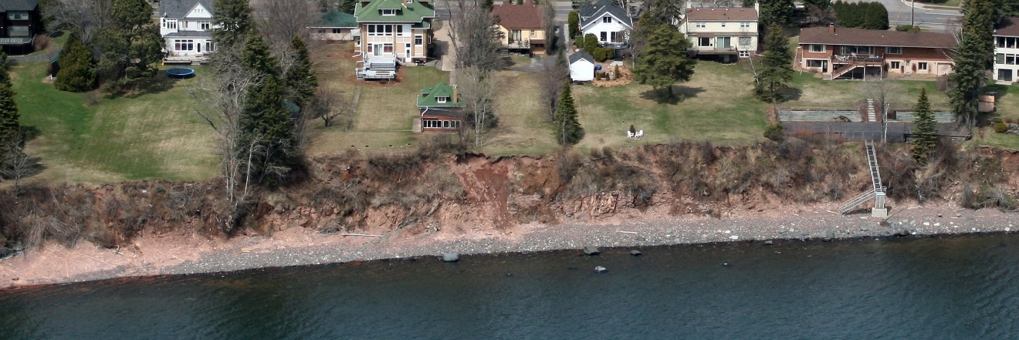
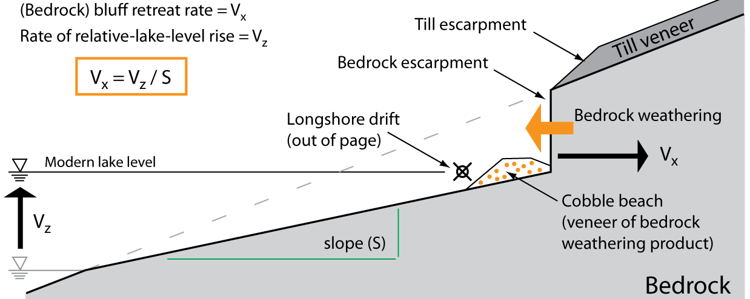
Rapid lake-level rise (1100 BP - present) drives bluff erosion
Photo: DNR (2007)
longshore transport
(into page)
after Lambert and Swenson (2016)

Slide 32
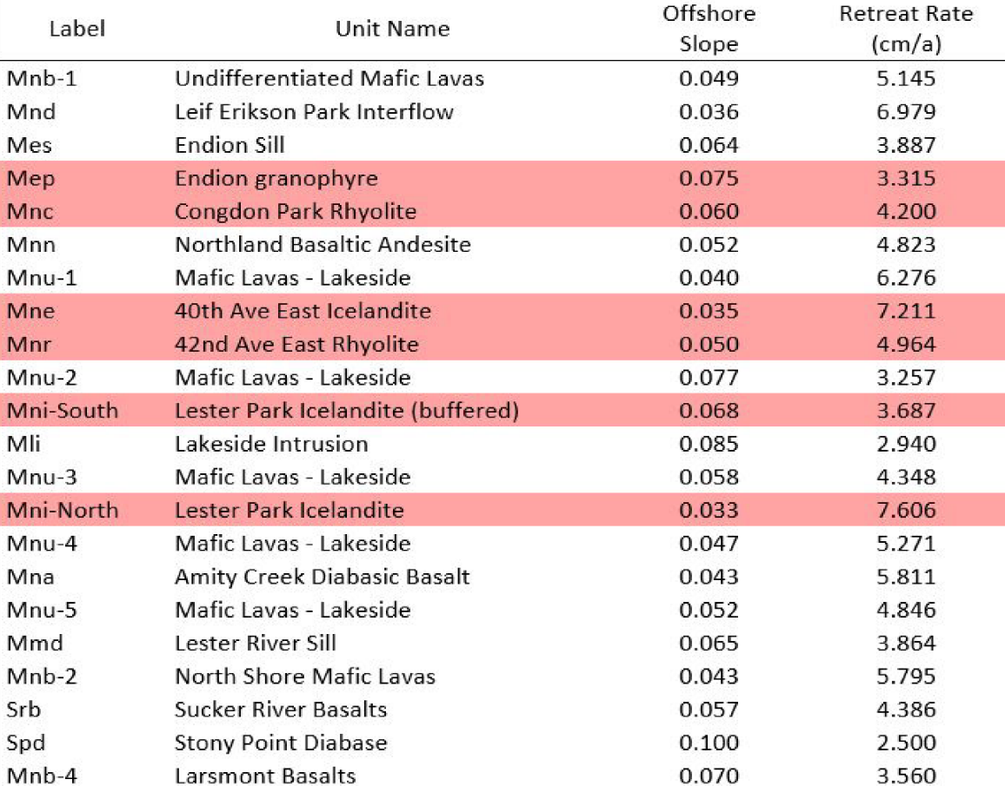
Century- to millennial-scale bluff erosion rates on north shore
Bedrock-cored north-shore bluff retreat rate ~ 5 cm/yr
Large variability because of mixed lithology, e.g. rhyolite vs basalt vs diabase
Long-term rates broadly consistent with decadal-scale rates (from aerial photos) as determined recently by Coastal Erosion Hazard Mitigation (CEHM) working group and earlier work by Johnston et al. (1990)
Lambert and Swenson (2016)
Key Points:
In the last millennium, with rapidly rising lake level, bedrock / till bluff erosion on the north shore may be the dominant source of gravel and sand feeding MN Point—from the north shore
Riverine input may be significant but is poorly constrained

Slide 33
Century- to millennial-scale bluff erosion rates on north shore
Bedrock-cored north-shore bluff retreat rate ~ 5 cm/yr
Large variability because of mixed lithology, e.g. rhyolite vs basalt vs diabase
Sample calculation for north-shore sediment supply (Q_{NS}) from bluff erosion alone:
5 cm/yr average retreat rate
4 m average bluff height
40 km source length (Duluth to Two Harbors)
Q_{NS} ~ 8,000 m³/yr
Long-term rates broadly consistent with decadal-scale rates (from aerial photos) as determined recently by Coastal Erosion Hazard Mitigation (CEHM) working group and earlier work by Johnston et al. (1990)
Very crude estimate
Lambert and Swenson (2016)
Key Points:
In the last millennium, with rapidly rising lake level, bedrock / till bluff erosion on the north shore may be the dominant source of gravel and sand feeding MN Point—from the north shore
Riverine input may be significant but is poorly constrained

Slide 34
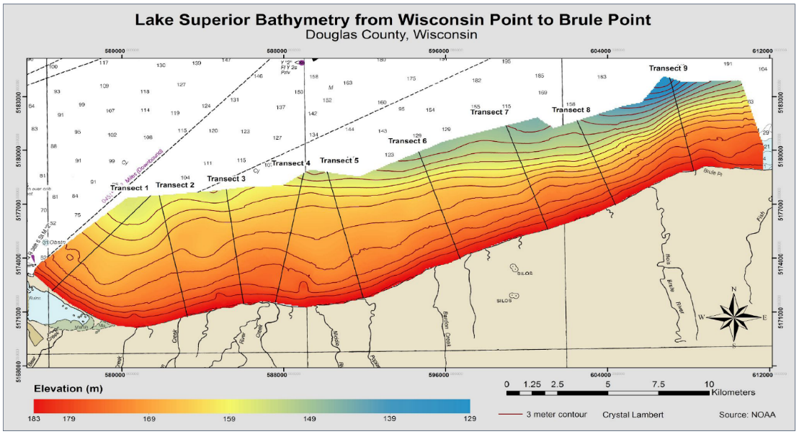
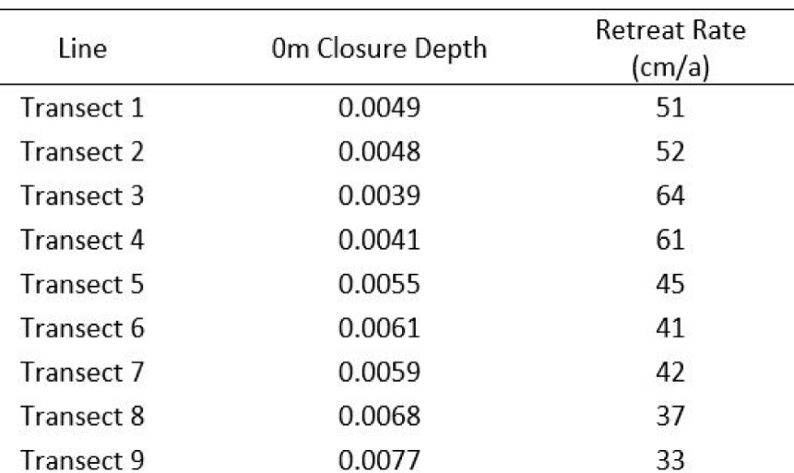
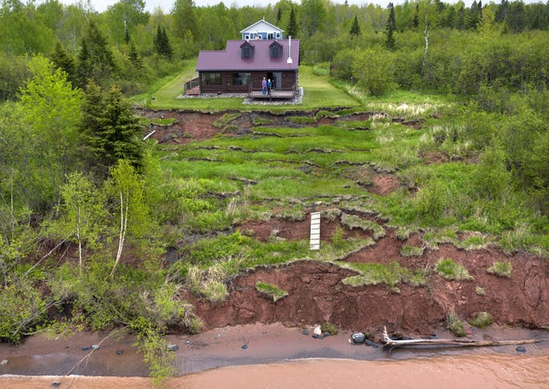
Century- to millennial-scale bluff erosion rates on south shore
Offshore slope
Lambert and Swenson (2016)
South-shore bluff retreat rate ~ 45 cm/yr
Mechanically weak, unconsolidated till
Less variability ↔ homogenous till
5 – 10% sand (Loy, 1962)
Long-term rates broadly consistent with decadal-scale rates (Need et al., 1980; Swenson et al., 2006; Lake Superior South Shore Bluff Recession Rate Study, Douglas and Iron Counties, 2012).
Image: Star Tribune

Slide 35
Century- to millennial-scale bluff erosion rates on south shore
Sample calculation for south-shore sand supply (Q_{SS}) from bluff erosion alone:
45 cm/yr average retreat rate; 15 m average bluff height
55 km source length (Superior to Herbster, WI)
7% sand
Q_{SS} ~ 25,000 m³/yr
Offshore slope
Lambert and Swenson (2016)
South-shore bluff retreat rate ~ 45 cm/yr
Mechanically weak, unconsolidated till
Less variability ↔ homogenous till
5 – 10% sand (Loy, 1962)
Long-term rates broadly consistent with decadal-scale rates (Need et al., 1980; Swenson et al., 2006; Lake Superior South Shore Bluff Recession Rate Study, Douglas and Iron Counties, 2012).
Image: Star Tribune

Slide 36
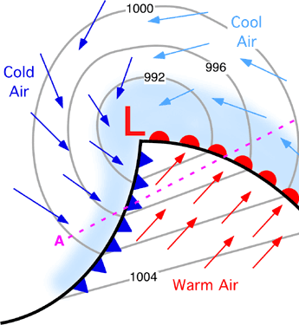
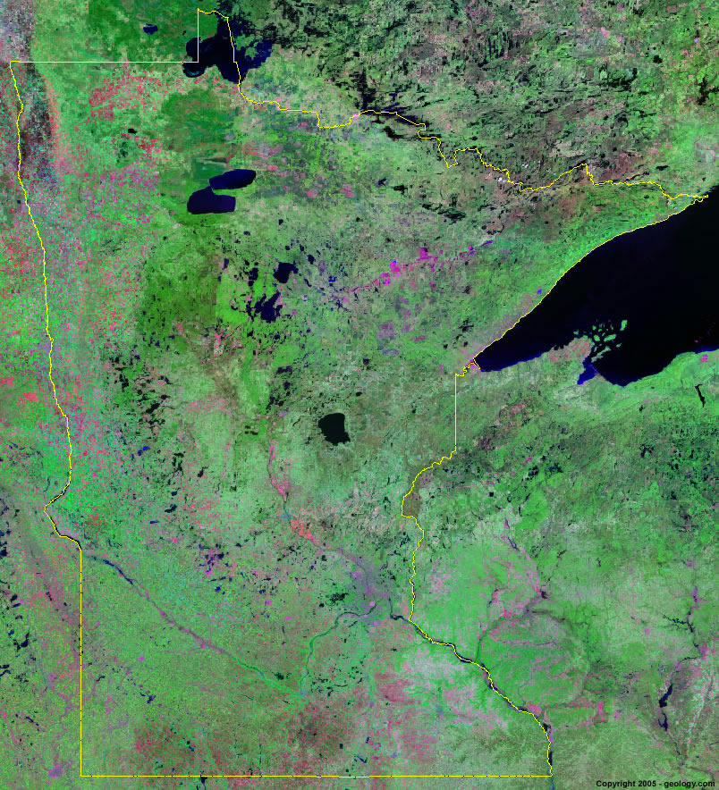
Transport pathways: Sand transported during ‘storms’ (cyclones)
Alberta Clipper
Nearly all extratropical cyclone tracks generate period of E – NE flow in the western arm of Lake Superior
Most important, by far. Sediment transport ‘switch’ is ON.
Colorado Low / Texas Hook

Slide 37
Transport pathways: Net longshore transport of sand near Duluth
convergence = deposition (SINK)
Net erosional coastline
E- NE wind
wave crests
wave crests
Longshore sand transport
Net depositional
coastline
Net erosional coastline
St. Louis & Nemadji Rivers historically added to net sediment convergence; not so much today (drowned)

Slide 38
Return to relevant aspects of Baird (1998) study:
Estimated sand supply of 50,000 m³/yr from south-shore sources
Predicted net northwestward transport of ~ 50,000 m³/yr of sand along entirety of MN Point between Federal structures
Predicted offshore transfer of ~ 50,000 m³/yr of sand in the northern portion of MN Point, south of—and proximal to—Duluth entry
Did not consider effects of long-term (multi-century scale) lake-level rise attributable to differential post-glacial crustal rebound
Assumed negligible input of barrier-building sediment (gravel / sand) from north-shore sources

Slide 39
Address points 1 – 4 first (next four slides):
Take-home message:
Baird (1998) estimate of south-shore sand supply (Q_{SS}) likely too large by a factor of two
Baird (1998) prediction of large-scale offshore sand transfer near Duluth entry is inconsistent with observed bathymetry
Instead, majority (60 – 75%) of modern sediment supply used to offset drowning of barrier by rapid lake-level rise
Remainder partitioned to building barrier lakeward (slowly), which is consistent with observed internal structure of barrier (e.g., GPR imaging by Harry Jol and students)
Shore-normal GPR transect near Park Point beach house (Simenson, Alger, and Jol, 2013)

Slide 40
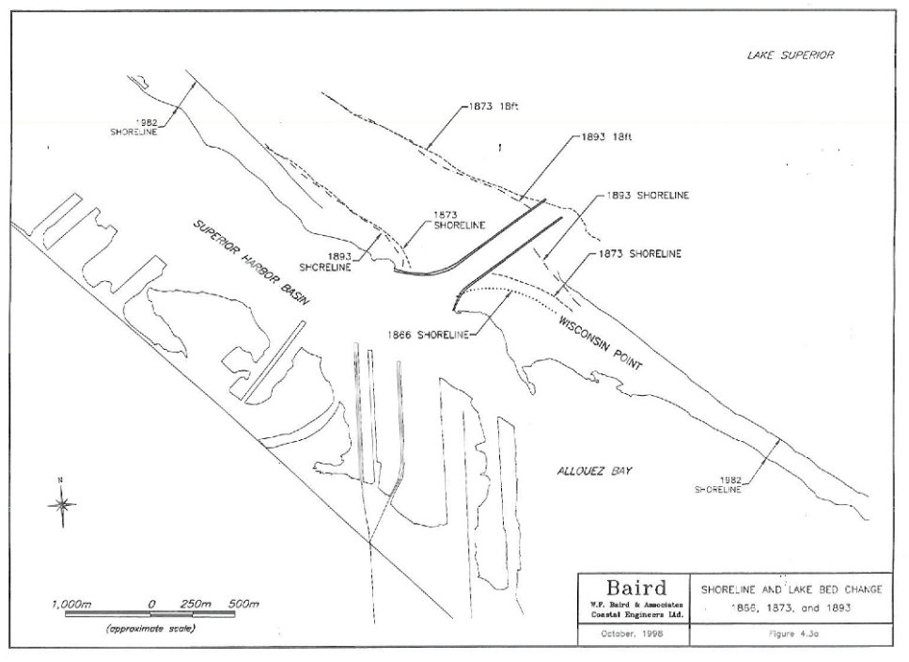

1
Estimates of modern south-shore sand supply (Q_{SS})
Baird (1998) estimate used 1873 & 1982 shorelines
Shoreface + beachface thickness of 12 m
Estimate Q_{SS} ~ 50,000 m³/yr
Fig 4.3a (Baird, 1998, in USACE, 2001)
Swenson and Johnson (2019; unpublished) used 1938 – 2018 shorelines to revise estimate
Identical 12-m shoreface + beachface thickness
Estimate Q_{SS} ~ 25,000 m³/yr
Comparable to earlier estimate of Q_{SS} ~ 17,000 m³/yr from USACE (1974, Sec 111)

Slide 41

2
3
Predicted large-scale offshore sand transport south of Duluth entry inconsistent with observed bathymetry
?
Occam’s Razor:
Simpler explanation: South- and north-shore sediment fluxes are progressively depleted via deposition along length of barrier. By extension, there exists a ‘node’ of zero sediment flux (stagnation point) on the barrier somewhere south of the Duluth jetties.
Fig 3.1 (Baird, 1998, in USACE, 2001)
Any observed bathymetric anomalies are:
Far too small (volumetrically)
Well below closure depth for sand (~10 m)
Shoreface is homogeneous along entirety of barrier
Fig 4.1 (Baird, 1998, in USACE, 2001)

Slide 42


4
Rapid lake-level rise and sediment budget
Historical ‘zero-flux’ point (node) reflecting exhaustion of north-shore and south-shore sediment fluxes
Key point: Majority of modern sand budget consumed in offsetting drowning
Transect on next slide
Lakeward boundary of control volume is closure depth (~10 m)
Goal:
Quantify sand supply required to offset drowning (Q_{drown})
NOAA 14975
Q_{SS} ~ 25,000 m³/yr

Slide 43

4
Quantify sand supply required to offset drowning (Q_{drown})
time = t+Δt
Calculation:
rate of lake-level rise: 2.5 – 3.0 mm/yr
along shore length of control volume ~ 7 km
width of barrier and shoreface ~ 850 m
sand layer to offset drowning
lake-level rise over Δt
Time
Q_{drown} ~ 15,000 – 18,000 m³/yr
Compare with
width of barrier and shoreface (~850 m)
Q_{SS} ~ 25,000 m³/yr
time = t
Claim:
Majority of sand supply offsets drowning and is not routed offshore
lake
Sand closure depth (~10 m)

Slide 44
Return to relevant aspects of Baird (1998) study:
Estimated sand supply of 50,000 m³/yr from south-shore sources
Predicted net northwestward transport of ~ 50,000 m³/yr of sand along entirety of MN Point between Federal structures
Predicted offshore transfer of ~ 50,000 m³/yr of sand in the northern portion of MN Point, south of—and proximal to—Duluth entry
Did not consider effects of long-term (multi-century scale) lake-level rise attributable to differential post-glacial crustal rebound
Assumed negligible input of barrier-building sediment (gravel / sand) from north-shore sources

Slide 45




5
North end of barrier composed of cobbles, gravel, and coarse sand derived from north-shore bedrock weathering & transport
NOAA 14975
Meade (1861)
“Major D.C. Houston in his report to the Chief of Engineers in 1872, …, noted the northern 2 miles of Minnesota Point was covered in gravel.” (USACOE, 1974 Sec. 111 report)
Photos: G. Glass

Slide 46



Glensheen Mansion, east Duluth
N
North-shore sediment supply (Q_{NS})
2016
Q_{NS}
Dock constructed ca. 1910
1948
Multiple lines of evidence (historical air photos, etc.) support non-trivial north-shore supply of cobbles / gravel / sand
1939

Slide 47


First (of two) quantitative constraint on north-shore gravel / sand supply (Q_{NS}):
A_{fillet} ~ 8∙10³ m²
H_{shore} + H_{beach} ~ 12 m
T_{accum} ~ 12 yr
Q_{NS} ~ 8∙10³ m³/yr
Line drawing from USACOE (1974)
Compare to Q_{SS} ~ 25∙10³ m³/yr
1873 shoreline
1861 shoreline

Slide 48


Second quantitative constraint on north-shore gravel / sand supply (Q_{NS}):
Q_{NS}
Barrier is homogeneous in structure
If barrier builds lakeward and upward (to offset lake-level rise) uniformly at rate R, then at first order:
$$\frac{Q_{NS}}{L_{NS}}=\frac{Q_{SS}}{L_{SS}}∝R$$
or
$$Q_{NS}=Q_{SS}\frac{L_{NS}}{L_{SS}}$$
L_{NS}
Zero-flux boundary
L_{NS} ~ 2 mi
L_{SS} ~ 8 mi
L_{SS}
~ stagnation point (node) of north-shore and south-shore sediment supplies (point of exhaustion)
Conservative position—boundary likely extended further south
Q_{NS} ~ 0.25∙Q_{NS}
If Q_{SS} ~ 25,000 m³/yr
then Q_{NS} ~ 6,000 m³/yr
Q_{SS}

Slide 49
Preliminary Alternative Plans
Matrix effectively unchanged from 1974 Sec 111 study
USACE presentation in August 2023

Slide 50

Alternative long-term solution
Locate (approximately) zero-flux node;
Construct new inlet (jetties) here;
Progressively decommission / remove both Duluth and Superior entries.
Zero-flux node = New jetties
Current locations of jetties / breakwaters represent a near-worst-case scenario for sediment starvation of MN Point

