Slide 1
Observation to Action: How Geospatial Data
is used for the tracking and management
of Invasive Phragmites in Minnesota
Presented by: Dani Sackett, NRSM Graduate Student

Slide 2
Goals
This thesis is a synthesis of the existing research related to invasive Phragmites in MN. It combines the following information into a single source for anyone who may observe the species in their area.
Who are the relevant stakeholders
How the public can help
How is Phragmites reported and tracked
What does the data collected look like
How scientists use the information for managing Phragmites
Notes:
Goals
Public engagement. Previous studies have focus on management on large scales that would require a government or other entity to enact. This thesis focuses on what individuals can do and how they can contribute. The things they need to know, and how to tell if a treatment in their area is working

Slide 3
Invasive Phragmites
The plant and its history

Slide 4





Scientific Name: Phragmites australis (Cav.) Trin. Ex Steud
Phylum or Division: Angiosperm
Class: Monocot
Family: Poaceae
Phragmites has multiple different methods for spreading and propagating new populations
Rhizomes~ Root masses underground that are capable of putting out new shoots to keep the plant alive and continue to spread if the parent shoot is damaged
Seed Dispersal~ A single flowering head can produce 1200-2000 seeds per year
Stolons~ Stems that grow along the surface of the soil. These can stretch for dozens of feet and produce new independent shoots
Notes:
Phragmites reaches sexual maturity after 3-4 years to produce seed heads
Been around for over a century

Slide 5
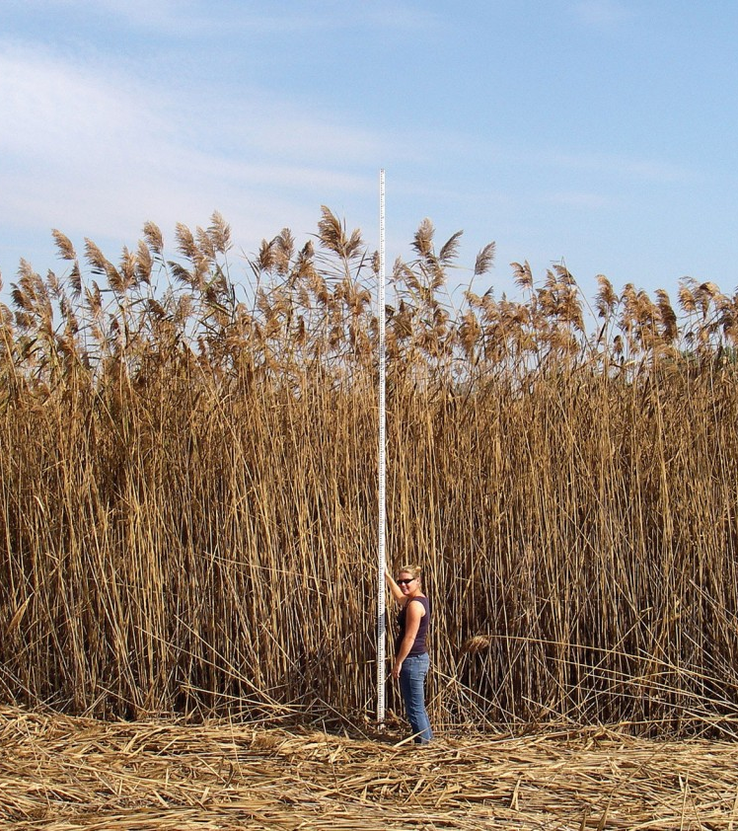
Phragmites australis ~ Also known as common reed
Why is it a problem?
Phragmites is a reed found in many shorelines and wetlands across the US.
Its dense stands can grow 12-18 feet high and these stands can quickly out-compete native species for space and resources.
Who it affects?
Can be problematic to homeowners, industry, land managers, and business reducing the value of land.
Notes:
Phragmites also can grow and clone from deep rhizome structure. These can grow up to 10 ft per season and continually spread to put up new shoots (Amesberry et al. 2000)
Economics of Invasive Species

Slide 6
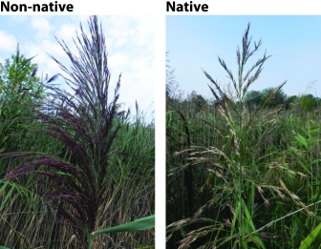
It is very difficult to distinguish the Invasive strain from the Native strain
Notes:
There are less than 100 acres of verified Invasive Phragmites in MN

Slide 7
How to treat Phragmites
Notes:
How individuals and entities can control it

Slide 8
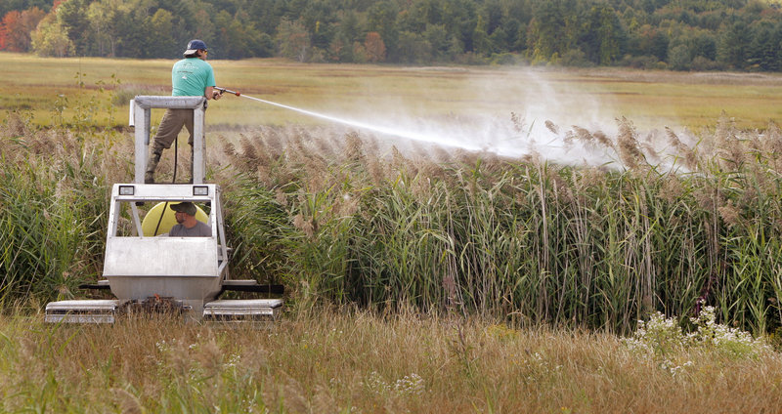
Common Treatment Options
Treatments for Phragmites are best used in conjunction with a larger integrated pest management plan, and on rotation
Herbicide application
  This is currently the most effective tool for reduction of sexually mature plants
Burning
  Only effective at the end of the season before seed heads are established
Flooding
  Difficult to manage properly and can result in the creation of new ecological niches
Mechanical removal (mowing)
  Used mostly to remove all ready treated dead stands
Notes:
There are no approved biological control agents
Burning only stops seed heads from dispersing, rhizomes and stolons are able to still spread
Spraying often requires permits due to the limitations of wetlands and chemical residency
Flooding must have a way to control the hydrology (most land owners can’t do this)

Slide 9
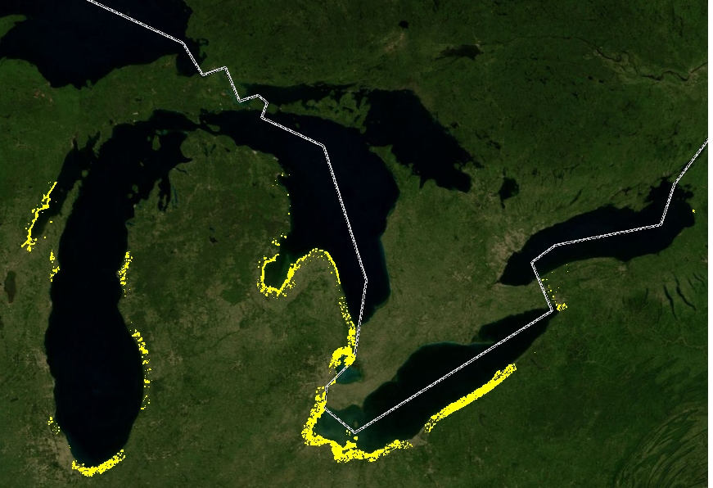
Most effective treatment option
The best option for Phragmites is Prevention.
Early Detection/Rapid Response (ED/RR) Is what most managers use to combat the forefront of an invasive population
Notes:
Risk/benefit analysis of varying control methods compared to prevention
current distribution in the Great Lakes

Slide 10
What does the information look like when it is reported to an agency?

Slide 11

Data reporting
Anyone who observes a suspicious plant in the environment can report it for verification
When you observe a plant you think may be Phragmites, you can follow this information to report it to the proper agencies
Take a picture to compare to the MN DNR or MN Department of Agriculture Invasive Species Lists
  Identify the species
  Note your location as accurately as possible
Submit your findings
  EDDMaps (National)
  Report a Pest (State)
  Your local Conservation Officer
Notes:
You do not need to be a trained scientist to observe an report and invasive species
The more landowners who are aware of problems on their property the better
Anyone near a body of water can report a problem for the future betterment of the area
Geospatial data is attributing information to a specific coordinate that then can be analyzed in the form of shapes and maps. This information is not just in a spreadsheet, but visually displayed in a location compared to other data

Slide 12
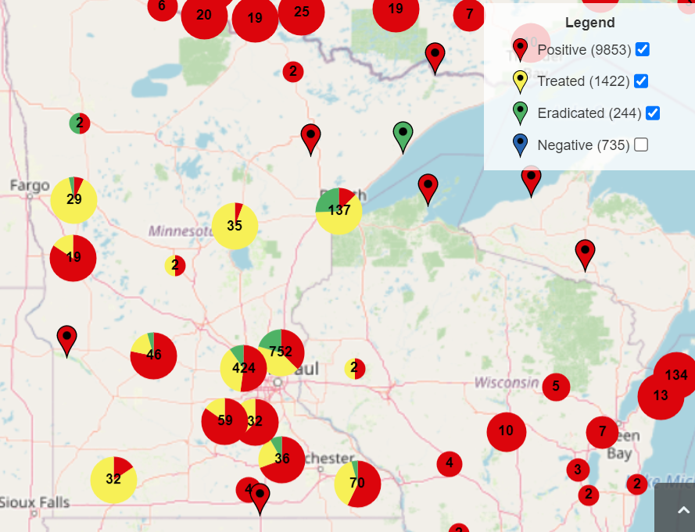
EDDMaps
Early Detection and Distribution Mapping systems
Used nationally to report invasive species
Available online and in apps to allow users to upload and track species
Uses geospatial data provided by users to track and map invasive populations
Industry Standard
Notes:
All species can be reported through EDDMapS.org on a computer or a smartphone. This site has distribution maps of non-native species in Minnesota. You create an account, upload the location of species, and upload photos and other information. Once your report is verified, it is the available as public information on the database
The Phragmites Adaptive Management Framework (PAMF) is another web-based initiative. PAMF uses statistical modeling to assist managers with site-specific control.

Slide 13
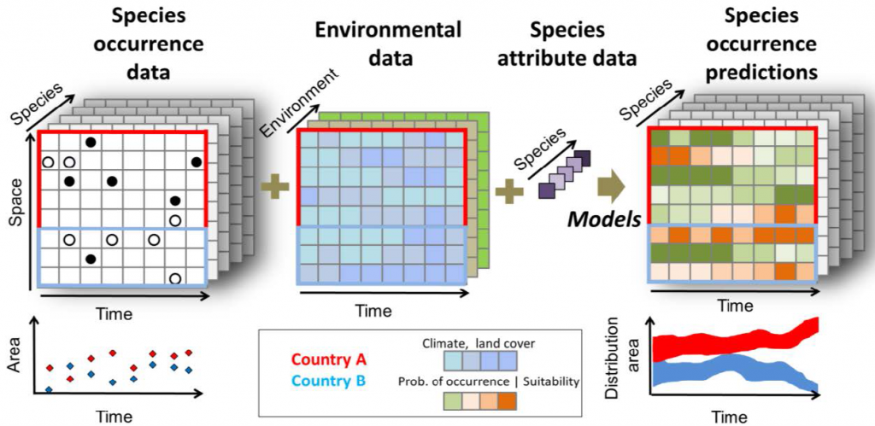
Data needed for a Model
Connectivity and pathways
Environmental requirements
Proximity to known populations
Phragmites has already entered the Great Lakes region up to Lake Michigan and part of MN and WI.
Phragmites is a plant with a wide tolerance range of environmental conditions. It grows on most soil textures from fine clay to sandy loams and is tolerant of saline or alkaline conditions
How a point source population spreads to other areas
Notes:
EDDMaps= species occurrence data. How geospatial data goes from an numbers to an excel sheet, a point with other values, a shape containing multiple points, then map displaying all shapes and information in a geographical map
iSDM, Species Distribution Model, RandomForest, RasterStack

Slide 14
Species Distribution Models
To properly implement ED/RR scenarios, Lands Managers need to know where the leading edge of invasions may be in order to monitor and quarantine
Uses existing environmental data and populations to extrapolate future populations from habitat suitability, environmental connectivity, and propagule pressure
Machine Learning (ML) tools run multiple iteration tests to determine the best fit scenario for the model an analyst chooses

Slide 15
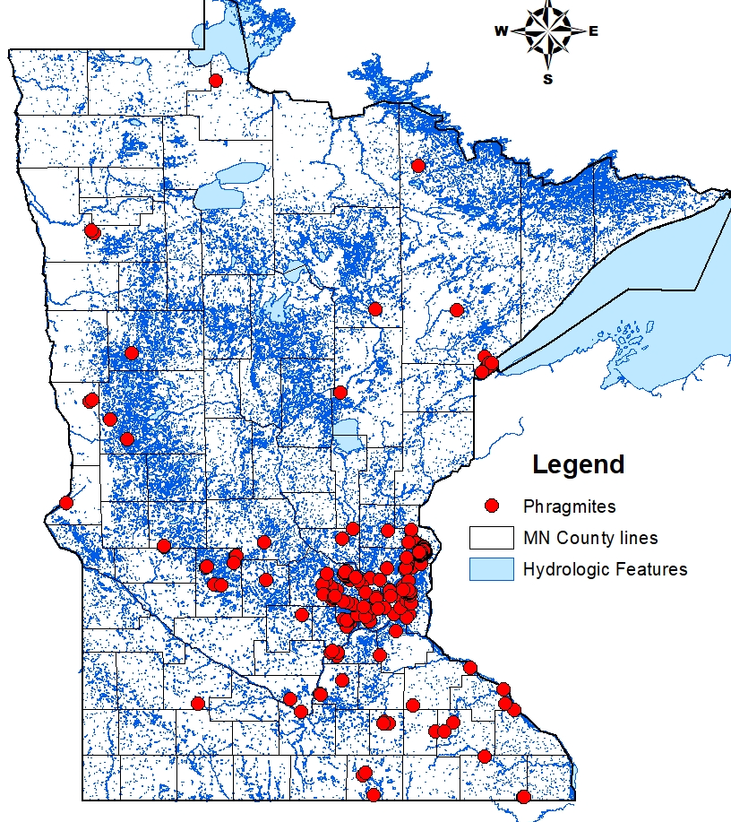
Areas at risk
Sites that are recently affected by ecological disturbance
Human Assisted Migrations
Increased propagule pressure from sexually mature stands
Proximity to known populations
Notes:
This is one of the few maps I created myself in ArcGIS before having to pivot the project

Slide 16
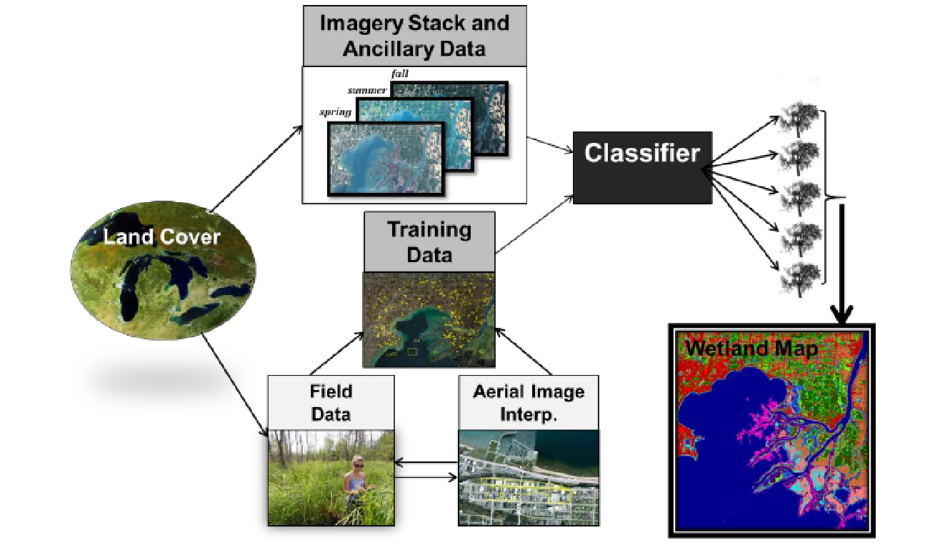
Invasive Species Risk Analysis Modeling
GIS modeling
Integrating environmental factors with proximity calculation
  Physical conditions
  Chemical conditions
  Recent disturbances
  Assisted migration
  Hydro-connectivity
Notes:
ED/RR would benefit from a predictive model to determine where Phragmites populations might establish
EDD Maps
USGS
MN DNR
This is only an example. While the models may seem complicated, the output ( is easily understandable for the public

Slide 17
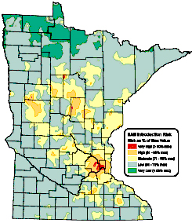
Final Product
Layering of different data can help scientists determine where areas are most susceptible to invasion
ED/RR can then use a map to determined where to allocate resources to reduce the likelihood of new populations establishing
Example: Species Distribution map
Notes:
Weights are to be determined by impact on Risk.
Example Proximity X10 where environmental conditions are 1.5
This is an EAB map. Invasive Species maps
How scientists use this information

Slide 18
Assessment and Monitoring
Where Phragmites already exists:
  Monitoring of established stands for seed production
  Tracking the size and density of the population
  Measure the area
  Determine treatment actions
After treatment, scientists and managers re-measure and analyze the area to determine the effectiveness of the treatment and make future adjustments for reporting to the agency or other stakeholders

Slide 19

Cost effective
EDDMaps and other geospatial databases are available for the public to use
Anyone can report sightings of invasive species
Prevention efforts in the form of education and monitoring for invasive species are on average <10% the cost of management and treatment plans
Predictive modeling can be helpful for scientists to determine where resources may be most effective for ED/RR

Slide 20
Conclusions
All members of the public are able to contribute to the observations and reporting of invasive species
Treatment of already established Phragmites can be difficult and costly
Powerful tools such as geospatial data and mapping can increase the likelihood of successful control
Control and eradication is possible, and most likely with ED/RR
Notes:
Conclusions

Slide 21
Questions
The views and opinions expressed in this presentation are strictly those of the author. The contents of this page have not been reviewed or approved by the University of Minnesota.
Contact information for the creator of this presentation: Dani Sackett Sack0093@umn.edu NRSM Graduate Student

Slide 22
Citations
Addison PFE, Rumpff L, Bau SS, Carey JM, Chee YE, Jarrad FC, McBride MF, Burgman M (2013) Practical solutions for making models indispensable in conservation decision-making. Divers Distrib 19:490–502
Blanke C., Larkin D., Bohnen J., Galatowitsch S. 2019.An assessment to support strategic, coordinated response to invasive Phragmites australis in Minnesota. University of Minnesota Department of Fisheries, Wildlife, and Conservation Biology. Minnesota Aquatic Invasive Species Research Center (MAISRC). https://maisrc.umn.edu/phragmites-project
Briscoe Runquist, R. D., Lake, T. A., & Moeller, D. A. (2021). Improving predictions of range expansion for invasive species using joint species distribution models and surrogate co‐occurring species. Journal of Biogeography, 48(7), 1693-1705.
Dullinger S, Kleinbauer I, Peterseil J, Smolik M, Essl F (2009) Niche based distribution modeling of an invasive alien plant: effects of population status, propagule pressure and invasion history. Biol Invasions 11:2401–2414
EDDMapS. 2023. Early Detection & Distribution Mapping System. The University of Georgia - Center for Invasive Species and Ecosystem Health. Available online at http://www.eddmaps.org/; last accessed March 17, 2023.
Haight, R. G., Kinsley, A. C., Kao, S. Y., Yemshanov, D., & Phelps, N. B. (2021). Optimizing the location of watercraft inspection stations to slow the spread of aquatic invasive species. Biological Invasions, 23(12), 3907-3919.
Jetz, W., McGeoch, M.A., Guralnick, R. et al. Essential biodiversity variables for mapping and monitoring species populations. Nat Ecol Evol 3, 539–551 (2019). https://doi.org/10.1038/s41559-019-0826-1
Lodge, D. M., Simonin, P. W., Burgiel, S. W., Keller, R. P., Bossenbroek, J. M., Jerde, C. L., ... & Zhang, H. (2016). Risk analysis and bioeconomics of invasive species to inform policy and management. Annual Review of Environment and Resources, 41, 453-488.
Marcaccio, J. (2019). Assessing remote sensing approaches to map invasive Phragmites australis at multiple spatial scales. Ph.D. Thesis, McMaster University.
Rohal, C. B., Kettenring, K. M., Sims, K., Hazelton, E. L. G., & Ma, Z. (2018). Surveying managers to inform a regionally relevant invasive Phragmites australis control research program. Journal of Environmental Management, 206, 807-816.
Srivastava, V., Lafond, V., & Griess, V. C. (2019). Species distribution models (SDM): applications, benefits and challenges in invasive species management. CABI Reviews, (2019), 1-13.

