Slide 1
Defense of MS Thesis
by
Syed Salik Hafeez

Slide 2


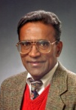
Authors
SYED SALIK HAFEEZ
Syed Salik hafeez received his B.E degree with First Class Honors in Electrical Engineering from NED University Karachi, in March 2013. Worked at Aero Systems Engineering, Inc at St. Paul, Minnesota as Controls Software Engineer from May 2016 to June 2019, currently working as software engineer at Cobham Mission Systems, Davenport Iowa.
D. SUBBARAM NAIDU
Dr. Naidu received his Ph.D. in Electrical Engineering from the Indian Institute of Technology (IIT) in 1977. His research interests include control theory, optimal control, singular perturbations, aerospace control applications, biomedical engineering, artificial neural networks, intelligent systems and control. He has over 200 publications including 6 books. Elected as a Fellow of the Institute of Electrical and Electronics Engineers (IEEE), ``the world's largest professional association for the advancement of technology", New York, USA, 1995.

Slide 3
Thesis Committee
Members | Department/College
Dr. D. Subbaram Naidu, (Advisor) | Electrical Engineering
Dr. Jing Bai (Member) | Electrical Engineering
Dr. Arshia Khan, (Member) | Computer Science

Slide 4

System Identification, Infinite and Finite-horizon Linear-Quadratic Control for Linear and Nonlinear Systems by State Dependent Riccati Equation
Submitted towards the degree of Master of Sciences Department of Electrical Engineering
By
Syed Salik Hafeez
Advisor
D. SUBBARAM NAIDU

Slide 5
Outline
Background
Introduction
Thesis Goal and Contribution
Overview of SDRE
Infinite-Horizon Nonlinear Regulator & Tracking Using SDRE
Finite-Horizon Nonlinear Regulator & Tracking Using SDRE
System Identification and Validation of results
Conclusion

Slide 6

Background
Optimization is a very desirable feature in day to day life. It is our desire to use time and resources in optimal manner.
$P\left(x_{1},y_{1}\right)$
  $P\left(x_{2},y_{2}\right)$
  Obvious that it’s a straight line. Any Mathematical proof that shortest path is a straight line?
S

Slide 7




Background
Let the line between two points S is divided into small parts known as ${[d}_{s}$]
$s=\int_{x_{1}}^{x_{2}}{d_{s}}$ , $({d_{s})}^{2}=({d_{x})}^{2}$+ $({d_{y})}^{2}$
$d_{s}=\sqrt{({d_{x})}^{2}\text{+} ({d_{y})}^{2}}$=$\sqrt{1+{\left(\frac{dy}{dx}\right)}^{2} }$ $d_{x}$
$S=\int_{x_{1}}^{x_{2}}{\sqrt{1+y^{′2}}d_{x}}$ , Let $F=\sqrt{1+y^{′2}}$
EULER- LAGRANGE EQUATION
$$\frac{∂F}{∂y}−\frac{d}{dx}\left(\frac{∂F}{∂y^{′}}\right)=0,$$
$$d_{s}$$
$$d_{y}$$
$$d_{x}$$

Slide 8
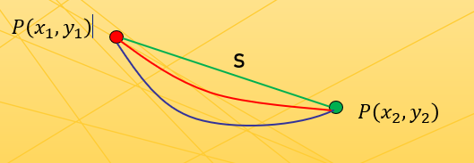

Background
Solving F, by Euler Lagrange Equation
  As $\frac{∂F}{∂y}=0$, $\frac{∂F}{∂y′}$=$\frac{y^{′}}{\sqrt{1+y^{′2}}}$
  $⇒\frac{d}{dx}\left(\frac{y′}{\sqrt{1+y^{′2}}}\right)=0$,
  $∴\frac{y^{′}}{\sqrt{1+y^{′2}}}=c ⇒y^{′2}=c^{2}\left(1+y^{′2}\right)$
  $∴y^{′2}\left(1−c^{2}\right)=c^{2} ⟹y^{′2}=\frac{c^{2}}{1−c^{2}}, let a^{2}=\frac{c^{2}}{1−c^{2}}$
  $∴ y^{′2}=c^{2} ⇒y^{′}=±c ⟹\frac{dy}{dx}=±c$
  By taking integral on both sides will lead us to the line equation
  $$y=cx+b$$

Slide 9
Background
JD Pearson
Garrard, McClamroch & Clark
Approximation Methods in Optimal Control Sub-optimal Control.
A linear time and state dependent approximation to a non-linear and non-stationary system is optimized with respect to a quadratic performance index by treating it as an instantaneously linear stationary system. By allowing for the variations of the model a realizable adaptive typo of controller can be devised.
1962
An Approach to Sub-optimal Feedback Control of Non-linear Systems
A method is developed for the determination of sub-optimal control laws for non-linear dynamical systems. The basis of the proposed technique is a method for the determination of approximate solutions for the associated Hamilton-Jacobi-Bellman equation.
1967
Burghart
A technique for suboptimal feedback control of nonlinear systems
The suboptimal control law is derived using a Taylor's series representation for the feedback gain matrix after modeling the nonlinear system by a linear system at each instant of time.
1969
Wernli & Cook
Suboptimal control for the nonlinear quadratic regulator problem
This suboptimal control law, based on the solution to the linear regulator problem, involves the steady-state solution to the Riccati differential equation. This matrix is expanded in a Taylor series.
1975
Cloutier, D’Souza
A new technique for nonlinear estimation
The SDREF is derived by constructing the dual of a little known nonlinear regulator control design technique has the same structure as the continuous steady-state linear Kalman filter. In contrast to the linearized Kalman filter (LKF) and the extended Kalman filter (EKF) which are based on linearization, the SDREF is based on a parameterization that brings the nonlinear system to a linear structure having state-dependent coefficients (SDC).
1996
Tayfun Çimen
Nonlinear optimal tracking control with application to super-tankers for autopilot design
This multi-input–multi-output nonlinear super-tanker model is well established in the literature and represents a challenging problem for control design, where the design requirement is to follow a commanded maneuver at a desired speed
2008

Slide 10
Introduction
Nonlinear System
Linearized System
(Around an Operating point)
Optimal Linear Tech
(LQR,LQT,.)
Optimal Nonlinear Tech. (SDRE, ASRE,..)

Slide 11

Introduction & Overview

Slide 12
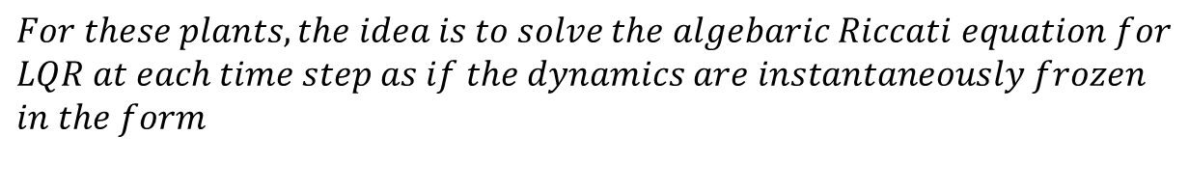





Overview of SDRE
$$SDRE applies to nonlinear systems whose nonlinear dynamics$$
$$\acute{x}=f(x,u)$$
$$Can be casted in the SDC state dependent coefficient form$$
$$\acute{x}=A\left(x\right)x+B\left(x\right)u$$
$$For these plants, the idea is to solve the algebaric Riccati equation for$$
$$LQR at each time step as if the dynamics are instantaneously frozen$$
$$in the form$$
$$A\left(x\left(t\right)\right),B\left(x(t)\right)$$
$$A feature of SDRE is that the SDC perameterization isn^{′}t unique and it may$$
$$impact the stability and performance$$
$$SDC must be choosen so that$$
$$A\left(x\left(t\right)\right),B\left(x(t)\right)$$
$$is stablizable at each point along$$
$$is stablizable at each point along the trajectory.$$

Slide 13
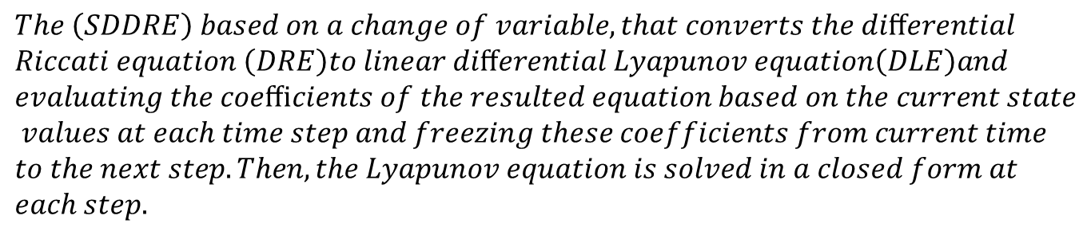
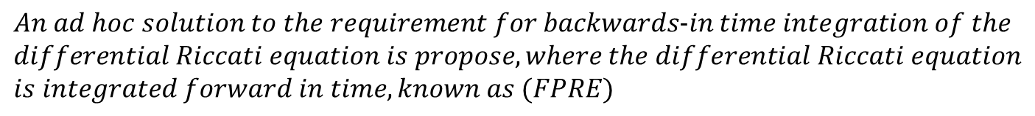
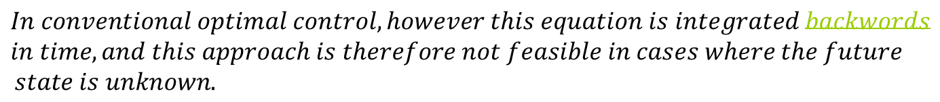
Overview of SDRE
$$This issue can be circumvented by replacing the ARE used in SDRE with$$
$$differential Riccati equation.$$
$$In conventional optimal control, however this equation is integrated backwords$$
$$in time, and this approach is therefore not feasible in cases where the future$$
$$state is unknown.$$
Anna Prach & Dennis S. Bernstein
$$An ad hoc solution to the requirement for backwards-in time integration of the$$
$$differential Riccati equation is propose, where the differential Riccati equation$$
$$is integrated forward in time, known as (FPRE)$$
Ahmed Khamis.PhD
$$The \left(SDDRE\right) based on a change of variable,that converts the diﬀerential$$
$$Riccati equation \left(DRE\right)to linear diﬀerential Lyapunov equation\left(DLE\right)and$$
$$evaluating the coeﬃcients of the resulted equation based on the current state$$
$$values at each time step and freezing these coefficients from current time$$
$$to the next step. Then, the Lyapunov equation is solved in a closed form at$$
$$each step.$$

Slide 14
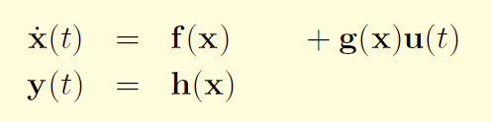



Infinite Horizon Nonlinear Regulator
X
At time step
delta =0.01
t=t0+delta
Given a Nonlinear system of the form :
Calculate
A(x), B(x)
Infinite-Horizon cost function :
Solve ARE for P
Calculate Gain K
Algebraic Riccati Equation :
Calculate Control U
State Update x
Feedback Controller :
Q =eye(2);
For
R=[0.001,0.6,1]
q = q + 1
The system
Notes:
practical suboptimal solution is to implement the asymptotic control law based on the algebraic Riccati equation (ARE), also known as Frozen Time Riccati Equation (FTRE).

Slide 15

Infinite Horizon Nonlinear Regulator
MATHIEU EQUATION
q(t) + (α + β cos(ωt))q(t) = b u(t)
The open-loop system is described by
Let q(0) = q0 and ˙q(0) = ˙q0 denote the initial conditions.
The task is to bring the states to the equilibrium [0;0].
In this example we use the parameter values α = 1, β = 1, b = 1, ω = 1. Let Q = eye(2), R2 take values from 0.001 to 1
Notes:
practical suboptimal solution is to implement the asymptotic control law based on the algebraic Riccati equation (ARE), also known as Frozen Time Riccati Equation (FTRE).

Slide 16
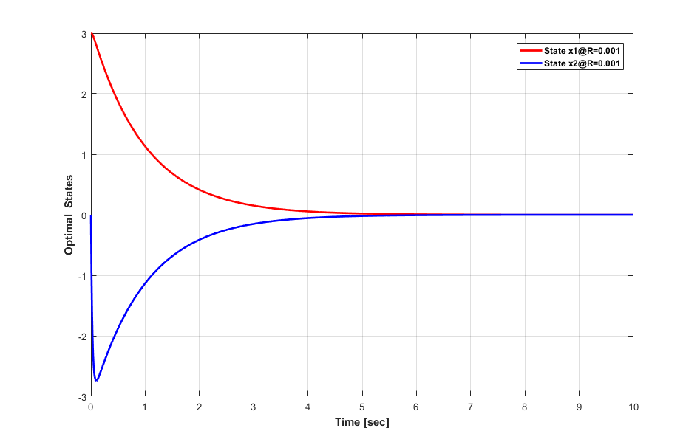
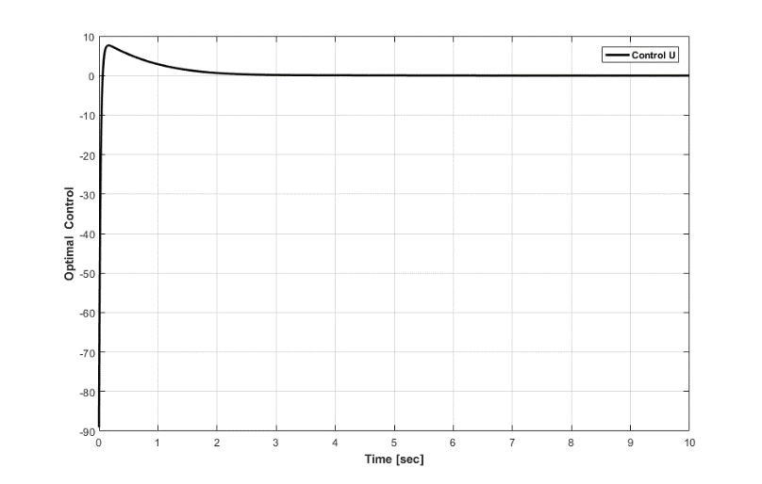
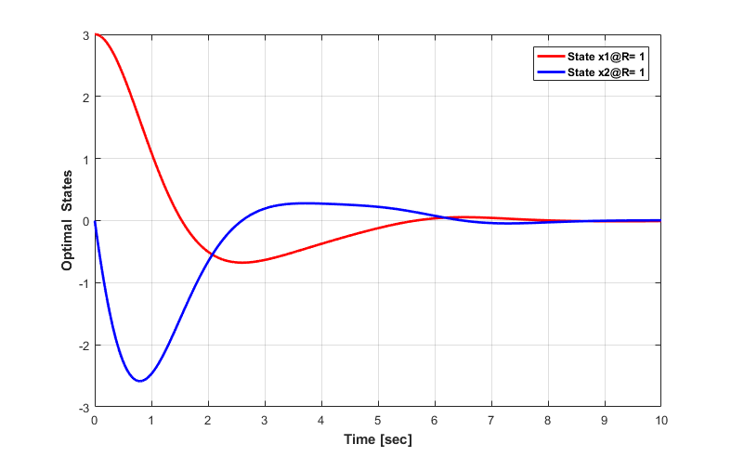
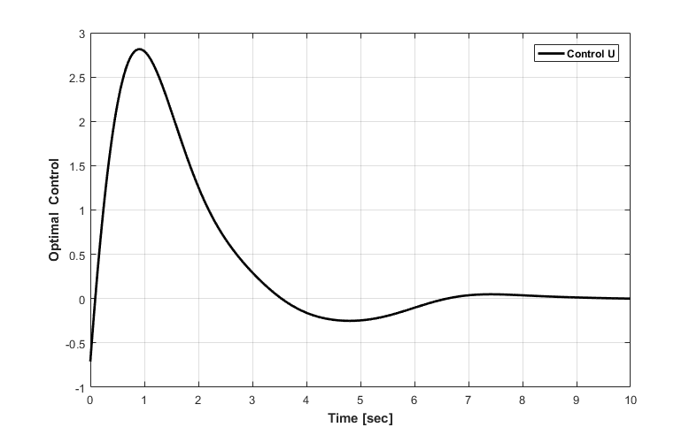
Reference Results
Notes:
practical suboptimal solution is to implement the asymptotic control law based on the algebraic Riccati equation (ARE), also known as Frozen Time Riccati Equation (FTRE).

Slide 17
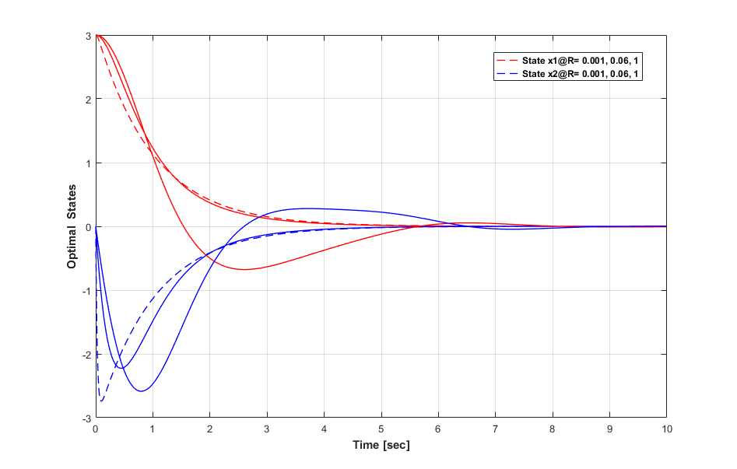
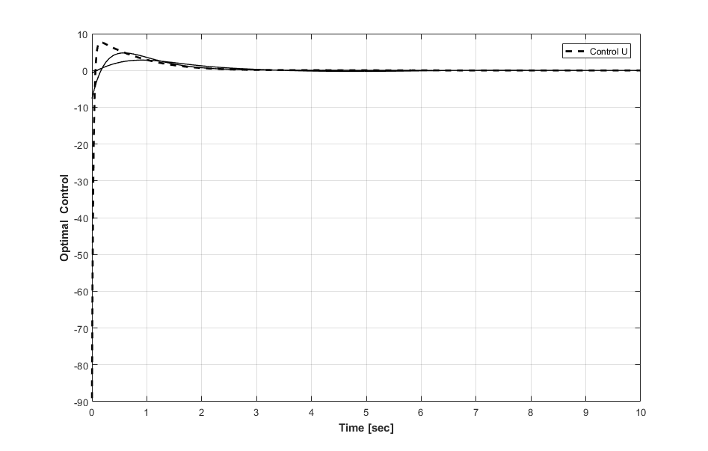
Reference Results
Notes:
practical suboptimal solution is to implement the asymptotic control law based on the algebraic Riccati equation (ARE), also known as Frozen Time Riccati Equation (FTRE).

Slide 18
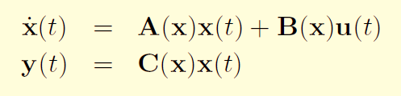
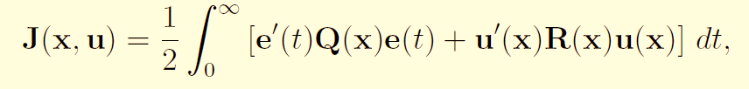

Infinite Horizon Nonlinear Tracking
X
At time step
delta =0.01
t=t0+delta
Given a nonlinear system of the form :
Z(x)
Calculate
A(x), B(x), C(x)
Infinite-Horizon cost function :
Solve ARE for P
Solve AE for G
Algebraic Riccati Equation :
Calculate Control U
State Update x
Feedback Controller :
Q =eye(2);
For
R=[0.001,0.6,1]
q = q + 1
The system
Notes:
practical suboptimal solution is to implement the asymptotic control law based on the algebraic Riccati equation (ARE), also known as Frozen Time Riccati Equation (FTRE).

Slide 19
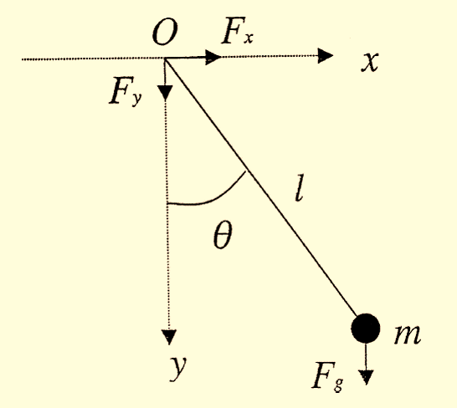

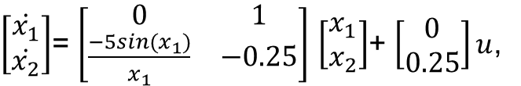



Infinite Horizon Nonlinear Tracking
Force Damped Pendulum
$$ml^{2}\ddot{θ}=mgl\sin{θ}−k\dot{θ}+T$$
$\left[\begin{matrix}\dot{x_{1}} \\ \dot{x_{2}}\end{matrix}\right]$= $\left[\begin{matrix}0 & 1 \\ \frac{−5sin{(x}_{1})}{x_{1}} & −0.25\end{matrix}\right]$ $\left[\begin{matrix}x_{1} \\ x_{2}\end{matrix}\right]$+ $\left[\begin{matrix}0 \\ 0.25\end{matrix}\right]u$,
y(t)= $\left[\begin{matrix}1 & 0\end{matrix}\right]$ $\left[\begin{matrix}x_{1} \\ x_{2}\end{matrix}\right]$
$Q_{1}$=(100,0),$Q_{2}=(110,5)$
$R$= Shown in graph
Notes:
practical suboptimal solution is to implement the asymptotic control law based on the algebraic Riccati equation (ARE), also known as Frozen Time Riccati Equation (FTRE).

Slide 20
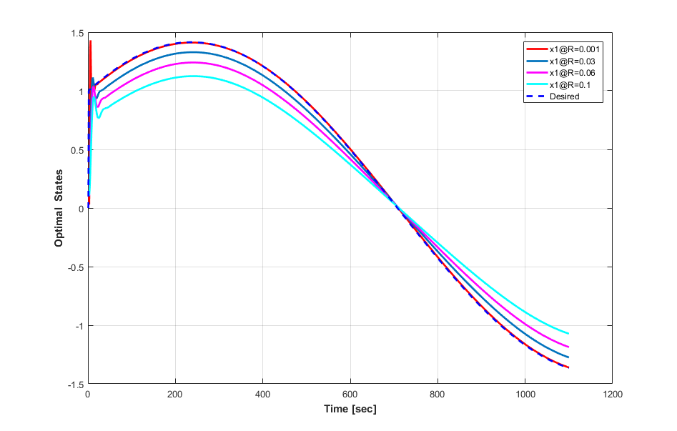
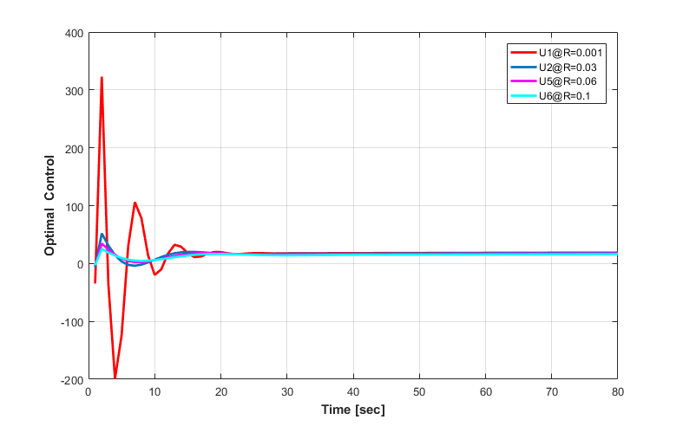
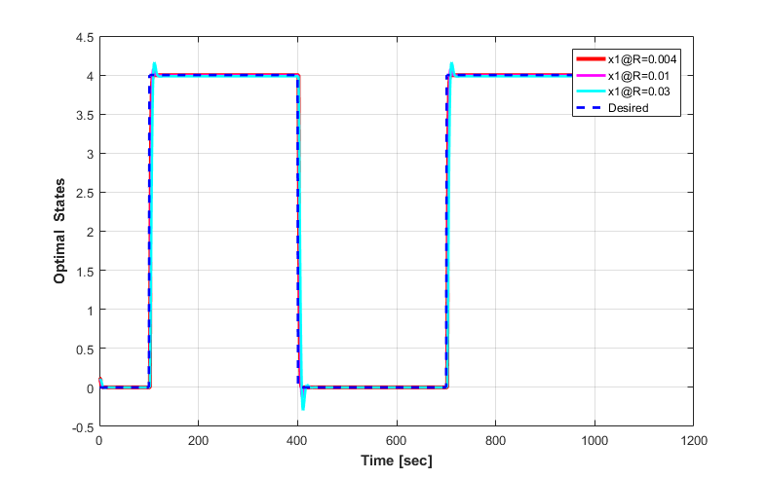
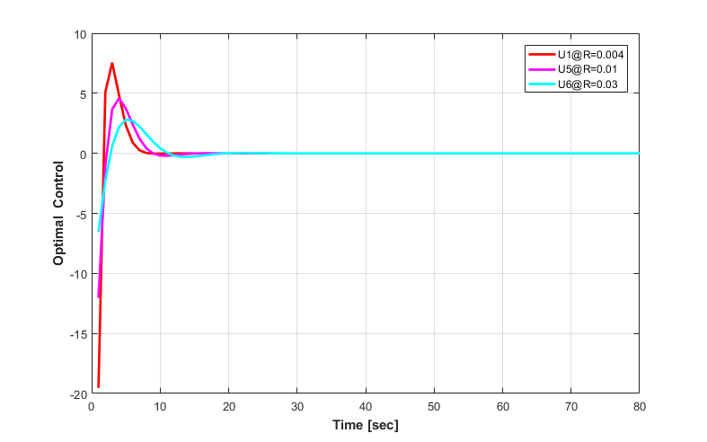
Reference Results
Notes:
practical suboptimal solution is to implement the asymptotic control law based on the algebraic Riccati equation (ARE), also known as Frozen Time Riccati Equation (FTRE).

Slide 21
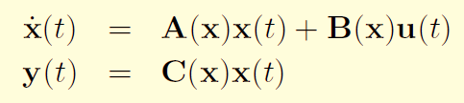
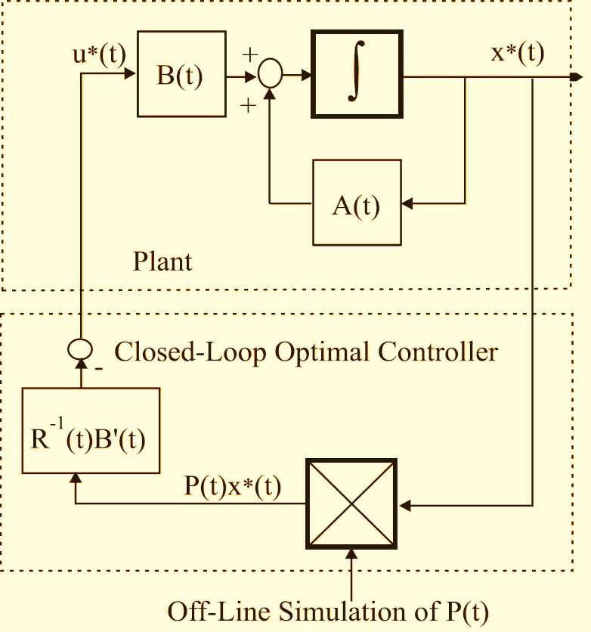
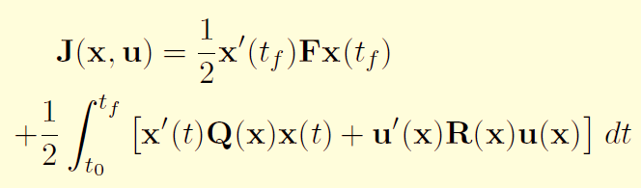
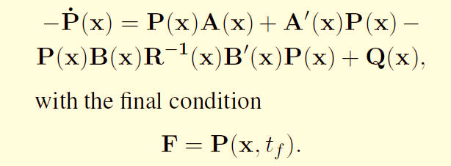


Finite Horizon Nonlinear Regulator
Problem Formulation
Given a Nonlinear System:
Finite-Horizon Cost Function:
Differential Riccati Equation:
The Control U can be formulated as:
Notes:
practical suboptimal solution is to implement the asymptotic control law based on the algebraic Riccati equation (ARE), also known as Frozen Time Riccati Equation (FTRE).

Slide 22
Finite Horizon Nonlinear Regulator
X
At time step t = t0
X = X0
Solve ARE
Calculate
A(x), B(x), C(x)
Pss(x)
Change of Variables
Solve DRE for P
Solve Diff. Lyapunov Eqn.
K(x,t)
Calculate Gain K
Calculate P (x,t)
Next time step
t= t+Δt
Calculate Control U
t<tf
Yes
No
stop
Notes:
practical suboptimal solution is to implement the asymptotic control law based on the algebraic Riccati equation (ARE), also known as Frozen Time Riccati Equation (FTRE).

Slide 23
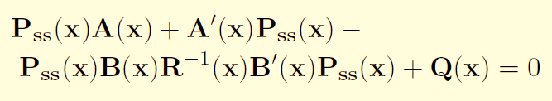



Finite Horizon Nonlinear Regulator
X
At time step t = t0
X = X0
Calculate
A(x), B(x), C(x)
Solve DRE for P
Calculate Gain K
Next time step
t= t+Δt
Calculate Control U
t<tf
Yes
No
stop
Notes:
practical suboptimal solution is to implement the asymptotic control law based on the algebraic Riccati equation (ARE), also known as Frozen Time Riccati Equation (FTRE).

Slide 24
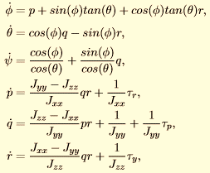
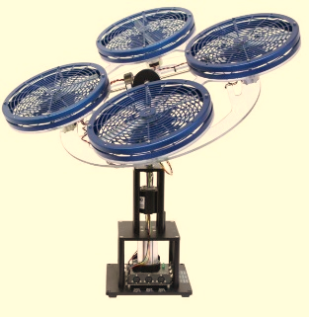
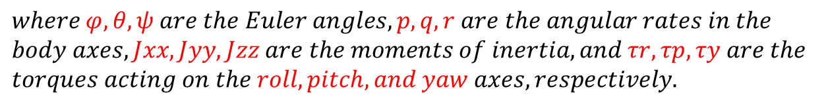
Finite Horizon Nonlinear Regulator
3 DOF HOVER
$$The nonlinear equations of motion of 3DH are given by$$
$$where φ, θ, ψ are the Euler angles, p, q, r are the angular rates in the$$
$$body axes, Jxx, Jyy, Jzz are the moments of inertia, and τr, τp, τy are the$$
$$torques acting on the roll, pitch, and yaw axes, respectively.$$

Slide 25

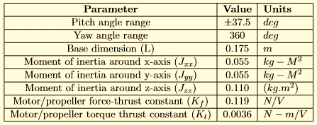
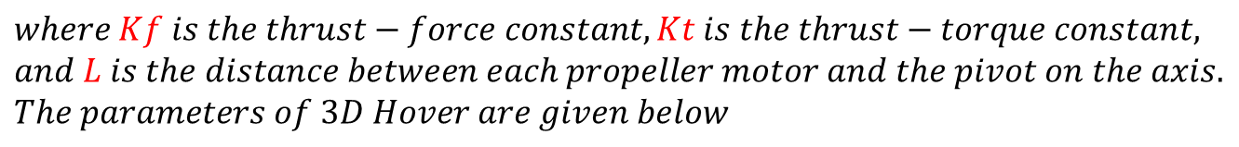
Finite Horizon Nonlinear Regulator
$$Let Vf, Vb, Vr, Vl be the corresponding voltages of the front, back, right,$$
$$and left motors. The torques are given by$$
$$where Kf is the thrust−force constant, Kt is the thrust−torque constant,$$
$$and L is the distance between each propeller motor and the pivot on the axis.$$
$$The parameters of 3D Hover are given below$$

Slide 26
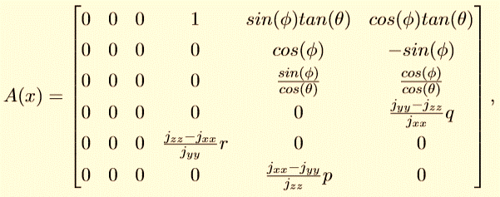
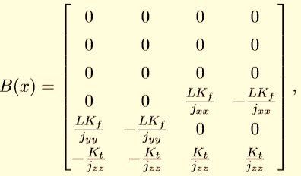







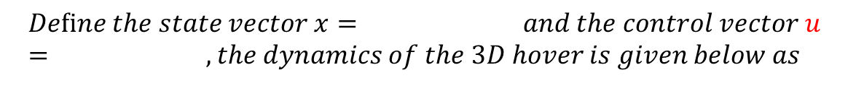

Finite Horizon Nonlinear Regulator
SDC Model 3 DOF HOVER
$$Deﬁne the state vector x= and the control vector u = , the dynamics of the 3D hover is given below as$$
$${[φ,θ,ψ,p,q,r]}^{T}$$
$${[Vf,Vb,Vr,Vl]}^{T}$$
$$Setting the initial condition as$$
$${x_{o}=[2,−2,0,0,0,0]}^{T}$$
$$Weighting matrices are selected as below$$
$$Q=diag(11∗\left(I_{2}\right),\left(I_{4}\right))$$
$$R=0.01(I_{4})$$
$$F=diag(0∗\left(I_{6}\right))$$
$$Let the desired trajectory for φ and θ are$$
$$Z_{1}(t)=0$$

Slide 27
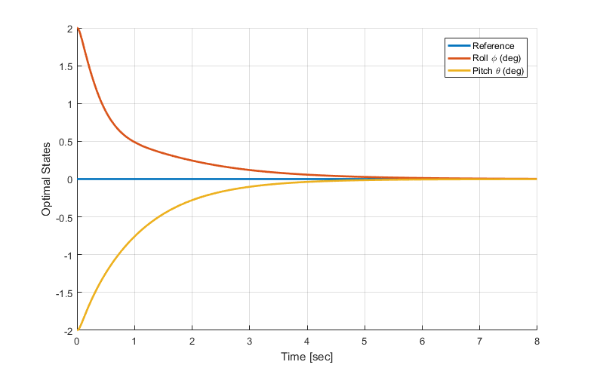
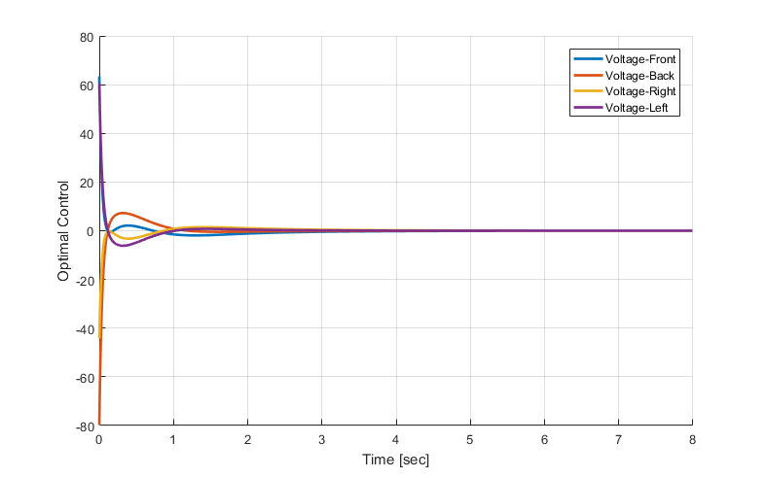
Reference Results
Notes:
practical suboptimal solution is to implement the asymptotic control law based on the algebraic Riccati equation (ARE), also known as Frozen Time Riccati Equation (FTRE).

Slide 28

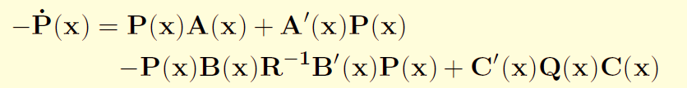
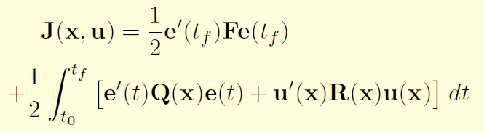



Finite Horizon Nonlinear Tracking
Problem Formulation
Given a Nonlinear System:
Optimal Controller:
Finite-Horizon Cost Function:
With final condition:
Where:
With final condition:
Notes:
practical suboptimal solution is to implement the asymptotic control law based on the algebraic Riccati equation (ARE), also known as Frozen Time Riccati Equation (FTRE).

Slide 29
Finite Horizon Nonlinear Tracking
At time step t = t0
X = X0
Z(t)
Solve ARE
Pss(x)
Change of Variables
Calculate
A(x), B(x), C(x)
Solve Diff. Lyapunov Eqn.
K(x,t)
Calculate P(x,t)
Solve DRE for P(x)
Solve DE for g(x)
Calculate Control U
Solve ARE
gss(x)
Next time step
t= t+Δt
Change of Variables
t<tf
Yes
Solve Diff. Lyapunov Eqn.
Kg(x,t)
No
Calculate g(x,t)
stop
Notes:
practical suboptimal solution is to implement the asymptotic control law based on the algebraic Riccati equation (ARE), also known as Frozen Time Riccati Equation (FTRE).

Slide 30
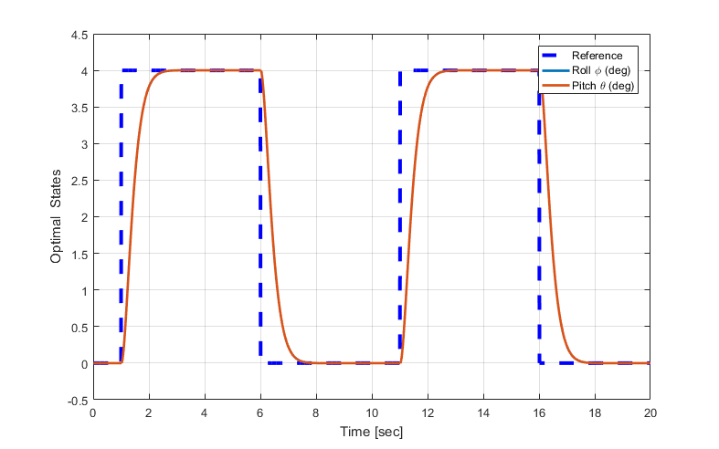
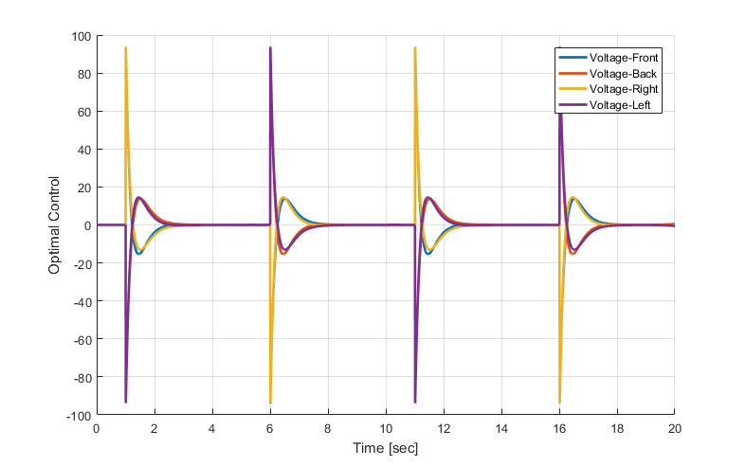
Reference Results
Notes:
practical suboptimal solution is to implement the asymptotic control law based on the algebraic Riccati equation (ARE), also known as Frozen Time Riccati Equation (FTRE).

Slide 31
Conclusion
The State Dependent Riccati Equation (SDRE) provide an eﬀective algorithm for optimal control design for nonlinear dynamical systems. The SDRE algorithm captures the nonlinearities of the system, transforming the original nonlinear system to a linear like structure with State Dependent Coeﬃcient (SDC) matrices, and minimizing a nonquadratic performance index with a quadratic-like structure. The main advantage of SDRE is the ability to make trade oﬀs between control eﬀort and state errors by tuning the SDC
.

