Slide 1




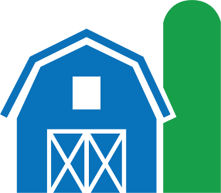



Supporting Public Access to Digital Scientific Data @ NAL
Data Curation Network
July 12, 2023
Peter Arbuckle
Scientific Data Management Branch
Knowledge Services Division
National Agricultural Library, Agricultural Research Service,
United States Department of Agriculture

Slide 2
Overview
Organization at-a-glance
Policy: USDA Departmental Regulation 1020-006
Ag Data Commons
Align Policy, Customer Requirements, and Best Management Practices

Slide 3
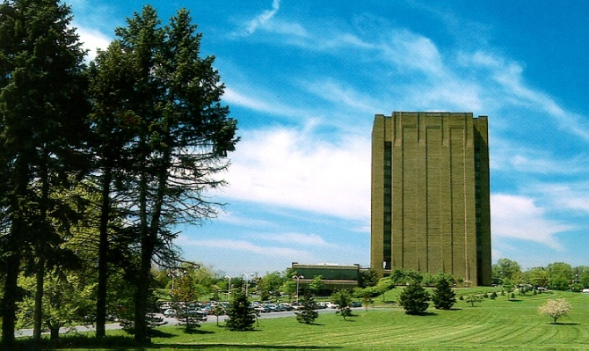
National Agricultural Library
USDA established in 1862…
“to acquire and to diffuse among the people of the United States useful information on subjects connected with agriculture and rural development”
Research, Education, and Economics Mission Area
Agricultural Research Service
National Institute for Food and Agriculture
Economic Research Service
National Agricultural Statistics Service

Slide 4




USDA Departmental Regulation 1020-006: Public Access to Scholarly Publications and Digital Scientific Research Data
Scope: All unclassified scientific research (intramural and extramural) supported wholly or in part by the USDA, regardless of the USDA funding level or funding mechanism
Scholarly Publications must be made publicly accessible via PubAg
Digital Scientific Research Data:
  Data Management Plans must accompany all scientific research
  Public Access to research data is required* through publication on an appropriate repository and a metadata catalog entry in the Ag Data Commons
  (*Excludes data containing PII or other types of sensitive data)
Persistent Identifiers for Researchers (e.g., ORCID iD) must be used by authors of scholarly publications and digital scientific research data assets.

Slide 5
OSTP Memorandum: Ensuring Free, Immediate, and Equitable Access to Federally Funded Research, August 2022
Scope remains the same: All unclassified scientific research (intramural and extramural) supported wholly or in part by the USDA, regardless of the USDA funding level or funding mechanism
New Requirements:
Scholarly Publications must be made publicly accessible via PubAg without embargo
Transparent procedures ensuring scientific/research integrity:
  Persistent identifiers for awards, researchers, and protocols
Coordination and reporting via White House Office for Science and Technology Policy

Slide 6
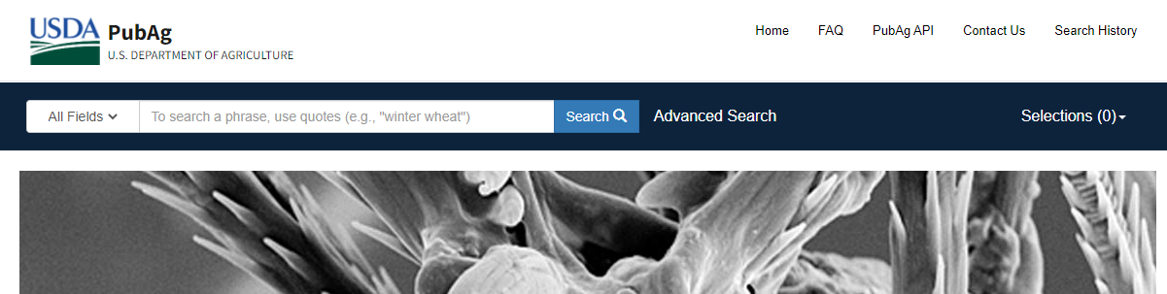
Implementation: PubAg
PubAg is a free, searchable database containing links to:
300,000+ full-text articles relevant to the agricultural sciences
indexed citations to peer-reviewed journal articles in the agricultural sciences
https://pubag.nal.usda.gov/

Slide 7
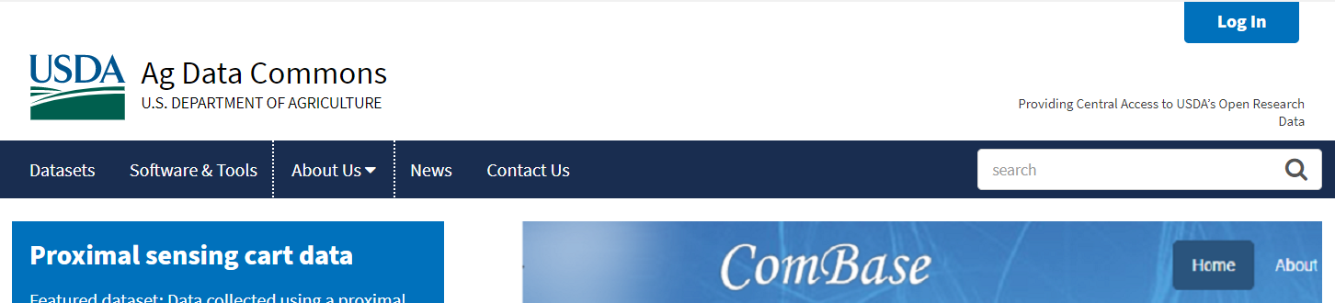
Implementation: Ag Data Commons
https://data.nal.usda.gov
Catalog & data repository for USDA-funded data
Services to create, curate, and enable access to machine-readable scientific metadata (FAIR data)

Slide 8




Implementation: Ag Data Commons services
https://data.nal.usda.gov/
Catalog services support:
Compliance with federal Open Data policy through a feed into data.gov
Cross-domain discovery of agricultural research data through harmonized metadata
Repository services provide:
Public access, storage and preservation for long tail data (data without subject-specific repository)
DOI minting for deposited datasets, making them accessible and citable
Value-added services include:
Expert data curation service and data management consultations
Development of microservices for ingest
Collaborations with customer community on addition of tools and workflows facilitating data analysis and integration

Slide 9


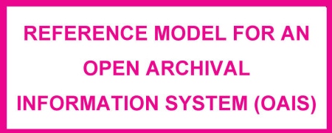
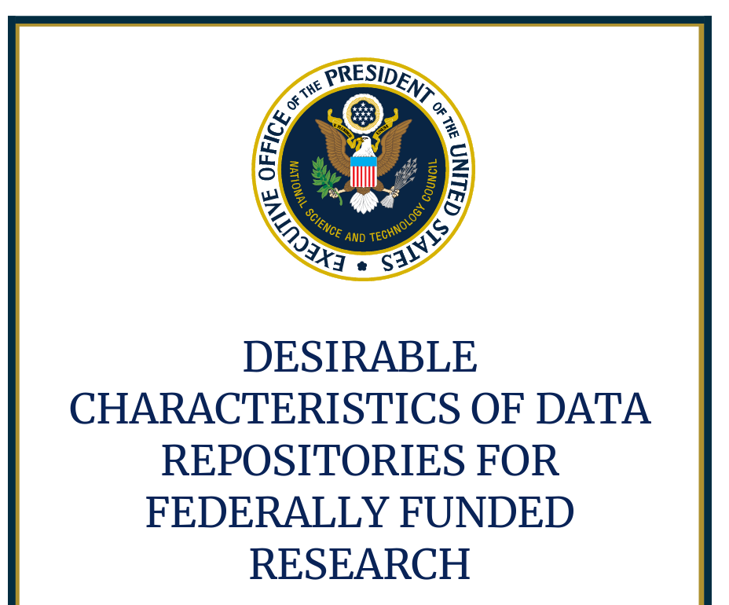

Implementation: Best Management Practices

Slide 10



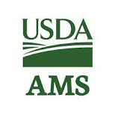



Implementation: Customer Requirements
Embedded within Agricultural Research Service
  Close connection with specific research communities allows us to monitor customer needs
    Training, outreach, tools, services
Extramural Research Support
Working closely with NIFA to build capacity for public access
  Publications and data
  Monitoring and reporting

Slide 11
Implementation: Software as a Service
Decision Analysis and Resolution (DAR) (CMMI-DEV)
Evaluation criteria for new platform for the Ag Data Commons was developed based on:
Polices and Procedures (Program and IT Policy)
Customer requirements
Best Management Practices, including DCDR

Slide 12

Implementation: Figshare
Embedded BMPs, met most of our functional requirements, and Federal technical/security requirements
Emerging community of Federal Users
Department of Homeland Security
EPA’s Center for Computational Toxicology and Exposure
Smithsonian
NIH Generalist Repository Ecosystem Initiative (GREI)
  One of the objectives – align with Desirable Characteristics for Data Repositories (DCDR)

Slide 13
Implementation: Figshare and DCDR
Unique PIDs
Long-term Sustainability
Metadata
Curation & Quality Assurance
Free & Easy Access
Broad & Measured Reuse
Clear User Guidance
Security & Integrity
Confidentiality
Common Format
Provenance
Retention Policy
https://help.figshare.com/article/how-figshare-meets-the-nih-desirable-characteristics-for-data-repositories

Slide 14
Implementation: Figshare and DCDR
Unique Persistent Identifiers
  DOIs for deposited datasets
  Handles for records of datasets deposited elsewhere
  ORCID for authors, Grant ID (Dimensions)
NAL provides Curation support
Provenance – automated versioning
Adherence to standards – minimization of customization
Dataset-level metrics
Open data only – no PII, no embargo
eAuth for user authentication
AWS Gov Cloud
Plans for developing connection to a preservation System

Slide 15
Summary
NAL is supporting Public Access requirements for USDA-funded research community
Implementation will continuously evolve and is primarily driven by:
Public Access Policy
Customer Requirements
BMPs (including DCDR)
Federal IT Policies and Procedures

