Slide 1

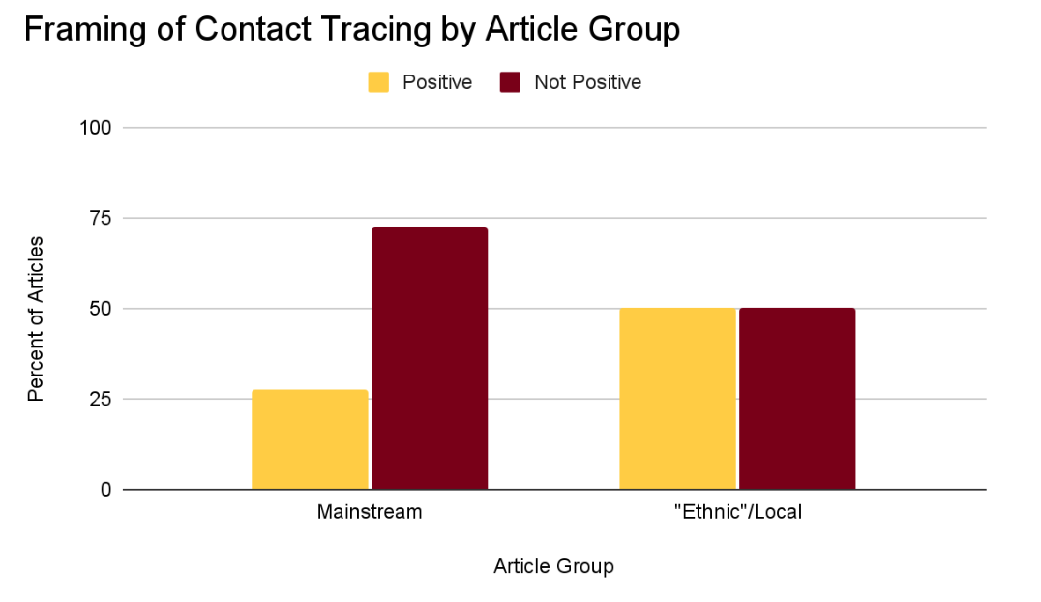
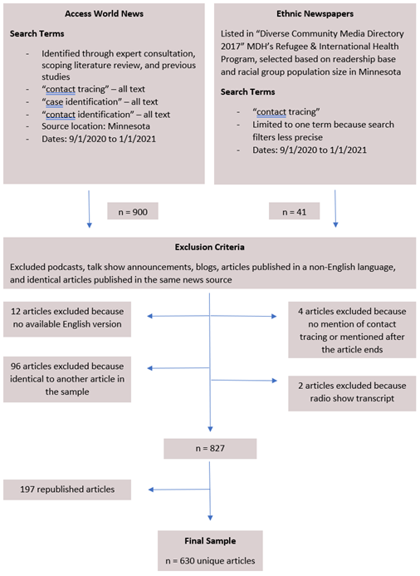
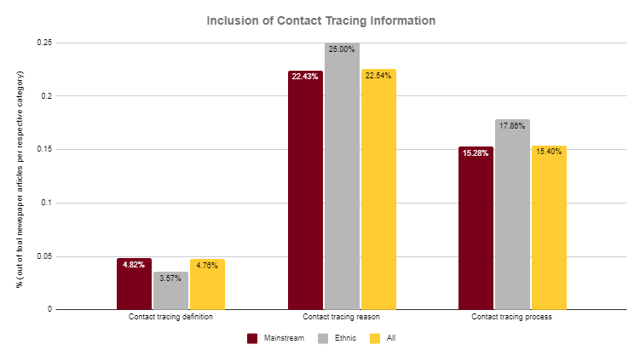
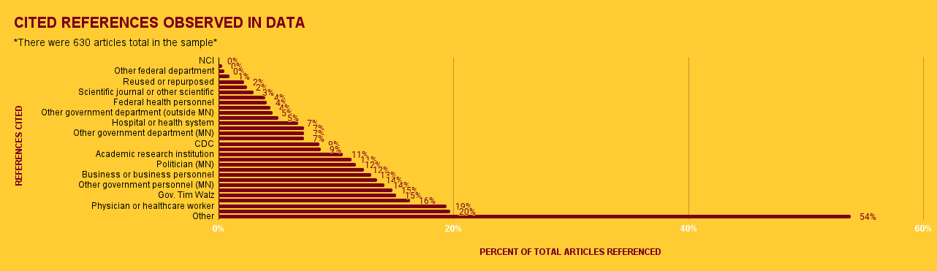
COVID-19 CONTACT TRACING NEWS ENVIRONMENT IN MINNESOTA
Alanalyn N. Pinaula-Toves¹, Maame Amma Adabor¹, Jennifer M. Korthas¹, Hannah T. Kinzer²
University of Minnesota-Twin Cities, 2) Washington University in St. Louis
INTRODUCTION
FRAMING OF CONTACT TRACING
CONCLUSIONS
The uncertain and rapidly evolving nature of the COVID-19 pandemic left much of the world relying on news outlets for the latest public health information. The content of the articles published by these news outlets may therefore have widespread and significant implications on public opinions, beliefs, and behaviors. Contact tracing is a key strategy of coronavirus response utilized by state and local health department personnel that involves locating the source of an outbreak and attempting to minimize the spread of the virus from this source¹. The present descriptive study analyzed content from Minnesota newspaper articles for their portrayal of COVID-19 contact tracing. It used content analysis to examine whether contact tracing was portrayed differently in mainstream versus local “ethnic” newspapers in factors such as the type of newspaper, the content of the information, and overall framing of contact tracing.
Contact tracing was framed positively significantly more often in "ethnic"/local newspapers than in mainstream newspapers.
  This indicates that different audiences received different messages regarding COVID-19 contact tracing. It could lead to differing thoughts, behaviors, and attitudes across audiences regarding COVID-19 contact tracing information.
Contact tracing reasons and processes were mentioned slightly more frequently in "ethnic"/local newspapers than in mainstream newspapers, while contact tracing definitions were mentioned slightly less frequently in "ethnic"/local newspapers than in mainstream newspapers.
  The amount of total contact tracing information was similar across both groups, indicating that the framing of the information, not just the amount, influences the overall message that the audience receives.
*
Figure 1 illustrates the percentage of each article group that framed contact tracing positively (mainstream n=602, “ethnic”/local n=28, total n=630).
Positive framing example: “That means it's critical to continue the measures that can limit the toll: mask-wearing, hunkering down, hand-washing, testing and contact tracing”
Not positive framing example: “Edwards said this week he was feeling better and hoped to be back at practice this week, but contact tracing and cardio evaluation results left the Sun Devils without enough players to play”
“
METHODOLOGY
CONTACT TRACING INFORMATION
REFERENCES
[1] Centers for Disease Control and Prevention (CDC). (2020a). Contact Tracing: Part of a Multipronged Approach to Fight the COVID-19 Pandemic Certain core principles of contact tracing must always be adhered to : 1–5. https://www.cdc.gov/coronavirus/2019-ncov/downloads/php/principles-contact-tracing-booklet.pdf
ACKNOWLEDGEMENTS
Figure 2 illustrates the percentage of articles in the 3 categories of news articles (630 articles total in the sample, N = 28 (ethnic), and N = 602 (mainstream)) that included the definition of contact tracing, a reason for it, and its process.
Thank you to our faculty guidance from Dr. Traci Toomey (University of Minnesota School of Public Health) and Dr. Elisia Cohen (University of Minnesota Hubbard School of Journalism and Mass Communication. Data cleaning and data analysis done by Hannah Kinzer (Washington University in St. Louis, Brown School). Funding provided by the Hawley Award for student research (University of Minnesota School of Public Health).
CITED REFERENCES
RESULTS
Contact tracing was framed positively in 50% of “ethnic”/local articles and 27.57% of mainstream articles, indicating that contact tracing was framed positively significantly more often in “ethnic”/local articles than in mainstream articles (Chi^2 value of 6.5930). * = significant difference with a p-value of 0.05.
Across all news articles categories: the inclusion of a definition of contact tracing was in <5% of articles, a reason for contact tracing was included in ≤ 25%, and an outline of the contact tracing process was included in >18%.
Other references which included out-of-state news agencies and sports coaches, were cited most often in over half (54%) of articles in the 630 sample. Physician/Healthcare Workers came in second with a value of 20%. The NCI, Other Federal Departments, and Reused/ Repurposed articles were cited the least at a value of 0%. (See Figure 3)
CONTACT INFORMATION
Maame Amma Adabor: adabo004@umn.edu
Alanalyn Pinaula-Toves: pinau003@umn.edu
Jennifer Korthas: korth073@umn.edu
Figure 3 illustrates who was referenced in the 630 total article samples that were observed in the data

