Slide 1

ReThink: Connecting Libraries to Metacognition, Student Learning, and Student Success
LOEX | May 2016

Slide 2


Slide 3
Who is in the room?

Slide 4
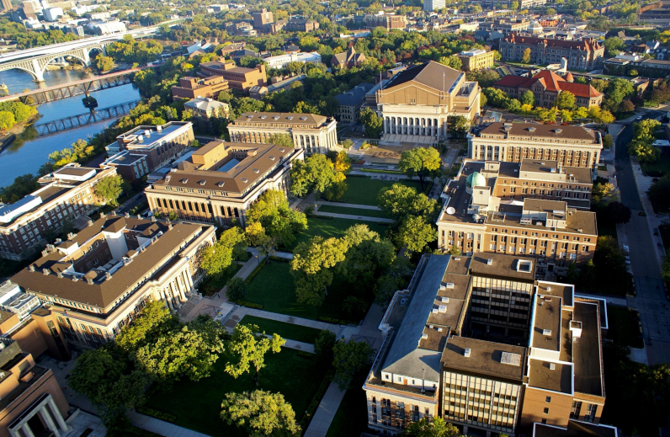

Slide 5
Learning Outcomes
Learners will:
be able to define metacognition in order to apply it to library tools
be able to brainstorm ways to apply metacognition and student engagement to your own instruction programs, services and spaces in order increase student learning.

Slide 6
Path
Metacognition
(ReThink) Student Success
ReFrame
Strengths approach to research
Connecting spaces and learning
Workshop on productivity (and metacognition)

Slide 7
Our own assumptions

Slide 8
Assumptions
Research process: Students know about workflow. Students know they need to plan out the steps of research/project.
Space: Students know why we have (and are making more) spaces for them to study (collaborate).
Services: Students know how libraries/librarians can help.
Instruction: (When we teach about a specific tool or assignment) Students are able to transfer those skills to their other assignments, future work, etc.

Slide 9
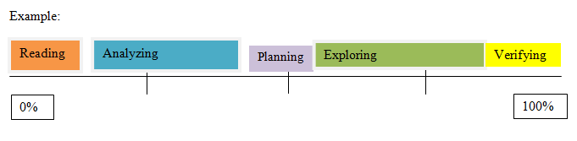
Learning Activity:
How much do students think about process and workflow? Plot out your assumptions on the handout. Although, there are other categories, let’s focus on these five. Try to refrain from worrying about order.
Analyzing
Exploring
Reading
Planning
Verifying

Slide 10
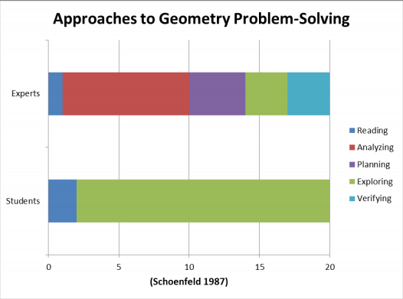

Slide 11
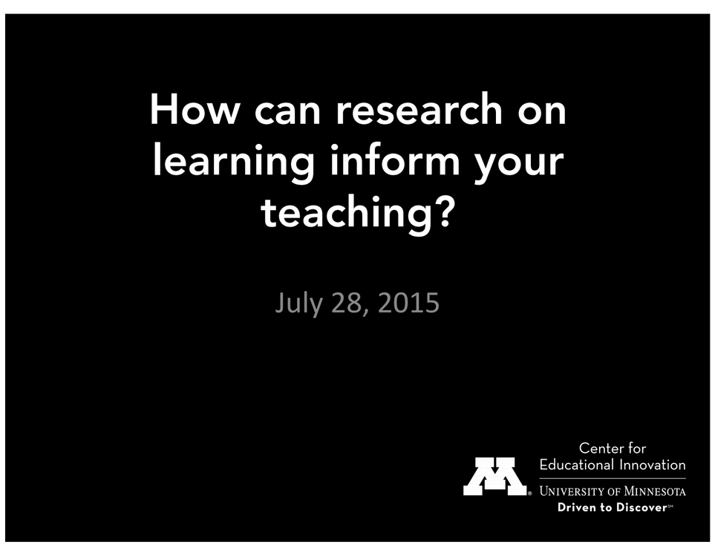
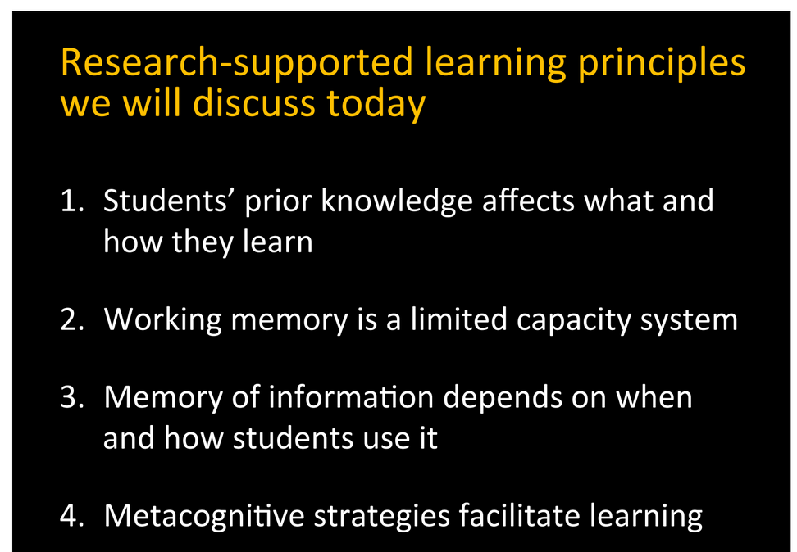

Slide 12
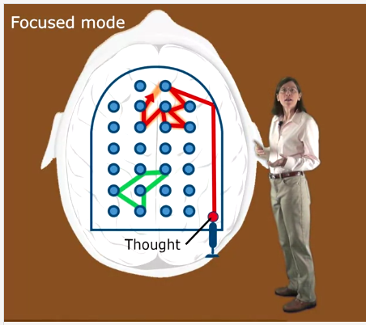
MOOC:
Learning How to Learn
https://www.coursera.org/learn/learning-how-to-learn
Memory
Chunking
Focused and Diffuse Thinking
Procrastination

Slide 13
Metacognition
awareness & understanding of one's own thought processes

Slide 14
Metacognition
What are you learning?
How are you learning?
vs.
(Weimer, 2012)

Slide 15
Metacognition
Cognitively passive
Cognitively active
vs.
(Weimer, 2012)

Slide 16
Metacognition
Metacognition is one’s ability to use prior knowledge to plan a strategy for approaching a learning task, take necessary steps to problem solve, reflect and evaluate results, and modify one’s approach as needed. It helps learners choose the right cognitive tool for the task and plays a critical role in successful learning.
(Fact sheet: Metacognitive processes, 2012)

Slide 17
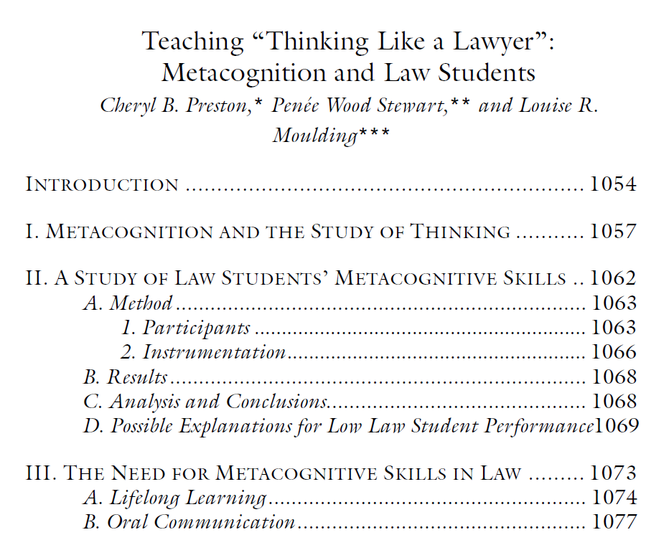
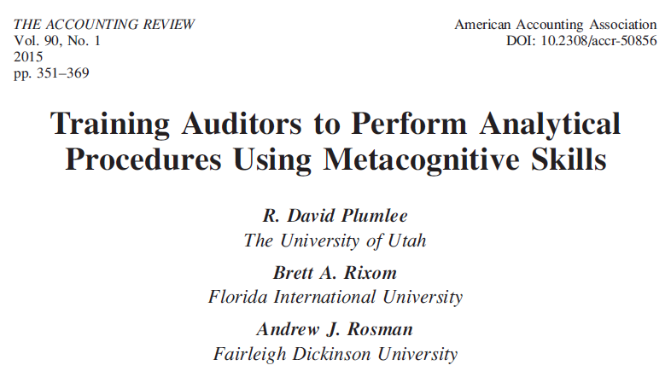
As seen in the literature

Slide 18
metacognitive skill development improves learning
Monitoring one's own comprehension of text
Evaluating progress
Planning approach to a learning task
Using skills and strategies to solve problems
Becoming aware of distracting stimuli
Self-assessing
=> self correcting
(Fact sheet: Metacognitive processes, 2012)

Slide 19
Metacognition
Threshold concepts

Slide 20
"This Framework depends on these core ideas of metaliteracy, with special focus on metacognition, or critical self-reflection, as crucial to becoming more self-directed in that rapidly changing ecosystem."

Slide 21
Dispositions
Authority is Constructed and Contextual -- "develop awareness of the importance of assessing content with a skeptical stance and with a self-awareness of their own biases and worldview"
Research as Inquiry -- “value persistence, adaptability, and flexibility and recognize that ambiguity can benefit the research process”
Research as Inquiry -- “seek appropriate help when needed”
Searching as strategic exploration -- “persist in the face of search challenges, and know when they have enough information to complete the information task”

Slide 22
(ReThink) Student Success

Slide 23

Student Success - Background Theories
Tinto (1997) - Academic integration and social integration
Austen (1984) - Input - Environment -Outcomes framework for student outcomes
Kuh - (2008) “Student engagement is everyone’s work”
High Impact Practices
Environment
Collegiate experiences, organizational/structural factors, students’ engagement/interactions, campus climate, students’ involvement, programs
Outcomes
Students’ learning and development, success (e.g., retention, graduation), academic achievement, satisfaction, civic and community engagement, research activity
Inputs
Students’ background, demographics, pre-college experiences, motivations

Slide 24
Why do we need to care about Student Success (Value)?

Slide 25
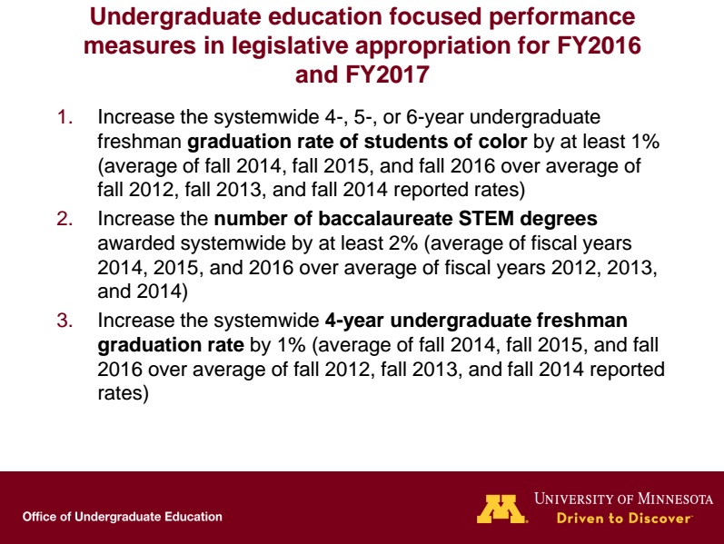
Retention tied to campus budgets by Legislature

Slide 26
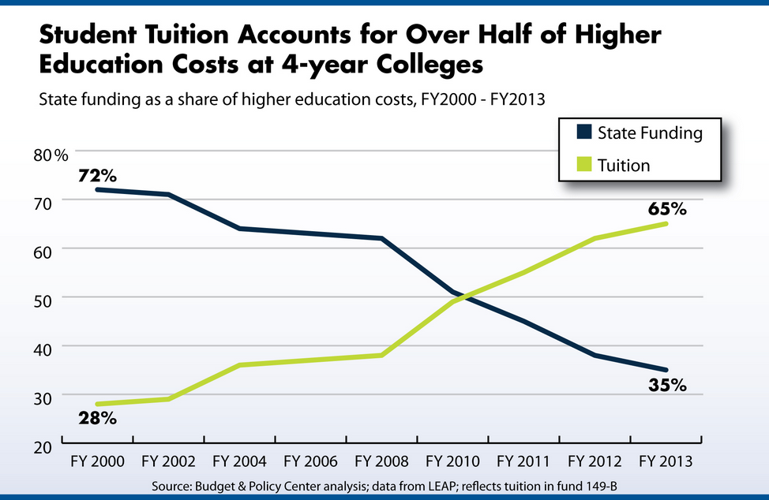

Slide 27
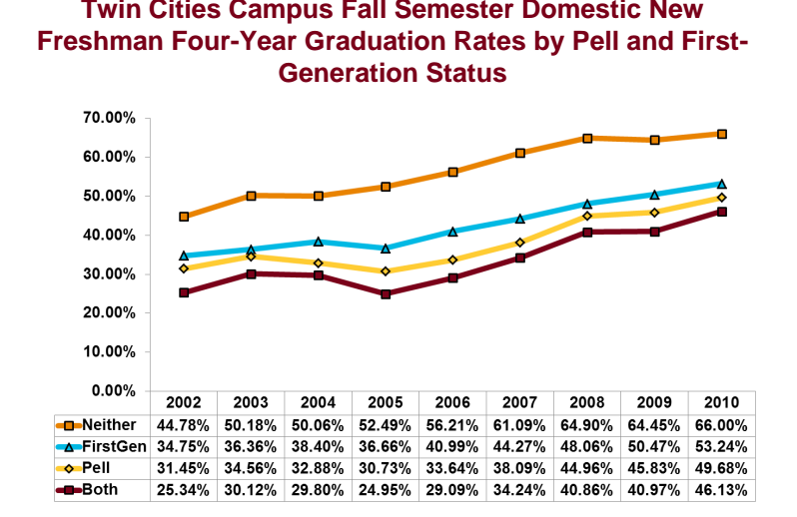

Slide 28

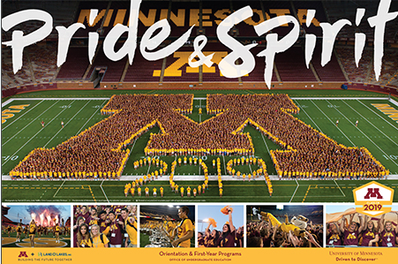
Academic Affairs
Student Affairs

Slide 29

Strengths at the U of MN
Gallup’s Clifton Strengths Finder created in 2001
After taking online assessment -- get “Top 5”
Starting in 2012 -- all incoming first year students took this
during Orientation. (over 95%)
Academic advisers, career services staff, etc. used results in interaction with students
Learn more:
“Knowing Me, Knowing You Building Strengths Awareness, Belonging, and Persistence in Higher Education.” Journal of College Student Retention: Research, Theory & Practice.
“Building a Strengths-Based Campus to Support Student Retention.” Journal of College Student Development, 56(6), 626-631.

Slide 30
Strengths Approach to Research

Slide 31
Strengths Approach to Research
Created research tips for all 34 Strengths
Reframe existing tools and services - but with a context students were already familiar with
It provides a shared mental model with advisers (and career staff)
Program coordinators were looking for ways to integrate Strengths with academics
https://www.lib.umn.edu/strengths

Slide 32
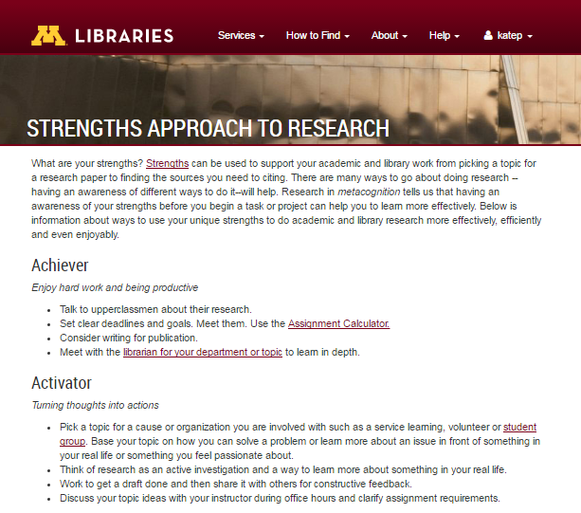

Slide 33
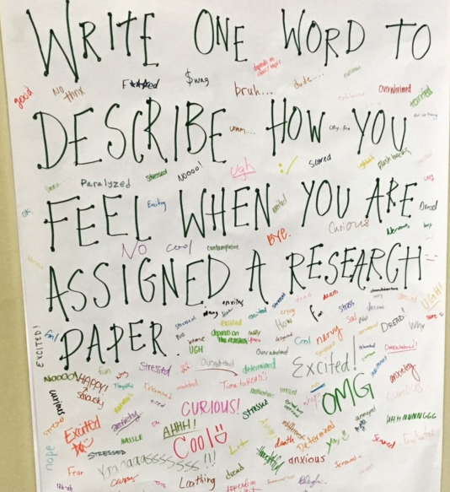

Slide 34
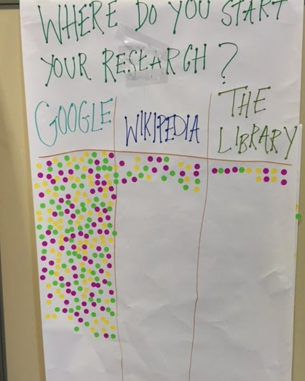

Slide 35
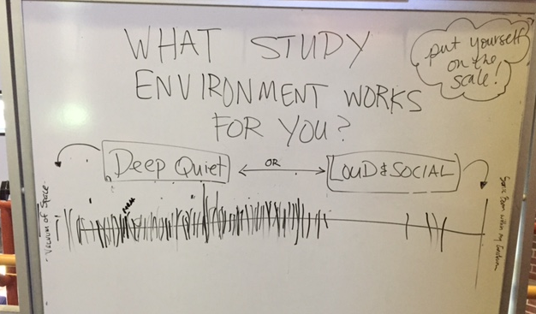

Slide 36
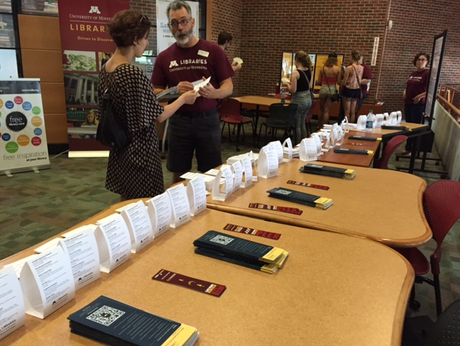

Slide 37
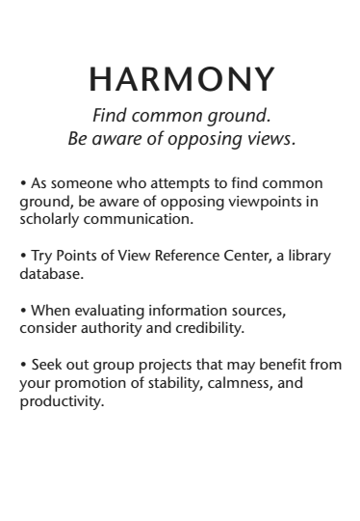
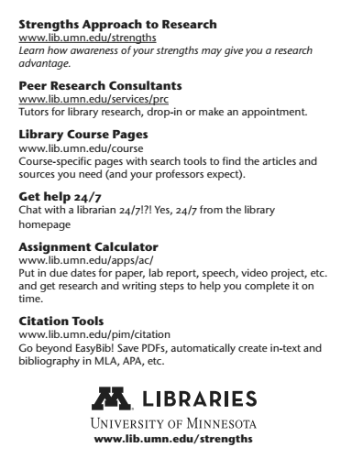

Slide 38
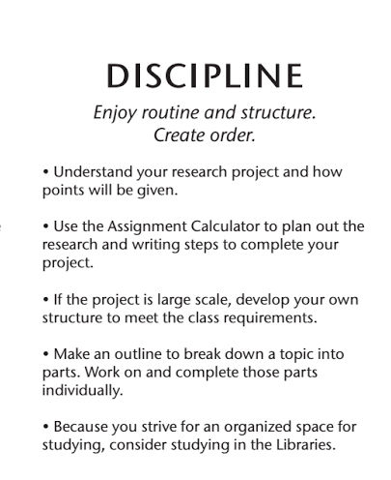
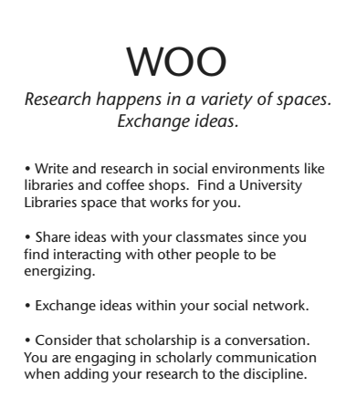

Slide 39
Learning How to Learn with Library Tools for CLA 1001
Be more Productive: Tools from U Libraries

Slide 40
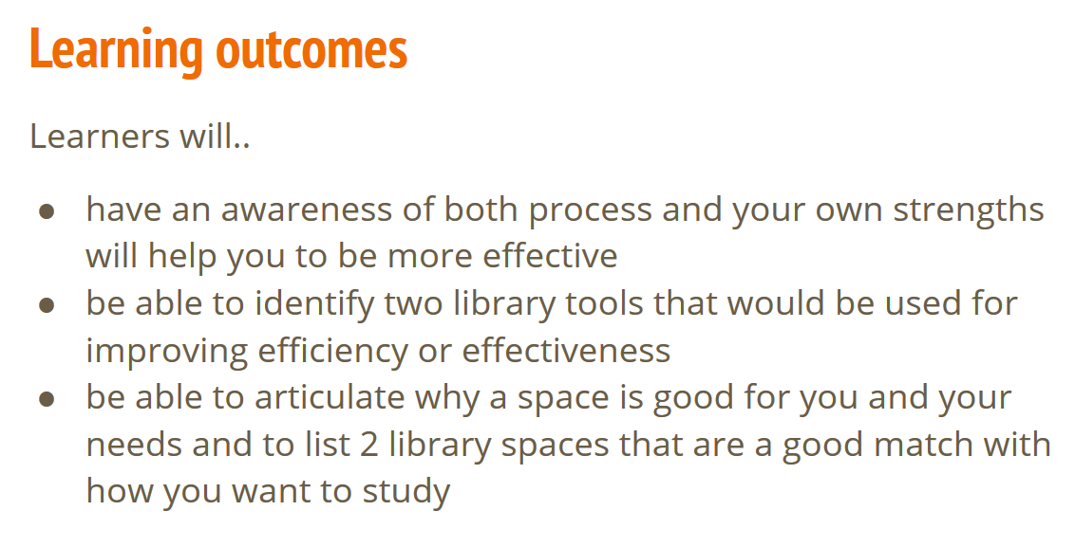

Slide 41
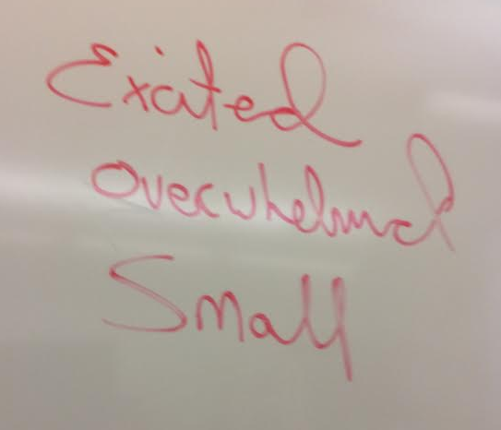
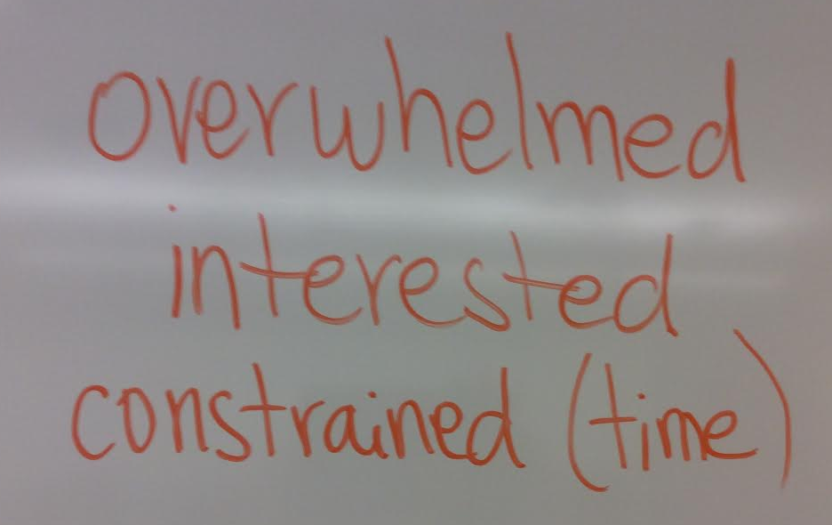
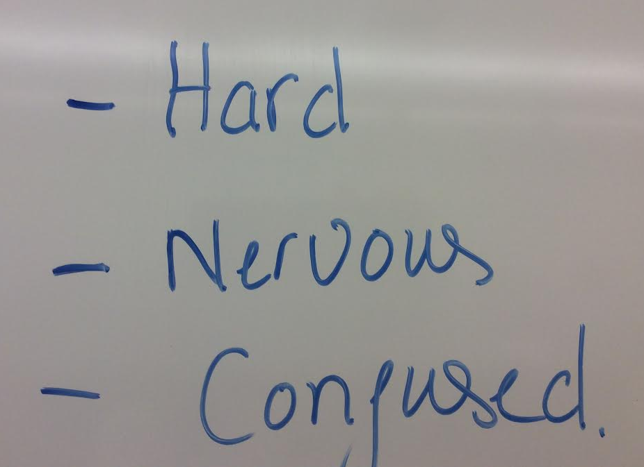

Slide 42
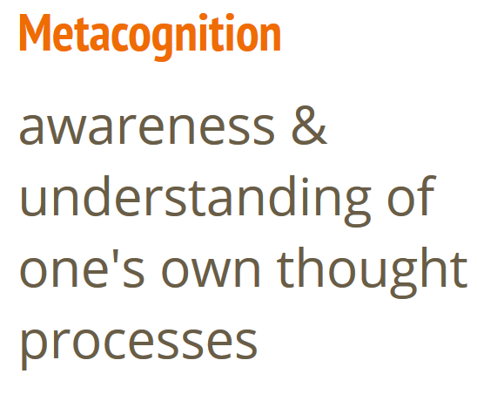

Slide 43
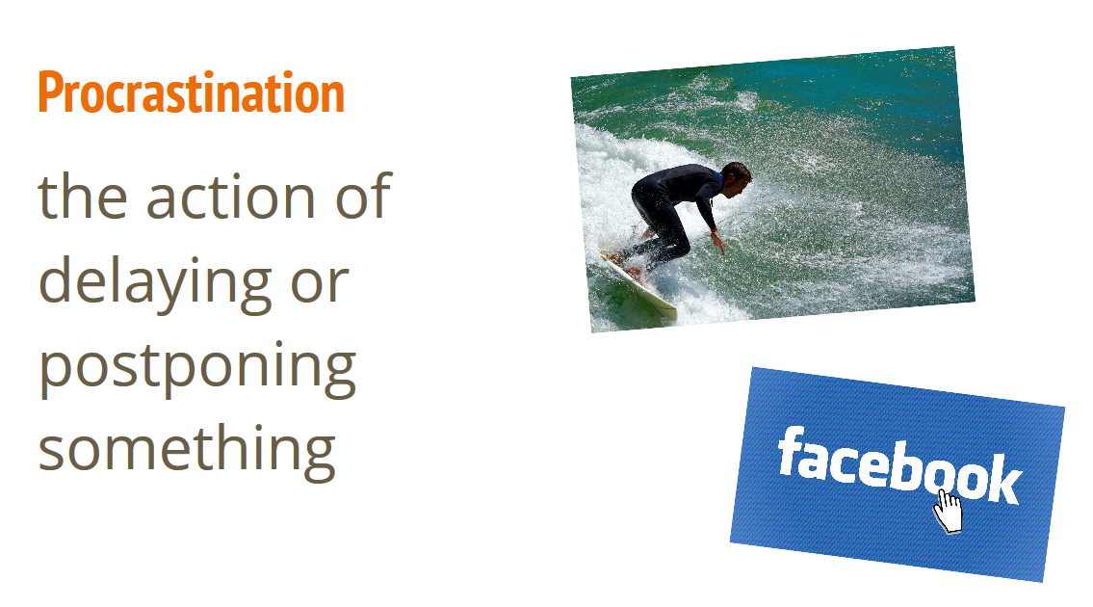

Slide 44
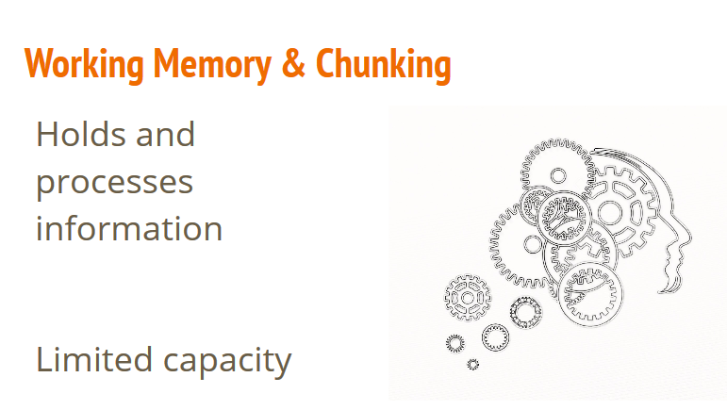

Slide 45
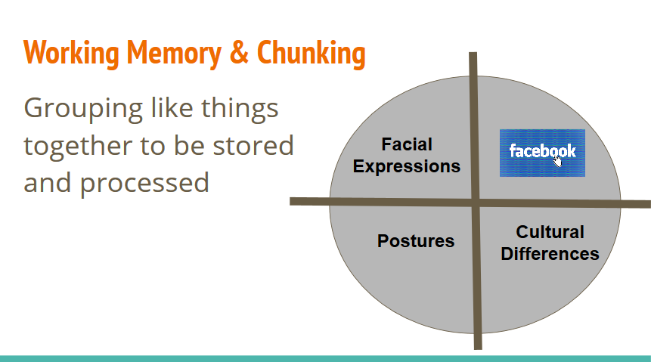
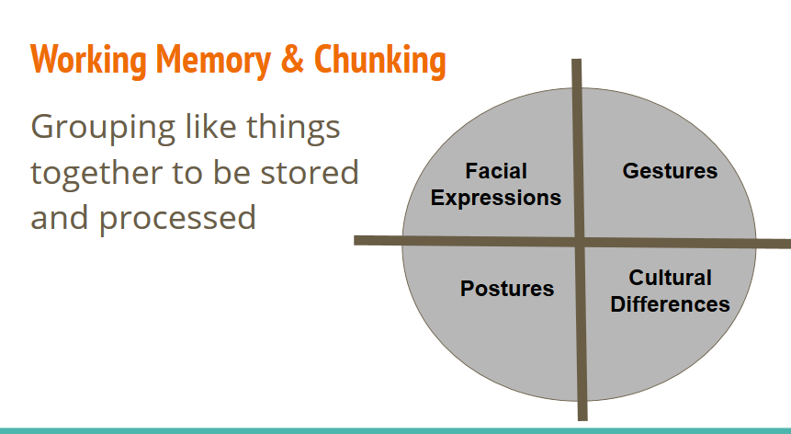

Slide 46
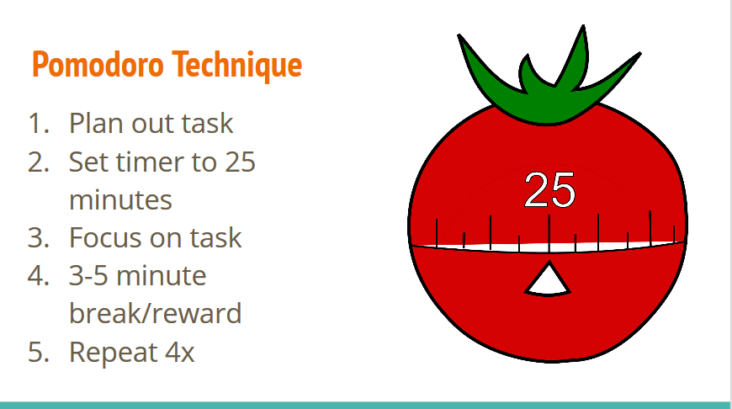
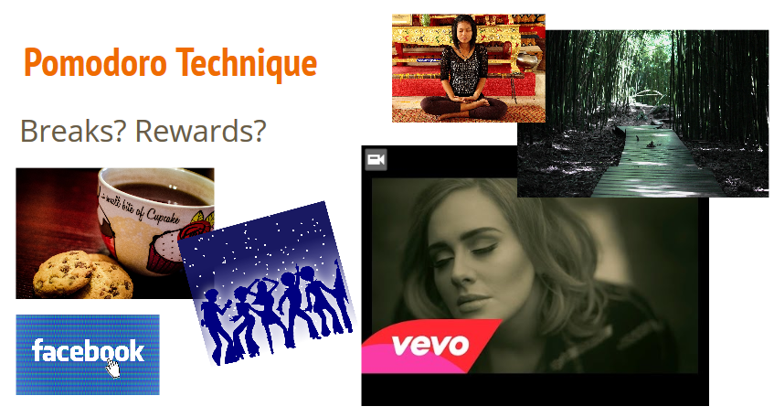

Slide 47
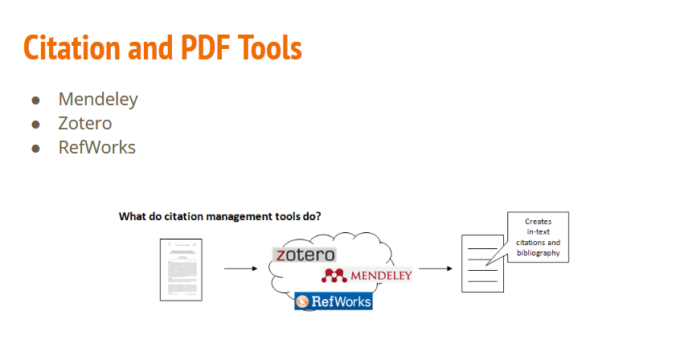
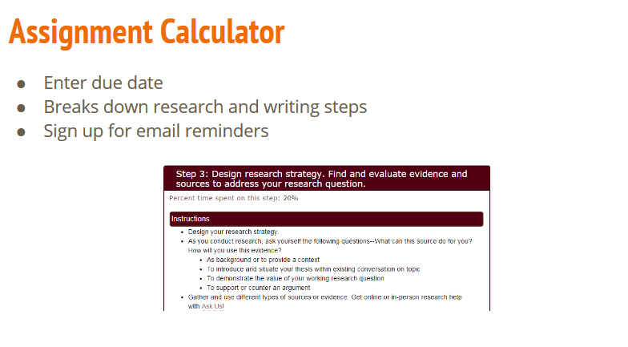

Slide 48




Project management app
Columns and cards
Completing and organizing a to do list
Keeping track of what you have completed
Note Taking
Organize for today & the future
Sync across devices
Try new techniques (e.g. class? per semester?)
Consider searching

Slide 49
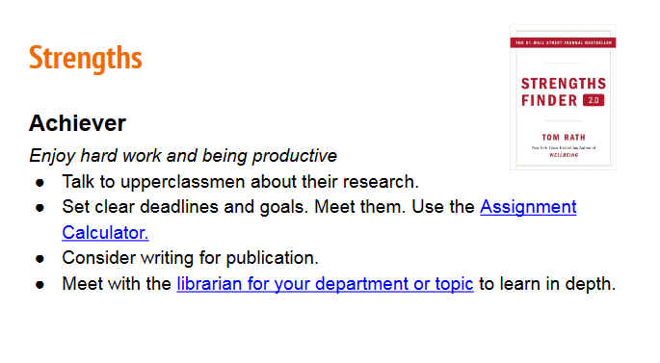

Slide 50
Draw your favorite study space.

Slide 51
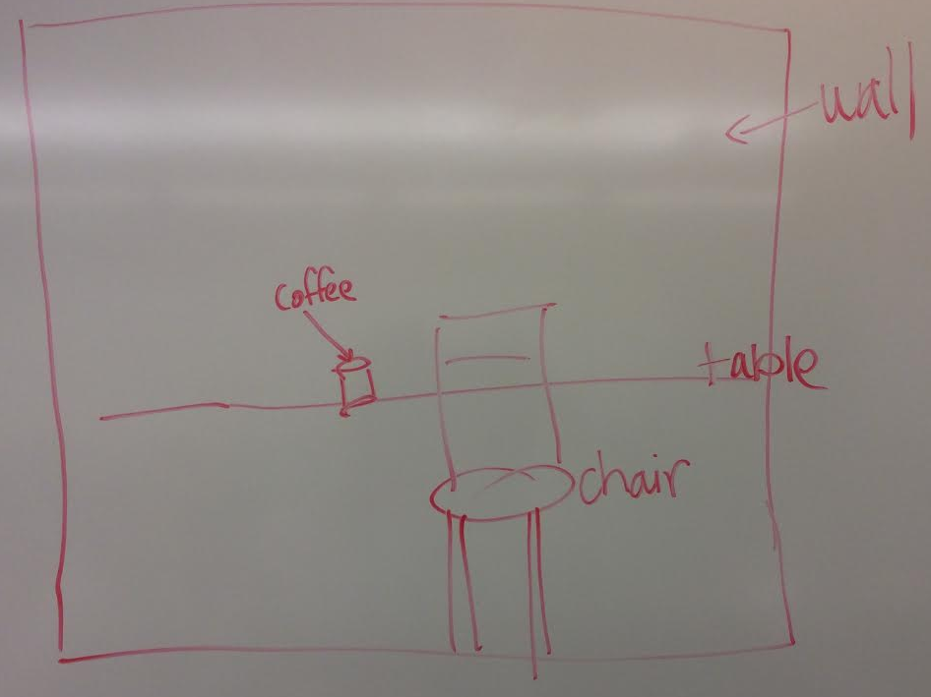
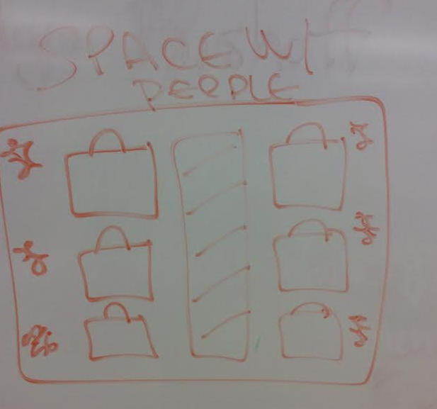
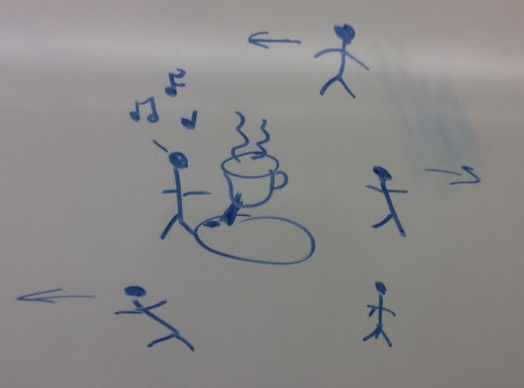

Slide 52
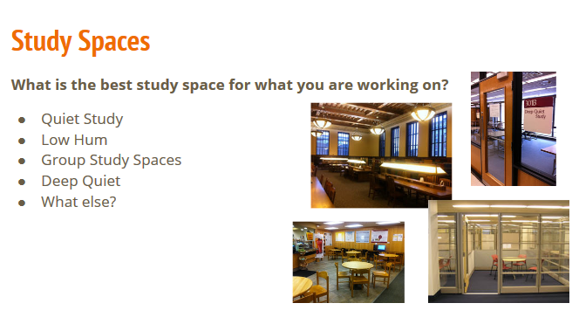

Slide 53
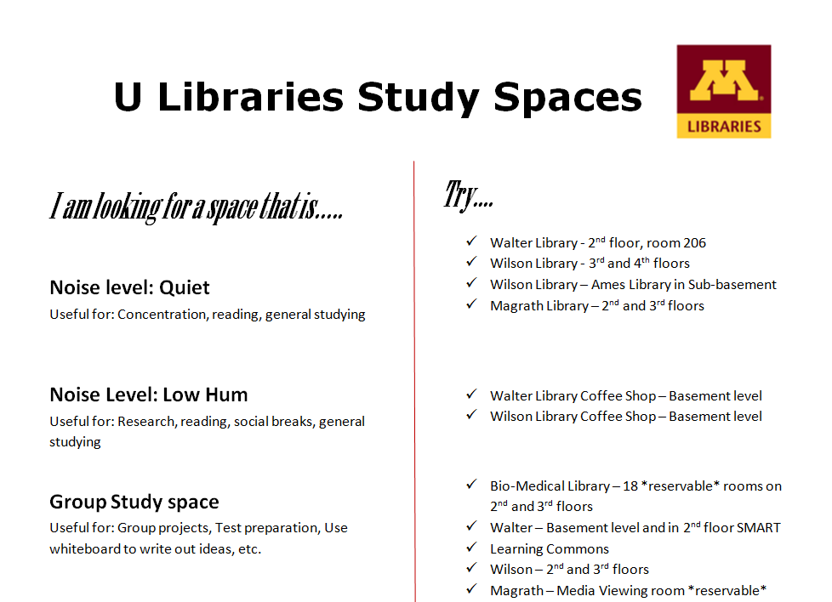

Slide 54

An actual email from a student who attended
Be more Productive: Tools from U Libraries
Hello; I just wanted to give you two some feedback and let you know that the info in Friday's workshop has been helpful to me already, especially the Pomodoro technique. Thanks.

Slide 55
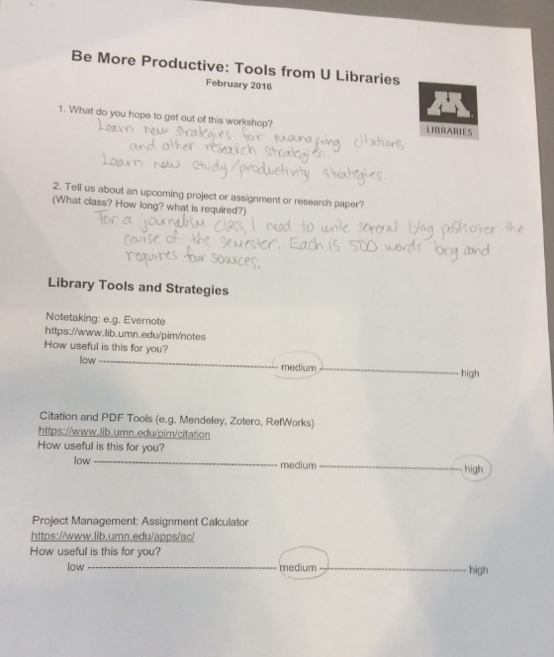
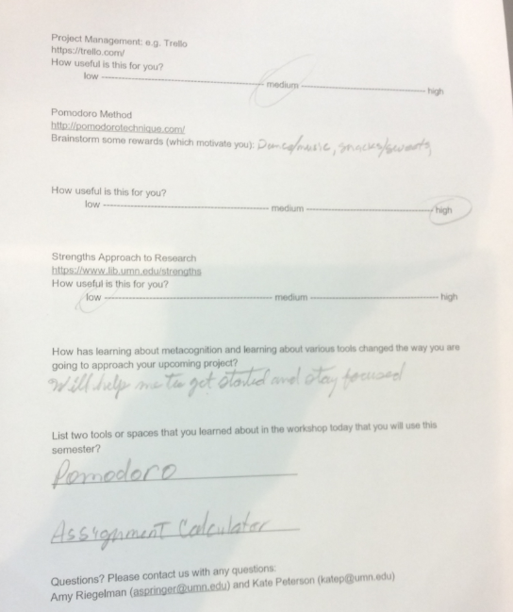

Slide 56
Next steps...

Slide 57
APLUS at UMN
Integrated planning and advising system (IPAS)
“...promotes shared ownership for educational progress among students, faculty, and staff through holistic information and services that contribute to credential completion.”
Used by academic advisers, career services, study abroad offices, etc.
Alerts and notifications
ECAR/EDUCAUSE Report: https://library.educause.edu/resources/2013/8/integrated-planning-and-advising-services-ipas-research

Slide 58
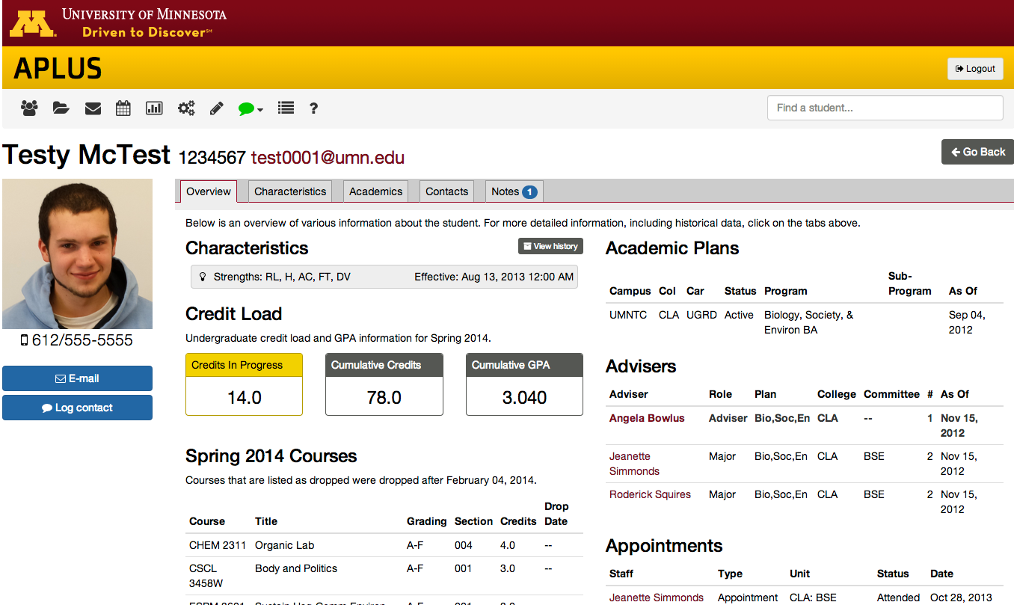

Slide 59
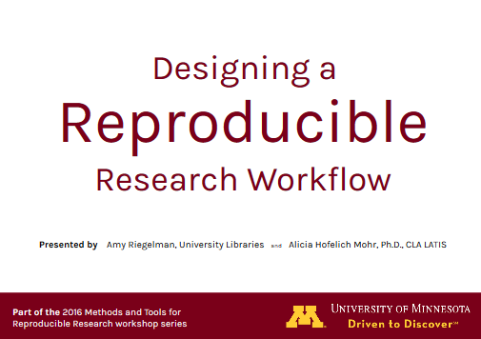
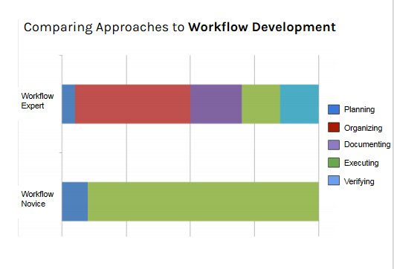

Slide 60
Brainstorm ways to apply metacognition/student engagement to your work

Slide 61
How can you rethink/reframe/give new context to existing services/tools?

Slide 62
Questions?
Amy Riegelman | aspringe@umn.edu
Kate Peterson | katep@umn.edu
z.umn.edu/rethink

Slide 63
References & Resources
Astin, A. W. (1984). Student involvement: A developmental theory for higher education. Journal of College Student Personnel, 25(4), 297-308.
Chick, N. (n.d.) Metacognition. Center for Teaching Guides. Retrieved from cft.vanderbilt.edu/guides-sub-pages/metacognition/
Fact sheet: Metacognitive processes. (2012, February) Just Write! Guide. TEAL: Teaching Excellence in Adult Literacy. Retrieved from https://teal.ed.gov/tealguide/metacognitive
Framework for Information Literacy (http://www.ala.org/acrl/standards/ilframework)
Integrated Planning and Advising Services (https://library.educause.edu/resources/2013/8/integrated-planning-and-advising-services-ipas-research
Kuh, G. D. (2005). Student Engagement in the First Year of College. In Challenging and Supporting the First-Year Student: A Handbook for Improving the First Year of College, edited by M. L. Upcraft, J. N. Gardner, and B. O. Barefoot, 86-107. San Francisco: Jossey-Bass.
Kuh, G. D., & Gonyea, R. M. (2003). The role of the academic library in promoting student engagement in learning. College & Research Libraries, 64(4), 256-282.

Slide 64
References & Resources (cont.)
Schoenfeld, A. H. (1987). What’s All the Fuss About Metacognitlon. Cognitive Science and Mathematics Education, 189.
Soria, K. M., & Stubblefield, R. (2015). Building a Strengths-Based Campus to Support Student Retention. Journal of College Student Development, 56(6), 626-631.
Soria, Krista M., & Stubblefield, Robin. (2015). Knowing Me, Knowing You: Building Strengths Awareness, Belonging, and Persistence in Higher Education. Journal of College Student Retention: Research, Theory & Practice, 17(3), 351-372.
Tanner, K. D. (2012). Promoting student metacognition. CBE-Life Sciences Education, 11(2), 113-120.
Tinto, V. (1997). Classrooms as communities: Exploring the educational character of student persistence. Journal of Higher Education, 599-623.
Weimer, M. (2012, November 19). Deep learning vs. surface learning: Getting students to understand the difference. Retrieved from the Teaching Professor Blog from facultyfocus.com/articles/teaching-professor-blog/deep-learning-vs-surface-learning-getting-students-to-understand-the-difference/.

