Slide 1
Learning Contact-Rich Manipulation Skills by Leveraging Multisensory Input
Final Project for CSCI 5980: DeepRob
Fall 2024
University of Minnesota
Group 5: Mason Hawver, Ryan Diaz, and Hanchen Cui

Slide 2
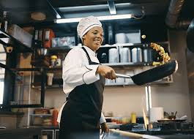
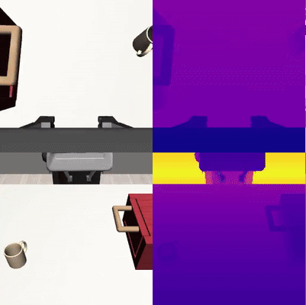


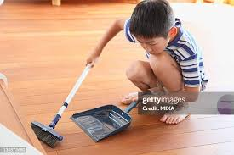
Pretraining
Vision Encoder
Policy
Pretrained
Vision Encoder
Vision Encoder
Policy
Vision Encoder
Policy

Slide 3
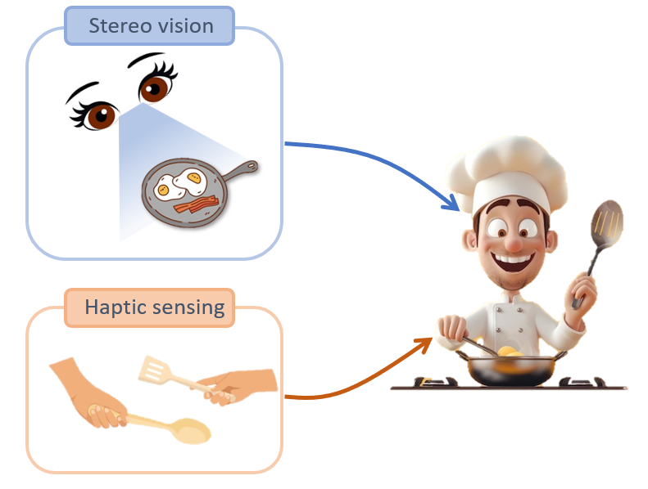
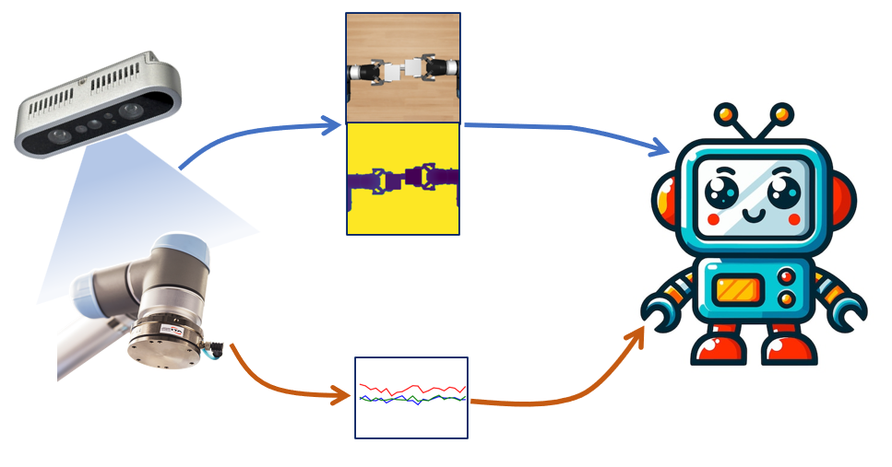
Multisensory Information

Slide 4
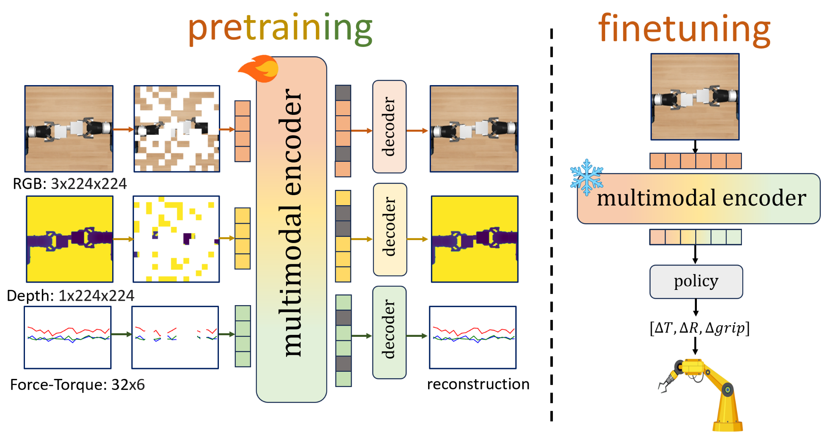

Multisensory Pretraining

Slide 5
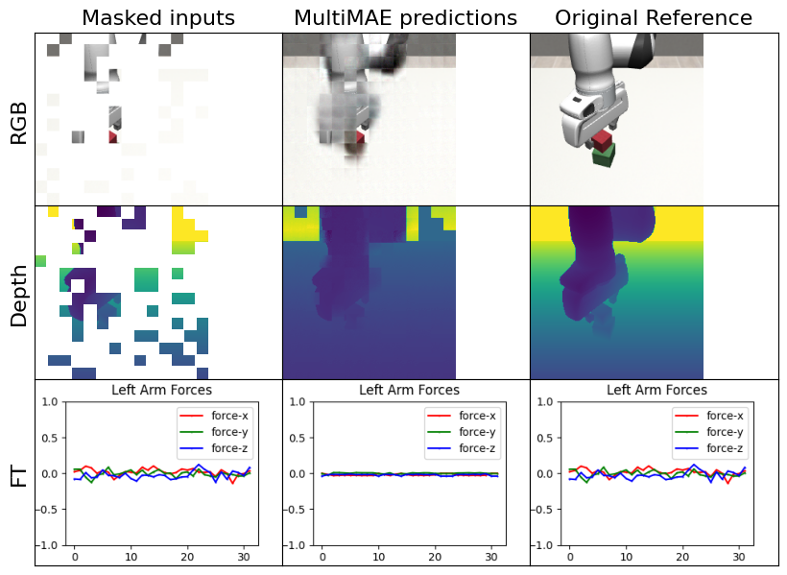
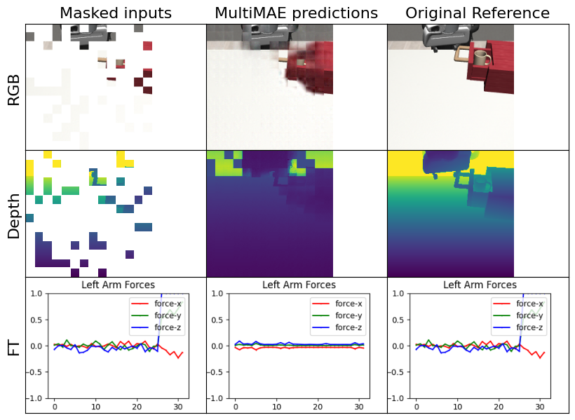
Results: Masked Reconstruction

Slide 6
Note: Hanchen did record the last two slides, but we lost the audio. And he left before he could record again. Don’t mark him off it was our fault not his.

Slide 7
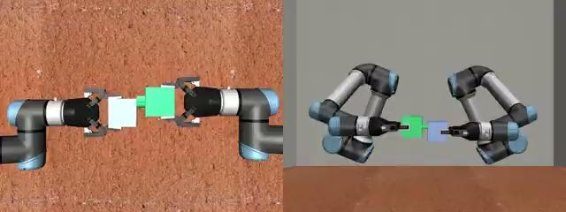





Results: Peg-In-Hole Task
0/20 successful rollouts
7/20 successful rollouts
10/20 successful rollouts

Slide 8
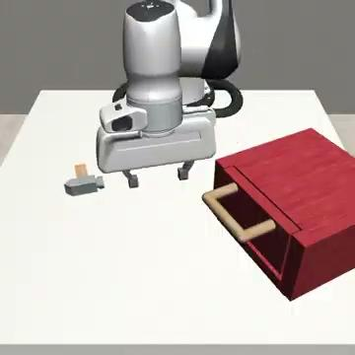
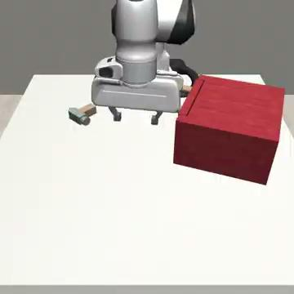
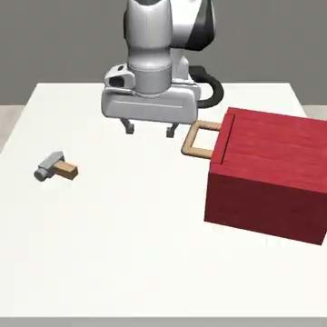
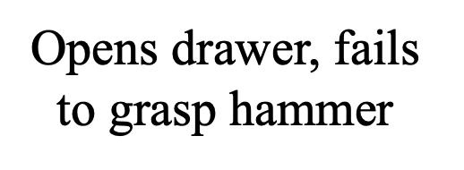
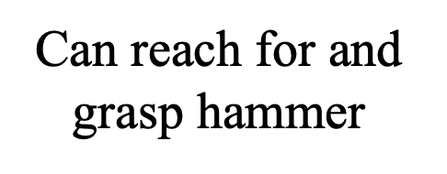
Results: Hammer Cleanup Task

Slide 9
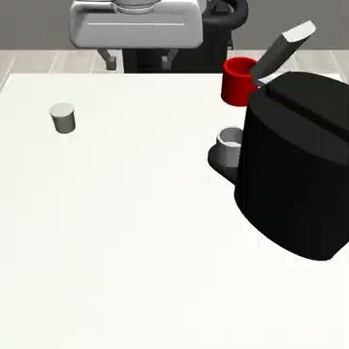
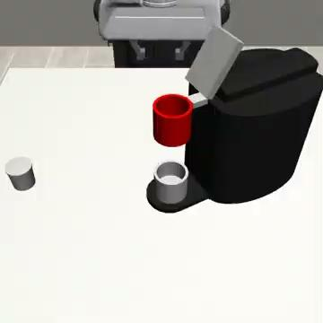
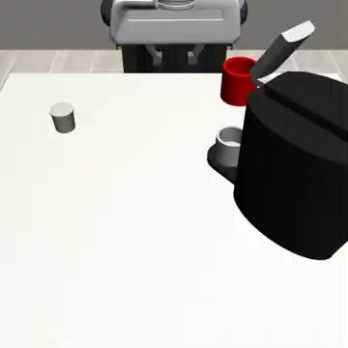
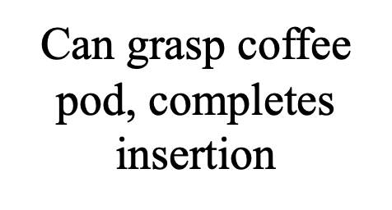
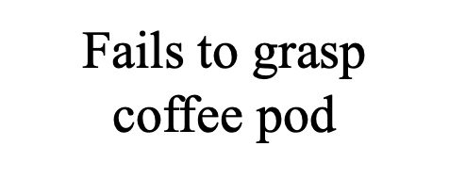
Results: Coffee Preparation Task

