Slide 1
A Conversation with Writer Charles Baxter
12:00 pm – 1:00 pm CT
December 3, 2020
The presentation will begin shortly

Slide 2
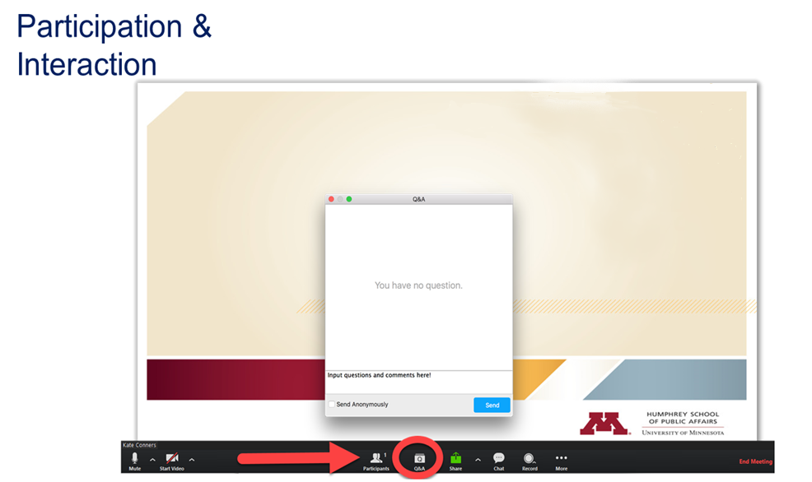

Slide 3
Upcoming Programs
A Conversation with Two-Time Newbery Children’s Book Author Kate DiCamillo
Fri, Dec 18, 12:00 pm CT z.umn.edu/DiCamillo2020

Slide 4
A recording of this event will be posted at z.umn.edu/Baxter2020 in 1-2 days
The Center’s events are made free and open to the public by major and individual donors. If you are interested in joining our donor circle, please contact Sara Benzkofer at benzk003@umn.edu, or visit give.umn.edu/giveto/cspg.

Slide 5
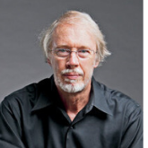
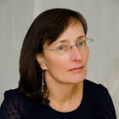
Today’s Presenters:
Charles Baxter,
Minnesota Author
Professor Julie Schumacher,
University of Minnesota

