Slide 1

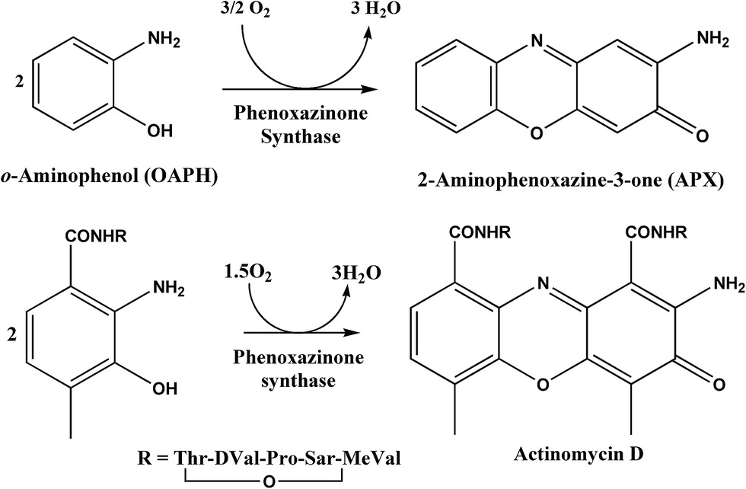
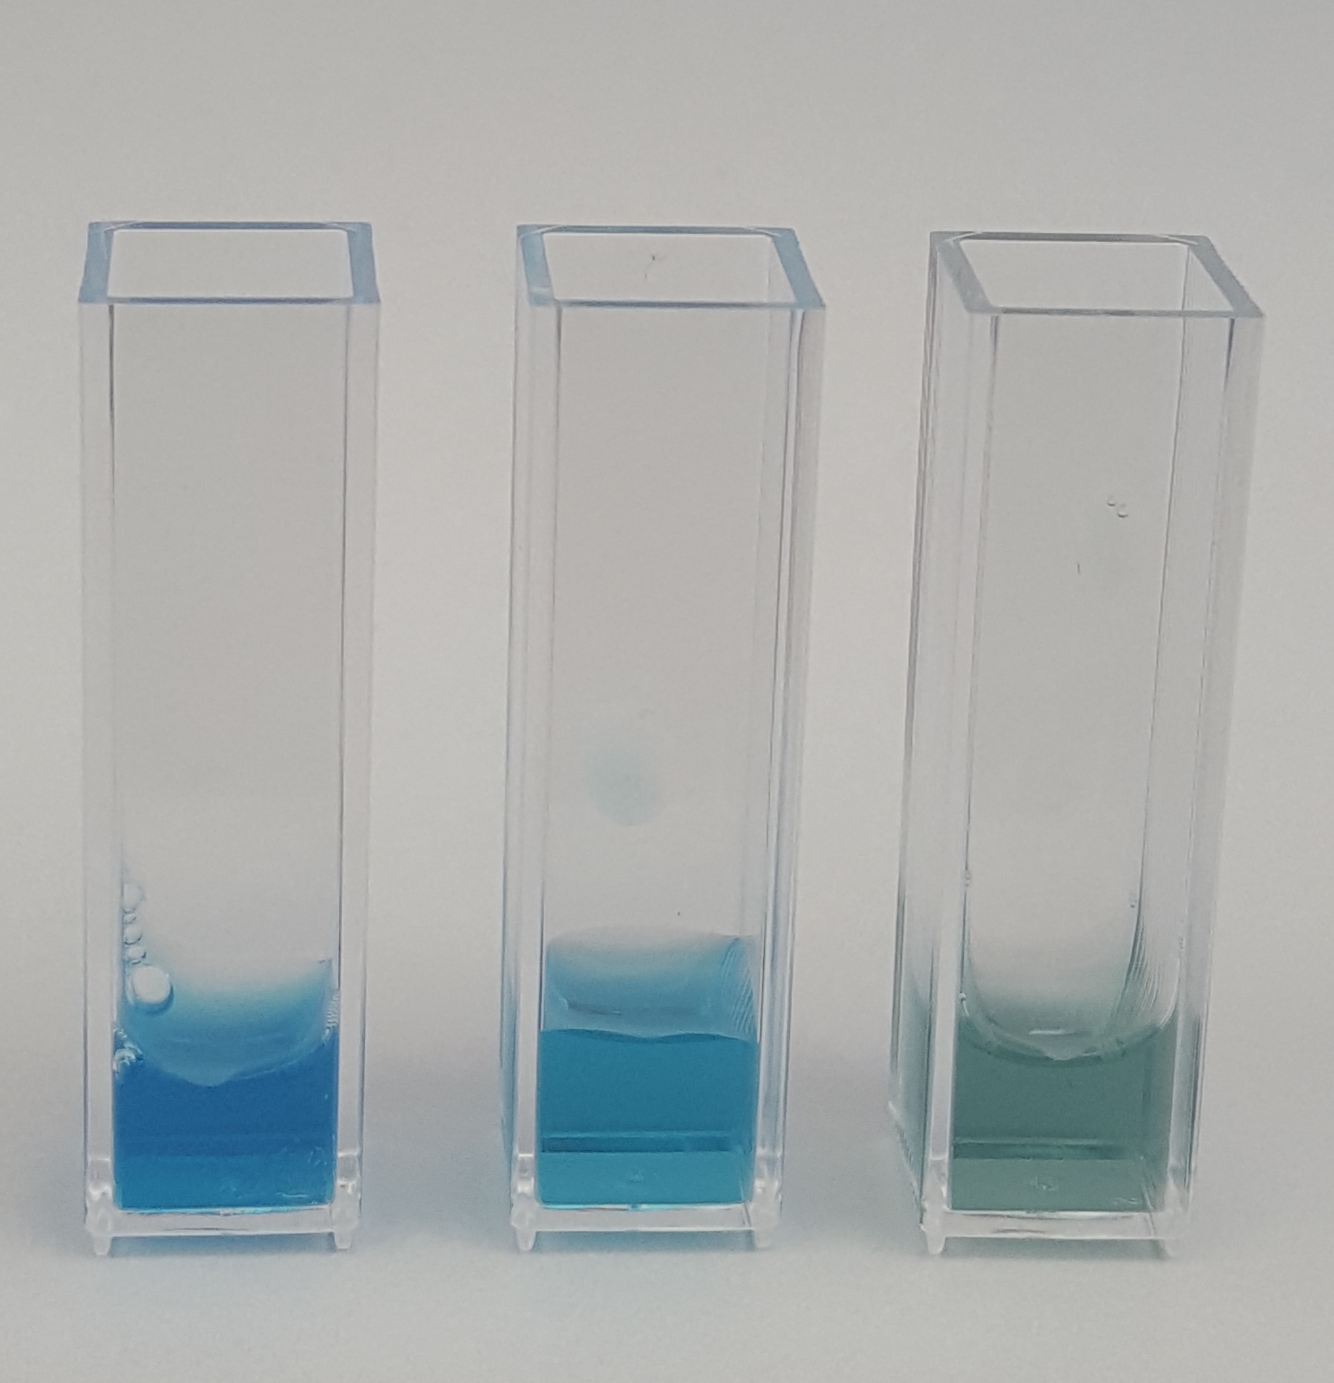
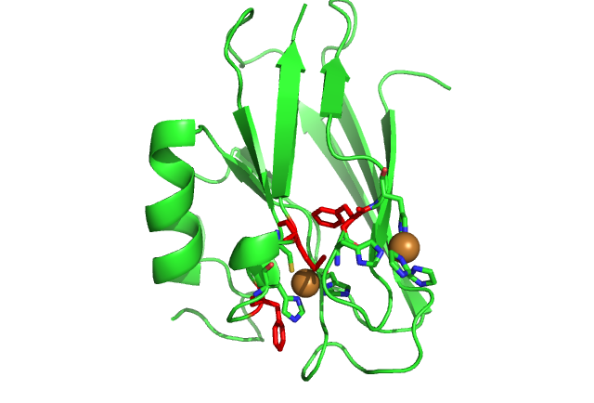
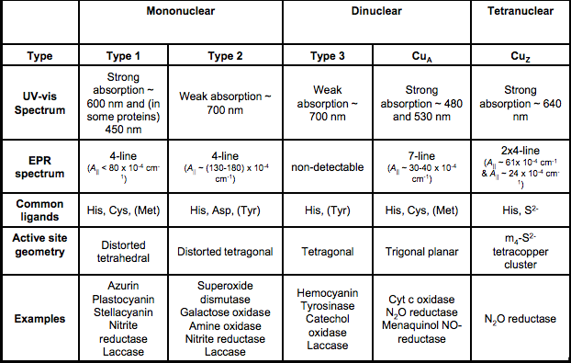
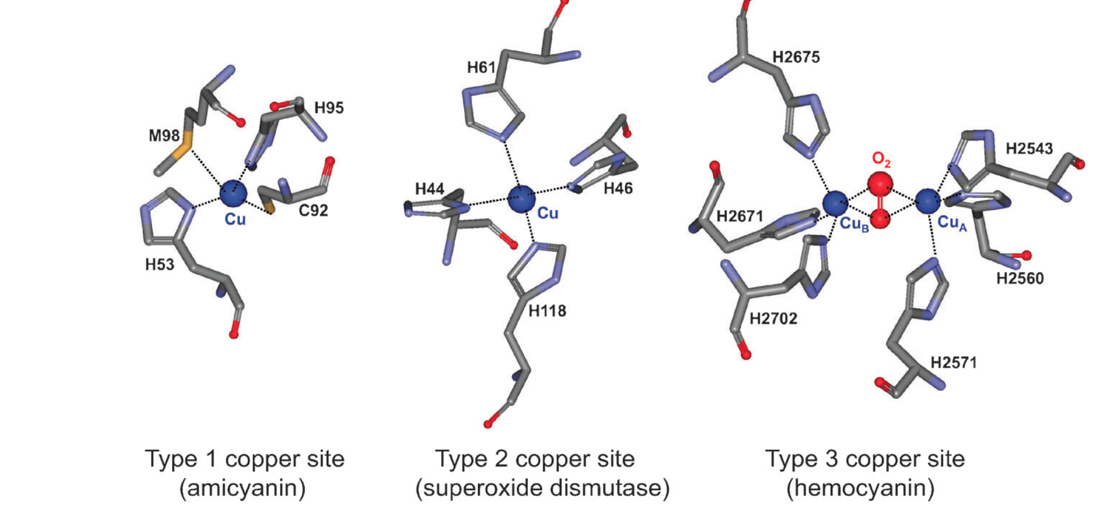
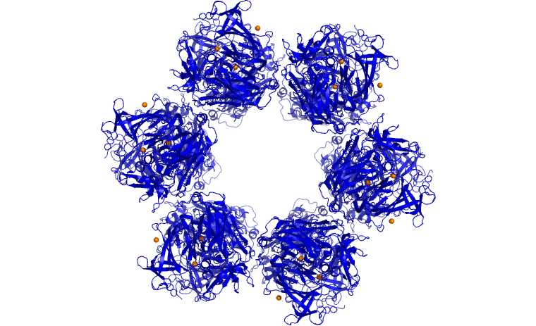
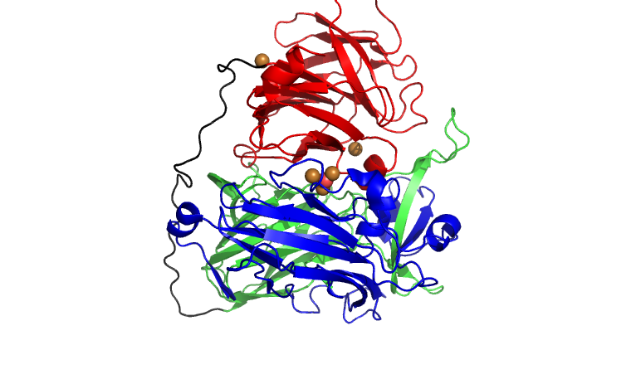
Modeling PHS Activity in Azurin Comparing Tert-Butyl Hydrogen Peroxide with Oxygen Gas as Oxidants
Austin Evenson. Dr. Steven M. Berry (smberry@d.umn.edu)
University of Minnesota-Duluth Department of Chemistry and Biochemistry Undergraduate Research Opportunities Program 
.
.
Abstract
APX is a component of Actinomycin D, an antibiotic that is used in the native bacteria to combat other neighboring organisms and out-compete them for resources. In humans, Actinomycin D has applications in the treatment of a wide range of cancer, due to its ability to intercalate mRNA synthesis. [3] It has been shown to increase the survival rate of those with Wilm’s tumor from 40% to 80% when used in combination with surgery.
One way to examine the enzymatic activity of PHS is through the use of the protein azurin as a model system. Native azurin is a small copper metalloprotein, with a single Type 1 copper center, and has no native PHS activity. However, it can be made to model the reactivity of PHS through the addition of a Type 2 copper center using targeted mutagenesis.
PHS assays
Comparison of the Mutant Activity
Metalloproteins are common among living organisms, with one third to one half of all proteins requiring a metal ion for proper structure or function. They are associated with many key processes, such as signal transduction, nutrient storage and enzyme-mediated catalysis. One such metalloprotein, phenoxazinone synthase (PHS), is a hexameric, multicopper oxidase that creates aminophenoxazinone (APX) from ortho-aminophenol (oAP). APX is a major component of actinomycin D, an antibiotic.
One way to examine the enzymatic activity of PHS is through the use of the protein azurin as a model system. Native azurin is a small copper metalloprotein, with a single Type 1 copper center, and has no PHS activity. However, it can model the reactivity of PHS through the addition of a Type 2 copper center via targeted mutagenesis. In our studies, the resulting models were then given additional mutations, in order to more accurately understand the effects that the proteins’ specific structure has on the kinetics and rate of the redox reaction. One of the original models, NiR3His-Azurin, has the added Type 2 copper center. This scaffold protein was found to be active in PHS enzyme assays and is the predecessor to a “second-generation” azurin mutant: Met121Leu, which was designed to alter the reduction potential and therefore reactivity of the copper centers in azurin. In the Met121Leu mutant, a methionine near the copper active site is replaced with a leucine. This leads to an increased reduction potential, and the hypothesis that the resulting PHS activity rate will be decreased, due to a decrease in the reoxidation of the protein, a rate limiting step in the catalysis.
The differences between the PHS activity of the NiR3His and Met121Leu mutants were explored by using both oxygen gas (O₂) and tert-butyl hydrogen peroxide (TBHP) as oxidants. It is known that TBHP is a stronger oxidant than O₂, and should cause a faster turnover of the redox reaction by the protein, thereby giving a higher rate of activity. However, O₂ allows for the study of the protein using the native oxidant.
Preliminary trials indicate that the Met121Leu variant is not significantly than the observable 0.0118 mMol/min V_{max} for Nir3His, using both TBHP and O₂ as oxidants.
The assay product, APX is yellow in color and absorbs light at 434 nm, with this absorbance directly correlating to the concentration of APX. In order to determine the rate at which each mutant produces APX, the absorbance of the product APX was measured over time, and a maximum rate (V_{max}) was found for each trial.
The redox reactions were explored by using both oxygen gas (O₂) and tert-butyl hydrogen peroxide (TBHP) as oxidants. It is known that TBHP is a stronger oxidant than O₂, and should cause a faster turnover of the redox reaction by the protein, thereby giving a higher rate of activity. However, O₂ allows for the study of the protein using the native oxidant.
Molecular oxygen was found to be a less effective oxidant for the catalysis of APX than TBHP, as expected. Using NiR3His-azurin as a model, it is shown that the mean V_{max} of trials done using T
BHP was 0.0093 mMol/min, with a K_{m} of 0.0060. The V_{max} and K_{m} of assays done using O₂ as an oxidant were 0.0011 and 0.13 respectively. The TBHP trials were much faster relative to O₂ trials, despite the oxygen assays the fact that the oxygen assays were performed with ten times the amount of their respective protein.
Figure 1. The oxidative condensation reactions catalyzed by PHS and NiR3His azurin. The reaction is also coupled with the reduction of diatomic oxygen to water. Adapted from reference 2.
Gly47
IMD
His16
Figure 10. Plot of the rates of APX formation by the two respective mutants using TBHP as an oxidant. CuSO₄ is shown as a way to control the effect of Cu on the rate. Error bars represent one standard deviation.
PHS Modeling in Azurin
His117
Cys112
Materials
Shimadzu UV-Vis spectrophotometer
1 cm cuvettes
Stir bar
20 mM potassium phosphate buffer pH 7.5
~500 µM protein (ex. NiR3His-Az)
100 mM stock o-aminophenol (oAP) in DMSO
100 mM tert-butyl hydroperoxide (TBHP)
Methods
Assays were performed by preparing a 2000 μL cuvette with concentrations: 1 μM Azurin, 10 mM TBHP, and a varied amount of oAP (for TBHP trials), and 10 μM Azurin and varied oAP (for O₂ trials) all in pH 7.5 potassium-phosphate buffer. These cuvettes were then measured for absorbance at 434 nm for 1000 sec for TBHP assays, and 3600 sec for O₂ assays. In both types, a varied amount of oAP was added to the cuvette after 30 sec, and in the case of the TBHP assays, tert-butyl hydrogen peroxide was added after 30 sec. This allowed the protein to reduce the oAP before the oxidant was introduced, and therefore the APX.
In order to model the activity of the multicopper PHS in azurin, an external Type 2 center was added to azurin through directed mutagenesis. In our studies, the resulting models were then given additional mutations, in order to more accurately understand the effects that the proteins’ specific structure has on the kinetics and rate of the redox reaction. One of the original models, NiR3His-Azurin, has the added Type 2 copper center and coordinates four His residues to it (originally designed to model nitrite reductase). This scaffold protein was found to be active in PHS enzyme assays and is the predecessor to a “second-generation” azurin mutant: Met121Leu, which was designed to alter the reduction potential and therefore reactivity of the copper centers in azurin.
Met121
IMD
His14
Figure 5. Color of pure protein stock in a cuvette. From left to right: NiR3His, Met121Leu in pH 5.5 phosphate buffer, Met121Leu in pH 7.5 phosphate buffer.
Figure 11. Plot of the rates of APX formation by the two respective mutants using molecular O₂ as an oxidant. CuSO₄ is shown as a way to control the effect of Cu on the rate. Error bars represent one standard deviation.
Figure 4. A crystal structure of the mutant NiR3His with a Type 1 and Type 2 copper center. The residues highlighted in red are altered in the 2nd generation mutants.
Type 1 (circle)- Internal center coordinated by 2 Histidines, a Cysteine, and Methionine. This copper site is native to azurin and gives the protein its blue color.
Type 2 (square)- Surface copper center coordinated by Histidines. Modeled from the Type 2 copper center in nitrite reductase with the addition of 3 Histidines. In Met121Leu, one of these Histidines is replaced with a Leucine .
His16
Met44
The graphs show that in the TBHP assays, the rates of APX catalysis between NiR3His and Met121Leu are not significantly different from one another, however Met121Leu may be slightly slower, consistent with our hypothesis. In the O₂ assays on the other hand, the Met121Leu mutant is faster and has a higher V_{max} than the accepted value of 0.0118 mMol/min for NiR3His. CuSO₄ shows little to no APX activity.
The observations suggest that with TBHP, the higher reduction potential of Met121Leu indeed lowers the reactivity from the parent NiR3His azurin. However, the data with O₂ as oxidant contradicts the hypothesis, where the rate of APX formation is clearly higher than with the “parent” NiR3His. Met121Leu should be slower than the parent NiR3His due to its loss of sulfur at the active site copper, and the resulting change in reduction potential. However, the data suggest that this may be different with different oxidants, suggesting the rate limiting step may change.
The relative inactivity of CuSO₄, as compared to the azurin samples, suggests that any free coppers in solution with the protein would not be contributing to the redox reaction.
Figure 6. Absorbance plot of 0.4 mM oAP trial with NiR3His and TBHP. This data was collected over 1000 seconds. The “spike” at the left side is the addition of TBHP.
Introduction
PHS Activity in NiR3His and Met121Leu Azurin
Copper metalloproteins are common in many biological systems. Therefore, it is important to understand their function and kinetics especially in the case of enzymes. Copper proteins can contain three different types of copper-binding sites: Type 1, which mediate the transfer of electrons through and between proteins, Type 2, which catalyze oxidations, and Type 3 which can reversibly bind oxygen molecules, allowing for the transport and use of oxygen in metabolic processes. [4]
In the Met121Leu mutant, a methionine residue in the type 1 copper site was replaced with a Leucine amino acid. This removed an active site sulfur that was normally bound to the copper in NiR3His, and therefore increased the reduction potential of the site from 350 mV to 450 mV. Because of this, the protein reduction step of oAP → APX formation could be faster in the Met121Leu mutant, and the protein oxidation step (O₂ → H₂O) could be slower. If the rate limiting step is the protein oxidation step, then the overall catalytic turnover should be slower in Met121Leu than in NiR3His Azurin.
From the mutation, Met121Leu experienced a shift in color as well. Most of the azurin mutations are a deep blue, at all pH levels, when given a type 2 copper center, including NiR3His azurin. Met121Leu azurin, however, becomes green and changes shape when subjected to pH levels higher than 6.5. This shift is reflected in the two mutants’ absorbance spectra, obtained through Electron Paramagnetic Resonance.
Figure 7. Absorbance plot of 0.4 mM oAP trial with NiR3His and molecular oxygen.
Table 1. Variants of metalloprotein copper centers, including Types 1, 2 and 3, with their amino acid residues and spectrophotometric absorbances when filled. [4]
Results
We studied the difference in kinetics between Azurin mutants, NiR3His and NiR3His Met121Leu. To calculate the rate from resulting absorbance plots, the initial slopes of the Michaelis-Menten curves were found. Slopes from approximately 55 to 105 seconds for assays oxidized with TBHP, and 300 to 1000 seconds for O₂ assays were determined as they were the most linear sections. The average slope of the initial curves of the graph, for each concentration trial, were then converted to rates of APX formation through the application of Beer’s law, and simple conversions (measured in mMol/min). In order to more easily compare the rates in relativity to one another, they were plotted in a Michaelis-Menten curve. A best-fit curve was then added to the rates to determine the V_{max} and K_{m}, standard measurements in enzyme catalysis.
Conclusion and Future Directions
The V_{max} of APX formation Met121Leu mutant was found to not be statistically different than the NiR3His mutant when using TBHP as an oxidant, although it appeared somewhat slower. It was also shown to be faster than the NiR3His when O₂ was the oxidant. These different outcomes for the different oxidants both support and deny the hypothesis that NiR3His would have a faster catalysis rate than the Met121Leu.
In future projects, the kinetics of mutant Met121Leu should continue to be explored, as the results shown are surprising. More data should be collected using the same oxidants and oAP concentrations as those shown here. Also, The kinetics of mutants with lower reduction potential should be analyzed to determine if they follow the original hypothesis.
Figure 2. Structure and residual coordination of the three copper sites found in PHS. [5]
Figure 5. EPR spectrum of NiR3His-azurin (top), Met121Leu in pH 5.5 phosphate buffer (middle), and Met121Leu in pH 7.5 phosphatebuffer. Each contains distinct hyper-fine peaks, that correspond to specific copper centers’ structure within the protein. Any differences between the spectra correlate to differences in the structure of the Type 1 and 2 bound-copper sites between the proteins. From this, the change that Met121Leu undergoes is apparent.
One metalloprotein, Phenoxazinone Synthase (PHS), is a hexameric multi-copper oxidase that is naturally present in S. antibioticus, and catalyzes the formation of aminophenoxazinone (APX) from ortho-aminophenol (oAP). PHS oxidizes the oAP substrate while also reducing molecular oxygen to water, with the transfer of six electrons. [2] Studies have shown that the PHS subunits contain a type 1 copper center and a type 2 copper center within 4 Angstroms of either two type 2 copper centers or one type 3 binuclear copper center [5].
Table 2. V_{max} and K_{m} from each separate trial. Rates were converted from the slopes of absorbance graphs, then were fit to a curve.
Acknowledgements
I would like to thank:
Dr. Steven M. Berry for allowing me to conduct research in his lab, for structuring the project, and, providing the guidance needed to complete it.
Riley Raskob, Garrett Stoddard and Tracy Roach for the information upon which this project was built.
Nicholas McCormick for his help in the teaching of necessary lab procedures and templates.
Figure 3. (left) Hexameric structure of PHS shown with 3 coppers per subunit displayed as orange spheres. (right) Subunit of PHS with 3 domains highlighted in blue, green, and red respectively. The loop connecting domains 2 and 3 (black) and copper atoms (orange) are also shown. Adapted from PDB file 3GYR. [2]
Figure 8. (top) Lineweaver-Burke plot of NiR3His O₂ trial. Both the concentration of oAP and the rate were set to their inverse. The resulting line gives an estimate of V_{max} and K_{m}.
Figure 9. (bottom) Michaelis-Menten plot ofNir3His O₂ trial rates with a best-fit curve. This curve approaches the V_{max}.
References
Barry, C. E. Nayar, P. G. Begley, T. P. Biochemistry 1989. 28, 6323-6333
Smith, .; Camara-Artigas, A.; Wang, M.; Francisco, W.; Allen, J. Biochemistry 2006
Roes-Hill, M. L.; Goodwin, C.; Burton, S. Trends in Biotechnology 2009, 27 (4), 248–258.
Lu, Y. Comprehensive Coordination Chemistry II 2003, 91–122 (2003).
Choi, M.; Davidson, V. L. Metallomics 2011, 3 (2), 140.
Notes:
Show a reoxidation trial
Title rate constant (right panel) – “Comparison on the mutant activity”
Put NiR3His below T1 only (dramatically faster than WT/T1 shows 2 coppers are necessary)
For M121Q/L restate the hypothesis and how it matches the conclusion

