Slide 1
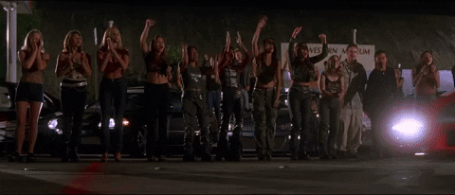
Driving in the slow lane:
Improving digital collections one quarter mile at a time
Hanna Bertoldi
Peggy Griesinger
Mikala Narlock
Presented at the ACRL / NY 2023 Symposium “Embracing Slow Librarianship”
Dec. 1, 2023
Notes:
Peggy
I’m Peggy Griesinger, my co-authors Hanna Bertoldi and Mikala Narlock

Slide 2
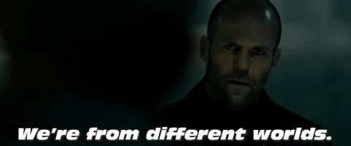
Context
Grant-funded digital collections platform
  Library, Archive, and Museum
Pervasive idea: More content is better.
Notes:
I’m Peggy Griesinger, here with my co-author Hanna Bertoldi. Also part of our research team is Mikala Narlock, who couldn’t be here today.
We are former colleagues who collaborated on a grant project to bring together digitized cultural heritage materials from a university archive, library, and art museum into a single digital collections platform.
From that collaboration, we developed an interest in the ethics of things like linked data, name authority data and classification, and digitization and digital collections.
We wrote a chapter together for the newly published Library Juice Press book, Ethics in Linked Data, edited by Alexandra Provo, Kathleen Burlingame, and Bri Watson. That chapter was largely centered around the grant project we worked on together and the ethical questions raised by users’ desires for more detailed personal information about creators in our digital collection, such as their gender, race, or ethnicity, usually to surface more works by creators with those identities.
Additionally, Hanna and Mikala are currently at work on an article that will examine whether or not digitization and description are inherently good when it comes to democratizing and diversifying our collections.
While we’re missing the archival perspective, we learned a lot during our grant planning process
Three different areas of expertise: Cataloging/metadata; museum metadata; building digital collections

Slide 3
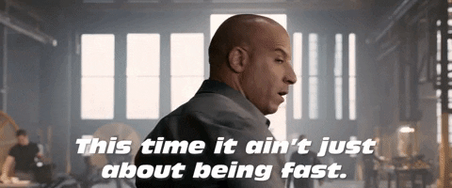
Our foundational beliefs
More does not always equal better
Something is not always better than nothing
Notes:
With that background on our research, I wanted to set the stage with some of the foundational beliefs that we have come to hold dear as we have been on this research journey. These are all focused broadly on the realm of digital collections, including the work of metadata, digitization, and curation, among others.
We want to be clear that most of what we’re presenting here is not new. Our literature review was EXTENSIVE and traveled many decades into the past. We realize change is slow, but part of our goal with this research is to draw attention to the fact that LAM professionals have been raising the alarm about these problems and advocating for a diverse array of solutions, but we still find ourselves having the same conversations over and over again and not making progress.
One: More does not always equal better
This is relatively uncontroversial at this point by our estimation. There’s lots of great work out there complicating this idea by presenting it through lenses of race, gender, accessibility, etc. Cultural heritage orgs as institutions still hugely struggle with actually demonstrating change in relation to this tenet, but the large cultural heritage scholarly community seems to have accepted this idea.
Two: Something is not always better than nothing
This is a little more of a hot take. The idea that getting basic information out there, no matter in what format, so people at least know we have a thing, is very attractive. It’s something I personally have knee-jerk positive reactions to. We want to complicate it by saying: we can’t just do that. There is a huge danger in this mindset that comes into play when it is used as a way to pat ourselves on the back for making our collections more diverse, but all we’ve really done is the absolute bare minimum, and we haven’t actually made the objects we’ve made available this way truly accessible.

Slide 4
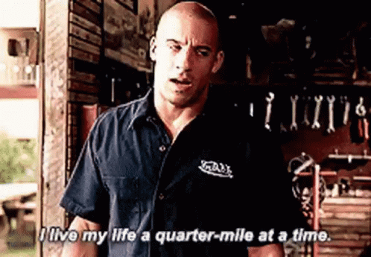
Challenges we’ve seen
Notes:
We’re fast and furious dorks, we want to take you on the emotional journey of Dominic Toretto
*And though we’re about to enumerate many challenges and shortcomings of digital collections, we are adamant advocates that online collections are good– but we have the imperative to do better

Slide 5
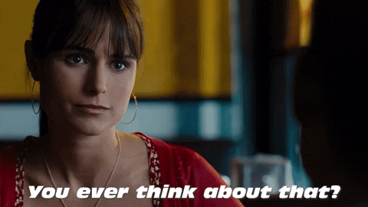
Challenges we’ve seen pt 1
Diversity in online collections = more equitable
Identities in descriptive systems
Privacy and PII
Notes:
I wanna now zoom back in and look at a few of the problems we’ve noticed in the realm of digital collections, metadata, and library work culture that have brought us to our foundational beliefs.
The idea that just getting more information out there from underrepresented groups will make our collections more equitable is really appealing, and has led a lot of cultural institutions to highlight these areas on their collections websites. But this attitude that digitization is democratizing can cause more harm than good when institutions use their online collections as evidence for Diversity, Equity, Inclusion and Accessibility (DEIA) without any additional context beyond basic metadata from the source system. Instead, institutions are not freeing themselves from their historical stumbling blocks through digitization, but rather the technology they are championing is reinforcing long-standing institutional biases that exist already.
Looking at metadata, issues pop up in terms of recording information about human beings, especially living ones. For example, identities are inconsistently recorded depending on whether a person is a member of a dominant cultural identity or not. Picasso is recorded just as Spanish, but Basquiat is recorded as Black and African-American. What does that say about what is considered normal in how we classify the world?
Another issue is one of consent and documentation, especially as it relates to privacy. In an effort to complete a name authority record, a cataloger may include Personally Identifiable Information that the author does not want publicized. If we agree that the ethical way to catalog living people is to ask for their consent before recording aspects of their identity, how do we know that name authority records have done this? The problem is that in most cases we don’t.

Slide 6
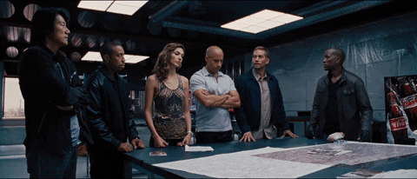
Challenges we’ve seen (cont.)
Transparency in cataloging
Cataloging systems
Prioritization ouroboros
Undervalued digital collections labor
Notes:
There is also the issue of transparency around how information is created. We don’t talk enough about all the decisions that go into the descriptive process, including making unwieldy metadata fit rigid standards and systems and the enormous importance and influence of catalogers’ judgment on how things are described. LAM institutions have used their intellectual control over collections, manifested by the authoritative voice, to obscure their cataloging and descriptive processes.
Our systems are another problem. We don’t acknowledge that we have taken systems that were once closed and for staff use only and tried to make them work for patron use without making that many changes to the underlying structure. Discovery layers sit over them, but without changing the fundamental static nature of the data and how it is organized.
Then there is what I call the Prioritization ouroboros. Objects are prioritized for digitization and description based on their use in teaching and research - but if they’re never digitized or described, how can there be a demand for them in teaching and research?
Objects from non-Western cultures often do not fit into our classification schemes. For example, objects that are simultaneously female and male in their culture - how can we accurately represent that in existing systems?
Finally, let’s look at the labor of digital collections. Cataloging and digitization positions tend to be undervalued because they are often structured to be transient and subordinate. This leads to staff turnover in these roles, and imbalanced labor distribution between term-funded positions and permanent staff. In museums, this is manifested in a common tension between staff who do cataloging work: curators, registrars, and collections managers, and those with curatorial positions. In libraries, this tension can similarly occur between subject librarians and catalogers. In both cases, all parties hold extensive knowledge, but the academic knowledge of curators and subject librarians is valued above the practical knowledge of collection catalogers and digitization staff. Traditionally, institutional leaders favor the disciplinary experts over the implementation experts, especially in academic institutions where positions are further differentiated by tenured status, leading to imbalances in institutional power.
Examples of these tensions could be differing opinions about content standards or about the pace at which objects should be displayed online. Not only does this create an unfair situation for the workers themselves, but these power dynamics manifest themselves online by creating imbalanced and inequitable collections.

Slide 7
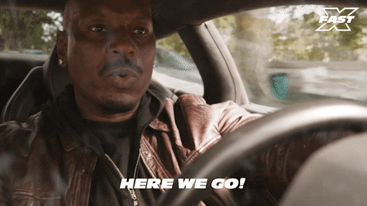
Suggestions
Notes:
[Hanna]

Slide 8
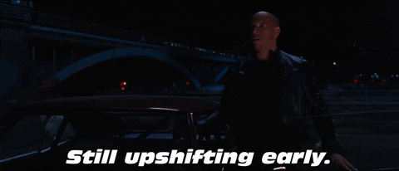
Slow Movement
Notes:
The slow movement provides a useful framework to address many of these issues. The demanding workload of digital collections work and lack of resources present in cultural heritage organizations is in conflict with the principles of the slow movement, but there are already some great examples of this type of work (eg. Oklahoma State University Library’s Native Artists Project, which is detailed in the Ethics in Linked Data book with a chapter by Madison Chartier and Megan Macken).

Slide 9
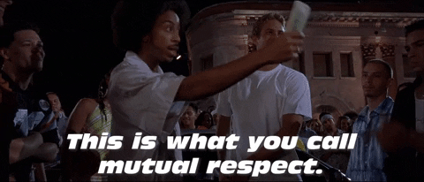
Possible solutions
Transparency and documentation
Notes:
(1) slow movement demonstrates that the time required to create ethical metadata should be worth the cost to institutions because it allows greater control over a living person's self-representation.
form trusted relationships with creators
descriptive work should include documentation of consent from living creators
create web pages which further enumerate the silences in their collections

Slide 10
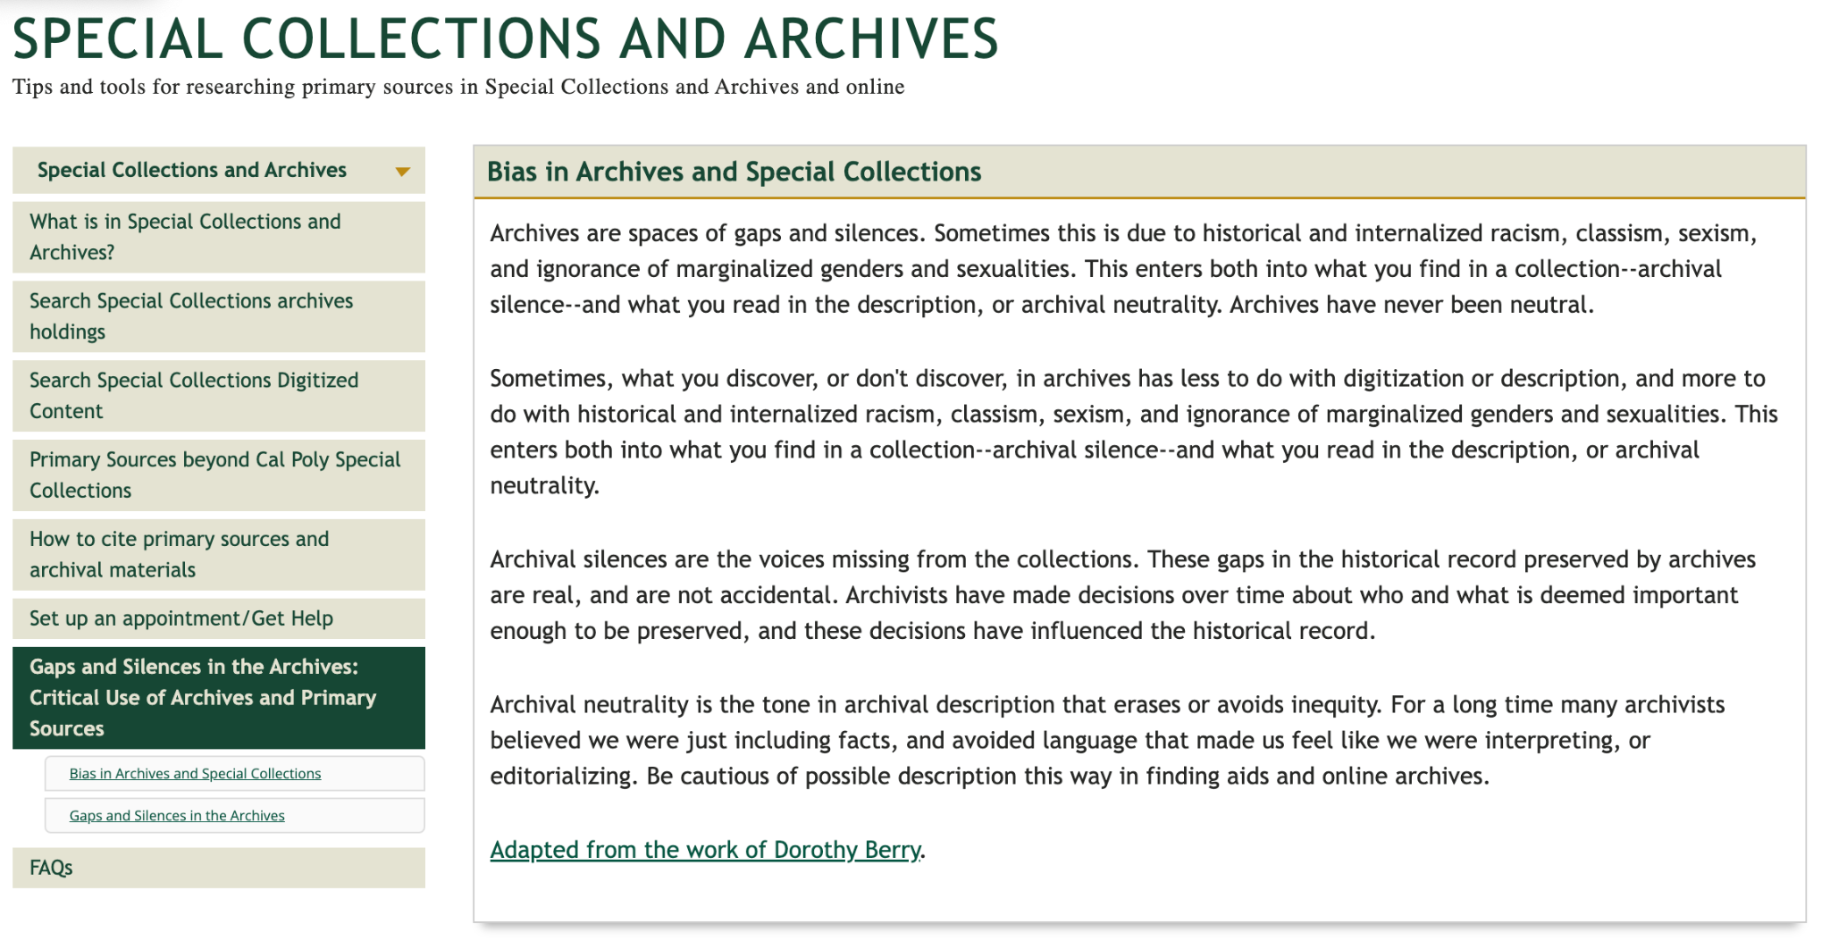
Example LibGuide
UCLA Silences page
Notes:
We think that other institutions can learn from this example to develop their own pages to surface gaps in their collections more specifically.
Source: https://guides.lib.calpoly.edu/archives/critical

Slide 11
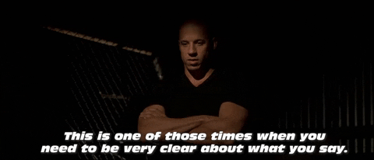
Possible solutions
Transparency and documentation
Equitable, not equal, attention for all materials
Notes:
(1) slow movement demonstrates that the time required to create ethical metadata should be worth the cost to institutions because it allows greater control over a living person's self-representation.
transparent about our descriptive processes by adding bibliographies to object records to combat the singular, unsourced voice
(2) diversifying our collections will require us to be equitable, and not necessarily equal, in the amount of time we dedicate to making materials available
re-use research that may already exist about an item and make it easily accessible online, such as exhibition labels or publications, to provide this greater context
leverage the power of linked open data to add additional search terms to a record for greater access, create more connections between objects using related records features, and allow more fields online for alternative classifications or functions of objects

Slide 12
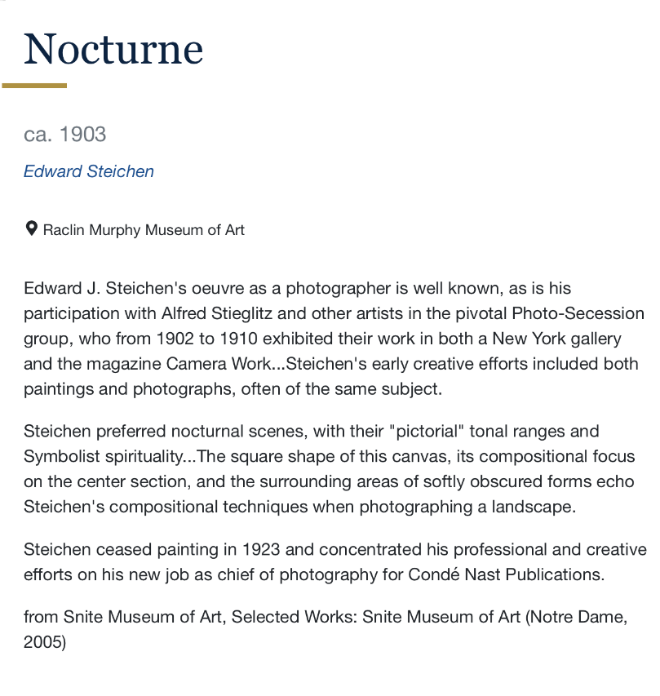
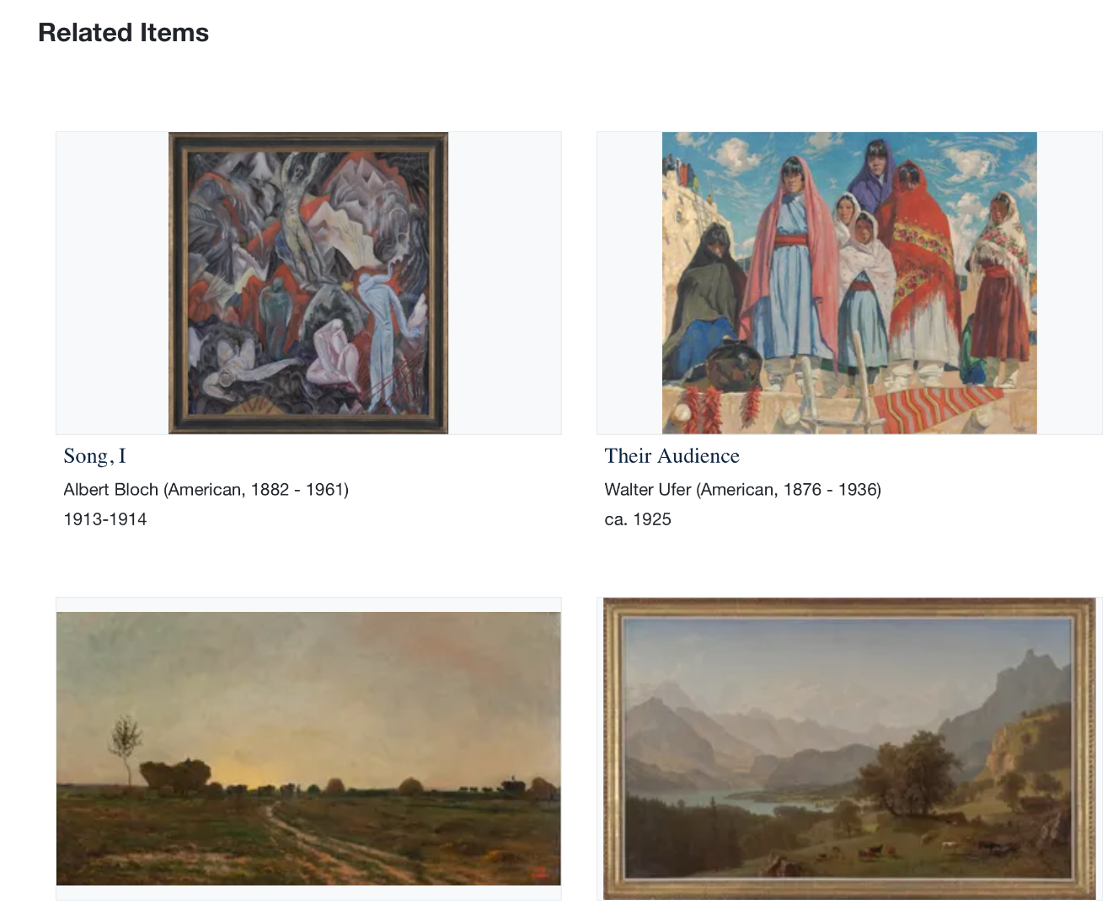
Example item
Notes:
Source: https://marble.nd.edu/

Slide 13
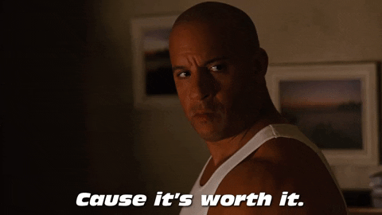
Possible solutions
Value and invest in cataloging and digitization positions
Notes:
(3) invest in professional staff and stop trusting students with important cataloging work

Slide 14
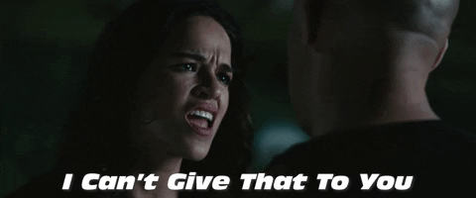
There’s no one solution.
Notes:
Implementing these ideas will not “fix” digital collections and make them suddenly ethical

Slide 15
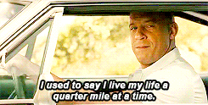
Summary
More does not always equal better
Something is not always better than nothing

Slide 16
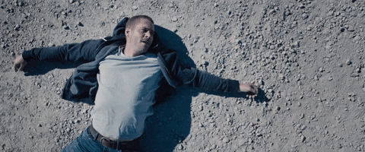
Peggy:
mgriesi2@nd.edu
Hanna:
h.bertoldi@bowdoin.edu
Mikala: mnarlock@umn.edu
Book chapter: https://curate.nd.edu/show/r494vh57h6s
Our Slides: https://hdl.handle.net/11299/258818
Thank you
(contact info)

Slide 17
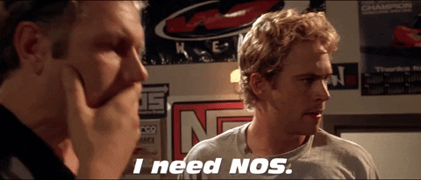
Since we’re almost out of time…

Slide 18
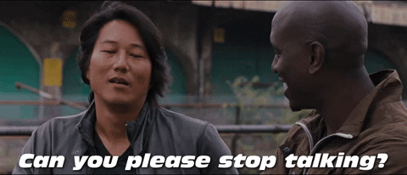
Fin.

