Slide 1
Foresight Leadership: Anticipating the Future of Doctoral Education in Nursing
Daniel J Pesut PhD RN FAAN
Professor of Nursing Population Health and Systems Cooperative Unit
Director of the Katharine Densford International Center for Nursing Leadership
Katherine R. and C. Walton Lillehei Chair in Nursing Leadership
www.Foresight-Leadership.org
University of Minnesota School of Nursing
308 Harvard St. SE
4-185 Weaver-Densford Hall
Minneapolis, MN 55455
dpesut@umn.edu
Linkedin
Office Phone number: 612-626-9443
© 2020 All Rights Reserved

Slide 2

Learning Objectives
Discuss the concept of nursing foresight leadership to anticipate challenges and opportunities associated with doctoral education in the nursing profession.
Generate ideas to advance awareness, knowledge, insight, and action related to the future of doctoral education in the discipline of nursing.
Explore references and resources to improve future literacy and foresight leadership related to doctoral education in nursing and the health professions.

Slide 3

Overview
AACN Vision for Academic Nursing
The Future of Universities
Knowledge Complexity and Nursing
Logical Levels of Learning and Leading
Polarities and the Squiggle Sense
Integral and Meta Integral Theory
21st Century Meta Learning
Future Consciousness
Change versus Transformation
Future Literacy and Foresight Leadership
Crowdsourcing New Ideas
Teaching Learning Challenges (TLC)
Pledge to the Future

Slide 4
AACN Vision for Academic Nursing
Clarify preferred educational pathways and the preparation necessary to succeed in evolving and future roles for nursing professionals.
Evaluate the future needs of the nursing workforce; consider academic nursing’s role in promoting population health while addressing the social determinants of health and advancing interprofessional engagement.
Propose overarching and broad-based curricular recommendations for baccalaureate and graduate nursing programs.

Slide 5
AACN Vision for Academic Nursing Goals
Advance diversity and inclusion in nursing education and practice.
Transition to competency-based education and assessment.
Increase collaboration between education and practice through expanded and more formalized academic-practice partnerships.
Increase emphasis on faculty development and career advancement.
Explore and adopt opportunities for resource efficiencies.

Slide 6

Vision For Academic Nursing
“Further thinking and action will need to address implementation strategies and actions to realize any or all the visionary goals.”

Slide 7
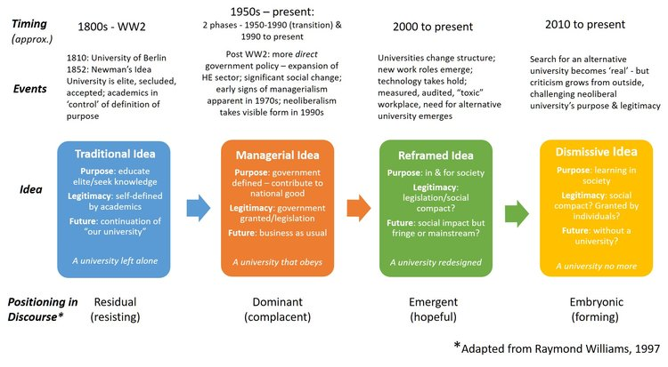
University Futures
Used with permission Maree Conway See https://www.universityfutures.net/blog/2019/10/30/contested-ideas-of-the-university

Slide 8
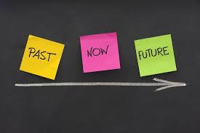
Nursing Knowledge Work
“The future happens at the intersection of knowledge and service and if you have the knowledge your can provide the service.”

Slide 9
Knowledge Complexity Framework
Allee, Verna (1997). The knowledge evolution: Expanding organizational intelligence. Butterworth Heinemann Boston, MA

Slide 10
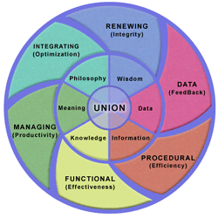
Knowledge Complexity
(©Verna Allee, 2002, 2003, used with permission)

Slide 11
Data | statistics, financial data, metrics
Information (Procedural) | procedures, standards, user guides, specifications, regulations, audits, filing and classification, order processing
Knowledge (Functional) | workflow planning, priorities, graphs, engineering, historical data, tracking, database design & management
Meaning (Managing) | business plans, goals, objectives, budgets, resources, roles, culture, managing variables, developing projects
Philosophy (Systems) | strategic planning, systemic mapping, competitive analysis, market forecasts
Wisdom (Renewing) | values, vision, future trends
Union | social, environmental & global issues, activism, ecological values work
© 2002 Verna Allee, used with permission

Slide 12
Time | Consciousness | Knowledge Orientation | Learning Mode | Action Focus | Performance
Right Now (this moment) | Awareness | Data | Instinctual | Data (input) | Feedback (awareness)
Present (very short) | Physical Sentience | Information | Single-Loop | Procedural (procedure) | Efficiency (know what)
Expanded Present (short) | Self-Reflective | Knowledge | Double-Loop | Functional (engineer) | Effectiveness (know how)
Medium to Long (past to future) | Communal | Meaning | Communal | Managing (context) | Productivity (know why)
Long Term (far past and future) | Pattern | Philosophy | Duetero | Integrating (systems) | Optimization (create why)
Very Long (distant past to future) | Ethical | Wisdom | Generative | Renewing (purpose and values) | Integrity (care why)
Timeless (inter-generational) | Universal | Union | Synergistic | Union (co-creating) | Sustainability (greater good)
The knowledge work we engage in needs to be supported in different ways in order for us to
take effective action and achieve the level of performance we desire. ( Allee, 1997)
© 1996 Verna Allee ( used with permission)

Slide 13
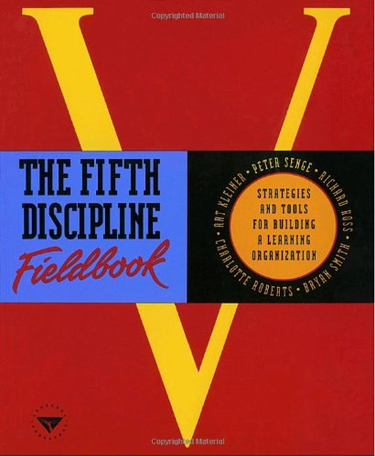
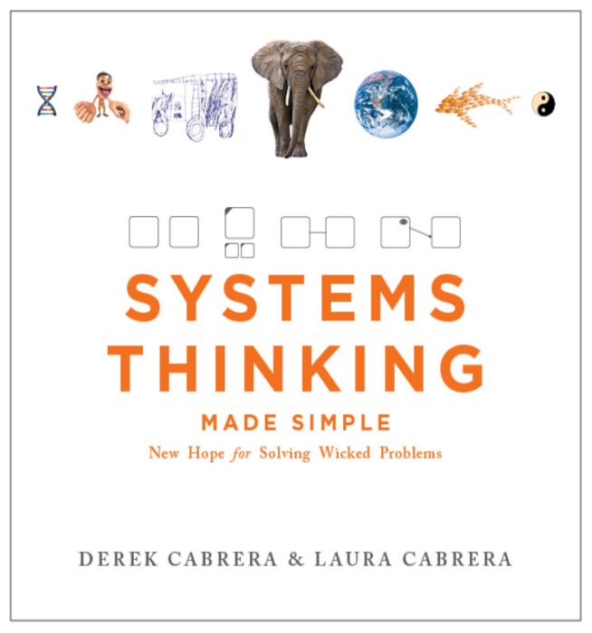

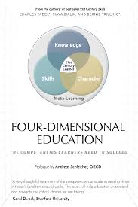
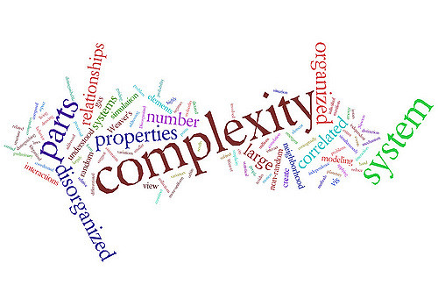
Systems Thinking and Learning Organizations
Systems Thinking
Shared Vision
Team Learning
Mental Models
Personal Mastery

Slide 14
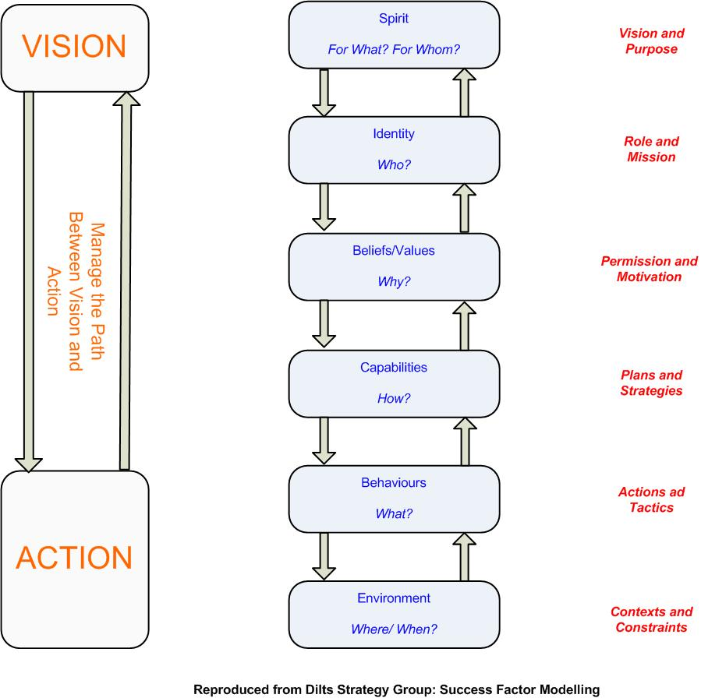
Leadership, Vision, Action, and Logical Levels
Dilts, R. (2014) A brief history of logical levels

Slide 15

The Squiggle Sense
The squiggle sense exposes a basic truth that both complementary aspects and their dynamics are required for understanding. If you see things like:
yin and yang
organism and environment
nature and nurture
mind and body
friend and enemy
living and dying
creation and annihilation
Nursing ~Negligence
…as mutually related and inextricably connected, as being complementary, you are using your squiggle sense.
If you see them as mutually exclusive contraries, us versus them, nature versus nurture, mind versus body, or if you overemphasize one extreme over the other, you are not using your squiggle sense.
PhD ~ DNP
Kelso, J. S., Engstrom, D. A., & Engstrom, D. (2006). The complementary nature. MIT press.

Slide 16
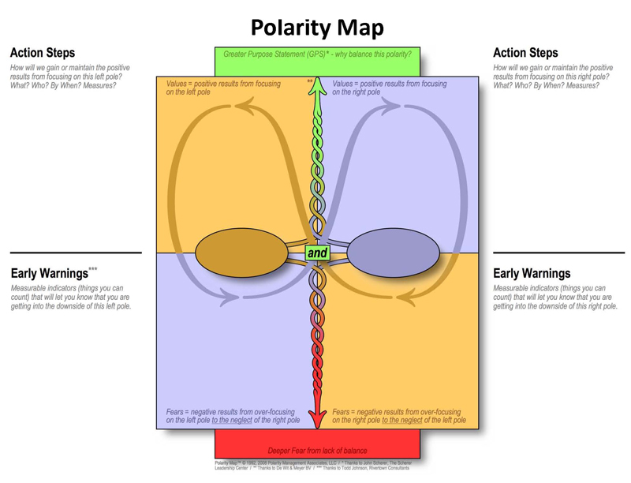
Polarities to Manage
Scott, E. S., & Cleary, B. L. (2007). Professional polarities in nursing. Nursing outlook, 55(5), 250-256.
Missing Logic https://www.missinglogic.com/

Slide 17
Integral Theory Principles
"Integral" means comprehensive, inclusive, balanced,
not leaving anything out.
Nonexclusion : acceptance of truth claims that pass the validity tests for their own paradigms in respective fields
Enfoldment: sets of practices that are more inclusive, holistic and comprehensive than others
Enactment: various types of inquiry disclose different phenomena depending on the quadrants, levels, lines, states and types of the inquirer.
Wilber, K. (2002d). "Excerpt D” The look of a feeling: The importance of
post-structuralism, unpublished manuscript
Notes:
17

Slide 18

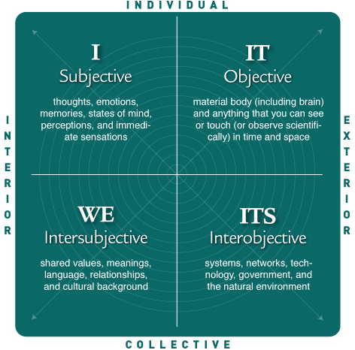
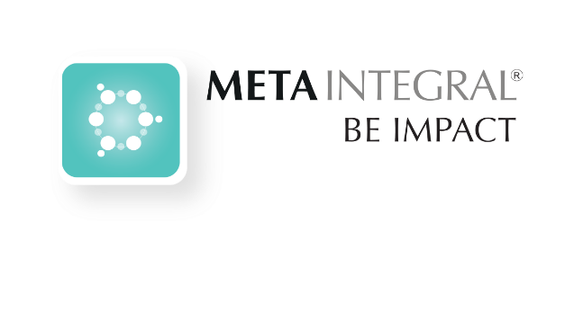
The Four Quadrants
Used with permission MetaIntegral

Slide 19




Slide 20

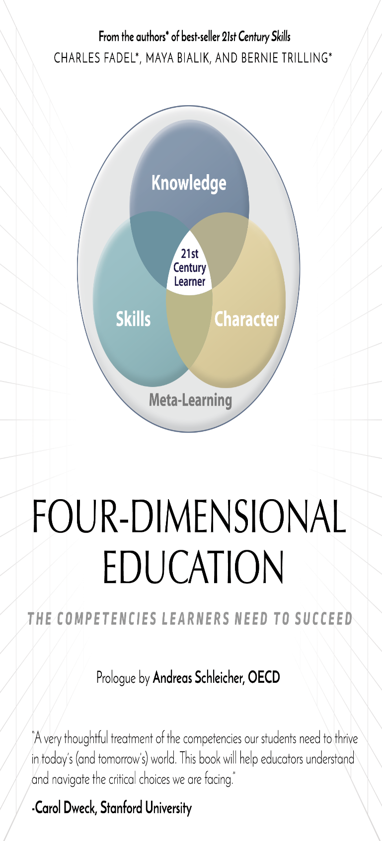



Slide 21
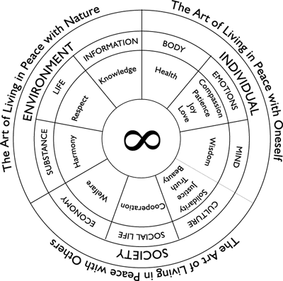
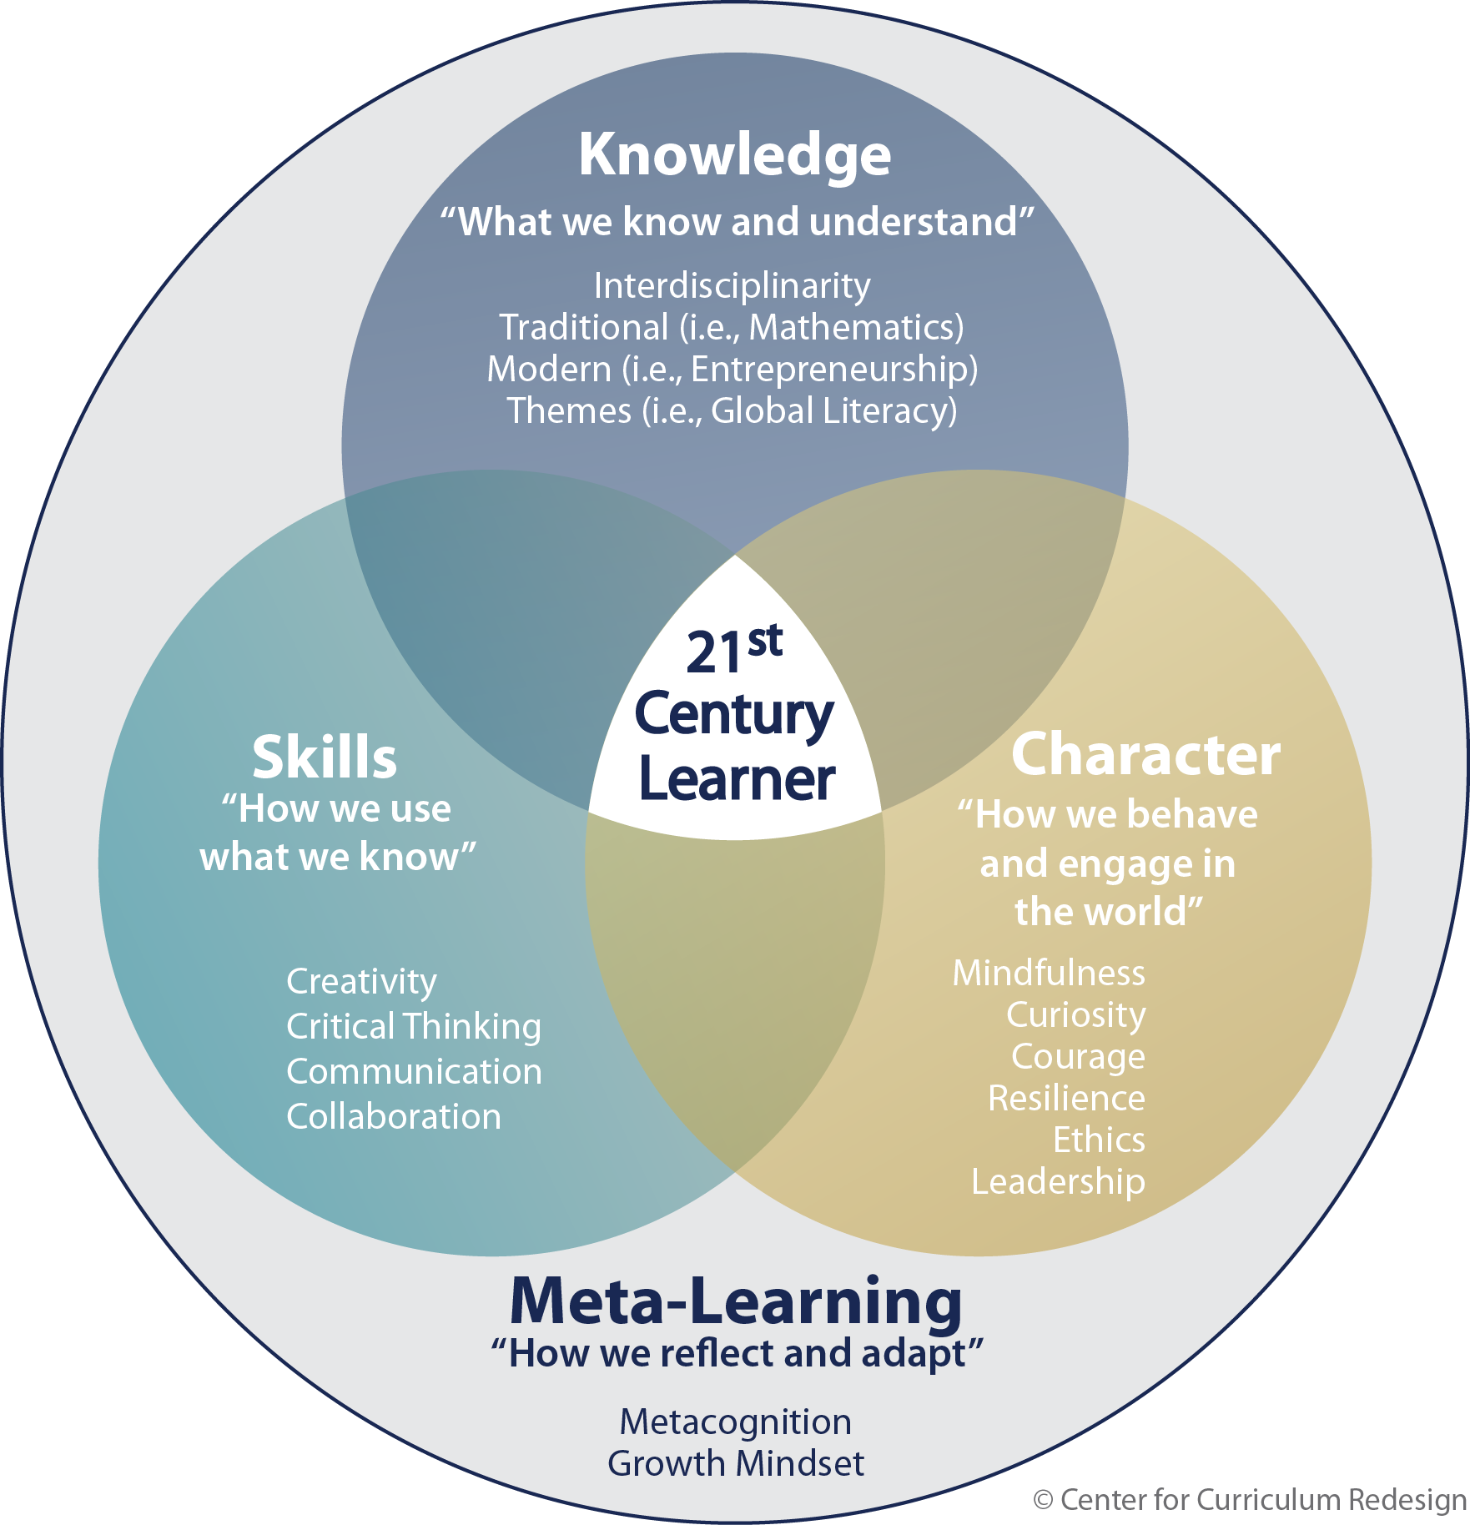
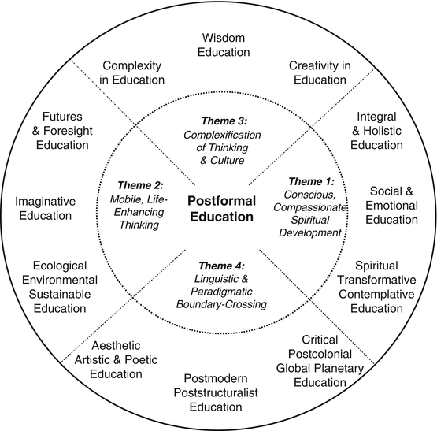
Used with permission MetaIntegral

Slide 22
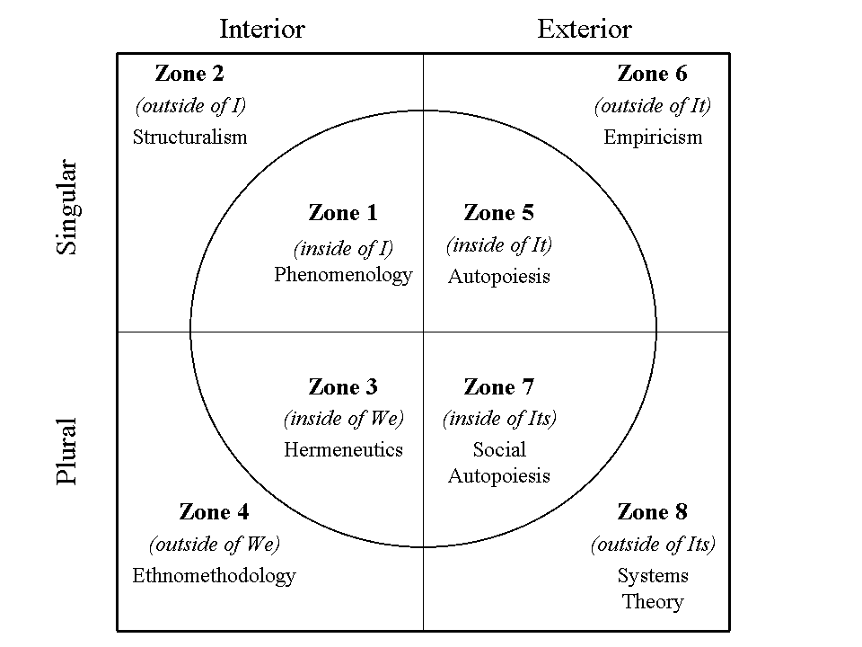
Integral Research: Eight Zones and Methodologies
Esbjorn-Hargens, S. (2006). Integral research: A multi-method approach to investigating phenomena. Constructivism in the Human Sciences,11(2), 79-107.

Slide 23

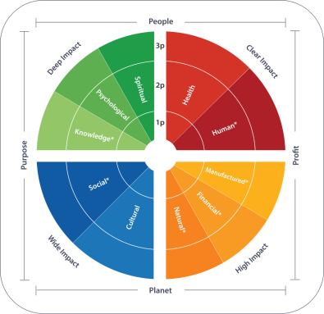
4 Dimensions
4 Types of Impact
      Clear, High, Wide, & Deep
10 Types of Capital
Health, Human, Manufactured,
Financial, Natural, Cultural, Social,
Knowledge, Psychological, & Spiritual
3 Types of Data
Subjective (1p), Intersubjective (2p),
& Objective (3p)
4 Types of Bottom Lines
Profit, Planet, Purpose, & People
Used with permission Meta Integral

Slide 24
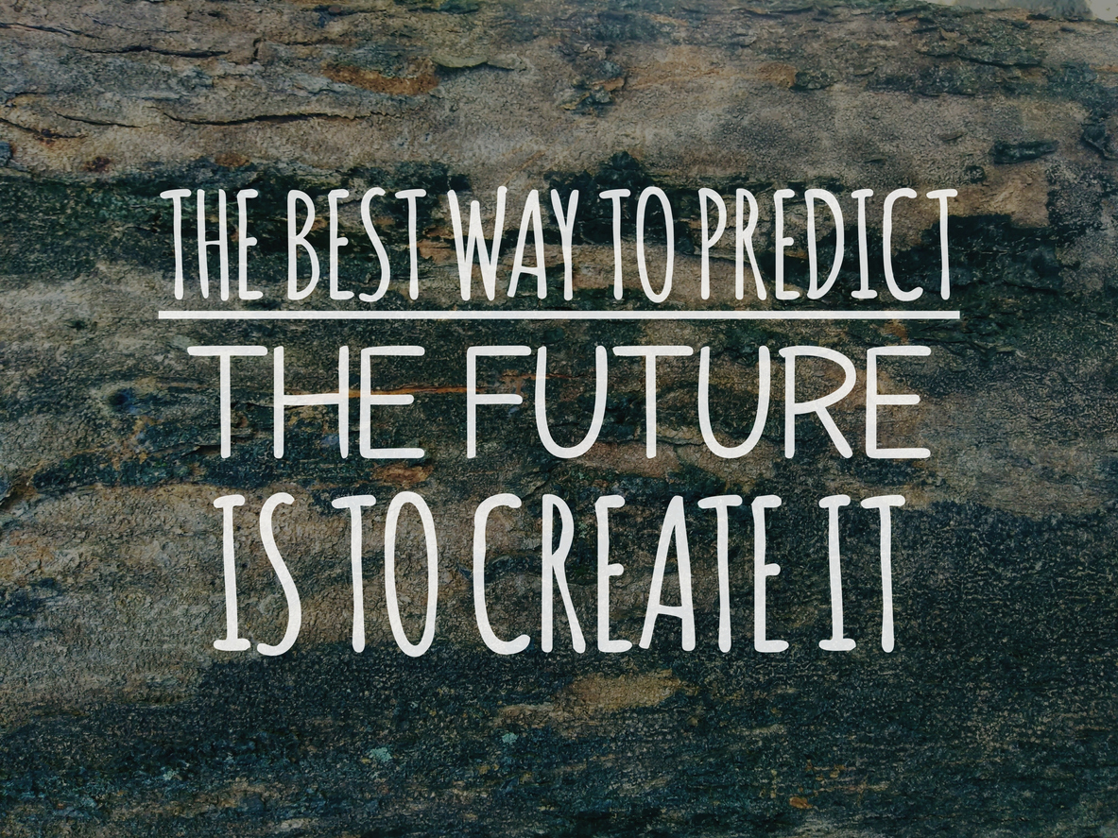

Slide 25

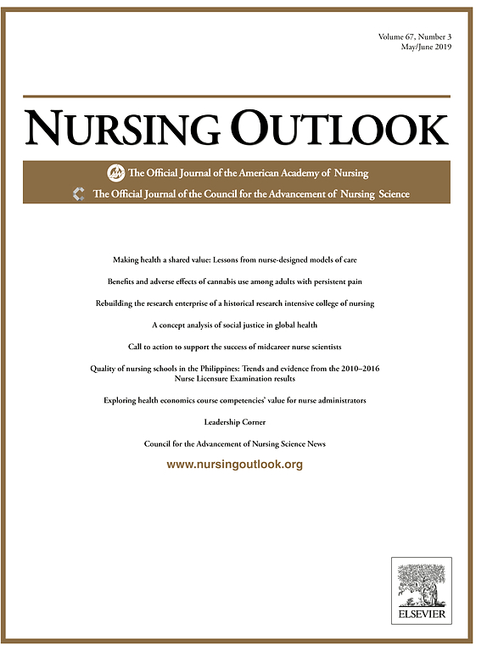


Create the Future Through Renewal
Pesut, D. J. (2004). Create the future through renewal. Reflections on nursing leadership/Sigma Theta Tau International,
Honor Society of Nursing, 30(1).

Slide 26
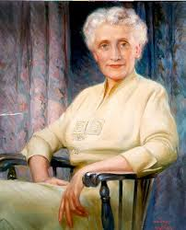

Katharine J Densford International Center for Nursing Leadership
“A profession in its thinking should be a generation or two ahead of the public. Keeping abreast of the world situation is not enough. At the same time, its position of leadership demands the nursing profession take on more and more responsibility for service, locally, nationally and even internationally. My job as President has permitted me to travel widely and associate with nurses all over the world. And this broad experience has borne out my conviction that what anyone of us does anywhere affects all of us everywhere, in nursing too, there is only one world.”
Katharine J. Densford Address to the President American Nurses Association,
36th annual convention in Chicago, Illinois May 31, 1948

Slide 27

Dimensions of Future Consciousness
Time perspective: understanding of the past, present and future and the value of long-term thinking.
Agency beliefs: trust in ability to influence future events.
Ahvenharju, S., Minkkinen, M., & Lalot, F. (2018). The five dimensions of futures
consciousness. Futures, 104, 1-13.

Slide 28

Dimensions of Future Consciousness
Openness: critical questioning of established truths and seeing possibilities of change.
Systems perspective: ability to see interconnectedness between human and natural systems and complex consequences of decisions.
Concern: for other’s aspirations for a better world for everyone.
Ahvenharju, S., Minkkinen, M., & Lalot, F. (2018). The five dimensions of futures
consciousness. Futures, 104, 1-13.

Slide 29

Future Blind
Future Blind

Slide 30

Future Blind
Lost and trapped in yesterday’s decisions, choices and consequences –become risk aversive.
Betrayed by expectations -must negotiate the expectations of youth with the experience of life.
Social systems once protective are destabilizing.
Hudson, Frederic (1999). The Adult Years: Mastering the art of self-renewal. Jossey-Bass: San Francisco, CA.
Notes:
People become future blind when they become Lost and trapped in yesterday’s decisions, choices and consequences this results in many of us becoming risk averse. Second some us feel betrayed by expectations when we realize we have to negotiate the expectations of our youth with the realities and experience of life. Another factor that contributes to future blindness is the fact that social systems once protective are destabilizing. Additionally people today are often overwhelmed with information and decisions and sometimes we become bewildered by change, complexity and discontinuities. As a result Dr. Hudson observes that many people develop a discourse of regret versus hope. It is the job of a leader to shift the nature of discourse in an organization to one of hope, inspiration, aspiration and vision. Creating a vision of the future that touches, moves and inspires people in an organization involves the develop of foresight leadership. Foresight is the antidote to being future blind. The development of foresight pre-supposes that leaders develop actively develop and master the art and science of anticipation that is associated with the development of future literacy skills. There are a number of resources available to help leaders activate and develop their foresight leadership skills.

Slide 31

Future Blind
Overwhelmed with information and decisions.
Bewildered by change, complexity and discontinuities.
Develop discourse of regret versus hope.
Hudson, Frederic (1999). The Adult Years: Mastering the art of self-renewal. Jossey-Bass: San Francisco, CA.
Notes:
People become future blind when they become Lost and trapped in yesterday’s decisions, choices and consequences this results in many of us becoming risk averse. Second some us feel betrayed by expectations when we realize we have to negotiate the expectations of our youth with the realities and experience of life. Another factor that contributes to future blindness is the fact that social systems once protective are destabilizing. Additionally people today are often overwhelmed with information and decisions and sometimes we become bewildered by change, complexity and discontinuities. As a result Dr. Hudson observes that many people develop a discourse of regret versus hope. It is the job of a leader to shift the nature of discourse in an organization to one of hope, inspiration, aspiration and vision. Creating a vision of the future that touches, moves and inspires people in an organization involves the develop of foresight leadership. Foresight is the antidote to being future blind. The development of foresight pre-supposes that leaders develop actively develop and master the art and science of anticipation that is associated with the development of future literacy skills. There are a number of resources available to help leaders activate and develop their foresight leadership skills.

Slide 32
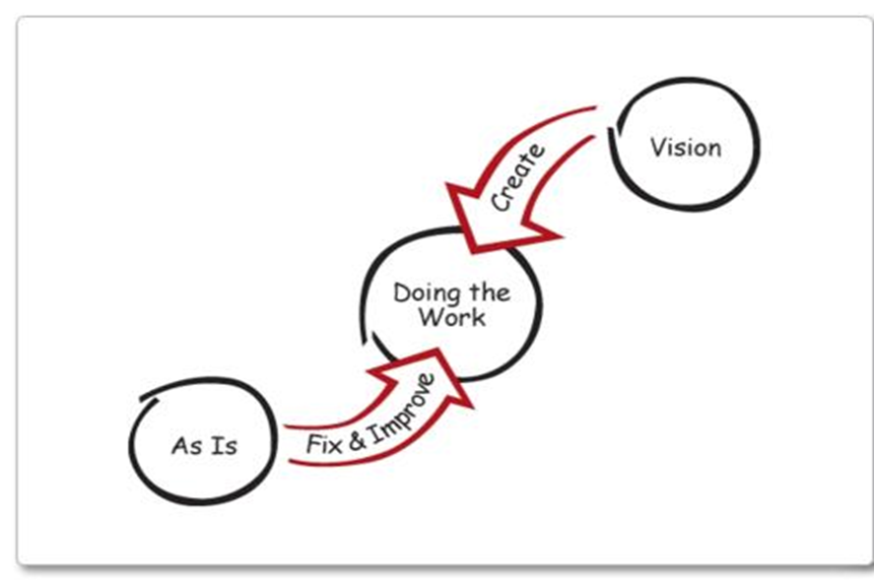
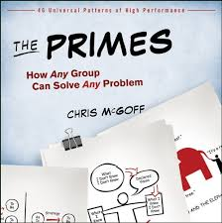
Change versus Transformation
The PRIMES are universal patterns of group behavior that outfit you to work
with any group to solve any problem
McGoff, Chris. (2011). The Primes: How Any Group Can Solve Any Problem,
Victory Publishers, and New York, NY. www.theprimes.com used with permission

Slide 33
Foresight Leadership Styles
Futurist: think in terms of 5-20 years
Activist: introduce new ideas commit to a cause
Opportunist: change the future leverage present possibilities
Flexist: grounded in present, use innovations to enhance survival
Equilibrist: work in present integrate new ideas into systems
Reactionist: protect and sustain organizations; wary of change and support the status quo
Dian, N. (2009). Foresight styles assessment: A theory-based study in competency and change.
Journal of Futures Studies, 13(3), 59-74.

Slide 34

Alpha Leadership:
Anticipate, Align, Act

Slide 35

Wonder
If a time traveler from 25 years in the future could give you the answer to one question about the future of Doctoral Education in Nursing, what would it be?

Slide 36

Pride
If you were looking back 10 years from now and telling the tale of the AACN’S greatest success regarding Doctoral Education in Nursing, what would the story be and why?

Slide 37

Shame
If you were looking back 10 years from now and telling the tale of AACN’S greatest failure regarding Doctoral Education in Nursing, what would the story be and why?

Slide 38

Memory
Regarding Doctoral Education in Nursing, What does the organization (AACN) need to forget?
What must it always remember?

Slide 39
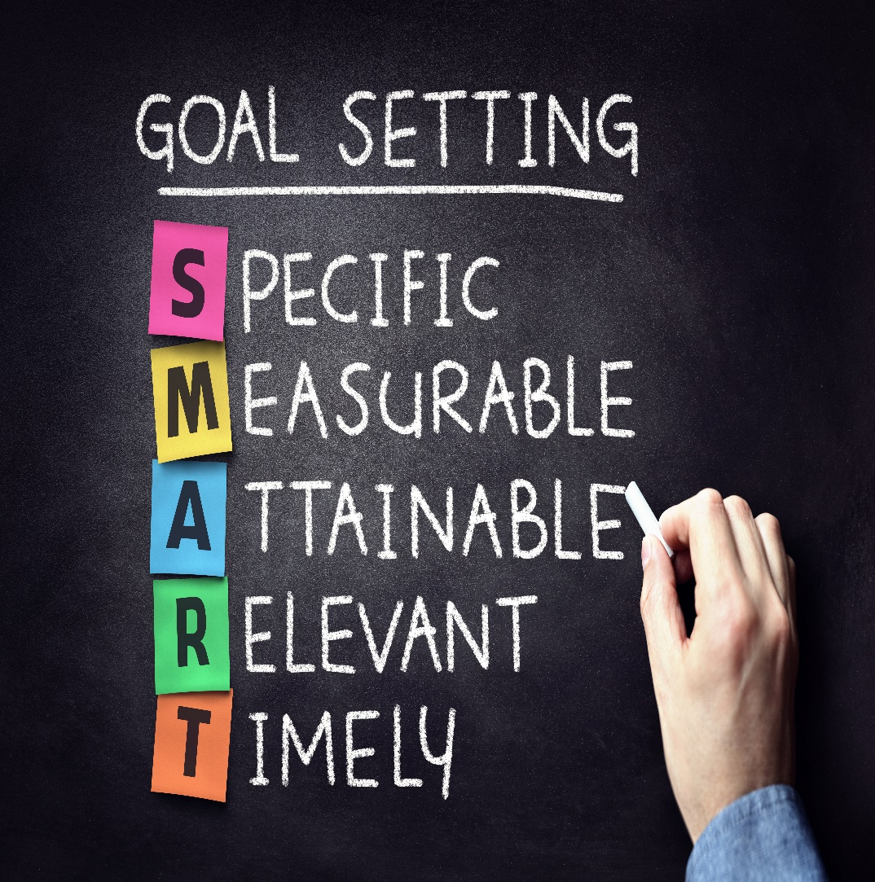
Imperatives
What are the most important strategic decisions we will have to make as an organization regarding Doctoral Education in Nursing?

Slide 40

Obstacles and Dangers
What will prevent us from succeeding?
What are the greatest risks and dangers?

Slide 41
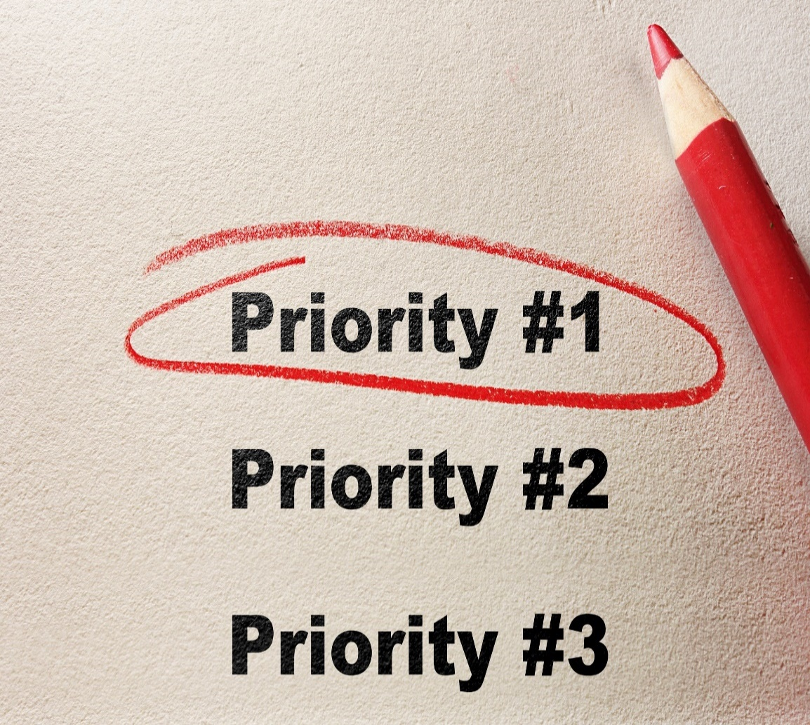
Priorities
If you had the power to do one thing related to Doctoral Education in Nursing, what would it be, and why?

Slide 42

Into the future
Wonder
Pride
Shame
Memory
Imperatives
Obstacles and Dangers
Priorities
1-2-4- all
Progressive, Rapid Cycle Conversation
http://www.liberatingstructures.com/1-1-2-4-all/

Slide 43

The New Leadership Literacies
Look backward from the future
Voluntary fear engagement
Leadership for shape-shifting organizations
Being there when you are not there
Create and sustain positive energy
Foresight ~Insight~ Action

Slide 44
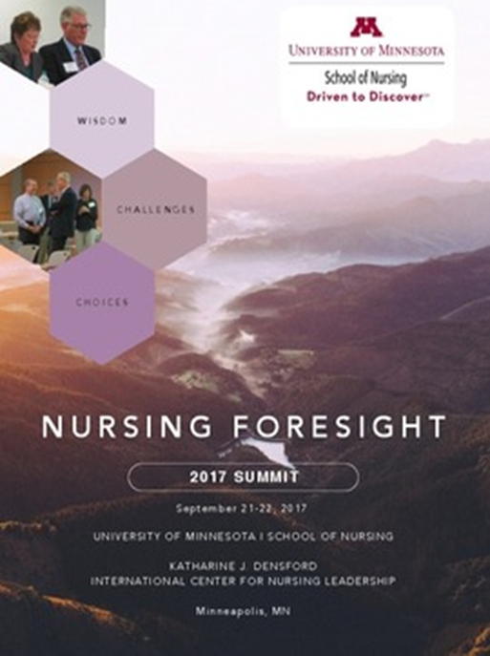

Nursing Foresight Leadership
Nursing foresight is the ability and act of forecasting what will be needed in the future considering emergent health care trends which have consequences for population and planetary health, as well as the nursing profession’s purpose, definition, professional scope, and standards of practice.
Notes:
Nursing foresight is the ability and act of forecasting what will be needed in the future considering emergent health care trends which have consequences for population and planetary health, as well as the profession’s purpose, definition, professional scope, and standards of practice.
Foresight is an essential nursing leadership competency, that prevents future blindness.

Slide 45
Develop Foresight Leadership
Know your personal, and your organization’s orientation toward time.
Appreciate the value of innovation, design, and hybrid thinking to develop foresight leadership.
Develop future fluency and literacy skills.
Actively monitor industry trends, forecasts, disruptions.
Discern logical consequences of trends using futures thinking tools, methods, and techniques.
Pesut, D. (2000). Looking forward: Being and becoming a futurist. Nurses Taking the Lead. Personal Qualities of Effective Leadership. Pennsylvania, PA: WB Saunders Company, 39-65.
Notes:
Over time, I have come to believe the following principles are essential to the develop of foresight leadership:
Know your personal, and your organization’s orientation toward time.
Appreciate the value of innovation and design thinking to support foresight leadership.
Develop future fluency and future literacy skills.
Actively monitor industry trends, forecasts, disruptions.
Discern logical consequences of trends using futures thinking tools and techniques.

Slide 46
Develop Foresight Leadership
Appreciate and value the use of vision-based scenarios.
Stimulate strategic conversations about espoused visions looking backwards from the future.
Navigate change efforts with Appreciation, Influence and Control.
Be clear and intentional about creating a professional and organizational leadership legacy.
Pesut, D. (2000). Looking forward: Being and becoming a futurist. Nurses Taking the Lead. Personal Qualities of Effective Leadership. Pennsylvania, PA: WB Saunders Company, 39-65
Notes:
Appreciate the use of vision-based scenarios.
Stimulate strategic conversations about espoused visions looking backwards from the future.
Navigate change efforts with the creative power of Appreciation, Influence and Control.
Be clear and intentional about a professional nursing leadership legacy.
Some years ago I studied with Philip and Mikela Tarlow.. They wrote a fascinating book, referenced at the end of this presentation titled Navigating the Future: A personal guide to achieving success in the New Millennium. In this work they note what the future holds for you depends on what you hold for the future. So in essence as you become more clear about what you want the future to be, that future will be realized through you conscious intentions to create it. Unfortunately many of us are become victims of what developmental psychologist Frederick Hudson calls future blindness. Hudson studies adult development and discovered many adults become future blind for the following reasons.

Slide 47
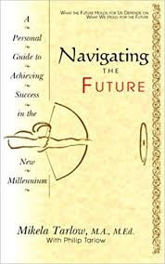

“What the future holds for you
depends on what you hold for the future”
Mikela Tarlow

Slide 48
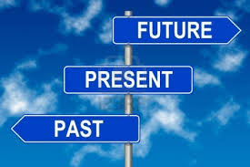
Know Your Personal and Organizational Orientation to Time
Notes:
An essential first principle related to the development of foresight is to become conscious and aware of your own personal orientation to time. Are you are person who thinks mostly about the past, present or future? To what degree do you engage in reflecting time shifting when situations and contexts demand it? More importantly, how would you define and categorize the time perspective of you’re your organization? Is your organization grounded in tradition? Trying to survive in the present? Or eager to tackle and anticipate the future?

Slide 49
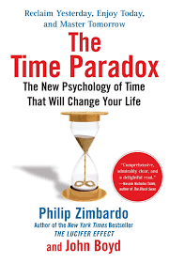
Time Perspectives
Past-negative
Past-positive
Present fatalistic
Present hedonistic
Future
Transcendental future
The time paradox survey
Bluedorn, A. C., & Denhardt, R. B. (1988). Time and organizations.
Journal of management, 14(2), 299-320.
Slawinski, N., & Bansal, P. (2017). The paradoxes of time in organizations. The Oxford Handbook of Organizational Paradox, 373.
Notes:
Check out the resources and links on this slide. Of particulate interest is the Your Tube video by Dr. Philip Zimbardo titled the Secret Powers of Time – Zimbardo and his colleagues believe people operate in one of six-time perspectives past, Past-negative Past-positive
Present fatalistic,
Present hedonistic
Future
Transcendental future
If want to understand more deeply your time perspective I invite you to take the time paradox survey and reflect on how your assessed time perspective influences your foresight leadership development.
Slawinski and Bansal note
Organizations that focus on the present over the future prioritize efficiency over learning and exploitation over exploration organizations that tend to focus on the past over the future tend to favor tradition over innovation

Slide 50

Appreciate the value of innovation, design, and hybrid thinking, to support foresight leadership.
Notes:
Creating the future depends on appreciating the value of innovation and design thinking. Recall Chris Mc Goff’s words from the Change versus Transformation Prime…. Transformation is a creation and not a fix. Crafting a vision of a desired future requires design thinking and creativity and appreciation of the value of innovation in action. Links associated with this slide will lead you to resources about the complexity and dynamics of design required in a health eco-system. Supporting creativity and innovation in an organization requires appreciation of creativity with a well defined purpose in mind. The future we model in the next slide outlines the competencies and skills leaders need to create to support a foresight leadership agenda

Slide 51
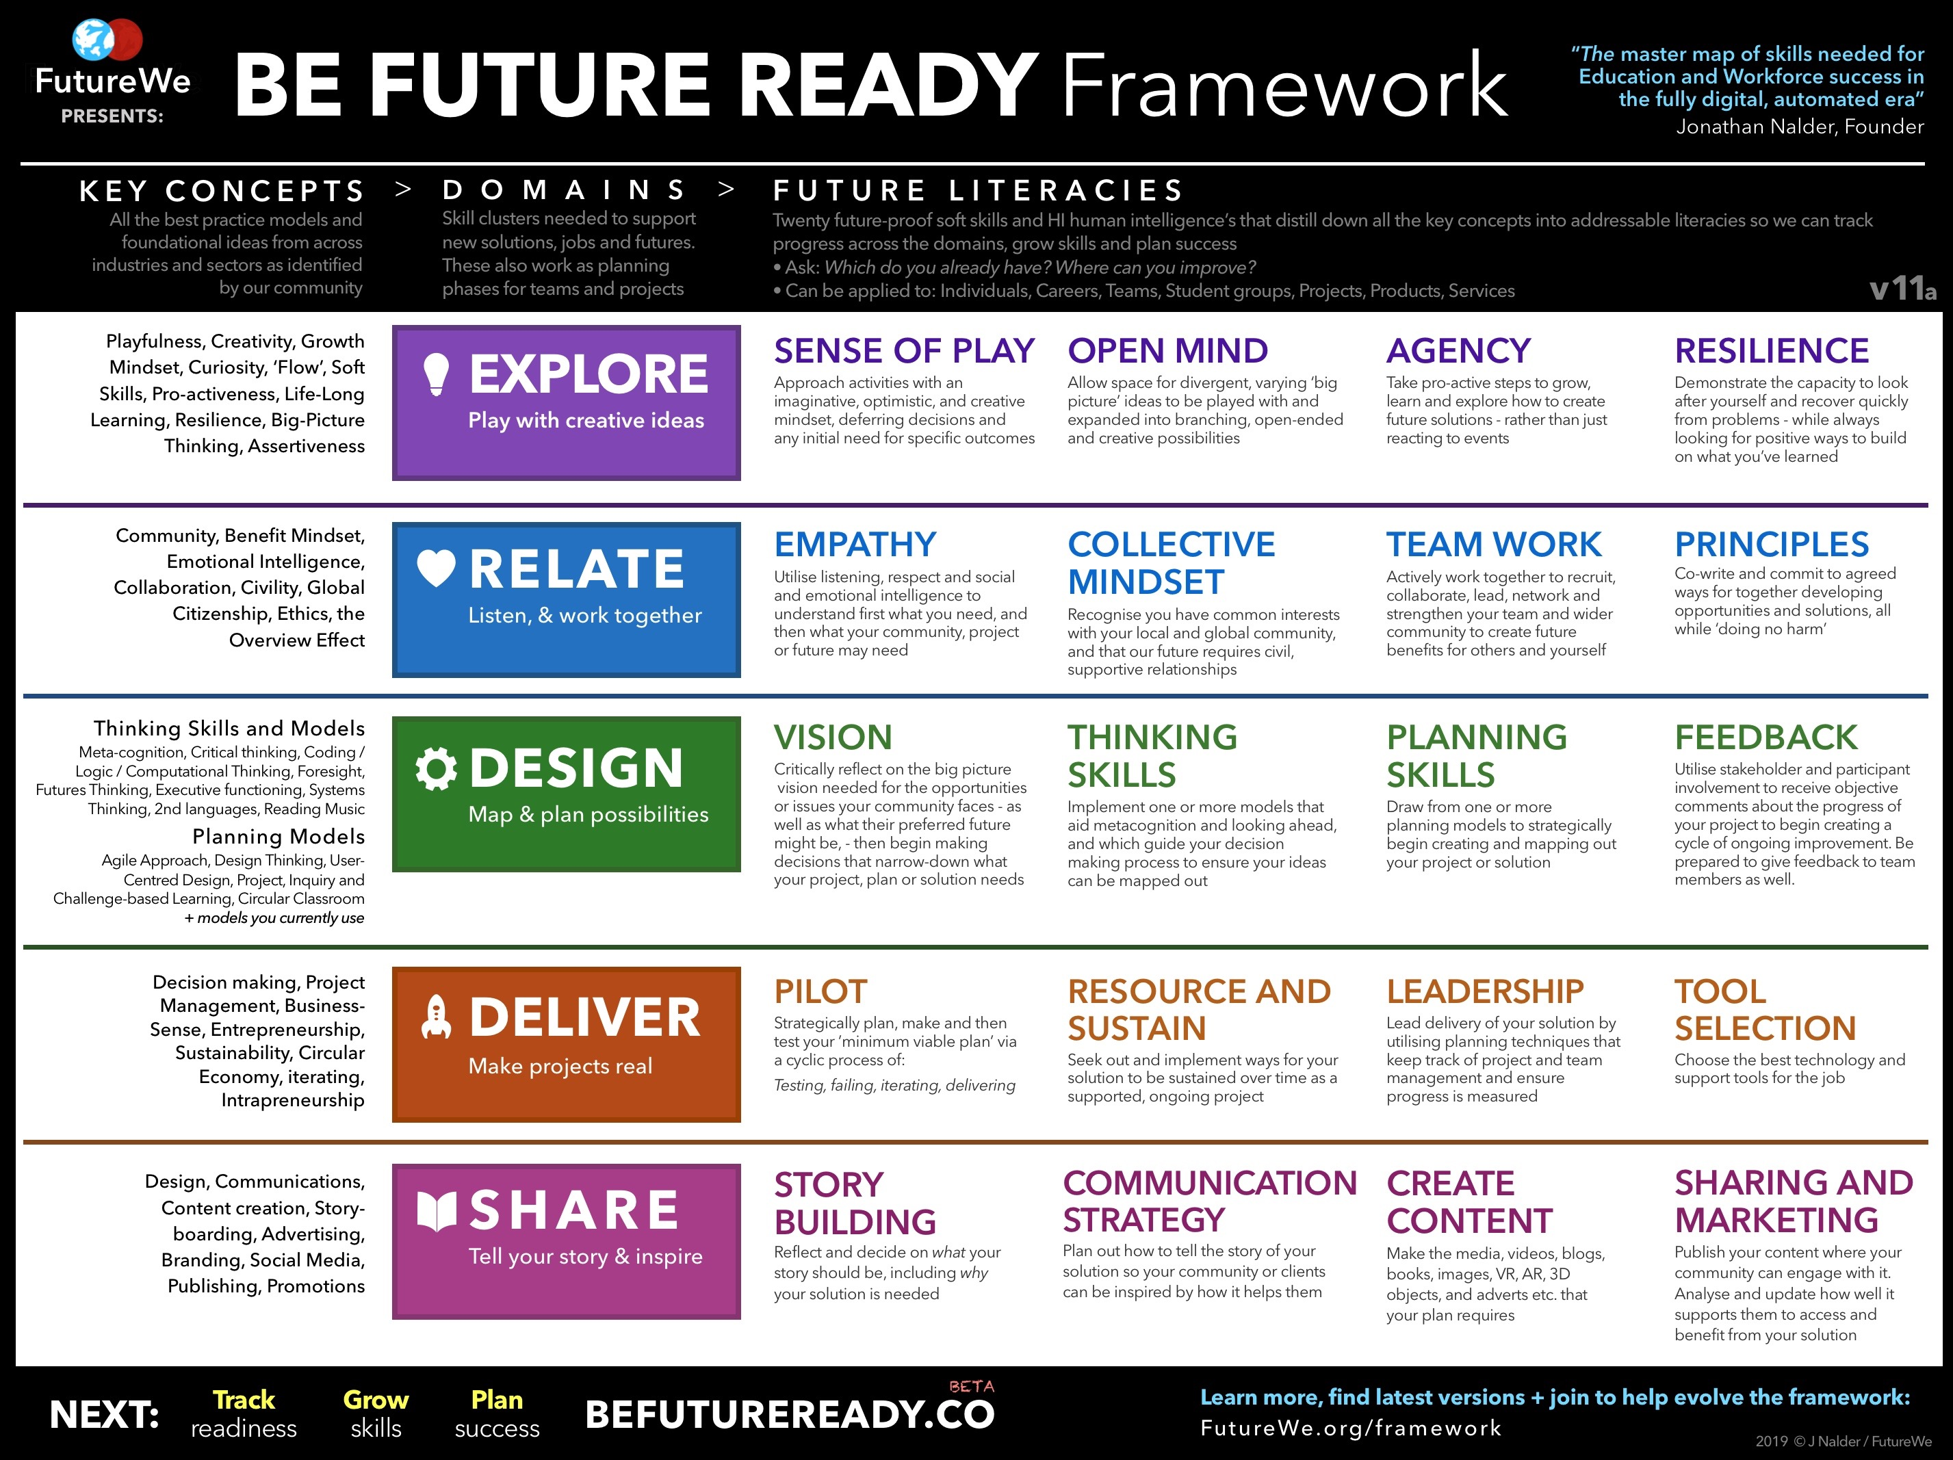
http://futurewe.org/framework/
Used with permission
Notes:
The five competencies of explore, relate, design, deliver and share are essential to a nursing foresight leadership skill set. As a leader you must play with new ideas, work together in community , map out solutions, make solutions real through piloting and rapid prototyping of projects an ideas and then inspire and share the learning through story telling, and communication strategies that help people understand and appreciate the consequences and impacts of emerging trends. There is also a survey https://docs.google.com/forms/d/e/1FAIpQLSeGW__0tqUKGCN9rJnrbno-VnOEtpQK7qboTFrj5LSXAys_Gw/viewform one can take to gauge and assess your future ready skills

Slide 52


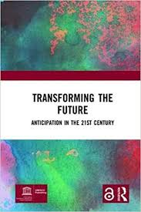

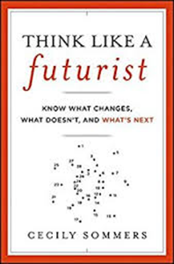
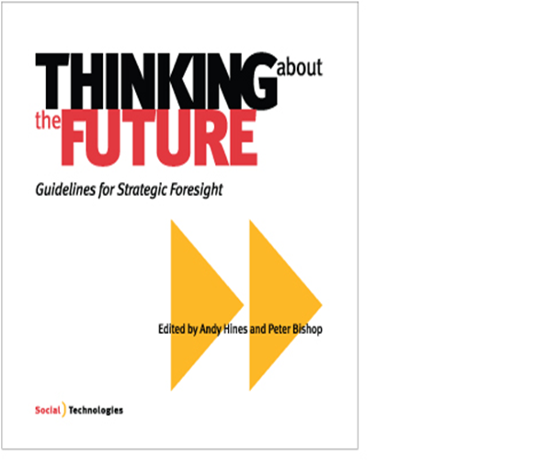
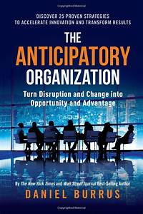

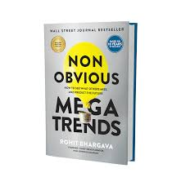
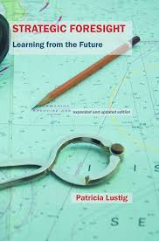
Develop Futures Literacy and Foresight
Notes:
For example, Click on the hyperlink in this slide and learn what the United Nations Education and Scientific Organizations are doing to help people round the world develop a future thinking orientation. Check out the references and resources at the end of this lecture to learn more about future literacy and how to develop knowledge, skills, and abilities to become more future literate. The University of Minnesota School of Nursing has been a pace setter in many areas and has always had a future time orientation. The School of Nursing is a leader in the development of knowledge, learning, and service activities that push the envelope in terms of research, education and practice. In particular the work of the Katherine J Densford International Center of Nursing Leadership has stimulated dialogues and discussions about the value, and importance and impact of nursing knowledge and wisdom work. Past projects include sharing the knowledge of nursing leaders with the Summit of Sages Initiative and the development of the Densford Center Library of Nursing Leaders. In the Fall of 2018 under my leadership the Center turned its attention to the issue of nursing foresight.. The School of Nursing and the Densford Center hosted an invitational summit to explore and develop the idea nursing foresight leadership.

Slide 53

Future Studies
The purpose of future studies is not to predict the future, but to envision desirable futures and avoid or prevent catastrophic ones.

Slide 54
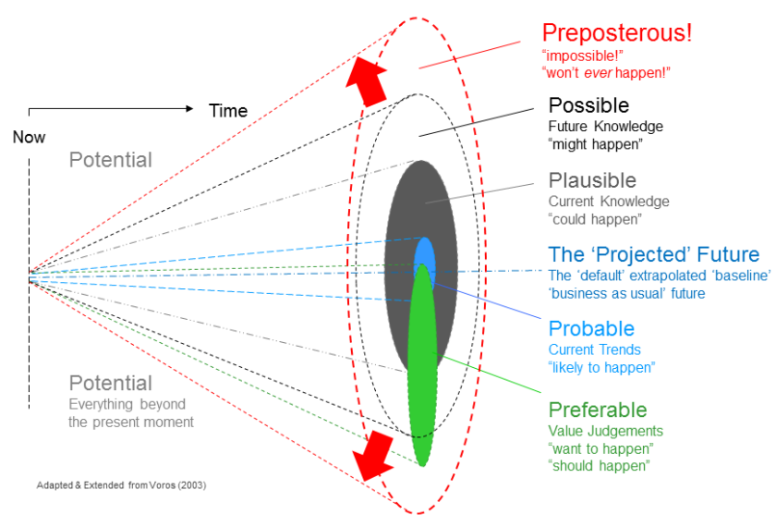
https://thevoroscope.com/2017/02/24/the-futures-cone-use-and-history/
used with permission
Notes:
This model developed by futurist Joe Voros illustrates there are many types of futures preposterous, possible, plausible, projected, probable and preferable.

Slide 55

Actively Monitor Industry Trends, Forecasts, Disruptions
Notes:
A key of course to the foresight process is the active monitoring of industry trends, forecasts and the anticipation of disruptive innovations. Many organizations do not have process in place to actively gather information about what is next in the industry.
Authors Deering ,Dilts, & Russell, J. (2002) in their book . Alpha leadership: Tools for business leaders who want more from life. John Wiley, NY. Ask the question is your organization more frog or bat?

Slide 56
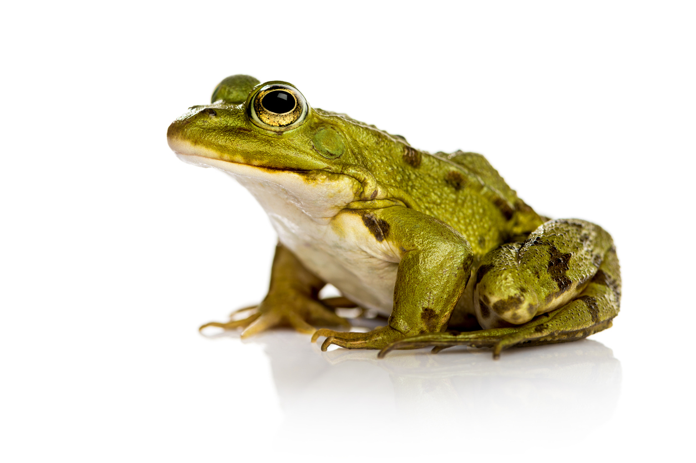
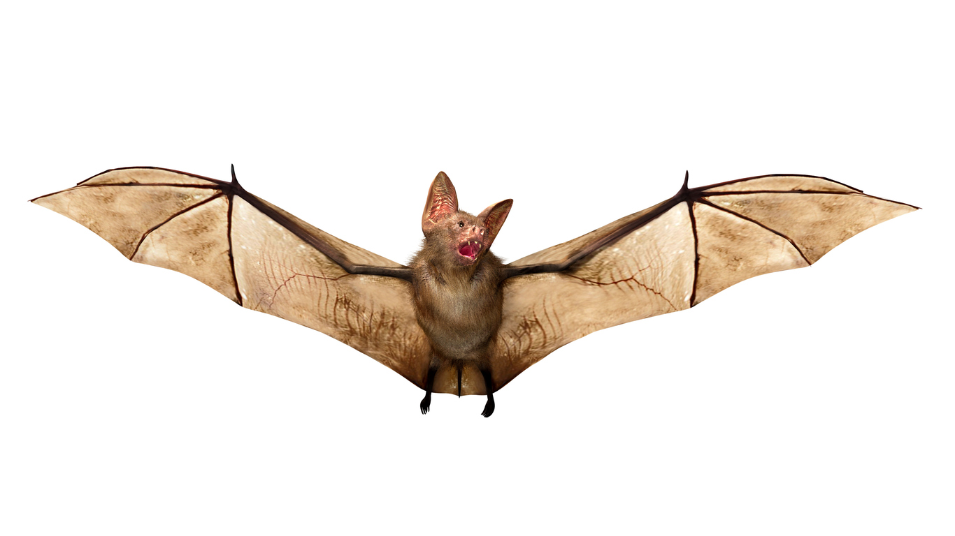

“If your organization is more frog than bat, perhaps you need to change it?”
University of Minnesota Library Foresight Leadership: The Future of Nursing and Health Resource Page
Foresight Leadership: The Future of Nursing and Health
Deering A., Dilts, R., & Russell, J. (2002). Alpha leadership: Tools for business leaders who want more from life. John Wiley, NY.
Notes:
Most people know that frogs are not very attentive to their environments. Legend has it that you can put a frog into a pot of water, and slowly turn up the heat and it will boil to death. In contrast, bats use sonar and navigate their environment by sending out signals and using the feedback to help them find their way and navigate. Fortunately there are a great number of resources and organizations who have their eyes on the future and are systematically gathering information about hard and soft trends likely to impact health can health care. For example

Slide 57
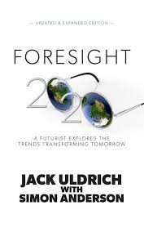
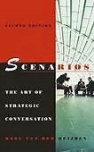

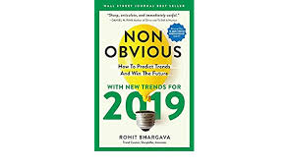






Discern Consequences of Trends and Disruptions
Personal
Professional
Organizational
Social
Planetary
Notes:
Trends, consequences and discussions are being aggregated and synthesized by a number of organizations and institute such at Shaping Tomorrow, the Institute for Alternative Futures, the Millennium Project, the Future today Institute, the Planetary Health Alliance. To support you in your access to future models, methods, theories, and trends. I invite you to explore the University of Minnesota school of Nursing Katherine J Densford International Center for Nursing Leadership web Site Foresight Leadership: The Future of Nursing and Health at www.foresight-leadership.org. Consider joining the linked in conversation about the future of nursing and health. Add your voice to the dialogue and discussion related to the consequences of projected trends on nursing education, practice and research. Some specific trends related to digital health are

Slide 58
The Medical Futurist
Empowered patients
Gamifying health
Eating in the future
Augmented and virtual reality
Telemedicine and remote care
Re-thinking health professions curriculum
Surgical and humanoid robots
Genomics and personalized medicine
Body sensors inside and out
Hospitals of the future
The medical tricorder and portable diagnostics
Growing organs in a dish
Do it your self biotechnology
3-D printing revolution
Iron man powered exoskeletons and prosthetics
End of human experimentation
Medical decisions- artificial intelligence
Nanorobots living in blood
Virtual digital brains
Recreational cyborgs
Cryonics and longevity
Mesko, Bertalan (2017). The Guide to the Future of Medicine, Create Space, USA

Slide 59
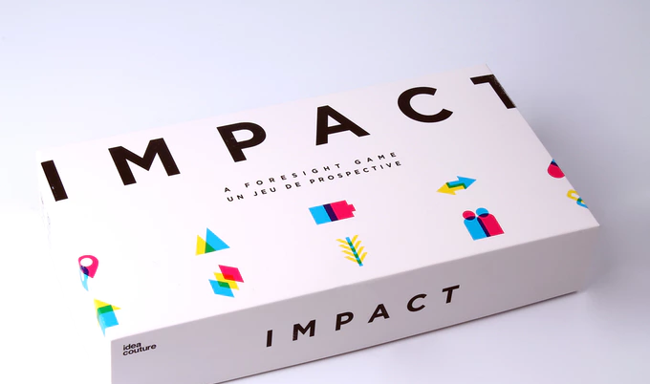
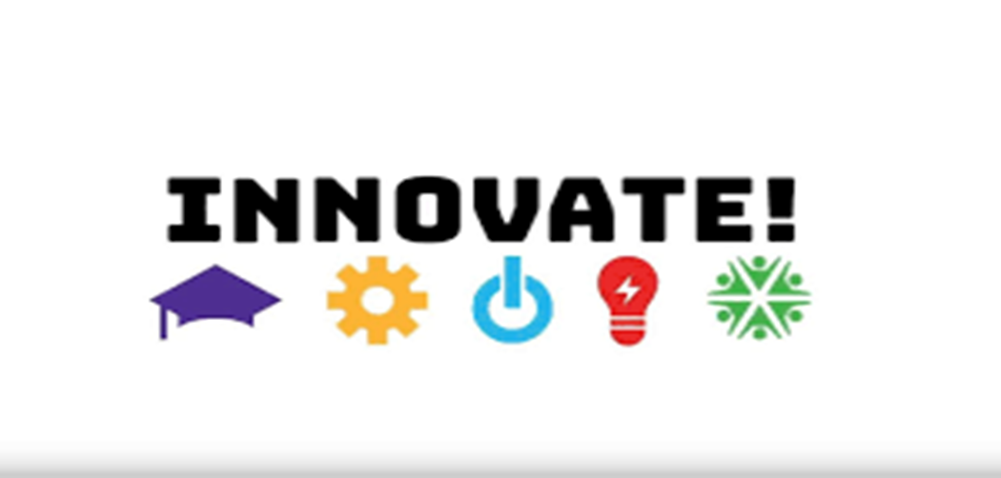
Impact Game
https://www.nesta.org.uk/feature/innovate-policymakers-board-game/

Slide 60



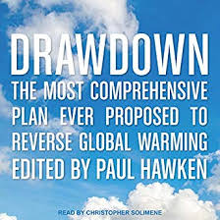
Planetary Health
https://envirn.org/
https://planetaryhealthalliance.org/
https://envirn.org/e-textbook/
https://www.drawdown.org/

Slide 61

Appreciate the Use of Vision Based Scenarios
A scenario is a method for telling a story about the future. It can be based on reliable or speculative data.
Notes:
Trends come alive through the creation of scenarios…A scenario is a method for telling a story about the future. It can be based on reliable or speculative data. For example the Robert Wood Johnson Foundation commissioned the Institute for Alternative Future to create and develop scenarios about the Future of Health in 2032. The next slide has a hyper links to the final report. Click on it and read the scenarios…which one resonates the most with you Which one do you think is most likely to emerge? Which one do you want to emerge?

Slide 62
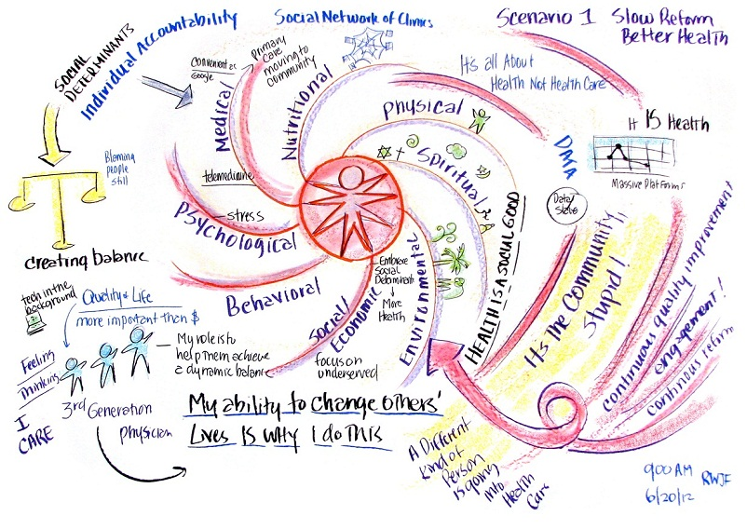
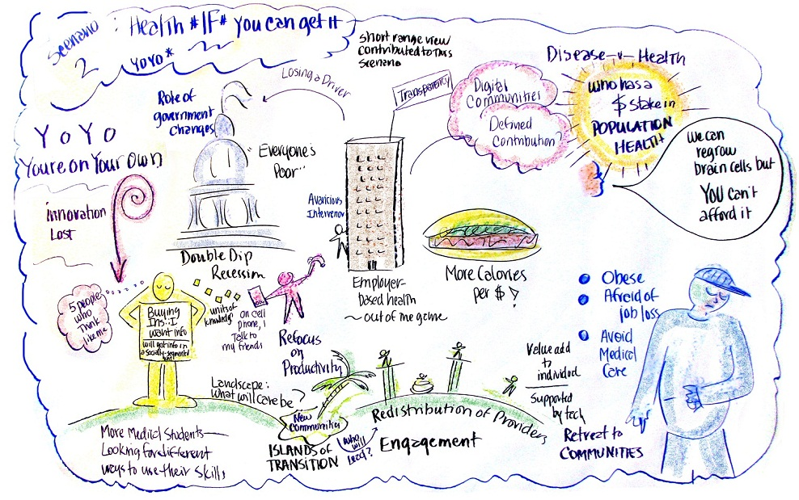
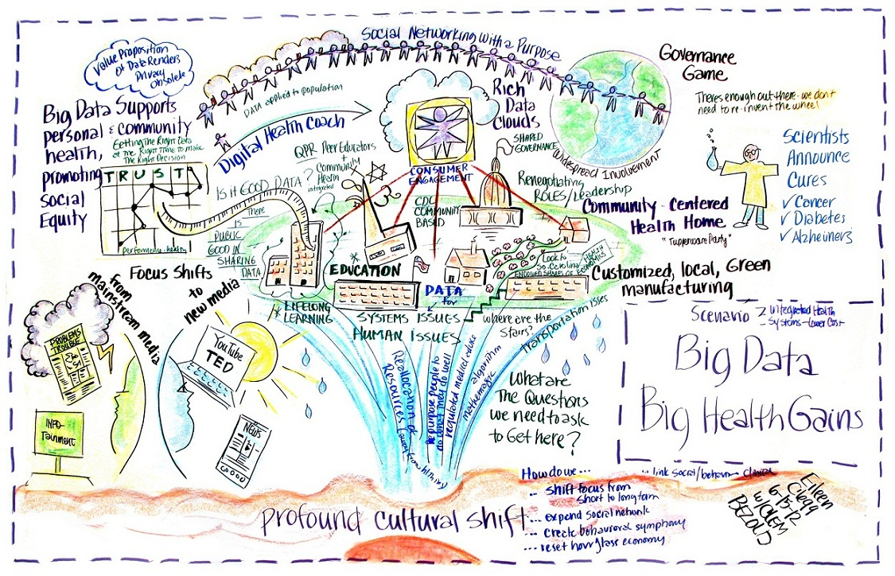
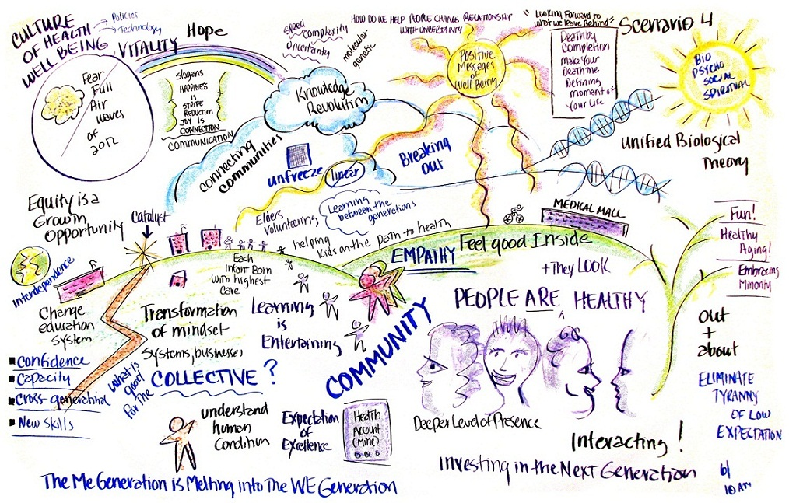
Health and Health Care 2032
http://www.altfutures.org/pubs/RWJF/IAF-HealthandHealthCare2032.pdf
Notes:
In addition to the Four Scenarios about Health and Health Care in 2032 The IAF has other scenarios about health care int the future as well as the future of human services in year 2035

Slide 63

Human Service 2035
Scenario 1: Reductions and Rebounds (Expectable) - Assumes a period of likely human service cuts during the 2017- 2021as well as the evolution of human service delivery, automation and the use of intelligent agents in all sectors of the economy along with expectable job loss.
Scenario 2: Navigating Unending Challenges (Challenging) considers some key things that “could go wrong” (including another great recession, funding cuts).
Scenario 3: Building Human Potential (Visionary) - Explores human progress in attitudes; technology including “abundance advances,” and policy.
Scenario 4: Thriving Communities (Visionary) --successful changes in attitudes, technology including job loss to automation, policy transformations, and the “abundance advances”.
http://altfutures.org/wp-content/uploads/2018/10/IAF_Human_Services_and_Human_Progress_2035.pdf
Notes:
Read and reflect on these four Human Service Scenarios for the year 2035 what are the implications of each of these for the future of nursing and health? Strategic conversations about scenarios like this should be organized around the following questions

Slide 64

Stimulate Strategic Conversations Looking Backwards from the Future
How plausible does the scenario seem?
What thoughts does it suggest?
What feelings does it generate?
Notes:
How plausible does the scenario seem?
What thoughts does it bring to mind?
What feelings does it generate?

Slide 65
Strategic Conversations
What are the implications for society, healthcare and the health care professions?
If parts of the scenario are desirable what actions need to be taken to increase the chances of it happening?
If parts are undesirable what actions need to be taken to prevent them from happening?
Notes:
What are the implications for society, healthcare and health care professions especially nursing?
If parts of the scenario are desirable what actions need to be taken to increase the chances of it happening?
If parts are undesirable what actions need to be taken to prevent them from happening?

Slide 66
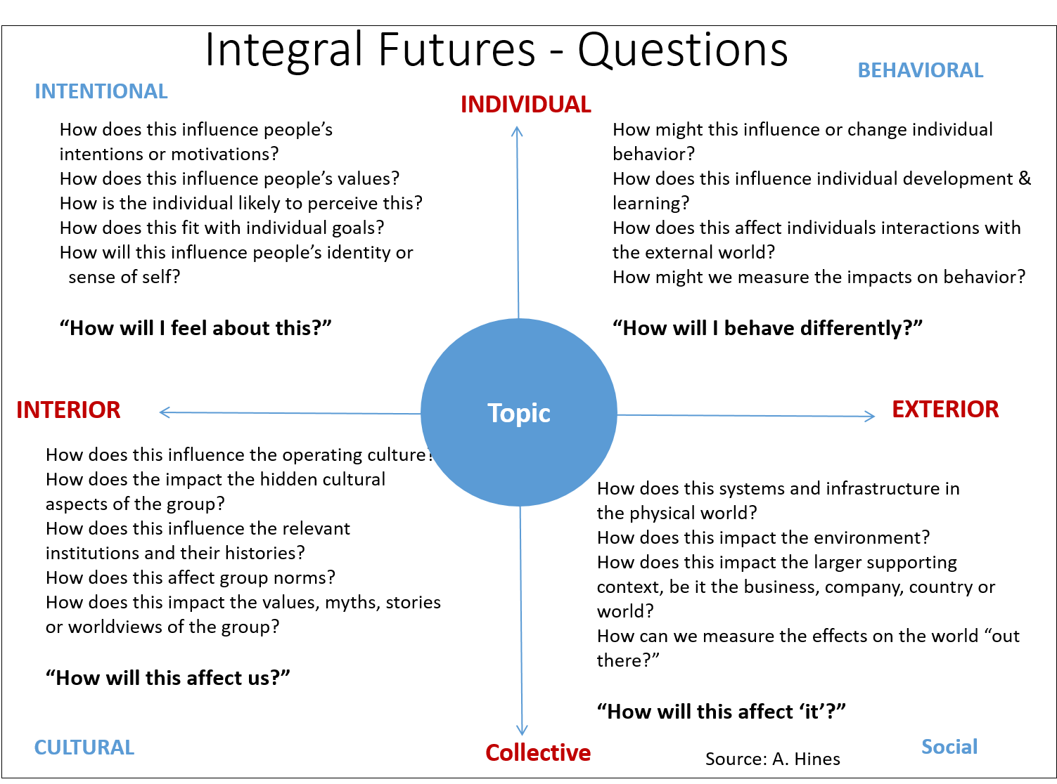
Used with permission
Notes:
An integral approach to considering the future involves attention to four dimensions, the personal, the cultural, the behavioral and the social. Think of an emerging topic related to the future of nursing and health like data science, genetics, artificial intelligence, climate change…. How can you use the questions to unpack and make explicit some of the consequences of these topics in terms of the future?

Slide 67
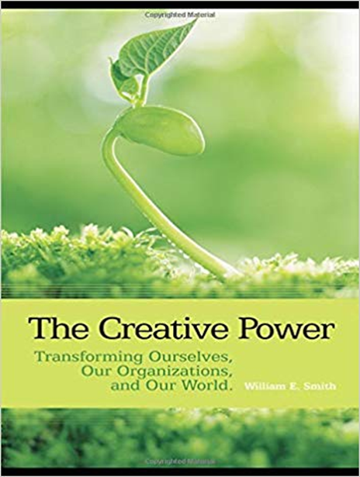

Navigate Change With the Creative Power of Appreciation, Influence and Control
The Simplicity Beyond Complexity
The Creative Power of AIC
Notes:
Once a direction or decision has been made about pursuit of a desired future, Leaders must navigate change with the appreciation, influence and control. The AIC model of leadership developed by William Smith is simple, elegant and powerful. Smith observes once a purpose is determined it sets up energies related to ideals, values and goals. And success is achieved with degrees of appreciation, influence and control. A leader's task is to help people compare and contrast the ideal with the reality, and discern who is going to support or not support the vision into action, and then one is challenged to decide what to do about it. Successful foresight initiatives have equal amounts of appreciation, influence and control factors. I invite you to learn more about the AIC model and consider how you can incorporate this model in your own leadership skill set.

Slide 68
Philosophy | Key Questions | Key Capacity | Key Process Points
Purpose The source of power | What level of purpose is central here - goals, values, or ideals? | Wisdom | Realize that all levels of purpose are present and the more aware you are of them all the more power you release for application to your issue.
Appreciation Our power to attract purpose through resonance with the whole. | What are the possibilities? What are the realities? | Intuition Sensing | Keep the process open. Use art, or other imaginative means to express appreciation and cause suspension of disbelief. Receive appreciation in silence.
Influence Our power with others we cannot control but who can affect our purpose. | What are the priorities? Who will support and who oppose? | Thinking Feeling | Keep engaged. Keep the dialogues going. Do not try to settle for one solution. Emphasize the quality of the options and engagement of others rather than focusing on a solution. Seek resolution of value differences.
Control Our power over the resources we own, relative to the purpose. | What will you commit to? Will it achieve the purpose? | Action Reflection | Allows those responsible to choose what they will do, given the insights from above. Let them be responsible for the results.
Feedback Cycle | How are we doing? | Commitment | Place reviews of progress at the center of your organizing process.
Smith, W. E. (2008). The creative power: Transforming ourselves, our organizations, and our world. Routledge.
Used with permission

Slide 69

Be Clear and Intentional About a Leadership Legacy
Hinds, P. S., Britton, D. R., Coleman, L., Engh, E., Humbel, T. K., Keller, S., & Walczak, D. (2015). Creating a career legacy map to help assure meaningful work in nursing. Nursing outlook, 63(2), 211-218.
The Achievement Center: Build an Organizational Legacy
Notes:
I began the lecture referencing the work of Philip and Mikela Tarlow with their observation what the future holds for you depends on what you hold for the future…. So this brings us to the issue of a personal and or professional leadership legacy. As you consider the future considering your personal and or professional past – what difference do you want to make in the world of nursing and health? What do you want to be known for? What stories will people tell after you leave your organization? What contributions will be most remembered when you are ready to retire? Create a career legacy map with a desired future in mind and begin to exercise your foresight leadership to make a positive difference in the world of nursing and health…
I hope you continue to learn more about foresight and futures literacy. Check out some of the references and resources in the next slide.. Visit the Foresight Leadership Future of Nursing and Health Web resource at www.foresight-leadership .org Join the Foresight leadership Future of Nursing and Health learning community on Linked in. Add your voice to the conversations about trends, impacts, consequences and developments likely to influence the future of nursing, health, and the planet… explore, learn and contribute because you are the next generation nursing leaders responsible for creating the professional future of nursing and health,

Slide 70

The Surprising Power of Liberating Structures
Anticipating the Future of Doctoral Education in Nursing
Notes:
Serious, serious fun.

Slide 71


25/10 Crowd Sourcing
Rapidly generate and sift a group’s most powerful actionable ideas
On index cards, each participant writes:
If AACN was 10 times bolder in advancing Doctoral Education in Nursing what should it do?
  No names
  Write legibly
Notes:
Directions:
Stand up, mill around, and pass your card to someone new. Keep milling…
Then stop in front of another person. Read the card you were given, and rate the card on a scale of 1-5. “5” is fabulous, 1 is ho-hum. Talk over your ratings adjust as needed. Write your final rating on the back of the card.
Mill again. Pass “your” card to someone else. Keep milling.
Stop in front of another person. Rate the cards in the same way.
Repeat five times, in five rounds. By round 5, each index card should have five ratings. Add them up. What is the score?
Await further instruction.

Slide 72

25/10 Crowdsourcing
Rapidly generate and sift a group’s most powerful actionable ideas
Pass cards around while milling
5 rounds: stop & rate the card in hand
Rate each card: 1 = ho-hum to 5 = fabulous, “I’m in!”
Decide* before looking at other scores Put rating on the back of the card

Slide 73

Final Steps
Rapidly generate and sift a group’s most powerful actionable ideas
Add all the scores* after the last round ( max score 25)
If you have a score of 25 find a microphone and share the idea
Cards will be collected and shared with organizational leadership
* If you have more than 5 scores, add them together, divide by the total number of scores, then multiply by 5

Slide 74


Slide 75

Knowledge Work Questions
What concepts, ideas, tools, theory, technique or resources are most useful?
How can the information be used?
Why is the information important?
Why care about the information?

Slide 76

Pledge to Future Generations
Tough, Allen. (1993). Making a Pledge to Future Generations, Futures, 25,90-92

Slide 77
Foresight Leadership: Anticipating the Future of Doctoral Education in Nursing
Daniel J Pesut PhD RN FAAN
Professor of Nursing Population Health and Systems Cooperative Unit
Director of the Katharine Densford International Center for Nursing Leadership
Katherine R. and C. Walton Lillehei Chair in Nursing Leadership
www.Foresight-Leadership.org
University of Minnesota School of Nursing
308 Harvard St. SE
4-185 Weaver-Densford Hall
Minneapolis, MN 55455
dpesut@umn.edu
Linkedin
Office Phone number: 612-626-9443
© 2019 All Rights Reserved

