Slide 1
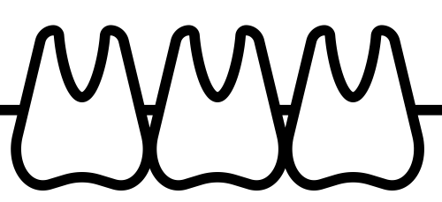

Something to Smile About: Librarian Support for Evidence-Based Dentistry
Nicole Theis-Mahon, MLIS, AHIP & Caitlin Bakker, MLIS, AHIP
Introduction
At the end of the session, participants would be able to:
Articulate principles of evidence-based dentistry
Employ strategies to efficiently identify quality resources
Articulate the strengths and weaknesses of individual articles
Begin to develop a research product
Outcome &
Evaluation
University of Minnesota offers a Certificate Program in Contemporary Restorative and Esthetic Dentistry.
This is a three-part Continuing Dental Education (CDE) course for dental practitioners interested in increasing their knowledge of esthetic dentistry.
The third level of this series involves conducting research and writing a paper on a topic in restorative or esthetic dentistry.
Ask
Acquire
Appraise
Develop a focused clinical question
Distinguish between background and foreground questions
Structure questions in the PICO(T) format
Build an effective, efficient search strategy
Identify the type of study and place it in the context of levels of evidence
Choose appropriate resources to answer the question
Iterate on the search depending on results
Develop an understanding of the key elements of original research articles
Apply
Integrate evidence into clinical practice
Choose a study design appropriate for a project of interest
Begin to develop a research product
Librarians have the skills and knowledge to engage beyond literature searching to writing up and reporting of research. These opportunities allow librarians to demonstrate their value to researchers and practitioners.
“[the program ] was a turning point for me professionally and opened the door to self-examination of how I was practicing dentistry vs. how I should practice dentistry.”
“Looking at my past cases I noticed things that could have been done differently (and in most cases better), it got me outside of my comfort zone …”
“[I received] excellence guidance from the librarians”
Description
Librarians have been invited instructors in this course since 2013. In 2018, the role of librarians expanded to instructing about the publication process and understanding the structure and design of a research paper.
The librarians developed and delivered a course on how to write and critically appraise a research paper for dental practitioners who were new to research.
Introduction
Orient the reader to the broad area of interest
Methods
Fully describe how the research question was addressed, including:
Results
Present the findings without discussion
Discussion
Synthesize previous research findings to highlight gaps
Articulates the research question
Data collection
Data analysis
Measures and instruments
Only reports data related to the question posed
Interpret the results
Integrate findings into the field of knowledge addressed in the introduction
References
Image: Teeth by Chanut is Industries from the Noun Project

