Slide 1
Sustaining Open Research: Institutional Repository Readiness
Heidi Imker PhD
Elaine & Allen Avner Associate Professor
in Interdisciplinary Research
Director, Research Data Service

Slide 2
Illinois Data Bank (databank.Illinois.edu)
Launched in 2016 with nearly 600 datasets to date (~12 TB total) representing the life sciences (~55%), social sciences (~23%), physical sciences (~13%), engineering (~8%), and the arts and humanities (<1%)
Has many features in common with other repositories (e.g., assign DOIs, etc.)
A unique feature is that it’s been developed locally, a.k.a. “home grown”

Slide 3
How it works …
DataCite
DOI minting service and global metadata store
Researchers
Describe & Upload
Metadata
DOI
Illinois Data Bank
Ruby on Rails web app
Metadata & Files
Amazon Web Services
Medusa
Digital preservation repository and collection registry

Slide 4
How it works …
Illinois Data Bank
Ruby on Rails web app
Amazon Web Services
Download
Medusa
Digital preservation repository and collection registry
Public Access

Slide 5
Why Home Grown?
Small but strong repository team
Medusa was advanced enough to be functional and successful enough to continued
Allowed datasets to be managed as part of a centralized strategy in the Library
Procurement is challenging
PROs – integrated, customizable, and responsive
CONs – whole lotta work and requires stable staffing

Slide 6
Your university’s context is everything.

Slide 7
Why institutional?
Whole lotta people haven’t shared data => front line for education/outreach/support
There is not a disciplinary repository for all data types and there never will be
Institutions do have an interest* in the research data created on their campus
* the extent and nature of that interest varies by campus, by data, and sometimes, it seems, by moon phase

Slide 8
What does your university get out of open data?

Slide 9
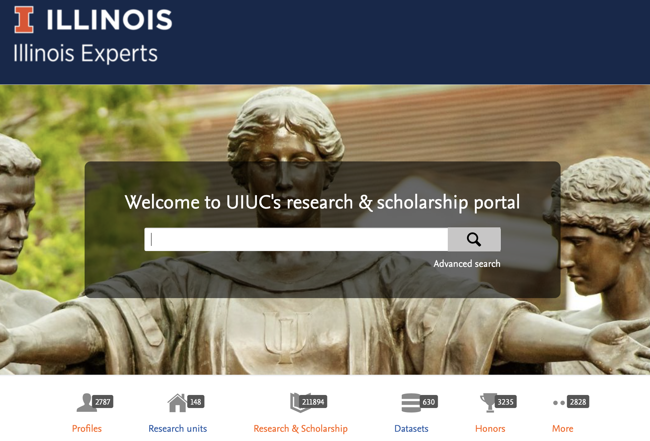
Visibility for the university – in aggregate

Slide 10
Visibility for the university – in aggregate

Slide 11
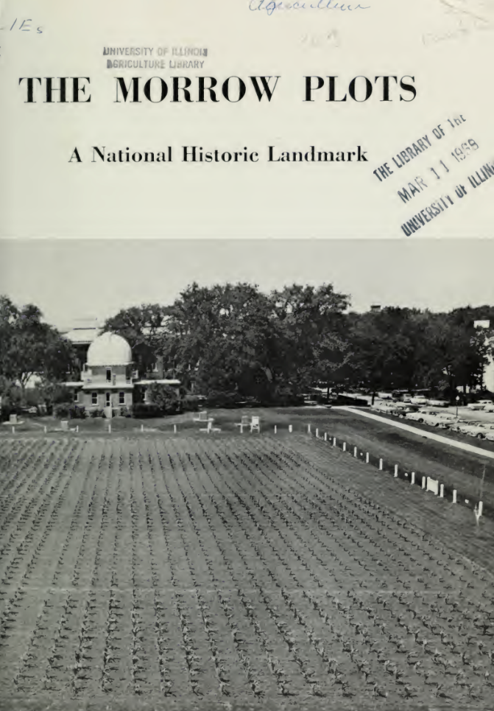
Visibility for the university - discrete
The Morrow Plots are experimental fields nearing their 150th birthday
2nd oldest in world and of great cultural significance locally
Collaboration with ag college and library to locate, aggregate, clean, and document data, and then publish in the Illinois Data Bank

Slide 12
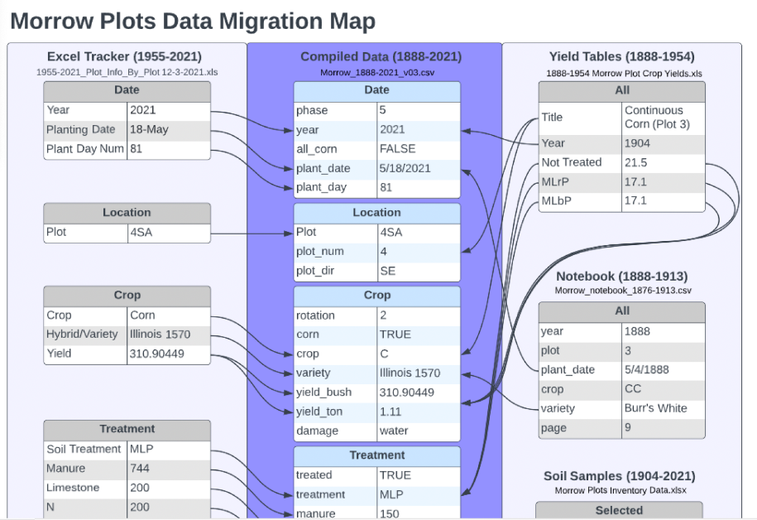
Visibility for the university
Downloaded > 200 times
Post on LinkedIn > 600 likes
Library Friends seminar >200 attendees (and with great engagement and questions!)
University, city, regional, and national news stories
Serendipitous connections
Morrow Plots Data Curation Working Group (2022): Morrow Plots Treatment and Yield Data. University of Illinois at Urbana-Champaign. https://doi.org/10.13012/B2IDB-7865141_V1

Slide 13
Bringing visibility to
the university’s
unique contributions

