Slide 1
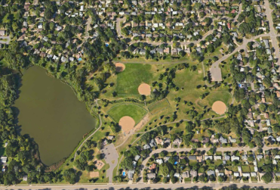


Casey Lake, North St. Paul
CE 5511 Urban Hydrology and Land Development
Instructor: John S. Gulliver
Presented by:
Joshua Balzer Stephanie Hatten
Maria Garcia-Serrana Delaney Kolb

Slide 2

Introduction
Casey Lake subwatershed
Goal: Provide stormwater treatment to reduce pollutant loading
  Total suspended solids (TSS) and total phosphorous (TP)
4 solutions were analyzed
Bioretention cell from Ramsey Conservation District Report

Slide 3
Background
Casey Lake is considered a wetland rather than a lake
  Classified as Management Class B
  High quality wetland that requires a minimum of 25’ buffer from development
  TP based on water quality for shallow lakes
    <60 ug/L
  Current TSS and TP is unknown as there is no water quality data available

Slide 4
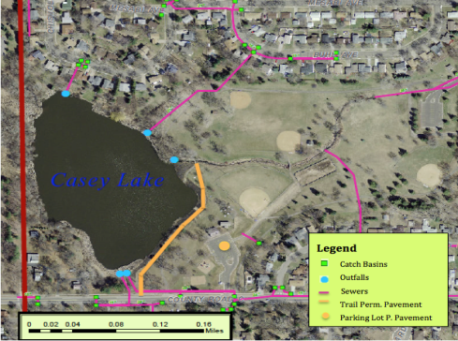
Methods
PERMEABLE PAVEMENTS
Porous Asphalt
Two locations:
  Trail along the lake
  Parking Lot
Soils HSG A and B:
  Water infiltrates
Maintenance is key:
  Sweeping 3 times per year

Slide 5
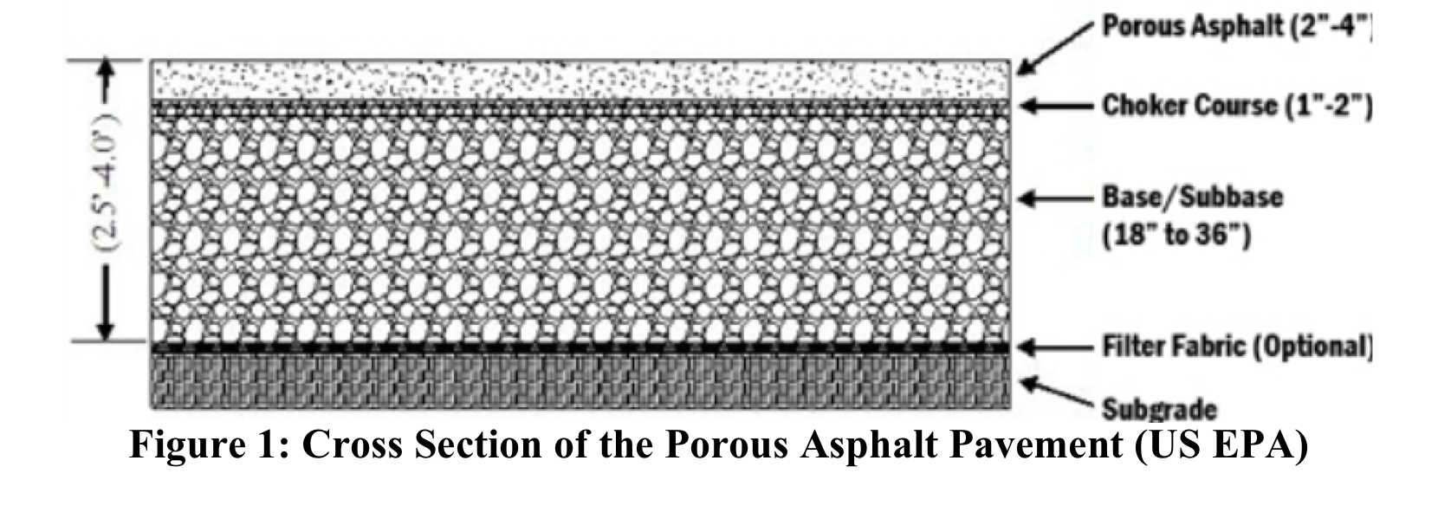
Methods
PERMEABLE PAVEMENTS
Trail:
  Base-Iron Enhanced Sand (88% TP)
    Drainage area: 8.7ac
    Area of PP: 800 m²
    Cost of installation: $196,980
Parking Lot:
  Base- Aggregates
    Drainage area: 0.75ac
    Area of PP: 2,954 m²
    Cost of installation: $$128,652
P8 Model:
Infiltration Trench
CN=40 (WERF)

Slide 6
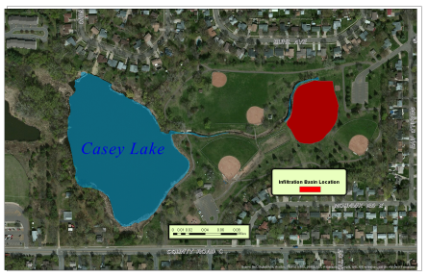
Methods
INFILTRATION BASIN
Route existing storm sewer into infiltration basin
Size for a 1.1 inch water quality storm
69-acre drainage area
  CN = 75
  38% impervious

Slide 7
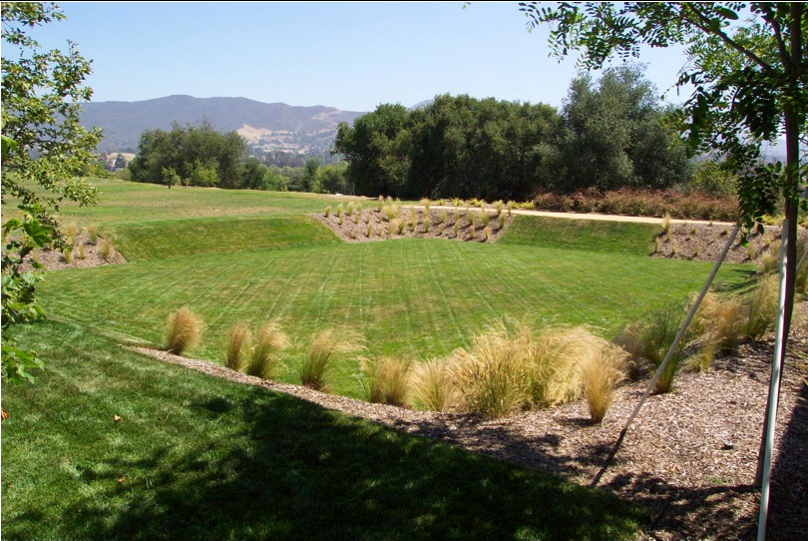
Methods
INFILTRATION BASIN
Sandy Loam Soil Assumption
Size of basin: 1.32 acres
Modeled in P8
Cost of Installation: $238, 326

Slide 8
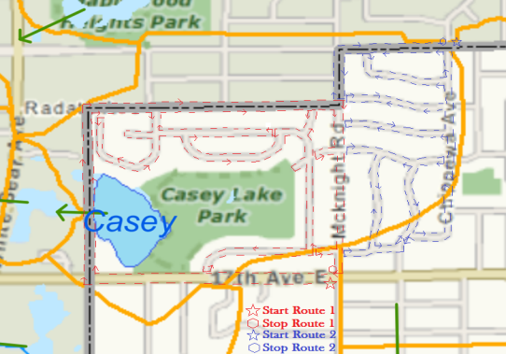
Methods
STREET SWEEPING
Leaves and street debris are a major source of phosphorus and suspended solids
Street sweeping removes pollutants before they reach stormwater systems

Slide 9
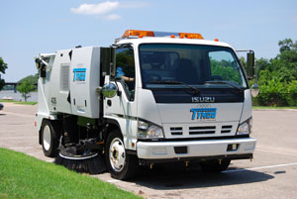
Methods
STREET SWEEPING
Street sweeping removes significant amounts of pollutants according to current research
Increased sweeping frequency is a cost effective method
Credit: http://www.tymco.com//

Slide 10
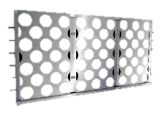
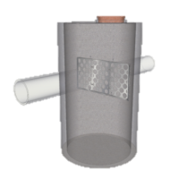
Methods
SUMP CLEANING
Retrofit with SAFL Baffles
SAFL Baffle is a post-construction stormwater pretreatment system that can be installed in existing sump structures
Helps increase settling of sediments flowing through the system
Vacuum truck is used to remove sediments

Slide 11
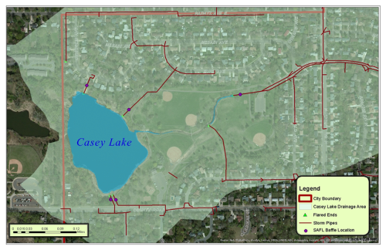
Methods
SUMP CLEANING
Modeled with Barr Engineering SHSAM program
  Sizing Hydrodynamic Separators and Manholes
Cleaned once a year

Slide 12
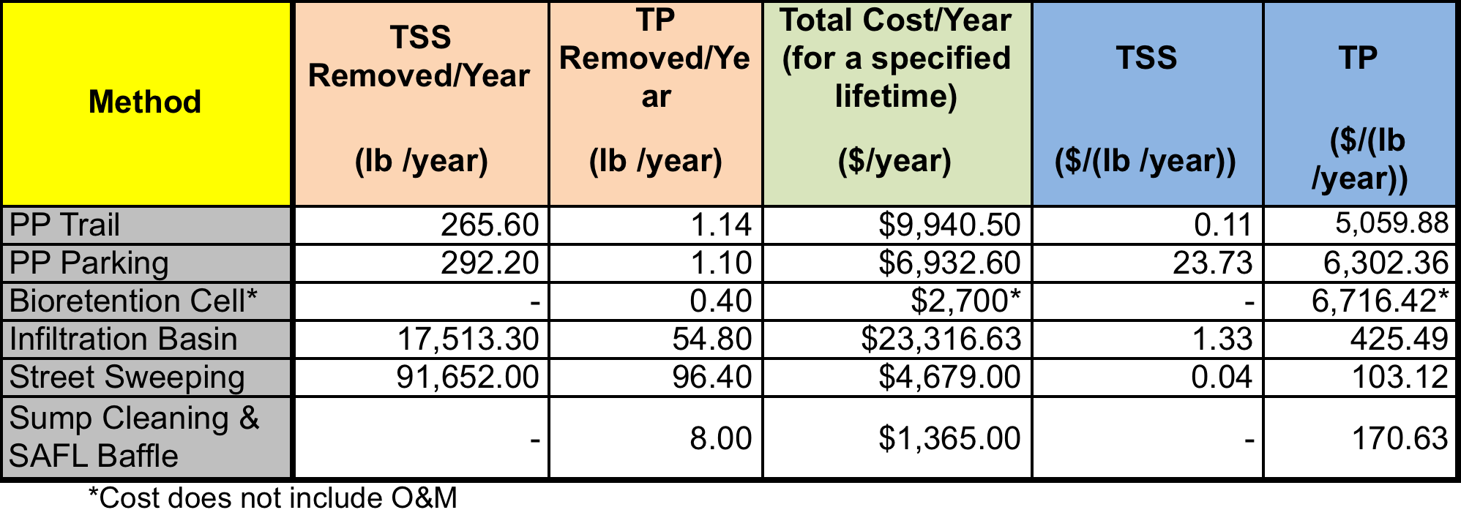
Results

Slide 13
Conclusions
Street Sweeping
  Highly efficient pollutant remover when optimized
  Very easy to implement
Sump Cleaning/SAFL Baffle installation
  Low-cost measure
  Good results for Phosphorous removal

Slide 14
Thanks for your attention
We look forward to your questions and participation

