Slide 1
Resilient Communities Project:
The City of North St. Paul
Stormwater Quality Improvement Plan for the
Urban Ecology Center Subwatershed
Petros Paulos
Bryan Sprang
John Hunter
Abigail Tomasek
Alexandra Miller

Slide 2


Resilient Communities Project
The mission of the Resilient Communities Project is to connect communities in Minnesota with the wide-ranging expertise of University of Minnesota faculty and students to address pressing local issues in ways that advance sustainability and resilience.
CE5511: “Urban Hydrology & Land Development
- taught by Dr. John Gulliver, P. E.

Slide 3
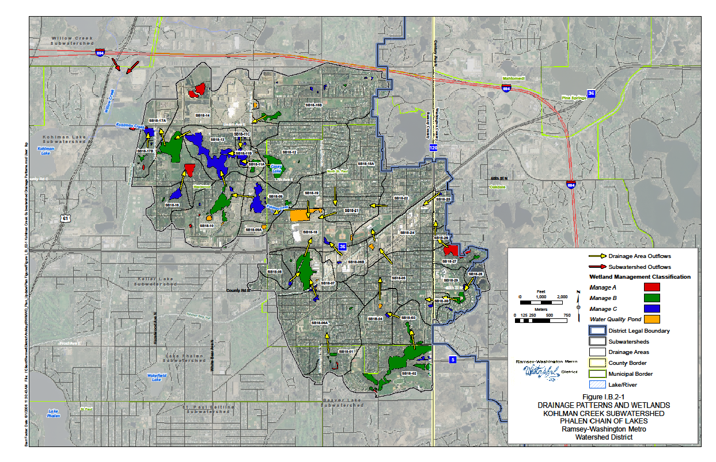
Kohlman Lake Subwatersheds
Kohlman Lake has been identified for impairment of aquatic recreation (swimming) due to excess nutrients. As a result, it has been placed on Minnesota’s list of impaired waters. In-lake concentration goal is 60 ug/ L.
10- year (summer) average was 98 ug/L (through 2006).

Slide 4
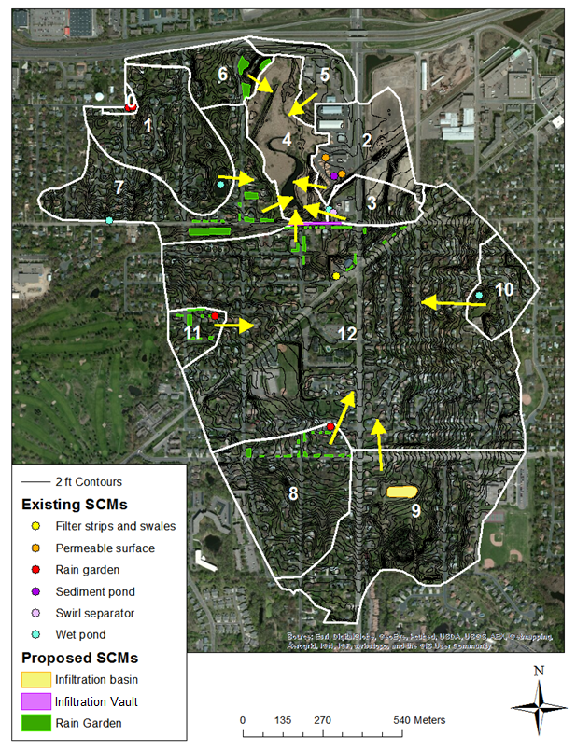
Study Area
Urban Ecology Center Drainage

Slide 5
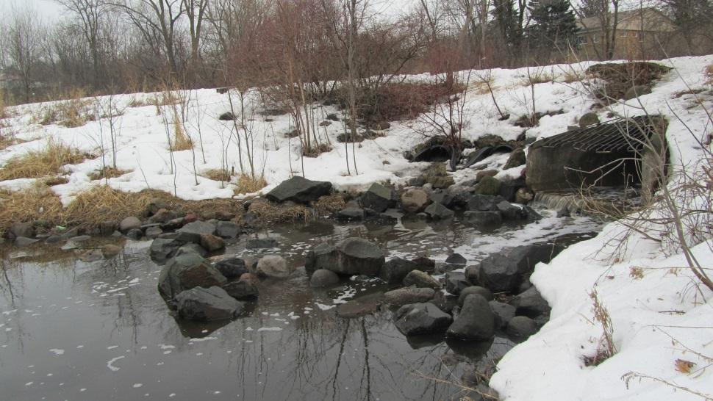
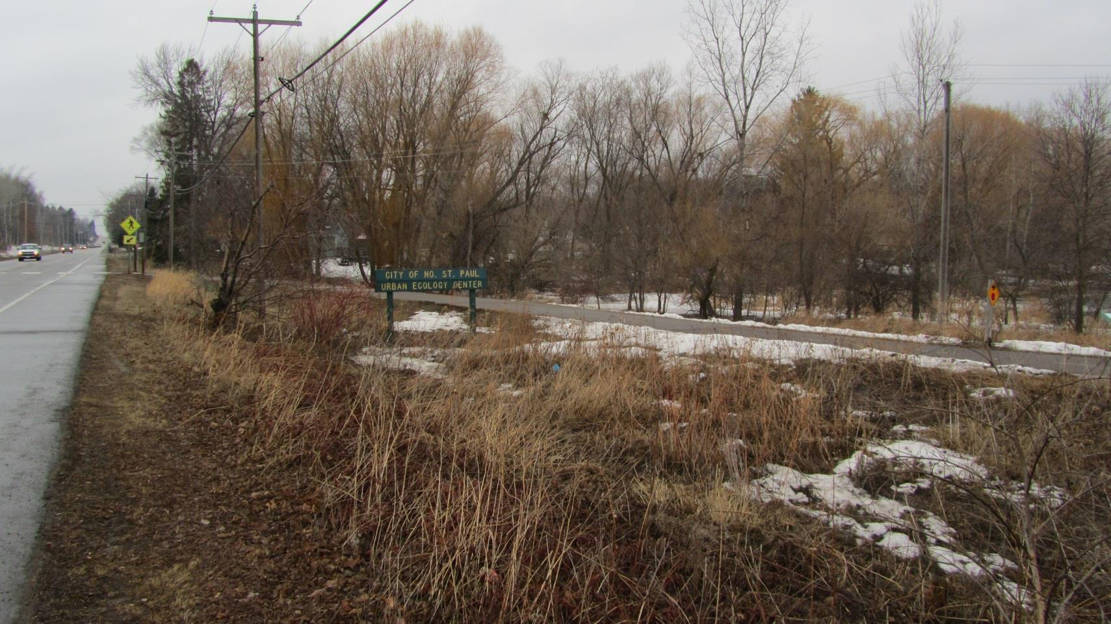
Study Area
Urban Ecology Center Drainage

Slide 6
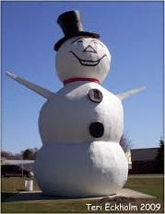

Goals
-Assist City of North St. Paul identify specific ways to reduce TP and TSS loading exiting the UEC drainage
-Compare several different load-reduction methods and/ or locations within computer model
-Provide cost analysis for construction and maintenance of added methods

Slide 7
Methods
Create Current Condition Model
Obtain Current SCMs
Delineate into Drainage Areas
Soil Type and Land Use
Current SCM Dimensions
Current Loading:
TP=177 lbs/yr
TSS=48,000 lbs/yr
Current SCM Effectiveness:
TP=30 lbs/yr
TSS=15,000 lbs/yr

Slide 8
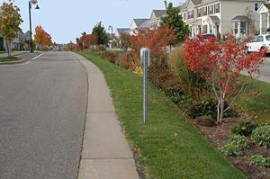
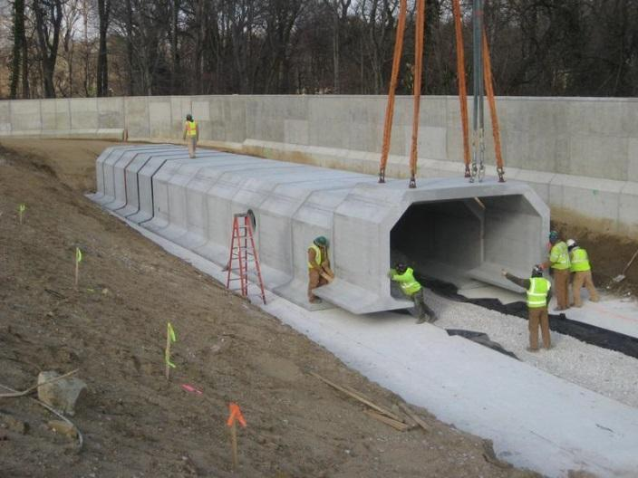
Stormwater Control Measures (SCMs)
Raingardens
Underground Infiltration

Slide 9
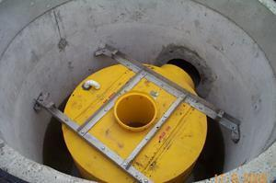
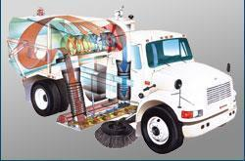
Stormwater Control Measures (SCMs)
Sumps
Street Sweeping

Slide 10
UEC Subdrainages
SCM type | Sub-drainage Number | Area (acres) | Volume (acre-ft) | Number of Practices
Rain Gardens | 6 | 0.3 | 0.45 | 4*
Rain Gardens | 7 | 0.7 | 1.05 | 9*
Rain Gardens | 8 | 0.51 | 0.76 | 6*
Rain Gardens | 9 | 0.84 | 1.24 | 10*
Rain Gardens | 11 | 0.4 | 0.6 | 5*
Rain Gardens | 12 | 0.63 | 0.94 | 8*
Infiltration Basins | 9 | 0.84 | 0.83 | 1
Infiltration Vaults | 12 | 0.5 | 1.5 | 1
*Based on Rain Gardens being approximately 150 meters cubed

Slide 11
Results/ SCMs
Sub-drainage Location | Stormwater Control Measure (SCM) | Total Phosphorous removed* | Total Suspended Solids removed**
 |  | [lbs. / yr.] | [lbs. / yr.]
6 | Rain Gardens | 3.4 | 1,124
7 | Rain Gardens | 10.9 | 3,003
8 | Rain Gardens | 6 | 1,646
9 | Rain Gardens | 10 | 2,888
11 | Rain Gardens | 1.2 | 314
12 | Rain Gardens | 30.9 | 6,822
9 | Infiltration Basin | 11.5 | 3,246
12 | Infiltration Vault | 32.9 | 8,988

Slide 12
Results/ SCMs
Sub-drainage | SCM Practice | Construction cost of new SCM [$] | Annual O&M [$] | *Cost efficiency [$/ per pound of TP removed] | *Cost efficiency [$/ per pound of TSS removed]
6 | Rain Gardens | 199,925 | 9,996.26 | 2,940.08 | 8.89
7 | Rain Gardens | 382,663 | 19,133.16 | 1,755.34 | 6.37
8 | Rain Gardens | 216,188 | 10,809.40 | 1,801.57 | 6.57
9 | Rain Gardens | 434,233 | 21,711.66 | 2,171.17 | 7.52
11 | Rain Gardens | 249,274 | 12,463.71 | 10,386.42 | 39.69
12 | Rain Gardens | 353,976 | 17,698.82 | 572.78 | 2.59
9 | Infiltration Basin | 312,084 | 15,604.21 | 2,298.53# | 8.15#
12 | Infiltration Vault | 1,132,500 | 856 | 1,737.52# | 6.36#

Slide 13
SUMPs in Parallel
SHSAM (BARR Engineering)
Sizing Hydrodynamic Separators and Manholes
Inputs
National Urban Runoff Program (NURP) Particle Size Distribution
Air Temperature Data (Golden Valley)
Precipitation Data (St. Paul)
Stormceptor (unknown model #)

Slide 14
Results / Sumps
Model | Unit Cost ($) | Installation Costs ($) | Annual Cleaning Costs ($) | Average Increase in Load Removal Efficiency (%) | Average Increase in lbs TSS Removed per year | Cost($) Per lbs of TSS Removed | Average Increase in lbs P Removed per year | Cost ($) Per lbs of TP Removed
450 | 7,600 | 2,280 | 400 | 3.9 | 624 | 1.19 | 0.24 | 3096.60
900 | 9,323 | 2,797 | 400 | 4.3 | 676 | 1.27 | 0.26 | 3289.32
1200 | 11,093 | 3,328 | 400 | 4.6 | 722 | 1.34 | 0.28 | 3465.22
1800 | 15,041 | 4,512 | 400 | 5.1 | 800 | 1.53 | 0.31 | 3957.70
2400 | 17,220 | 5,166 | 400 | 5.3 | 836 | 1.64 | 0.33 | 4146.88
3600 | 23,391 | 7,017 | 400 | 5.8 | 906 | 1.95 | 0.35 | 5056.09
4800 | 27,339 | 8,202 | 400 | 6 | 940 | 2.16 | 0.37 | 5476.36
6000 | 31,424 | 9,427 | 400 | 6.1 | 965 | 2.37 | 0.38 | 6030.86
7200 | 33,556 | 10,067 | 400 | 6.2 | 977 | 2.49 | 0.38 | 6395.65

Slide 15
Results / Street Sweeping
Street Sweeping
Regenerative Air Sweeper (e.g. TYMCO)
  Possible partnership with neighboring cities
Cost=$23/Curb Mile
38.4 Curb Miles
 | Street Sweeping Events | Lbs. TP removed/ yr | Additional lbs. TP removed/ yr | Operational Cost | Cost/ lb.
Current Schedule | Apr/ May/ Oct/ Nov | 61.1 | - | $3,532.80 | $57.82
Enhanced Schedule | Apr/ May/ 2 X Oct/ 2X Nov | 81.4 | 20.3 | $5,299.20 | $65.10

Slide 16
Summary Costs
SCD Practice | SCD location/ type/ schedule | *Cost efficiency [$/ lb. of TP removed] | *Cost efficiency [$/ lb. of TSS removed]
Rain Gardens | 6 | 2,940.08 | 8.89
Rain Gardens | 7 | 1,755.34 | 6.37
Rain Gardens | 8 | 1,801.57 | 6.57
Rain Gardens | 9 | 2,171.17 | 7.52
Rain Gardens | 11 | 10,386.42 | 39.69
Rain Gardens | 12 | 572.78 | 2.59
Infiltration Basin | 9 | 2,298.53# | 8.15#
Infiltration Vault | 12 | 1,737.52# | 6.36#
Sump | Model 450 | 3,096.60# | 1.19#
Street Sweeping | Apr/ May/ Oct/ Nov | 57.82 | -

Slide 17
Questions?

