Slide 1
Where we’ve been and where we’re going: Reflecting on the Data Curation Network
Mikala Narlock, Director, Data Curation Network
University of Minnesota Libraries

Slide 2
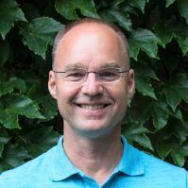
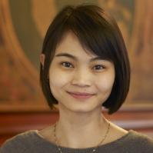
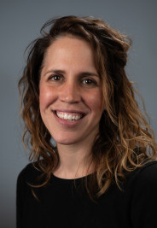
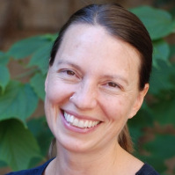
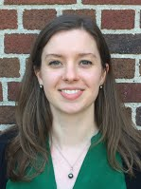
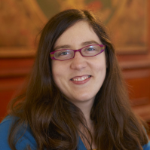
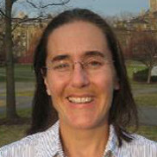
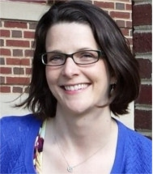
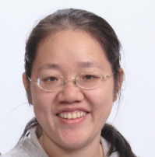
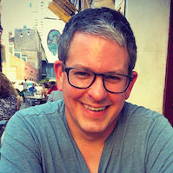
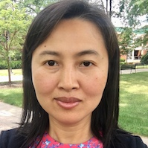
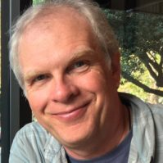

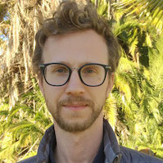
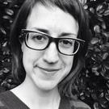
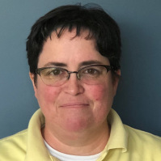
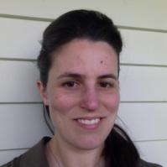
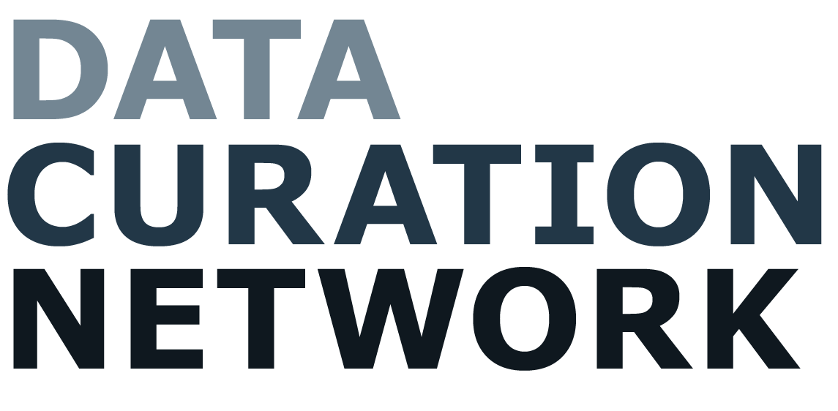
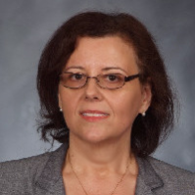
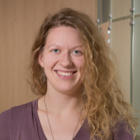
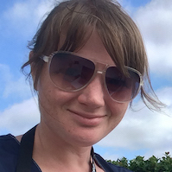
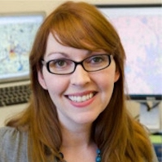
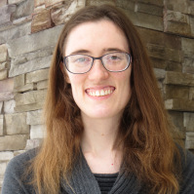
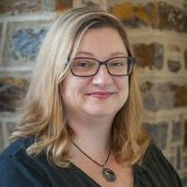
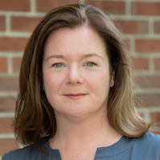
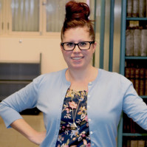


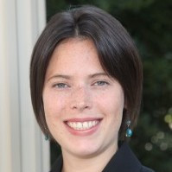
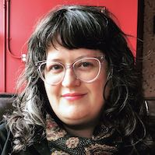
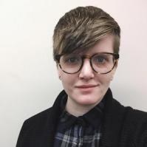
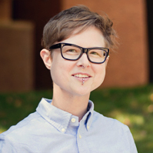
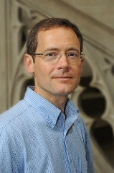
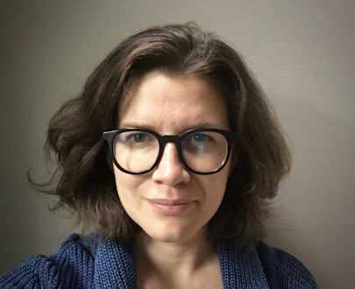
Notes:
I’m going to use words like “we” and “our” but I want to emphasize that this work has been the result of many individuals volunteering their time and labor.
Additionally, we’d like to extend our deepest gratitude to the Alfred P. Sloan Foundation and IMLS for funding this work.

Slide 3
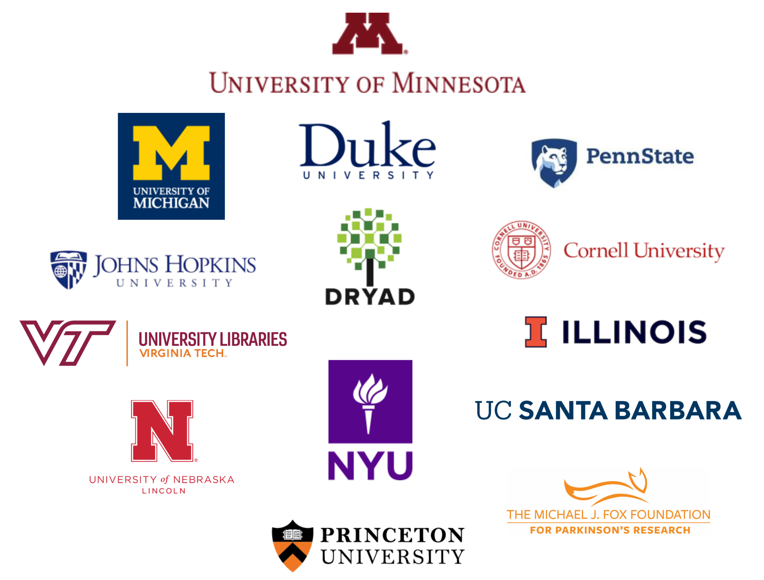
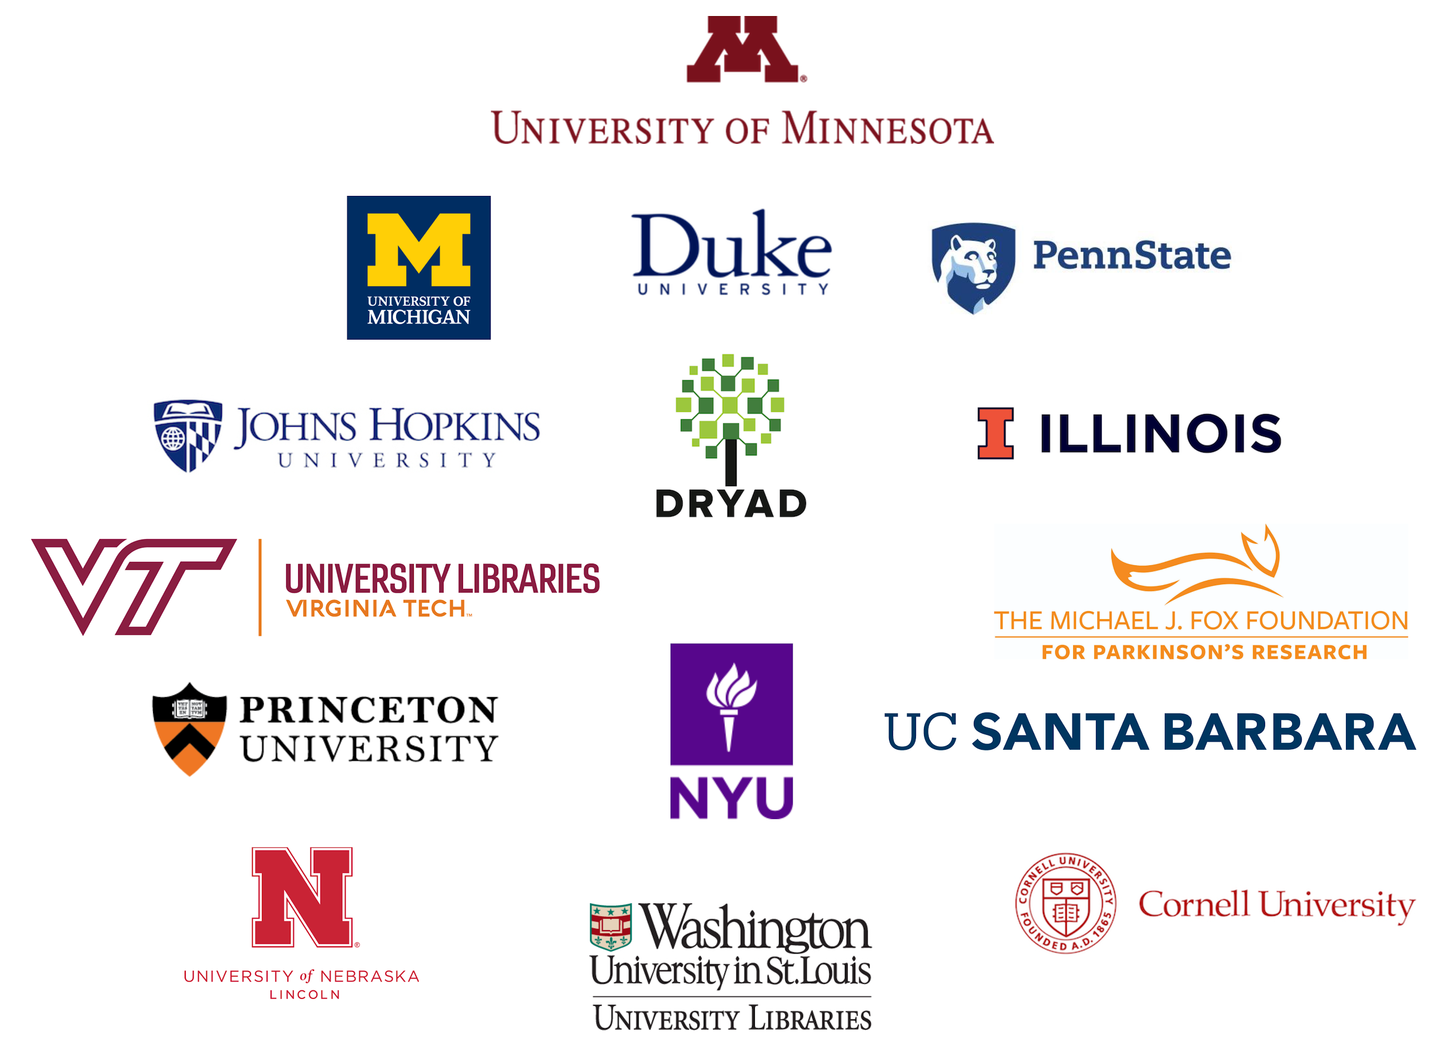
Mission
Trusted, community-led network of curators advancing open research by making data
Ethical. Reusable. Better.
Notes:
As a bit of background, the Data Curation Network, or DCN, is a community-led network of curators advancing open research by making data more ethical, reusable, and understandable. We are an active community of data stewards and curation practitioners who share knowledge and time to collaboratively curate research outputs and advance the data curation profession. The DCN has been active since 2016, and officially launched as a member-funded organization in July 2021.
The DCN collaborates to curate datasets, shares expertise and resources, offers education and professional development opportunities to the wider research community, and advocates for the role of data curators and information professionals. In this way, we help ensure that data shared by researchers at our institutions is more findable, accessible, and reusable.

Slide 4

Toward Sustainability
Towards Sustainability
Planning Phase Grant
Implementation Phase Grant
Sustaining the DCN
Shared curation
6 partners
8 partners
10 partners
12 partners
Steady growth
2016
2017
2018
2019
2020
2021
Research and planning
Model published
Launching the Network
Data Curation Network goes live Jan 1, 2019 with 10 partner institutions!
Assess and Adjust
Transition to membership model
Researcher focus groups “Most important curation activities”
Pilots
Comparison of curation workflows
Fiscal models
(2017) A cross-institutional staffing model for curating research data. IJDC 13(1)
Hired 1FTE coordinator
Trained first curator cohort
Put technology/ workflows into place.
Special interest groups
Research value of curation
Sustainability planning
Establish membership model
Launch Governance Board
Notes:
The DCN was initially conceived of in 2016 with funding from the Alfred P. Sloan Foundation. After this one year planning grant, the project team launched into a three year implementation grant again from the Alfred P. Sloan Foundation. After a one year no cost extension, the DCN concluded the grant phase is May 2022 and officially transitioned to be exclusively member funded. As we neared the end of the grant funded, we brought team members together for a project retrospective to better understand the structures that enabled the successes of the DCN as well as the challenges the team either overcame or is still grappling with.

Slide 5
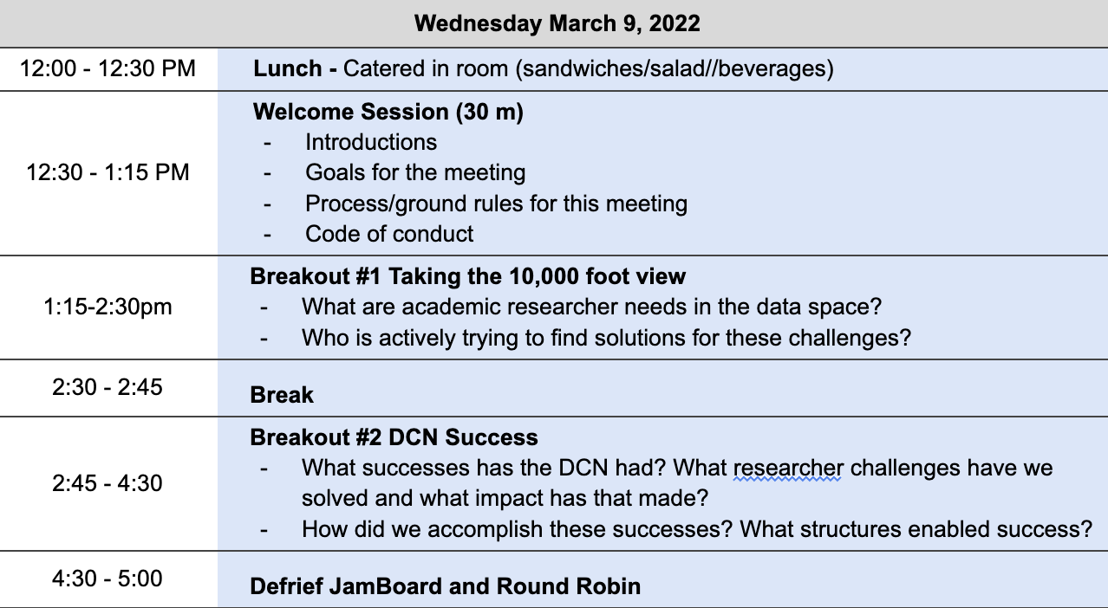
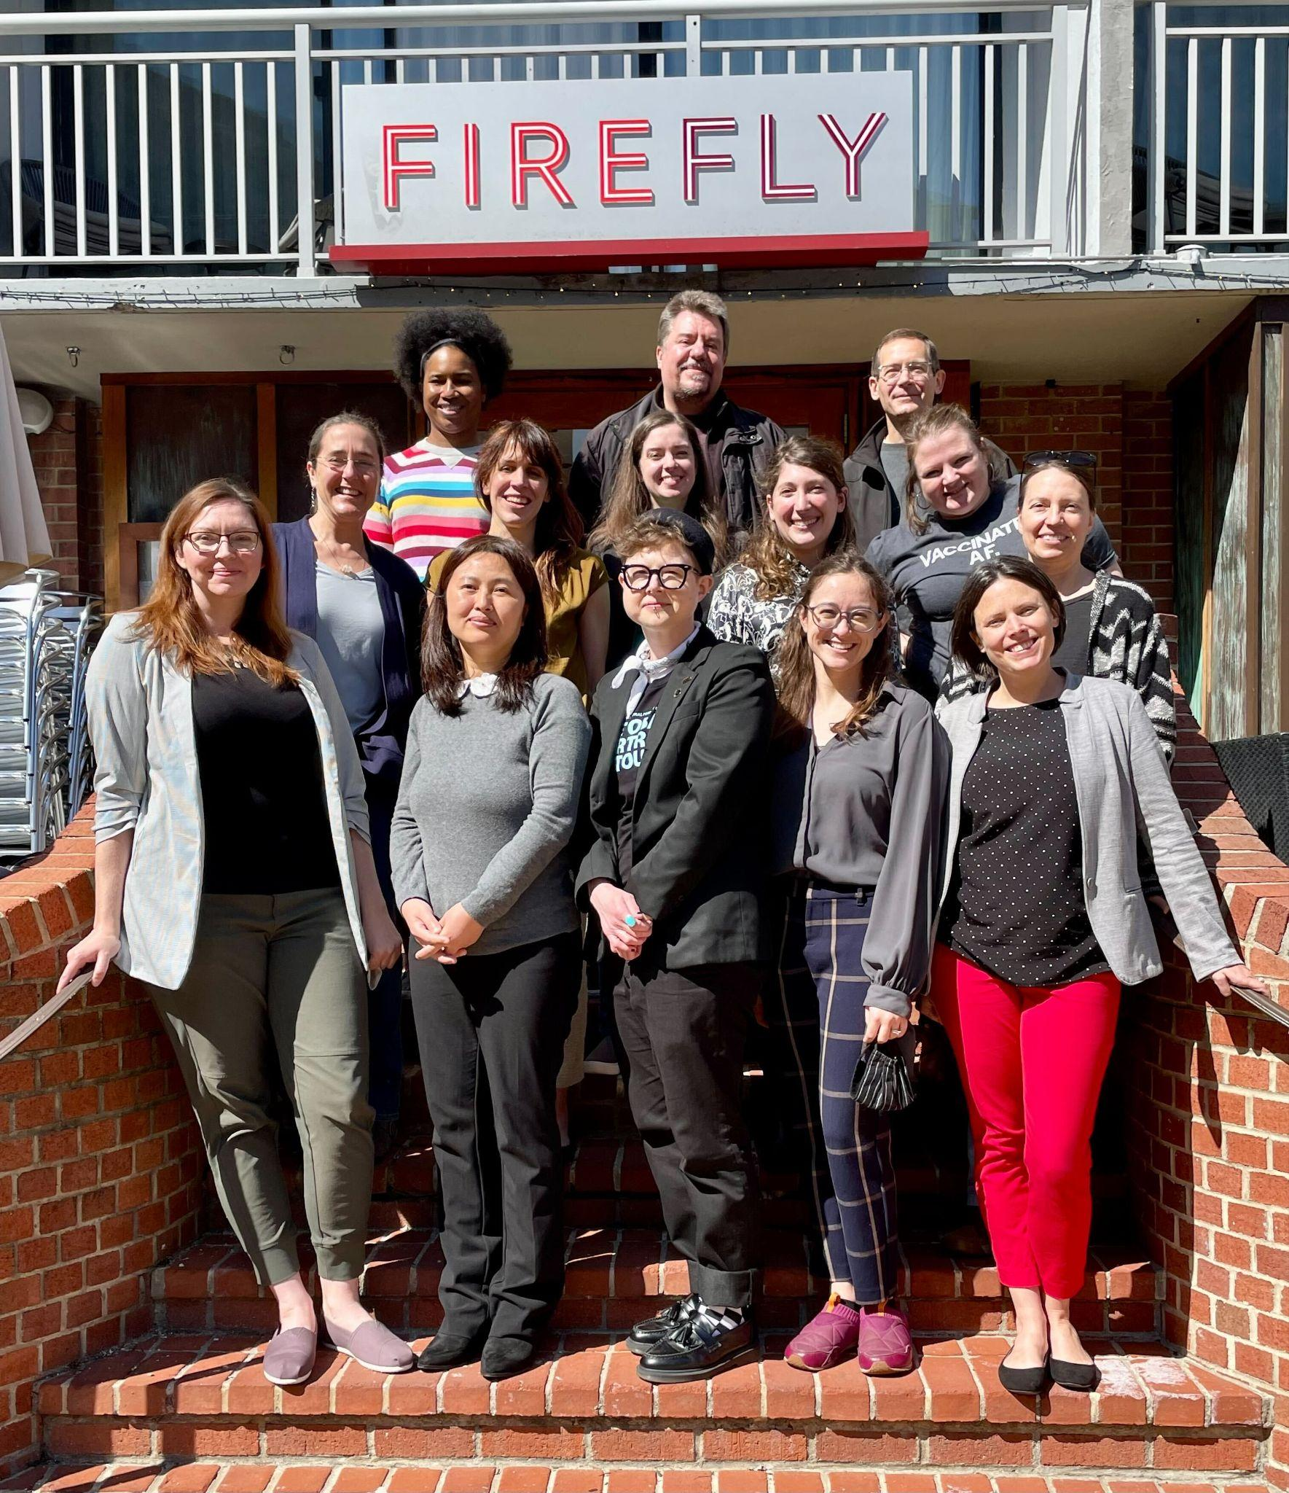
Notes:
This retrospective was held in March 2022 in Washington D.C. Over the course of 2.5 days, team members engaged in discussions and activities to really unpack the work of the network. We are incredibly excited to share that the result of this retrospective were published in March 2023 through the University of Michigan Press

Slide 6
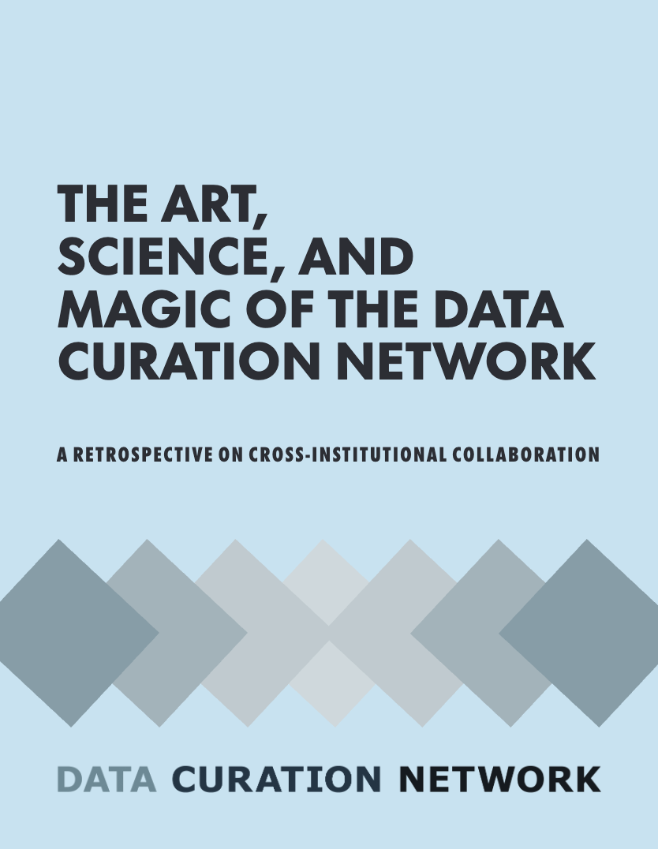
Notes:
Titled: The Art, Science, and Magic of the Data Curation Network, a retrospective on cross institutional collaboration.

Slide 7
doi.org/10.3998/mpub.12782791
Notes:
Read the full report – it’s only about 50 pages of content
In this briefing, I’m going to cover the key components of the report – but, if you are interested in learning more, I encourage you to check it out, and you can always connect with the DCN on our website, datacurationnetwork.org

Slide 8
Table of contents
Successes
Enabling Structures
Challenges / In Hindsight
Future Directions
The things we achieved as a community
The tools and infrastructure that enabled our successes.
Goals we didn’t achieve, and how we would do them differently.
Other research data sharing challenges.
Notes:
Report is structured according to the conversation we had in washington DC
Successes– what are the things that we’re proud of
Structures of success – how did we achieve what we set out to
Challenges – what are the things that we maybe didn’t achieve? How do we want to address them moving forward?
Future directions – what other research data sharing challenges might benefit from a cross-institutional approach?
Appendices, which include the names of everyone who has contributed to the DCN over the years, as well as the agenda for our project retrospective and some of the “data” we generated at the meeting and pulled from to create this report

Slide 9
Table of contents
CNI Fall 2022 Presentation
Successes
Enabling Structures
Challenges / In Hindsight
Future Directions
The things we achieved as a community
The tools and infrastructure that enabled our successes.
Goals we didn’t achieve, and how we would do them differently.
Other research data sharing challenges.
Notes:
So I’m of course not going to read through the report, but I wanted to highlight some sections of the report that I found particularly resonant. I will be pulling primarily from the success, challenges, and future directions sections – for a discussion of the enabling structures of collaborative endeavors, please see our CNI Fall 2022 Member Meeting presentation, authored by Jake Carlson, Wind Cowles, Lisa Johnston, and Mikala Narlock

Slide 10
Successes

Slide 11
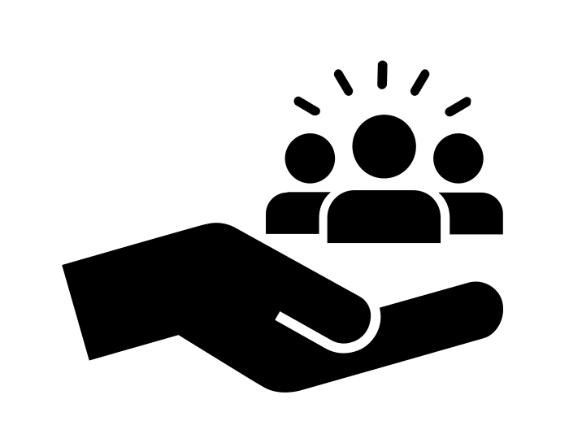
Our success is the result of our community
Research grounded in our experience to inform our work
Practical guidance on data curation
Radical interdependence
Shared curation workflow
Notes:
Research grounded in our experience to inform our work
And advocate for ourselves – value of curation – repository managers but also end users– what do the researchers think of our work? There are two articles current under peer review, but our takeaways is that this work is essential, and researchers appreciate our support
Practical guidance on data curation
Evolving field – kept our work very practical in order to help not only grow our own skills, but also to provide guidance for our colleagues
CURATE(D) steps, which would later become the foundation for a workshop curriculum, and data curation primers
Radical Interdependence and Community
Slow, thoughtful, intentional growth
Trust
Models of data services and can learn from one another in a welcoming environment where we can say “i don’t know”
Our shared curation workflow
Members can submit a dataset to the DCN for expert curation. This means that when a dataset falls outside of an institution’s expertise, in terms of discipline or format, or even when capacity might be limited, we can lean on one another to curate data for our researchers and ensure it is shared in high quality and FAIR manners
This means that no one institution has to have a data curation expert in every field or format, but instead we can rely on another

Slide 12
Challenges

Slide 13

Balancing shared and local curation
Homogeneity of DCN members
Managing community capacity
Notes:
Balancing shared and local curation
This shared curation workflow I was just talking about, though a key success, has also been used less than we anticipated. And one of the key reasons for this is the need for member institutions to balance local curation, empowering their curators, helping them upskill, and then using the shared workflow.
While the network receives fewer datasets than anticipated, we recognize that the benefits of the DCN are more than its data curation services, as each institution leverages the DCN in ways that best suit their needs. Which includes upskilling local curators through practice, data primers, and even the data curation workshop.
Homogeneity of DCN members
Our members are well-resourced institutions. This includes R1 academic institutions and non-profit data repositories.
To a large degree, we understand why we formed this way– these institutions had the resources to dedicate to this project and even had curation units – so it makes total sense that they would have the resources to commit to this experiment. However, we recognize that this reinforces, and in some ways exacerbates, structural inequities inherent in systems of higher education.
Additionally, while we are eager to include other institution types, we want to be sure that membership in the DCN meets the needs of and is of value to non-R1s, Minority Serving Institutions (MSIs), and other types of research institutions not currently represented in the membership of the DCN, such as disciplinary repositories or government agencies.
We have to do research on our end to better understand the needs of these institutions, and what value the DCN can provide them.
Manage our community capacity and ensure sustainability of the network
Near to my heart – because I’m the only full time employee of the network! I get to spend all of my time helping the DCN grow,However, every other DCN member also has responsibilities to their home institution: engagement in the DCN comes on top of their daily work
So, while we’ve done a lot of really awesome and wonderful work over the years, As the DCN keeps growing there is a risk that the number of initiatives that it develops and supports will outweigh the amount of time and resources available
We need to make sure that we are being realistic with our capacity and only taking on the projects that align with our strategic framework and guiding values.
Similarly, we need to ensure the organizational sustainability of the DCN– this is especially important as our value proposition continues to be refined - The DCN began as a means to support the work of curating data sets, but it has become a strong community engaged in advocacy, research, and education, in addition to the distributed data curation work.
As the DCN continues to mature, explore membership models, and articulate a value statement, ensuring the sustainability of the organization will be a community-driven effort.

Slide 14
In hindsight…
Develop paid fellowships and other workforce development programs
Incorporating more peer learning opportunities
Notes:
Developing paid fellowships and other workforce development programs:
Learning how to be a successful curator requires hands-on experience working with datasets and researchers. This invaluable experience would significantly benefit library science students while providing additional curatorial support to DCN members.
We’ve started some work in this area, in partnership with the National Center for Data Services based out of the Network of the National Library of Medicine. This has been helpful to better understand the needs of students, but we wish we’d done some of this work earlier.
Incorporating more peer learning opportunities – this is both a thing we wish we would have done differently as well as a continued challenge
We learn much from the information sharing sessions focused on the details and specifications of curatorial actions taken and we continue to learn more from tours of each other’s repositories, discussions of practices and procedures, and other more informal information exchange opportunities. The challenge is enabling these meaningful conversations virtually. Understanding how we can best facilitate meaningful interaction between members when we are challenged by distance will continue to be a hurdle as we balance providing in-person and virtual opportunities to accommodate all members of our community.

Slide 15
Looking forward
Notes:
Looking forward, we think there are other shared challenges in the field of RDM that could benefit from a collaborative approach. This is by no means an exhaustive list, but here are some ideas that we want others to take up!

Slide 16
Potential Collaborative Endeavors
Supporting data communities in data management
Reviewing and creating research data management plans
Applying metadata standards
Notes:
Supporting data communities in data management – data communities are “formal or informal groups of scholars who share a certain type of data with each other, regardless of disciplinary boundaries”-- and we think supporting these communities could similarly span disciplinary and institutional boundaries.
Reviewing and creating research data management plans - many of us are tasked with reviewing or helping researchers create data management plans– collaborative evaluative tools could be extremely useful.
Applying metadata standards– among our institutions, fields like Date, Keyword or Subject, or even Creator can be used differently depending on how a repository defines and applies them. By addressing these issues through a collaborative effort and aligning our metadata schemas, academic institutions can leverage the expertise of information professionals to not only uncover the challenges of creating a more unified approach to applying metadata standards, but also work toward solving the problem through a connected and interdependent community of practice.

Slide 17
Conclusion

Slide 18
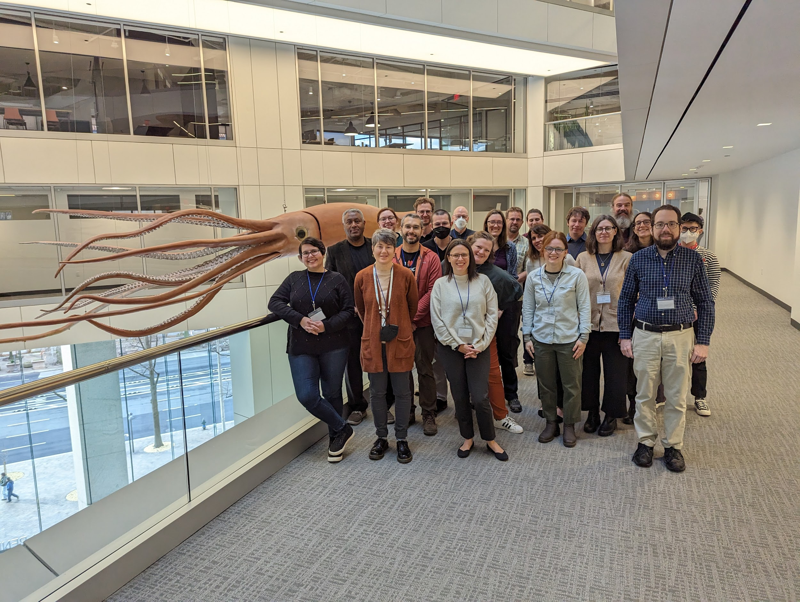
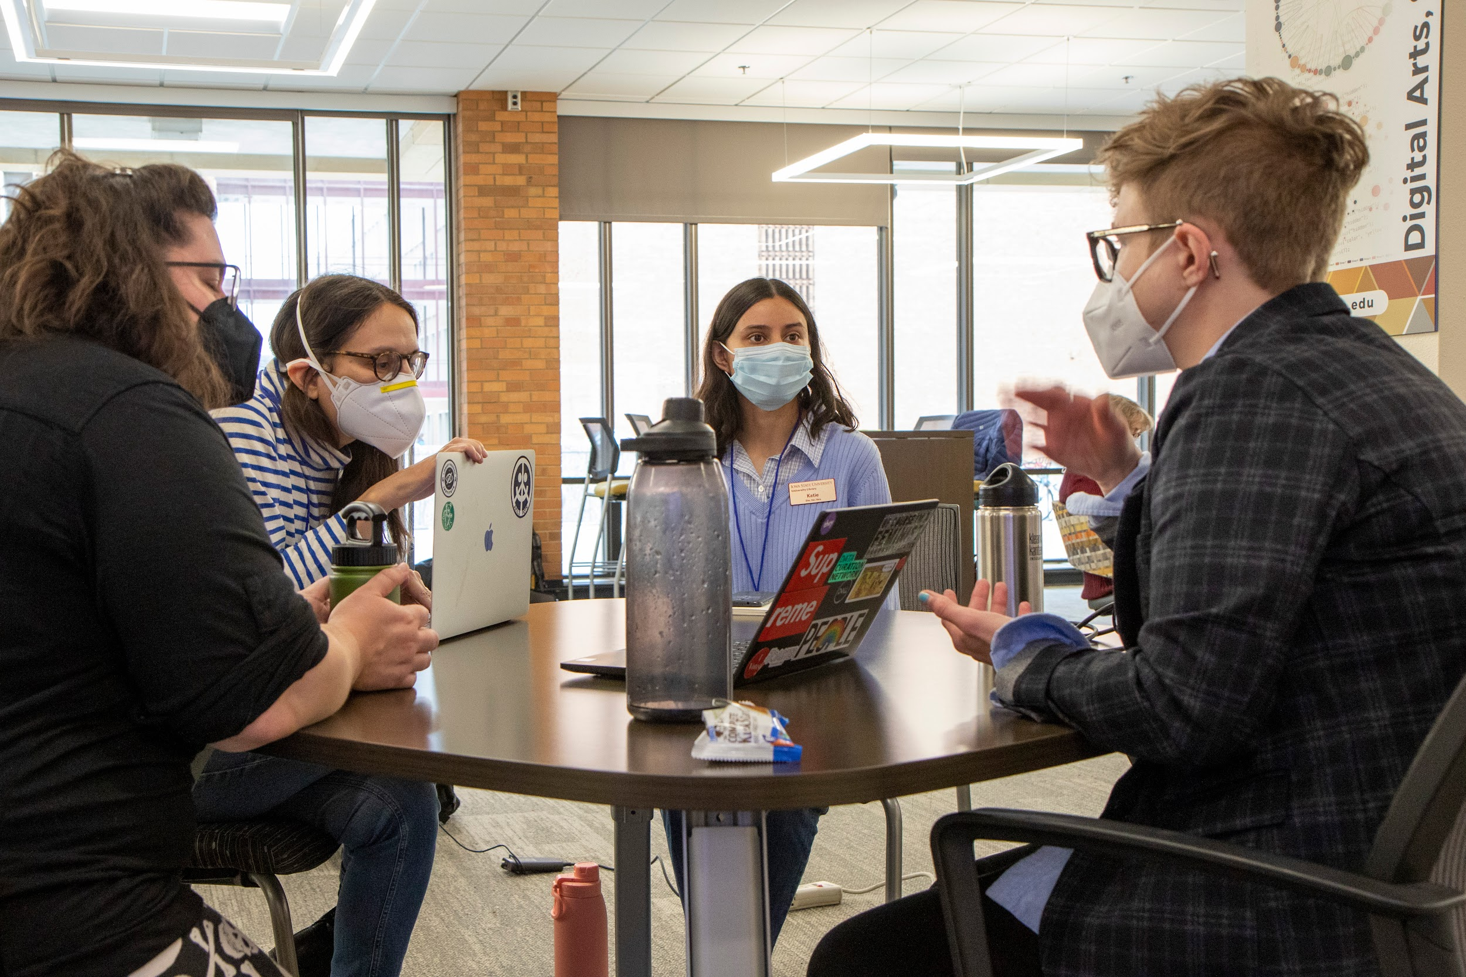
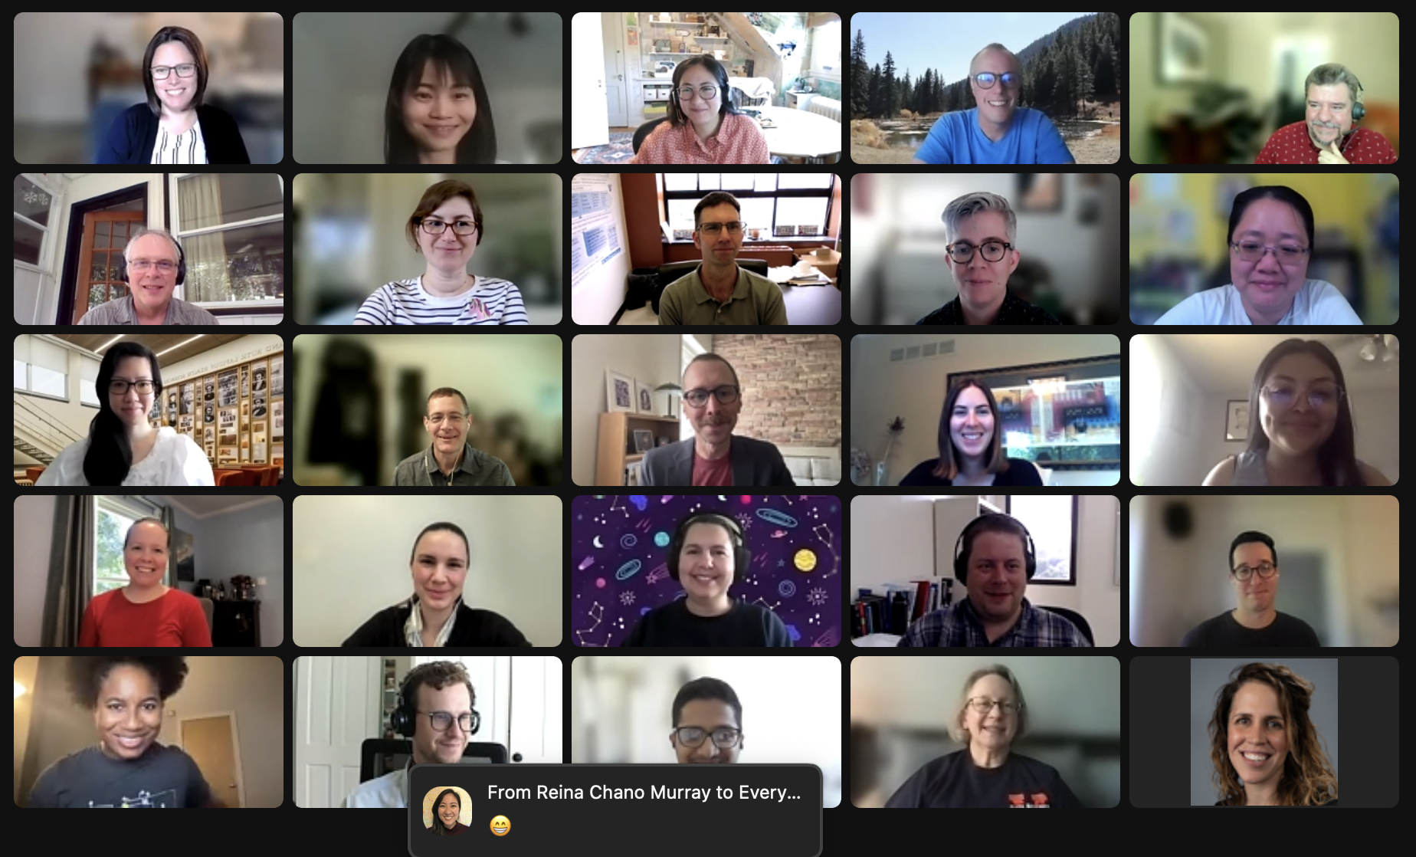
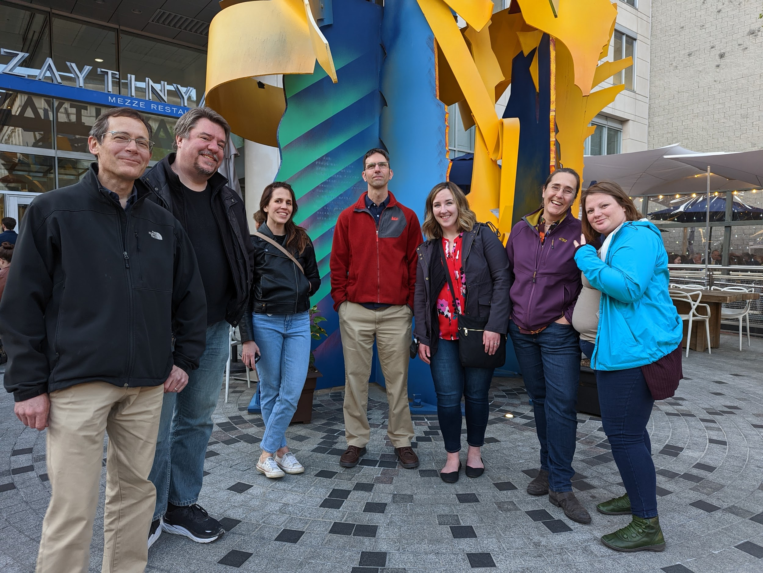
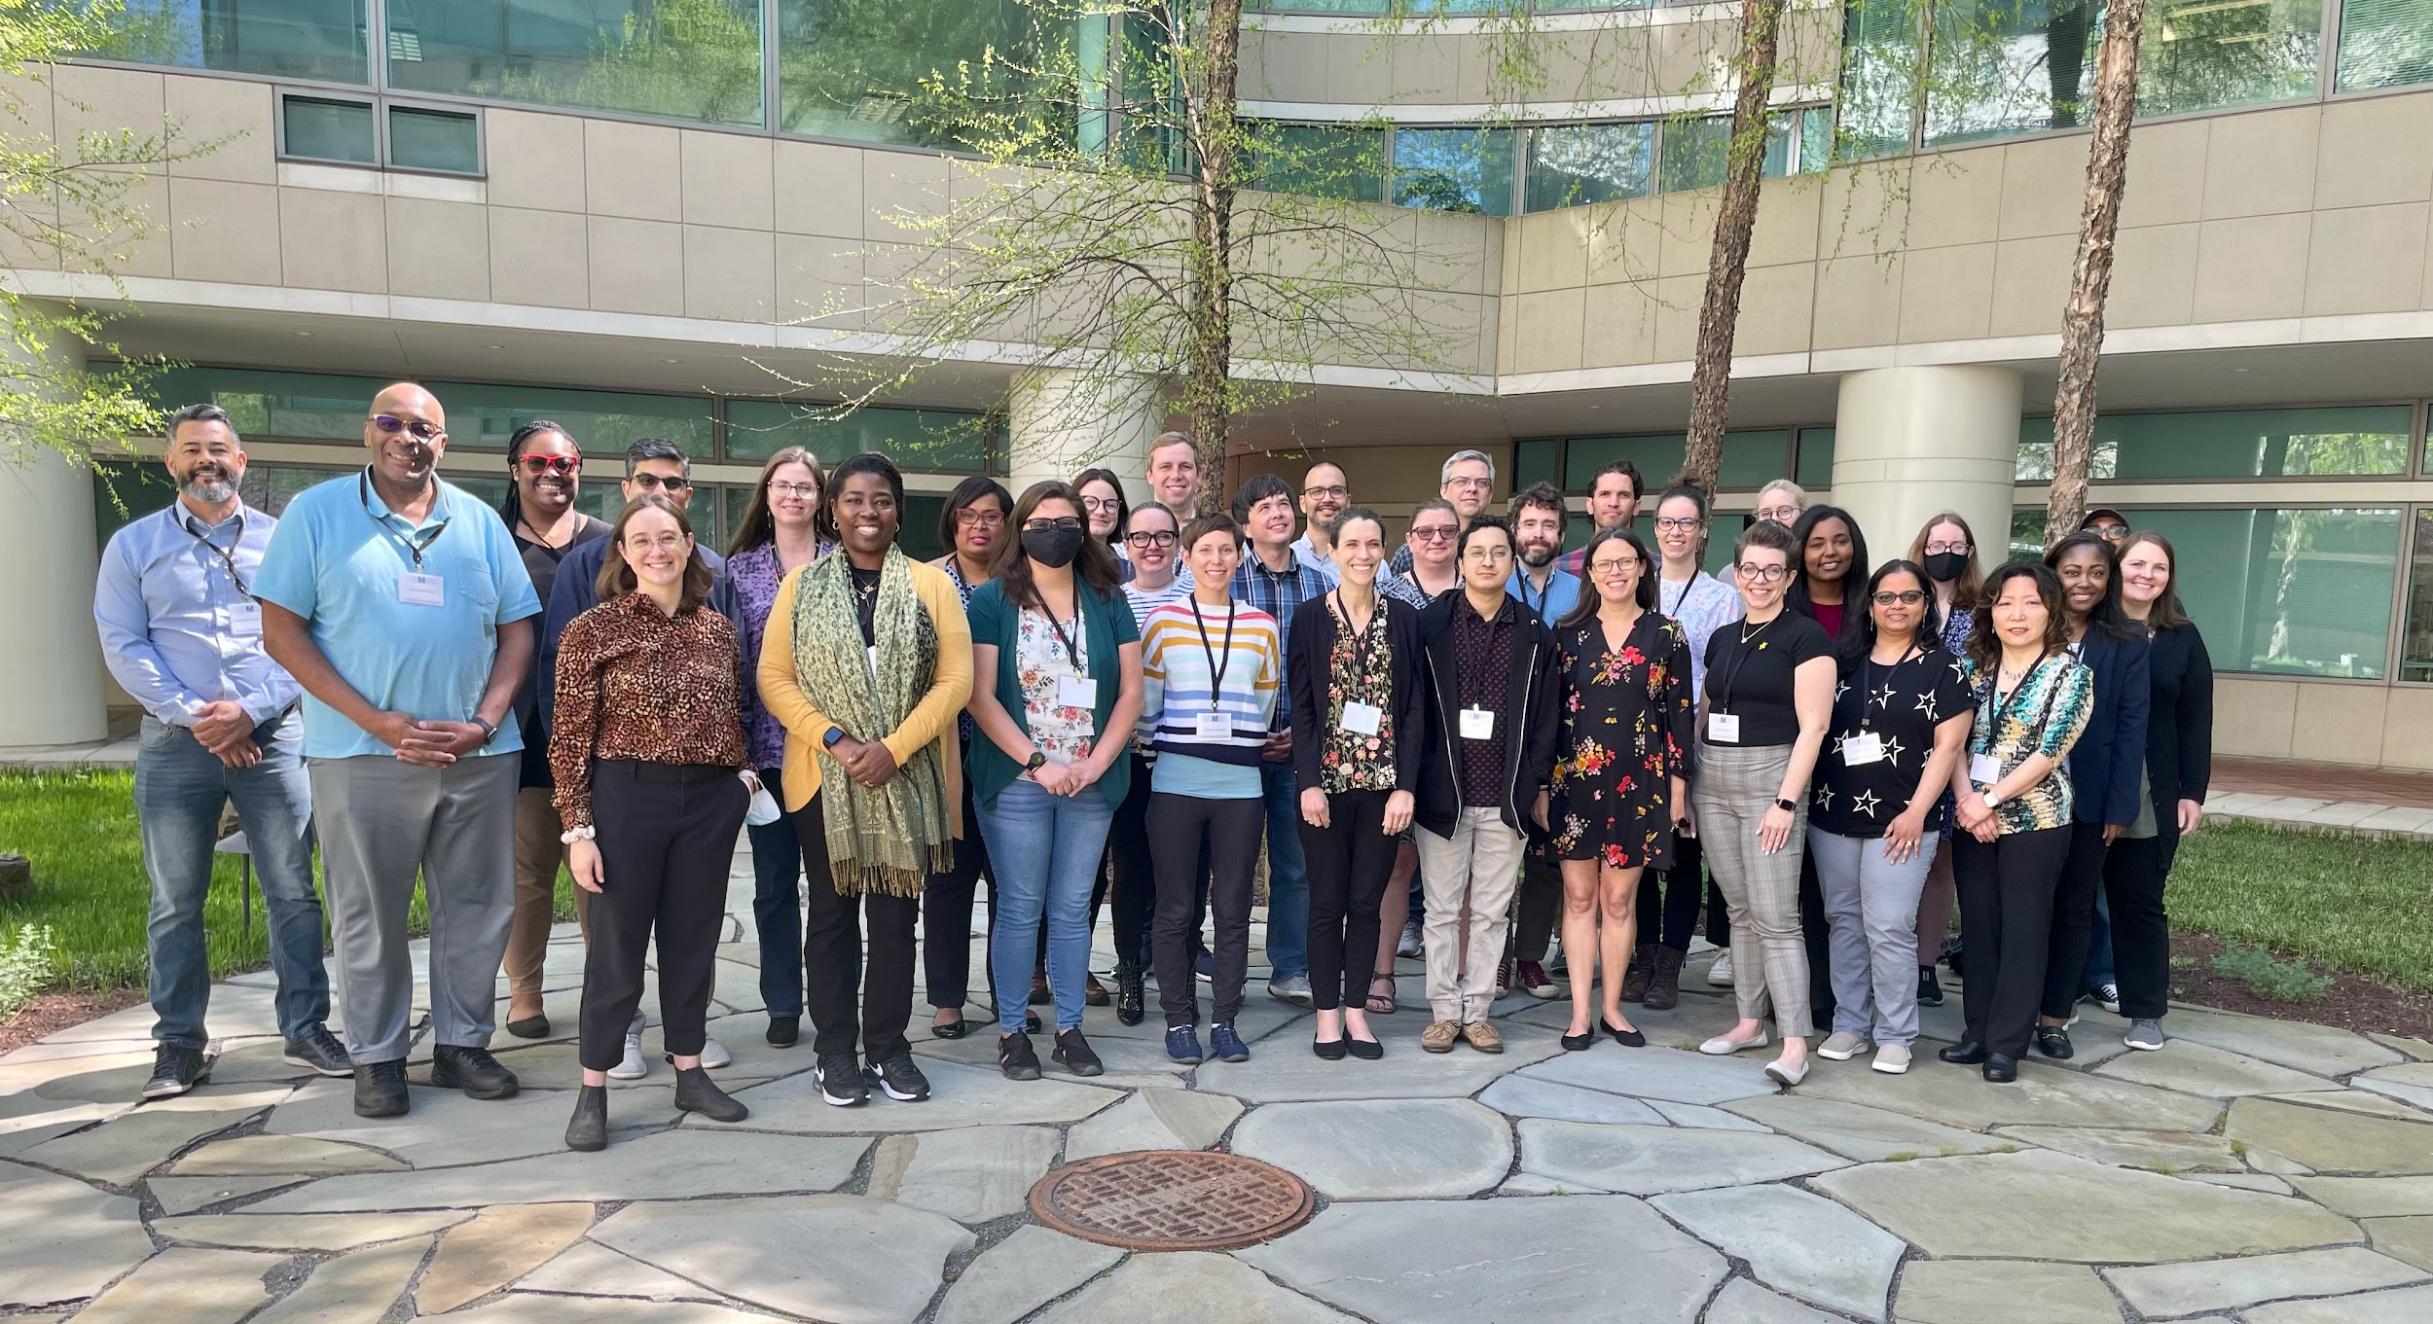
Notes:
The work of bringing together a community, launching a collaborative effort, and finding appropriate capacity levels to avoid burnout is challenging labor, which will need to be carefully balanced as the DCN grows. Community development, especially for an organization grounded in radical interdependence, is not particularly speedy—in fact, this work is often slow, thoughtful, and deliberate, as it requires careful planning to ensure the fabric of a community grows with new members. However, this work is critically important to the mission of the DCN and it will remain our primary focus in continuing to develop our organization.

Slide 19
Thank you!
Mikala Narlock
mnarlock@umn.edu
Notes:
Thank you to everyone who made this report possible, including our colleagues at the University of Michigan Press. A special thanks to the University of Minnesota for serving as the fiscal home of the DCN.

