Slide 1


August 6, 2014
2014 SHEEO Higher Education Policy Conference - Denver

Slide 2
Presenters & Team
Chris Rasmussen
Midwestern Higher Education Compact (MHEC)
David Weerts
Jandris Center for Innovative Higher Education (JCenter), U of MN
Virajita Singh
Design Thinking @ College of Design, U of MN
Todd Harmening
Minnesota State Colleges & Universities
Nichole Sorenson
Jandris Center for Innovative Higher Education (JCenter), U of MN
Leah Reinert
Midwestern Higher Education Compact (MHEC)
The Higher Ed Redesign Initiative
Notes:
10:45 - 10:50 - Chris
introduce team (presenters and Nichole and Leah)
Describe unique collaboration of partners
Acknowledge the legacy of NCPPHE Associates Program, Highlight Pat Callan and Joni Finney

Slide 3
What is Design Thinking?
Notes:
10:50 - 11:00 What is Design Thinking? - Virajita

Slide 4
Design Thinking is an emerging field, rooted in the tools and processes used traditionally by design disciplines (architecture, landscape architecture, graphic design, interior design, and others). The process involves problem definition, field research, idea generating, story boarding, frequent prototyping and narrative as a mode for engaging participants and motivating action.
The Higher Ed Redesign Initiative

Slide 5
Design Thinking is a step-by-step process

Slide 6
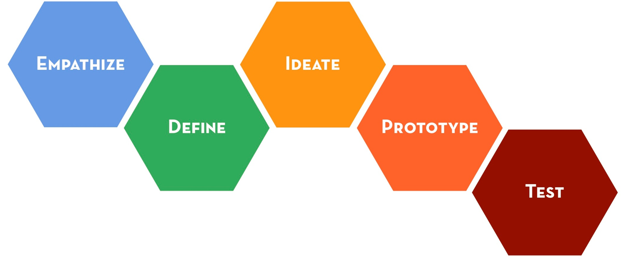
The Higher Ed Redesign Initiative
Notes:
Toby: 9:00-9:15
quick intro….so you have a conceptual understanding of the steps
Empathy
Problem definition
Ideation
Prototyping and testing
Introduce the concept and explain
Discuss
Practice activity
discuss

Slide 7
Step 1: Empathy empathize with ‘users’ in the system
The Higher Ed Redesign Initiative
Notes:
Speaking Truth to Policy - 2014 conference theme
could be incorporated by highlighting the empathic interviews in the process, user perspective as ‘truth’

Slide 8
Step 2: Define problem deepen your understanding of the problem
The Higher Ed Redesign Initiative

Slide 9
Step 3: Ideate generate an abundance of ideas. Tweak & Leap!
The Higher Ed Redesign Initiative

Slide 10
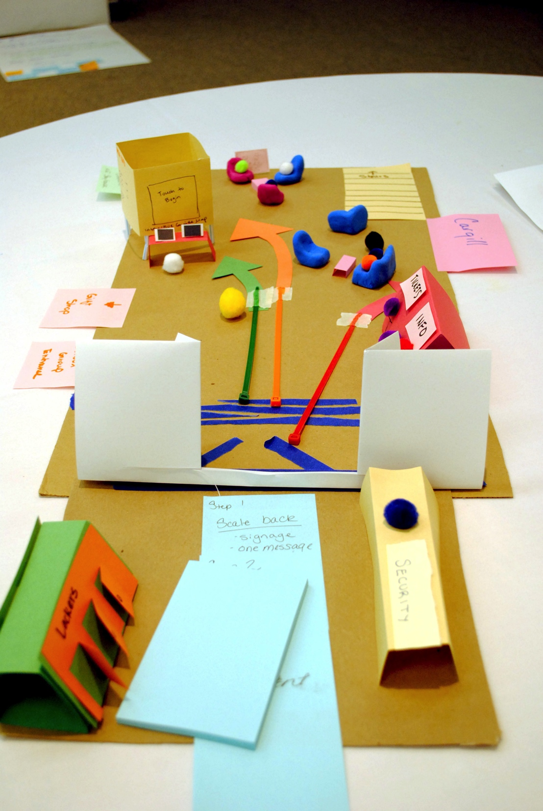
Step 4: Prototype
Think with your hands
The Higher Ed Redesign Initiative

Slide 11
What is prototyping?
pro·to·type - noun \ˈprō-tə-ˌtīp\
an original or first model of something from which other forms are copied or developed
a first or early example that is used as a model for what comes later
The Higher Ed Redesign Initiative

Slide 12
Why is prototyping useful?
Every product evolves from its preliminary version before it is developed to its final version
Design products inherently require prototyping, systems and processes do tooAddress achievement gaps and advance
The Higher Ed Redesign Initiative

Slide 13
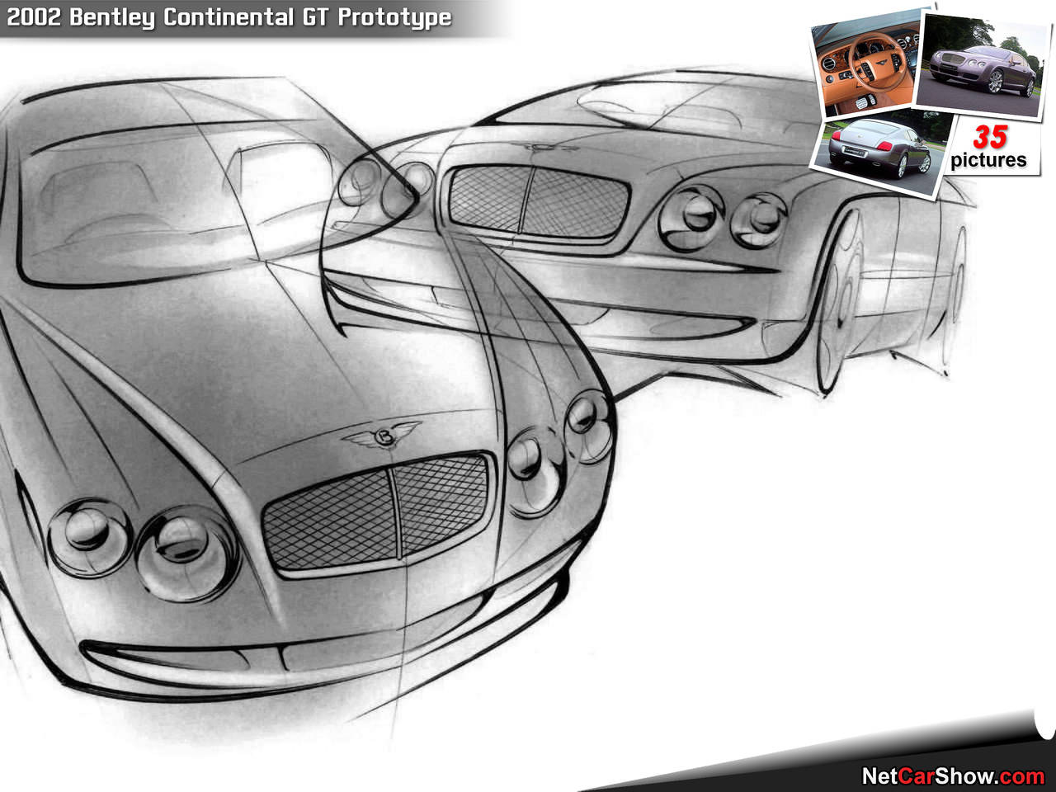
Step 5: Test
Where the rubber meets the road
The Higher Ed Redesign Initiative

Slide 14
Step 6: Apply 5-step process again & again, anytime
The Higher Ed Redesign Initiative

Slide 15
Why are other problem solving methods needed?

Slide 16
Three Modes of Inquiry, Knowledge Creation, and Problem Solving
 | Scholarly Research | Policy Analysis | Design Thinking
Purpose | Empirical orientation: Theory development, contribute disciplinary knowledge, improve policy and practice | Problem-oriented: propose set of solutions to a problem | User-oriented: Enhance user experience related to a specific set of challenges
Outcomes | Findings inform theory, future research and practice | Proposed set of policies and actions | New prototypes for testing and critique
The Higher Ed Redesign Initiative
Notes:
Setting the Scene
Why other forms of problem solving are needed – David
How D.T. is different from other forms of problem solving in higher education policy - David
Table as handout

Slide 17
Why is applying Design Thinking relevant to our times?

Slide 18
We need to increase our collective creative capacities
We need to include everyone in the process of this new design
Our world is changing rapidly – more uncertainty and risk
We need predictable processes to design new systems
The Higher Ed Redesign Initiative

Slide 19
Why is Design Thinking relevant to Higher Ed?

Slide 20
1. We need to focus on the user, not (just) the system
2. Bring much needed change/redesign to the system
3. Help transform higher ed institutions into hubs of relevant creativity
4. Make real on-the-ground impact, now!
The Higher Ed Redesign Initiative

Slide 21
2013-14 Pilot
Design Associates Program
video
Notes:
11:05 - 11:15 Describe Design Associates Program process (video) - Chris

Slide 22
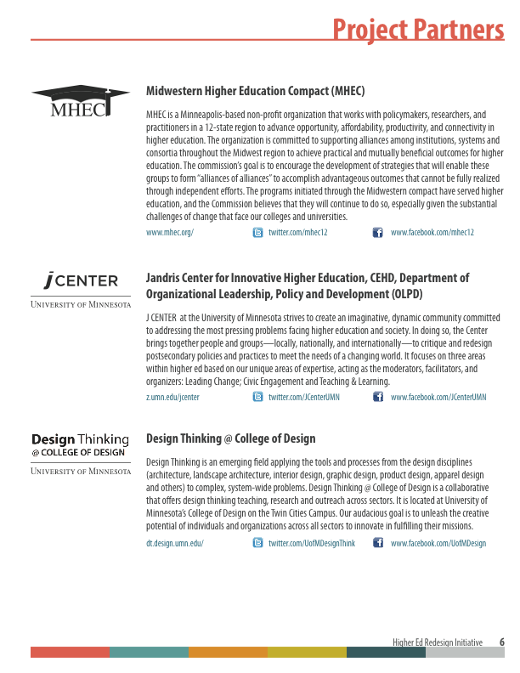
The Higher Ed Redesign Initiative

Slide 23
The Higher Ed Redesign Initiative

Slide 24
The Higher Ed Redesign Initiative

Slide 25
The Higher Ed Redesign Initiative

Slide 26
The Higher Ed Redesign Initiative

Slide 27
Team Perspective
Notes:
11:15 - 11:20 Team Perspective - Todd
how their team’s idea developed over the three weekends

Slide 28
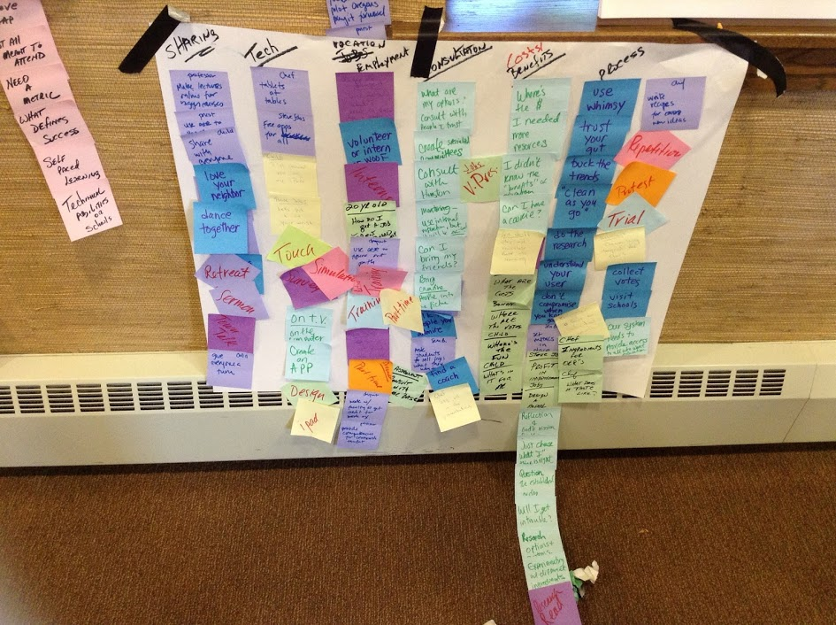
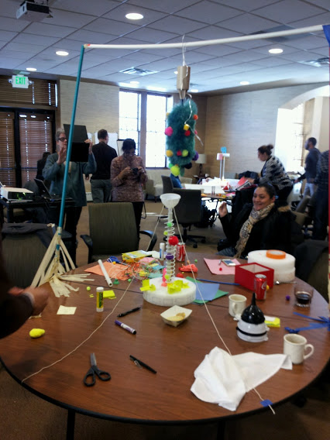
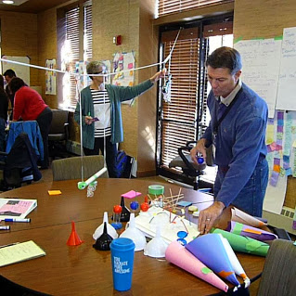

Slide 29


Edvisable
Local
One stop shop
Advising
Open educational resources
Match with a mentor
Assess educational and career aspirations
Develop an online portfolio
Guidance to open educational resources (OERs)
Advising and peer support
Match to institutions
Notes:
Description of the model

Slide 30
Add more team slides here?
The Higher Ed Redesign Initiative
Notes:
11:25 - 11:30 Feedback - Todd’s participant perspective on the value of this
how this might relate to his work
more broadly, the value as an individual

Slide 31
Participant Experience
Notes:
11:25 - 11:30 Todd shares participant experience and potential value and uses

Slide 32
1. Effective for creative thinking and engagement
2. Adds another tool to toolboxn the toolbox
3. Consider as a means of implementation
4. Stretches the comfort zone of participants
The Higher Ed Redesign Initiative

Slide 33
5. Relation to professional work
6. Value as an individual
The Higher Ed Redesign Initiative
Notes:
11:25 - 11:30 Feedback - Todd’s participant perspective on the value of this
how this might relate to his work
more broadly, the value as an individual

Slide 34

Program Outcomes

Slide 35
MHEC Feedback
Benefits to participants
  Skills
  Networking
  Future collaboration opportunities
  Partners in addressing higher ed problems
The Higher Ed Redesign Initiative
Notes:
11:20 – 11:25 Outcomes of the program - Chris
feedback video snippets from MHEC presentation possibly
benefits to individuals involved, skills, networking, future collaboration opportunities
partners in addressing problems in higher education

Slide 36
Lessons Learned
Notes:
Just use this slide – not the next
11:30 - 11:40 Lessons Learned from the Pilot – David & Virajita
Benefits and challenges to organizations in the collaborative
how this impacts each of the partner organizations
transparent reflection on the process, things that might be done differently in future iterations

Slide 37
Benefits and challenges to individuals and organizations
Impacts to each partner organization
What might be done differently in the future
The Higher Ed Redesign Initiative
Notes:
11:30 - 11:40 Lessons Learned from the Pilot – David & Virajita
Benefits and challenges to organizations in the collaborative
how this impacts each of the partner organizations
transparent reflection on the process, things that might be done differently in future iterations

Slide 38
Audience Q&A
Questions?
Notes:
11:40 - 12 Audience Q & A
OR
Is there time for an audience participation activity?
offer a design challenge at the outset OR during Virajita’s section
provide pipe cleaners, etc. on table for them to create a 3 dimensional representation of how they would address design challenge
offer time toward the end to discuss what they created

Slide 39
Thank you for your participation!

