Slide 1

ENVIRONMENTAL SUSTAINABILITY &
NORTH ST. PAUL
John Frost, Spencer Peck, & John Ryan

Slide 2
AGENDA
Introduction & Overview
Project 1: Municipal Sustainability
Project 2: GreenStep Cities
Conclusion and Questions

Slide 3
INTRODUCTION & OVERVIEW
Who We Are
  The Clinic
    Year-long multidisciplinary, public policy Clinic
  Instructors
    Professor Jean Coleman
      Attorney & Land Use Planner
      Staff Attorney, Minnesota Pollution Control Agency
      Adjunct Professor, University of Minnesota Law School
    Professor Sherry Enzler
      PhD & Attorney
      General Counsel, Minnesota DNR
      Adjunct Professor, University of Minnesota Law School

Slide 4
INTRODUCTION & OVERVIEW
Who We Are (continued)
  Student Director
    John Ryan
  Certified Student Attorneys
    John Frost
    Spencer Peck

Slide 5
INTRODUCTION & OVERVIEW
What We Do
  Provide legal assistance and advice to local governments
  Advocate before state or federal administrative agencies
  Draft legislation, ordinances, and public comments
  Provide research and produce policy statements

Slide 6
INTRODUCTION & OVERVIEW
Resilient Communities Project
  Generally
    One-year partnership between UMN and a community
    Cross disciplinary program featuring faculty-supervised projects to assist the community partner with its sustainability goals
  Our Role
    Provide counsel on sustainability projects identified by the City of North Saint Paul
      Municipal Sustainability
      GreenStep Cities

Slide 7
INTRODUCTION & OVERVIEW

Slide 8
Municipal Sustainability
Spencer Peck

Slide 9
Municipal Sustainability
City Administration and City Council
  The foundation of all sustainability activities.
  A stepping stone for future action by City Administration and City Council
The Project
  Sustainability Definition
  Redevelopment Master Plan & Best Management Practices
Notes:
Foundation
Recognizes the challenges facing the community as a whole and individuals w/i the community.
Commits to, at the very least considering sustainability, if not strong commitments to future oriented, intergenerational planning, and decision making.
Builds on existing activities by recognition, and by broadening and intensifying sustainability-focused activities.
Provides guidance for creating equal and equitable planning processes; inclusive, community-wide decision making; and measuring outcomes.
a

Slide 10
Municipal Sustainability
What is Sustainability?
  “Decision making and development that meets the needs of the present without compromising the ability of future generations to meet their own needs.”
    ~ United Nations Brundtland Commission, 1987

Slide 11
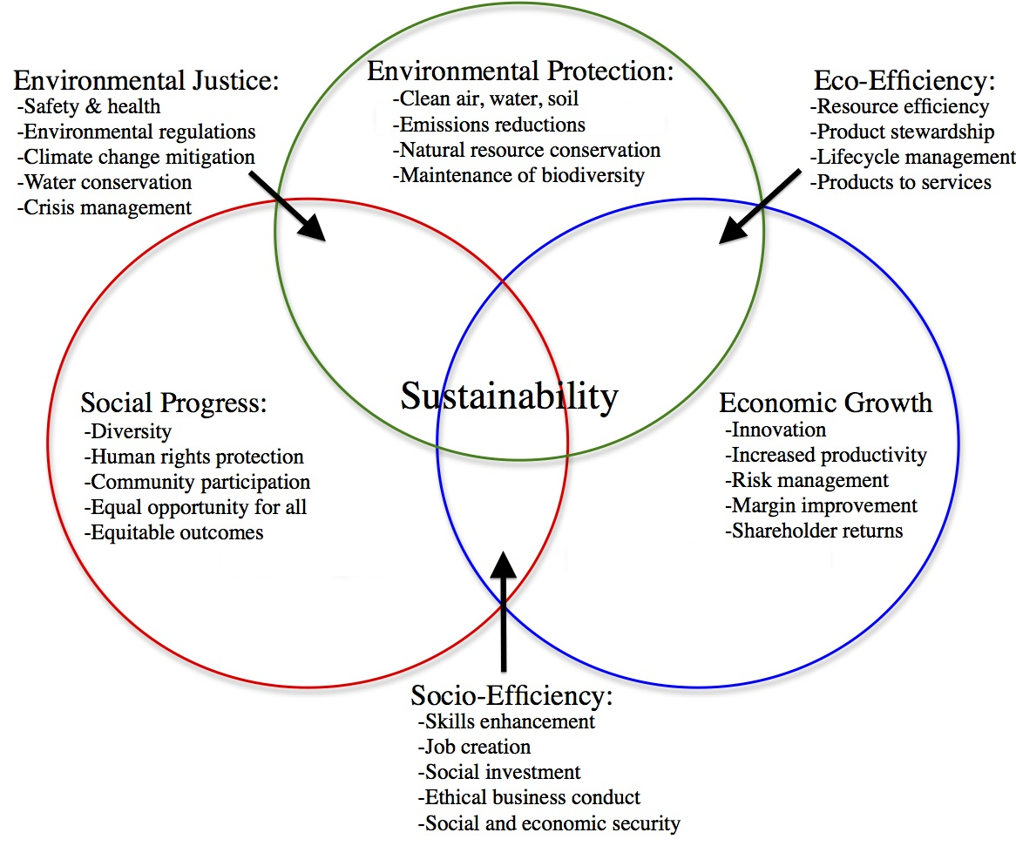
Notes:
This is on page

Slide 12
Municipal Sustainability
Why become a sustainable City?
  National and International government action
  Minnesota State and Regional action
  The power of local action
Notes:
Rationale
Problems: Traffic congestion, population growth, economic development, urban sprawl, municipal tax revenues, climate change, peak oil, pollution, water wars, inequitable distribution of income, health outcomes, energy prices, etc…
National/Intl action
Regardless sustainability’s definition, it is increasingly important
Any one of the issues, taken alone, is significant enough to warrant action. Each of these have had measureable impacts in Minnesota, and will only continue to change.
Federal governments actions are controversial, and although I point them out for reason of full disclosure, I do not want to focus on those actions.
States all across the nation, including bastions of conservatism like Texas, Tennessee, Utah, and Georgia. Municipalities large and small are also pursuing sustainability—Philadelphia, PA; Oakland, CA; Olympia, WA; Austin, TX; Denver, CO; Cambridge, MA; NYC, NY; Boston, MA; Seattle, WA; Pittsburgh, PA;
Minnesota Action
Next generation Energy Act
MEPA
MPLS Climate Action
Met Council—Thrive MSP
Mankato
University of Minnesota
Local/Regional action
Proximity to residents
Willingness to act
Tools
Benefits of acting now, greatly outweigh the costs
Economic: efficient operations → Monetary savings, increased investment, long-term perspective, reduced energy consumption
Environment: Improved environment; more trees; cleaner lakes rivers, and streams; cleaner air
Social: healthier/happier citizens more jobs, affordable cost of living, transportation options, protect culture, encourage expression
The City is a system—see Meadows

Slide 13
Municipal Sustainability
How does a city become sustainable?
  Define sustainability
  Identify a community strengths and needs
  Create a vision of North St. Paul in 20, 40, 50 years.
  Develop policies to achieve the vision by addressing all three aspects of sustainability (environmental, social, economic)
  Monitor and evaluate outcomes, and adjusting policies to better achieve goals
Notes:
Definition: This is the brundt of my project, and where I believe North St. Paul is today. Though this is somewhat complicated because of NSP’s participation in GreenStep Cities.
Identify: In this step, the community should assess the current situation to establish a baseline; including environmental assessments, tree counts, ecological footprint analysis, fleet inventory, energy audits, supply chain assessment
Vision:

Slide 14
Municipal Sustainability
Sustainability Definition (p. )
  Draws on:
    State action
    Regional action
    North St. Paul’s previous actions
      GreenStep Cities
      Comprehensive Plan
      Living Streets Program

Slide 15
Municipal Sustainability
Sustainability Definition
  Resolves to:
    Adopt a strategic definition of sustainability
    Provide guidance for future decision making
    Requests the City Manager to integrate the definition into long-term planning and day-to-day operations.
    Requests the City Manager to provide annual updates to the City Council on implementation and achievements of integrating sustainability

Slide 16
Municipal Sustainability
Redevelopment Master Plan
  Best Management Practices for:
    Zoning Code Modernization
    Development Review and Permitting
    Transit-oriented Development
    Bicycle Infrastructure
    Appendix of nearly 80 policy ideas incorporating sustainability

Slide 17
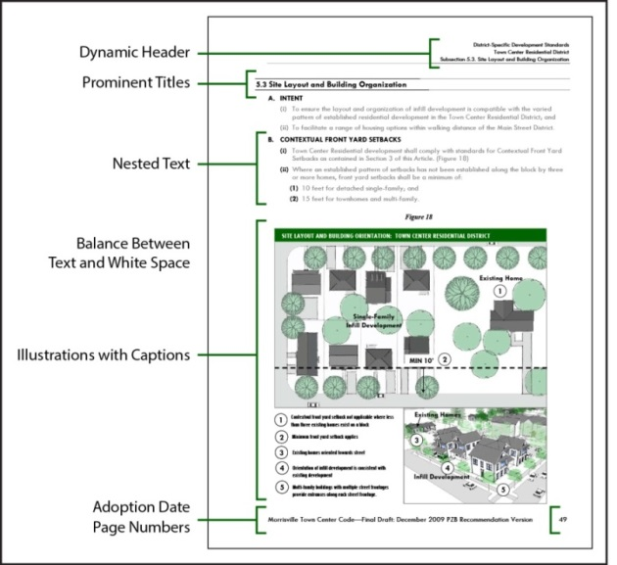
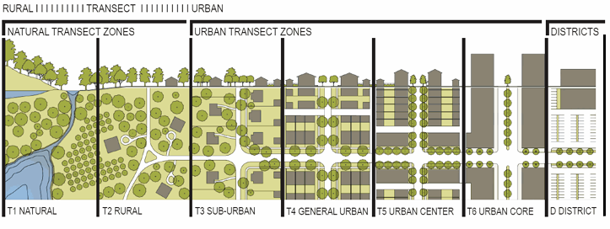
Municipal Sustainability
Best Management Practices #1
  Zoning Code Modernization

Slide 18
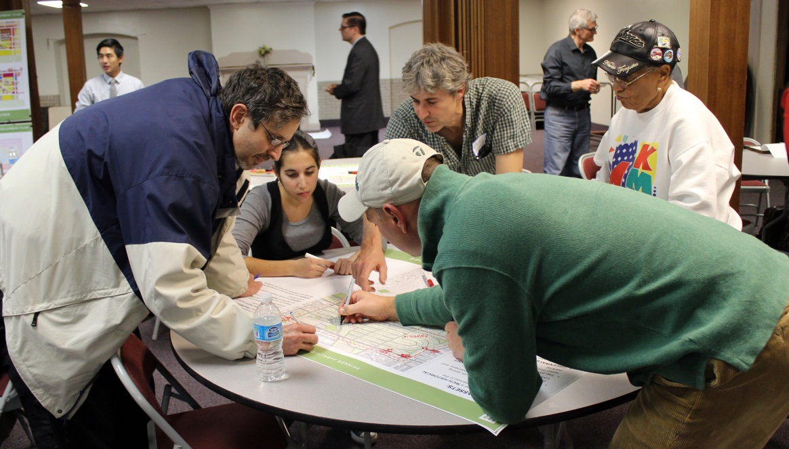
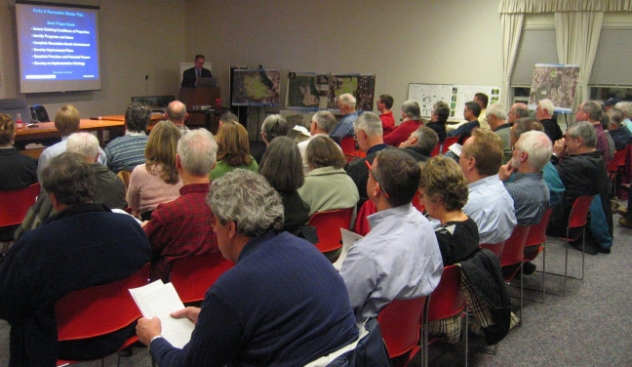
Municipal Sustainability
Best Management Practices #2
  Development Review and Permitting
Notes:
Communication: single point of contact, pre-application process, concurrent application, physical proximity of professional staff
Standardization: clear submission requirements, predictable accurate fees, permitting flow chart and check lists, and site plan approval
Enhancing the process: professional development & training, maximizing municipal website, electronic applications, development agreements

Slide 19
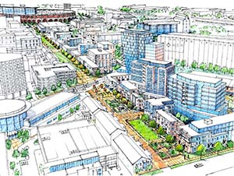
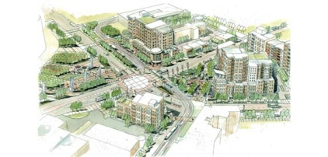
Municipal Sustainability
Best Management Practices #3
  Transit Oriented Development (TOD)

Slide 20
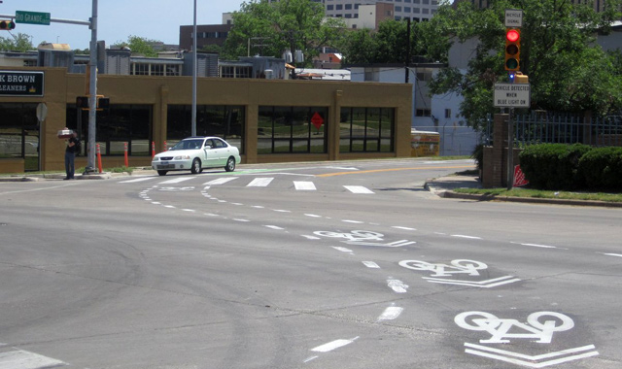
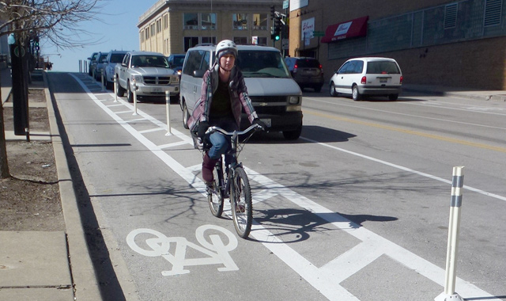
Municipal Sustainability
Best Management Practices #4
  Bicycle Infrastructure

Slide 21
Municipal Sustainability
Best Management Practices
  Appendix of nearly 80 policy ideas incorporating sustainability (p. )
    Energy
    Water
    Public Health
    Green Infrastructure
    Parking
    Commercial Districts

Slide 22
Minnesota GreenStep Cities
John Frost

Slide 23

GREENSTEP CITIES
Overview
  Local Governments
    State based program designed to recognize the role of local governments in reducing greenhouse gas emission

Slide 24

GREENSTEP CITIES
Overview (continued)
  Steps and Blocks
    Six (6) steps are required for a city to be recognized as a “Step 3 GreenStep City”
    Three (3) “recognition blocks” are earned upon completion of the six (6) steps

Slide 25
GREENSTEP CITIES
Overview (continued)
  Best Practices
    Twenty Eight (28) total Best Practices
      Fall under five (5) categories of sustainability
      Composed of 168 unique actions
  North Saint Paul
    Category B City
      Twelve (12) total required Best Practices
      Particular distribution of Best Practices

Slide 26
GREENSTEP CITIES
Buildings and Lighting |  |  | Land Use |  |  | Transportation
Best Practice | Required | Status | Best Practice | Required | Status | Best Practice | Required | Status
1. Efficient Existing Public Buildings | • | ◉ | 6. Comprehensive Planning & Implementation | • | ✓ | 11. Complete Green Streets
2. Efficient Existing Private Buildings |  | ✓ | 7. Higher Density |  |  | 12. Mobility Options |  | ✓
3. New Green Buildings |  |  | 8. Mixed Uses |  | ✓ | 13. Efficient City Fleets
4. Efficient Building & Street Lighting and Signals |  | ◉ | 9. Efficient Highway-Oriented Development |  |  | 14. Demand-Side Travel Planning
5. Building Reuse |  |  | 10. Conservation Design
Total | 1 | 1 | Total | 1 | 2 | Total | 0 | 1
Key
• | Required | ◉ | Partially Complete
✓ | Complete | ✗ | Required and No Action Taken
Notes:
Key

Slide 27
GREENSTEP CITIES
Environmental Management |  |  |  |  |  | Economic and Community Development
Best Practice | Required | Status | Best Practice | Required | Status | Best Practice | Required | Status
15. Environmentally Preferable Purchasing |  | ✗ | 20. Efficient Water & Wastewater Facilities |  |  | 24. Benchmarks & Community Engagement |  | ¤
16. Urban Forests |  | ✓ | 21. Septic Systems |  |  | 25. Green Business Development |  | ✓
17. Efficient Stormwater Management |  | ✓ | 22. Solid Waste Reduction |  |  | 26. Renewable Energy |  | ¤
18. Parks & Trails |  |  | 23. Local Air Quality |  |  | 27. Local Food
19. Surface Water Quality |  |  |  |  |  | 28. Business Synergies
 |  |  | Total | 2 | 2 | Total | 2 | 1
Key
• | Required | ◉ | Partially Complete
✓ | Complete | ✗ | Required and No Action Taken

Slide 28

GREENSTEP CITIES
NSP’s Final Tally
  Required BPs – 6 total
    Complete: 3
    Incomplete: 3
  Optional BPs – 22 total
    Complete: 4
    Partially Complete: 3
  Total BPs – 28 total
    Required: 12
    Complete: 7

Slide 29

GREENSTEP CITIES
BP 1 (required): Efficient Existing Public Buildings
  Requirements
    Two (2) Actions
  Recommendations
    Action 1: In progress! Continue recording B3 Benchmarking data for one year.
    Action 2: Write it down! Recent upgrades to lighting in NSP city-owned and school buildings should meet the requirements for this action.

Slide 30

GREENSTEP CITIES
BP 15 (required): Purchasing
  Requirements
    Two (2) Actions
  Recommendations
    Complete Action 1 by adopting an Environmentally Preferable Purchasing Policy.
    Evaluate Action 2. Does NSP purchase energy from renewable energy sources? Alternatively, does NSP’s public utility distribute energy from renewable energy sources? If so, write it down!

Slide 31

GREENSTEP CITIES
BP 24 (required): Benchmarks & Community Engagement
  Requirements
    Two (2) Actions
  Recommendations
    Action 1: Already complete!
    Evaluate Actions 2, 3, 4, and 5. Did NSP already take any of these actions? If so, write it down!

Slide 32
GREENSTEP CITIES
BP 4 (optional): Efficient Outdoor Lighting and Signals
  Requirements
    Two (2) Actions
  Recommendations
    Action 5: Already complete!
    Evaluate Action 2. Does NSP purchase LED lights for all new street lighting and traffic signals? If so, write it down!

Slide 33

GREENSTEP CITIES
BP 11 (optional): Complete Green Streets
  Requirements
    Two (2) Actions
  Recommendations
    Action 1: Write it down! NSP’s Living Streets Plan is one of Minnesota’s best Green Streets concepts.
    Evaluate Actions 3, 4, and 5. Did NSP already take any of these actions? If so, write it down!

Slide 34
GREENSTEP CITIES
BP 26 (optional): Renewable Energy
  Requirements
    Two (2) Actions
  Recommendations
    Action 5: Already complete!
    Evaluate Action 2. Does NSP’s public utility offers a green power purchasing program? If so, write it down!

Slide 35
CONCLUSION
North St. Paul can achieve sustainability
  Builds a foundation for future improvements that directly benefit the community
  Real benefits and minimal costs
  Creates and maintain an inclusive, community-oriented process that directly addresses the issues the community believe are important
  Adaptable at multiple scales
  Its recognizable

Slide 36
CONCLUSION
Questions?
  Municipal Sustainability: Spencer Peck
  GreenSteps Cities: John Frost

