Slide 1

Space and the University
(Cambridge and Minnesota)
Alworth Center Brown Bag
David Beard
Department of Writing Studies

Slide 2
The Argument
The Space of a University reflects
Curriculum
Relationship to Community

Slide 3
The Evidence
In Minnesota, Colleges are defined by field of inquiry of faculty since their inception.
In Cambridge, they are defined by social bonds and traditions.

Slide 4
The Evidence
Both Minnesota and Cambridge develop apart from their communities.
The University of Minnesota (Duluth and Twin Cities) develops as a world apart.
The Colleges of the University of Cambridge develops as a palimpsest. As their function changes, they are overwritten by tourism and commercialization.

Slide 5
The U of Minnesota:
Space Reflects Disciplines.
Disciplines are Manifest in Colleges.
The University is a world apart.

Slide 6
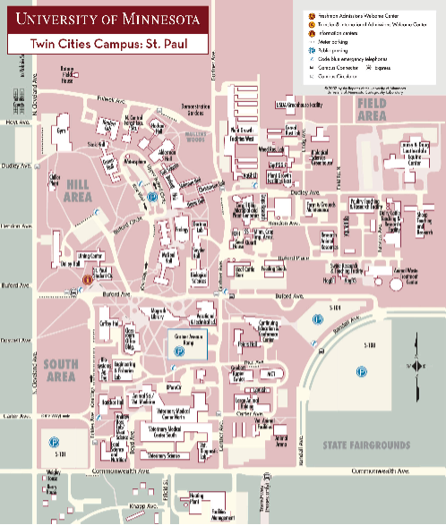
The U of Minnesota St. Paul: Where the Farms Are

Slide 7
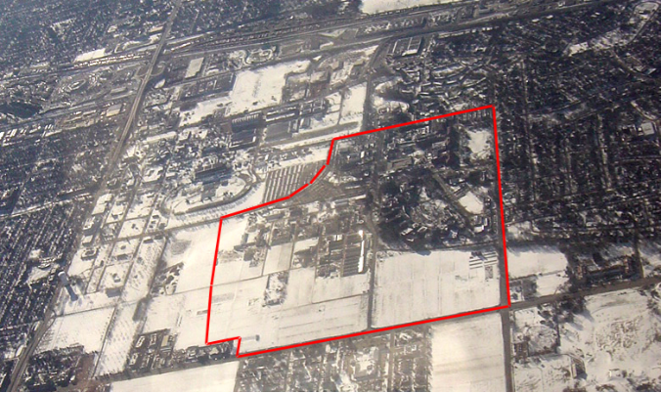
The U of Minnesota St. Paul: Where the Farms Are

Slide 8
The U of Minnesota St. Paul: Where the Farms Are
Supported by the Morrill Act, the St. Paul Campus has been home to colleges of
Food, Agriculture and Natural Resources
Human Ecology
Biological Sciences

Slide 9
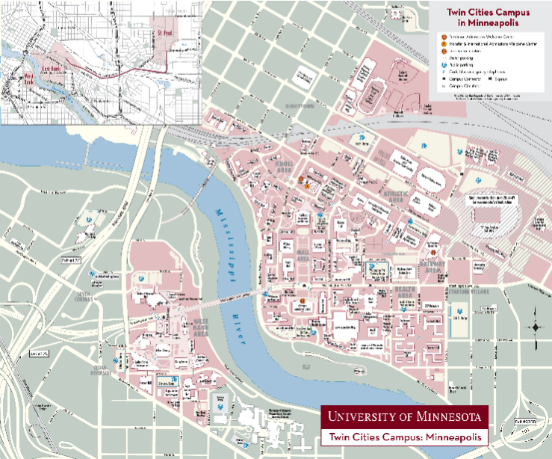
The U of M: East & West Banks

Slide 10
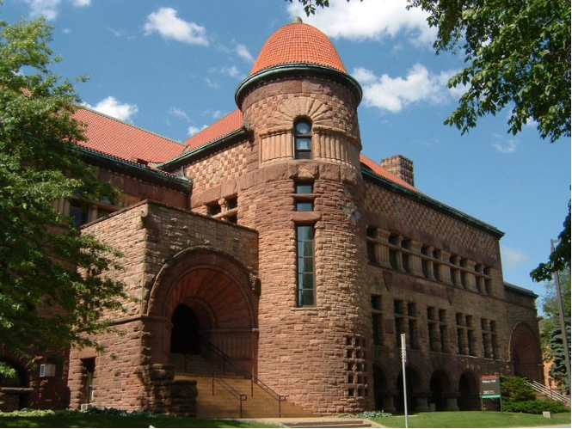
The U of M East Bank:
Birth of the Liberal Arts
Pillsbury Hall, 1889

Slide 11
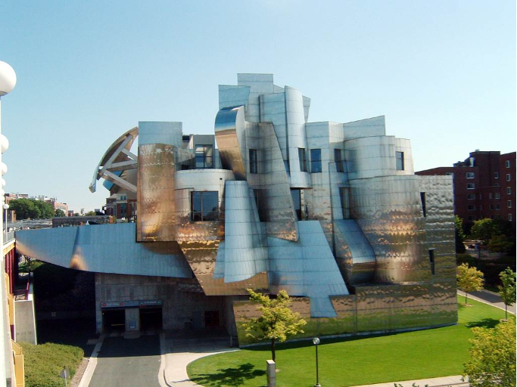
The U of M East Bank:
Apex of the Liberal Arts
Weisman Art Museum,
Frank Gehry

Slide 12
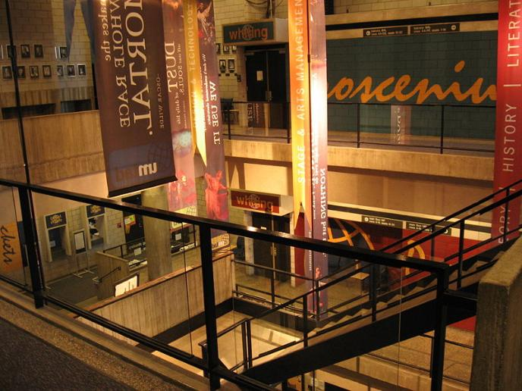
The U of M West Bank:
Professional Arts, Business, & Policy
Rarig Center

Slide 13
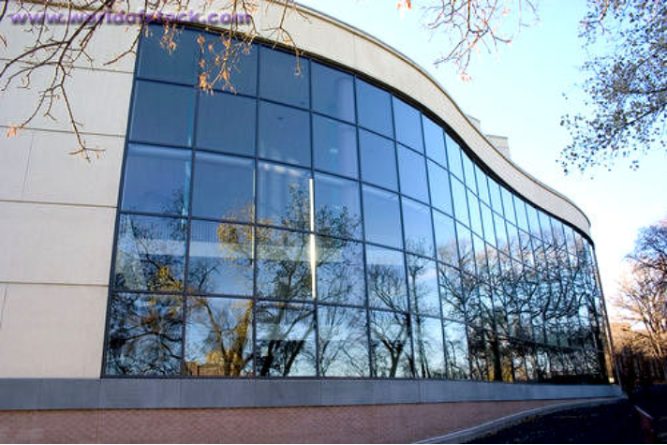
The U of M West Bank:
Professional Arts, Business, & Policy
Carlson School

Slide 14
The U of M TC:
16 Colleges & Schools
Carlson School of Management (CSOM)
College of Biological Sciences (CBS)
College of Continuing Education (CCE)
School of Dentistry (DENT) --- College of Design (CDES)
College of Education and Human Development (CEHD)
College of Food, Agricultural and Natural Resource Sciences (CFANS)
College of Liberal Arts (CLA) --- College of Veterinary Medicine (CVM)
Hubert H. Humphrey Institute of Public Affairs (HHH)
Institute of Technology (IT) --- Law School (LAW)
Medical School (MED) --- School of Nursing (NURS)
College of Pharmacy (PHARM) --- School of Public Health (SPH)

Slide 15
The U of M TC:
16 Colleges & Schools
… spatially clustered by disciplines…
…separated from the nonacademic spaces
of the City…

Slide 16
The U of M Duluth:
… spatially clustered by disciplines…
…separated from the nonacademic spaces
of the City…

Slide 17
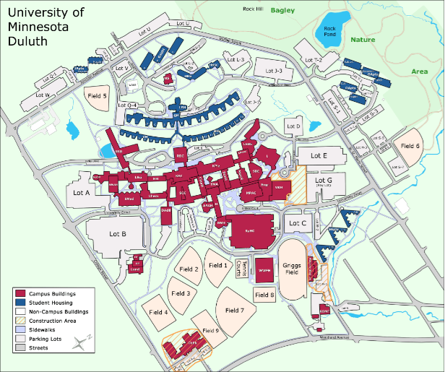
The U of M Duluth:
… clustered by discipline,
…separated from the non-academic spaces of the City

Slide 18

The University of Cambridge
…colleges cluster by social background of its alumni and tradition… shaping curriculum…
…the world apart from the medieval colleges is changing…

Slide 19
The University of Cambridge
Origins:
Murder! Hanging! Oxford Faculty Flee to Cambridge in 1209
Oxford Faculty Take Residence in Religious Institutions
From these Institutions, the School at Cambridge becomes a University and its Colleges are born.

Slide 20
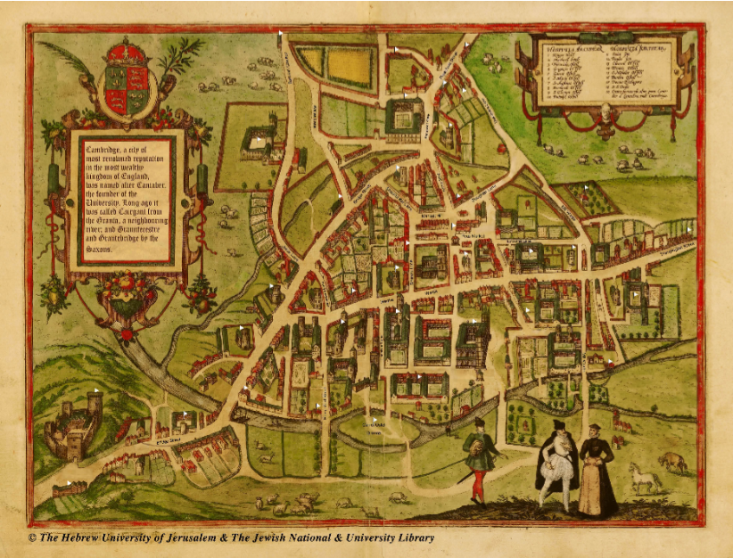
Map: The Early University

Slide 21
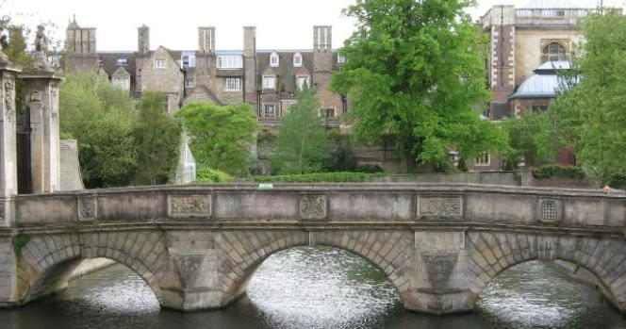
The Early University
The space of the early University
is defined by the River Cam.

Slide 22
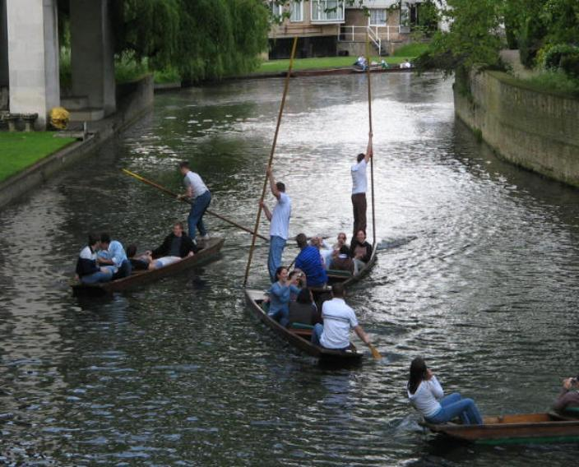
The River Cam
The space of the University
is defined by the River Cam.

Slide 23
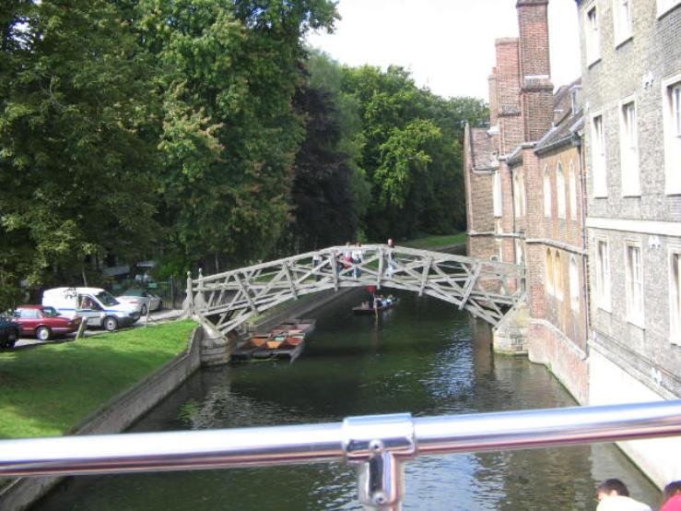
The River Cam
The space of the University
is defined by the River Cam.

Slide 24
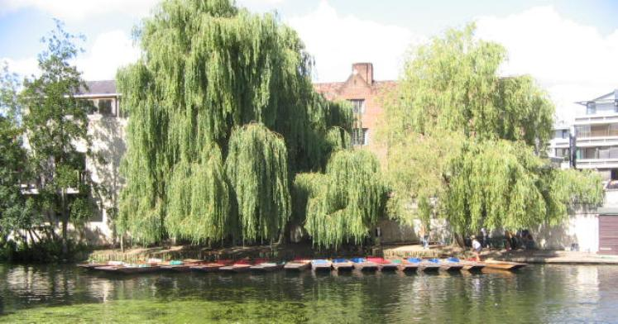
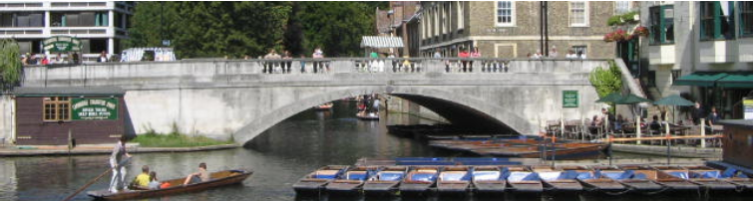
The River Cam
The space of the University
is defined by the River Cam.

Slide 25
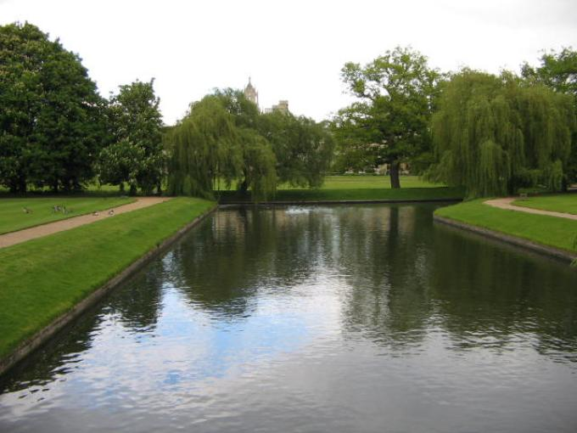
The River Cam

Slide 26
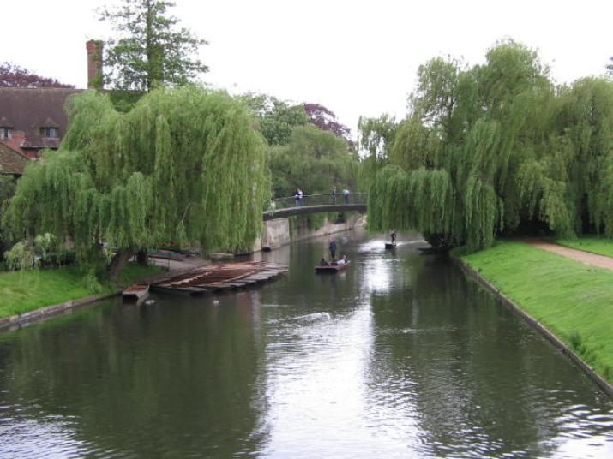
The River Cam

Slide 27
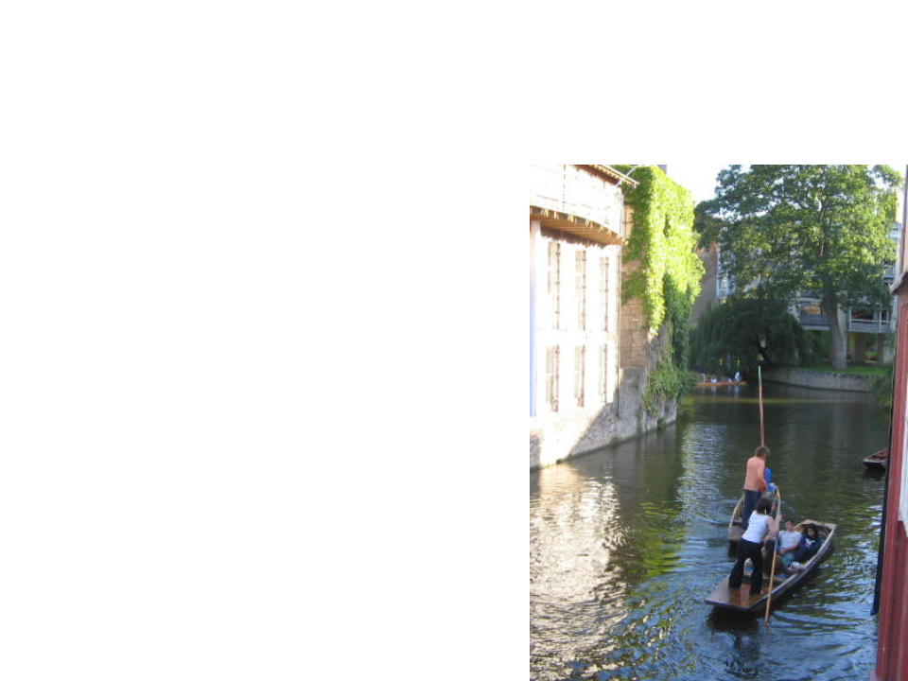
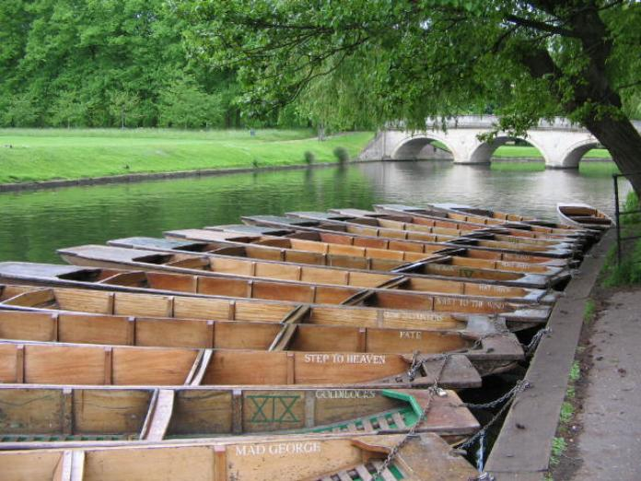
The River Cam

Slide 28
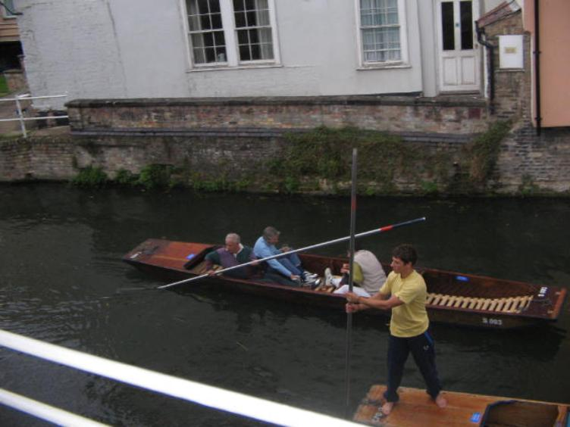
The River Cam

Slide 29
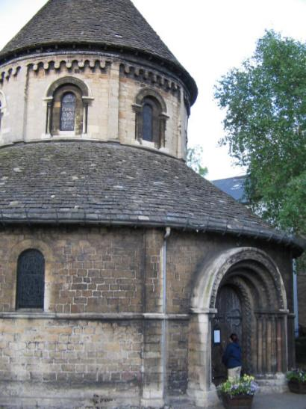
The Religious Institutions
The Round Church
The oldest continually standing church, unaffiliated with any college.

Slide 30
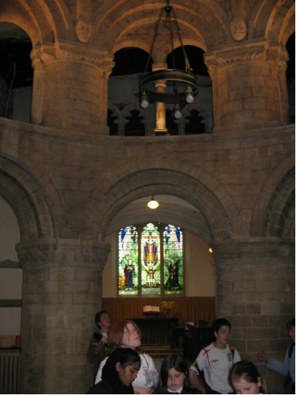
The Religious Institutions
The Round Church
The oldest continually standing church, unaffiliated with any college.

Slide 31
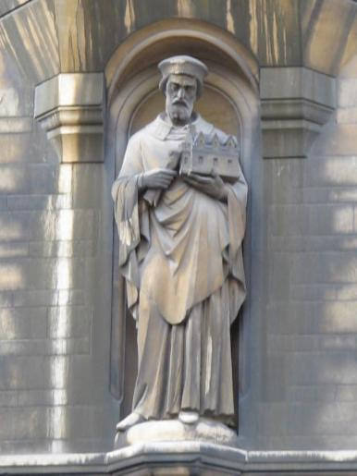
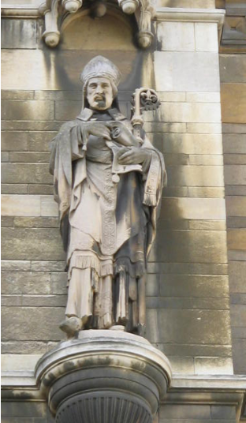
The Religious Institutions
The Colleges develop in part from seminaries, and develop with religious iconography at the start.

Slide 32
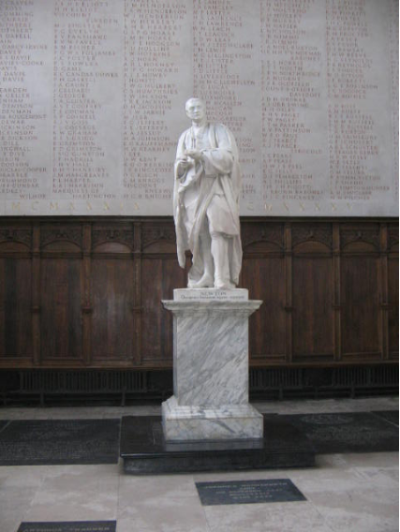
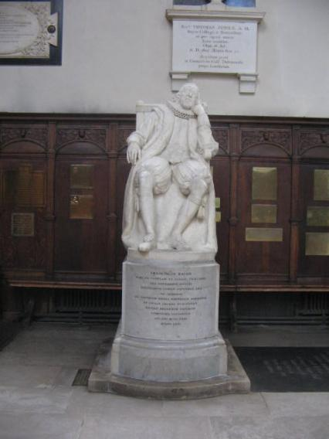
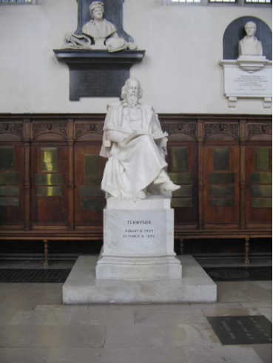
The Secularized Religious Institutions

Slide 33
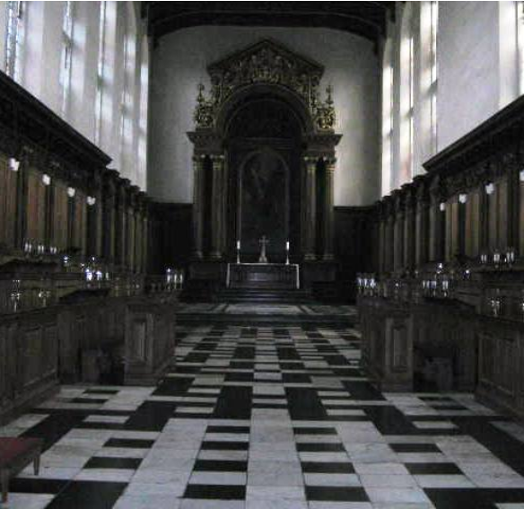
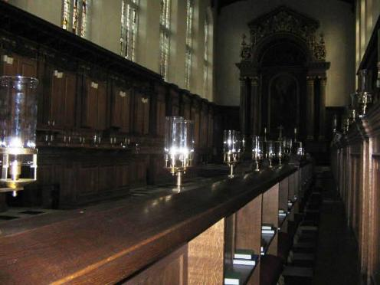
The Secularized Religious Institutions

Slide 34
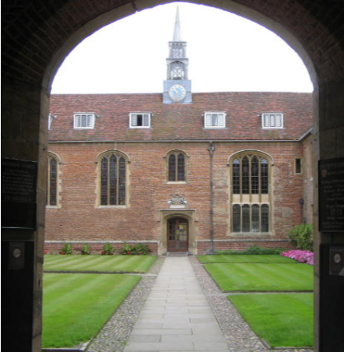
The Far Side of the River Cam
Colleges that are nearly 500 years old are considered “new” colleges, in part because they are born on the wrong side of the river.

Slide 35
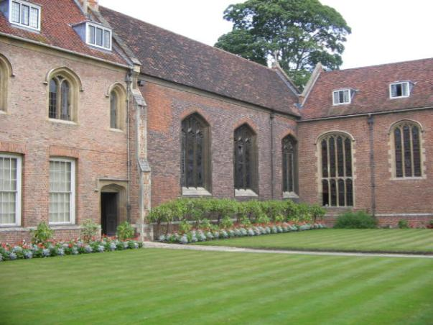
The Far Side of the River Cam
More of Magdalene College

Slide 36
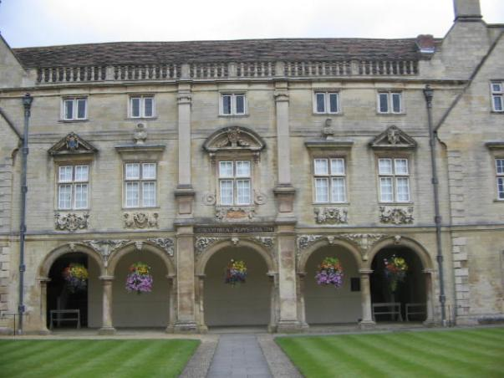
The Far Side of the River Cam
Pepys
Library,
Magdalene College

Slide 37
Isolation and the River Cam
The river insulated the colleges from the community.
The colleges enjoyed that independence.

Slide 38
Isolation of the Colleges
Rothblatt:
“Walls, gates and ditches surrounding the colleges were meant to restrict student mobility and prevent townsmen from disturbing the college peace. Proctors flanked by subordinates called ‘bulldogs’ policed the streets … to prevent town and gown conflicts and to enforce … academic dress” (184).

Slide 39
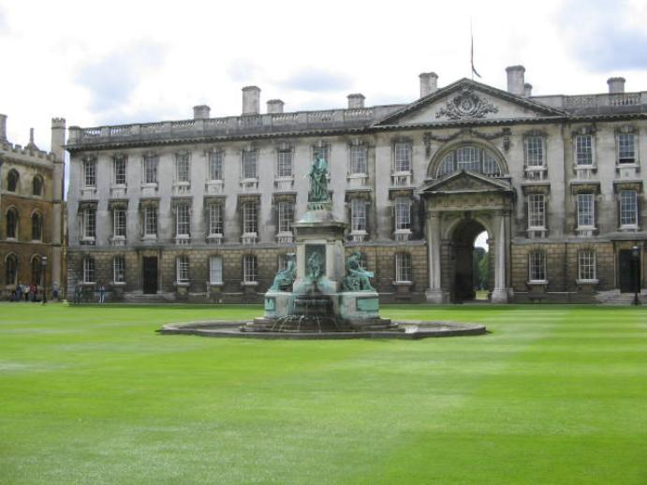
Isolation of the Colleges: King’s Courtyard

Slide 40
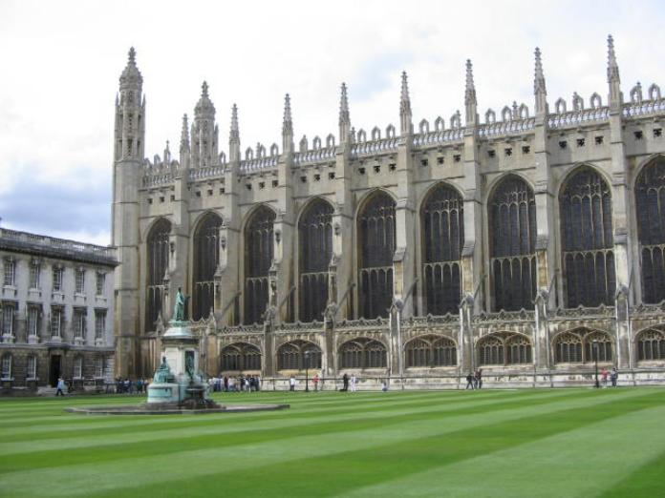
Isolation of the Colleges: King’s Courtyard

Slide 41
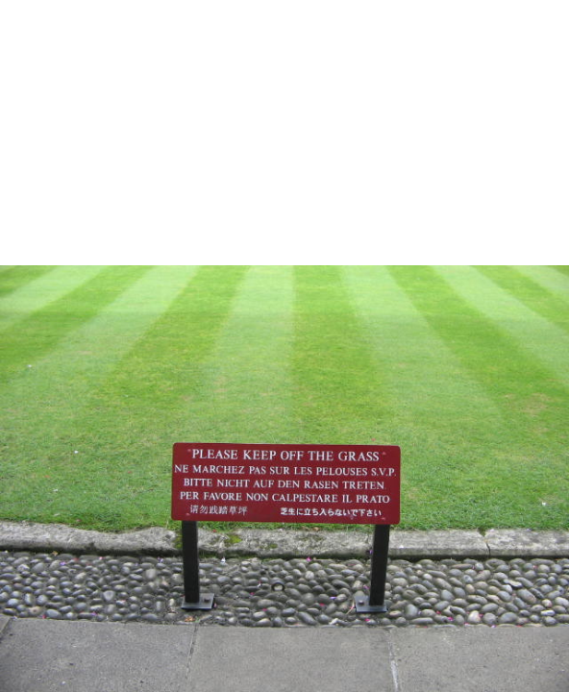
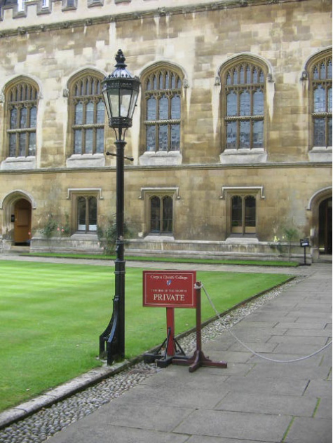
Isolation of the Colleges: King’s
Courtyard

Slide 42
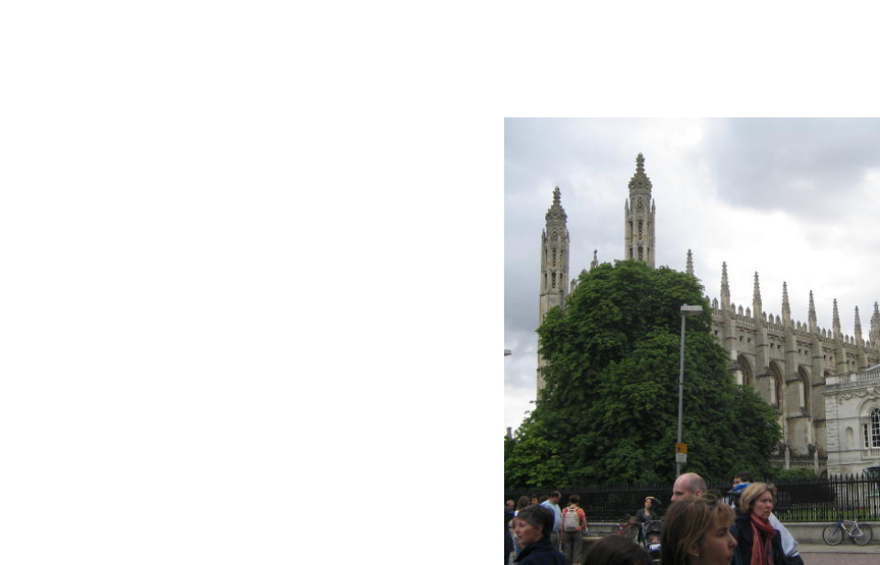
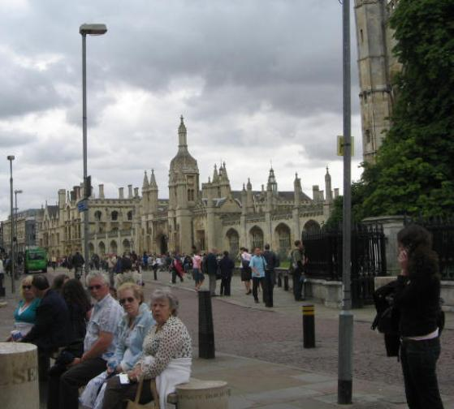
Isolation of the Colleges: King’s Courtyard

Slide 43
The Train Threatens the Isolation
The train station is located a half an hour’s walk from the Colleges…
…to increase the sense of isolation and division between town & gown.

Slide 44
The Colleges at Cambridge:
(Typically) Defined by Lifestyle and Tradition, Not Intellectual Work
There are 31 Colleges in Cambridge.
Three are for women (Murray Edwards, Newnham and Lucy Cavendish)
Two admit only graduates (Clare Hall and Darwin).
The remainder house and teach all students enrolled in courses of study at the University.

Slide 45
Life in the Early Colleges
Haffenden on the early Cambridge colleges:
“a residential club for young gentlemen who wished to develop their faculties in intimate association with one another and with as little interference as possible from directors of studies and dons in general” (100).

Slide 46
Life in the Early Colleges
Rothblatt:
College Fellows, responsible for the academic preparation of students, also participated in athletics. This indicated their embeddedness in the whole development of the student, resulting in “friendliness, mutual respect and a sense of common effort” (209).

Slide 47
Transformation in the 19th Century
Between 1800-1899, more than 30% of all students were children of the clergy.
Education for the clergy was the most structured, and it included rhetorical education.

Slide 48
Transformation in the 19th Century
Between 1800 and 1849, the children of landowners accounted for 31% of the student body, a share that drops to 19% between 1850-1899.
In the meantime, the children of the middle class (bankers, lawyers, civil servants) became a larger portion of the student body.

Slide 49
19th Century Education
As a result, outside the structured education for clergy, 19th century education was nonsystematic and nonstandardized.

Slide 50
19th Century Education
The most popular courses of study were
Mathematics (including physics and a variety of related fields)
Classics (theatre, philosophy, archaeology) -- popular with the growing population of women, too!

Slide 51
19th Century Education
In their own way, each student really got a 4-year lib ed degree, in terms of coursework…
…but more importantly, they also received admission into the social world of the colleges.

Slide 52
The Transformation of the 20th Century
The Colleges were intentionally small
-- some admitting as few as 10 students a year --
and depended wholly on tuition and endowments for support.
After WWI, this was no longer tenable.

Slide 53
Centralization in the 20th Century
Government funding lead to:
Increased centralization of instruction,
Increased faculty affiliation with Departments, rather than Colleges
Increasingly standardized education.

Slide 54
What becomes of the Colleges?

Slide 55
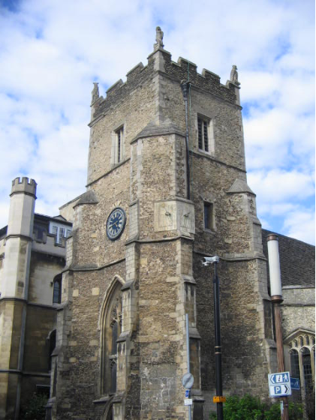
The Colleges as Palimpsests
After 800 years, there’s bound
to be some repurposing.

Slide 56
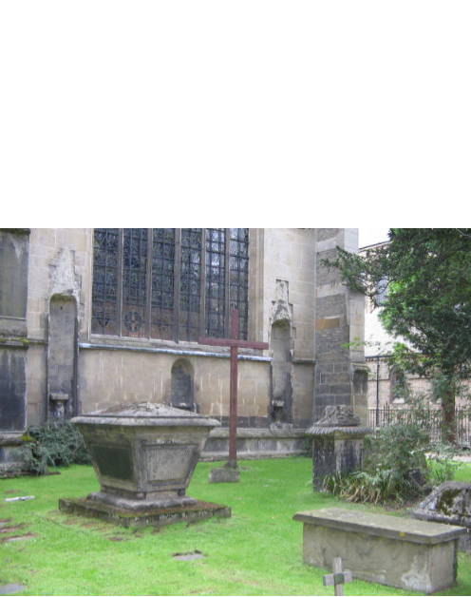
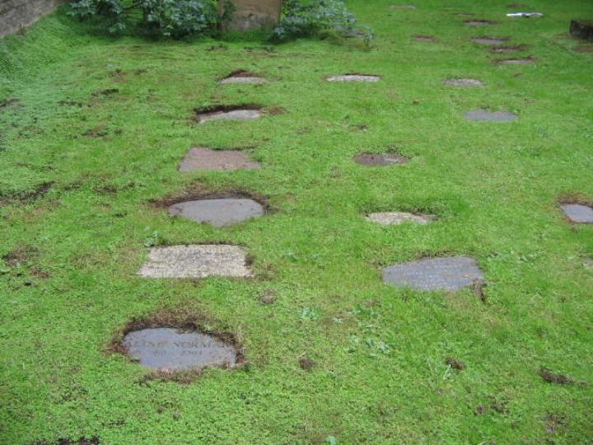
The Colleges as Palimpsests
Written upon, erased, and written on again

Slide 57
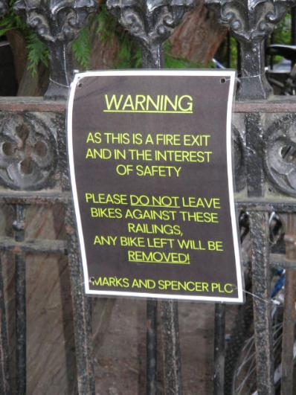
The Colleges as Palimpsests
After 800 years, there’s bound to be some repurposing.

Slide 58
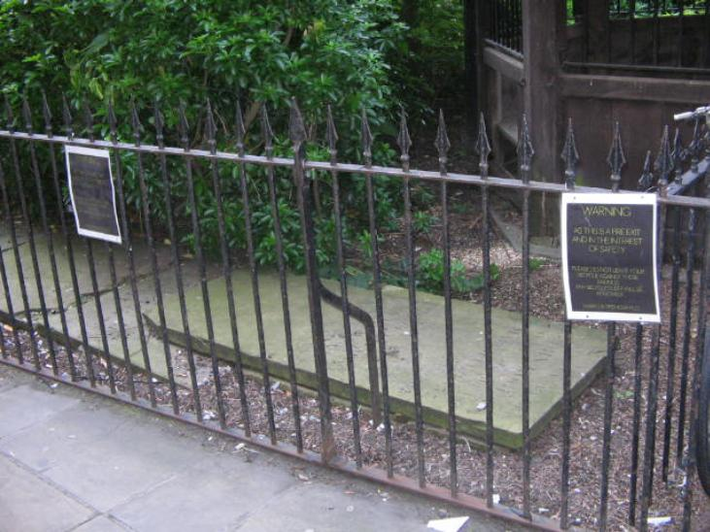
The Colleges as Palimpsests

Slide 59
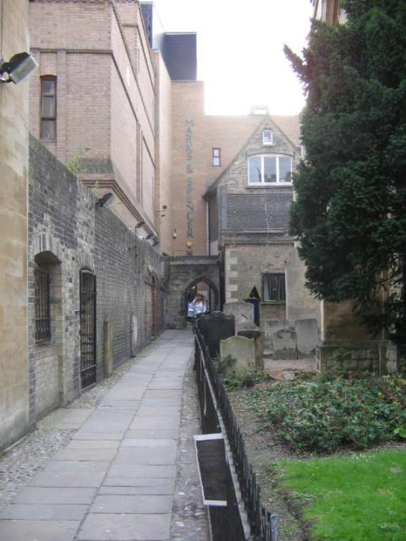
The Colleges as Palimpsests
Marks &
Spencer
Grocery

Slide 60
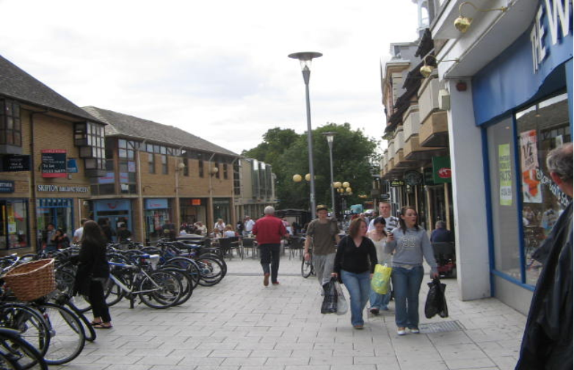
Shopping used to be on the outskirts…

Slide 61
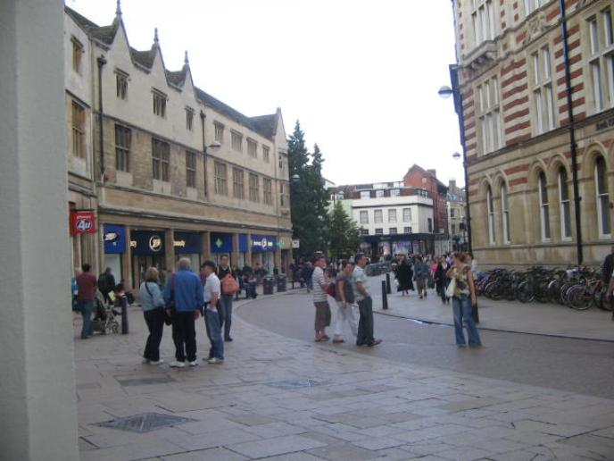
Shopping has moved into the city center…

Slide 62
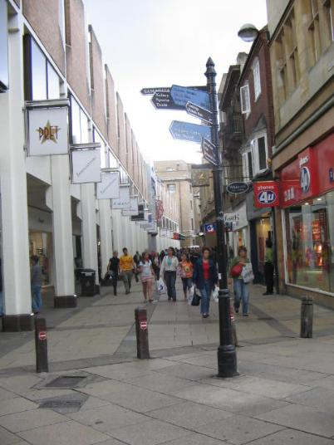
The Colleges Become Tourist and Shopping Centers

Slide 63
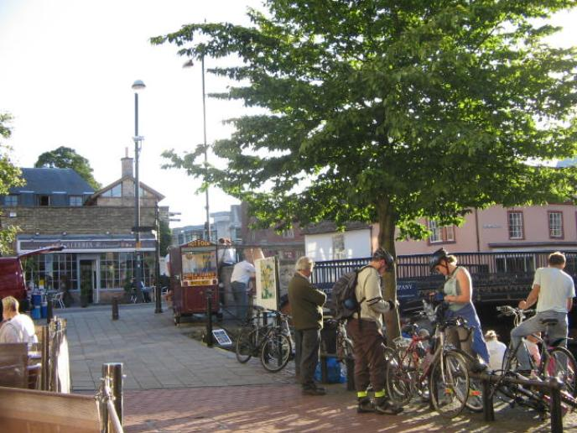
The Colleges Become Tourist and Shopping Centers

Slide 64

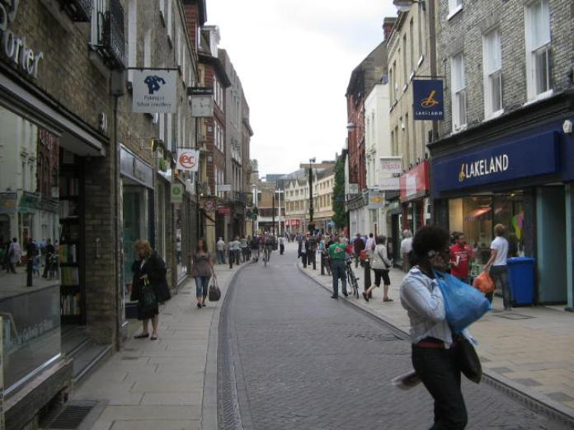
The Colleges Become Tourist and Shopping Centers

Slide 65
At Cambridge, the process of commercialization is palimpsestic.
Palimpsest:
A manuscript, typically of papyrus or parchment, that has been written on more than once, with the earlier writing incompletely erased and often legible.

Slide 66
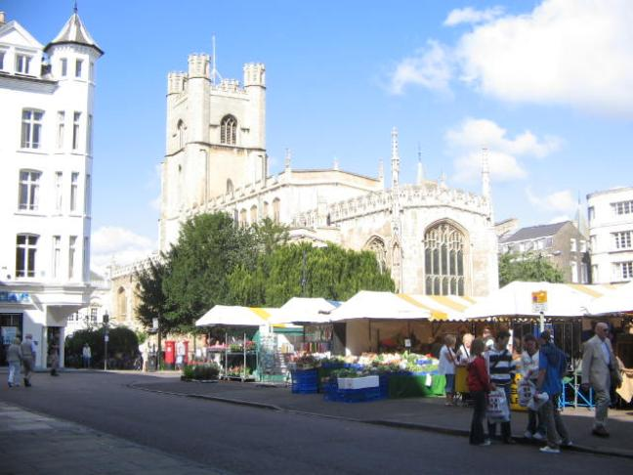
At Cambridge, the process of commercialization is palimpsestic.

Slide 67
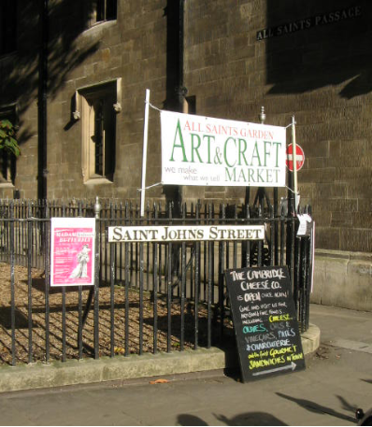
At Cambridge, the process of commercialization is palimpsestic.
Palimpsest:
An object, place, or area that reflects its history.

Slide 68
Conclusions
The space of a university reflects its curriculum.
-- nothing new there, maybe; it’s just illustrated nicely by my examples.

Slide 69
Conclusions
The space of a university reflects its relationship to its community.
-- nothing new there, maybe; it’s also just illustrated nicely by my examples.

Slide 70
Concluding Provocation
Cambridge shows that the space of a university can be written upon, palimpsestically, by commercial and touristic entities.
--But what of the US?

Slide 71

Concluding Provocation
What do we feel when we see this?
--CSOM
--We also see it when outside companies control food service and other campus services.

Slide 72
Concluding Provocation
Are we okay with this transformation? Does it change the nature of feel of the space of the University?

Slide 73
dbeard@d.umn.edu
David Beard, Assistant Professor of Writing Studies.
Photos & Maps of UMTC and UMD from UM Sources (except CSOM photo, from commercial stock photo provider).
Photos of Cambridge taken by David Beard or Kate Vo Thi-Beard (except map of medieval Cambridge taken from auction website).

