Slide 1
Assessing the Impacts of Various Grazing Management Strategies on Southern Minnesota Stream Channels
May 16th, 2018
Masters Candidate: Seongjun Kim
Advisor: Dr. Joe Magner
Committee: Dr. Bruce Wilson and Dr. Chris Lenhart

Slide 2
Overview
Introduction
Objectives
  Research questions and hypotheses
Literature Review
  Stream stability
  Stream classification
  Grazing management
Methodology
  Field surveys
  Data analyses
Findings
  Site descriptions
  Results and discussion
Conclusions
Objectives
Literature Review
Methodology
Findings
Conclusions
Notes:
Here is an overview of the sections of the presentation, which will be shown at the bottom of each slide as well.
I will introduce the project and its objectives, then go over some my literature review topics to give you a better understanding of this subject.
Next, I will go through the methodology for my data collection and analyses. I will go over the study sites and the findings from each separately.
Lastly, I will summarize the results and provide conclusions and future recommendations.

Slide 3
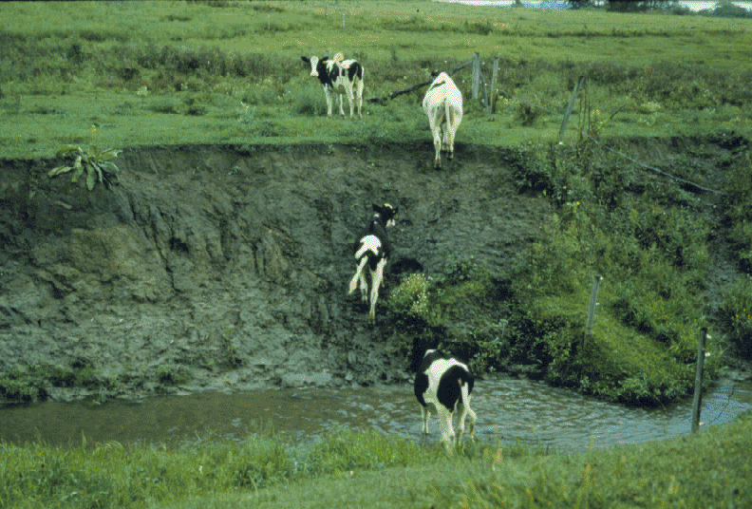
Why is grazing harmful to streams?
Objectives
Literature Review
Methodology
Findings
Conclusions
© Megan Bauer
Notes:
Why is grazing harmful to streams, and why are grazing management strategies important to assess?
Livestock that have open access to the stream pollute it with their waste, overgraze and trample vegetation, and collapse stream banks.
A full grown cow weighs about half a ton. Now imagine a herd of these animals, climbing up and down the stream bank to cross or access water.
Grazing in this way can cause continued degradation of a stream will result in loss of aquatic habitat, loss of land to erosion, and a reduced capacity for processing agricultural runoff, which already causes a myriad of water quality problems in many watersheds.
I hope to show that these problems can be addressed with efficient management changes instead of banning grazing or requiring extensive and expensive restorations.

Slide 4
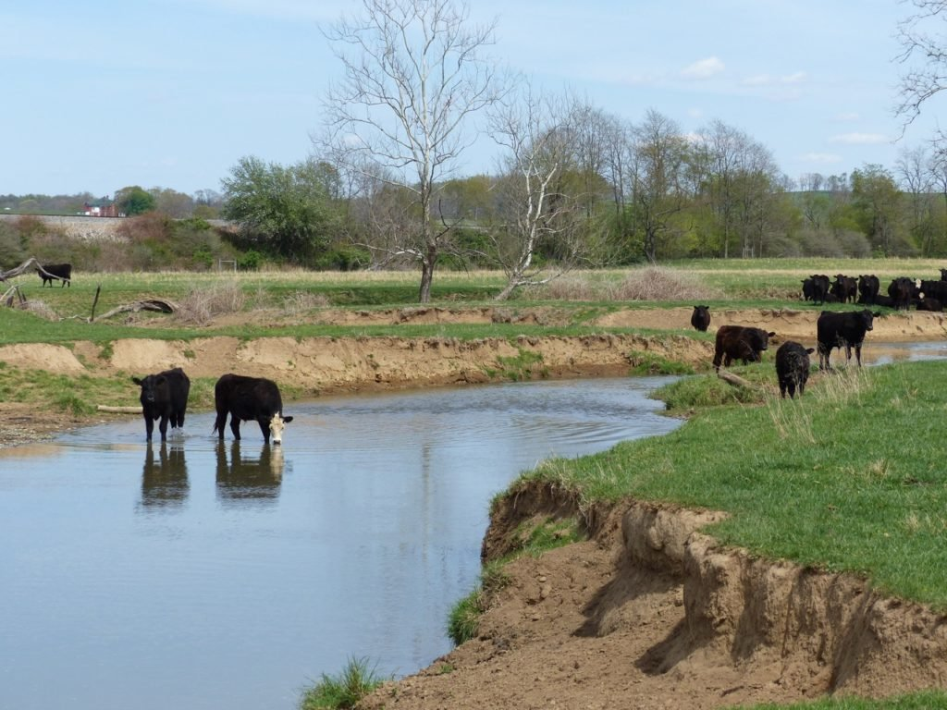
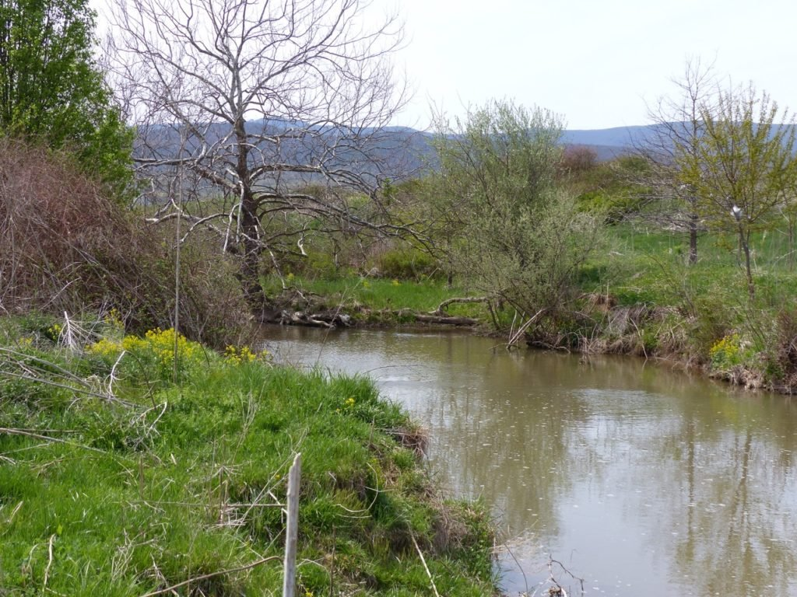
Objectives
Literature Review
Methodology
Findings
Conclusions
© William Funk
Notes:
The first picture is looking downstream at a farm that allows conventional grazing; the cows have open access to the stream and the banks. Notice the exposed soil on the banks.
Now imagine turning around 180 degrees. This next picture is looking the other way, upstream. Here, cattle have been excluded for 15 years. The difference in vegetation on the banks is noticeable.
Removing cattle is one of the most advocated solutions to fixing damage caused by grazing. However, this is not always desirable to the landowner, as it has economic consequences. Grazing exclusion has also been criticized as not being a permanent or complete solution as studies have found that not all sites respond positively and some may remain more susceptible to impacts in the future.

Slide 5
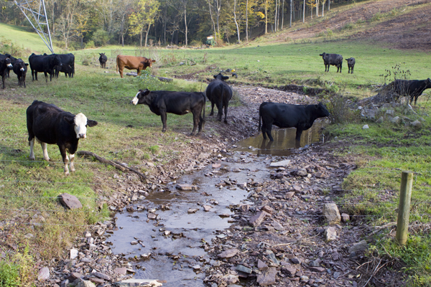
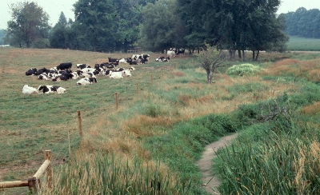
© Bill Wolfe
© Ontario MAFRA
Conventional Grazing (CG)
Managed Grazing (MG)
Objectives
Literature Review
Methodology
Findings
Conclusions
Notes:
There are three types of grazing represented in this study.
Conventional grazing, as you’ve seen in the pictures so far, is keeping the cattle in an open area, without restrictions on the time they spend there.
For the purposes of this study, managed grazing is when the cattle are limited in the time and area that they are allowed to graze. In this photo on the right, they are fenced out of the riparian corridor.
There are many types of management that fall under this category: rest-rotation systems, short duration grazing, and more. While there are additional economic costs for managed grazing, it has shown in other studies to increase forage production, decrease erosion, and result in more stable stream channels. Many cost-share programs also exist to help landowners cover costs such as water pumps and fencing.
Non grazing or grazing exclusion is exactly what the name says, no grazing of any kind has taken place in these areas for a long time, or ever.
By looking at specific cases as examples, and by comparing within this group of similar streams, I hope to gain a better understanding of how different grazing strategies affect streams.

Slide 6
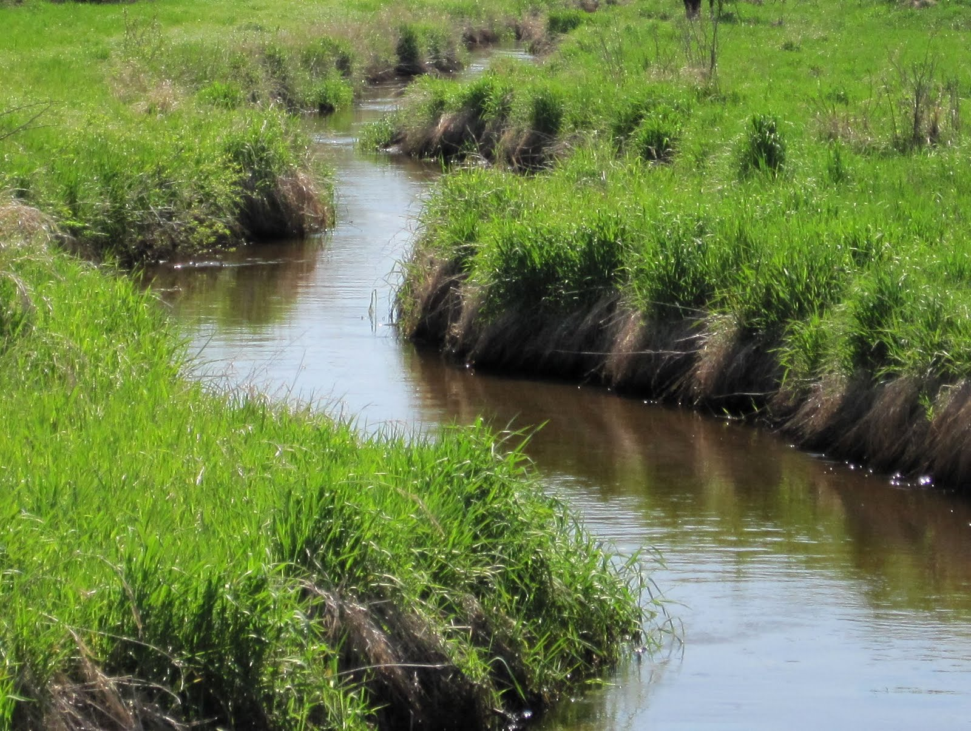
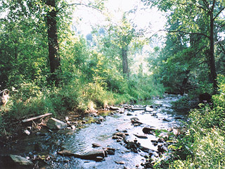
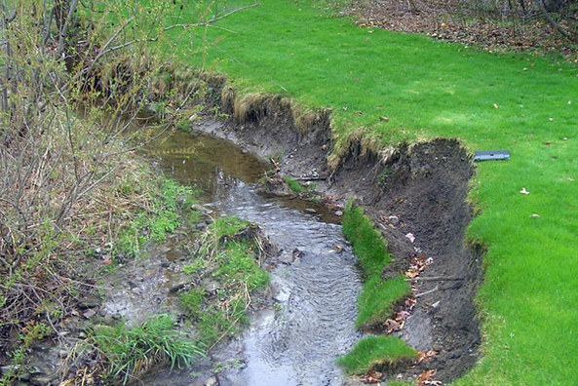
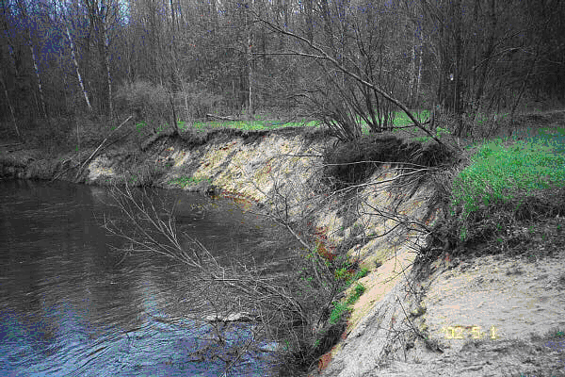
Grassed Banks
Wooded Banks
© Sue Micawber
© B.K. Haynes
© Green City Blue Lake
© RR Northern Michigan
Eroded Grassed
Eroded Wooded
Non Grazing (NG)
Objectives
Literature Review
Methodology
Findings
Conclusions
Notes:
Within the nongrazing sites, I also hope to look into what the differences are between having a mostly grassed or wooded bank area.
While wooded bank areas provide shade for fish habitat and have deeper roots, grassed bank areas have denser roots and less exposed soil.
While literature exists supporting both sides, I would like to explore which is better in the southern Minnesota region.

Slide 7
Research Objectives
Can managed grazing meet or exceed the benefits of grazing exclusion? In other words, can it accomplish the desired degree of natural restoration?
Is conventional grazing as damaging to ecosystems and bank stability as the literature shows?
Is a wooded or grassed stream bank area better for channel health?
Objectives
Literature Review
Methodology
Findings
Conclusions
Notes:
The main objectives of this study are listed here.
1. Can managed grazing meet or exceed the benefits of grazing exclusion?
I want to see how the grazing strategies compare to one another among similar study sites.
2. Is conventional grazing as damaging to ecosystems and bank stability as the literature shows?
Previous literature has shown that conventional grazing causes degradation in stream channels. Will this be confirmed in this study?
3. Is a wooded or grassed stream bank area better for channel health?
This is specific to the geology, climate, and terrain of this region.

Slide 8
Research Hypotheses
Managed grazing will show similar or better results than grazing exclusion.
Conventional grazing will show the poorest results of the grazing types studied.
Streams with grassed stream bank areas will have healthier channels.
Objectives
Literature Review
Methodology
Findings
Conclusions
Notes:
Based on a review of the available literature, I hypothesized that managed grazing can be just as good or better than non grazing for stream health and bank stability. This is because I believe that there are advantages to having managed grazing on bank areas, such as promoting growth of shrubs and bushes, denying wooded species, and added fertilization.
I hope to confirm that conventional grazing is the most harmful method and should be discouraged.
Lastly, I believe grassed areas are better than wooded because of greater vegetative cover, less bare soil, and denser root systems.

Slide 9
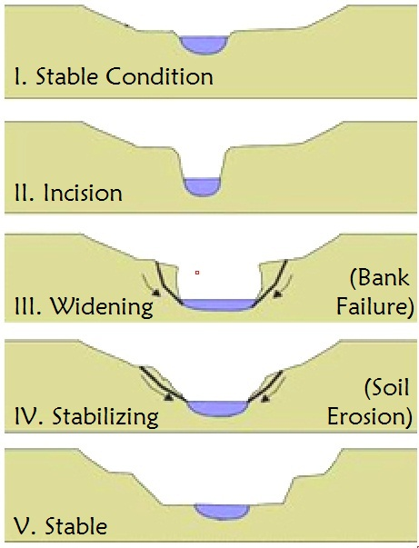
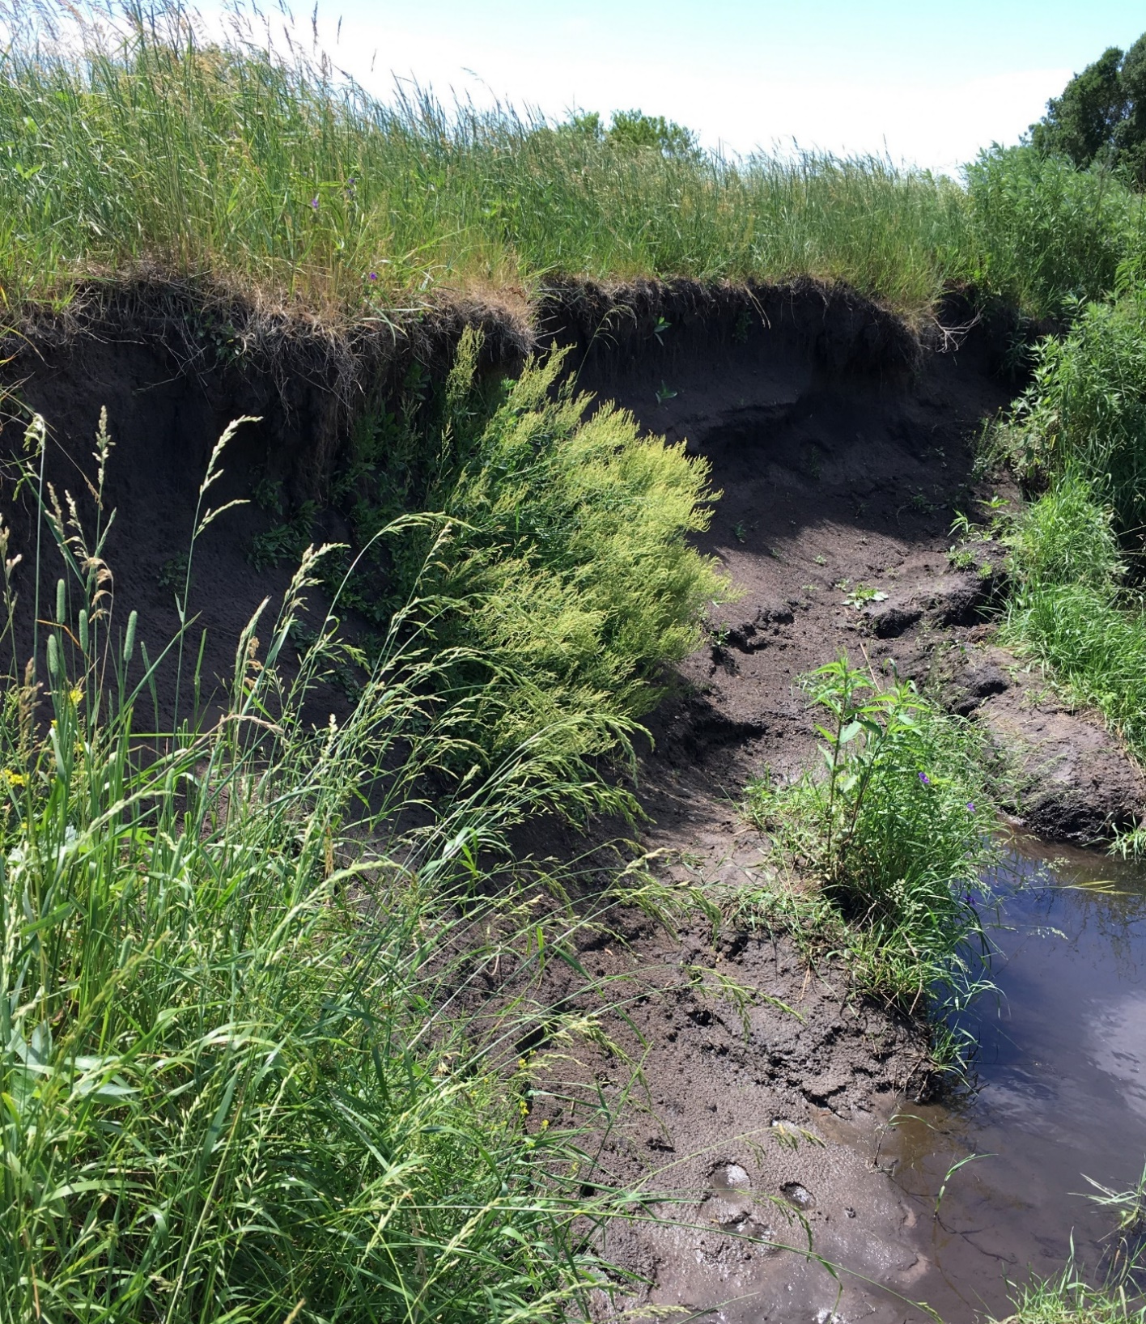
© Fairfax County, VA
Objectives
Literature Review
Methodology
Findings
Conclusions
Notes:
Before we go into the study methods and findings, I’d like to go through some basics of stream morphology and stability.
The figure on the left shows the progression of a stream that is becoming incised. The energy in the flow of the water causes shear stress on the bed and the banks, deepening and widening the channel.
A good example of a bank between steps 3 and 4 is the photo on the right is a bank at one of my sites, where you can see the bank is widening and seeing bank failure. .
So what makes a stream channel healthy?
Stability is defined as a stream’s ability to transport water and sediment over time without aggrading or degrading. Aggradation is deposition of material raising the base level of a channel and degradation is the erosion of channel beds and banks.
In short, stability means that the stream maintains its dimension, profile, and pattern over time.

Slide 10
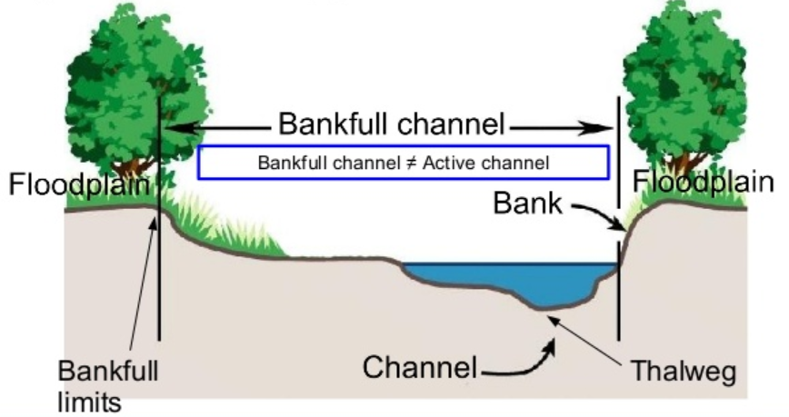
© Pierluigi De Rosa, 2015
Objectives
Literature Review
Methodology
Findings
Conclusions
Notes:
An important concept to talk about, before getting into the parts of a stream is bankfull. Bankfull elevation is the stage at which the water leaves the channel and enters the floodplain. The bankfull is not the active channel, but the water level during about a 1.5 year storm event. This means a storm that comes on average, once every 1.5 years. So fairly large.
This is important as a measurement for flood awareness, but also because flows near or at bankfull stage tend to move large amounts of sediment. These storms are channel-defining events.

Slide 11
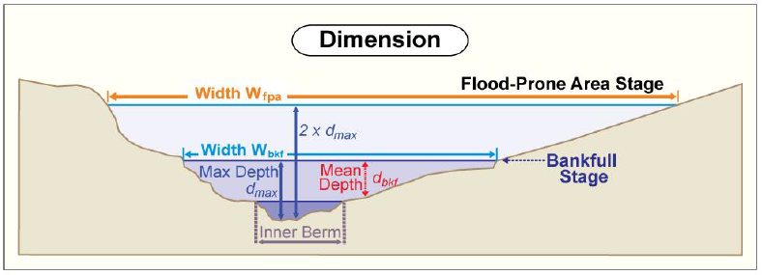
Dimension
© MN DNR
Objectives
Literature Review
Methodology
Findings
Conclusions
Notes:
A stream is made up of three things; its dimension, profile, and pattern.
Dimension includes depths and widths of the channel and flood prone area.
Data is collected by performing cross-section surveys, as well as looking at topographical maps.

Slide 12
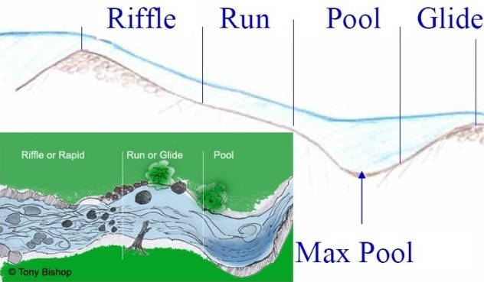
Profile
Objectives
Literature Review
Methodology
Findings
Conclusions
Notes:
The profile of a stream includes channel slope, particle sizes in the bed, and the bed features. These are measured during the longitudinal profile and pebble count surveys.
The bed pattern of a stream goes riffle, run, pool glide; this is the natural way that streams form to dissipate energy.
Each of the features is unique, and together they create diverse aquatic habitat. Some streams will not have well defined bed feature patterns, due to erosion or straightening. However, all natural streams will try to return to this sequence.

Slide 13
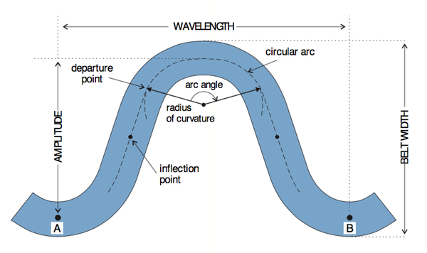
Pattern
© NCSU
Objectives
Literature Review
Methodology
Findings
Conclusions
Notes:
Pattern includes sinuosity and the shape of the meander of a stream.
This is useful for seeing how the stream has moved or changed over time, by comparing to older photographs or maps.
This data can also be used to predict how the stream will move or change in the future.
Pattern measurements were done using GIS maps and aerial photographs.

Slide 14
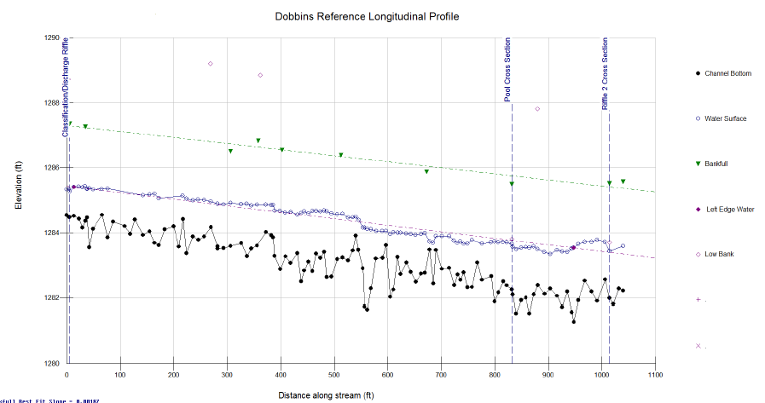
Longitudinal Profile
Objectives
Literature Review
Methodology
Findings
Conclusions
Notes:
Several surveys were conducted to collect data for each reach of a stream.
A longitudinal profile is used to characterize the profile of a stream. This measures the average stream slopes and depths of riffles, pools, runs, and glides. The thalweg and water surface are measured at every point. Bankfull and low bank height measurements are made if there is a good indicator. The slope changes in bed elevation and water surface can be seen as the stream progresses through its bed feature sequences. The surveying was done with a rotary laser level and a grade level rod.
The stream gradient is more accurate when determined by this method than by using topographic maps. This information is useful for assessing the sediment transport capacity and the shear stress acting on the channel banks

Slide 15
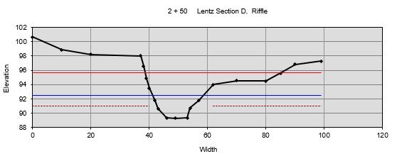
Cross-section Survey
T-7 Site D Cross-section, Riffle
Objectives
Literature Review
Methodology
Findings
Conclusions
Notes:
Dimension is represented by the cross-section survey. The ideal location for a cross-section survey is at the narrowest part of a riffle section. It should also be far enough away from any bridges or channel modifications.
These cross-sections were surveyed using a rotating laser level. The diagram in the upper right shows how cross-sections are measured.

Slide 16
Pebble Count
Objectives
Literature Review
Methodology
Findings
Conclusions
Notes:
Particle size distribution is an important part of a river’s profile. Particles are collected at evenly spaced intervals along the entire bankfull channel.
At least 10 particles are measured at 10 total transects, giving a total of 100 particles sampled in the reach.
The percent distribution of particle size classes is calculated once the data is input into RIVERMorph. D50 and D84 represent the average of the 50th and 84th percentiles of particles.
Depending on the D50 or D84, the dominant particle size can be determined.

Slide 17
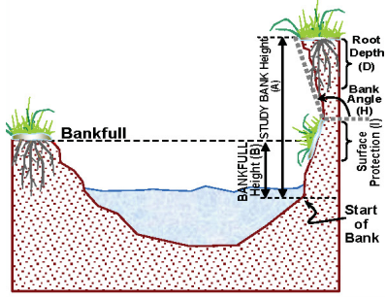
BEHI Rating
© Wildland Hydrology
Objectives
Literature Review
Methodology
Findings
Conclusions
Notes:
Another survey often done in the field is the Bank Erosion Hazard Index (BEHI).
This quantitatively assesses a stream bank’s susceptibility to erosion, and assigns it a score. Eight measurements are made to predict a bank’s potential erodibility. The study bank height (ft), bankfull height (ft), root depth (ft), root density (%), bank angle (degrees), surface protection (%), bank material, and stratification of bank material are determined and converted into ratios. Each ratio can then be converted to a BEHI score, which are summed to determine a total BEHI score and adjective rating of ‘very low’, ‘low’, ‘moderate’, ‘high’, ‘very high’, or ‘extreme’ risk of erosion.
A higher score means the bank is more at risk.

Slide 18
Data Analysis Process
1
Organize the data using RIVERMorph or Mecklenburg Excel sheets
2
Run a correlation matrix
3
Standardize Dobbins and Overall datasets
4
Run one-way ANOVA tests for Dobbins and Overall datasets
5
Run post-hoc Games-Howell tests for statistically significant ANOVA tests
6
Compare means for the T-7 and 300th Ave sites
Objectives
Literature Review
Methodology
Findings
Conclusions
Notes:
I directly collected the morphological data for Dobbins Creek in the field, and entered it into the RIVERMorph application.
For Sugarloaf and Elm Creeks, data were already available in Mecklenburg Excel sheets, which serve the same function as the RIVERMorph application, which is to organize and process the data.
Using the geomorphic data, I analyzed the reaches within each site, as well as the dataset as a whole.
First, I checked to see which variables were correlated.
Then, for the Dobbins site and the overall dataset analysis, I standardized the data.
Standardizing multivariate data is important to account for significant differences in variable scales.
Then, I performed one-way ANOVA tests, or analysis of variance tests. The post-hoc test I used for the statistically significant ANOVA results was the Games-Howell test.
For the T-7 reach of Sugarloaf creek and the 300th Ave reach of Elm Creek, there were not enough data points to perform a one-way ANOVA test.
Instead, I compared the before and after datasets, and looked at the average differences between the sites. Even though it cannot be declared statistically significant, conclusions for these specific sites can still be drawn from these differences.

Slide 19
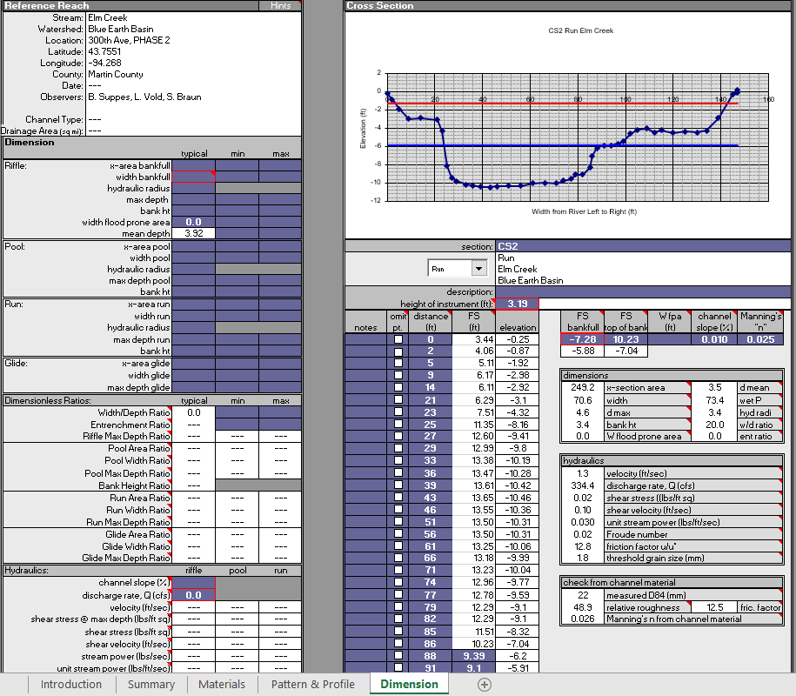
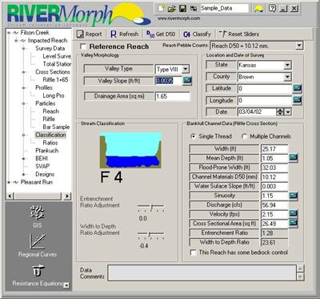
Objectives
Literature Review
Methodology
Findings
Conclusions
Notes:
The morphological data for the 600th Ave reach were entered into the RIVERMorph application. For all other reaches, data were already available in Mecklenburg Excel sheets, which serve a similar function as the RIVERMorph application. Resources like RIVERMorph or Mecklenburg sheets are used to enter and organize stream morphology data for a single reach. It can calculate the bankfull width, bankfull area, mean depth, maximum depth, width-depth ratio, entrenchment ratio, and channel slope by using the inputs of the longitudinal profile and cross-section surveys. They also provide automated ways of visualizing the data. Longitudinal profiles and cross-sections can be plotted and edited. The particle size distribution is also plotted from the pebble count input.

Slide 20
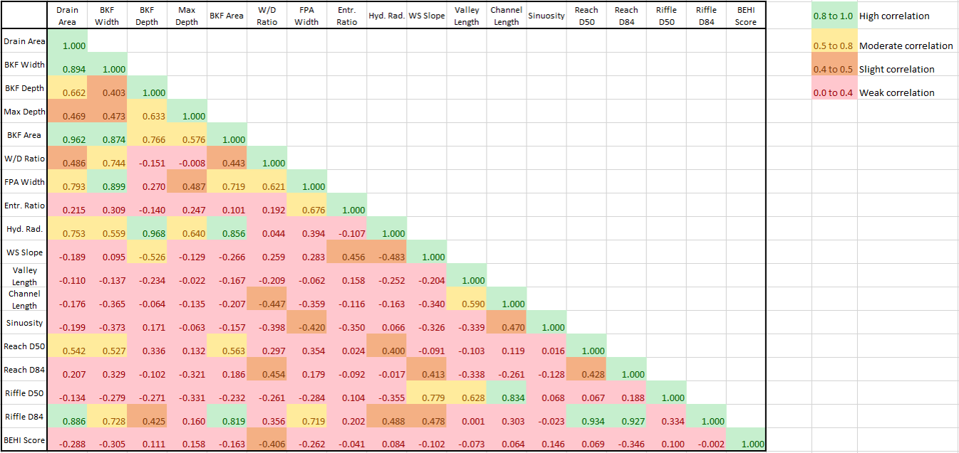
Objectives
Literature Review
Methodology
Findings
Conclusions
Notes:
A correlation matrix was generated between all of the variables measured. This shows how strongly each variable is associated with another, indicated by the p-values.
This table supports expected correlations and exposes unexpected ones. For example, bankfull area should be highly correlated to the bankfull width and depth. However, it was not as expected that Riffle D84 would be so highly correlated with bankfull area when the other particle sizes were not.
This is useful for filtering the variables for exploratory data analysis, such as developing proper regression models.

Slide 21

Standardization
Objectives
Literature Review
Methodology
Findings
Conclusions
Notes:
For the overall dataset, the data points were standardized. Standardizing multivariate data is important to account for significant differences in variable scales. It was used here to account for the difference in drainage area of the Elm creek sites. It was also used to account for differences between the Dobbins creek sites. It can also help reduce multicollinearity issues when running regression models.
A standardized dataset will have a mean of zero and a variance of 1. This can be achieved using this equation.

Slide 22
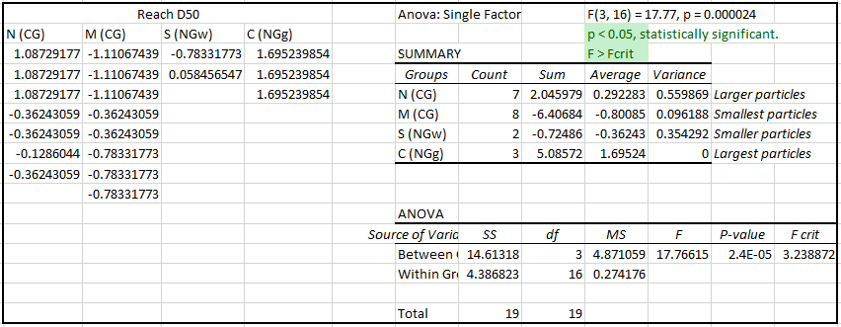
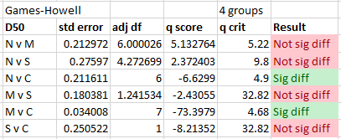
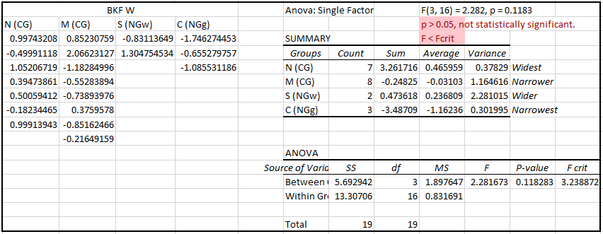
One-way ANOVA examples
Reach D50 particle sizes for Northern (N) vs Reference (C) and Middle (M) vs Reference (C) are significantly different.
While not statistically significant, bankfull widths still vary between the sites.
Objectives
Literature Review
Methodology
Findings
Conclusions
Notes:
I performed one-way ANOVA tests, or analysis of variance. One-way ANOVA is used to determine whether there are any statistically significant differences between the means of three or more independent groups.
I wanted to see if any variables are significantly different between grazing types or reaches.
This slide shows what the output looks like from an ANOVA test and how it is interpreted.
The post-hoc test I used for statistically significant ANOVA results was the Games-Howell test.

Slide 23

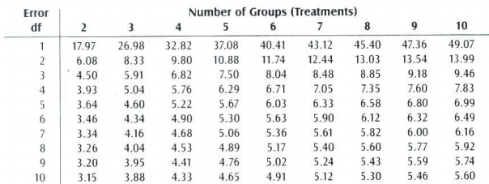
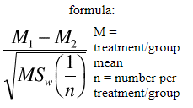
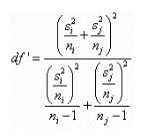
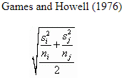
Example ANOVA output
Compare to:
Critical Value Table
Tukey’s HSD test
Adjusted degrees of freedom
Games-Howell modification
Objectives
Literature Review
Methodology
Findings
Conclusions
Notes:
Post-hoc tests are used to find where the differences occurred between groups, and they are only run when the ANOVA has shown an overall statistically significant difference in the group means.
The post-hoc test I applied is the Games-Howell test. Two groups within the ANOVA are compared.
The modified version of Tukey’s honest significant difference test uses this denominator, to account for uneven group sizes and unequal variances.
Error in degrees of freedom should also be adjusted if this modification is used, and the final q value obtained from the Games-Howell test is compared against a critical value using the table. Depending on the error df and the number of groups used in the ANOVA, the critical value will vary. If the q value is greater than the critical value, that comparison is significantly different.

Slide 24
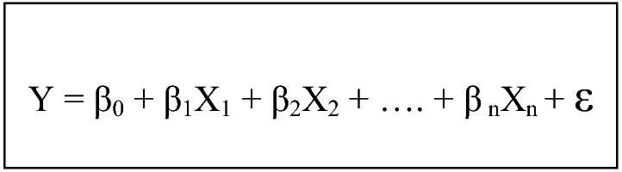
Regression
© Abhijit Bangera
Objectives
Literature Review
Methodology
Findings
Conclusions
Notes:
The purpose of regression analysis is to predict the value of one dependent variable from the values of independent variables. In order to determine what combination of independent variables best represents the dependent variable, backward stepwise selection was used. This model starts with all of the variables, then removes the least useful predictor. It repeats this process until all predictors are significant. This provides a starting point, and then variables were added or removed based on their p-values. The best combination is generally determined by the lowest p-values and highest adjusted R-squared value. The adjusted R-squared value is the fraction by which the variance of the errors is less than the variance of the dependent variable, adjusted for the number of coefficients in the model relative to the sample size. However, since the goal is to determine which predictors are statistically significant and how changes in these predictors influence changes in the response variable, the R-squared value is not as important. The dependent variable, predicted dependent variable, and 95% confidence intervals are then plotted to view the prediction.
Y is the variable we are trying to predict. X_n are the variables we are using to predict Y.
Beta_0 is the intercept. Beta_n is the coefficient of X_n, or how that variable affects Y. Finally, epsilon is the error term, or the regression residual.

Slide 25
What defines a healthy stream?
Higher entrenchment ratio: Less entrenched
Lower width-depth ratio: Narrower and deeper, less hydraulic stress
Larger particle sizes: Less turbidity, habitat creation
Larger range of particle sizes: Good for habitat creation, bed feature diversity
Lower BEHI Rating: Less at risk of erosion, more stable bank
Objectives
Literature Review
Methodology
Findings
Conclusions
Notes:
What does a healthy stream look like, in numbers?
In general, the following are desirable for a healthy, stable stream:
Higher entrenchment ratio = less entrenched
Lower W/D ratio = narrower channel, less shear stress on banks. As the W/D ratio value increases (i.e, the channel grows wider and more shallow), the hydraulic stress against the banks also increases and bank erosion is accelerated..
Larger particle sizes (less fine sediment that could be suspended and impact habitats, larger particles create habitat)
A larger range of particles is good for habitat diversity and bed feature diversity.
Lower BEHI Rating

Slide 26
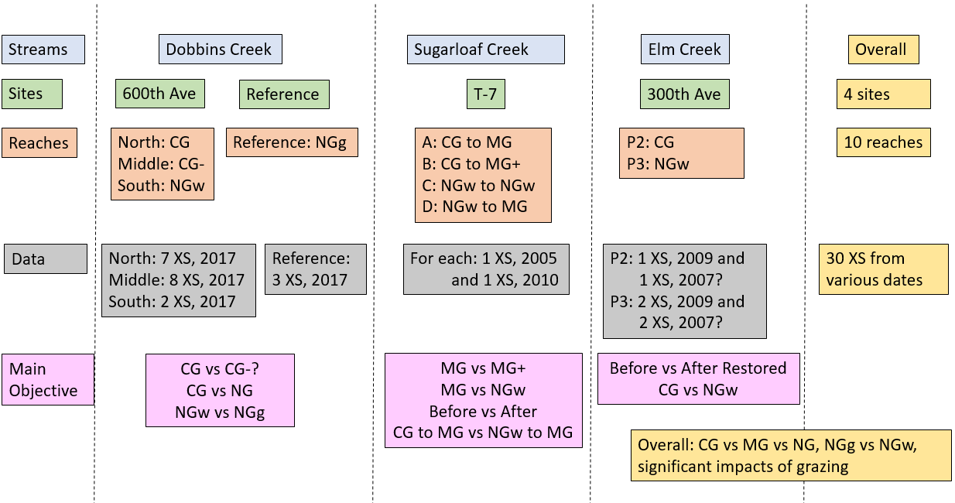
Objectives
Literature Review
Methodology
Findings
Conclusions
Notes:
This figure summarizes the data included in this study. XS stands for cross-section.
There were three streams: Dobbins, Sugarloaf, and Elm.
On Dobbins, two sites were studied.
The main objectives that were studied using this data are listed at the bottom. For example, for the 300th Ave reach of Elm creek, the data was used to evaluate the stream channel before and after restoration, as well as comparing conventional grazing to a wooded non grazing area.
By combining these comparisons and observations, conclusions can be drawn regarding the different types of grazing.

Slide 27
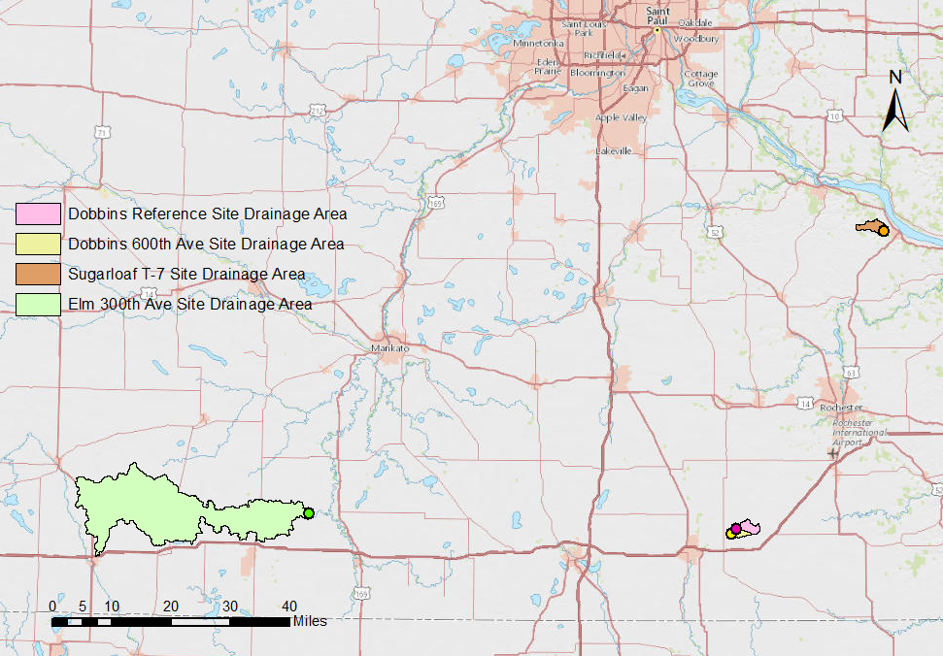
Objectives
Literature Review
Methodology
Findings
Conclusions
Notes:
Sites introduction:
This is a map of the sites included in my study, intended to give you an idea of where they are located in this region and in relation to eachother.
Four sites on three different streams were included in this study: the reference reach of Dobbins Creek in pink, the 600th Ave reach of Dobbins Creek in yellow, the T-7 reach of Sugarloaf Creek in orange, and the 300th Ave reach of Elm Creek in green.
The shape represents the drainage area included and the dot is the point furthest downstream for that reach.
We’ll be going through an introduction of each site, then discussing the results from that site. At the end, I will talk about the overall dataset results.

Slide 28
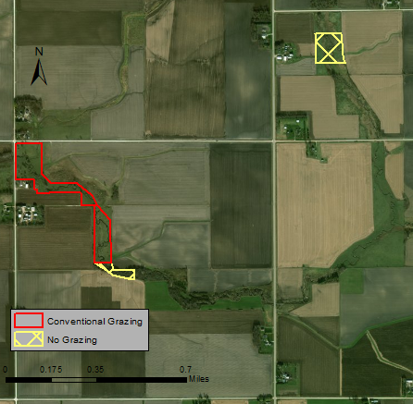
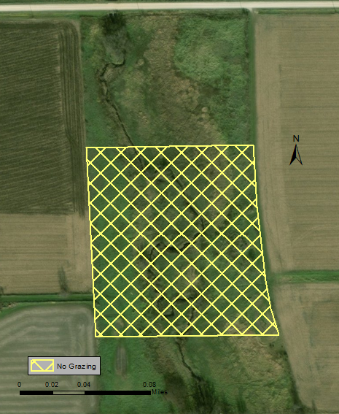
Dobbins: Reference Reach (NG)
Objectives
Literature Review
Methodology
Findings
Conclusions
Notes:
The first site is the reference reach of Dobbins Creek. It is a grassed, nongrazed site. This is upstream of the 600th Ave site, shown on the map on the left. The water is flowing from the north to the south. This site was recommended by the DNR as the closest thing to a reference reach for this region.

Slide 29
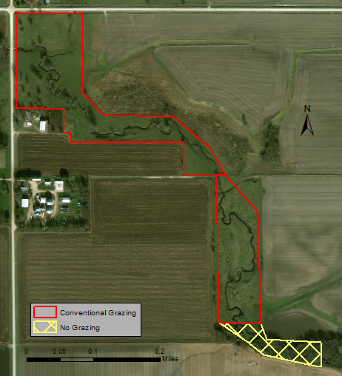
Dobbins: 600th Ave
Objectives
Literature Review
Methodology
Findings
Conclusions
Notes:
The 600th Ave reach is downstream of the reference reach. It is split into three sites; the northern and middle reaches are CG while the southern reach is NG and wooded. The flow is from the southeast towards the northwest. Historically, the landowner has used the riparian area as pasture for 12 to 14 calf-cow pairs of Angus beef cattle. For the past 20 years, the grazing management strategy has been to openly graze the cattle in the riparian area during the warm seasons. This site represents traditional landowner behavior regarding management of riparian areas with livestock present.

Slide 30
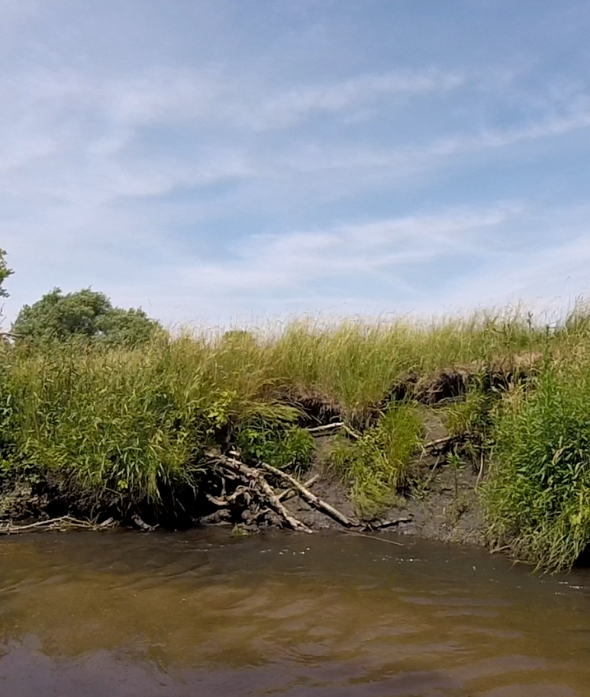
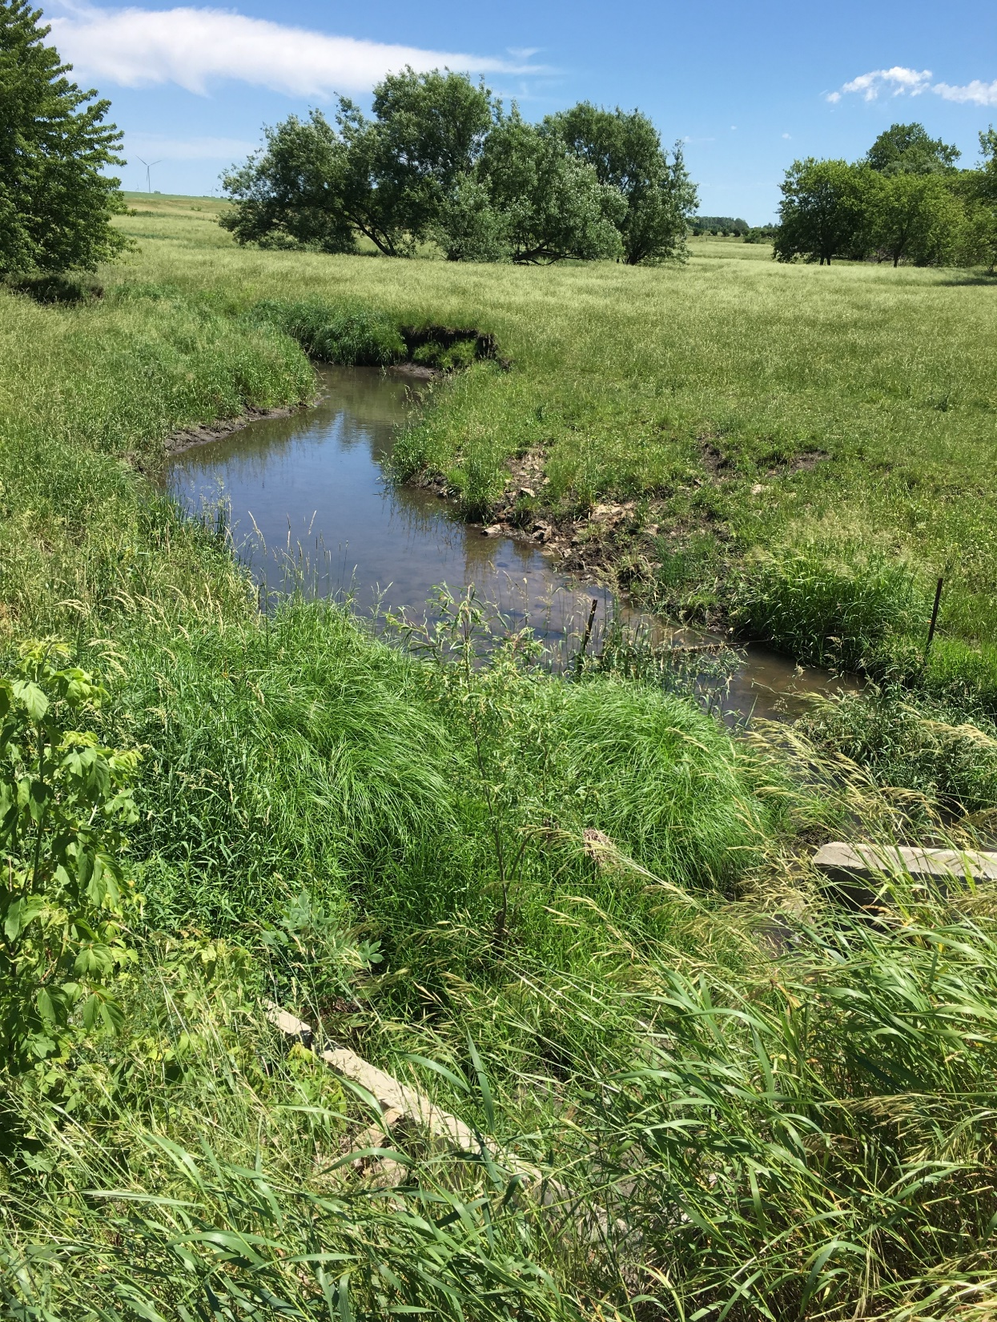
600th Ave: Northern (CG)
Objectives
Literature Review
Methodology
Findings
Conclusions
Notes:
Here are some pictures of the northern reach, which hosts cattle for all of the summer months. You can see where the cattle enter and cross the channel, from the exposed soil and slumped banks.

Slide 31
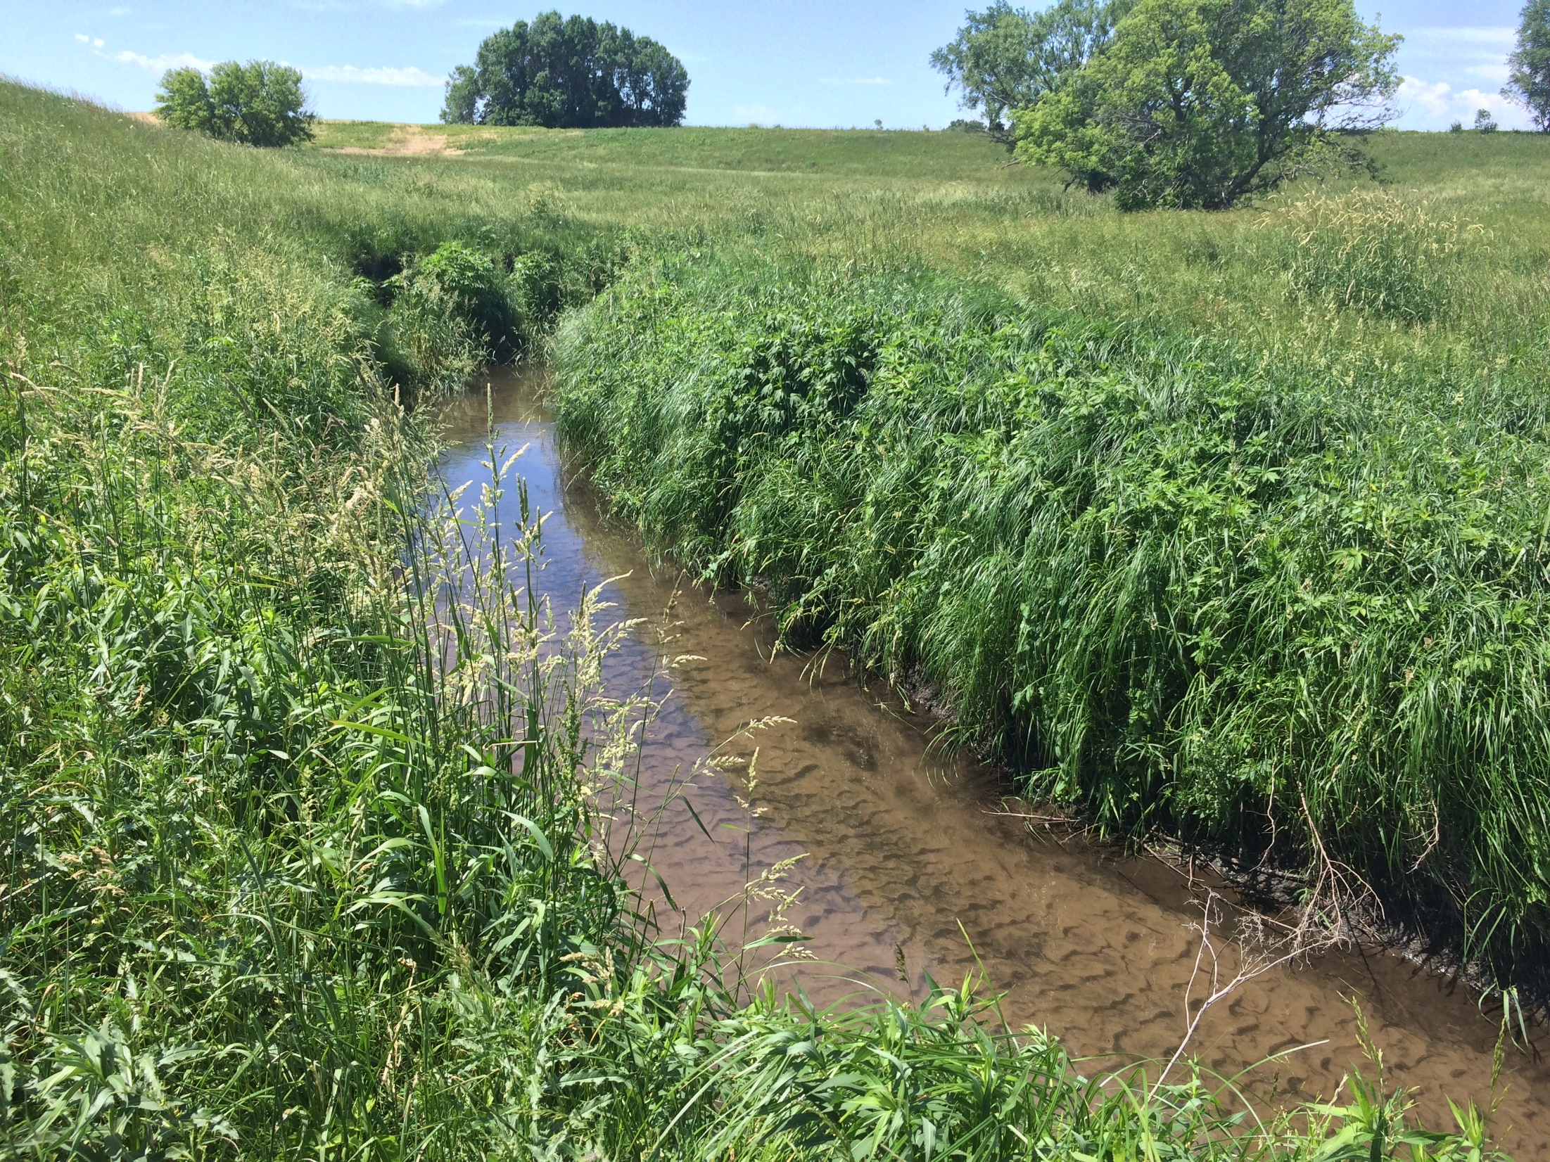
600th Ave: Middle (CG)
Objectives
Literature Review
Methodology
Findings
Conclusions
Notes:
The middle reach is usually grazed one or two months less than the northern reach, depending on the severity of the grazing and the condition of the pasture there. Note the extreme sand/silt deposition in the bed.

Slide 32
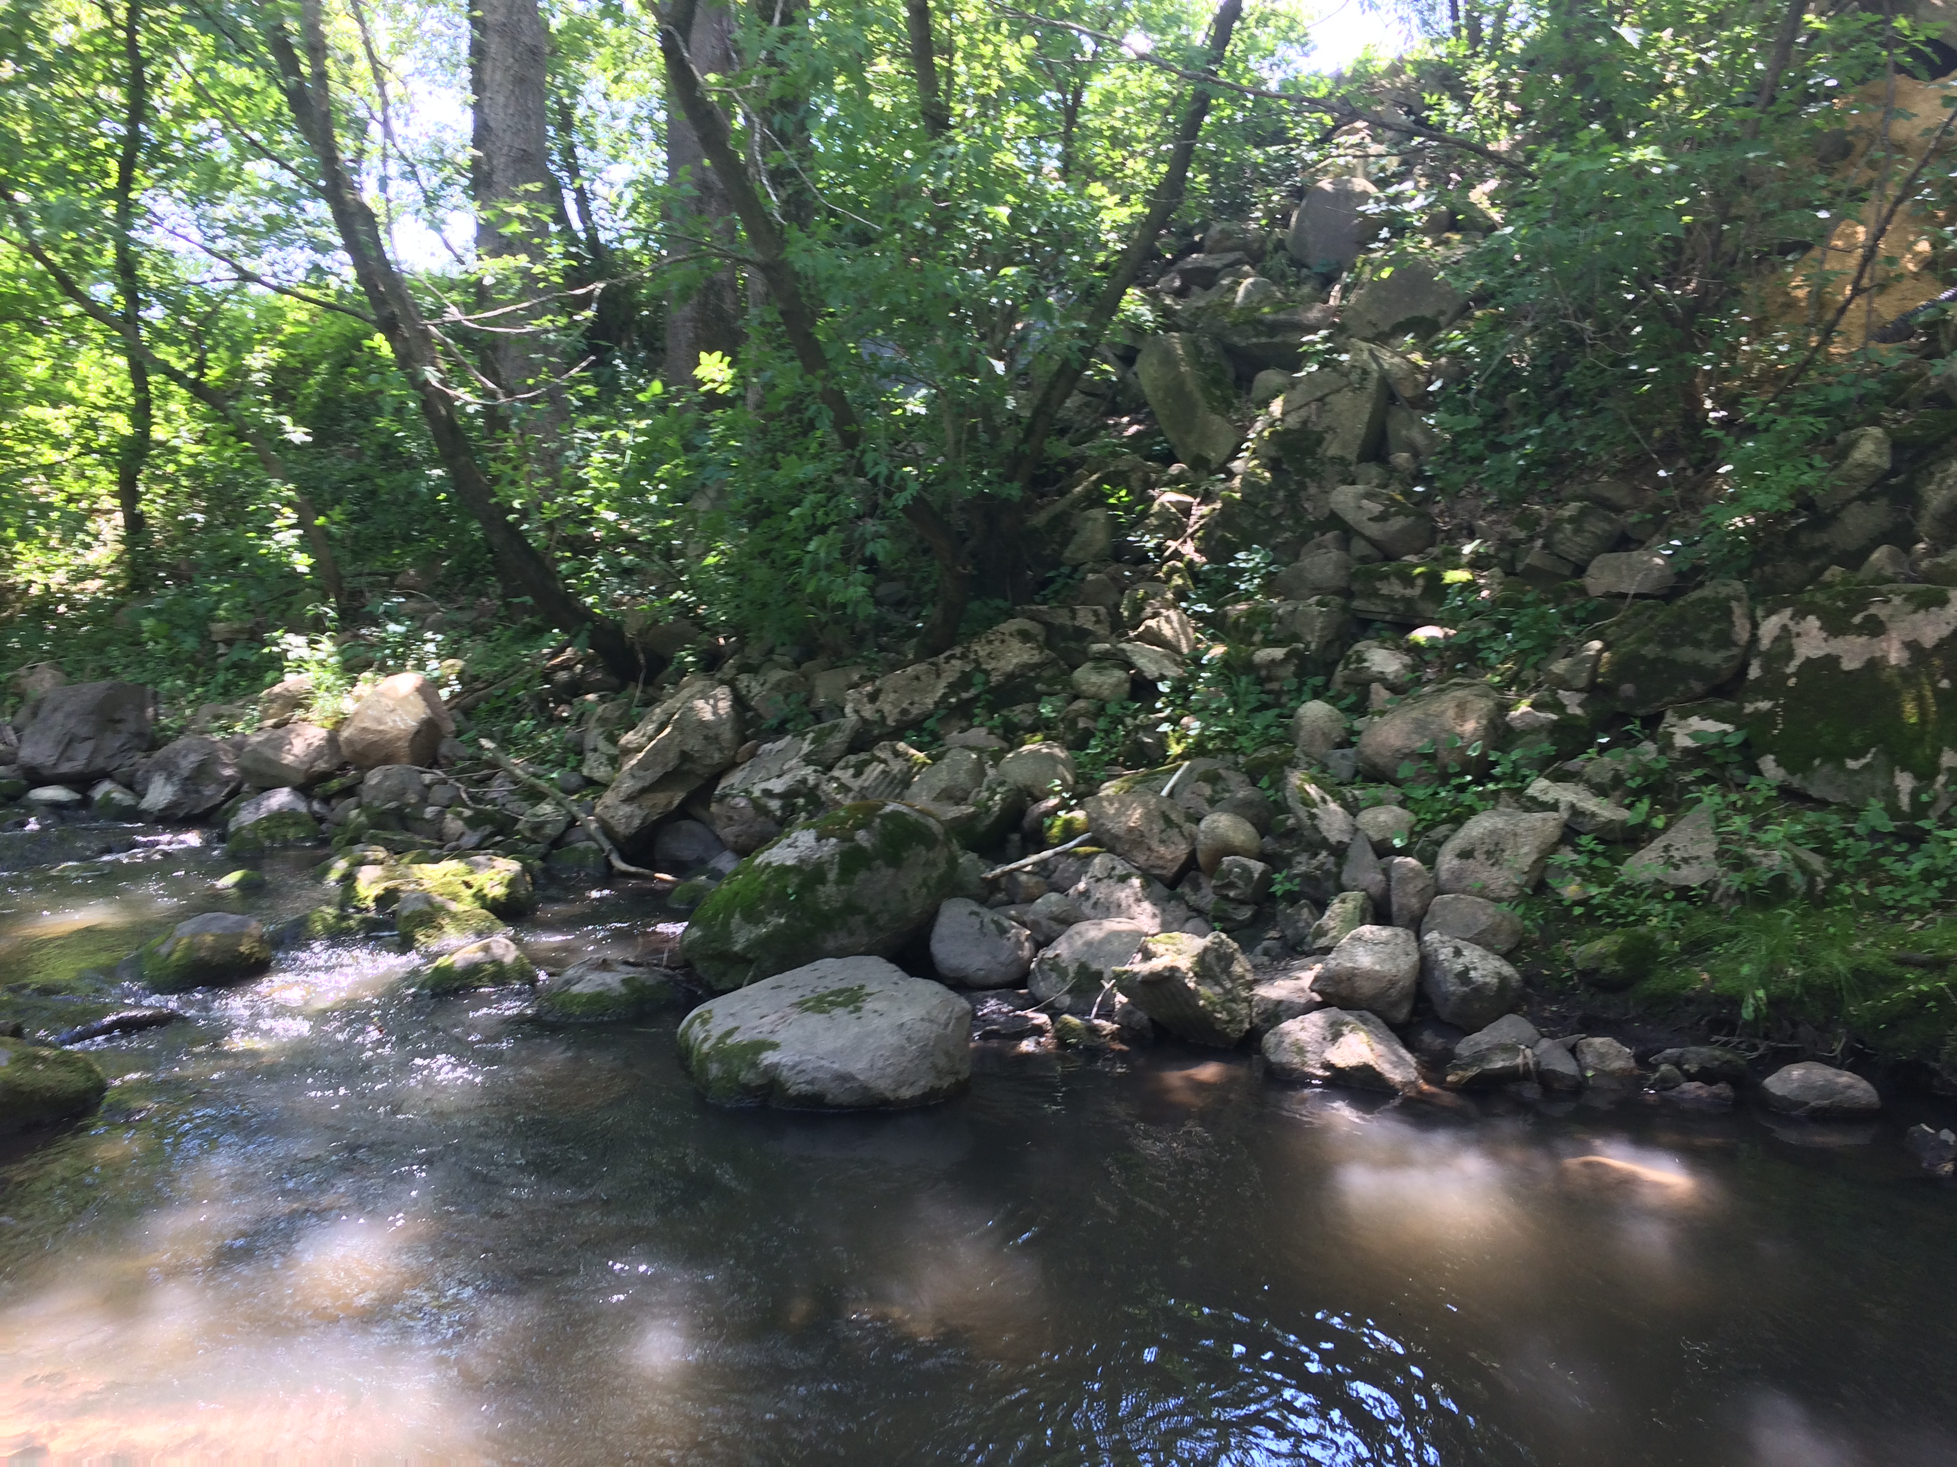
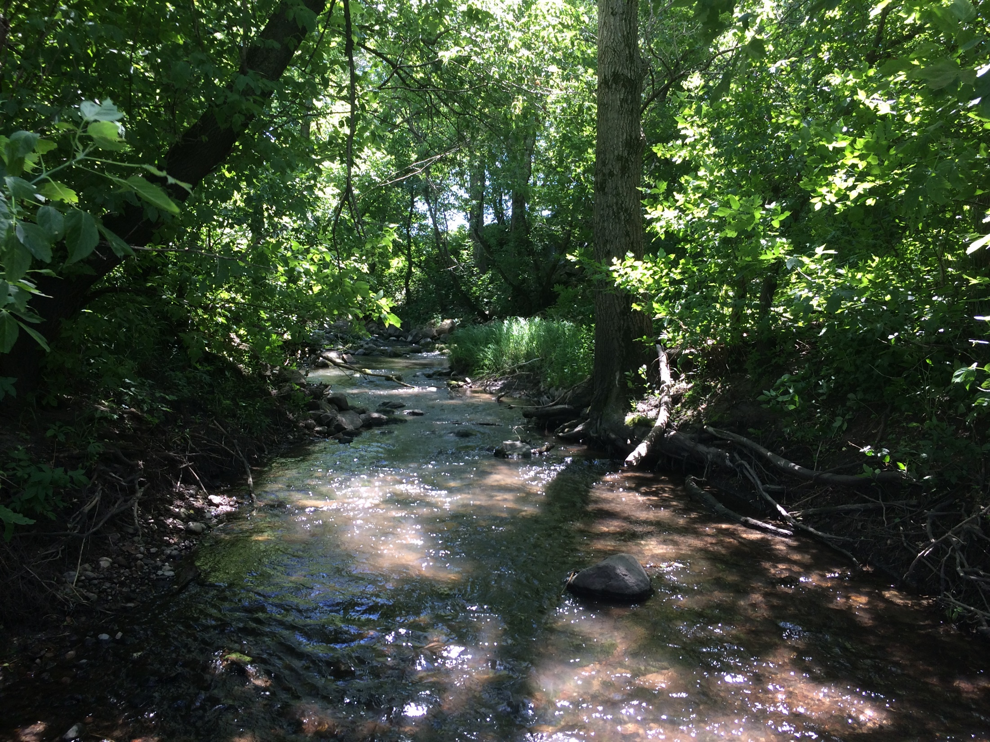
600th Ave: Southern (NG)
Objectives
Literature Review
Methodology
Findings
Conclusions
Notes:
The southern reach is a wooded corridor between two fields, with steeper slopes and manmade rip rap. Due to these conditions, grazing has never occurred in this section.

Slide 33
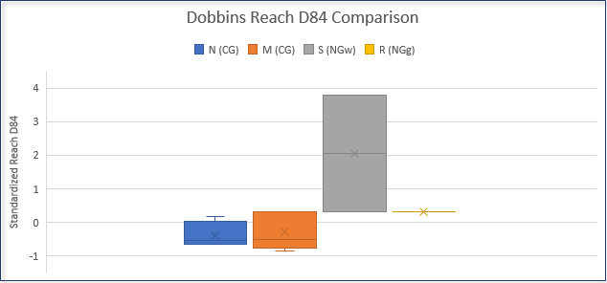
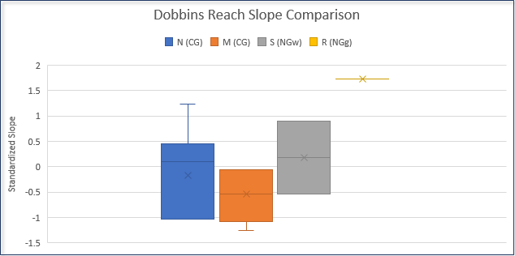
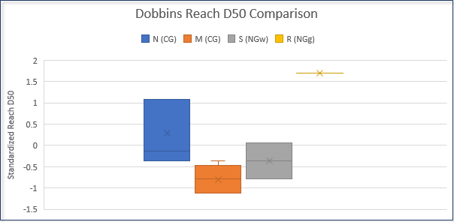
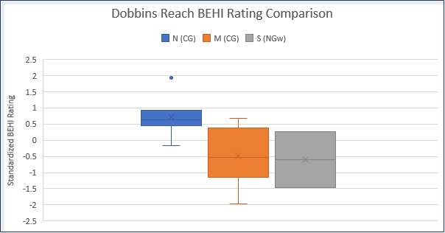
Objectives
Literature Review
Methodology
Findings
Conclusions
Notes:
While the middle section is generally grazed about one month less than the northern section each year, no significant disparity between the two CG sections was found.
The CG areas had significantly smaller particle sizes and higher BEHI ratings than the grassed NG section. The slopes were also significantly flatter at the CG sections. These attributes indicate greater suspended fine sediments, greater bank erosion, and a less stable at the CG sections than the wooded or grassed NG sections. Flatter slopes may indicate less diversity in bed features and aggradation of fine sediments. These slopes, as well as the greater depths and widths of channels in the CG sections, could be attributed to the effects of cattle trampling and exposing banks.
While grassed, the CG sections showed poorer results than the wooded NG section. However, grassed NG was better than wooded NG for all parameters except for the reach D84 measurement.
Unfortunately, no BEHI rating data was available from the reference reach.

Slide 34
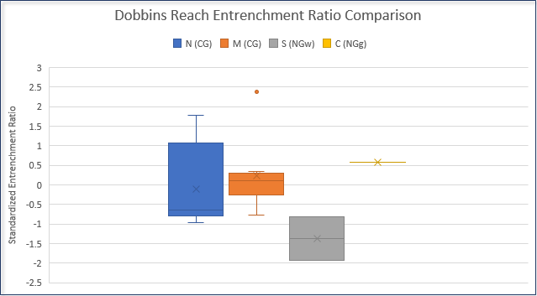
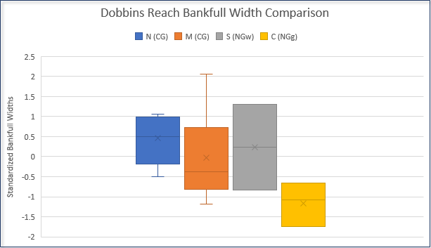
Section Averages | Bankfull Width (ft) | Bankfull Depth (ft) | Width-depth Ratio | Entrenchment Ratio | Reach D50 | Reach D84 | BEHI Rating
Northern (CG) | 21.09 | 2.18 | 10.24 | 4.18 | 0.38 | 3.1 | 38.24
Middle (CG) | 18.18 | 2.22 | 9.08 | 4.73 | 0.15 | 3.64 | 31.63
Southern (NGw) | 19.75 | 2.23 | 9.7 | 2.07 | 0.24 | 15.6 | 31
Reference (NGg) | 11.55 | 1.91 | 6.12 | 5.3 | 0.68 | 6.62 | N/A
Objectives
Literature Review
Methodology
Findings
Conclusions
Notes:
Compared to the grassed NG reference reach further upstream, the 600th Ave sites had larger widths but similar depths, resulting in much larger bankfull areas and width-depth ratios.
The reference reach had the least entrenchment, or highest entrenchment ratio, and larger D50 particle sizes indicating that the reference site may have more defined bed features and less fine sediments. The large D84 value for the southern reach is likely due to the manmade riprap.
The CG areas were observed to have little vegetative cover and low vegetative diversity.
At several spots along the sections, the banks had collapsed due to livestock crossing the stream and many other areas were trampled and the soil compacted.
Based on the comparison among Dobbins sites, it could be concluded that the grassed NG sections have healthier channels than wooded NG sections, while both NG sites are healthier than the CG sections.
The entrenched nature of the southern reach can likely be attributed to its location and the manmade influence of riprap.

Slide 35
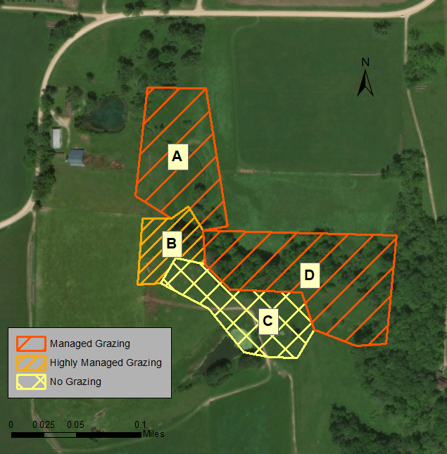
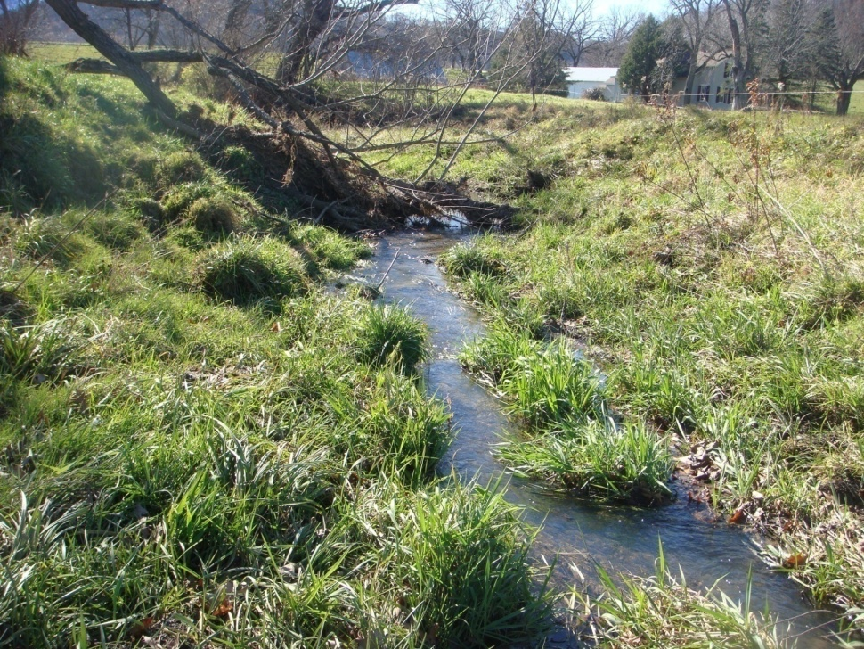
Sugarloaf: T-7 Reach
A – CG to MG (2 days per 3 months)
B – CG to MG (2 days per 1 year)
C – Stayed NG
D – NG to MG (2 days per 3 months)
Site A: Before, 2005
© Cristina Lopez-Barrios
Objectives
Literature Review
Methodology
Findings
Conclusions
Notes:
The T-7 reach landowner wanted to test grazing strategies, and did so by managing four different sections of pasture separately. Unlike the 600th Ave reach, grazing was much more restricted. This site had 155 acres for grazing 40 non-dairy Pinzgauer cow-calf pairs.
Data collection occurred in 2010. This data is compared to the data collected in 2004 and 2005, before the management changes, showing the difference these changes have had on the area for about five years.

Slide 36
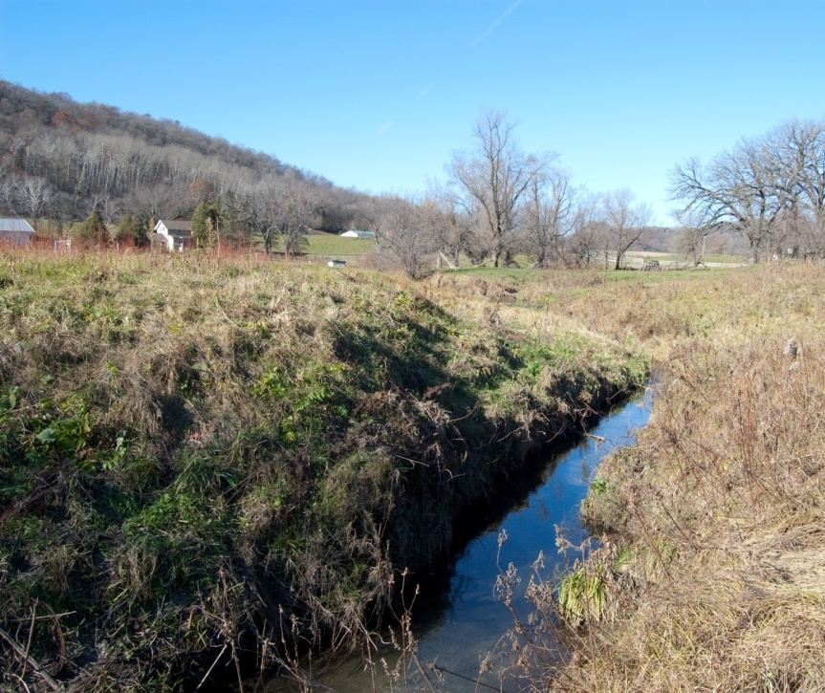
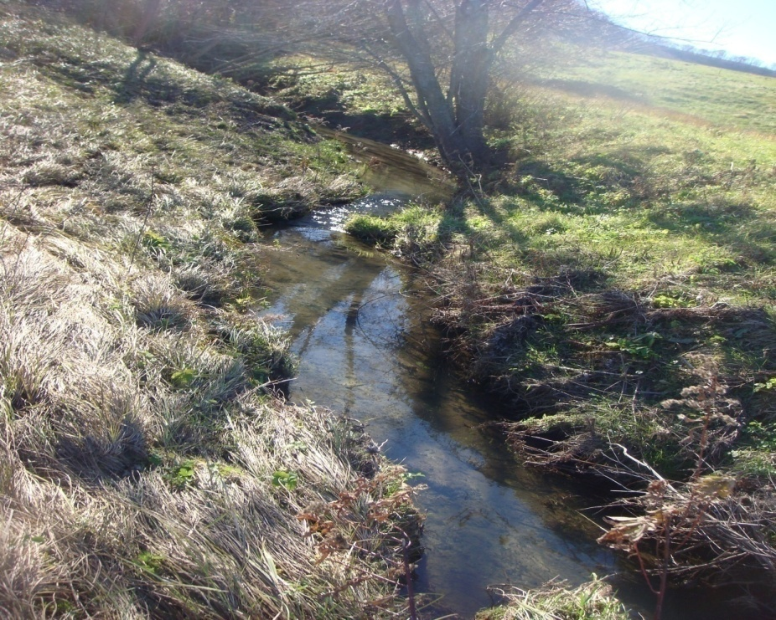
Site B: Before, 2005
Site B: After, 2010
© Cristina Lopez-Barrios
Objectives
Literature Review
Methodology
Findings
Conclusions
Notes:
Grazing strategies were changed from CG to MG at sites A and B. Site A allowed grazing for three days every two months while site B only allowed grazing for three days per year.

Slide 37
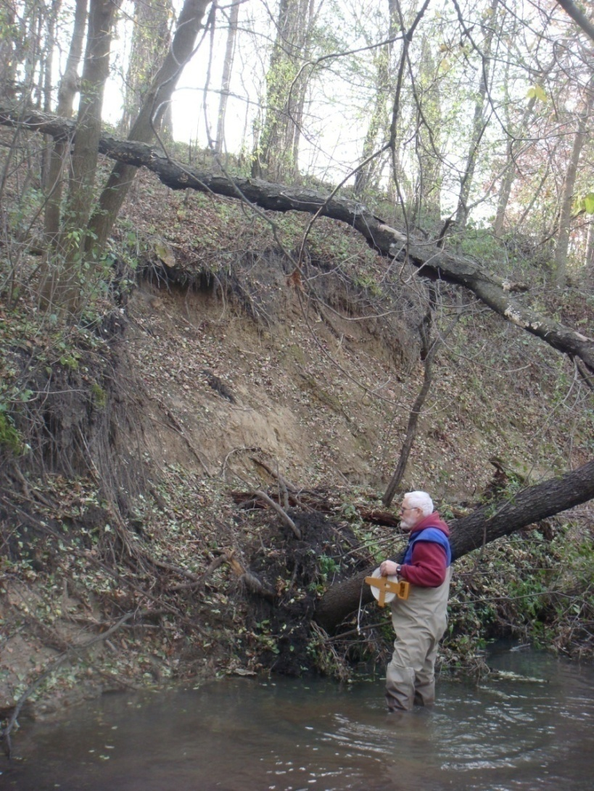

Site C: Before, 2005
Site D: Before, 2005
© Cristina Lopez-Barrios
Objectives
Literature Review
Methodology
Findings
Conclusions
Notes:
Site C was managed as NG since 1967, and a section of it was turned into Site D in 2005, which has since been grazed three days every two months just like site A.

Slide 38

Site D: After, 2010
© Cristina Lopez-Barrios
Objectives
Literature Review
Methodology
Findings
Conclusions
Notes:
And here is a photo after at site D, where they’ve removed some of the trees to make room for cattle to graze.
The differences before and after cannot be seen very well visually. The data is much more telling.

Slide 39
Geomorphological Results
Section | Average Channel Width (ft) | Average Pool Depth (ft) | Average Pool Length (ft) | Width-depth Ratio
A | 6.89 | 3.49 | 85 | 14.3
B | 7.08 | 1.99 | 14 | 20.8
C | 10.83 | 3.35 | 13.3 | 9.4
D | 6.77 | 2.65 | 38 | 11.3
Objectives
Literature Review
Methodology
Findings
Conclusions
Notes:
The changes in site A were desirable. A reduction in the depth of fine sediments is good for aquatic habitat and indicates less erosion. Smaller width-depth ratios are also associated with less erosion and bank stress. A larger distribution of particles may not always be positive, but combined with the reduction in fine sediments, it could indicate more diversity in the bed features and healthier bed habitats.
Site B saw some conflicting changes. While it saw a larger distribution of particles, the width-depth ratio also increased which indicates more stress on the banks. However, the depth of fines drastically decreased here, so perhaps the widening of the channel is not associated with erosion or fine sediments in this situation.
Large changes were observed at site C, where the channel widened and created a new floodplain within the old channel. This is likely due to the channel progression that occurred in the 5 year period. A new channel forming within the old one is a common progression. The decrease in particle sizes may be due to the vulnerable new banks, though the depth of fines is lower as well, indicating that the fine sediments are not being deposited here.
Site D saw reduced bank slopes and a narrower channel. The decrease in particle sizes is similar to site C, and may be due to the sites’ previous conditions as a wooded, non-grazed area. D was the only site to see an increase in the depth of fines, perhaps due to the change it saw from losing trees and going from NG to MG.

Slide 40
A vs B vs C vs D
Ground Cover Compositions
Section | Tree % | Bush % | Grass % | Herb % | Bare %
A (MG) | 3.08 | 7.24 | 18.68 | 56.65 | 14.24
B (MG) | 4.15 | 2.67 | 23.74 | 59.64 | 9.8
C (NG) | 5.25 | 1.1 | 4.01 | 26.43 | 63.21
D (MG) | 3 | 4.18 | 12.73 | 50.69 | 29.4
Geomorphological Results
Section | Average Channel Width (ft) | Average Pool Depth (ft) | Average Pool Length (ft) | Width-depth Ratio
A | 6.89 | 3.49 | 85 | 14.3
B | 7.08 | 1.99 | 14 | 20.8
C | 10.83 | 3.35 | 13.3 | 9.4
D | 6.77 | 2.65 | 38 | 11.3
Objectives
Literature Review
Methodology
Findings
Conclusions
Notes:
Overall, the areas that were turned into MG saw higher vegetative cover, better bank stability, lower risk of erosion, narrower channels, larger pools, and larger particle sizes than the NG section of site C. The NG section had the highest % bare ground, lacking in bush and grass coverage compared to the other areas.
This type of intensive management, at least for this site, has shown improvements in the stream channel.
Greater vegetative cover is desirable to prevent erosion of the banks and fine sediment deposition. More stable banks and narrower channels are great examples of improvements in stability. Lastly, larger pools indicate a healthier bed feature pattern and greater habitat for aquatic life. On average, switching from CG, as shown in sites A and B, or from NG, like in site D, showed improvements over the observed five year period, more so than keeping an area as NG, represented by site C. While this is a very site-specific study, areas similar in geography and hydrogeology to this site can benefit from and improve on these results.

Slide 41

Elm: 300th Ave Reach
© Britta Suppes
Objectives
Literature Review
Methodology
Findings
Conclusions
Notes:
The 300th Ave reach site underwent a large-scale restoration in 2007. The photo on the left shows what the stream looked like prior to the restoration. The map on the right shows what it looks like more recently. Note some changes: the sediment bar in phase 2 is gone, and the bank has been reshaped. The blue rectangles represent cattle crossing locations.
The reaches for phases 1 and 2 belong to one landowner, while phase 3 of the project belongs to someone else. Following the completion of this project, the two landowners resumed their practices. Phase 3 returned to being NG while phases 1 and 2 returned to CG of Hereford and Angus cattle. Cattle weren’t allowed on the west bank now due to the oxbow being reconnected, but were allowed to access the east and south banks using the cattle crossings.
Data is available prior to the project as well as after. This site allows for direct comparison of grazing and non-grazing impacts at a site that has recently been restored.

Slide 42
Phase 1: Before, 2007
Phase 1: After, 2008
© Britta Suppes
Objectives
Literature Review
Methodology
Findings
Conclusions
Notes:
These are before and after pictures of phase 1.
There was no riparian buffer, minimal vegetation, and heavily compacted soils.
Restoration included revegetating and reshaping the banks and stabilizing the cattle crossing.
Grazing returned to this reach in 2009. I wish I had pictures of this site more recently, but I was only able to get to the site in the winter and the snow prevented any good comparisons from being made.

Slide 43
Phase 2: Before, 2007
Phase 2: During, 2007
Phase 2: After, 2008
© Britta Suppes
Objectives
Literature Review
Methodology
Findings
Conclusions
Notes:
Phase 2 is similarly impacted by grazing.
Restoration included reconnecting an old oxbow to reduce the energy of the flow during high water levels, by constructing a cross vane to redirect some flow into the oxbow. The sediment bar was also removed.
The last photo looks beautiful, but once grazing returned in 2009, much of this vegetation was destroyed. This is apparent in the dataset.

Slide 44
Phase 3: Before, 2007
Phase 3: During Construction
© Britta Suppes
Objectives
Literature Review
Methodology
Findings
Conclusions
Notes:
Phase 3 had a large undercut bank that was bleeding sediment and quickly eroding.
Restoration included 6 log vanes, to deflect the flow energy away from the bank. The bank was also revegetated and reshaped, and root wads were placed for more stability.

Slide 45
Phase 3: After, 2008
Objectives
Literature Review
Methodology
Findings
Conclusions
© Britta Suppes
Notes:
Grazing never returned to this site, so it looks like this now.
Without the pressure of constantly grazing livestock, the sandbar willows on this site have flourished, and the bank cover is much higher than before. In addition, the log vanes have successfully been deflecting the flow, preventing scouring and resulting in shallower pools.

Slide 46
Pre-restoration data: 2006
Restoration: 2007-2008
Post-restoration data: 2009
Phases 1 and 2 vs Phase 3
Section | Bankfull Width (ft) | Bankfull Depth (ft) | Width-depth Ratio | Entrenchment Ratio
Phase 1 and 2 (2009) | 64.15 | 3.725 | 17.8 | 5.34
Phase 3 (2009) | 60.51 | 3.69 | 16.68 | 7.26
Before vs After
Phase 1: CG, Restoration, CG
More entrenched
Narrower channel
Phase 2: CG, Restoration, CG
More entrenched
Wider channel
Phase 3: NG, Restoration, NG
No big changes
Shallower depths
Better bank stability
Geomorphological Results
Section | Bankfull Width (ft) | Bankfull Depth (ft) | Width-depth Ratio | Entrenchment Ratio
Pre-restoration (2006) | 65.6 | 4.47 | 14.7 | 7.62
Phase 1 (2009) | 57.7 | 3.92 | 15.6 | 4.85
Phase 2 (2009) | 70.6 | 3.53 | 20.01 | 5.84
Phase 3 (2009) | 60.51 | 3.69 | 16.68 | 7.26
Objectives
Literature Review
Methodology
Findings
Conclusions
Notes:
A visit to the 300th Ave restoration site at the end of February of 2018 provided key observations. Data was also analyzed against a pre-restoration survey.
The main differences shown by the data is in the width-depth and entrenchment ratios. All other factors remained fairly constant despite the restoration project and the grazing.
Phase 2 saw the greatest increase in width-depth ratio, likely due to the widening channel after the sediment bar was moved as well as the continued erosion of the banks from the grazing.
Phases 1 and 2 became more entrenched, while phase 3 remained in nearly the same state.
For phase 2, the cross vane that is supposed to redirect the flow to the oxbow is suffering from aggradation. Sand is building up at the entrance and along the oxbow channel, reducing the amount of water entering. Eventually, this will become completely blocked off again. No willows were seen, as much of the vegetation had been destroyed before it had a chance to establish.
Keeping the livestock from grazing in the restored area until the bank revegetation project had time to establish may have mitigated the impact. Implementing a MG strategy may have been even more effective, pruning the willows to promote more shoot growth and allowing grasses and forbs to grow by keeping larger shrubs and trees in check.
I wish that percent ground cover surveys had been done here as well, like for the T-7 reach of Sugarloaf creek.

Slide 47


Overall Comparison
Conventional Grazing | Managed Grazing | Non Grazing
Most entrenched | Least entrenched | In-between
Flattest slopes | Steepest slopes | In-between
Highest BEHI Rating | Lowest BEHI Rating | In-between
In-between | Largest W/D Ratio | Smallest W/D Ratio
Smallest particle size range | Largest particle size range | In-between
Objectives
Literature Review
Methodology
Findings
Conclusions
Notes:
Between CG, MG, and NG overall, statistical significant differences were found in entrenchment ratios and slope. Between CG and MG, the difference in entrenchment ratios was statistically significant. CG sites were the most entrenched, while MG sites were the least entrenched.
For slope, MG had the steepest slopes while CG had the flattest slopes. While this may be due to differences in the site locations, it could mean that MG has led to better bed feature patterns, since transitioning between pools and riffles require changes in slope.
While not statistically significant, there were other differences that are still noted to be of importance, and are in italics in the table here.
CG sites had the highest BEHI rating, or risk of erosion, MG sites had the lowest ratings.
WD was smallest at NG but largest in MG, showing that excluding cattle still has it’s advantages, and that MG is not without shortcomings.

Slide 48




Non Grazing Comparison
Objectives
Literature Review
Methodology
Findings
Conclusions
Notes:
The data between nongrazed areas shows that grassed areas have smaller width-depth ratios, are less entrenched, and have steeper slopes. However, while they have larger D50 particles, they tend to have smaller D84 sizes.
This could mean that grassed areas are more desirable for stabilizing banks, but some woody species are desirable for creating habitat and preventing excess fine sediments. It should be noted that overall, the streams for the grassed sites were smaller, which may account for some of the differences in width, depth, and particle sizes.
Between the NG sites, it seems that grassed sites have healthier channels than wooded sites. Grassed sites had lower width-depth ratios, higher entrenchment ratios, and larger D50 particles indicating that there is less fine sediment.

Slide 49
Regression
1. Flood-prone area width as a predictor for width-depth ratio.
2. Drainage area, bankfull depths, and D84 particle size as predictors for bankfull width.
Objectives
Literature Review
Methodology
Findings
Conclusions
Notes:
Four regression models were run.
Larger flood-prone areas having greater width-depth ratios is expected, as receiving flow from greater areas during large storm events means that those streams will carve out wider rivers.
Bankfull width was expected to be related strongly to drainage area and bankfull depths, but it is interesting to find that the D84 particle size plays a role as well. This suggests that larger particles in the channel result in larger bankfull widths. This is the case for channels with deeper maximum depths and larger drainage areas as well. However, deeper mean bankfull depths result in narrower bankfull widths. It seems that while deeper maximum depths are related to widening, a deeper mean depth is the opposite. This result is likely a spurious relationship and there may be another factor that was not considered.

Slide 50
Regression
3. Drainage area, slope, and D84 particle size as predictors for entrenchment ratio.
4. Drainage area, hydraulic radius, and D50 particle sizes as predictors for BEHI rating.
Objectives
Literature Review
Methodology
Findings
Conclusions
Notes:
It is no surprise that the entrenchment ratio relies on the drainage area and slope of the channel, but the D84 particle size appears again as a significant factor. In this case, a larger D84 decreases the entrenchment ratio, causing greater entrenchment in the channel. This suggests that the promotion or inclusion of larger particle sizes should be reconsidered.
The BEHI rating was found to decrease for larger drainage areas and increase with D50. This is unexpected as larger channels tend to have less stable banks and fewer fine sediments are a result of more stable banks.
The variables of reach D84 and drainage area were found to be significant influences of many main dimensions of a channel. While drainage area is hard to change and the size of a river and its flow are expected to be major factors of its properties, reach D84 stands out as being an unexpected variable that can be managed. The relationships are clearly significant.
Larger D84 particle sizes have shown to be detrimental to a stable channel. This is the opposite of what is expected. Generally, larger D84 particles sizes are desirable for stability, habitat, and indicates erosion has lessened. Another explanation of this result is that it could be due to higher flows or large recent storm events that have washed away the finer particles. This could mean that the channel was eroding and unstable prior to the disturbance, as such an event would have a greater effect on an area with previous erosion problems. This could have resulted in a greater D84 particle size at the time of data collection. In either case, a larger D84 particle size is connected with a more unstable channel. Further research and study is recommended on precipitation events and how their intensity and duration affect stream channels.

Slide 51
Conclusions
Can managed grazing meet or exceed the benefits of grazing exclusion or restoration projects? In other words, can it accomplish the desired degree of natural restoration?
A: Yes, managed grazing was more beneficial than non grazing for some of these sites.
Is conventional grazing as damaging to ecosystems and bank stability as the literature shows?
A: Yes, conventional grazing resulted in the most entrenched, eroded, and unstable channels.
Is a wooded or grassed stream bank area better for channel health?
A: Grassed bank areas were more advantageous for channel stabilization for these sites.
New: Larger reach D84 particle size may be detrimental to channel stability.
Objectives
Literature Review
Methodology
Findings
Conclusions
Notes:
Revisiting the initial research questions, we now have answers.
For these small southern Minnesota streams, managed grazing can improve bank stability, lower risk of erosion, and improve habitat.
CG sites were clearly shown to be significantly more entrenched and have flatter slopes. This is not desirable for a healthy stream. Greater entrenchment leads to further bank erosion and sediment leakage, and flatter slopes promote deposition of sediment and poor or non-existent habitat. On the other hand, the MG sites showed the best results regarding these two factors.
Managed grazing should be considered more as a realistic, efficient, yet effective strategy for riparian pasture sites. It should be specifically tailored to an individual landowner’s goals and sites.
Nongrazing resulted in healthier sites as well, but consider that it may not be feasible or desirable to some situations and landowners.
Grassed bank areas were more advantageous for these sites, but we cannot say for sure that it will always be better. Careful evaluation of the site and the goals should be made before deciding what is better for any specific project.
Conventional grazing should be discouraged. Overall, it had the severest impacts on the sites. Conventional grazing is damaging to the stability of the channel, accelerates erosion, hurts aquatic habitat, and creates more issues downstream.
Lastly, a larger D84 particle size is connected with a more unstable channel, which was unexpected and warrants further investigation.
It needs to be acknowledged that this study was limited. More data on more sites and from more dates would greatly improve this study. Factors not considered such as plant species compositions, vegetative height, soil composition, nearby land use, and fish and benthic IBI scores may be useful in providing new and further insight into the impacts of grazing.

Slide 52

Future Research
Bed feature creation using log jams, large woody debris, or step pools.
Within managed grazing
Reach D84 relationship with stability
© Public Works Magazine
Objectives
Literature Review
Methodology
Findings
Conclusions
Notes:
Some areas where future research is recommended to expand on this study are bed feature creation, rotational grazing, silvopasture, and more research on the reach D84 relationship with stability found in this study.
Bed feature creation needs further investigation to develop designs that are long lasting, effective, and cheap. Currently, these restoration practices are facing issues with lasting longer than a year and being expensive to implement.
More research on specific types of managed grazing such as rotational grazing and silvopasture would be helpful in exploring the differences between managed grazing types. While this study shows the advantages of managed grazing, it generalizes the different strategies under one category.
Lastly, as I said before, the relationship that the Reach D84 has with stability should be further explored as well.

Slide 53
Thank You
Advisor: Dr. Joe Magner
Committee: Dr. Bruce Wilson and Dr. Chris Lenhart
MN DNR: Brooke Hacker and Jon Lore
Mower SWCD: James Fett and Cody Fox
Special thanks to: Emily Deering, Chelsea Delaney, Mark Greve, Masha Guzner, Emily Johnson, Alex Van Kirk, Douglas Klimbal, Chris Kucek, Patrick Lown, Mose Mclain, John Mueller, Hilary Pierce, Austin Yantes.
Objectives
Literature Review
Methodology
Findings
Conclusions
Notes:
I’d like to thank my advisor, Dr. Joe Magner, as well as my other committee members Drs. Bruce Wilson and Chris Lenhart, for their advice and input with this project.
I am grateful to the staff at the DNR and Mower County SWCD for assisting me with data collection and analysis.
I also would like to thank all of my colleagues and undergraduate assistants who made all of the data collection possible and helped me during the writing process.
Lastly, I want to thank you all your attention and attendance today. I’d love to take any of your questions and comments at this time.

Slide 54

Questions?
Seongjun Kim
kimx3304@umn.edu

