Slide 1
Elevating Engagement with Health Sciences Faculty:
The Implementation of Research Sprints at the University of Minnesota

Slide 2


MEDICAL LIBRARY ASSOCIATION ANNUAL MEETING
Elevating Engagement with Health Sciences Faculty:
The Implementation of Research Sprints at the University of Minnesota
Tuesday, May 7, 2019
Chicago, IL
Session: Innovation and Research Practice
Presentation template by SlidesCarnival
Notes:
Sarah

Slide 3

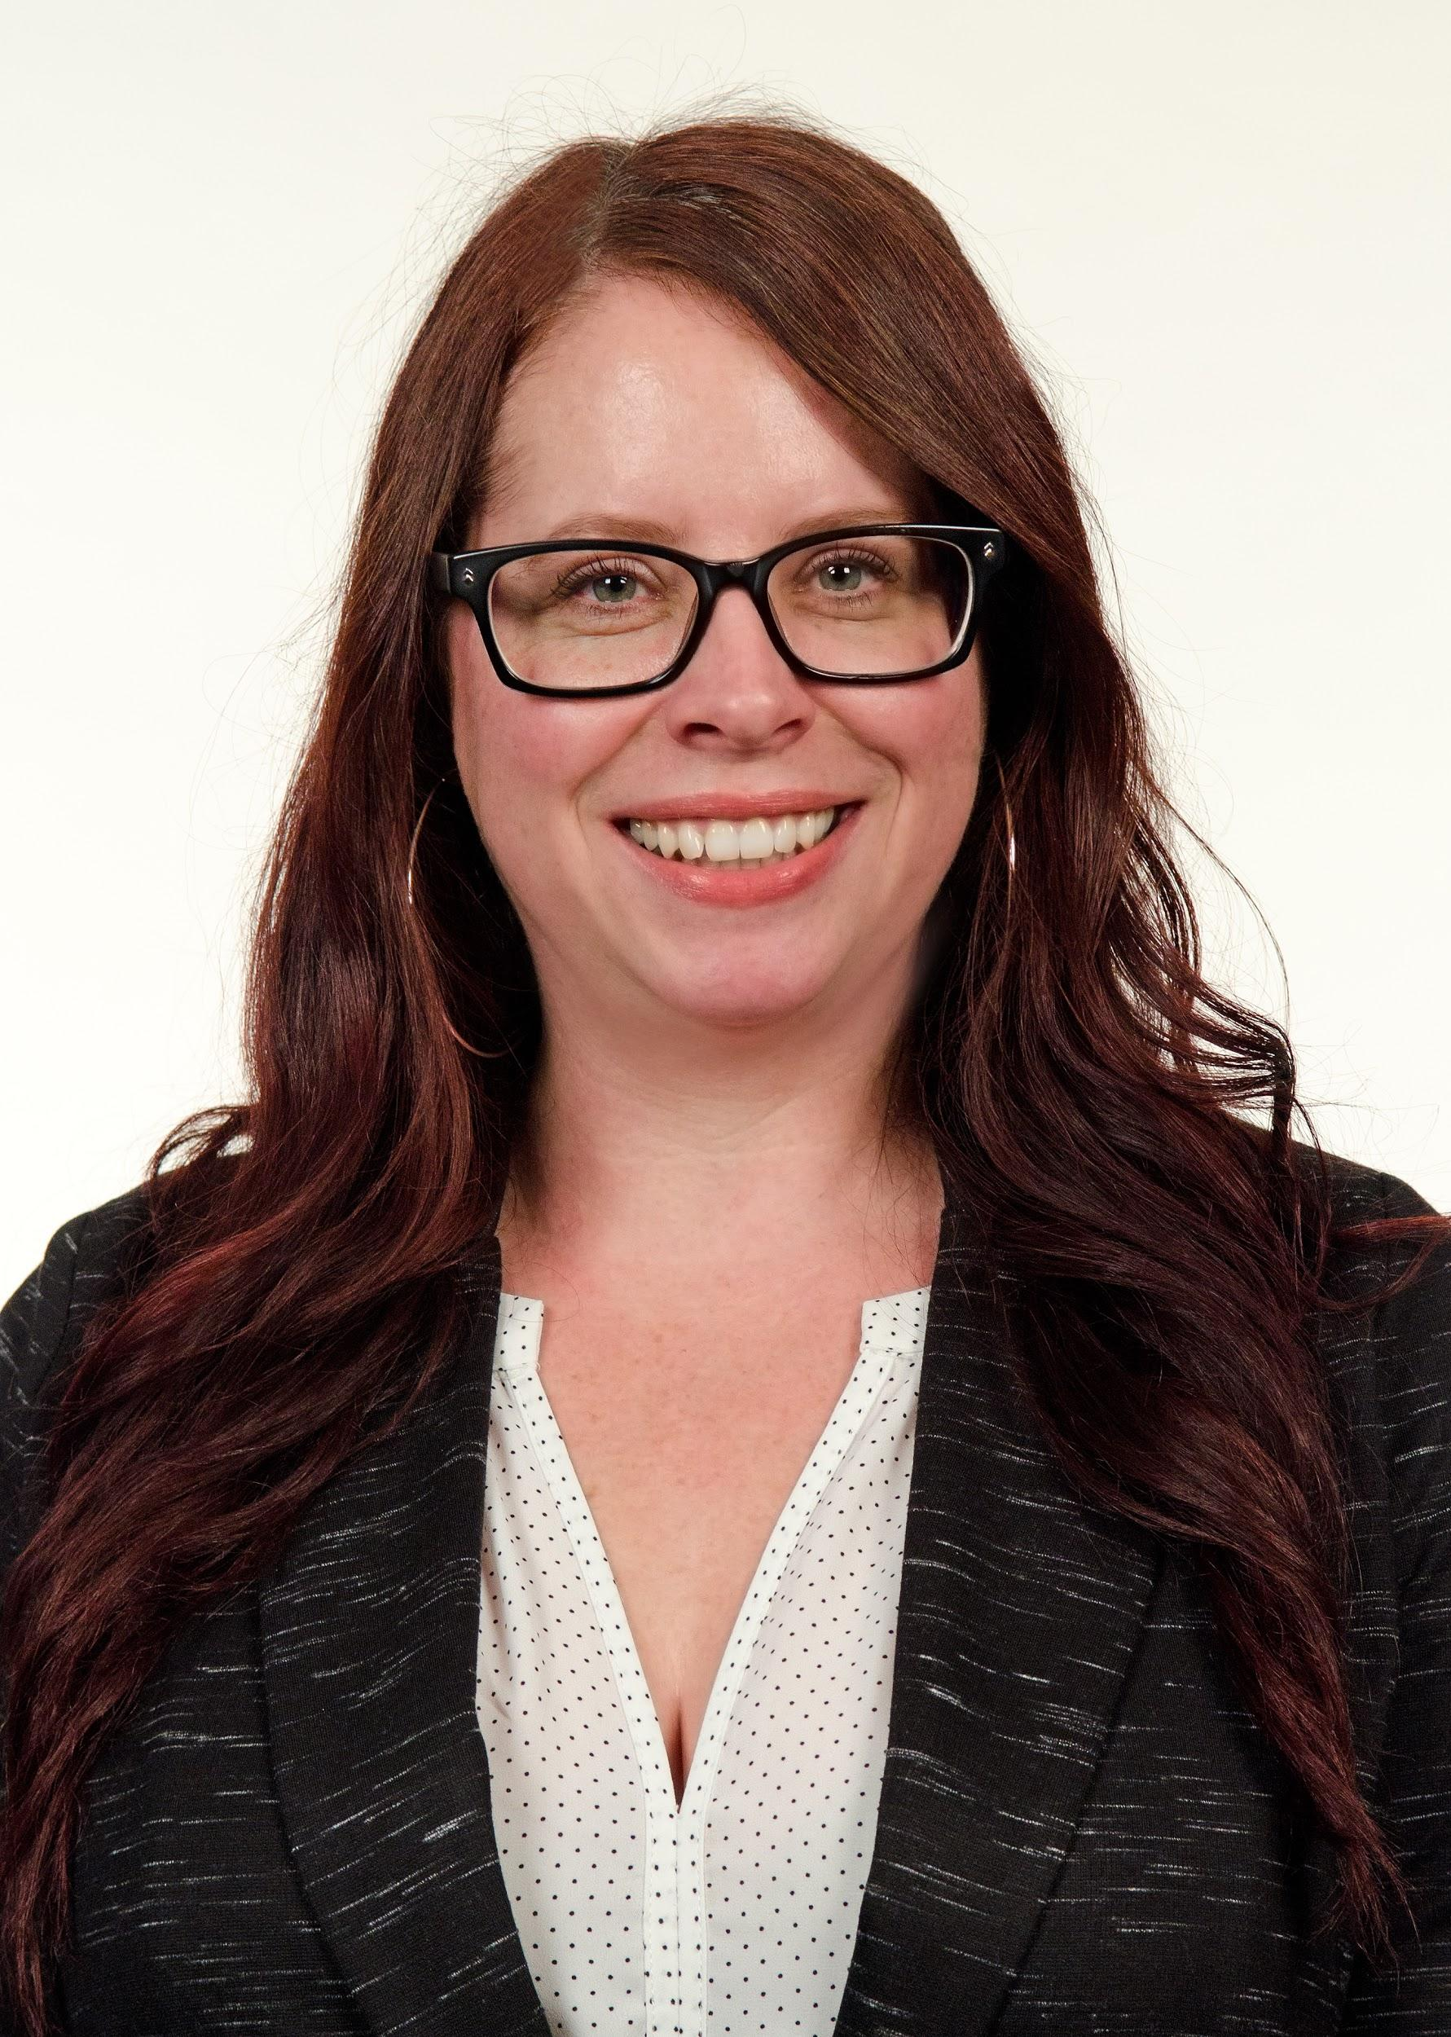
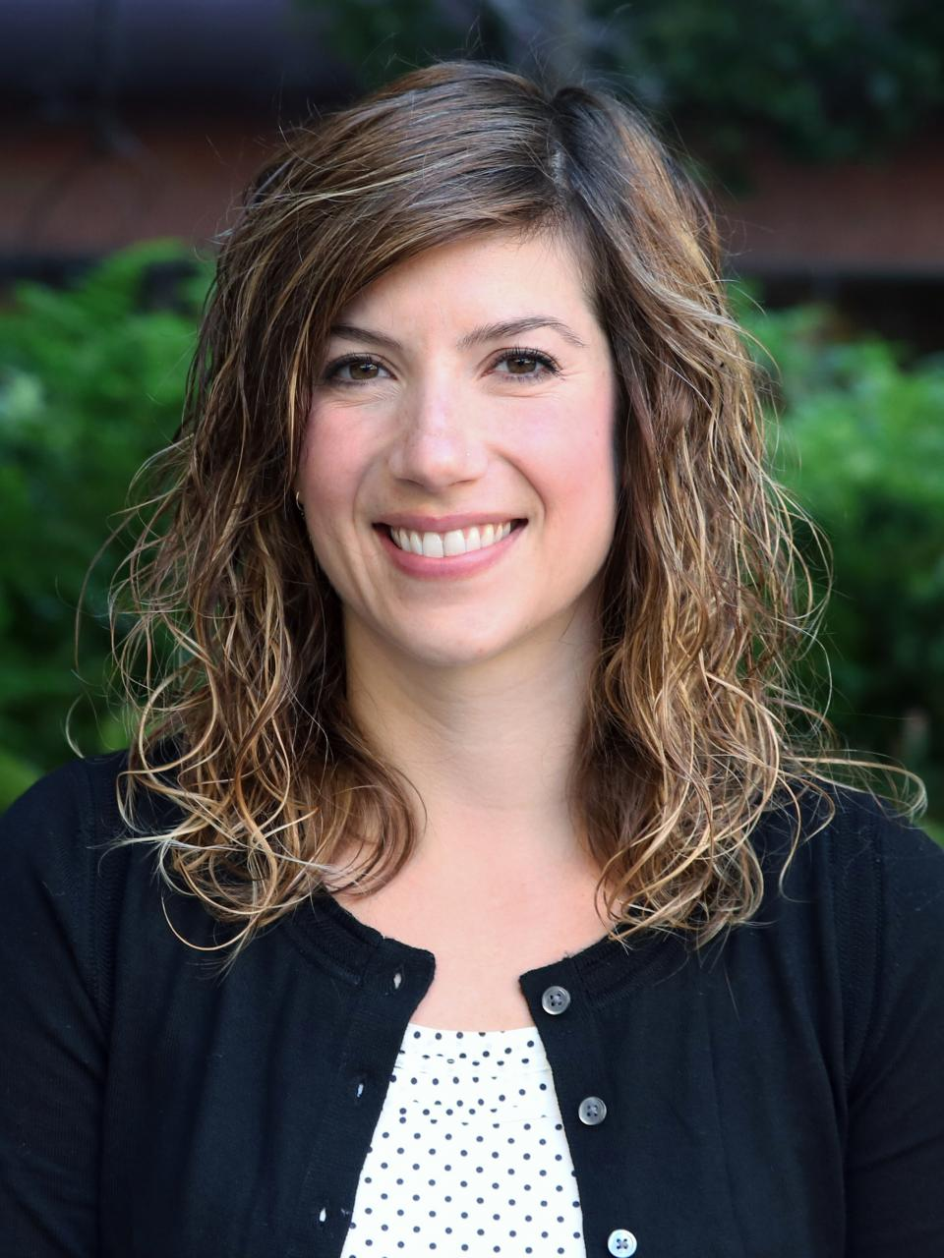
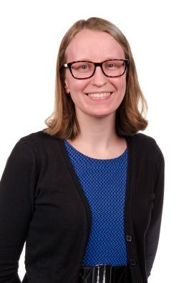
UNIVERSITY OF MINNESOTA LIBRARIES
SHANDA HUNT
Public Health Librarian
SARAH JANE BROWN
Pharmacy Librarian
JENNY MCBURNEY
Social Sciences Librarian
hunt0081@umn.edu
sjbrown@umn.edu
jmcburne@umn.edu
Notes:
Sarah

Slide 4

1. BACKGROUND
Inception, Goals, & Structure of Research Sprints
Notes:
Sarah

Slide 5

Faculty Research Sprints offer faculty the opportunity to partner with a team of expert librarians on a specific project, or component of a broader project. Sprints differ from one-time consultations in their timing and depth of interaction. The intent is for the entire team—faculty and librarians—to work without distractions to produce a tangible product or outcome.
Notes:
Sarah

Slide 6

UNIVERSITY OF KANSAS
First iteration 2016
UMN began consulting with KU shortly after
UMN first iteration May 2017
KU’s Research Sprint website
Notes:
Sarah

Slide 7
UMN RESEARCH SPRINT GOALS
Engage with faculty
Elevate librarians to collaborator status
Advance Libraries’ strategic goals
  Advance University Priorities for Research, Enable Grand Challenges Research & Support Field-Shaping Researchers
  Partner in Teaching and Learning, Reinforce Grand Challenges Curriculum & Engage Field-Shaping Teachers
  Support Reciprocal Engagement With External Communities & Leverage the Distinctive Urban Location of the University
  Embrace Excellence & Reject Complacency in Developing Programs in Support of University Goals
Notes:
Sarah
The Faculty Research Sprints directly relate to Libraries Strategic Goals 1 & 2:
Advance University Priorities for Research, Enable Grand Challenges Research & Support Field-Shaping Researchers
Faculty Research Sprints allow faculty to propel their research forward by offering them a team of information experts coupled with vast resources that include hundreds of electronic databases and unique archives. In the Sprints evaluations, faculty have remarked that the Research Sprints are the perfect kick-off to their summer research endeavors. As a result of the Research Sprints, the Libraries were invited to participate in the 2018 Grand Challenges events.
Partner in Teaching and Learning, Reinforce Grand Challenges Curriculum & Engage Field-Shaping Teachers
Faculty Research Sprints do not only serve researchers, but educators as well. The proposals that we receive and accept often have a pedagogical component or focus. The tangible products that have resulted from the Research Sprints are currently being used in classrooms to disseminate knowledge. One of the original Sprints was a “Choose Your Own Adventure”-style website for a course taught in the Carlson School of Management. Another Sprint developed a map of underlying waters around the Twin Cities that is used in the College of Design to teach about sustainable building and architecture. The latter was also shared in an open platform so that this knowledge was freely available to anyone who might need it.
The Faculty Research Sprints also indirectly relate to Libraries Strategic Goals 3 & 4:
Support Reciprocal Engagement With External Communities & Leverage the Distinctive Urban Location of the University
An unexpected result of the Faculty Research Sprints has been a connection with communities outside of the University. Several past Sprints recipients have had community collaborators who were able to engage in the Spints activities. One community partner even requested that the University Libraries offer them a Sprint at their county-level organization.
Embrace Excellence & Reject Complacency in Developing Programs in Support of University Goals
The Libraries’ values around resource allocation and agility are exemplified in the Faculty Research Sprints. The Sprints are an innovative approach to connecting with campus stakeholders, and was embraced by the Libraries wholeheartedly after a successful pilot launch. While the time and resource commitments that go into the Research Sprints can be a strain at times, the Libraries continue to dig deep to provide exemplary partnerships with University faculty.

Slide 8
RESEARCH SPRINTS STRUCTURE
Spring iterations
  Planning committee (coordinators)
  3rd week of May
  4 full days
  One large room for cross collaboration
  Meals and snacks
  End-of-Sprint celebration
Notes:
Sarah

Slide 9
RESEARCH SPRINTS STRUCTURE
Marketing & information session
  Coordinated through the Libraries’ Communication Team
    Campus-wide news
    Targeted emails
  Held informational session for interested faculty
Notes:
Sarah

Slide 10
RESEARCH SPRINTS STRUCTURE
Faculty applications
  What is the project proposal?
  What’s already been done?
  How would the Libraries contribute?
Scoring rubric
  Feasibility
  Impact
  Fit with Libraries’ strategic goals
Notes:
Sarah

Slide 11
RESEARCH SPRINTS STRUCTURE
Assemble teams
  Project manager
  Liaison, ideally
  Functional specialists
  Other areas of expertise
  Librarian consultants
  Ask faculty if they will bring research assistants - clarify their roles
Notes:
Sarah

Slide 12
RESEARCH SPRINTS STRUCTURE
Pre-Sprint planning
  Orientation for librarians
  Full-team meetings with faculty
  Preparing documentation
  Pre-Sprint research
Notes:
Sarah

Slide 13
2. IMPLEMENTATION
Realization of the Research Sprints
Notes:
Sarah

Slide 14
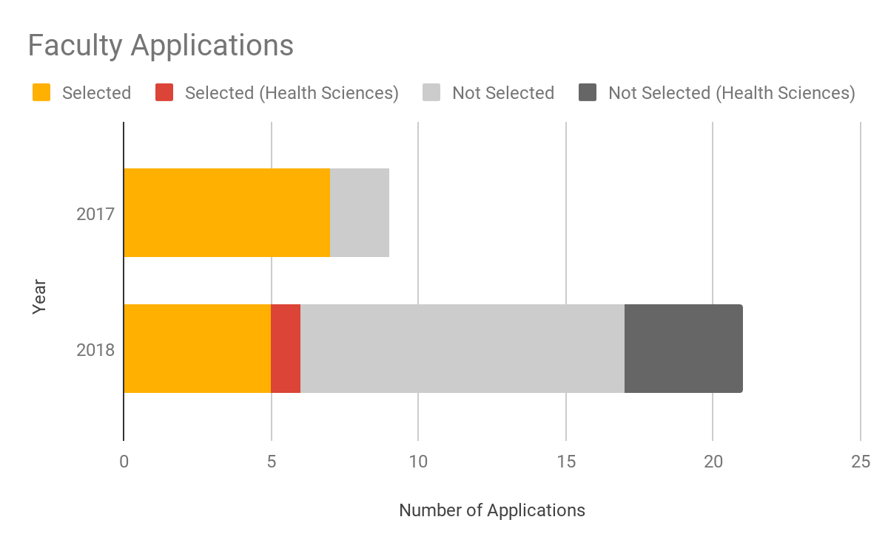
PROPOSALS RECEIVED & SELECTED
Notes:
Sarah
30 applications total
7 selected in 2017
6 selected in 2018
5 health sciences applications total
1 selected in 2018

Slide 15
HEALTH SCIENCES APPLICATIONS
1 School of Nursing
2 School of Public Health
2 Medical School
School of Public Health chosen for a Research Sprint, May 2018
Notes:
Sarah

Slide 16
SELECTED HEALTH SCIENCES SPRINT
PI: Dr. Betsy Wattenberg
Proposal: Create a website to curate public health education materials that would be available to all public health professionals and students across the globe.
Context: USAID grant to support Hanoi University in Vietnam
Notes:
Shanda starts

Slide 17
SELECTED HEALTH SCIENCES SPRINT
Libraries’ team
  Shanda Hunt, project manager & public health library liaison
  Kristi Jensen, program development lead for the Libraries’ eLearning initiative
  Andrew Palahniuk, instructional designer
  Nancy Ching, DASH research assistant & graphic design student

Slide 18
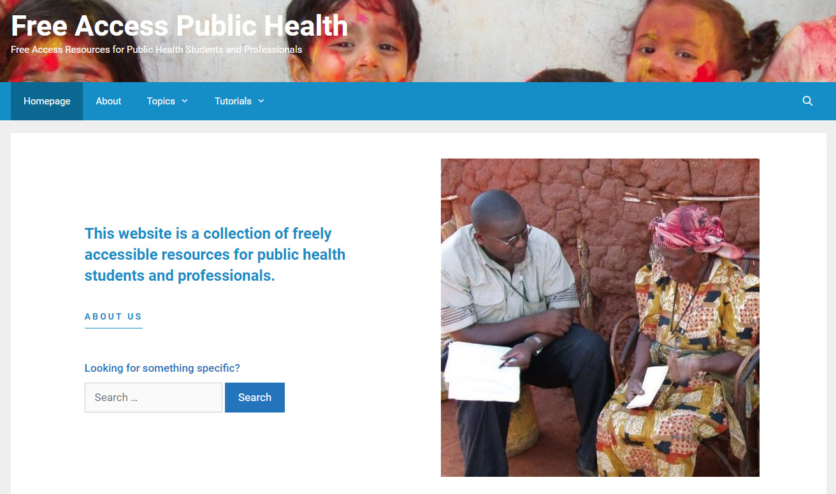
http://publichealthaccess.org/

Slide 19

http://publichealthaccess.org/

Slide 20
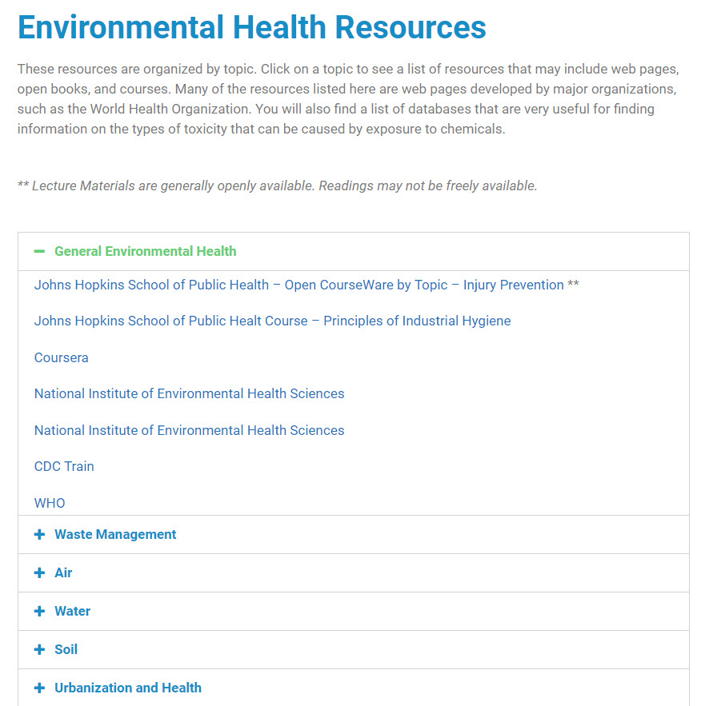
Resources by Topic
Online courses
Websites
Lectures
Curriculum

Slide 21
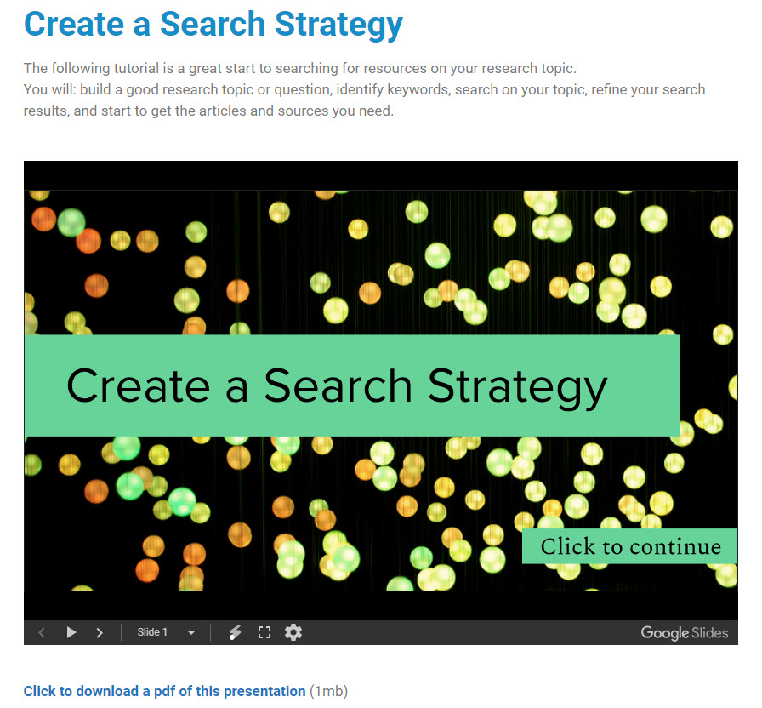
Professional Development Resources
Create a search strategy
Search for literature
Evaluate sources
Search for datasets
Develop professional skills
Find funding

Slide 22
SUPPORT FOR PROJECTS NOT SELECTED
Notification email to faculty included contact information for librarians able to support their projects
Suggest meeting with liaison and/or other librarians to discuss project and steps for moving forward

Slide 23
SUPPORT FOR PROJECTS NOT SELECTED
Public Health
Comprehensive literature review for textbook on effects of institutionalized racism in public health
Completed reviews for 5 chapters in the summer of 2018
3 librarians
  Shanda Hunt, Public Health
  Sarah Jane Brown, Medicine
  Malaika Grant, African American studies
Course reading list
Open-access reading list
Policy & News Media Impact Services for promotion & tenure

Slide 24
SUPPORT FOR PROJECTS NOT SELECTED
Medical School
Scoping review on the ethics of healthcare rationing during a “long emergency”
2 librarians
  Caitlin Bakker, Medicine
  Sarah Jane Brown, Medicine
Presented at Global Alliance for Behavioral Health and Social Justice, October 2018
Presented at the American Public Health Association Conference, November 2018
Ongoing plans to continue research
Notes:
Sarah

Slide 25
SUPPORT FOR PROJECTS NOT SELECTED
Medical School
Scoping review on the concept of “validity” in rehabilitation literature
2 librarians
  Caitlin Bakker, Medicine
  Sarah Jane Brown, Medicine
Met with faculty to advise on the project and explain the process of a scoping review
After following up several months later, faculty informed the library that the project was on hold
Notes:
Sarah

Slide 26
SUPPORT FOR PROJECTS NOT SELECTED
Nursing
Comprehensive literature review on self-care among children
  Write a manuscript
  Provide justification for a grant application
  Update a conceptual model
  Update lecture materials
1 librarian
  Liz Weinfurter, Nursing
  Previously established relationship
  The faculty member has chosen to place this project on hold. They continue to work with the librarian on other projects.
Notes:
Sarah

Slide 27
3. EVALUATION
Assessment of Processes & Outcomes

Slide 28
SURVEY INSTRUMENT
Developed by KU and used by UMN with permission in both 2017 and 2018
Surveyed both faculty and librarian participants
  Topics covered by the survey:
    Timing of the Sprints
    Expectations
    Pre-planning activities
    Project management tools
    Space
    Networking opportunities
Streamlined for 2019

Slide 29
OVERALL FACULTY SATISFACTION
94% said expectations were met or exceeded
89% said their team accomplished everything they’d hoped or more
92% rated the quality of their team as excellent
89% rated the expertise of the librarians as excellent
78% rated the quality of the partnerships they developed with librarians as excellent
39% had never sought help from the Libraries prior to the Sprints
94% said they would likely turn to the Libraries for future research or pedagogic projects

Slide 30
PROGRAMMATIC CHANGES
2017 → 2018
  Formalized charter for annual Research Sprints
  Engagement of Libraries’ leadership in selecting Sprint proposals and forming librarian teams
  Streamlined rubrics and templates for documentation
  Mandatory Sprints orientation for librarian staff
  Additional pre-Sprint team meetings
  Designated one team per project manager

Slide 31
UNEXPECTED OUTCOME
Marketing itself is an outreach activity
  List of our capabilities in the marketing materials
  Faculty think about how that connects to their own work
  They flesh out a proposal, and even if not selected, they are connected to a team of librarian experts
  Whether or not they follow through, they are made aware of the Libraries offerings
  Still potential for word-of-mouth

Slide 32
CONCLUSIONS
Research Sprints is an effective engagement strategy for connecting with health sciences faculty.
The proposal process led to meaningful collaborations between librarians and faculty members, whether or not not their proposal was selected.
The Research Sprints planning process is iterative, requiring adaptation for each event.

Slide 33

THANK YOU!
Any questions?
Slides: https://z.umn.edu/SprintsMLA2019

