Slide 1
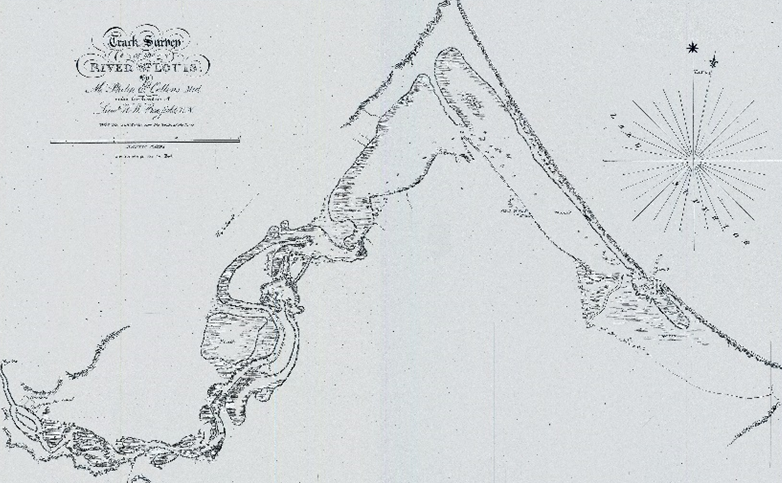
Assessment of sediment budget in 2001 Section 111 study for Minnesota Point
John Swenson
Department of Earth and Environmental Sciences
University of Minnesota Duluth
Map: Collins & Bayfield (1825)
USACE MN Point Section 111 Charrette (March 10 & 11, 2022)

Slide 2
Conclusions of 2001 study relied heavily upon conceptual and quantitative models developed by W.F. Baird (1998)
Relevant aspects of Baird (1998) study:
Estimated sand supply of 50,000 m³/yr from south-shore sources
Predicted net northwestward transport of ~ 50,000 m³/yr of sand along entirety of MN Point between Federal structures
Predicted offshore transfer of ~ 50,000 m³/yr of sand in the northern portion of MN Point, south of—and proximal to—Duluth entry
Did not consider effects of long-term (multi-century scale) lake-level rise attributable to differential post-glacial crustal rebound
Assumed negligible input of barrier-building sediment (gravel / sand) from north-shore sources

Slide 3
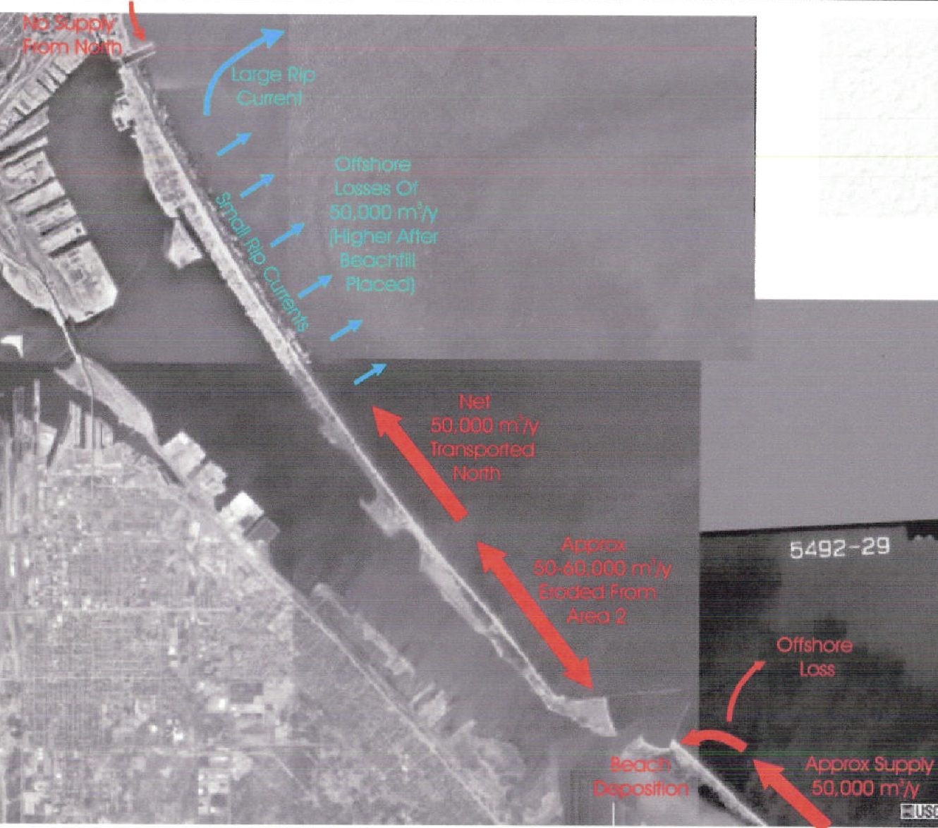
Fig 4.1 (Baird, 1998, in USACE, 2001)

Slide 4
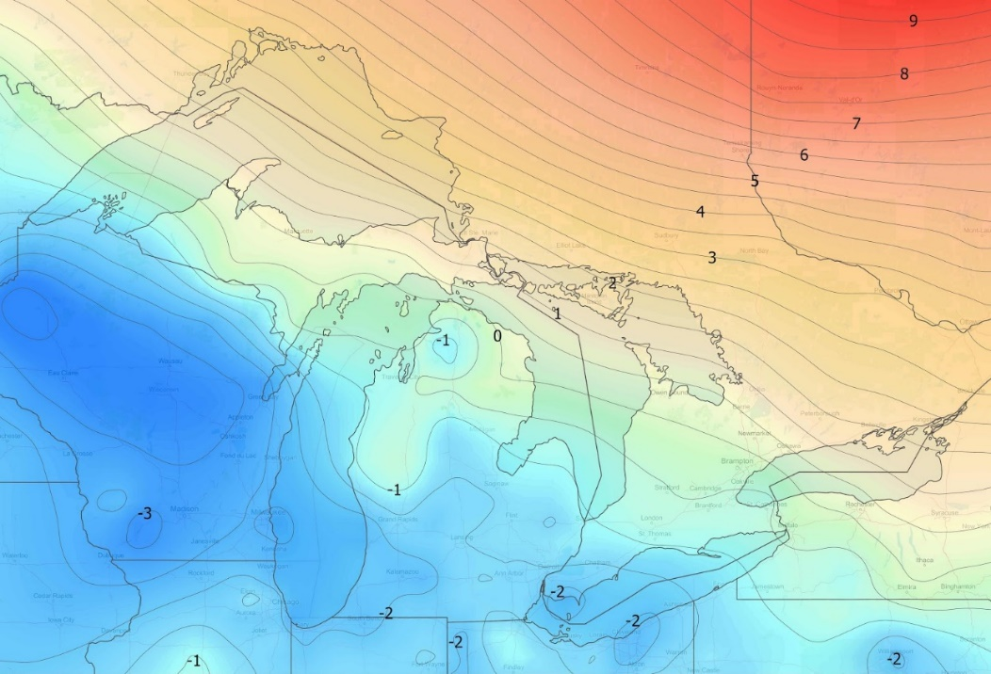
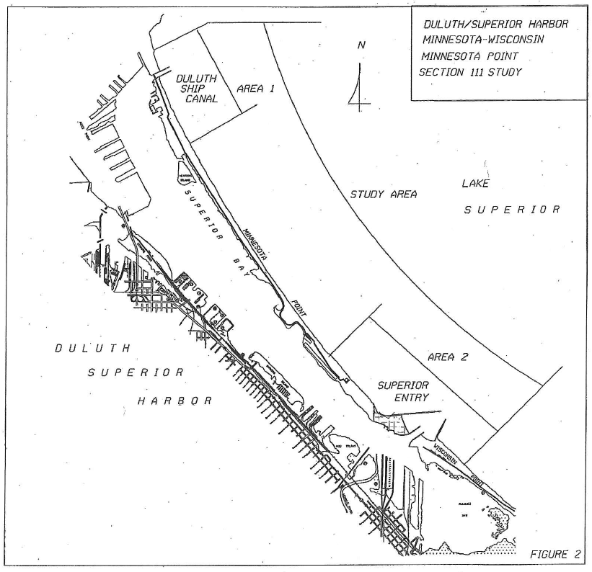
5
Assumed negligible north-shore sediment input
Crustal uplift (mm/a)
X
3
Predicted offshore sand transport of 50,000 m³/yr
No consideration of millennial-scale lake-level rise
New IGLD data (Craymer and Wisotzsky, 2021)
2
4
Predicted northward sand transport of 50,000 m³/yr
Twin Ports hydrograph (Breckenridge et al., 2016)
Five relevant aspects of Baird (1998) model, as reported in USACOE (2001)
1
estimated sand supply of 50,000 m³/yr
Drawing: ACOE (2001)

Slide 5
Two important concepts:
Long-term lake-level in Twin Ports region
Long-term sediment (sand & gravel) sources for MN Point and their dependence on lake level
For the last millennium (~1100 BP – present), lake level has been rising rapidly (2.5 – 3.0 mm/yr)
Earlier (~4200 BP – 1100 BP) lake level was falling or quasi-stable
The barrier (MN / WI Point) most likely emerged in response to rising lake level (Loy, 1962; Breckenridge et al., 2016)

Slide 6
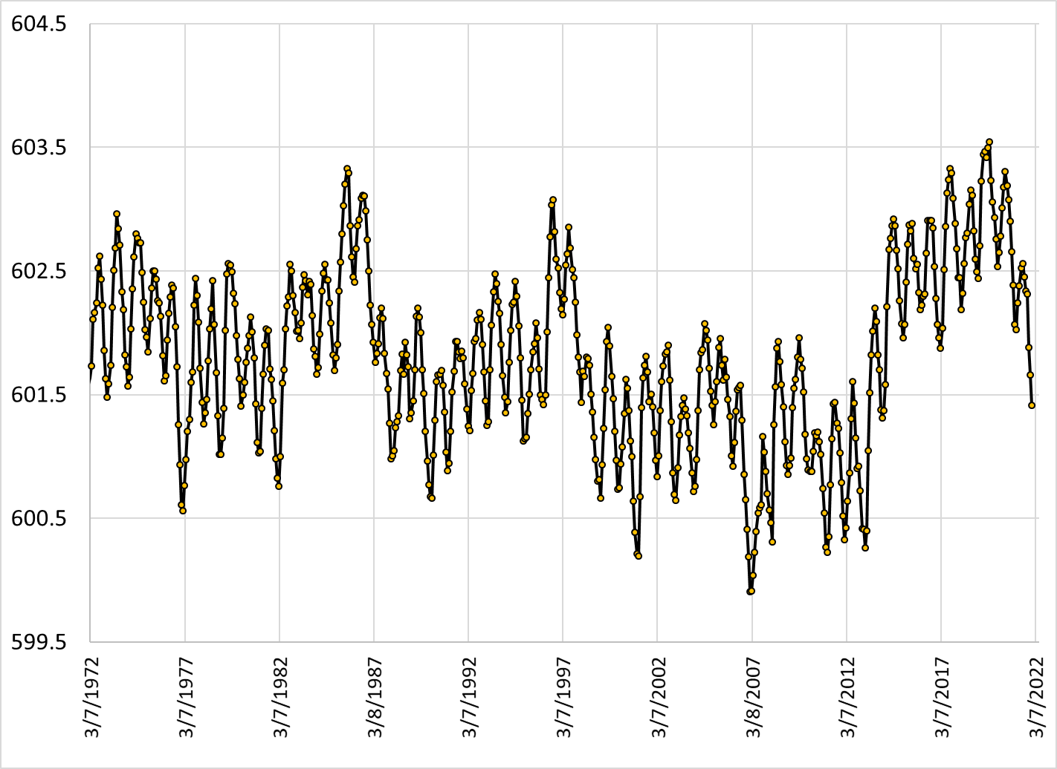
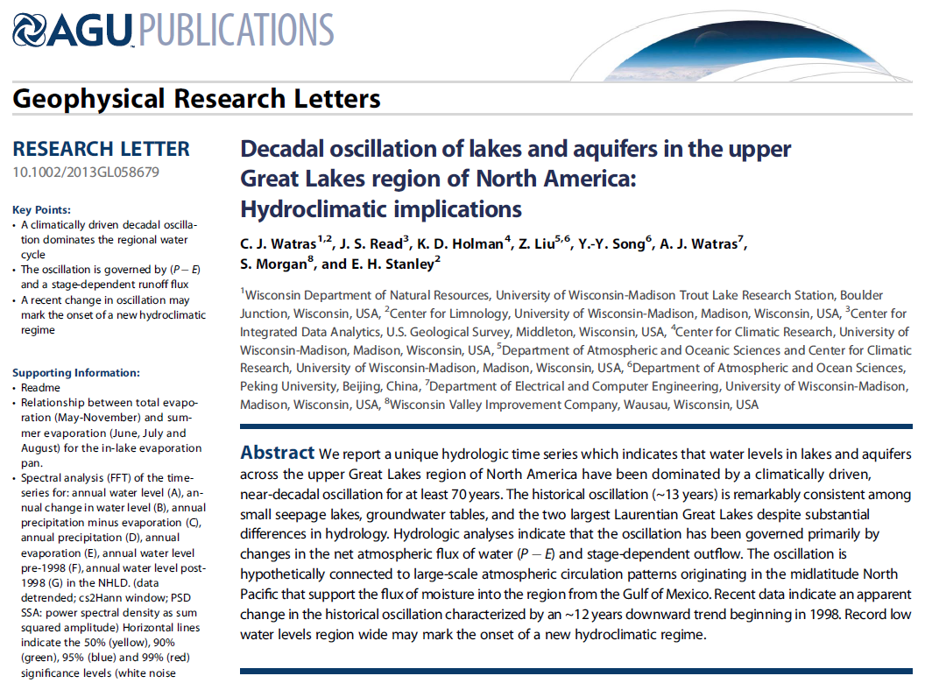
Lake level
50-year hydrograph at DLH
Short-term fluctuations (rises) garner our attention, particularly on ‘soft’ coasts like MN Point.
These climate-driven fluctuations are superimposed on a long-term (millennial scale) signal driven by lithospheric dynamics, i.e. differential post-glacial rebound, and shifting drainage outlets

Slide 7
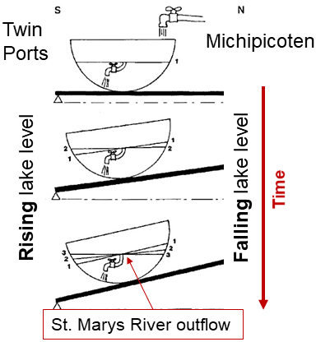

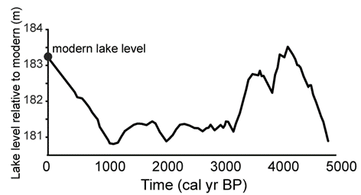
Crustal rebound (mm/a)
New IGLD data (Craymer and Wisotzsky, 2021)
Larsen (1987); extension of ideas in Goldthwait (1908)
Breckenridge et al. (2016)
1100 BP – present:
Rapid rise (2.5 – 3.0 mm/yr)
4200 BP – 1100 BP:
Generally falling to stable
Some uncertainty in timing and magnitude; trends certain

Slide 8
Two important concepts:
Long-term lake-level in Twin Ports region
Long-term sediment (sand & gravel) sources for MN Point and their dependence on lake level
Two sources: River input & bluff erosion
In the last millennium—with rapidly rising lake level—bluff erosion may be the dominant source of sand / gravel to MN Point
River-sourced sand / gravel may be secondary in importance
Crude estimates for sediment supply from bluff erosion alone on the north shore (Q_{NS}) and south shore (Q_{SS}) are:
Q_{NS} ~ 8,000 m³/yr
Q_{SS} ~ 25,000 m³/yr

Slide 9
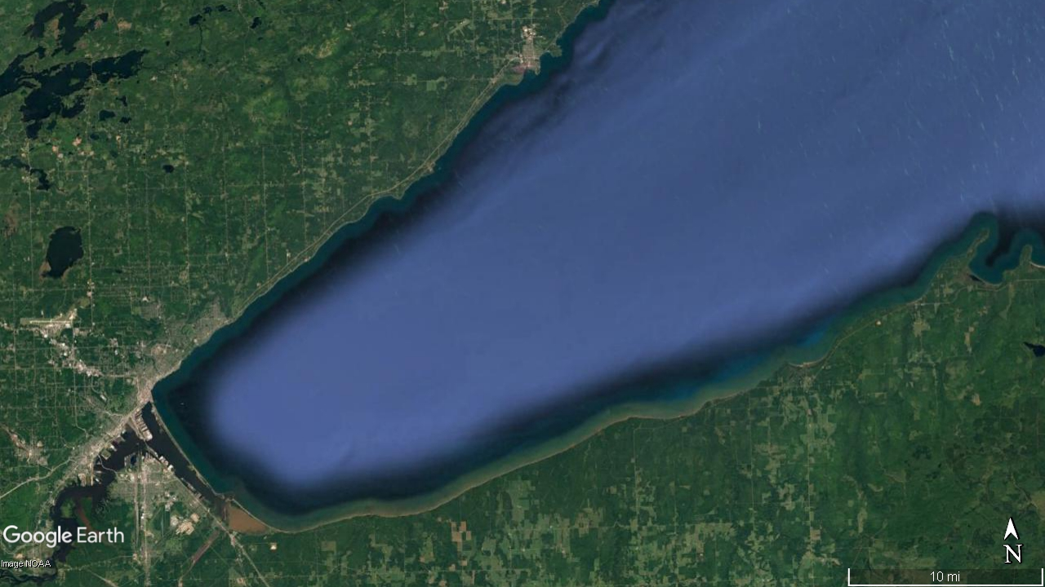
Sand sources: River (fluvial) input
Riverine input trends (big picture):
Little reason to expect significant change in sediment yield for last 4500 years
(except last 150 years ↔ land-use changes)
From 1100 years BP – present, river mouths flooded (in part) by rapidly rising lake level
Progressive disconnection of St. Louis and Nemadji rivers from coastal waters
Degree of disconnection less clear on north- and south-shore rivers
North Shore: Small catchments, relatively low sediment yield
St. Louis: Large catchment, very low sediment yield
Sand input (rivers)
South Shore: Small & medium catchments, modest sediment yield
Nemadji: Medium catchment, high sediment yield

Slide 10
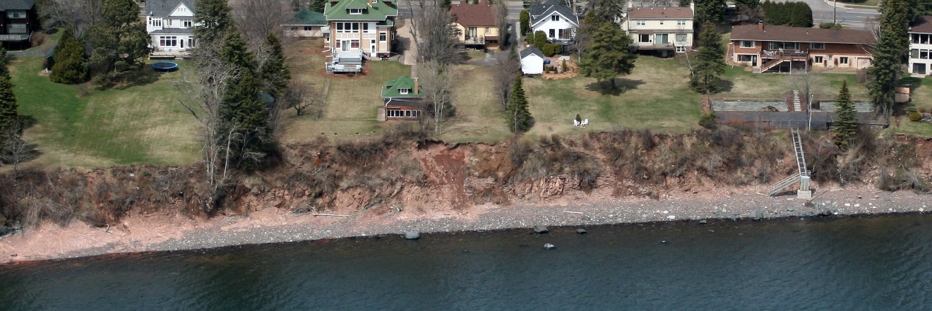
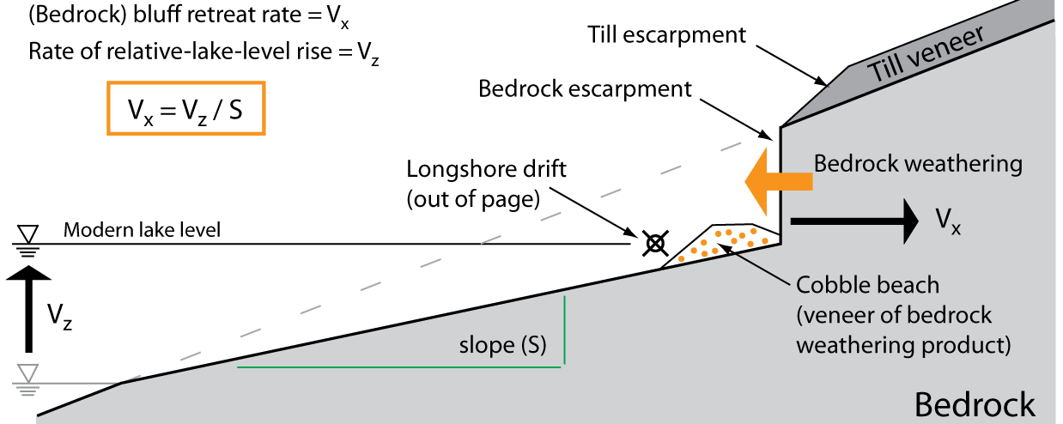
Rapid lake-level rise (1100 BP - present) drives bluff erosion
longshore transport
(into page)
after Lambert and Swenson (2016)

Slide 11
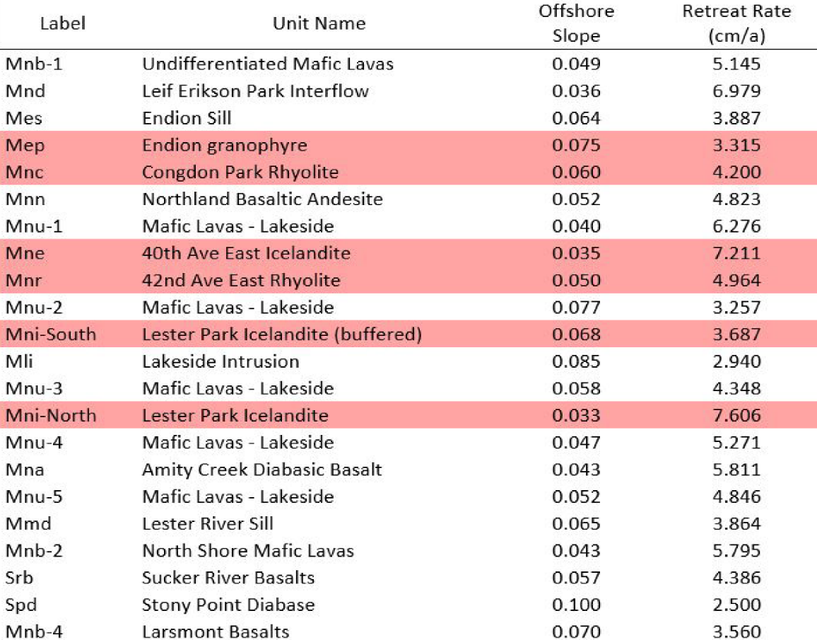
Century- to millennial-scale bluff erosion rates on north shore
Bedrock-cored north-shore bluff retreat rate ~ 5 cm/yr
Large variability because of mixed lithology, e.g. rhyolite vs basalt vs diabase
Sample calculation for north-shore sediment supply (Q_{NS}) from bluff erosion alone:
5 cm/yr average retreat rate
4 m average bluff height
40 km source length (Duluth to Two Harbors)
Q_{NS} ~ 8,000 m³/yr
Long-term rates broadly consistent with decadal-scale rates (from aerial photos) as determined recently by Coastal Erosion Hazard Mitigation (CEHM) working group and earlier work by Johnston et al. (1990)
Lambert and Swenson (2016)
Key Points:
In the last millennium, with rapidly rising lake level, bedrock bluff erosion on the north shore may be the dominant source of gravel and sand feeding MN Point—from the north shore
Riverine input may be significant but is poorly constrained

Slide 12
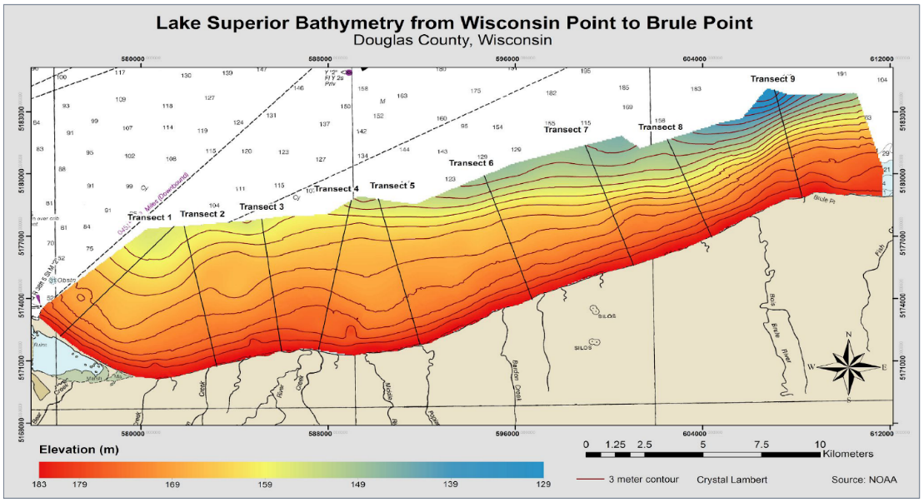
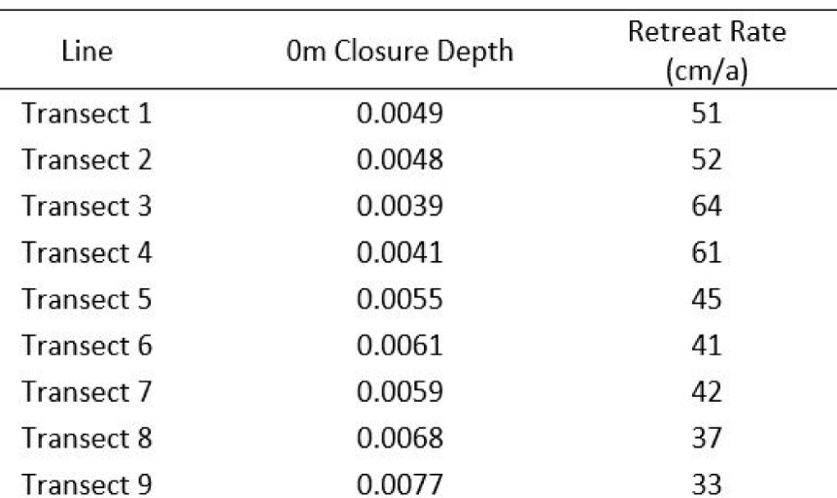
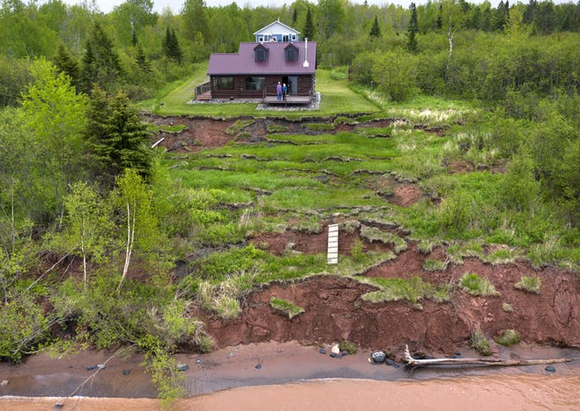
Century- to millennial-scale bluff erosion rates on south shore
Sample calculation for south-shore sand supply (Q_{SS}) from bluff erosion alone:
45 cm/yr average retreat rate; 15 m average bluff height
55 km source length (Superior to Herbster, WI)
7% sand
Q_{SS} ~ 25,000 m³/yr
Offshore slope
Lambert and Swenson (2016)
South-shore bluff retreat rate ~ 45 cm/yr
Mechanically weak, unconsolidated till
Less variability ↔ homogenous till
5 – 10% sand (Loy, 1962)
Long-term rates broadly consistent with decadal-scale rates (Need et al., 1980; Swenson et al., 2006; Lake Superior South Shore Bluff Recession Rate Study, Douglas and Iron Counties, 2012).
Image: Star Tribune

Slide 13
Return to relevant aspects of Baird (1998) study:
Estimated sand supply of 50,000 m³/yr from south-shore sources
Predicted net northwestward transport of ~ 50,000 m³/yr of sand along entirety of MN Point between Federal structures
Predicted offshore transfer of ~ 50,000 m³/yr of sand in the northern portion of MN Point, south of—and proximal to—Duluth entry
Did not consider effects of long-term (multi-century scale) lake-level rise attributable to differential post-glacial crustal rebound
Assumed negligible input of barrier-building sediment (gravel / sand) from north-shore sources

Slide 14
Address points 1 – 4 first (next four slides):
Take-home message:
Baird (1998) estimate of south-shore sand supply (Q_{SS}) likely too large by a factor of two
Baird (1998) prediction of large-scale offshore sand transfer near Duluth entry is inconsistent with observed bathymetry
Instead, majority (60 – 75%) of modern sediment supply consumed in offsetting drowning by rapid lake-level rise
Remainder partitioned to building barrier lakeward (slowly), which is consistent with observed internal structure of barrier (e.g. GPR imaging by Harry Jol and students)
Shore-normal GPR transect near Park Point beach house (Simenson, Alger, and Jol, 2013)

Slide 15
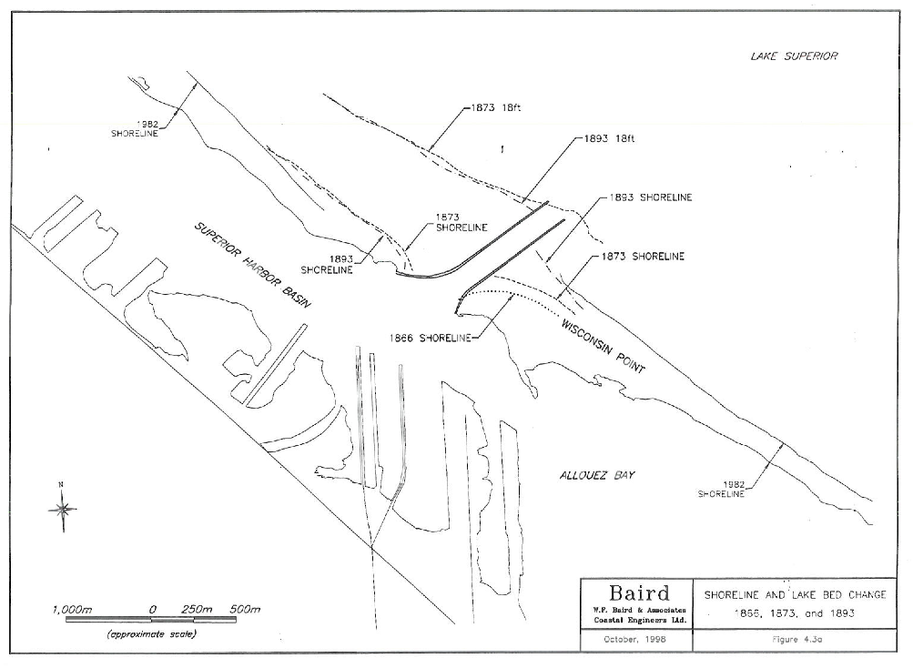
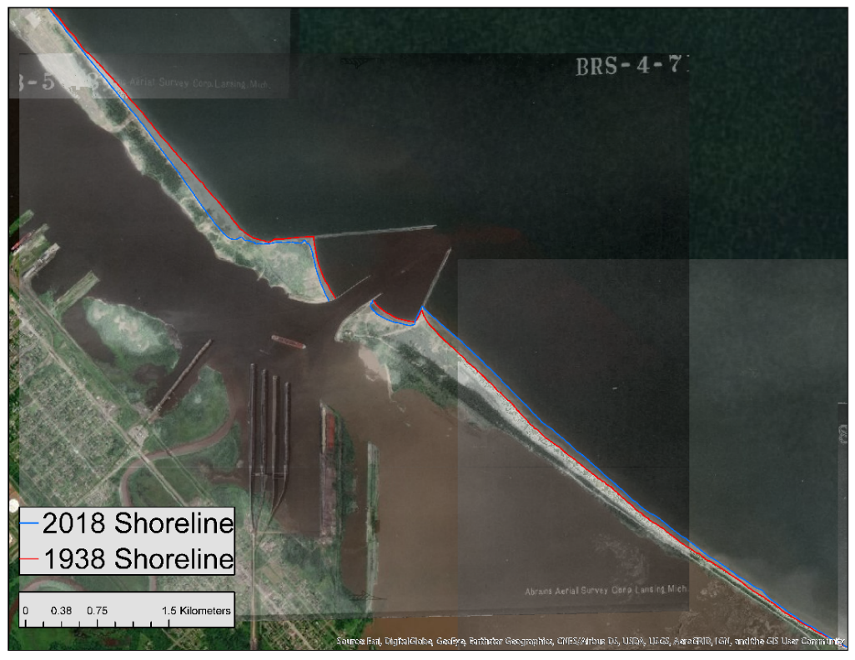
1
Estimates of modern south-shore sand supply (Q_{SS})
Baird (1998) estimate used 1873 & 1982 shorelines
Shoreface + beachface thickness of 12 m
Estimate Q_{SS} ~ 50,000 m³/yr
Fig 4.3a (Baird, 1998, in USACE, 2001)
Swenson and Johnson (2019; unpublished) used 1938 – 2018 shorelines to revise estimate
Identical 12-m shoreface + beachface thickness
Estimate Q_{SS} ~ 25,000 m³/yr
Comparable to earlier estimate of Q_{SS} ~ 17,000 m³/yr from USACE (1974, Sec 111)

Slide 16
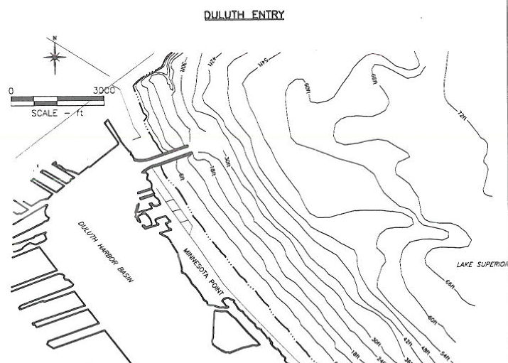
2
3
Predicted offshore sand transport just south of Duluth entry inconsistent with observed bathymetry
?
Fig 3.1 (Baird, 1998, in USACE, 2001)
Any observed bathymetric anomalies are:
Far too small (volumetrically)
Well below closure depth for sand (~10 m)
Shoreface is homogeneous along entirety of barrier
Fig 4.1 (Baird, 1998, in USACE, 2001)

Slide 17
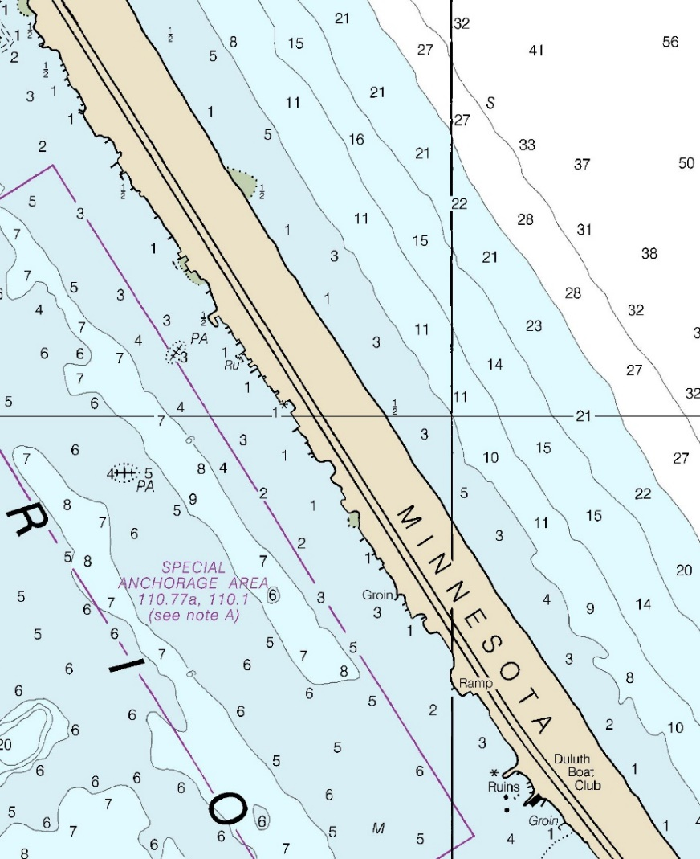
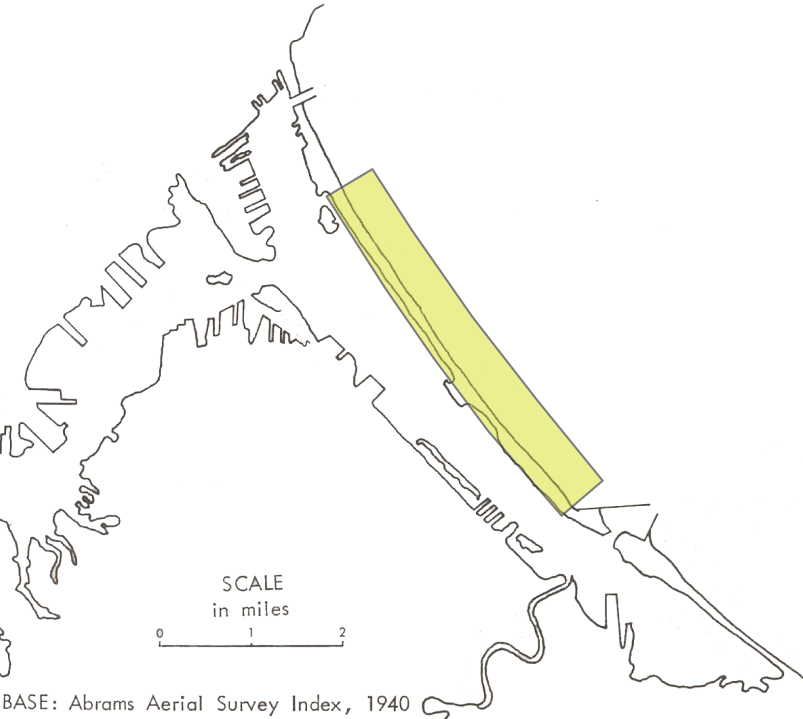
4
Rapid lake-level rise and sediment budget
Historical ‘zero-flux’ point reflecting exhaustion of north-shore and south-shore sediment fluxes
Key point: Majority of modern sand budget consumed in offsetting drowning
Transect on next slide
Lakeward boundary of control volume is closure depth (~10 m)
Goal:
Quantify sand supply required to offset drowning (Q_{drown})
NOAA 14975
Q_{SS} ~ 25,000 m³/yr

Slide 18
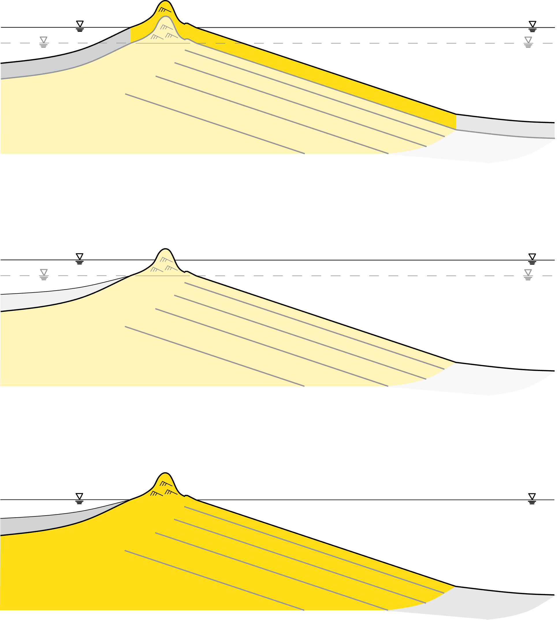
4
Quantify sand supply required to offset drowning (Q_{drown})
Calculation:
rate of lake-level rise: 2.5 – 3.0 mm/yr
along shore length of control volume ~ 7 km
width of barrier and shoreface ~ 850 m
sand layer to offset drowning
lake-level rise over Δt
time = t+Δt
Q_{drown} ~ 15,000 – 18,000 m³/yr
Compare with
width of barrier and shoreface (~850 m)
Q_{SS} ~ 25,000 m³/yr
time = t
Majority of sand supply offsetting drowning, not being routed offshore
lake
Sand closure depth (~10 m)

Slide 19
Return to relevant aspects of Baird (1998) study:
Estimated sand supply of 50,000 m³/yr from south-shore sources
Predicted net northwestward transport of ~ 50,000 m³/yr of sand along entirety of MN Point between Federal structures
Predicted offshore transfer of ~ 50,000 m³/yr of sand in the northern portion of MN Point, south of—and proximal to—Duluth entry
Did not consider effects of long-term (multi-century scale) lake-level rise attributable to differential post-glacial crustal rebound
Assumed negligible input of barrier-building sediment (gravel / sand) from north-shore sources

Slide 20
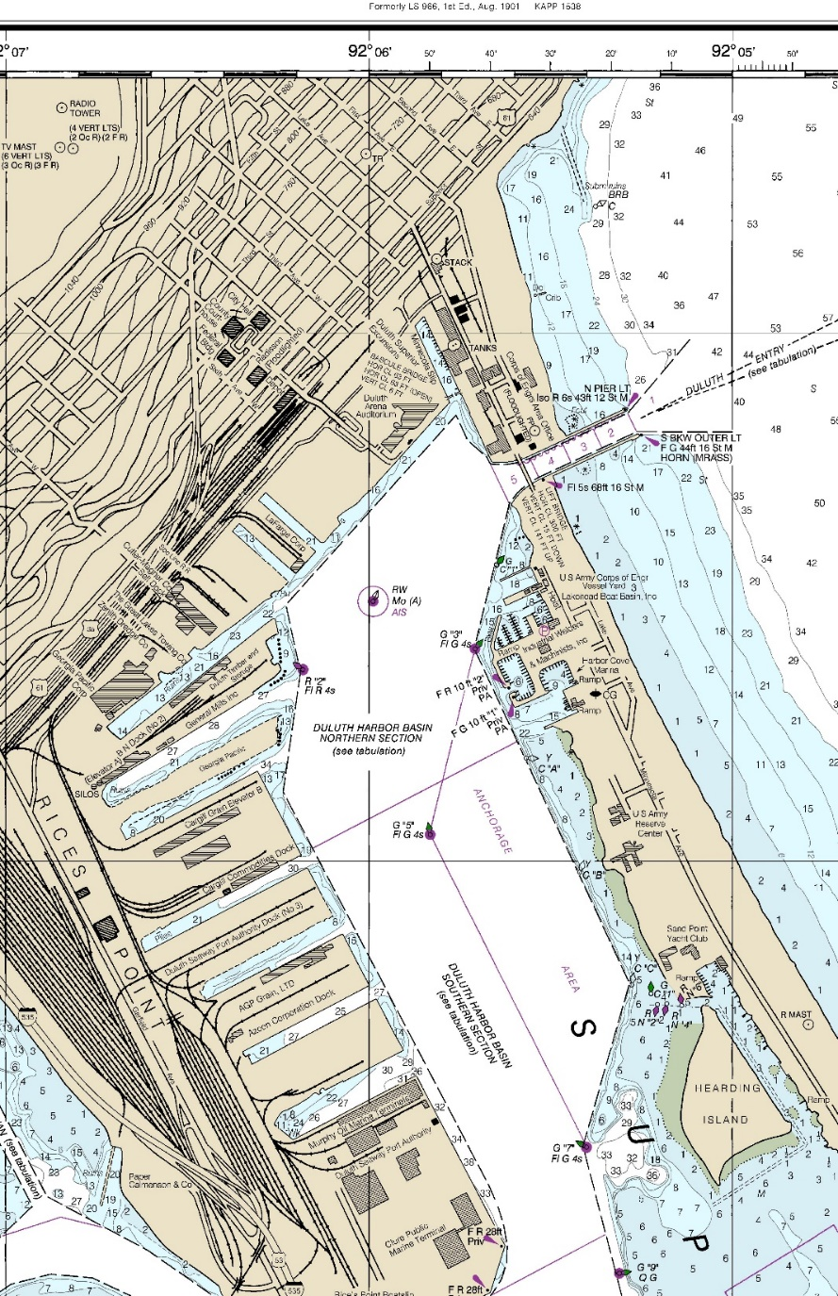
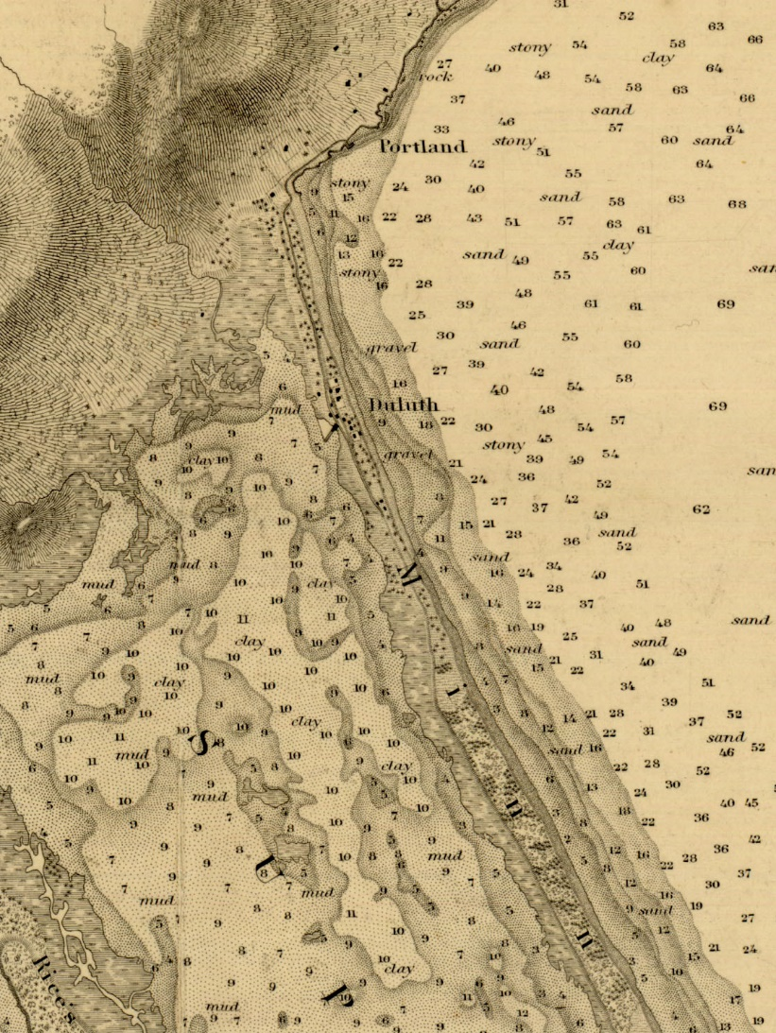
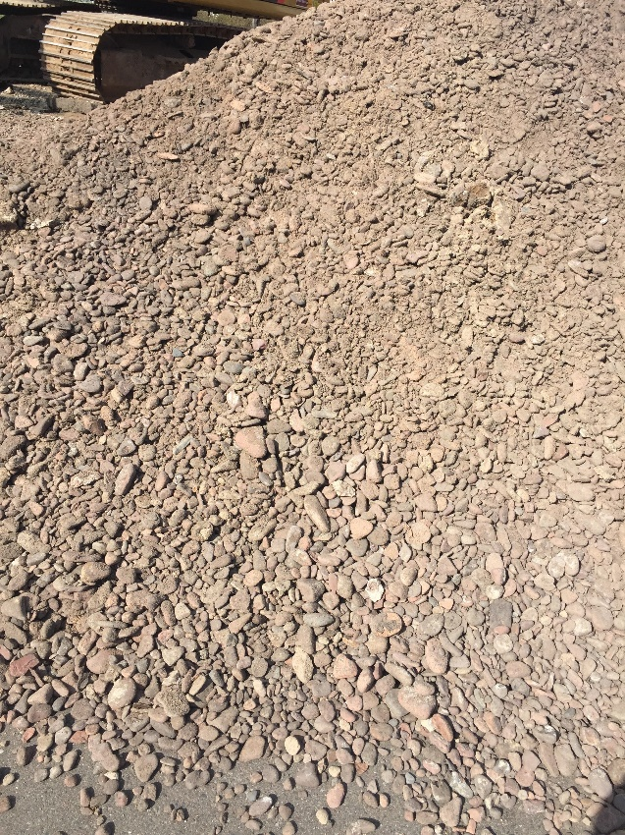
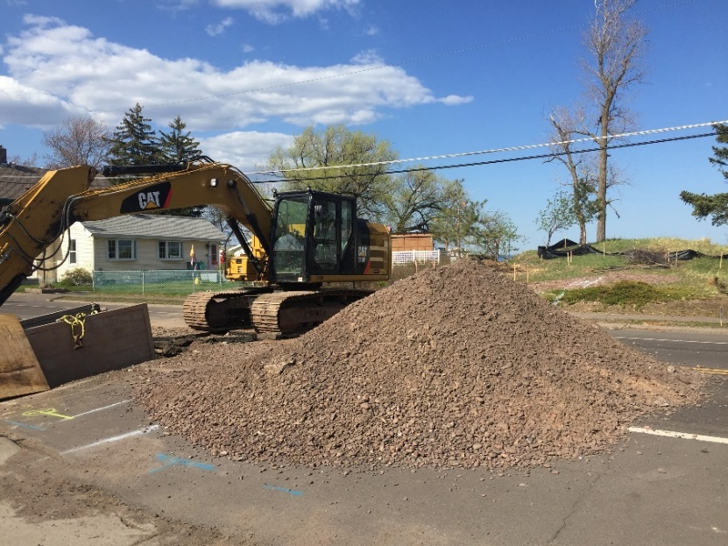
5
North end of barrier composed of cobbles, gravel, and coarse sand derived from north-shore bedrock weathering & transport
NOAA 14975
Meade (1861)
“Major D.C. Houston in his report to the Chief of Engineers in 1872, …, noted the northern 2 miles of Minnesota Point was covered in gravel.” (USACOE, 1974 Sec. 111 report)
Images: G. Glass

Slide 21
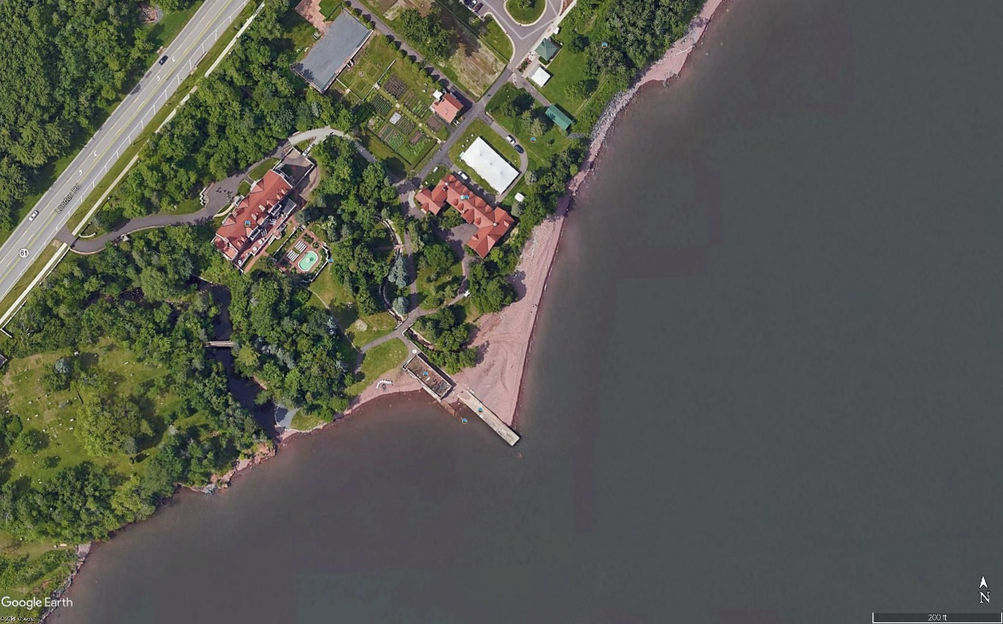
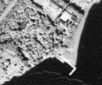
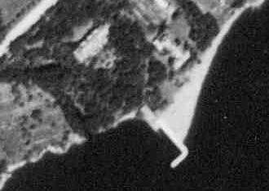
Glensheen Mansion, east Duluth
N
North-shore sediment supply (Q_{NS})
2016
Q_{NS}
Dock constructed ca. 1910
1948
Multiple lines of evidence (historical air photos, etc.) support non-trivial north-shore supply of cobbles / gravel / sand
1939

Slide 22
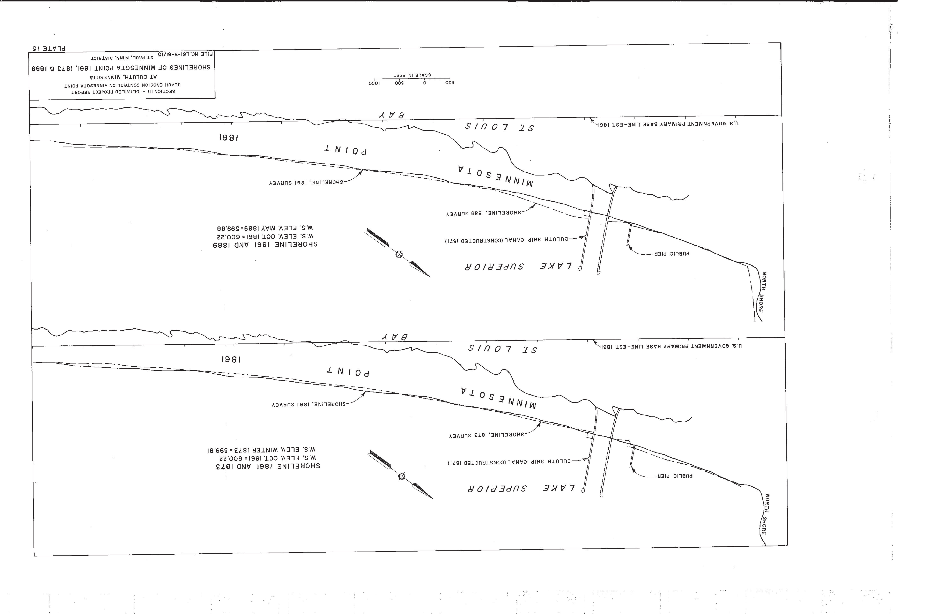

First (of two) quantitative constraint on north-shore gravel / sand supply (Q_{NS}):
A_{fillet} ~ 8∙10³ m²
H_{shore} + H_{beach} ~ 12 m
T_{accum} ~ 12 yr
Q_{NS} ~ 8∙10³ m³/yr
Line drawing from USACOE (1974)
Compare to Q_{SS} ~ 25∙10³ m³/yr
1873 shoreline
1861 shoreline

Slide 23
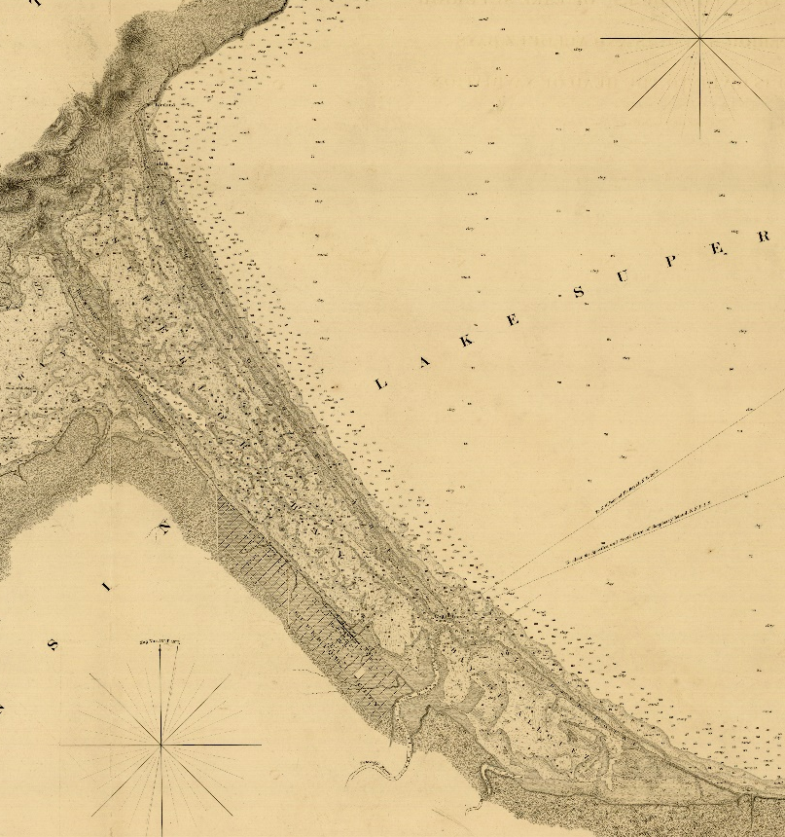

Second quantitative constraint on north-shore gravel / sand supply (Q_{NS}):
Q_{NS}
Barrier is homogeneous in structure
If barrier builds lakeward and upward (to offset lake-level rise) uniformly at rate R, then at first order:
$$\frac{Q_{NS}}{L_{NS}}=\frac{Q_{SS}}{L_{SS}}∝R$$
or
$$Q_{NS}=Q_{SS}\frac{L_{NS}}{L_{SS}}$$
L_{NS}
Zero-flux boundary
L_{NS} ~ 2 mi
L_{SS} ~ 8 mi
L_{SS}
~ boundary between north-shore and south-shore sediment supplies (point of exhaustion)
Q_{NS} ~ 0.25∙Q_{NS}
If Q_{SS} ~ 25,000 m³/yr
then Q_{NS} ~ 6,000 m³/yr
Q_{SS}

Slide 24
Conclusions
Previous 111 study likely overestimates south-shore sand supply and underestimates (significantly) north-shore sand / gravel input
In simplest genetic model, north-shore supply of sand / gravel is responsible for construction (and slow lakeward growth) of northern two miles of barrier (including location of current Federal structure)
Similarly, south-shore sand supply constructs / maintains remainder of barrier
No solid evidence for significant offshore transfer of sand in northern reaches of barrier
In the last millennium, majority of sediment supply (60 – 75%) used to offset rapid lake-level rise; remainder likely drove slow advance of barrier (consistent with GPR imagery of Harry Jol and students)
Q_{SS} ~ 25,000 m³/yr Q_{NS} ~ 6,000 – 8,000 m³/yr

