Slide 1

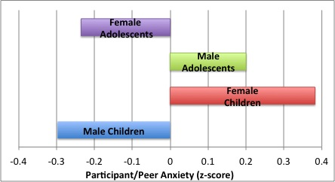
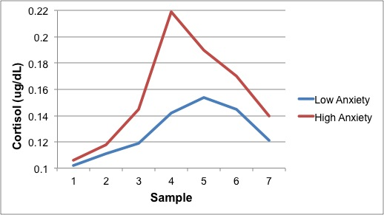
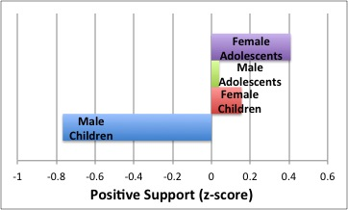
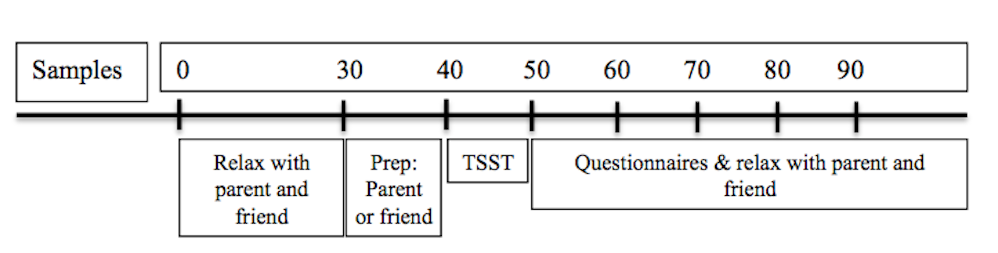
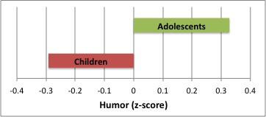
Gender Differences in Buffering Stress Responses in Same-Sex Friend Dyads
Sydney N. Pauling, Jenalee R. Doom, & Megan R. Gunnar
Institute of Child Development,
University of Minnesota
Introduction
One important aspect of peer relationships involves the ability of peers to buffer an individual’s response to stress.
Prior evidence in the field suggests that having a high quality friend present while recovering from a stress task is related to a faster return to baseline levels of the stress hormone cortisol in 7-12 year olds (Calhoun et al., 2014).
In pre-pubertal children, parents can lower levels of cortisol in response to stress (Hostinar et al., 2014).
However, after puberty, parents are less potent stress buffers and youth must rely more on peer support (Hostinar et al., 2014).
The purpose of this study was to investigate gender and age differences in friendship behaviors and to examine whether friendship behaviors predict the cortisol response to social stress.
Specifically, do boys and girls differ in how they provide support to friends before a stressful task, and do these variations in support affect their friend’s physiological response to the task?
Methods
Participants
55 participants (33 female dyads)
29 participants 9-10 years of age (M = 10.0 yrs , SD =.44)
26 participants 15-16 years of age (M = 15.8 yrs, SD = .46)
Each participant brought a same-sex friend within 2 years of their age
Procedure
Trier Social Stress Test (TSST) consisting of public speaking task and math task in front of judges
Peer assists participant in five minutes of speech preparation prior to TSST
A coding scheme was then implemented to measure the various friendship behaviors that occurred during the speech preparation process
Friendship Variables
Inter-rater reliability was above α=.756 for all individual categories.
Researchers coded for various friendship behaviors within the following categories:
Positive support
  Validation
  Sensitivity
  Time spent engaged
  Positive valence
Participant and peer anxiety (mean of these variables)
Humor/Distraction Factor (mean)
  Use of humor
  Distraction
Cortisol
Salivary cortisol, a stress hormone, was collected 7 times to measure each individual’s physiological response
All sessions were conducted in the late afternoon due to diurnal rhythm of cortisol levels
Medication and time since wake were used as co-variates
Area under the curve (AUC) calculated to look at overall cortisol production throughout the session.
Results
Friendship Behaviors
Age [t(50) = -.63, p = .53] and sex[t(50) = -.67, p = .51] did not predict peer/participant anxiety. There was a trend towards an age x sex interaction [t(50)= 1.95, p= .06]. In children, boys show less anxiety than girls (0.03).
Sex [t(50) = -2.55, p = .01] predicted level of positive support during speech prep. Boys give less positive support.
Age [t(50) = 1.79, p = .08] had a tendency to predict level of positive support. Adolescents tend to give more positive support.
Age [t(50) = 2.37, p = .02] predicted how much humor/distraction was used, but sex [t(50) = .812, p = .421] did not. Adolescents use more humor/distraction than children.
Cortisol (AUC)
Medication and hours since wake did not predict cortisol in any of the analyses, p > .10.
Sex did not predict cortisol in any of the analyses p> .10.
Across analyses, the adolescents tended to produce more cortisol than children, p <.10.
Greater participant and peer anxiety significantly predicted higher cortisol levels [t(49) = 2.06, p = .05].
Positive support was not related to cortisol [t(49) = -.09, p = .93].
Humor/distraction was not related to cortisol [t(49) = -1.4, p = .18].
Discussion
This study suggests both age and sex differences in a variety of friendship behaviors: positive support, peer/participant anxiety, and humor/distraction. Statistically marginal effects indicate that larger n’s were needed in each age/sex group to adequately test our predictions.
Peer support did not correlate with cortisol responses; although peer/participant anxiety did. Other measures of stress (e.g., HR) might have been more sensitive to peer support and should be examined.

