Slide 1
Benzimidazole synthesis for anti-cancer therapeutics
By: John McClay
Notes:
Hello Everyone,
My name is John McClay and I have been working in Dr. Mereddy’s Lab for about 1.5 years now. In his lab we utilize a lot of organic chemistry techniques to synthesize possible anti-cancer therapies. For this presentation in particular I will be talking about my research focusing on the synthesis and testing of benzimidazole derivates.

Slide 2
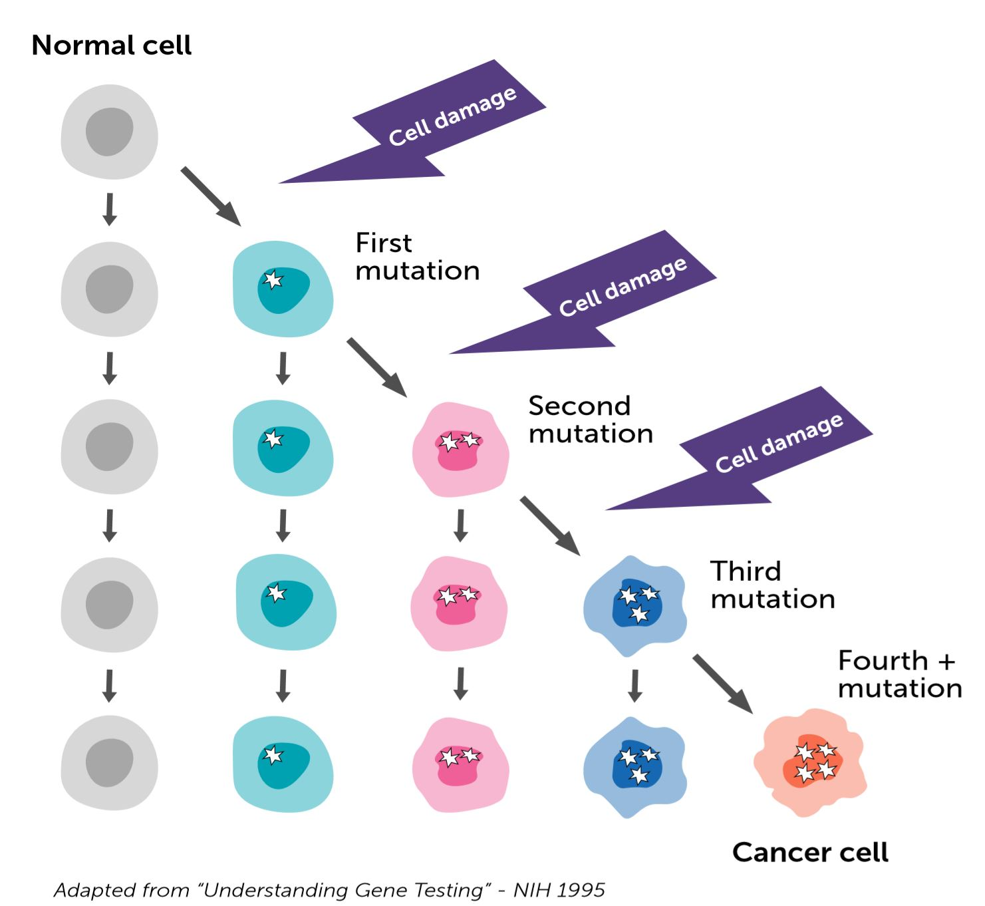
What is Cancer?
Mutations within DNA due to cellular damage or infection
Work in conjunction to formulate a cancerous cell
Upregulate proliferation and/or downregulate apoptosis
Effected Pathways and Receptors:
  Cytokine (Jak/STAT)
  TGFβ
  Integrin
  Notch
  GPCR
  Estrogen Receptors
Notes:
Before I can move into the actual synthesis and testing of benzimidazoles, it is first necessary to describe the target of interest.

Slide 3
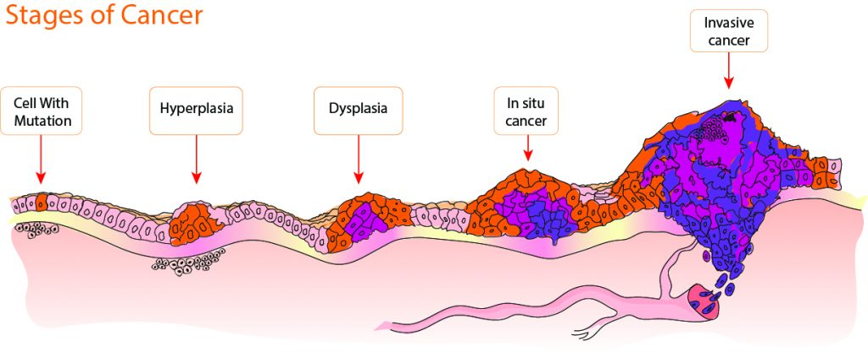

Progression of Cancer
Stage IV
Stage 0
Stage I
Stage II
Stage III
Notes:
Cancers exist in different stages or cycles when first diagnosed. Each stage is unique because of what the cancer cells are doing. Stage 0 is the moment before any cells have become cancerous, normal cells are in this stage 0. Stage 1 begins when a localized area of cancer cells emerge. They often emerge as a small lump called a tumor, which is just a bundle of cells. Following stage 1, stage 2 marks continued tumor growth, still localized. However, once these cancer cells begin to spread to nearby tissue, such as the skin or lymph node, the cancer is stage 3. The most dangerous form of cancer is often in the metastatic stage, or stage 4. This means they have been able to spread to other tissues and organs using the circulatory system. Advanced metastatic cancer cells are extremely dangerous and often become fatal for individuals with cancer

Slide 4
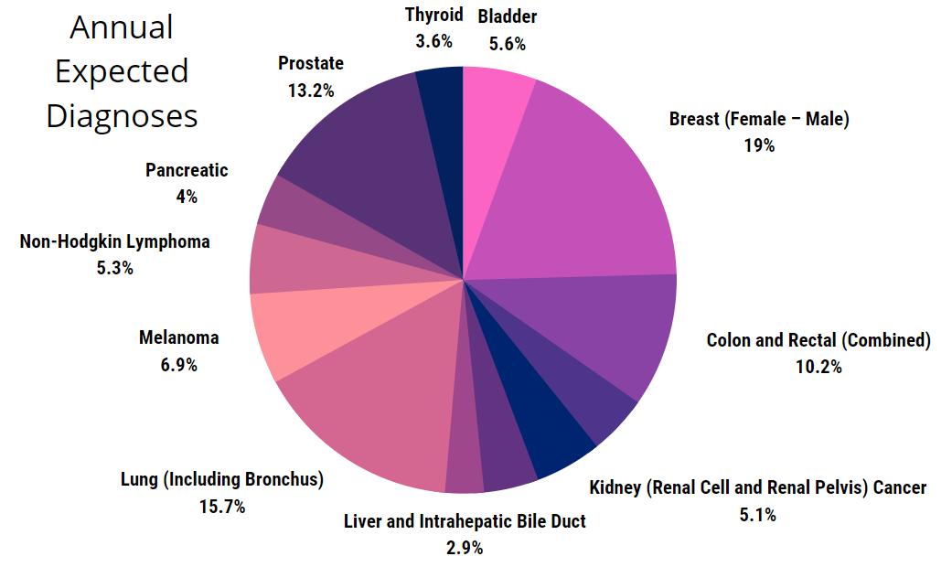

1.8 million newly diagnosed cancer cases are expected for 2021
600,000 individuals are projected to die from it as well
Notes:
Cancer is diagnosed to millions of people every year, and hundreds of thousands are dying from it as well.
Breast cancer is responsible for approximately 19% of yearly diagnosed cancers with an estimated 276480 new cases annually. Of the diagnoses, 42170 individuals will likely die from it yearly

Slide 5
Treatment Options
Surgery. remove the cancer or as much of the cancer as possible
Chemotherapy. uses drugs to kill cancer cells throughout the body
Radiation therapy. uses high-powered energy beams, such as X-rays or protons, to kill cancer cells
Immunotherapy. also known as biological therapy, uses your body's immune system to fight cancer
Hormone therapy. removing hormones from the body or blocking their effects may cause the cancer cells to stop growing
Targeted drug therapy. focuses on specific abnormalities within cancer cells that allow them to survive
Notes:
Due to the severity of breast cancer, treatment options are extremely important. Examples of common treatments for breast cancer are mastectomies, drug therapy, as well as chemotherapy. By targeting upregulated metabolism via pharmaceutical drugs, we can halt proliferation and potentially save a person's life⁶. However, the time frame needed to go from chemist to patient can be a long one. Often taking more than a decade before approval.

Slide 6
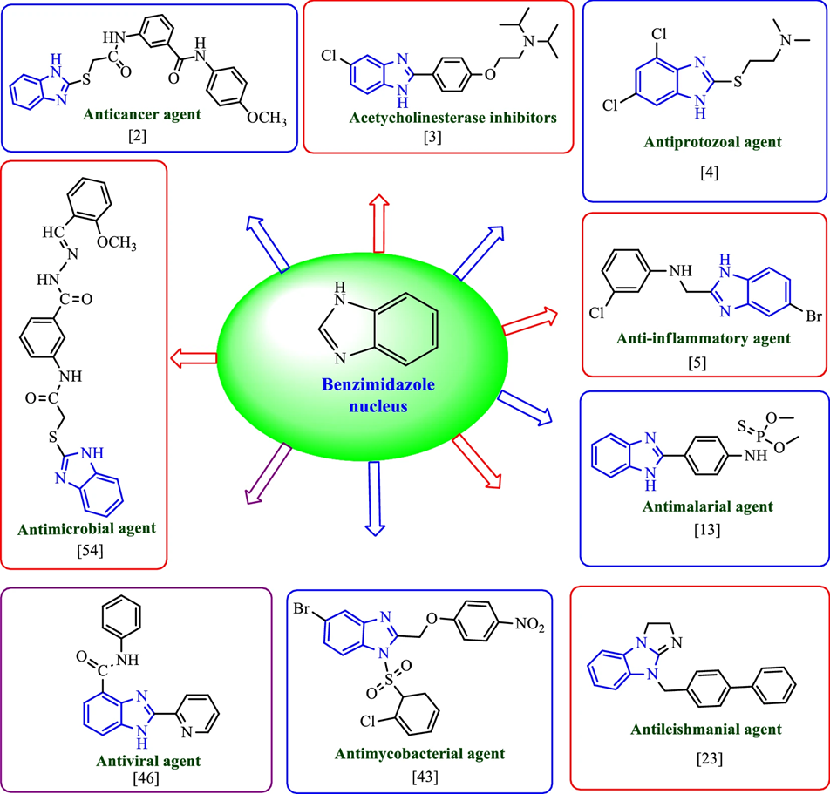
Why Benzimidazoles?
Key Natural Structure/Motif
  Anticancer
  Antiproliferative
  Antimicrobial
  Antiviral
  Antiparasitic
  Anthelmintic
  Anticonvulsant
  Antioxidants
  Anti-inflammatory
  Antihypertensive
  Anticoagulants
  Antidepressants
  Antidiabetics
Notes:
In literature various substituted derivatives of benzimidazole demonstrated various therapeutic agents such as anticancer, antiproliferative, antimicrobials, antivirals, antiparasites, anthelmintic activity, anticonvulsant, antioxi- dants, anti-inflammatory, antihypertensive, immunomodulators, proton pump inhibitors, anticoagulants, hormone modulators, and CNS stimulants as well as antidepressants, antidiabetics, anti-HIV, lipid level modulators, etc. and have made an important scaffold for the development of new therapeutic agents
The clearly conserved motif of this structure is the key here. Allowing for a multitude of variations that can all act differently and have varying targets of application just by altering the groups around it.

Slide 7
Some Quick Chemistry
Notes:
The reaction utilized for this experiment utilized methyl 3,4-diaminobenzoate and varying aldehydes with different functional groups to form each benzimidazole derivate. Excess aldehyde was used in order to completely consume the methyl 3,4 diaminobenzoate, because a simple hexane wash could remove the more nonpolar aldehyde.
Complications with sodium metabisulfite due to the bisulfite base forming secondary products resulting in more washing and purification.
(Karthikeyan et al., 2017)

Slide 8
Synthesized Derivatives
Notes:
These are the 8 current formulated therapeutics that have been purified. Proton NMR was utilized to ensure any organic solvents or secondary products had been removed from the formulated drug before testing on cell lines. It should be noted that more benzimidazoles are still being synthesized but have yet to be evaluated.

Slide 9
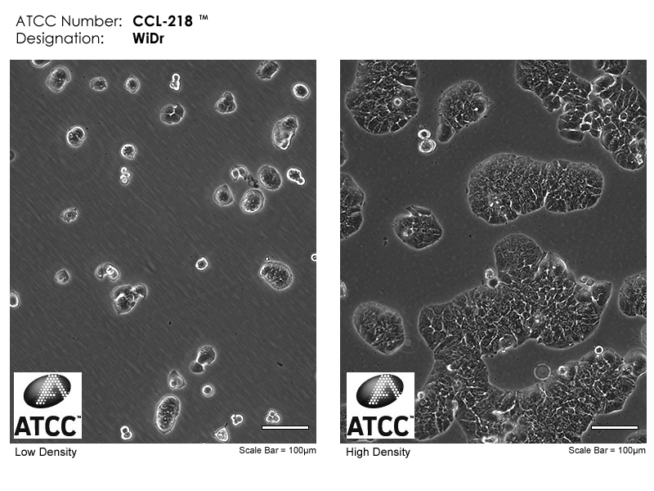
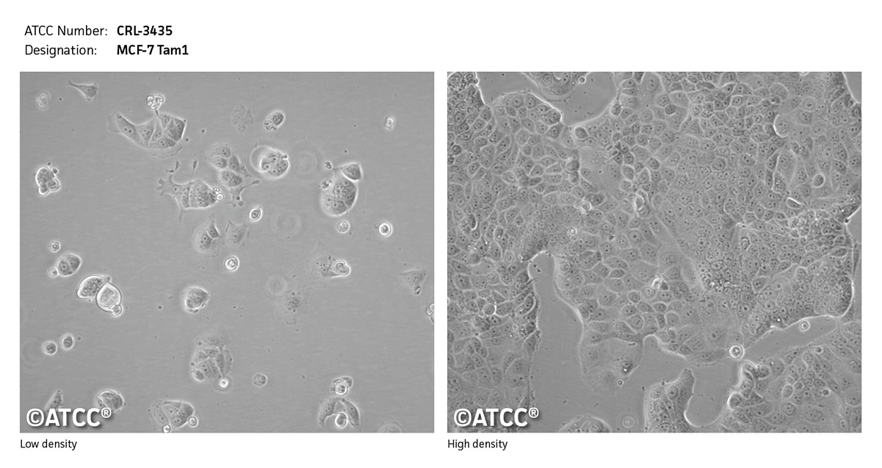
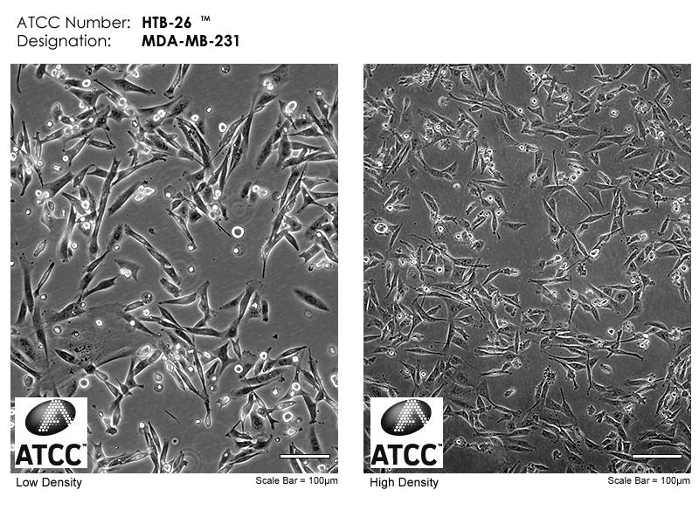
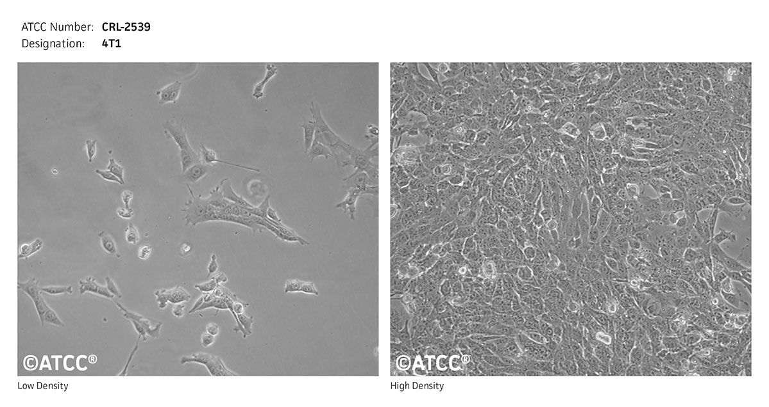
Cell Lines
WiDr – Colorectal Adenocarcinoma
MCF-7 – Ductal Carcinoma
MDA-MB-231 – Breast Adenocarcinoma
4T1 – Stage IV Breast Cancer
Notes:
WiDr is from the Colon, colorectal adenocarcinoma
MCF-7 is mammary gland; breast / Disease: ductal carcinoma
4T1 is Tissue: mammary gland / Disease: This tumor produced mimics an animal stage IV human breast cancer.
MDA-MB-231 is epithelial / Tissue: mammary gland/breast; derived from metastatic site: pleural effusion / Disease: adenocarcinoma
Acquired from ATCC

Slide 10
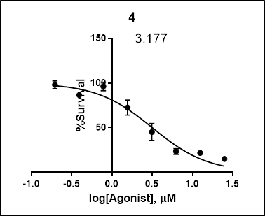
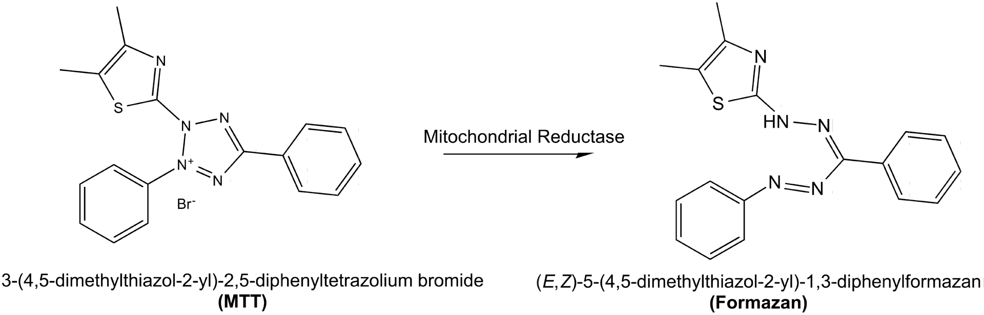
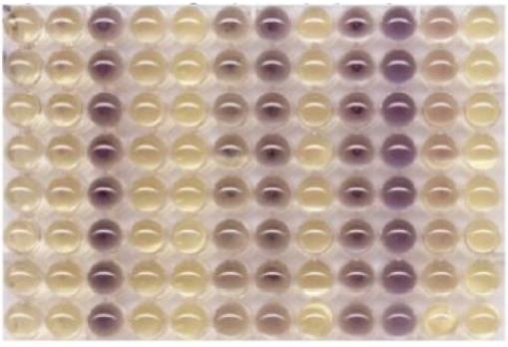
MTT Assay
96 Well Plate
  25µM of initial derivative concentration dissolved in DMSO
  Dilution factor of 2 across each well resulted in a final concentration of 195nM
Colorimetric Assay
  MTT: Yellow in appearance
    Added 72 hours after the addition of cells and derivatives
  Formazan: Purple in appearance
    SDS added 4 hours after MTT
    Absorbance measured at 570nm
  Determines cellular metabolic activity
NAD(P)H-dependent oxidoreductase
Notes:
High absorbance = More Formazan = Poor cytotoxicity
Use SDS to lyse the cells and measure absorbance
tetrazolium dye
Tetrazolium dye reduction is generally assumed to be dependent on NAD(P)H-dependent oxidoreductase enzymes largely in the cytosolic compartment of the cell.[2][8] Therefore, reduction of MTT and other tetrazolium dyes depends on the cellular metabolic activity due to NAD(P)H flux. Cells with a low metabolism such as thymocytes and splenocytes reduce very little MTT. In contrast, rapidly dividing cells exhibit high rates of MTT reduction. It is important to keep in mind that assay conditions can alter metabolic activity and thus tetrazolium dye reduction without affecting cell viability. In addition, the mechanism of reduction of tetrazolium dyes, i.e. intracellular (MTT, MTS) vs. extracellular (WST-1), will also determine the amount of product. Additionally, proof has been provided as to the spontaneous MTT reduction in lipidic cellular compartments/structures, without enzymatic catalysis involved.[3] Nevertheless, even under this alternative paradigm, MTT assay still assesses the reduction potential of a cell (i.e. availability of reducing compounds to drive cellular energetics).[1] As such, the final cell viability interpretation remains unchanged.
The included graph is a log concentration scale with respect to cell survival and is necessary for the comparison of each benzimidazole derivative.

Slide 11

IC₅₀ Values
IC₅₀ is the concentration at which half of the cells are inhibited by the therapeutic
  A lower value represents a more effective inhibitory therapy
  Benzimidazole was used as a control
Notes:
In order to directly compare the cytotoxicity of each derivative a key term of IC 50 is used. IC 50 represents the concentration at which half of the cells are inhibited by the given therapeutic, a lower value is better.
Of the 8 derivatives of benzimidazole, these two had the lowest observed IC50 values with respect to each cancer cell line.

Slide 12
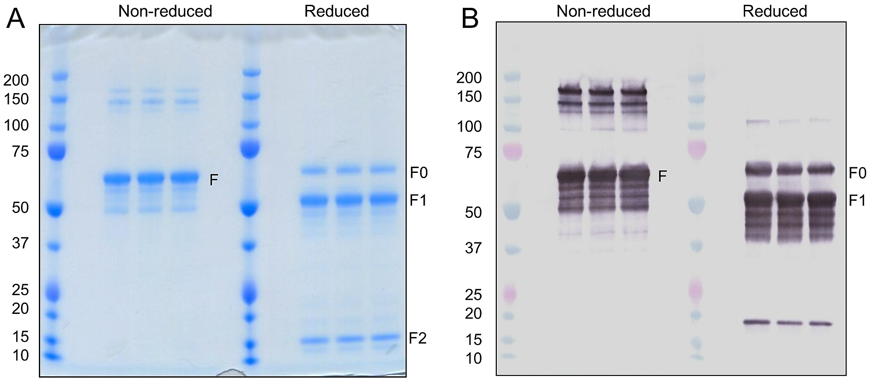
Next Steps
Reaction optimization
Find mechanism of action
  SDS-PAGE
  Western Blotting
Other therapeutic activity
  Antiviral
  Antifungal
Notes:
Utilize hydrolysis for formulate an aldehyde rather than an ester in hopes of attaching more groups, increasing the effectiveness of the derivative.
Utilize different reaction conditions, mainly the bisulfite base, to prevent other product formations
Determine the mechanism of action by taking performing SDS-PAGE and Western Blotting to determine the protein of interest with regards to anti-cancer activity
Due to benzimidazoles being privileged, I would be curious to see whether the formulated derivates could have any effect as being anti-viral or anti-fungal

Slide 13
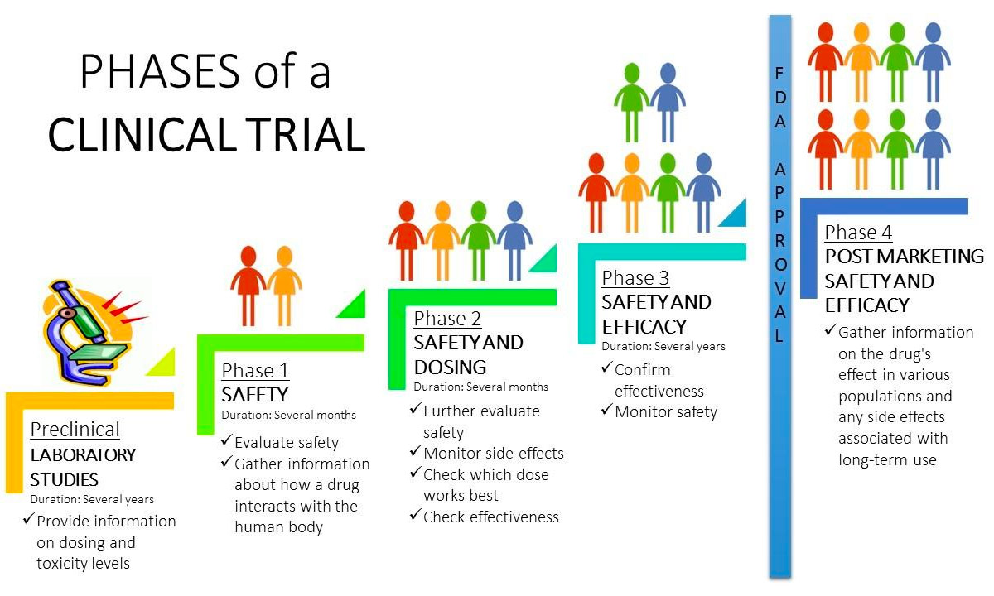
Long Term Implications
Notes:
This is still the first step in a long process, the formulation of anti-cancer therapies can take up to a decade and cost nearly a billion dollars, so modifying known therapy is important in limiting the cost of the research and possibly reduce the time to approval.
Still preclinical, although if further optimization of benzimidazoles results in formidable activity later trials to in vivo rather than in vitro.

Slide 14

Acknowledgements
Research Advisor: Dr. Venkatram Mereddy
Graduate Students: Tanner Schumacher, Greeshma Kumpati, Zach Gardner, Mike Williams, and Nathan Dunaway
Recent Graduates and Undergraduates: Amy Bowman and Mike McParlan
Swenson College of Science and Engineering and its Faculty
University of Minnesota UROP

Slide 15
References
(1) Cancer Facts and Figures 2021. American Cancer Society. 2021, pp 1-72. https://www.cancer.org/research/cancer-facts-statistics/all-cancer-facts-figures/cancer-facts-figures-2021.html.
(2) Dadashpour, S.; Küçükkılınç, T. T.; Ercan, A.; Hosseinimehr, S. J.; Naderi, N.; Irannejad, H. Synthesis and Anticancer Activity of Benzimidazole/Benzoxazole Substituted Triazolotriazines in Hepatocellular Carcinoma. Anticancer. Agents Med. Chem. 2019, 19 (17), 2120–2129. https://doi.org/10.2174/1871520619666190808152051.
(3) El-Nassan, H. B. Synthesis, Antitumor Activity and SAR Study of Novel [1,2,4]Triazino[4,5-a] Benzimidazole Derivatives. Eur. J. Med. Chem. 2012, 53, 22–27. https://doi.org/10.1016/j.ejmech.2012.03.028.
(4) Kamanna, K. Synthesis and Pharmacological Profile of Benzimidazoles. In Chemistry and Applications of Benzimidazole and its Derivatives; IntechOpen, 2019. https://doi.org/10.5772/intechopen.85229.
(5) Karthikeyan, C.; Solomon, V. R.; Lee, H.; Trivedi, P. Synthesis and Biological Evaluation of 2-(Phenyl)-3H-Benzo[d]Imidazole-5-Carboxylic Acids and Its Methyl Esters as Potent Anti-Breast Cancer Agents. Arab. J. Chem. 2017, 10, S1788–S1794. https://doi.org/10.1016/j.arabjc.2013.07.003.
(6) Keri, R. S.; Hiremathad, A.; Budagumpi, S.; Nagaraja, B. M. Comprehensive Review in Current Developments of Benzimidazole-Based Medicinal Chemistry. Chem. Biol. Drug Des. 2015, 86 (1), 799–845. https://doi.org/10.1111/cbdd.12462.
(7) Refaat, H. M. Synthesis and Anticancer Activity of Some Novel 2-Substituted Benzimidazole Derivatives. Eur. J. Med. Chem. 2010, 45 (7), 2949–2956. https://doi.org/10.1016/j.ejmech.2010.03.022.
(8) Salahuddin; Shaharyar, M.; Mazumder, A. Benzimidazoles: A Biologically Active Compounds. Arab. J. Chem. 2017, 10, S157–S173. https://doi.org/10.1016/j.arabjc.2012.07.017.
(9) Singh, M.; Tandon, V. Synthesis and Biological Activity of Novel Inhibitors of Topoisomerase I: 2-Aryl-Substituted 2-Bis-1H-Benzimidazoles. Eur. J. Med. Chem. 2011, 46 (2), 659–669. https://doi.org/10.1016/j.ejmech.2010.11.046.
(10) Sridhar Goud, N.; Kumar, P.; Dawn Bharath, R. Recent Developments of Target-Based Benzimidazole Derivatives as Potential Anticancer Agents. In Heterocycles - Synthesis and Biological Activities; IntechOpen, 2020. https://doi.org/10.5772/intechopen.90758.
(11) Tahlan, S.; Kumar, S.; Kakkar, S.; Narasimhan, B. Benzimidazole Scaffolds as Promising Antiproliferative Agents: A Review. BMC Chemistry. BioMed Central Ltd December 15, 2019, p 66. https://doi.org/10.1186/s13065-019-0579-6.

