Slide 1

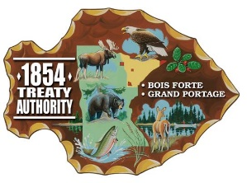





Twin Ports Climate Conversations

Slide 2
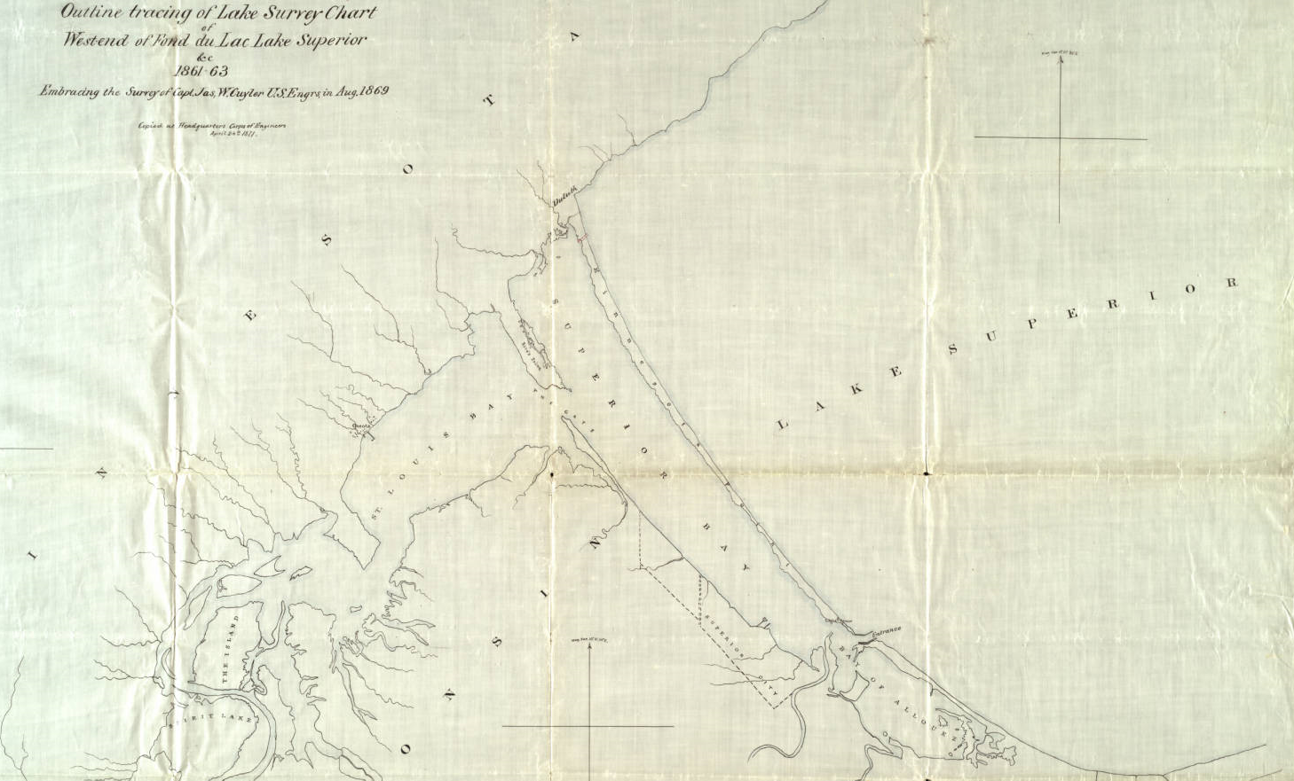
Drowned, starved, and battered: the interplay of natural and anthropogenic processes in the uncertain fate of Minnesota Point
6
John B. Swenson
Department of Earth and Environmental Sciences
University of Minnesota Duluth
218-726-6844
jswenso2@d.umn.edu

Slide 3
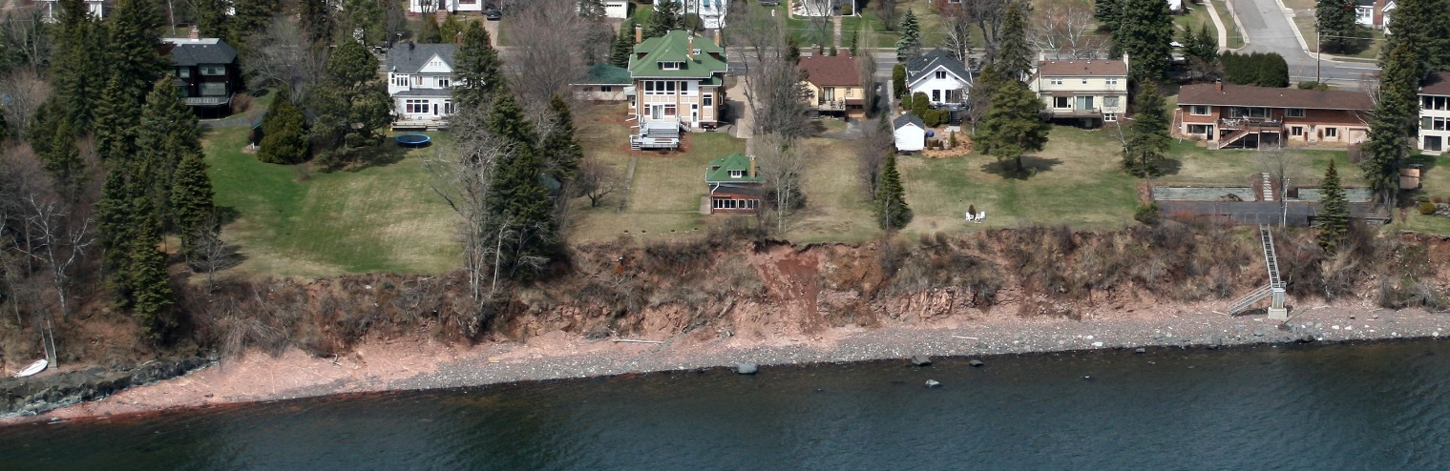

Motivation
Photo in next image
Childhood / current home
2007 photo
Bluff edge (2019)
Bluff edge (1967)
2 m

Slide 4
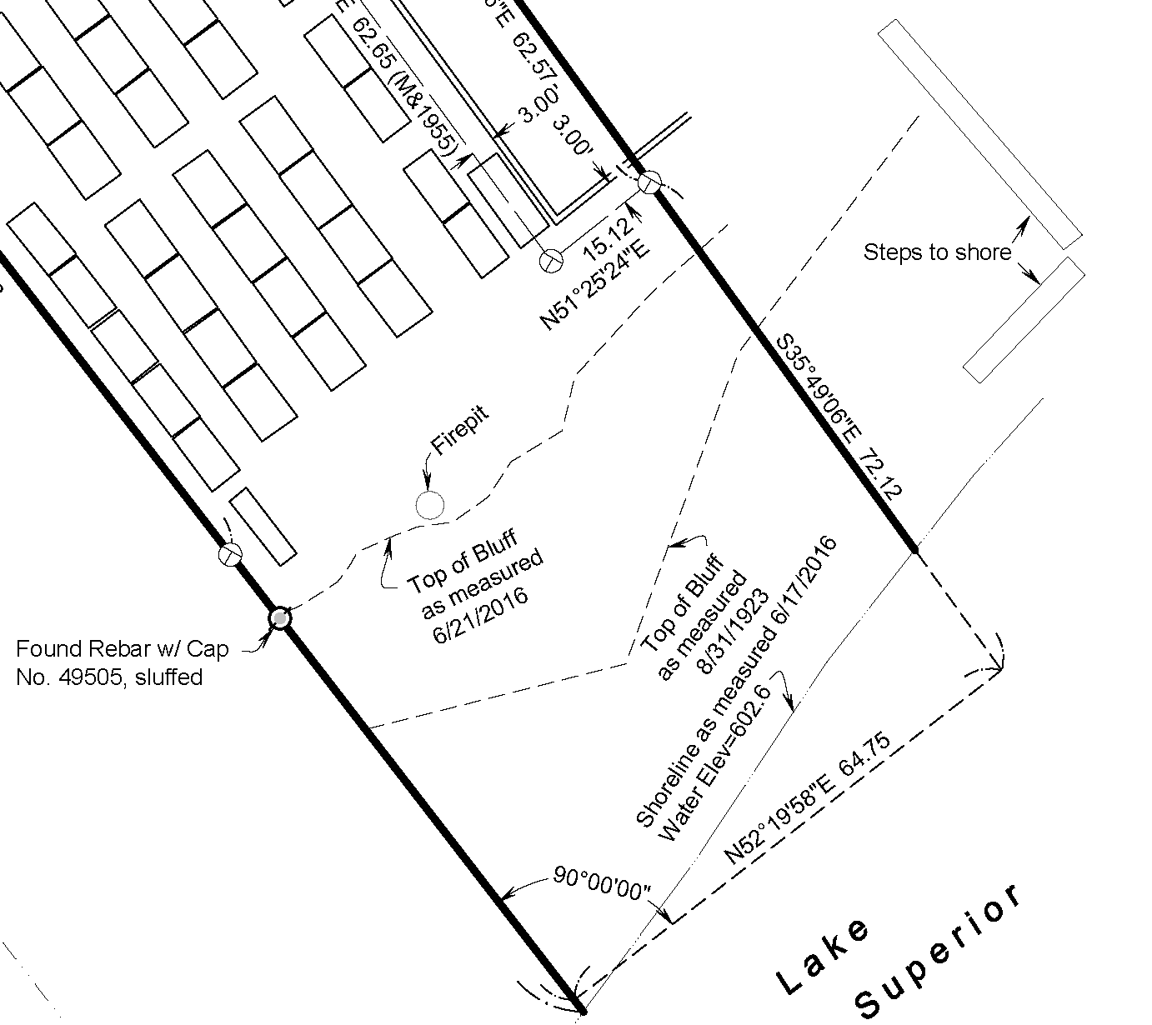
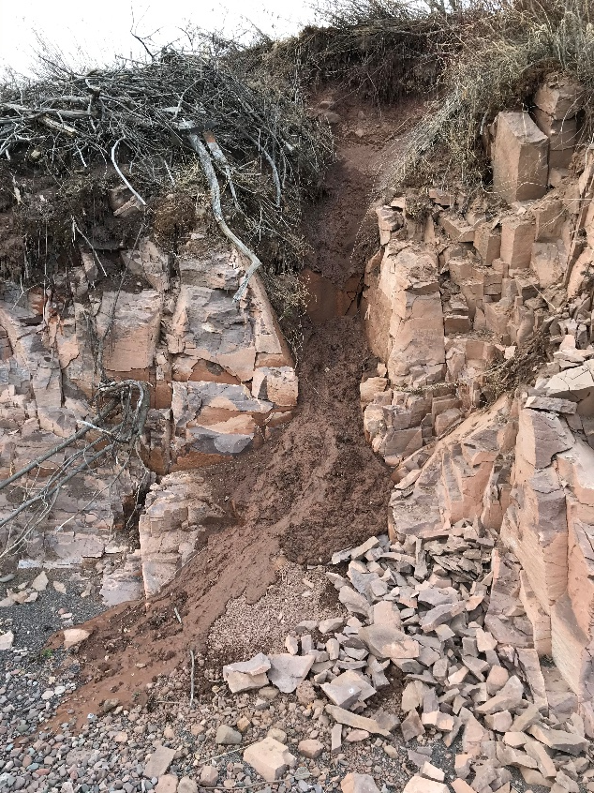
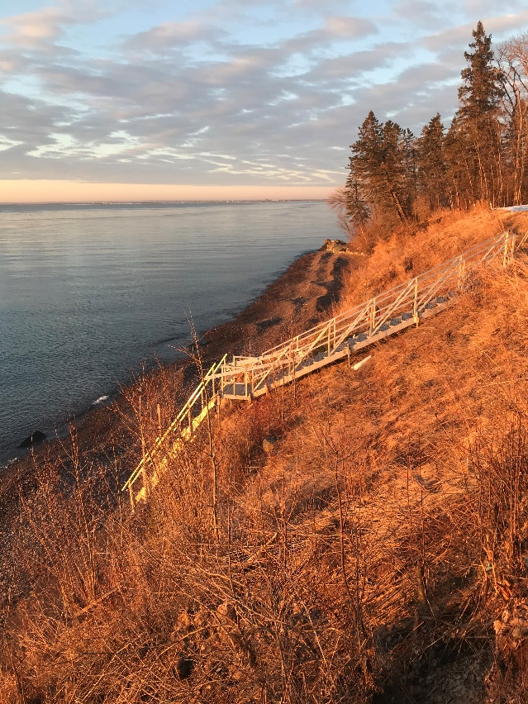
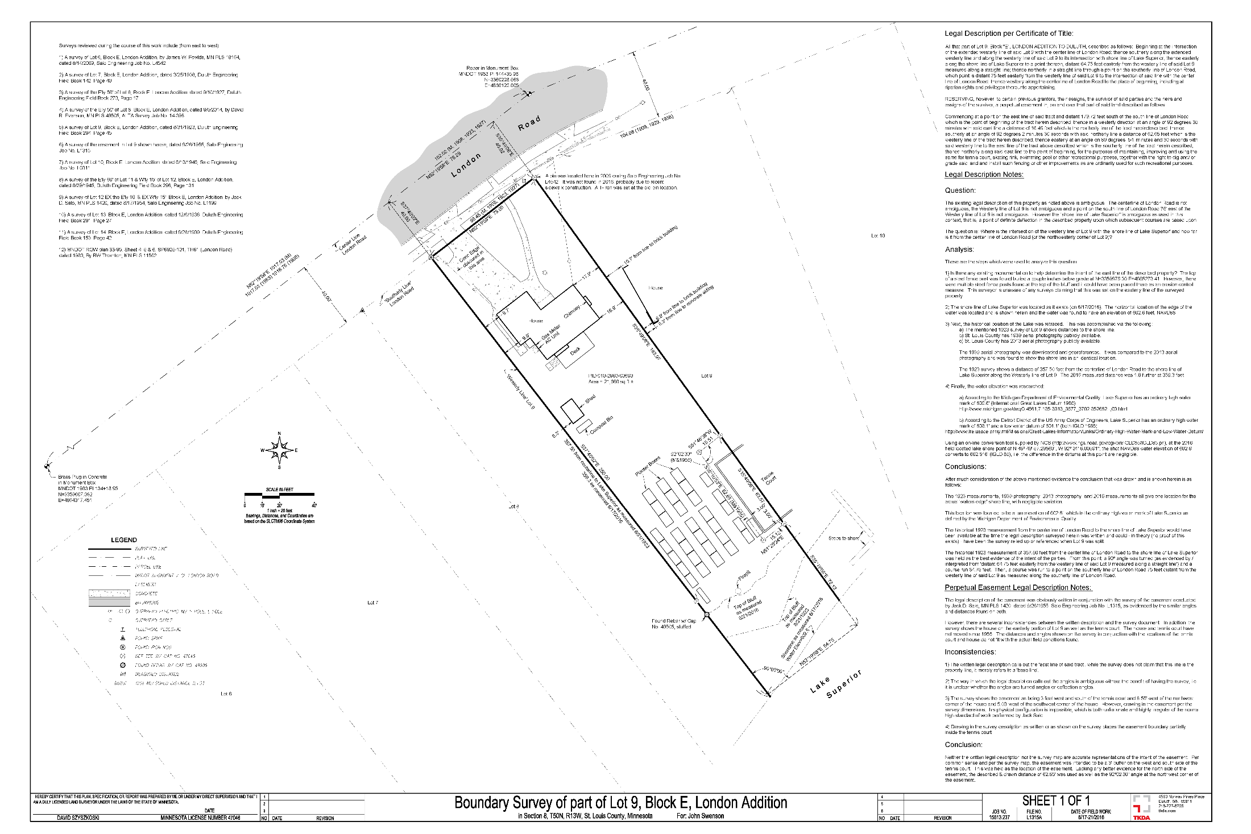
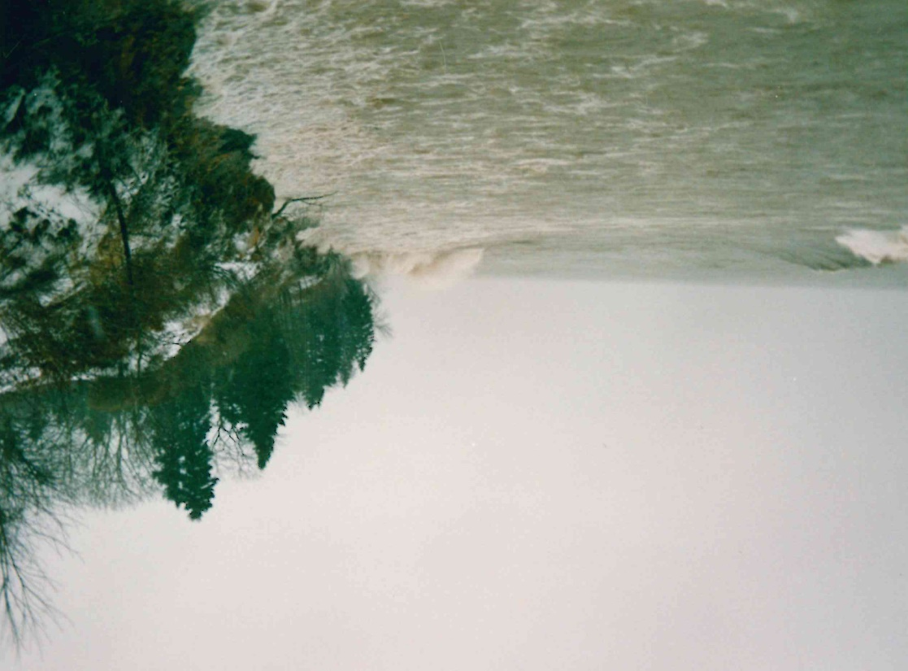
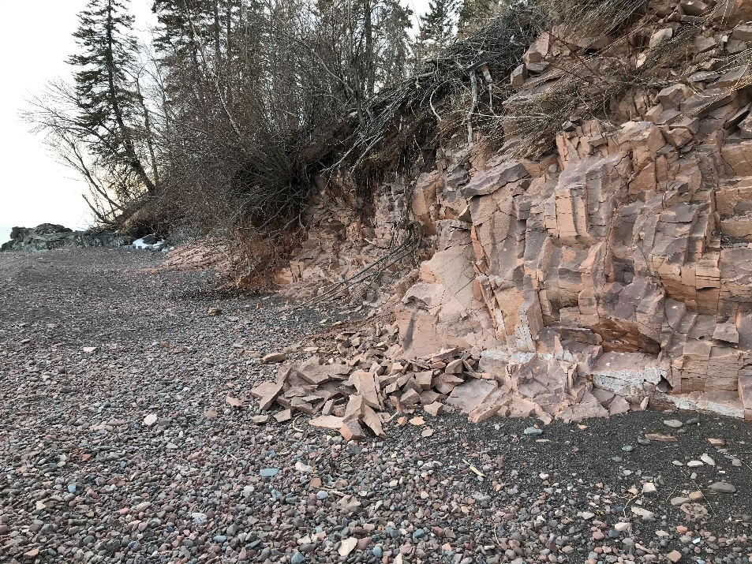
Lateral bluff retreat rate ~ 8 cm/yr
2016 bluff edge
1923 bluff edge
Key point: Despite lack of tectonics, we have a very dynamic coastline
Fate of eroded material?
6 m

Slide 5
Goals of this talk:
Highlight recent research by myself, students, & collaborators
Synthesize our work with previous research
  Assemble the pieces of the puzzle…
Present a long-term, source-to-sink model framework for erosion, transport, and deposition (sediment pathways) in the Duluth coastal region
Use model framework to discuss the effects of anthropogenic infrastructure (‘starved’) and climate change (‘drowned and battered’)
Expenditure of tens of millions of taxpayer dollars requires sound understanding of sediment pathways and rates

Slide 6

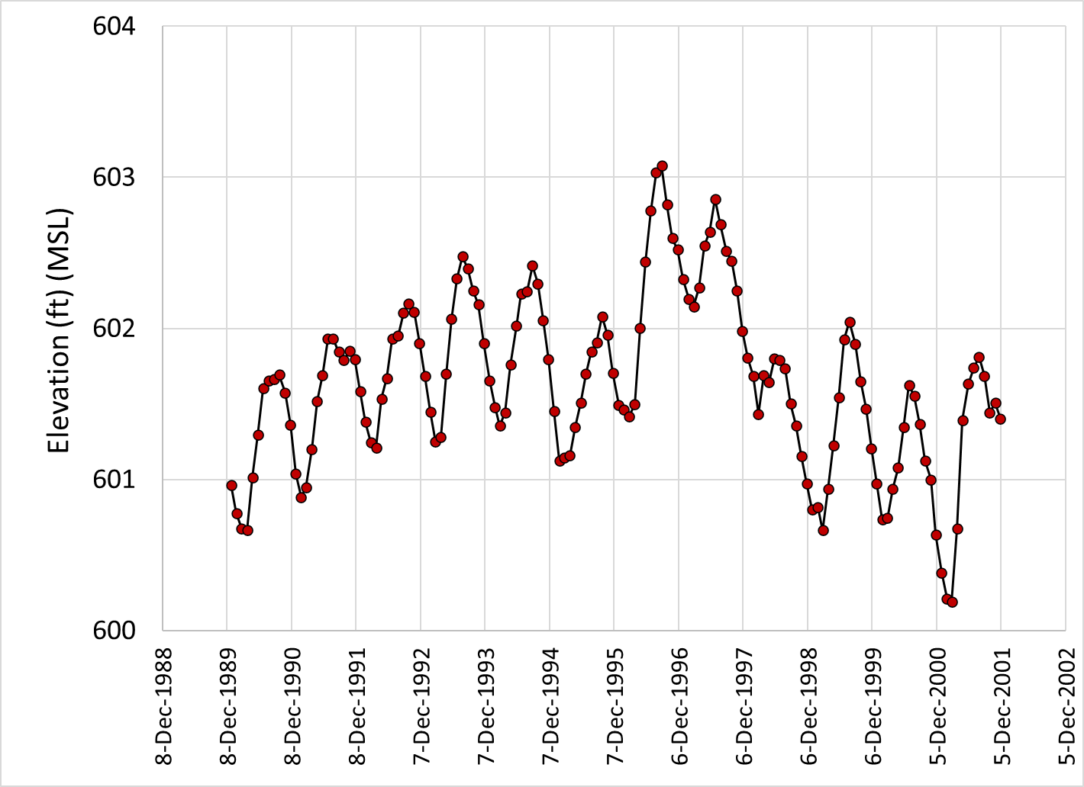
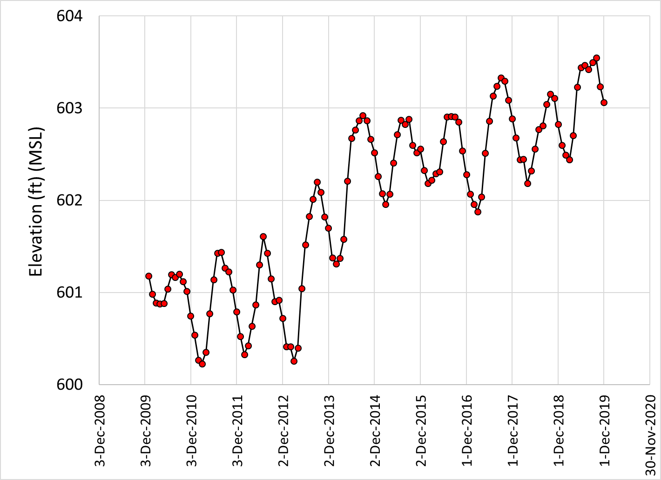
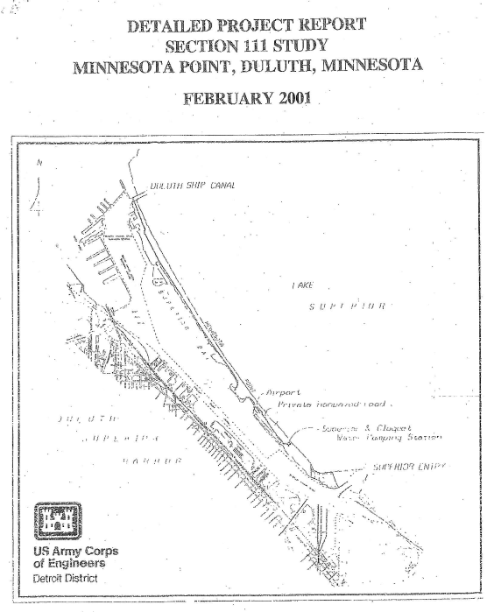
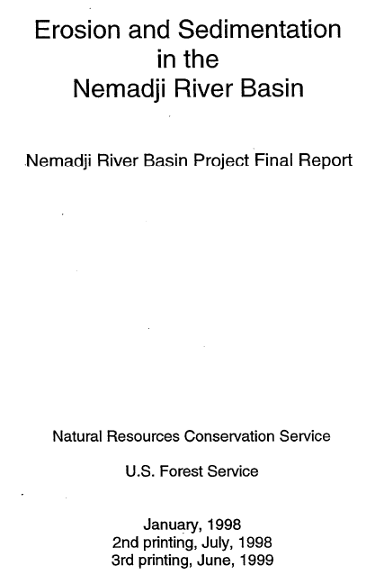
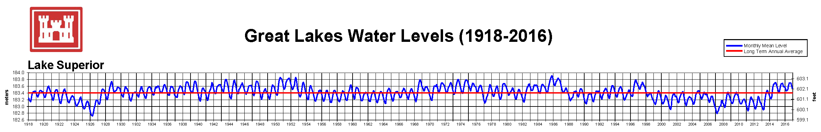
Lake Superior level
(2009 – 2019)
Déjà vu?
Last ‘highstand’ triggered key studies…
My take-home message:
Coastal erosion in western Lake Superior is a persistent ‘problem’ over the last 1200 +/- years
Driver for erosion is long-term lake-level rise (2 - 3 mm/yr)
Long-term rise and associated erosion ‘problem’ gave us Minnesota Point…
…and the Duluth-Superior Harbor

Slide 7
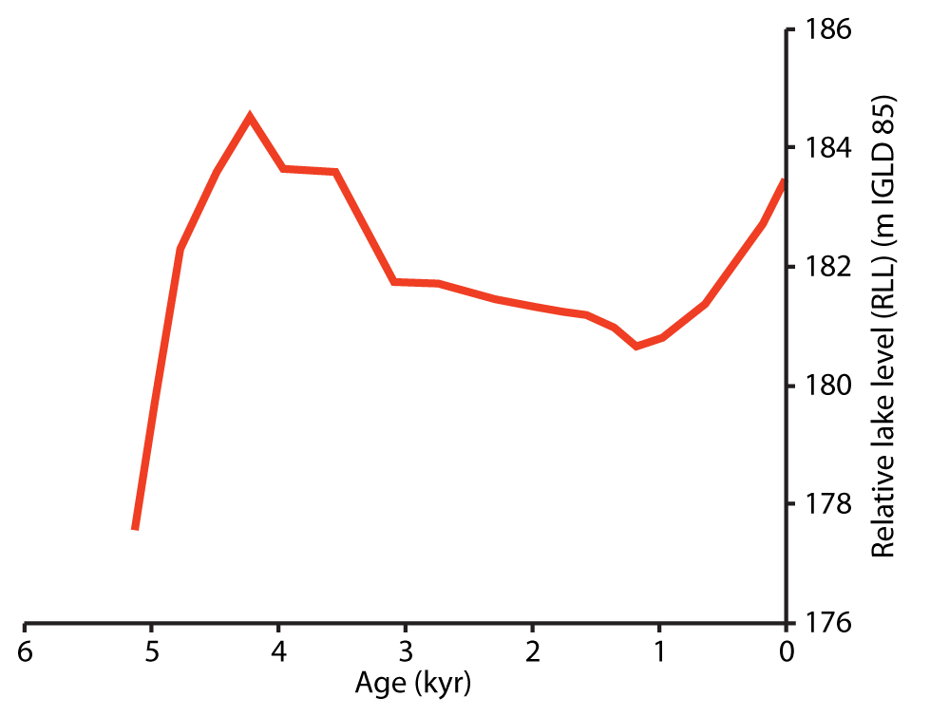
Long-term lake level change in Duluth area
Lake-level curve by Andy Breckenridge (UWS; unpublished; pers. comm.) based on earlier work by Johnston et al. (2012) and Yu et al. (2013)
Slowly falling lake level from about 4500 yr BP – 1200 yr BP
Birth of Park Point?
Change in outlet of Lake Superior @ ~ 1200 yr BP triggers rise in lake level
‘slow’ fall
Rise rate ~ 2.5 – 3.0 mm/a in Duluth = FAST (geologically speaking)
~ 1200 yr BP (+/- geologic slop)

Slide 8
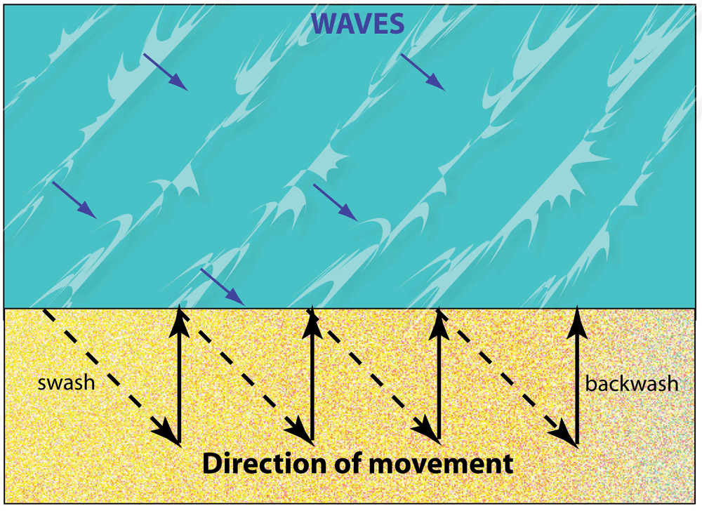
Coastal processes 101: Waves and longshore transport
Angled approach of wave crests to the shoreline sets up a longshore current of water and SAND
Longshore ‘drift’ (transport) = ‘River of sand’
wave crests
Longshore transport
Longshore transport
Longshore transport

Slide 9
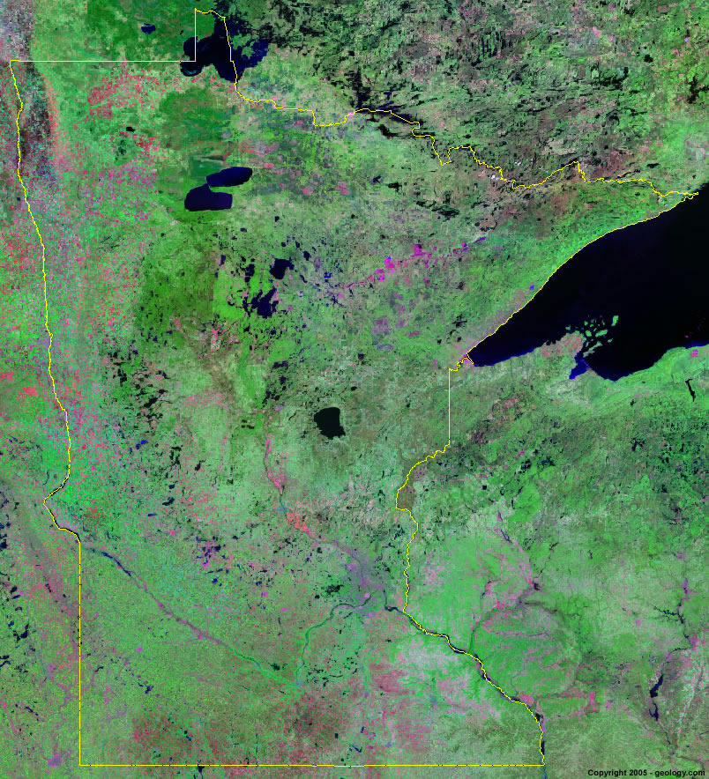
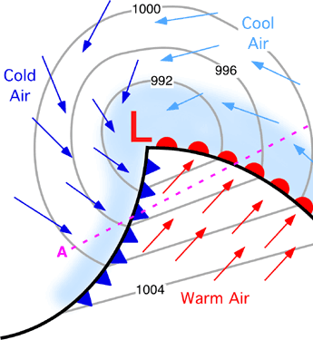
Alberta Clipper
Nearly all cyclone tracks generate period of E – NE flow in the western arm of Lake Superior
Colorado Low / Texas Hook

Slide 10
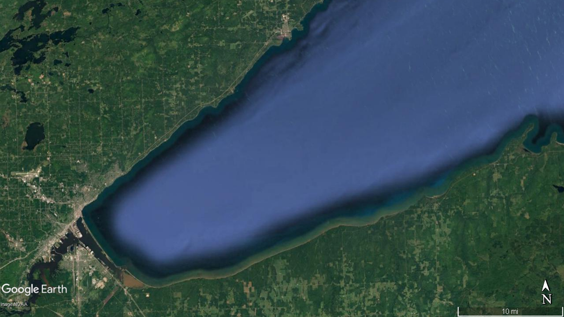
Net longshore transport near Duluth
NE wind
wave crests
convergence = deposition (SINK)
Longshore sand/gravel transport
Source of this sand?
wave crests
Longshore sand transport

Slide 11
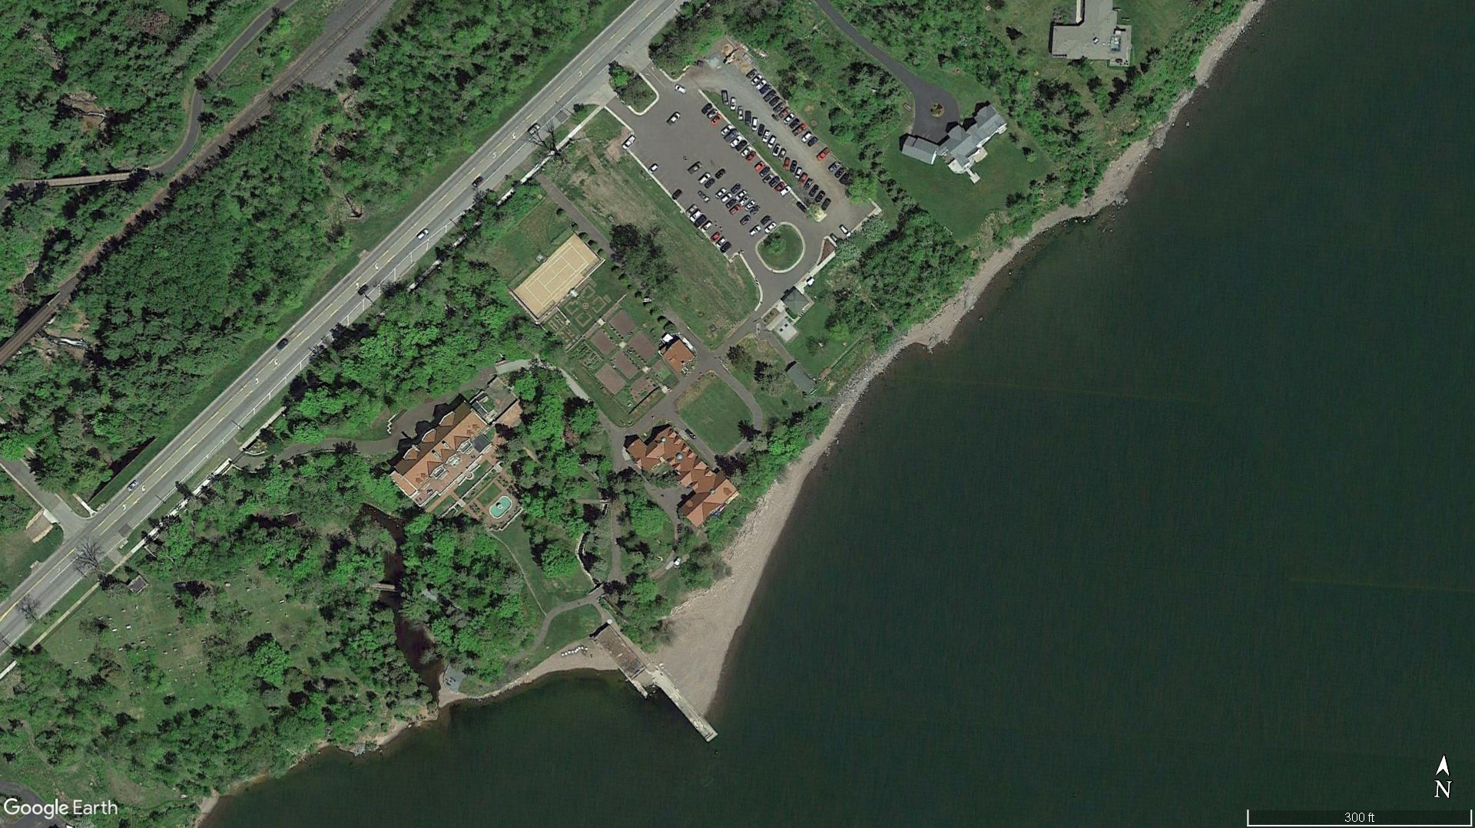
Net longshore transport near Duluth
Glensheen Mansion
wave crests
NET longshore transport
concrete dock: ‘dams’ river of sand

Slide 12
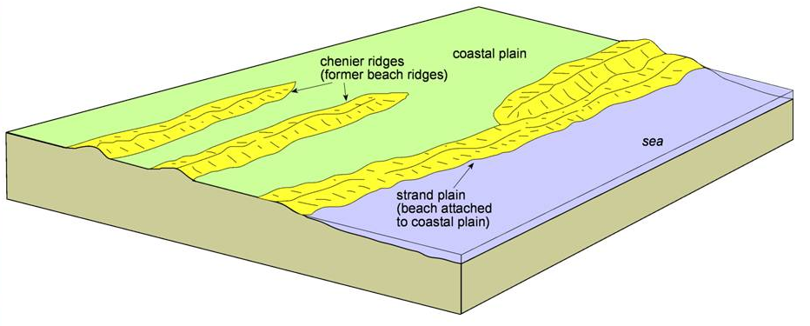
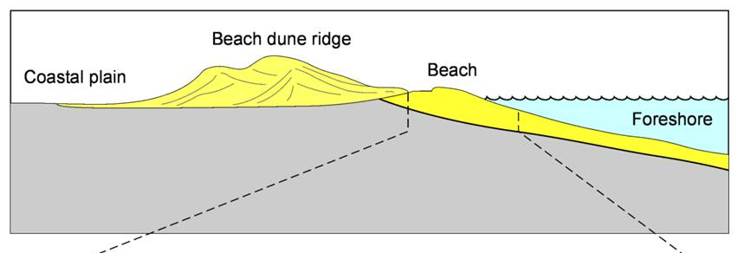
Coastal processes 101: Beaches and Strandplains
Basic constructional unit of a depositional coastline is a strandplain
Successive accretion (‘welding on’) of beach ridges builds the coastline lakeward
coastal expansion
… in net depositional coastlines
… provided lake level does not rise too quickly

Slide 13
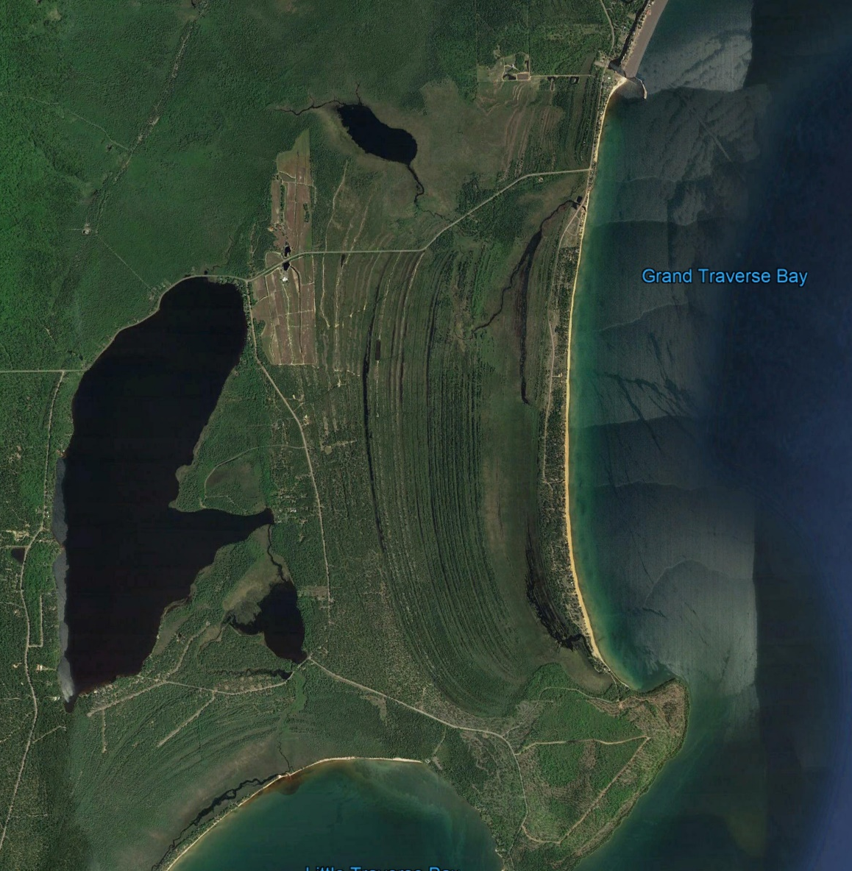
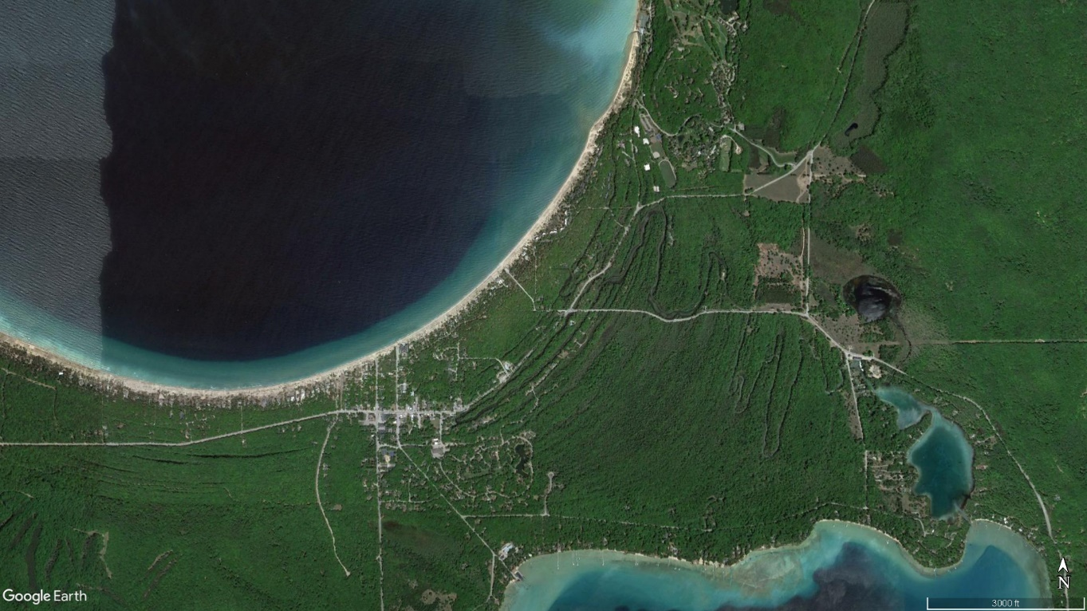
Great Lakes strandplains
Grand Traverse Bay, east shore of Keweenaw Peninsula
Key Point: Strandplains form with stable or slowly falling lake level
Glen Arbor, MI (west of Traverse City, Leelanau Peninsula, Lake Michigan)

Slide 14
Long-term lake level change in Duluth area
Lake-level curve by Andy Breckenridge (UWS; unpublished; pers. comm.) based on earlier work by Johnston et al. (2012) and Yu et al. (2013)
Slowly falling lake level from about 4500 yr BP – 1200 yr BP
‘slow’ fall
~ 1200 yr BP (+/- geologic slop)

Slide 15
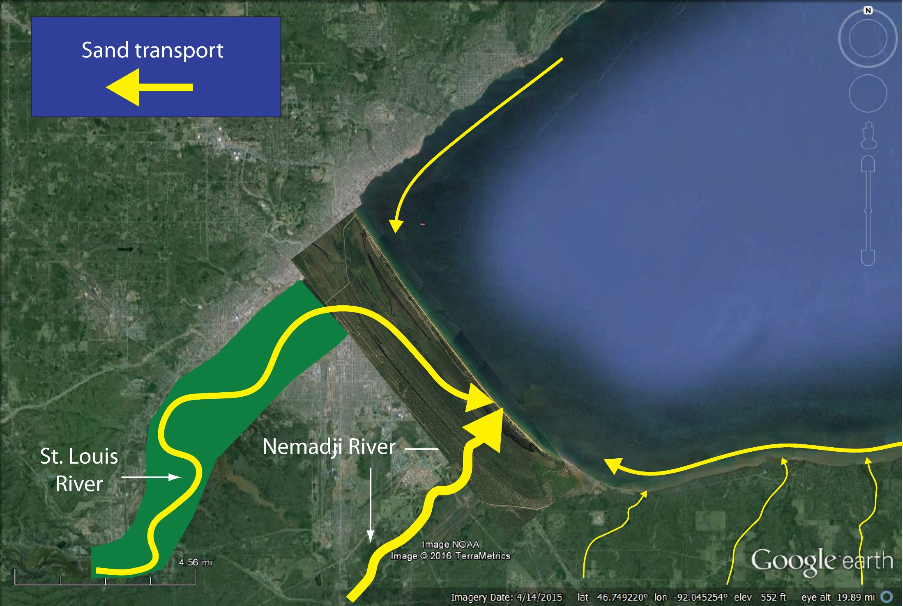
5000 – 1200 years BP: Slow lake-level fall
Sand supply mostly from St. Louis and Nemadji Rivers
Some longshore transport of sand from north- and south-shore rivers
Minor bluff erosion
Construction of strandplain (now drowned)
Ancient ‘Park Point’ = leading edge of strandplain complex
No harbor
No estuary

Slide 16
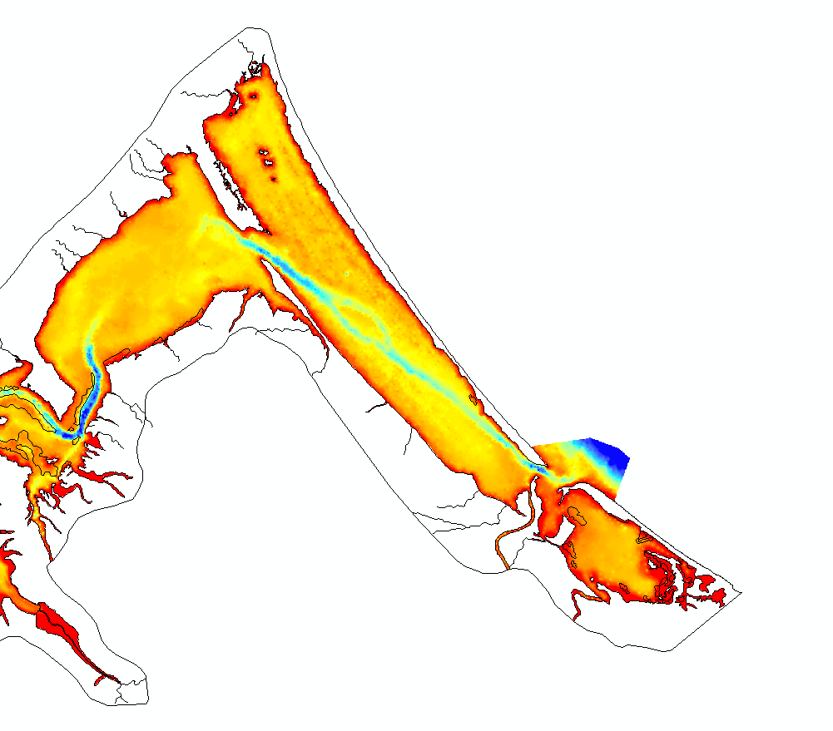
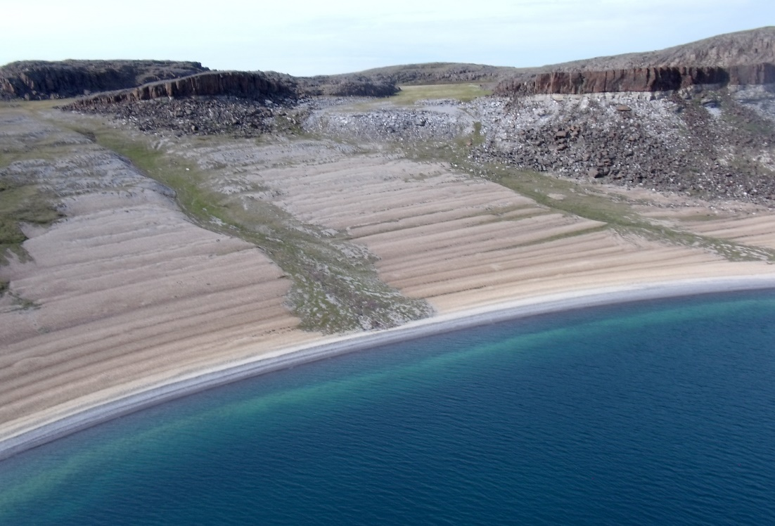
Supporting evidence for strandplain beneath harbor
An (elusive) feature like this underlies the muddy bottom of the harbor
Note curvilinear (arcuate) features in mapped 1863 bathymetry = beach ridges (drowned)
Wiki image of Bathhurst Inlet, Nunavut
Digitization of 1863 Hearding map by Andy Breckenridge and students

Slide 17
1200 years BP: Things change!
Lake-level curve by Andy Breckenridge (UWS; unpublished; pers. comm.) based on earlier work by Johnston et al. (2012) and Yu et al. (2013)
Change in outlet of Lake Superior @ ~ 1200 yr BP triggers rise in lake level
Rise rate ~ 2.5 – 3.0 mm/a in Duluth = FAST (geologically speaking)
~ 1200 yr BP (+/- geologic slop)

Slide 18
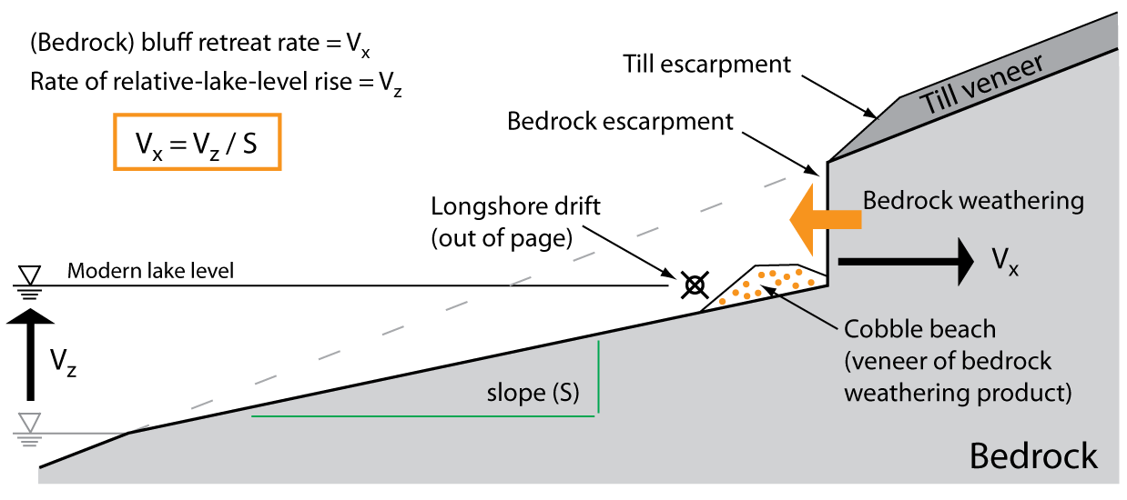
Rapid lake-level rise drives bluff erosion
Key Point: Nearshore lake-floor geometry holds information about long-term bluff-retreat rates
Contact between glacial till and underlying volcanic flow (bedrock)
Thin veneer of active beach cobbles
Diabase dike (intrusive rock): More resistant to weathering
(Lambert and Swenson, 2016)

Slide 19
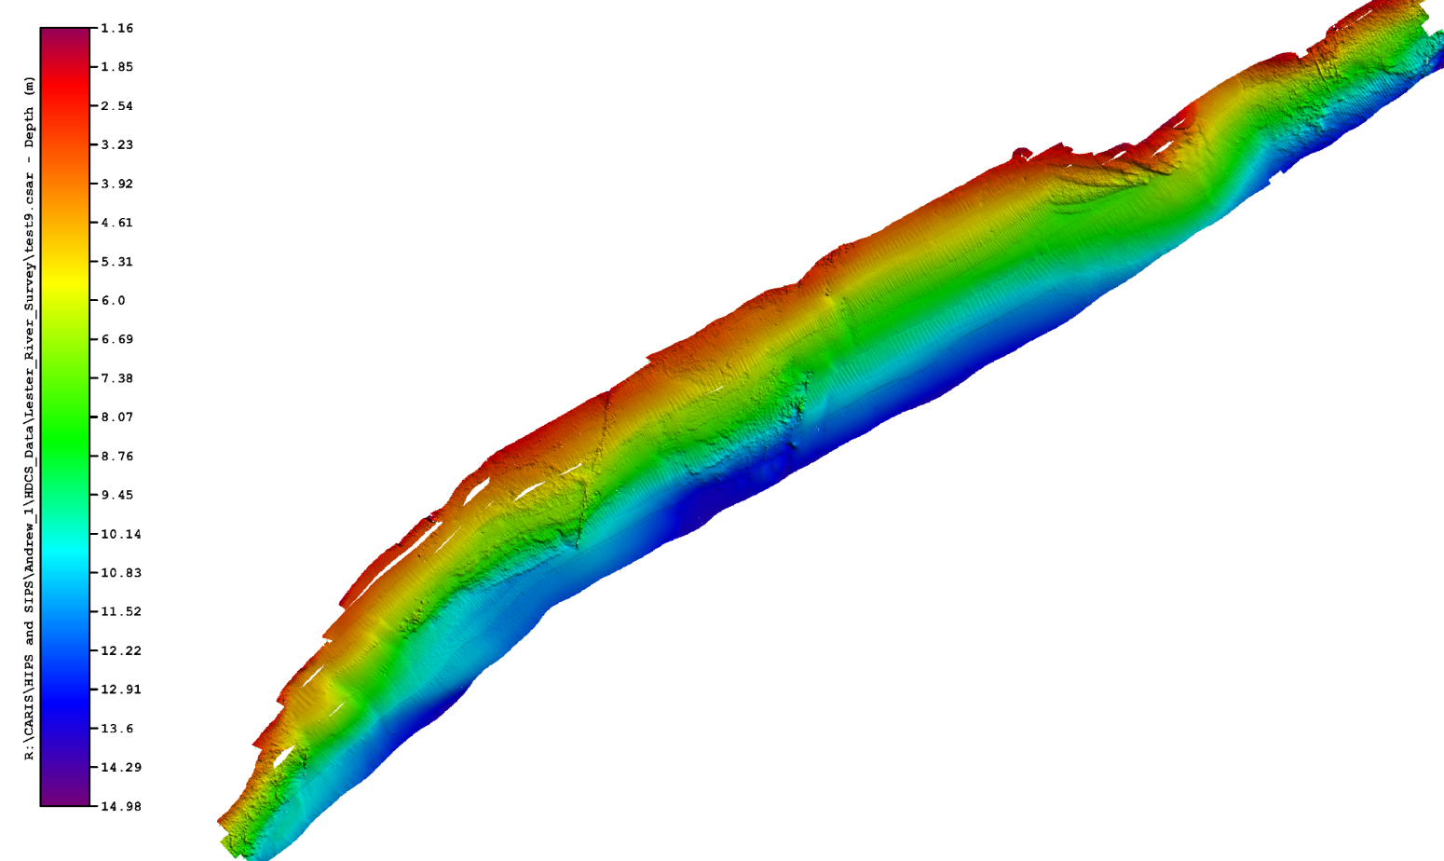
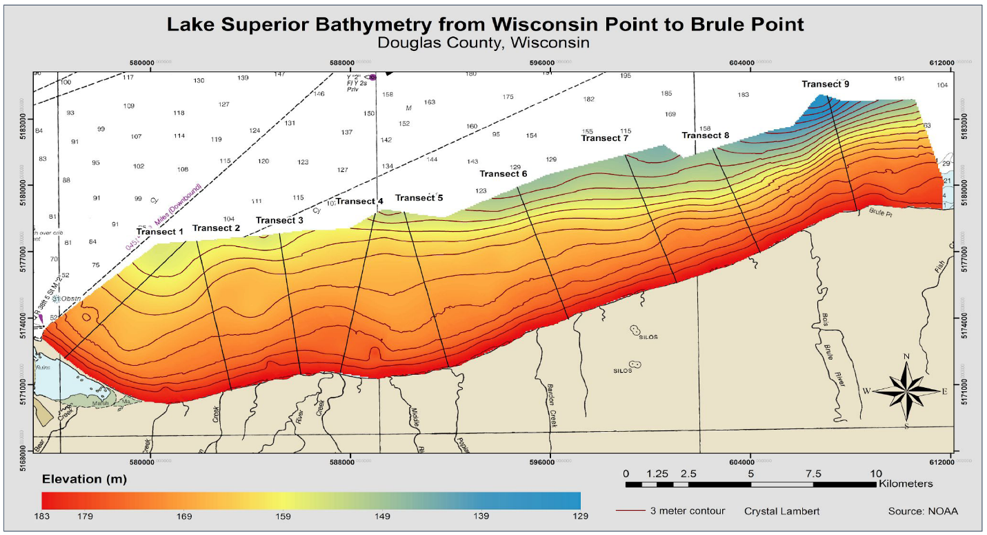
Long-term bluff erosion rates
Nearshore bathymetry, eastern Duluth
Lester River ‘delta’
My house
Multibeam data from Dennison, Wattrus, & Swenson
Nearshore bathymetry east of Superior
Lambert and Swenson (2016)

Slide 20
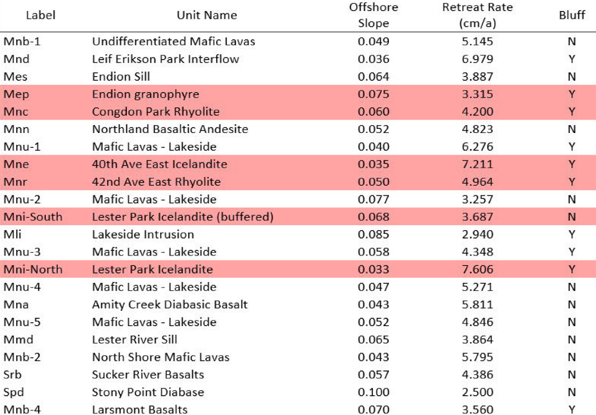
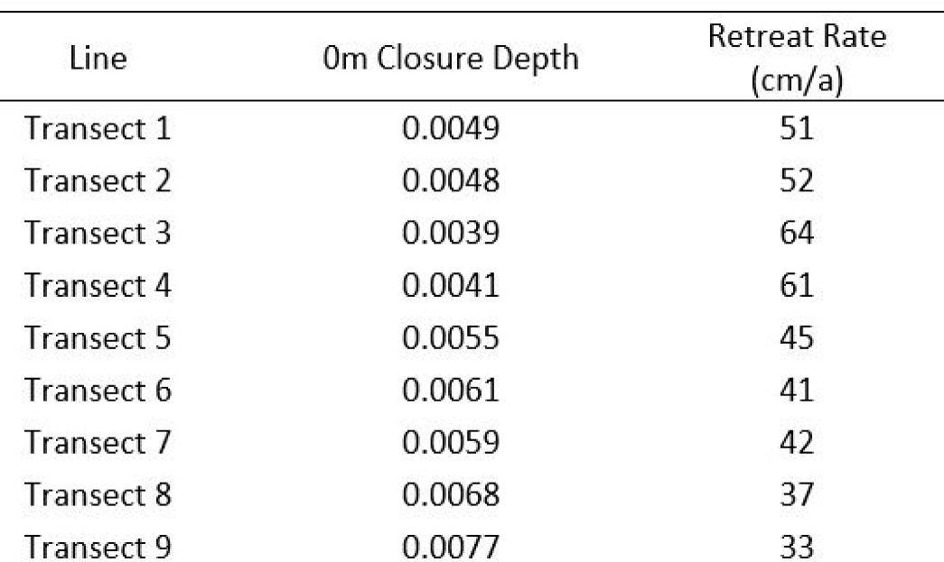
Long-term bluff erosion rates
Bedrock-cored north-shore bluff retreat rate ~ 4 cm/yr
Large variability because of mixed lithology, e.g. rhyolite vs. basalt vs. diabase
Offshore slope
Lambert and Swenson (2016)
South-shore bluff retreat rate ~ 40 cm/yr
Mechanically weak, unconsolidated till
Less variability -> homogenous till

Slide 21
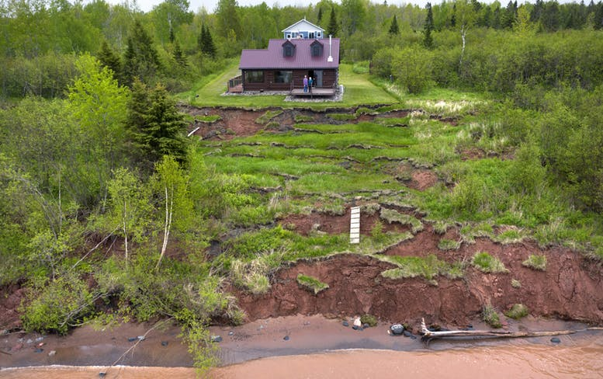
Bluff retreat is driven by rise in lake level from 1200 yr BP - present
North shore retreat rate ~ cms / year
Large variability (tied to lithology)
~ 4 cm/yr
South shore retreat rate ~ TENS of cms / year
Less variability (~homogeneous material)
What is the fate of this eroded material?
~ 40+ cm/yr
Image: Star Tribune

Slide 22
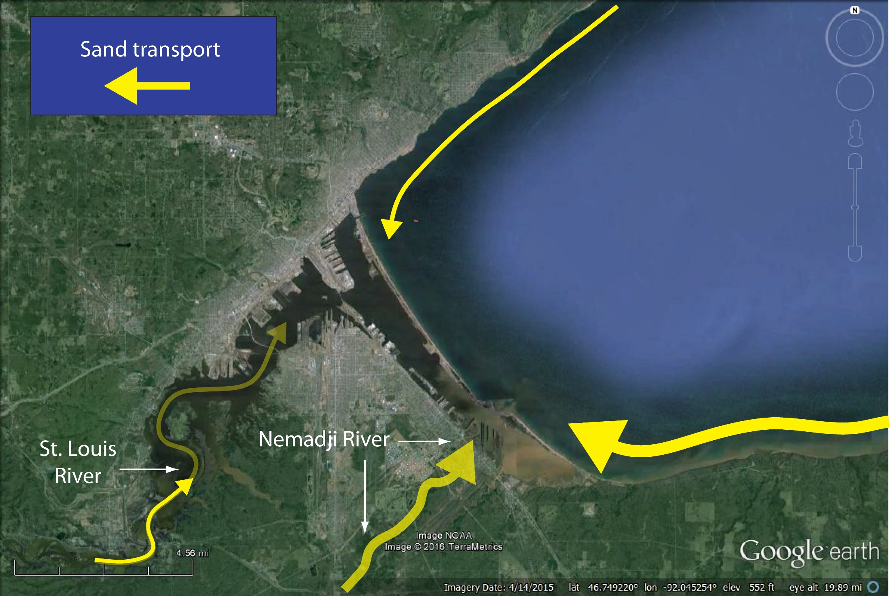
1200 years BP - modern: Rapid lake-level rise
Sand supply from erosion of south-shore bluffs dominates budget
Order of magnitude less from north shore bluffs
St. Louis and Nemadji Rivers contribute almost nothing because of progressive drowning and trapping in estuary
Abandonment (?) and drowning of strandplain
Northwestward growth of current Minnesota / Wisconsin Point (?)
Harbor and estuary formation
(almost) the only show in town

Slide 23
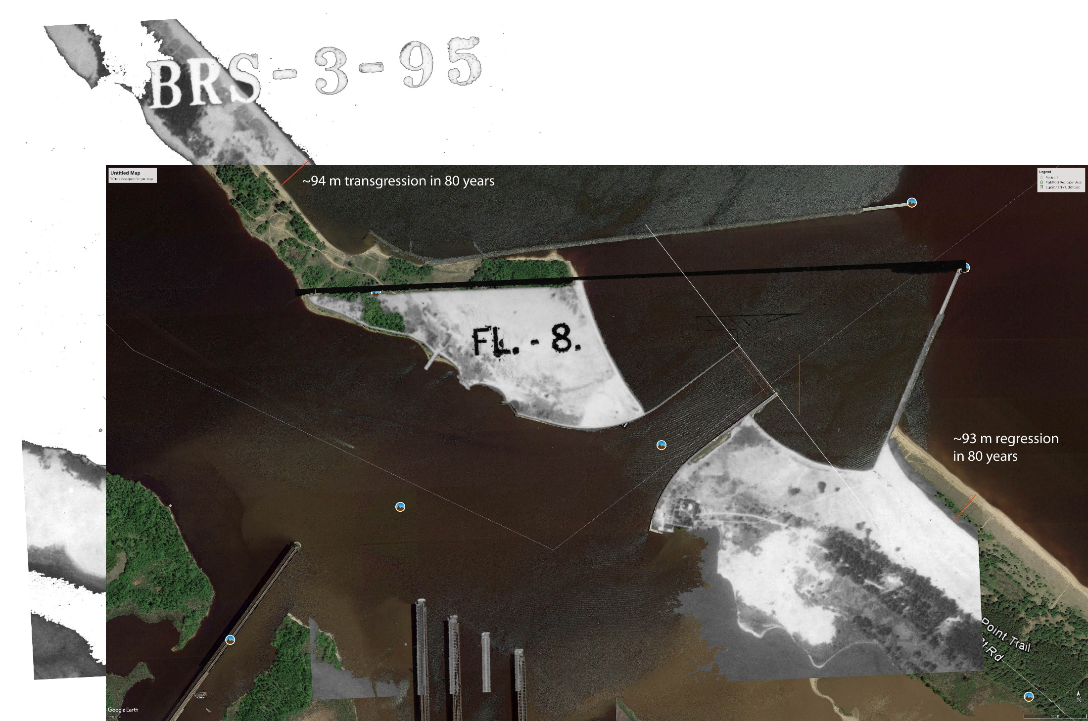
The ‘infrastructure’ problem: Starvation
Superior entry forms nearly perfect ‘dam’ in the ‘river of sand’ from south shore
~ 90 m erosion in 80 years
~ 90 m growth in 80 years
Overlay of 2017 (color) satellite image and 1938 aerial photo.

Slide 24
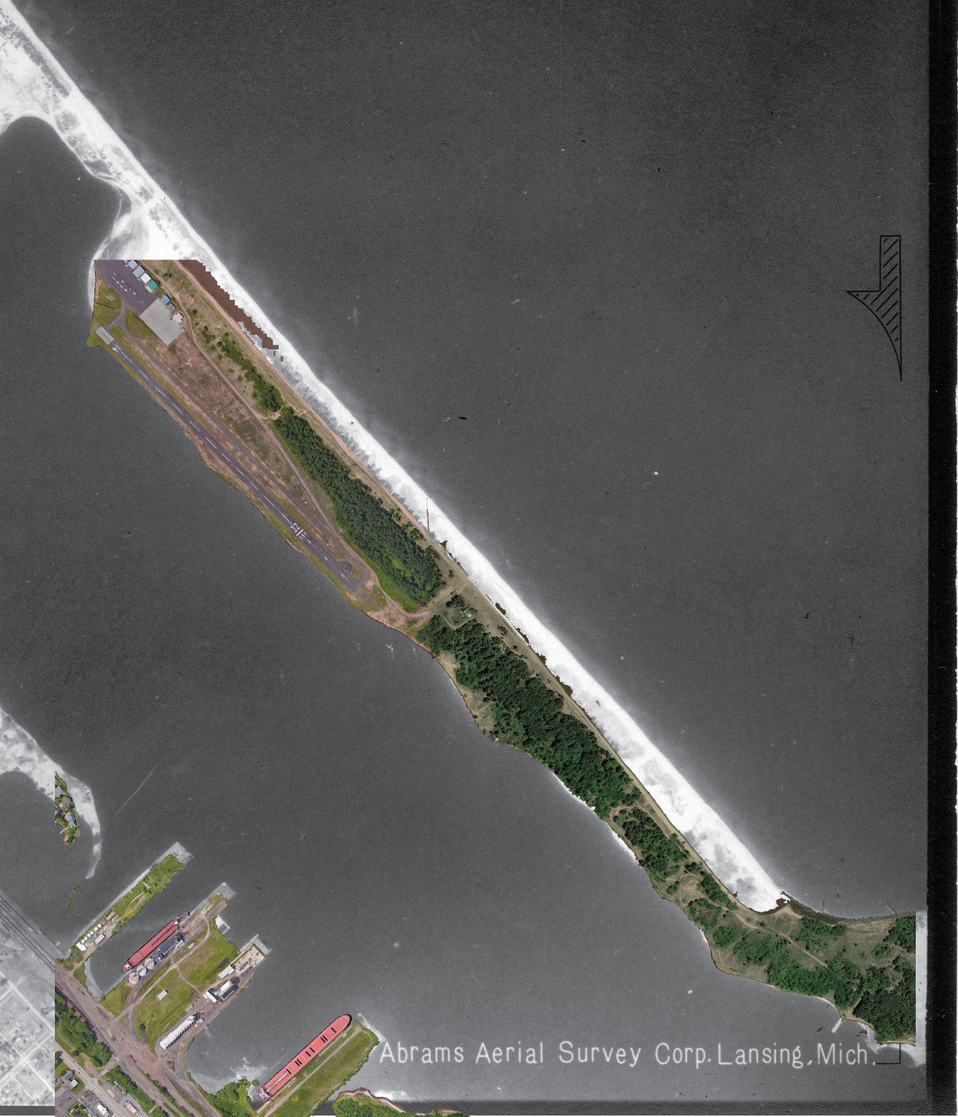
The ‘infrastructure’ problem: Starvation
Eroded sand moving ‘downstream’
Similar story with the Duluth breakwater
Blocks sediment supply from north-shore bluff erosion
But sediment supply from north shore is significantly smaller

Slide 25
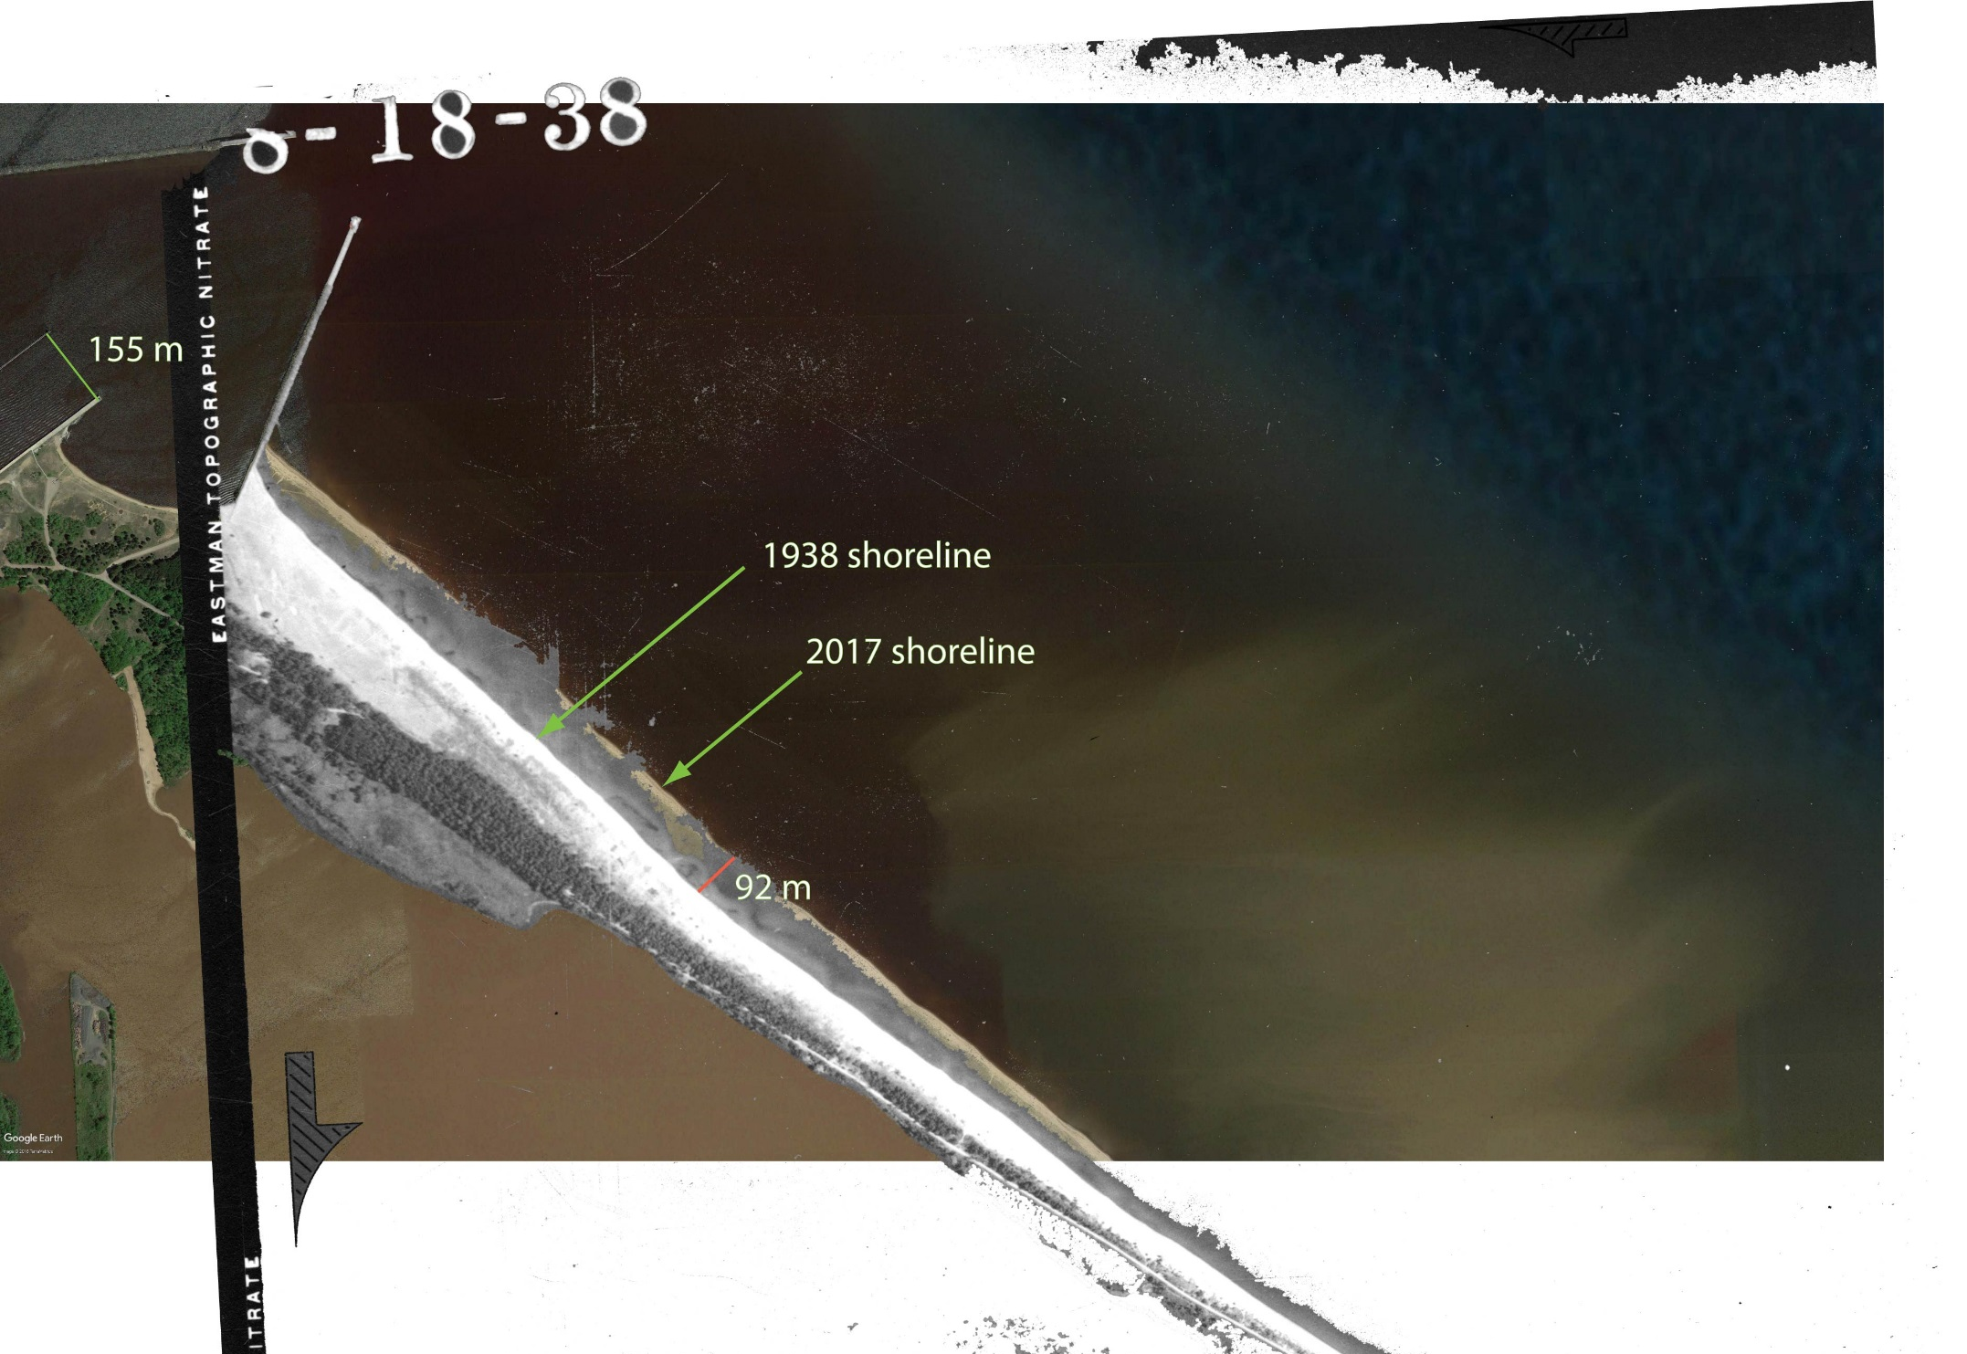
The ‘infrastructure’ problem: Starvation
Sand budget:
35,000 – 45,000 m³/yr sand
(2001 Corps estimate ~ 50,000 m³/yr sand)
Bluff erosion alone can close sand budget (little river input):
35 km of bluff x 10% sand x 40 cm/yr retreat rate x 30 m total bluff height = 40,000 m³/yr sand
Where might we find the necessary sand volume to nourish Minnesota Point downstream of the Superior entry?

Slide 26
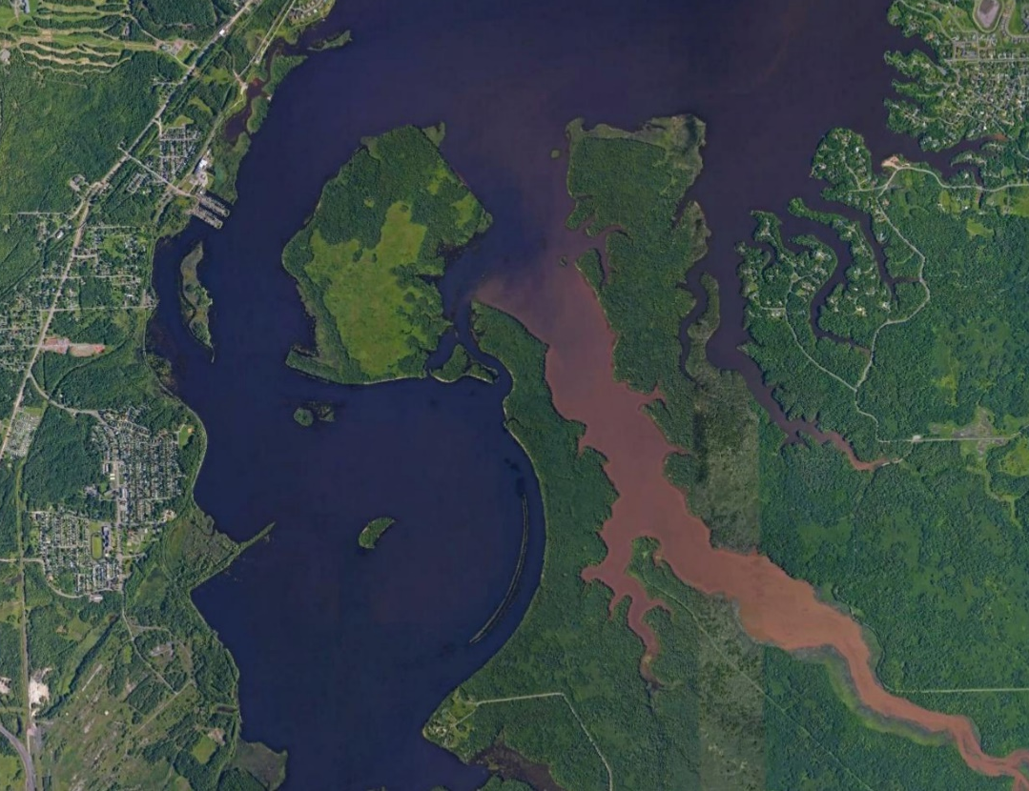
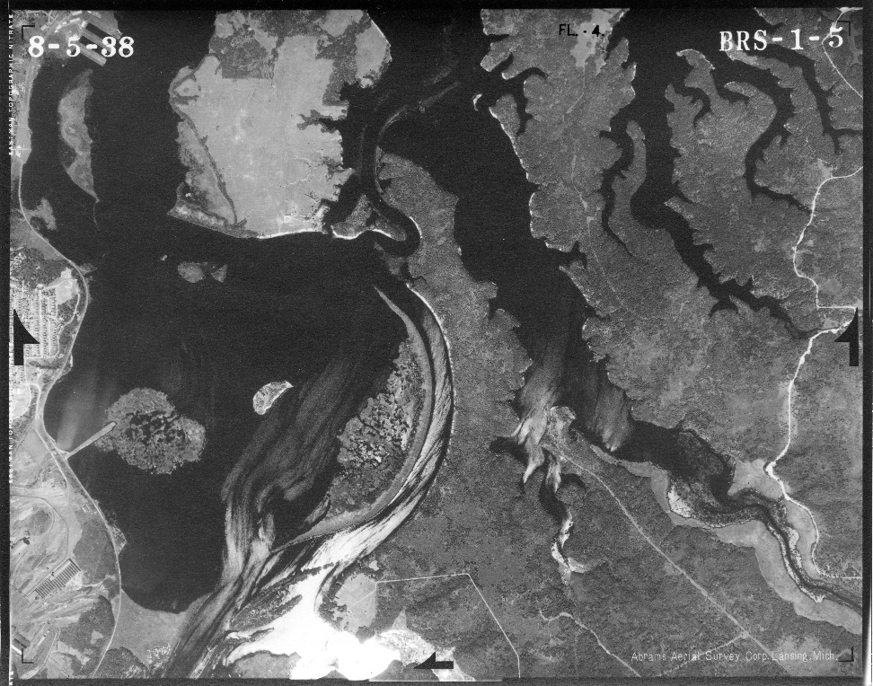
Modern sand sources: What about the St. Louis River?
1861
2017
1938
Note progressive drowning of RELICT (inactive) SAND levees over 160-year timespan
Little sand was reaching Spirit Lake in 1860 (pre-dam era)
Where was it deposited?

Slide 27
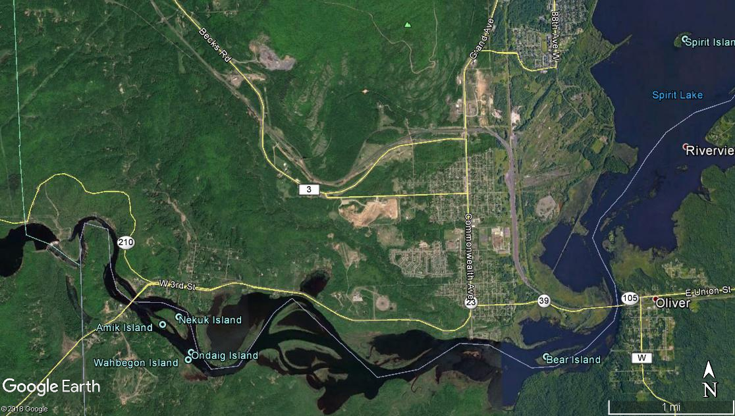
St. Louis could deliver sand to lake (strandplain) during 4.5 – 1.2 kyr BP RLL fall
Onset of RLL rise at 1.2 kyr BP drowned river mouth and drove depocenter ‘upstream’
Last position (pre-dam) was Fond du Lac
Modern bayhead delta (pre-dam sand depocenter)

Slide 28
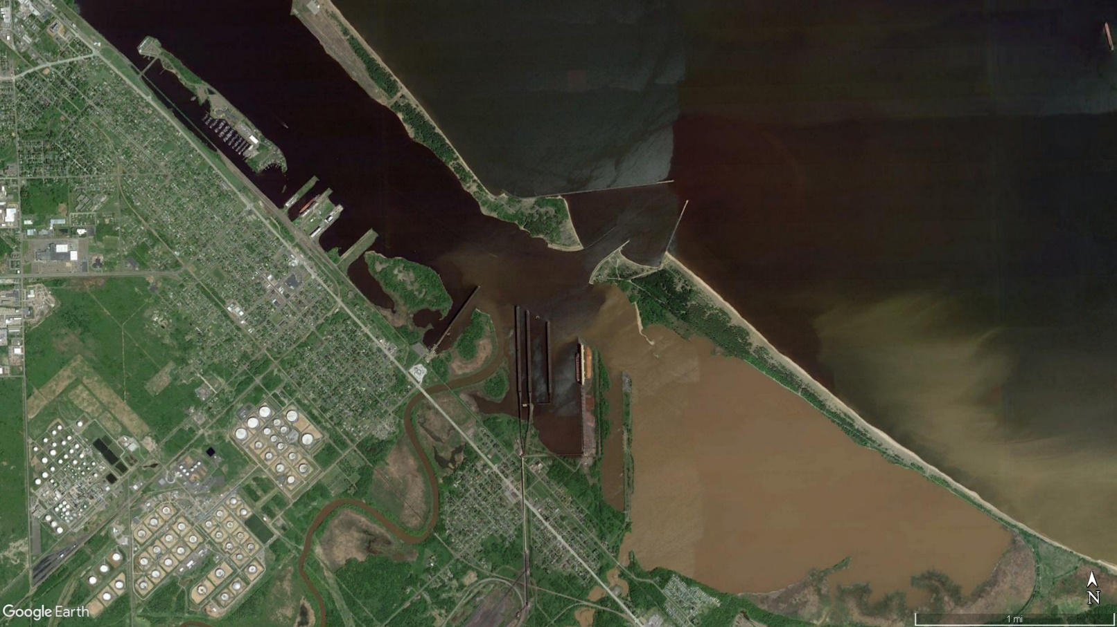
Modern sand sources: What about the Nemadji River?
Modern sand contribution from Nemadji likely is minimal
Dredging prevents Nemadji from maintaining weak connection to the lake side of the barrier
Absent dredging, Nemadji outlet would drown naturally, as well

Slide 29
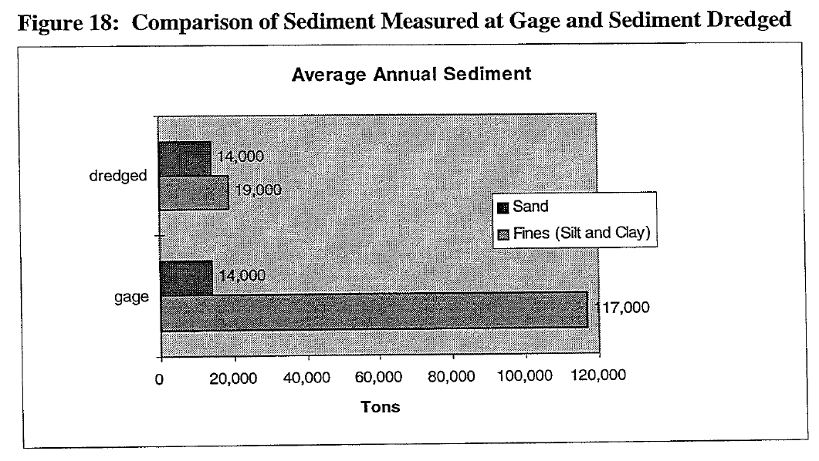
Modern sand sources: What about the Nemadji River?
gage = dredged ⬄ no Nemadji sand leaves harbor
Take-home message:
All sand trapped in harbor (and then dredged)
Significant mud transfer to lake (visual confirmation)
14,000 tons/yr ~ 6300 m³/yr
Small fraction of 35,000 – 50,000 m³/yr needed

Slide 30
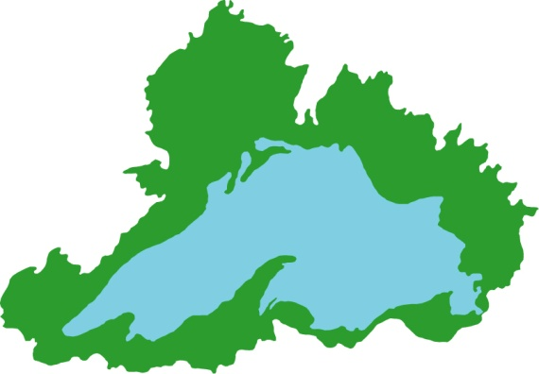
The ‘climate change’ problem: Drowned and battered
How might climate change affect Minnesota Point?
A_{C} ~ 1.5 ^{x} A_{L}
Most climate models predict increased precipitation and temperature (‘warmer & wetter’)
Perturb hydrologic budget
Increased runoff and lake level
A_{C}
A_{L}
‘Typical’ lake
Lake Superior:
Small ratio of catchment (A_{c}) to surface area (A_{c})
Somewhat less sensitive to runoff changes (?)
A_{C} >> A_{L}

Slide 31
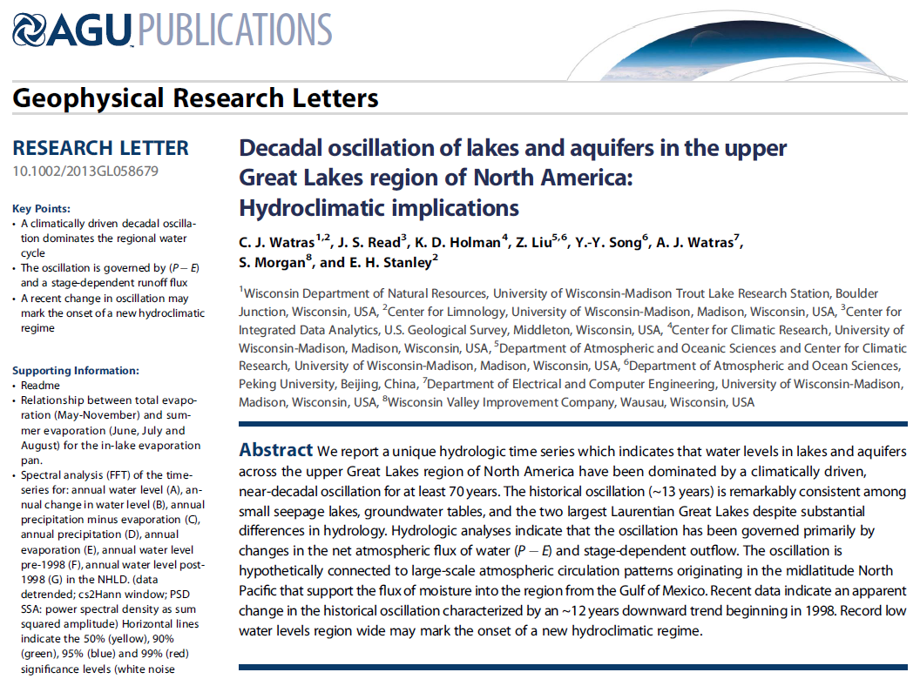
Next TPCC talk (April 21, online format)
Brandon Krumwiede
“Lake Superior Water Levels and Coastal Impacts”
Quasi-decadal cycles:
Δ Lake level ~ 60 – 80 cm
Driver: Fluctuations in atmospheric circulation
Might be changing flavor…
"NOAA National Centers for Environmental Information reports that the 12 months ending in January of 2020 is the wettest 12-month period on record in the Great Lakes basin. Moreover, the 60 months ending in January 2020 was the wettest 60-month period on record in the basin."

Slide 32
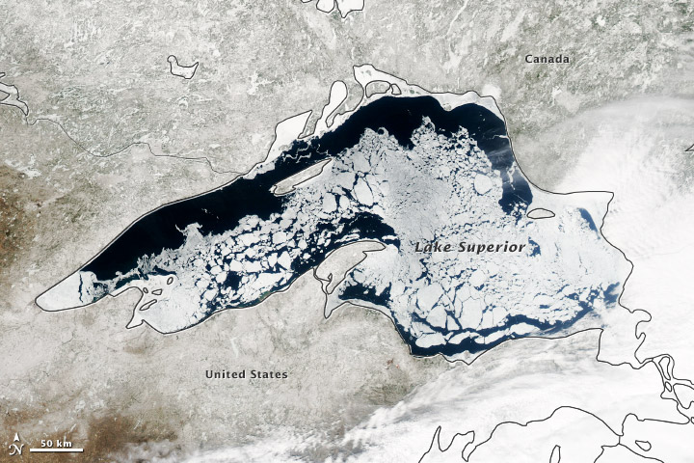
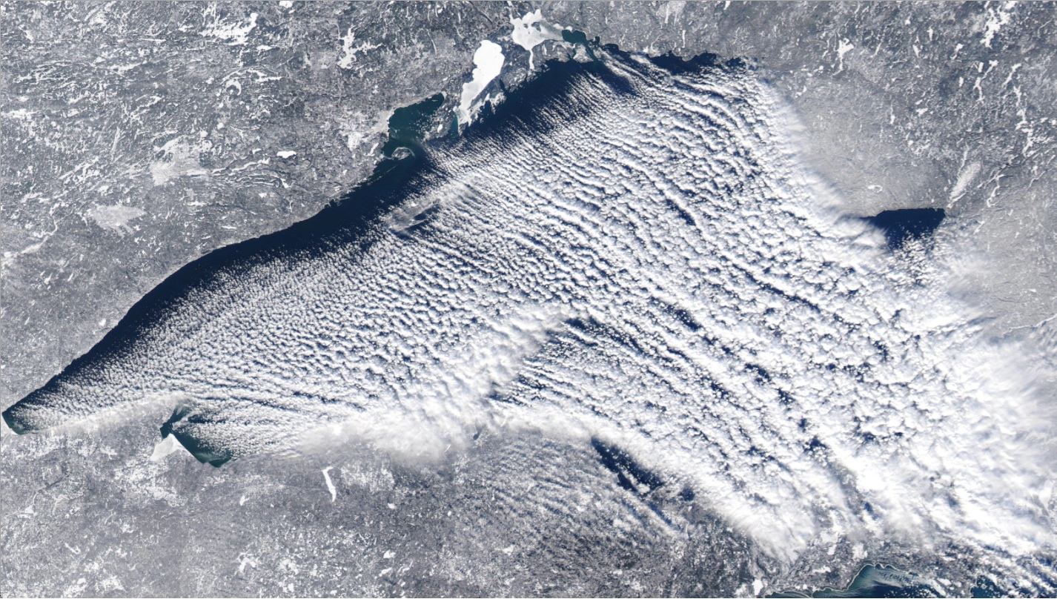
The ‘climate change’ problem: Drowned and battered
How might climate change affect Minnesota Point?
‘Winter’ evaporation extremely important…
Will a warmer climate reduce ice cover and lead to increased evaporation?
NASA Earth Observatory
https://lakesuperiorpp.files.wordpress.com/2013/12/modis-lake-effect-snow-dec-13jpeg.jpg

Slide 33
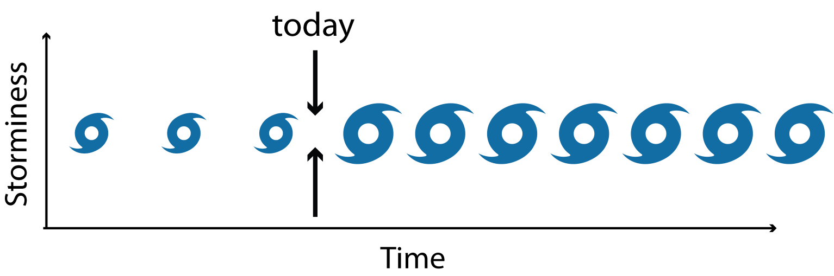
The ‘climate change’ problem: Drowned and battered
How might climate change affect Minnesota Point?
Potential for increased frequency and/or magnitude of mid-latitude cyclones and associated wind/wave field
Increased efficiency (diffusivity) of longshore transport
Rapid morphodynamic response of barrier
Modeled barrier (MN/WI points) response to climate change
Developed simple morphodynamic model of longshore transport and barrier response
Focused on Superior entry
Imposed change in transport efficiency (‘climate’ proxy)

Slide 34
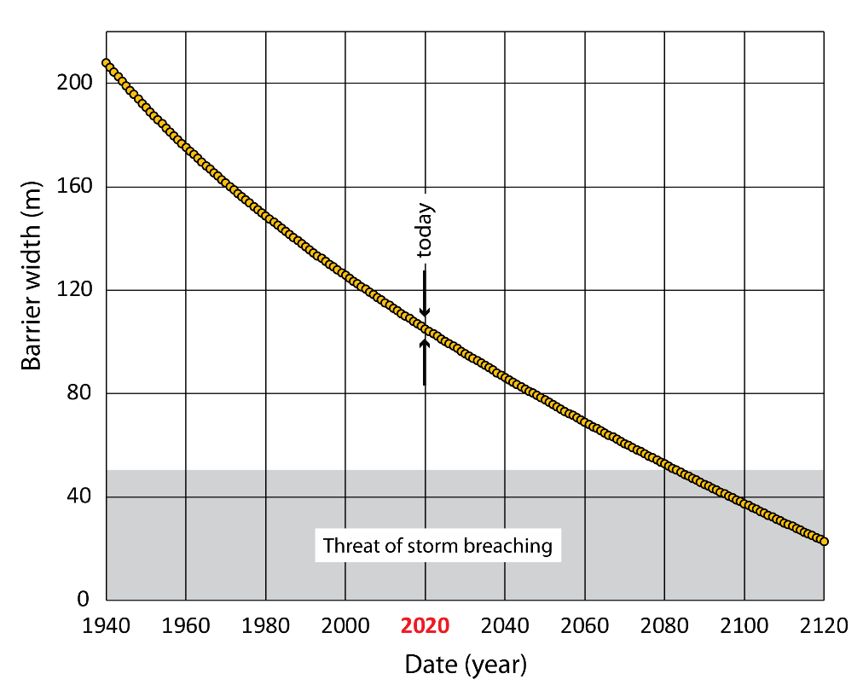
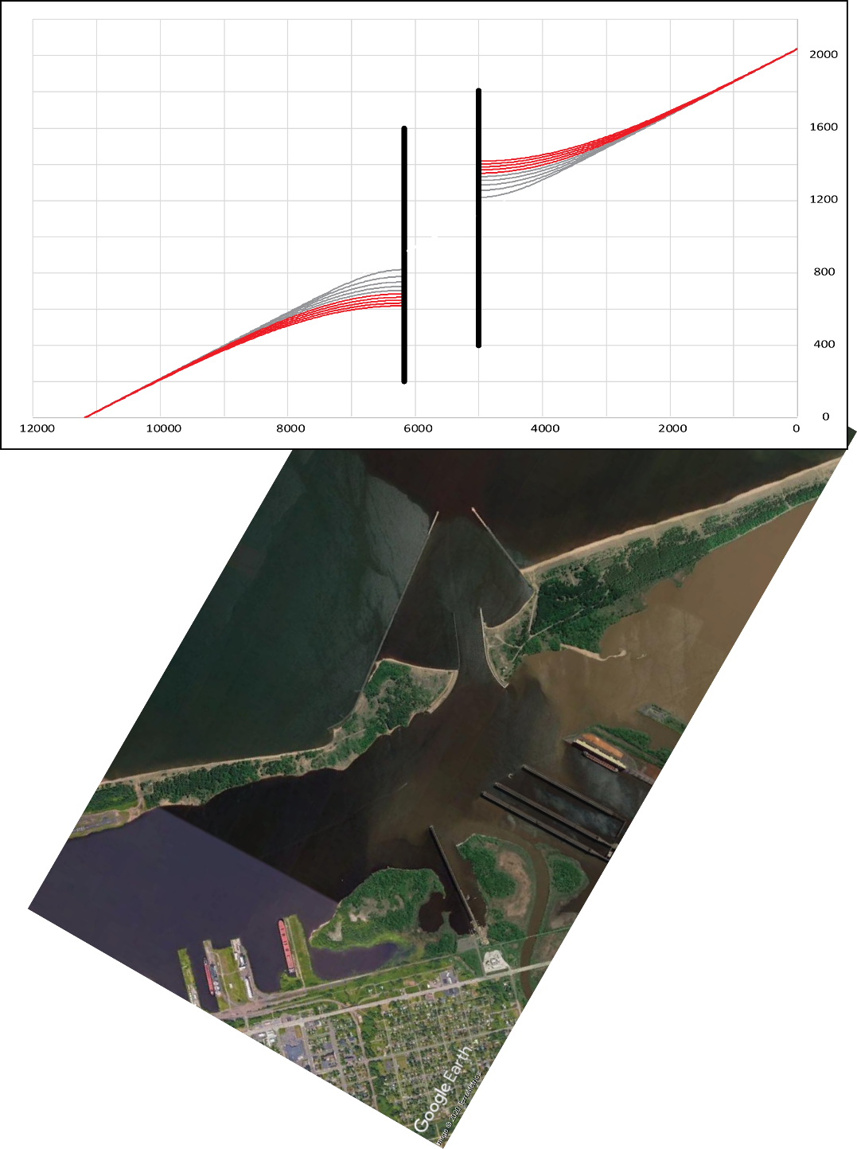
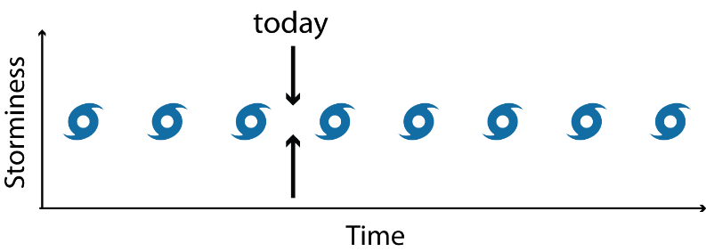
The ‘climate change’ problem: Drowned and battered
Very preliminary morphodynamic model predictions
Baseline (‘current’) climate
Beach profiles: 1910 – 2120 (20-year increments)
Gray = 1910 – modern
Red = future
Under current climate regime, barrier vulnerable to breaching within a century (very conservative estimate—likely sooner)

Slide 35



The ‘climate change’ problem: Drowned and battered
Doubling of ‘climate’ (increasing frequency and magnitude of cyclones)

Slide 36



Final thoughts
For their size, barrier islands are the most dynamic / ephemeral landforms on Earth
Chandeleur Islands (Mississippi delta)
Drowned:
Sea level rise & sediment compaction (subsidence)
Starved:
Trapping of sand supply behind upstream dams
Battered:
Increasing frequency and magnitude of tropical cyclones
X
Drowned:
Post-glacial lake level rise
Starved:
Trapping of sand supply behind breakwaters
Battered:
Increasing frequency and magnitude of mid-latitude cyclones
Katrina
X
NASA Earth Observatory
Geologic literature replete with examples of barrier systems reaching ‘tipping point’ from which there is no recovery
Drawing: ACOE (2001)

Slide 37
Questions?
218-726-6844
jswenso2@d.umn.edu

