Slide 1
How Did that Get in There?: Streaming Media in the Land of Discovery
Scott Spicer, University of Minnesota
Harry Kaplanian, EBSCO Publishing
Aaron Wood, Alexander Street Press
Charleston Conference 2012 “Accentuate the Positive!”
Nov. 8, 2012
Francis Marion, Charleston, South Carolina

Slide 2
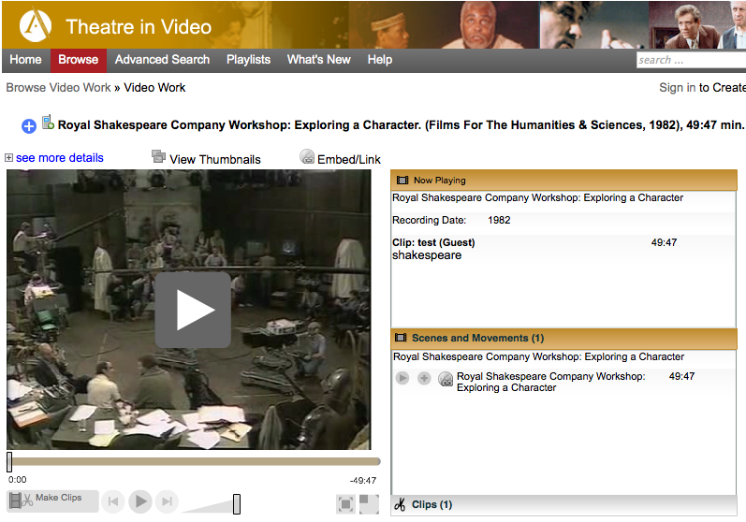
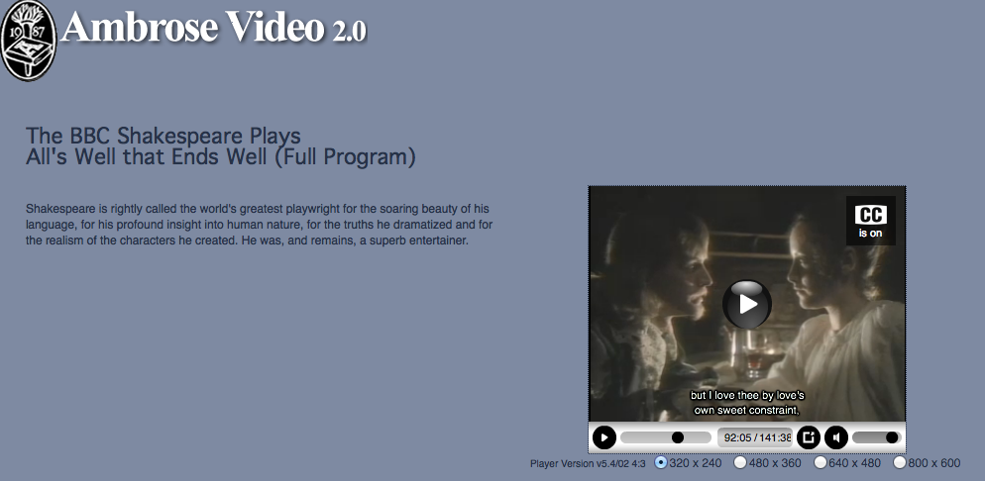
How are media meeting faculty/student needs?
Case Study 1: Performing Arts Affordances of Digital Video
Access - students need to watch BBC Shakespeare film during the summer before fall classes began to prepare for class monologues
Being able for students to view clips from Royal Shakespeare series outside of class now allows more time to focus on in-class performance (i.e., flipped classroom)
Essential value of the audio/video medium (vs. print) in conveying nuances of performance
"You can't equate reading a Shakespeare play to seeing and hearing it: it aides in clarity, relationship understanding, and is simply more interesting." - Steve Cardamone (instructor)
Notes:
Narrative: Access to streaming video (digital media writ large) is transforming teaching and learning. We need to better capture how our instructors and students are using these materials pedagogically, in order to a) better understand where to make strategic streaming collections investments (from content selection to discovery and LMS integration) and b) perhaps more importantly, to position the library as instructional design partners as eLearning/hybrid "active learning" pedagogy evolves. We need to cross the bridge between content and in-depth support of user practice.
Instructor quote:
"You can't equate reading a Shakespeare play to seeing and hearing it: it aides in clarity, relationship understanding, and is simply more interesting," referring to the Barton video series as the course "text".

Slide 3
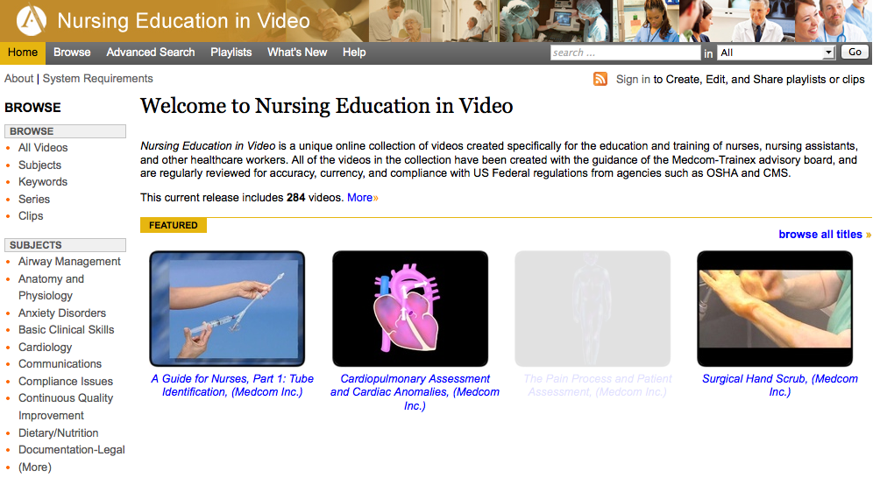
How are media meeting faculty/students needs?
Case Study 2: Nursing Dept. Affordances of Digital Video
Visual understanding and reinforcement of concepts learned in text and graphic course materials
Ability to prepare for and study practicum procedures which are then reinforced by follow up text self assessments
The opportunity to review and reinforce clinical practicum procedures visually
"Access to digital video brings to life many of the professional and interpersonal interactions between nurses, colleagues and patients. This significantly enhances instruction provided through text and graphic materials. Digital video has enhanced Nursing instruction for online and in class courses and practicums immeasurably." - Nima Salehi (instructional designer, Nursing)

Slide 4
          Providing solutions through discovery mechanisms
  LibGuides
UMN Libraries Digital Video Guide
  Faculty grassroots outreach
  OPACs
  Link resolvers
NISO iota
  Discovery services
NISO ODI
  A-Z lists
NISO KBART Phase II

Slide 5
The barriers to digital media integration?
  Authentication & access
Blackboard
Angel Learning
Moodle
Sakai
Desire2Learn
  Discovery

Slide 6
The barriers to digital media discovery?
    Metadata: Usually none
      Do you trust the Discovery vendor to create this? Quality? How much time will this add to the process?
      Required metadata:
        Multimedia title
        Year of creation
        Multimedia creator / provider name
        Multimedia author / performer
        Length of media
        Summary of content
        Transcripts - crucial for sec 508 for accessibility
        Standard language codes
        Subjects
        Numeric Dates with mm-dd-yyyy vs c.1600 or 19th century

Slide 7
The barriers to digital media discovery?
  Content Format: Many providers still provide old formats like FLASH.
    Current formats needed to accommodate media into aggregators workflow are:
      MP4 or HTML 5 for Video
      MP3 for Audio
      Do you trust the vendor to convert for you?
  Video and Audio First Frame/Video Jackets
    Thumbnail size is 60 x 40 pixels
    Medium size is 352 x 240 pixels
    The still frame (first frame) should be of the featured entity whenever possible.
  Who hosts the media? What impact will this have on usability?

Slide 8
Streaming media collections evaluation & assessment
  Stats reporting
    COUNTER 3 allows recording of downloads of images, videos, podcasts, etc. in the context of a database
    COUNTER 4 introduces a Multimedia Report specifically for tracking use of image and other collections
      Counts the number of requests for full content units (a picture, audio recording, video, etc.) by month and collection vs searches
  Cost per use vs. learning outcomes
Notes:
Cost per use vs. learning outcomes - we need to gather info. to insure our streaming approaches truly align with our users practice
Three Metrics for Assessing Instructional Digital Media Collections (why we need title-by-title, aggregate tools, solid descriptive metadata)
Role of media use stats for confirming focused classroom outreach
Role of media use stats for assessing departmental use of media collections
Role of media use stats for assessing overall collections instructional digital content offerings (discipline use, topics, formats, budget, local/licensed/open, etc..)

Slide 9
Questions?
Scott Spicer
Media Outreach and Learning Spaces Librarian
University of Minnesota
Email: spic0016@umn.edu
Harry Kaplanian
Director, Discovery Services
EBSCO Publishing
Email: hkaplanian@ebscohost.com
Aaron Wood
Vice President, Systems & Data Architecture
Alexander Street Press
Email: awood@astreetpress.com

