Slide 1
Foresight Leadership: The Future of Nursing and Health:
Horizon Scanning
Daniel J Pesut PhD RN FAAN
Professor of Nursing Population Health and Systems Cooperative Unit
Director of the Katharine J. Densford International Center for Nursing Leadership
Katherine R. and C. Walton Lillehei Chair in Nursing Leadership
University of Minnesota School of Nursing
308 Harvard St. SE
4-185 Weaver-Densford Hall
Minneapolis, MN 55455 dpesut@umn.edu
612-626-9443

Slide 2
Objectives
Discuss the concept of futures literacy for nursing and healthcare innovation.
Describe competencies that support the development of foresight leadership.
Explore foresight models and frameworks.
Use horizon scanning library resources to identify trends and consequences that support the development of healthcare innovation in practice, education, research and product development.

Slide 3
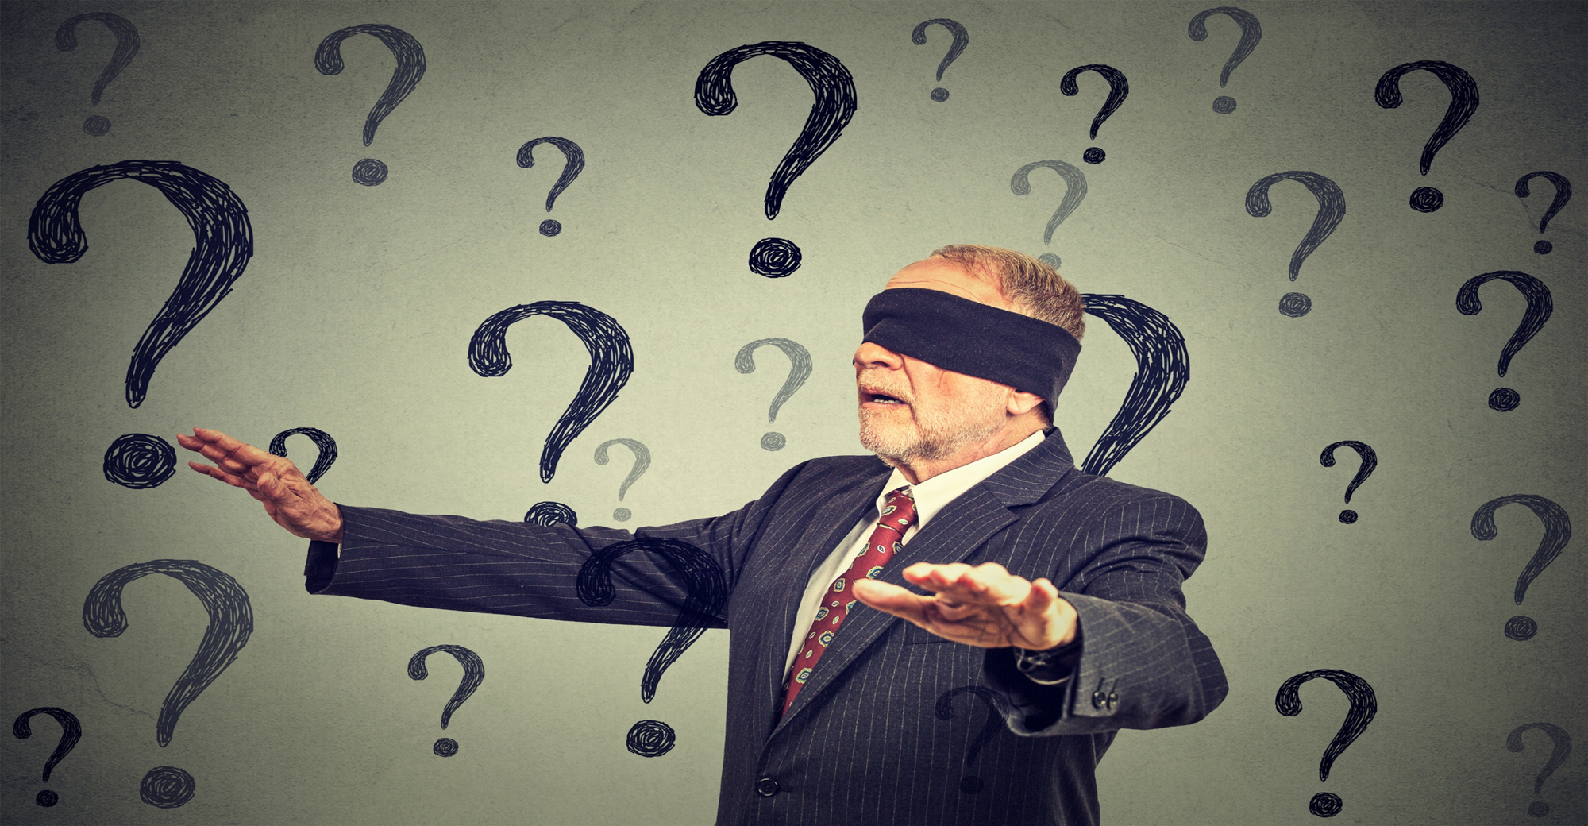
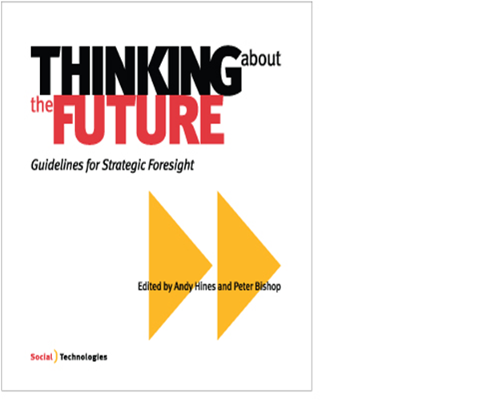
Future Blind vs Foresight

Slide 4
Future Blind
Lost and trapped in yesterday’s decisions, choices and consequences –become risk aversive
Betrayed by expectations -must negotiate the expectations of youth with the experience of life
Hudson, Frederic (1999). The Adult Years: Mastering the art of self-renewal. Jossey-Bass: San Francisco.

Slide 5
Future Blind
Social systems once protective are destabilizing
Overwhelmed with information and decisions
Bewildered by change, complexity and discontinuities
Develop discourse of regret versus hope
Hudson, Frederic (1999). The Adult Years: Mastering the art of self-renewal. Jossey-Bass: San Francisco.

Slide 6
“Future studies is the art and science of taking responsibility for the long term consequences of our decisions and our actions of today.”
Gidley, Jennifer. ( 2017). The Future : A Very Short Introduction, Oxford University Press, UK.

Slide 7
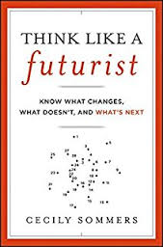
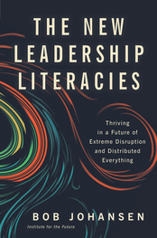

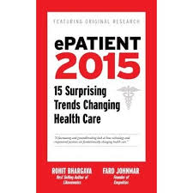


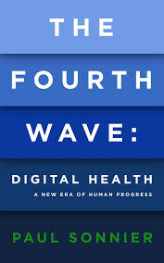
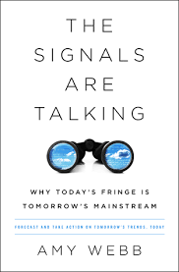
Futures Literacy Skills
Awareness
Discovery
Choice
Miller, Riel. (2007). Futures literacy: A hybrid strategic scenario method. Futures, 39(4), 341-362

Slide 8
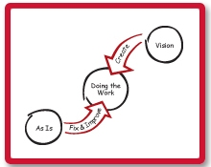
The Primes: Change vs. Transformation
McGoff, Chris. (2011). The Primes: How Any Group Can Solve Any Problem,
Victory Publishers, and New York, NY. www.theprimes.com

Slide 9
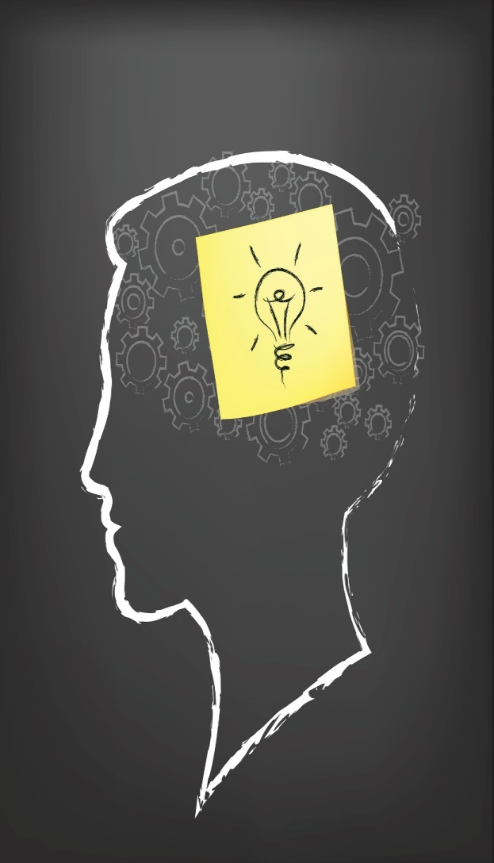
Think ~Pair~ Share
I used to think……
Now I think……

Slide 10
Becoming Future Literate
Know your personal orientation toward time
Consider the value of foresight thinking to support anticipatory leadership.
Learn about the future.
Actively monitor industry trends, forecasts, disruptions.
Discern logical consequences of trends using futures thinking tools and techniques.
Pesut, D. (2000). Looking forward: Being and becoming a futurist. Nurses Taking the Lead. Personal Qualities of Effective Leadership. Pennsylvania, PA: WB Saunders Company, 39-65.

Slide 11
Becoming Future Literate
Appreciate the use of vision-based scenarios.
Stimulate strategic conversations about espoused visions looking backwards from the future.
Navigate change efforts through the use of Appreciation, Influence and Control (AIC).
Build a leadership legacy through creating the future.

Slide 12
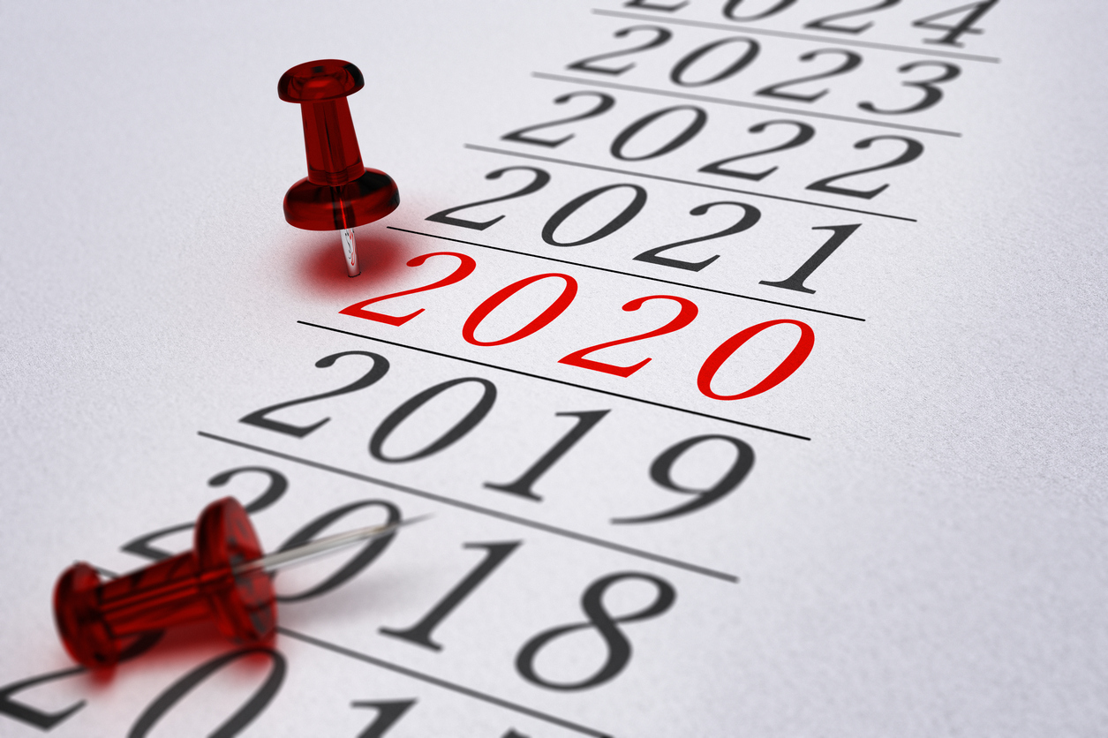
Future Blind vs Foresight

Slide 13

Foresight
“Images of the future are the blueprints that we use in constructing our lives.”
Cornish, E. (1977). The study of the future. Bethesda, MD: World Future Society.
http://millennium-project.org/
State of the Future Index

Slide 14
The New Leadership Literacies
Look backward from the future
Voluntary fear engagement
Leadership for shape-shifting organizations
Being there when you are not there
Create and sustain positive energy
Foresight ~Insight~ Action

Slide 15
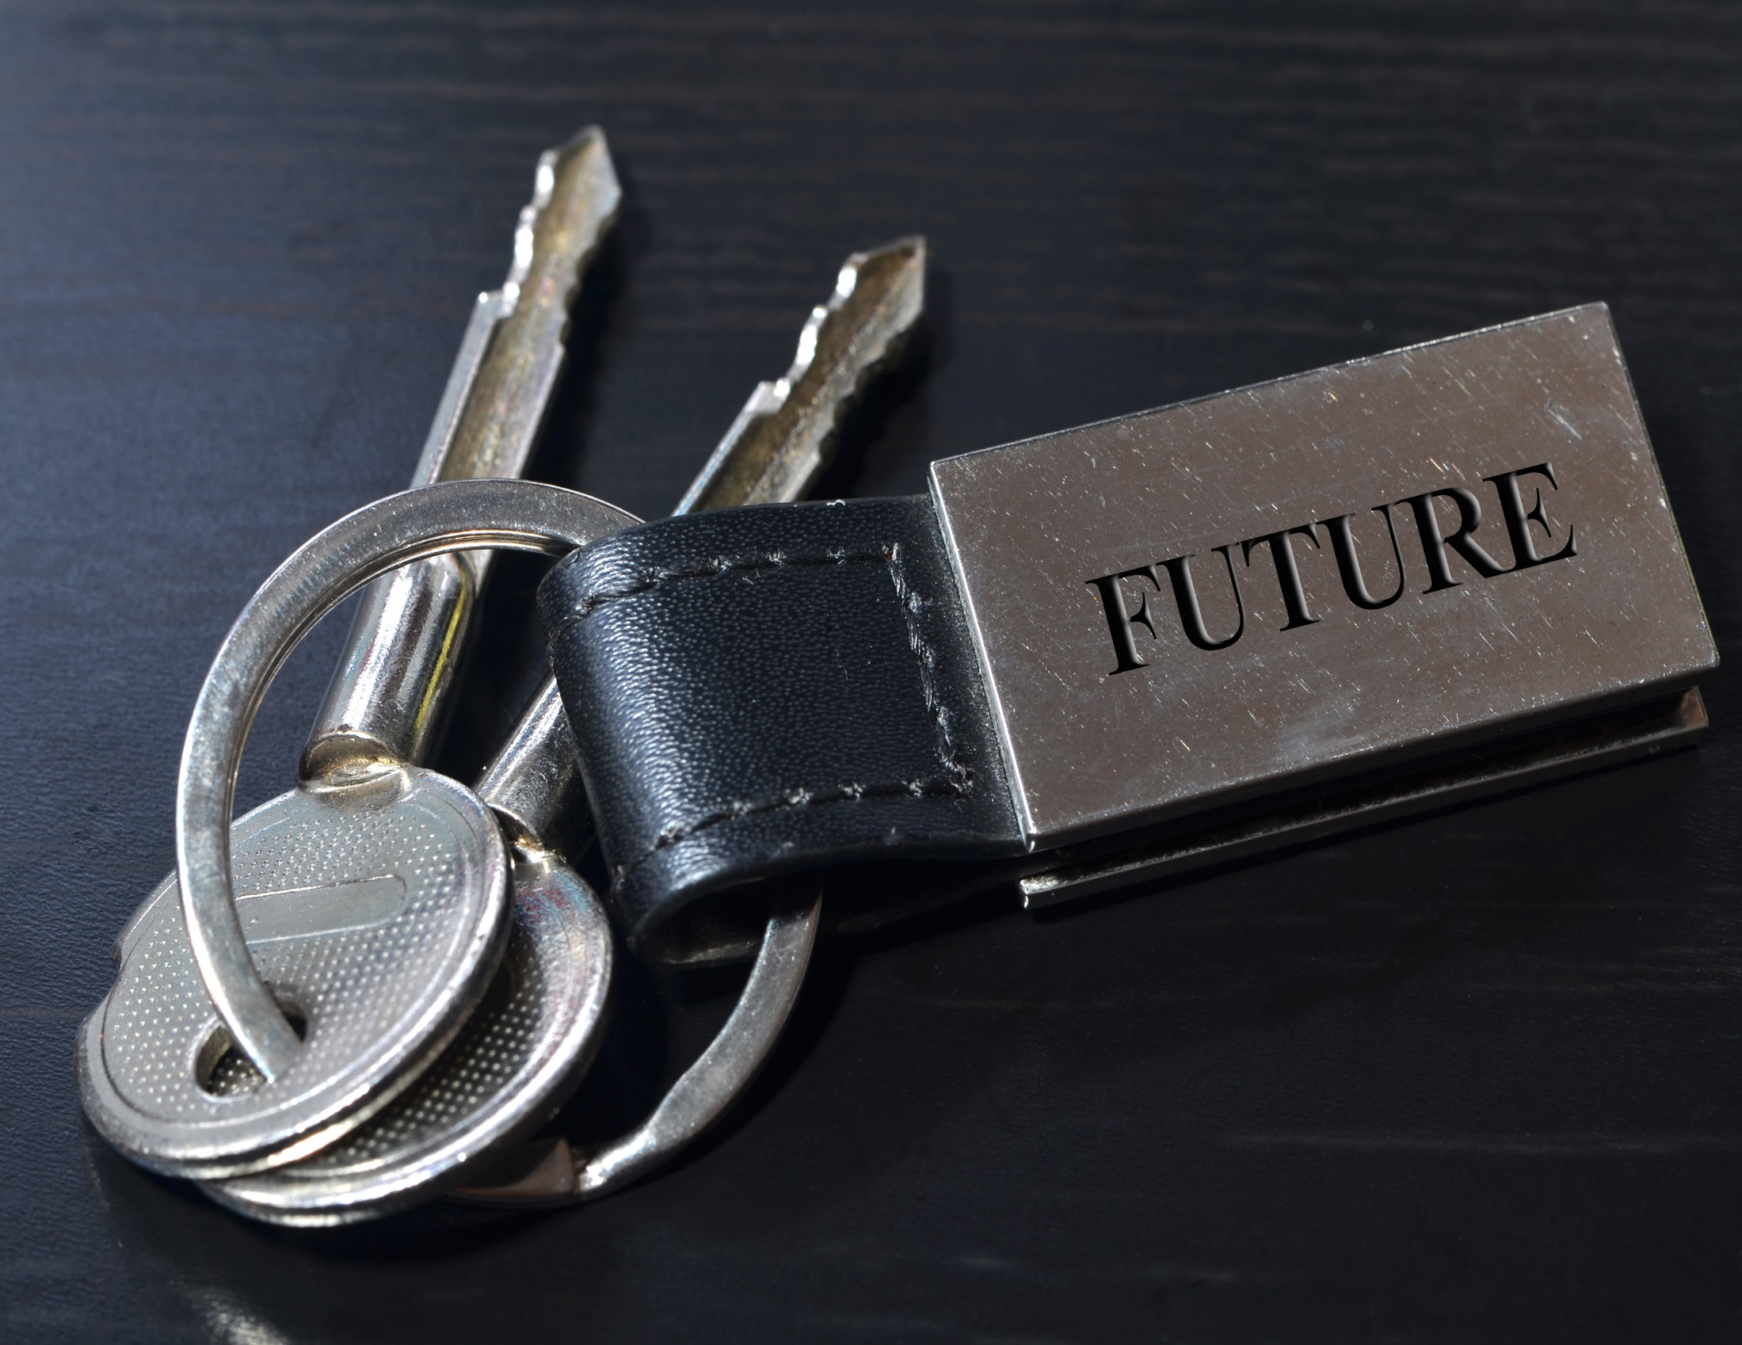
Alpha Leadership:
Anticipate, Align, Act

Slide 16
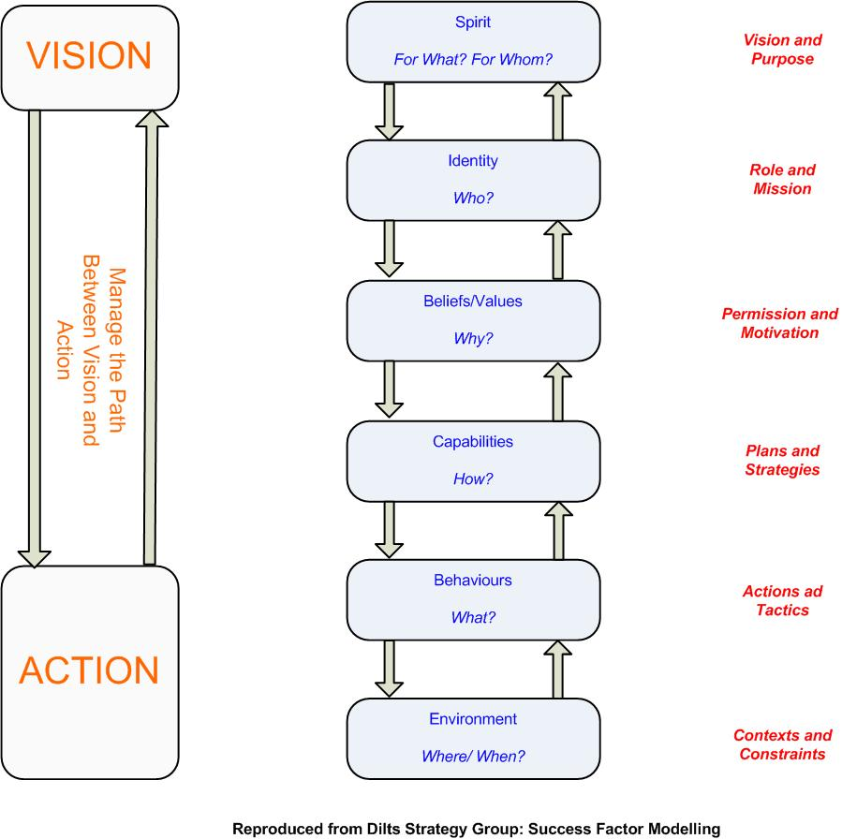
Leadership, Vision, Action, and Logical Levels
Dilts, R. (2014) A brief history of logical levels

Slide 17

Introduction to Strategic Foresight

Slide 18
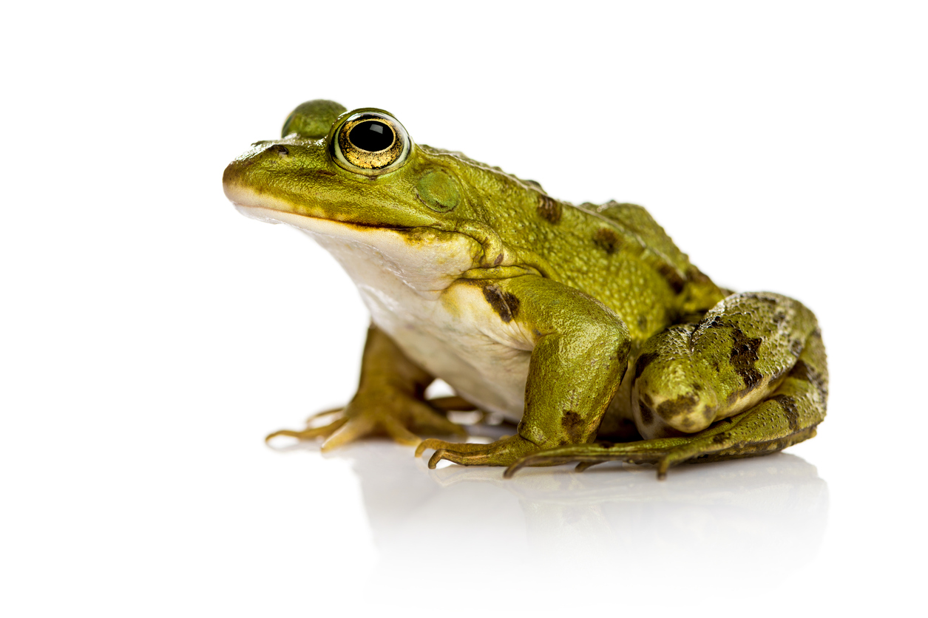
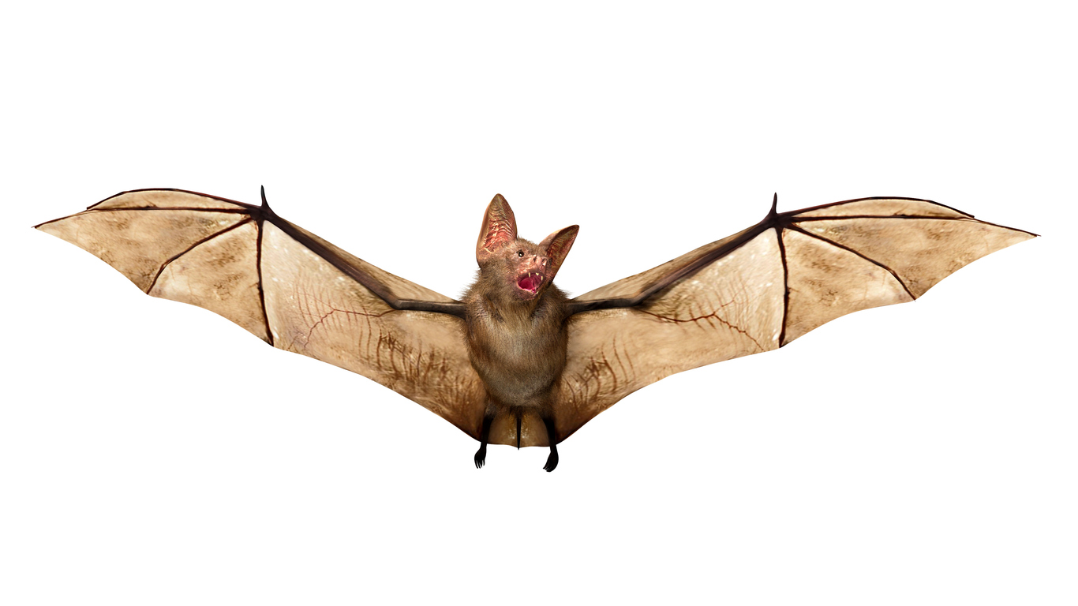
“If your organization is more frog than bat, perhaps you need to change it?”
Deering A., Dilts, R., & Russell, J. (2002). Alpha leadership: Tools for business leaders who want more from life. John Wiley, NY.

Slide 19
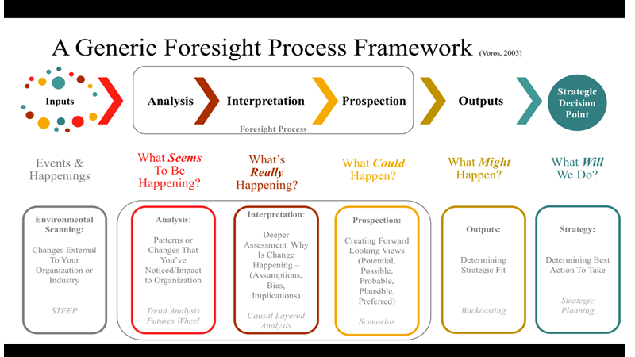

Slide 20
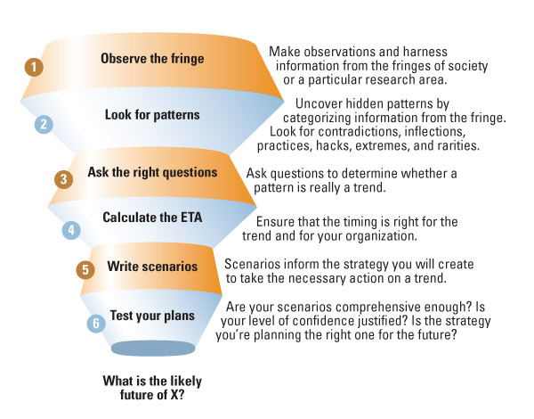
Flaring A Six Step Forecasting Method
Webb, A. (2016). The Signals are Talking: Why Today's Fringe is Tomorrow's Mainstream. Public Affairs.

Slide 21
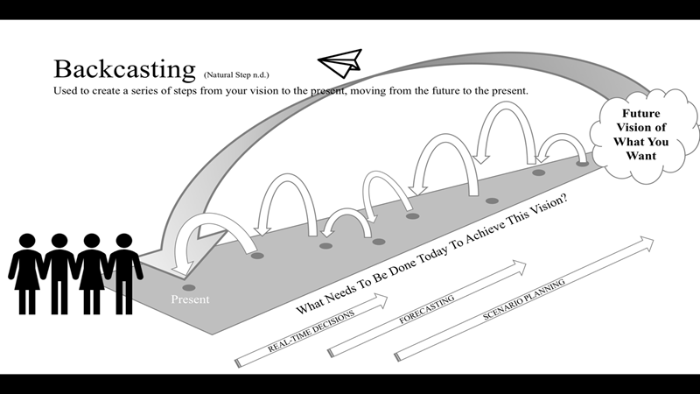

Slide 22
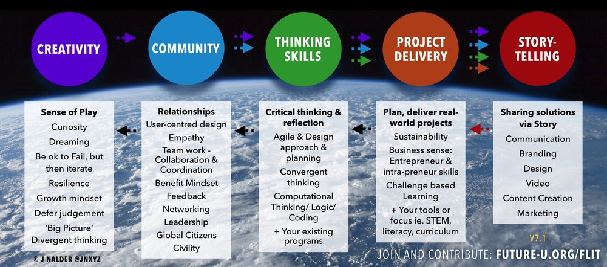

Slide 23
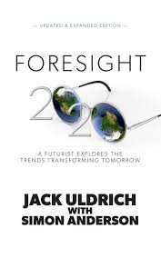
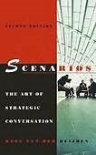


Trends, Consequences, Disruptions
Personal
Professional
Organizational
Social
Planetary
Future Today Institute

Slide 24
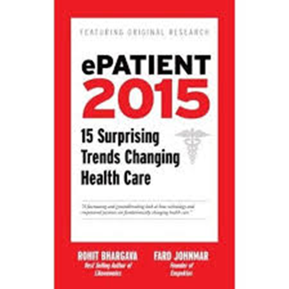
Health Care Trends
Health Hyper Efficiency
Empathetic Health Interfaces,
Predictive Psycho-history
Unhealthy Surveillance
The Personalized Health Movement
Augmented Nutrition
The Device Divide
Multicultural Misalignment
Medical Genealogy
Neuroinfluence Mapping
Natural Medicine
Healthy Real Estate
The Over Quantified Self
Micro Health Rewards
Digital Peer to Peer Health Care
Care Hacking
Accelerated Trial Sourcing
Virtual Counseling

Slide 25
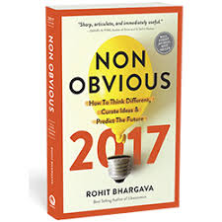
Become a Trend Curator
Be curious always asking why, investing in learning and improving knowledge
through investigation and questions.
Be observant learn to see small details in stories and life that others may
Ignore or fail to recognize as significant.
Be fickle move from one idea to the next without becoming fixated or over
Analyzing each idea in the moment.
Be thoughtful take time to develop a meaningful point of view and consider
Alternative viewpoints without bias.
Be elegant seek beautiful ways to describe ideas that bring together disparate
Concepts in simple and understandable ways.

Slide 26

Horizon Scanning
Scanning involves searching information resources, consciously (active) or not (passive), for a particular kind (directed) of information which is then subjected to special attention.

Slide 27

The Five What's of Trends
What does this really mean?
What does this really mean?
What does this really mean?
What does this really mean?
What does this really mean?

Slide 28
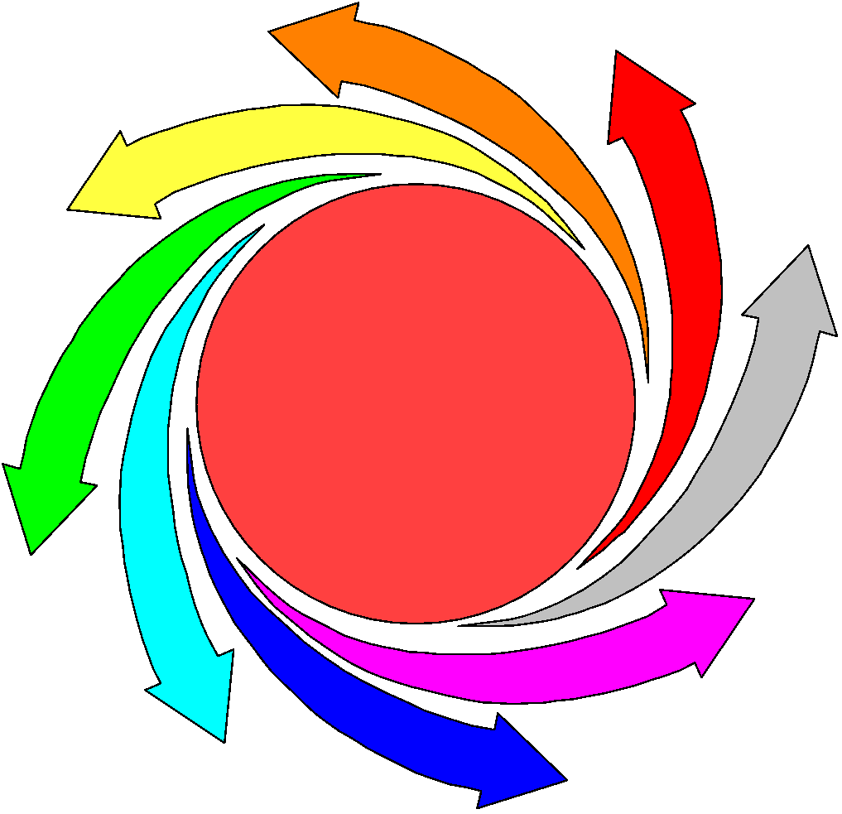
Futures Wheel
A futures research method that draws out the consequences and expands the impact of an identified trend or event.

Slide 29

Futures Wheel
The search for consequences continues until three unanimously agreed-upon consequences have been developed.

Slide 30
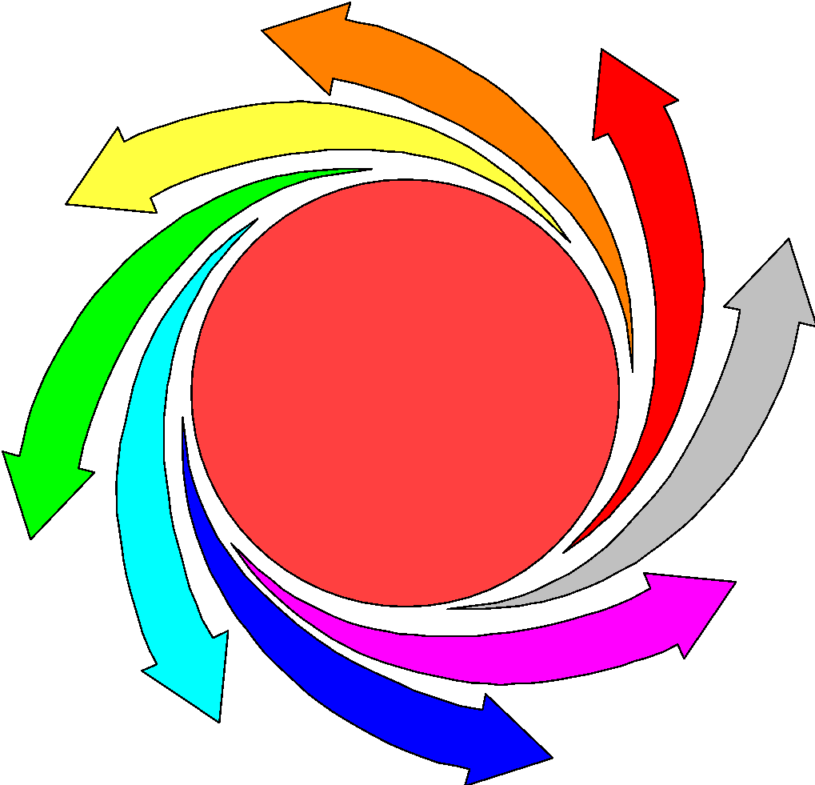

Issues Wheel
Write issue in center circle
Fill in the inner ring with names of stakeholders. These may be interest groups, institutions or individual who are concerned with or who may champion the issue.
For each stake holder consider the following questions:
  What is the group concerned about? What are their fears?
  What are their goals and objectives in relation to the issue?
  What would it take for them to act? What are their actions likely to be?

Slide 31
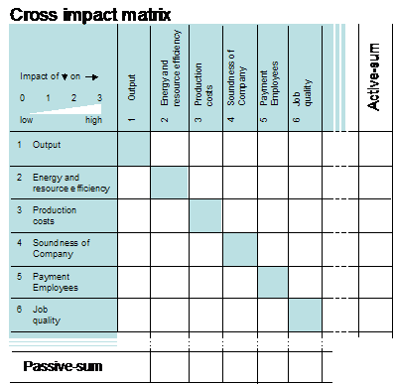
Cross-Impact Analysis
A futures method technique used to make judgments about relationships among identified trend consequences.
A matrix is developed with the identified trends.
Judgments are made about the positive and negative impact of the trends in relation to one another.
This Photo by Unknown Author is licensed under CC BY-SA

Slide 32
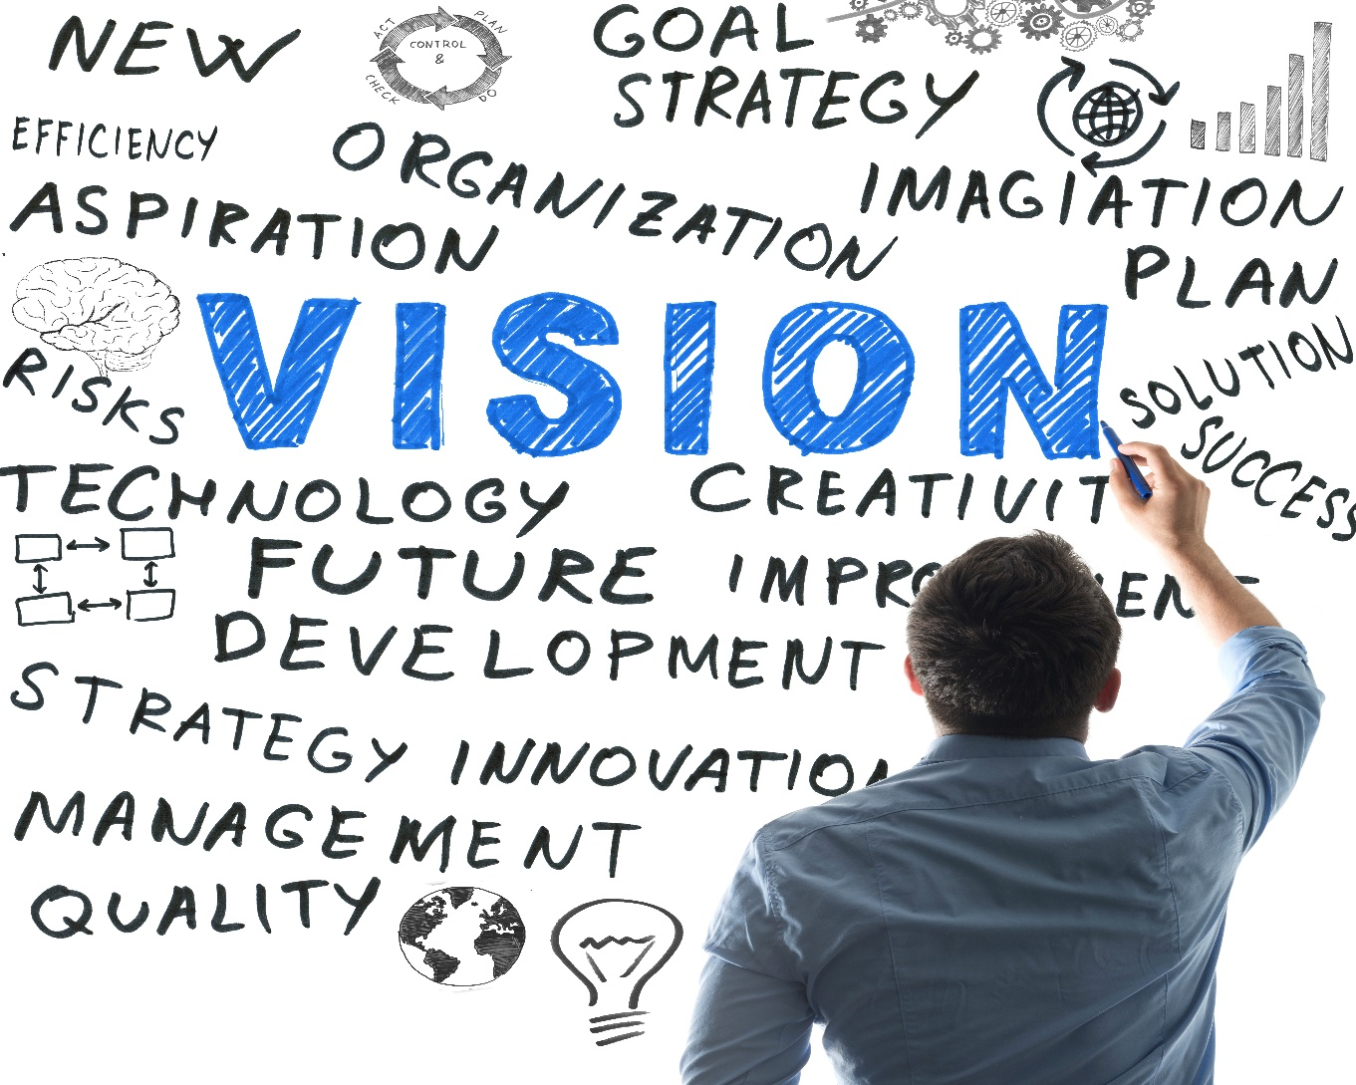
Create Vision Based Scenarios
A scenario is a method for telling a story about the future. It can be based on reliable or speculative data.

Slide 33
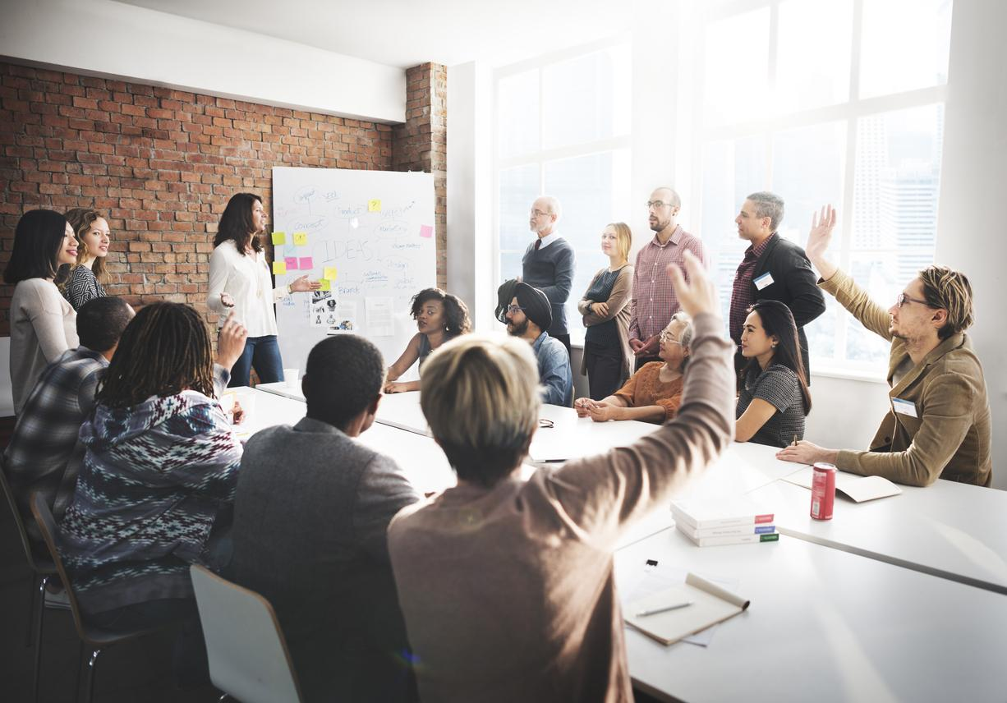
Strategic Conversations
How plausible does the scenario seem?
What thoughts does it bring to mind?
What feelings does it generate?

Slide 34
Strategic Conversations
What are the implications for society, healthcare and nursing?
If parts of the scenario are desirable what actions need to be taken to increase the chances of it happening?
If parts are undesirable what actions need to be taken to prevent them form happening?

Slide 35
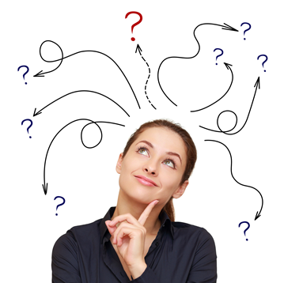
The Future
Issues
Services
Policy and Regulation
Knowledge
  Genetics
  Informatics
  Artificial Intelligence
  Alternative RX
  Gaming
  Aging
  Biotechnology

Slide 36

Think ~Pair~ Share
What concept, idea, did you find interesting and /or useful?
How can the knowledge be used ?
Why is the knowledge important?
Why care about the knowledge or information?

