Slide 1

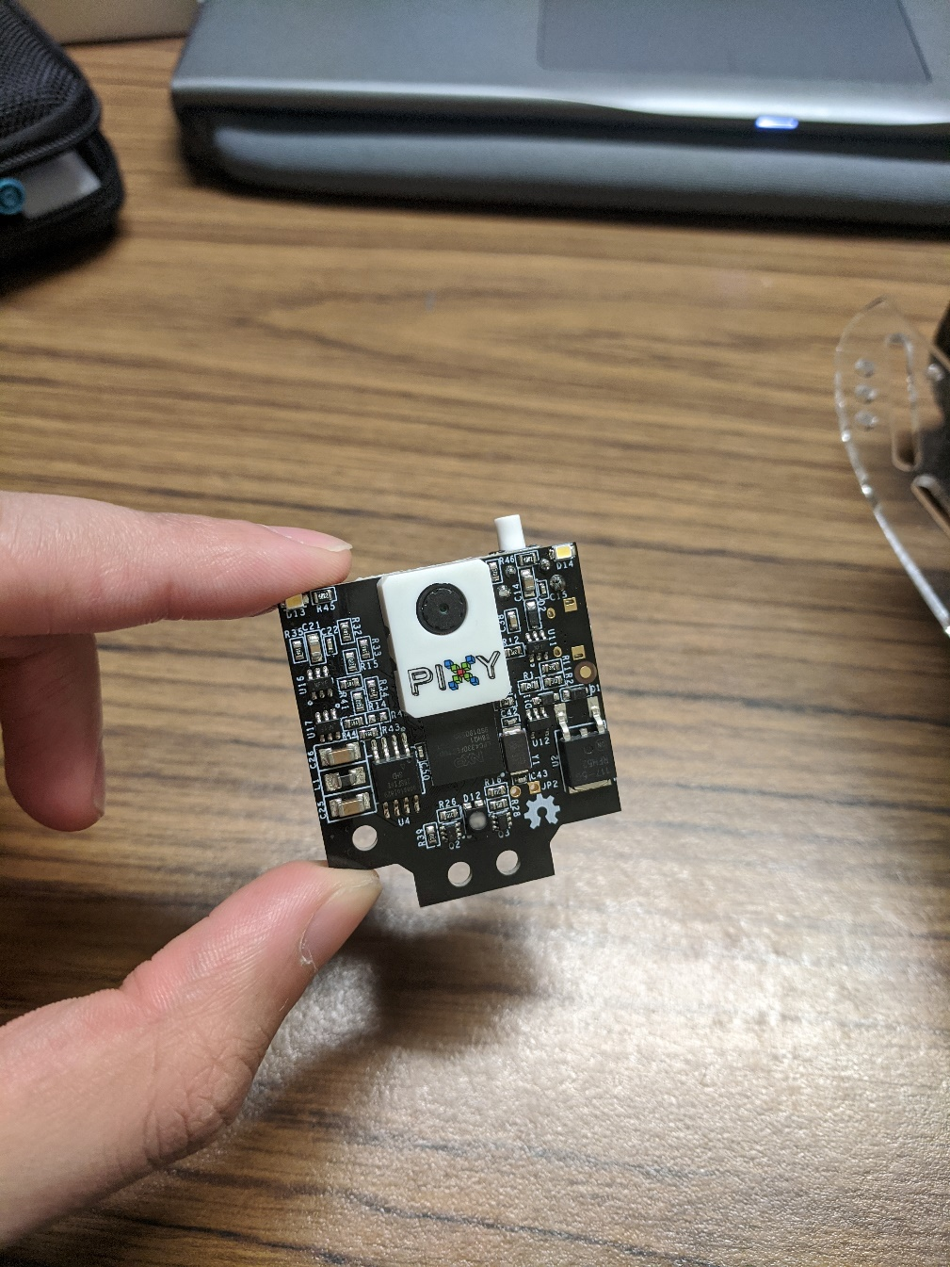
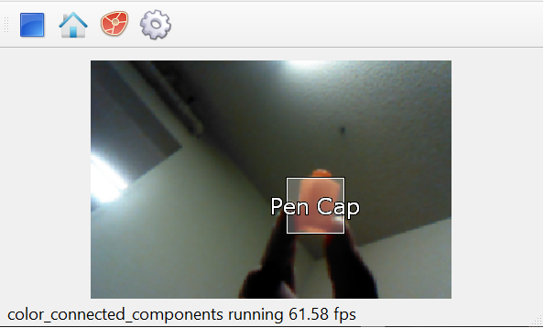
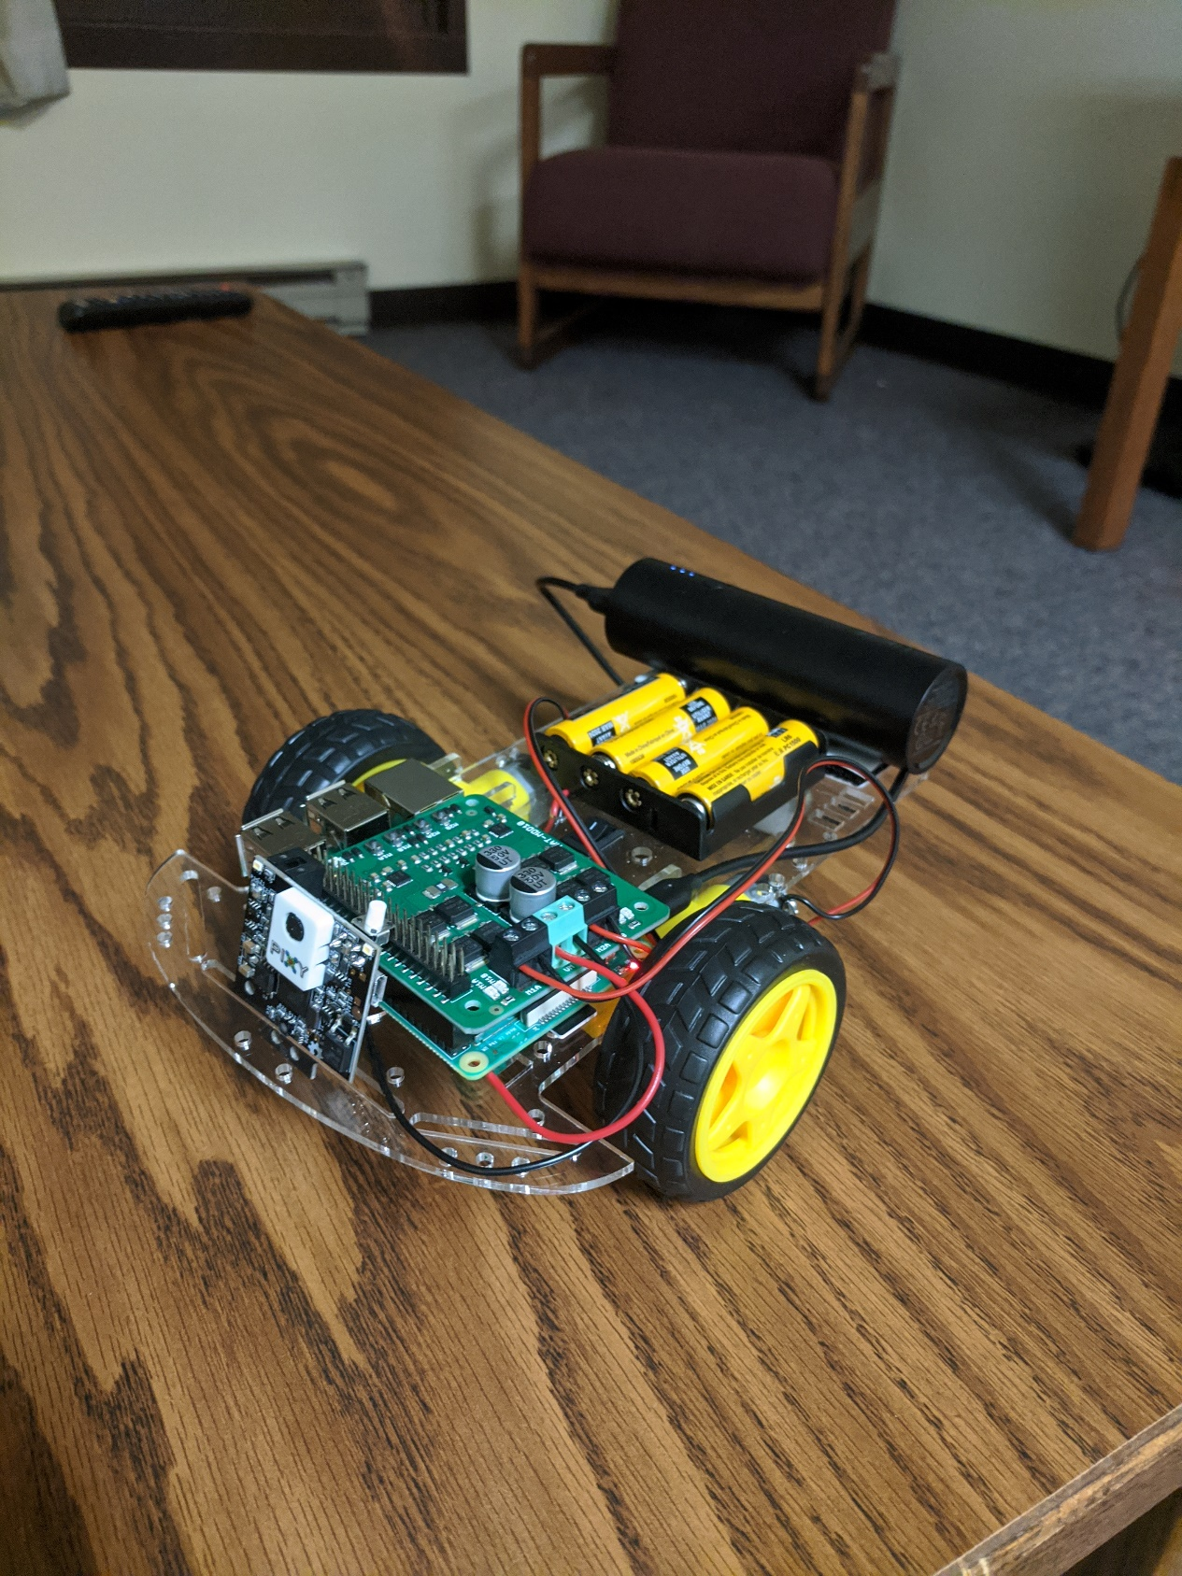
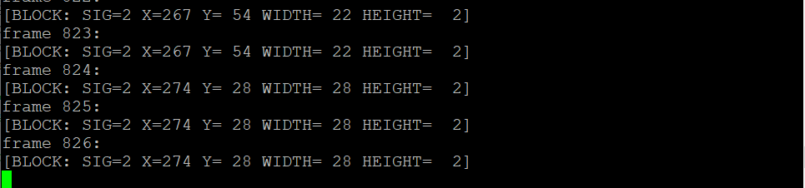
Optical Tracking and Recognition for Stage Robotics
Aaron Cherian^{1,2}; Sam Shanks, PhD¹
¹University of Minnesota - Duluth, ²Swenson College of Science and Engineering
ABSTRACT
INTRODUCTION
DISCUSSION
Optical tracking is a way to measure in real time the position of an object with the use of certain markers on that particular object. The markers used are usually a form of infrared light. This type of optical recognition technology is widely used in the robotics world, but rarely in a theatre setting. In this study, a working prototype of an object detecting robot was completed with a functional algorithm to read object signatures and react to different cues in the environment.
In a theatre setting, moving props and platforms require the effort from crew members, pulleys and/or other mechanisms. These methods are inefficient and outdated. There are over 10 million hues of colors that a computer can detect. We can use the idea of color codes to relate them to an object. The color code related to the object will be so distinct that other hue signatures in a stage environment will not affect it. The hue emitted can be detected through the robot from various ranges so the position of the object does not matter. The purpose of this study is to be able to read “spike marks” which could represent positions of props or scenery in a theatre stage. The robot is able to use object cues to have a “home base” guiding mechanism. The big picture is to translate this prototype robot into a bigger robot to move stage platforms through automation which could be used in an UMD stage production in the near future.
In this study, by calculating certain elements of the detected object through the Pixy2 camera, the robot was able to accurately detect the object and follow instructions while locating itself in space. Using the object detection algorithm, the robot can now track multiple objects in its field of view with each object corresponding to a different task. This study shows how powerful and accurate optical tracking can be.
FUTURE WORK
Achieving a fully functioning robot that can detect multiple objects through various distances was a rewarding task, but there are many additional features that should be added to the robot to be fully successful in a stage environment. One addition would be object following. The robot should be automated to follow a particular object till it reaches its goal state. Right now the instructions are restricted and human controlled. Another important addition would be collision avoidance. If there are other props/sets on the stage that are meant to not move, the robot needs to successfully avoid that object and continue its main task. These two features will be the main focus moving forward.
Fig 3. The Pixy2 detecting a Pen Cap in view
MATERIALS
Anker PowerCore 5000 Portable Charger
Charmed Labs Pixy2 Camera
Cytron 2x10A Motor Driver HAT
Raspberry Pi 3 B+
Perseids Robot Chassis
2 x DC Gear Motor
2 x Speed encoder
2 x Wheels + 1 Universal Wheel
Battery Box
4 x AA Batteries
Fig 2. Pixy2 Camera
RESULTS
The robot successfully was able to capture all the objects available in a given frame. Each object (or block) was given a labelled signature/color-code number. Each signature then had its corresponding elements such as:
Signature: color-code number
X: x location of the center of the block
Y: y location of the center of the block
Width: Width of the block
Height: Height of the block
Angle: Angle of color-code in degrees
The signature for each object was used to let the robot know to trigger specific instructions such as start, stop, turn left or right according to what the objects represented. The following algorithm (pseudocode) was executed whenever a certain object was viewable in the cameras frame:
Initialize blocks[] structure
count = getblocks() //number of objects saved to a signature
if count > 0:
if blocks[index].signature = 1: //signature 1 corresponds to initiate program
//do instructions
if blocks[index].signature = stopCue:
//stop
METHODS
Fig 4. The Algorithm outputting elements of the object detected
CONCLUSION
Robot: To create a robot used for this study, the two wheels were attached to the DC motors which were hooked up to the battery pack. A Raspberry Pi microcontroller was connected to a power bank for power output. All these hardware components were then built on to a chassis to assemble a functional robot.
Camera: A Pixy2 camera was used for this study which was attached directly through USB to the microcontroller which provided power as well as connectivity.
Software and programming components: This robot was programmed using integrated C and Python. The libraries used where the Pixy2 libraries by Charmed Labs and the GPIO libraries for the Raspberry Pi. The software's used were the PixyMon GUI and Python IDE’s while using both a Windows and Linux environment simultaneously. The algorithm created reads a color signature from an object, then follows specific instructions related to that object like speed and direction.
Optical tracking for scene stages in a theatre environment is an innovative way in the field of robotic guidance. This study shows that an objects data can be read in through a camera attached to a microcontroller which runs an algorithm to follow certain instructions when the object is in the field of view. We are able to produce a fully functioning robot that can be now translated to a larger prototype that can be tested in a stage setting.
Fig 1. The TARS Robot
CONTACT
Aaron Cherian
University of Minnesota - Duluth
Department of Computer Science
Email: cheri023@d.umn.edu
Sam Shanks
Email: sshanks@d.umn.edu
REFERENCES
Charmedlabs. “Charmed Labs Pixy2.” GitHub, 23 Aug. 2019, https://github.com/charmedlabs/pixy2.
CytronTechnologies. “Cytron_MDD10_Hat.” GitHub, https://github.com/CytronTechnologies/Cytron_MDD10_Hat.
“Pixy2 API .” Wiki:v2:general_api [Documentation], https://docs.pixycam.com/wiki/doku.php?id=wiki:v2:general_api.

