Slide 1
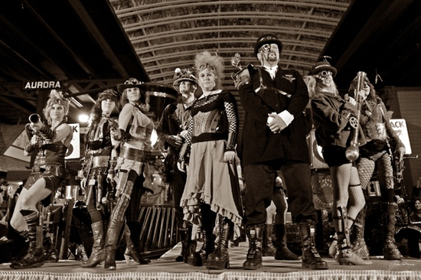
Manifestations from Our Local
Rust Belt Steampunk Scene

Slide 2
Outline
Confessions of a Steampunk Journalist
The Benefits of Steampunk
The Path to Chronicle
The First DAI Steampunk Adventure
Friends of Industry
Expanding Circles and Intersecting Lines

Slide 3
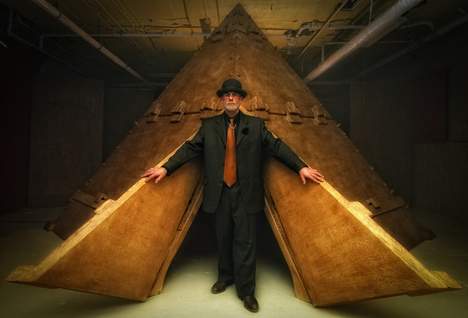
Steampunk in the Northland

Slide 4
Benefits of Steampunk
Teaches History
Develops and Broadens Imagination
Teaches Collaboration Skills
Entertainment
Aesthetics
Personal Satisfaction
Role Playing & Self-Expression

Slide 5
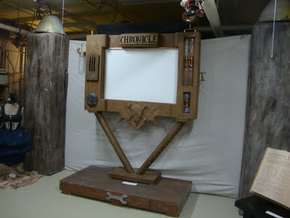
“Chronicle was the first local Steampunk event as far as I’m aware.” ~Richard Rosvall

Slide 6
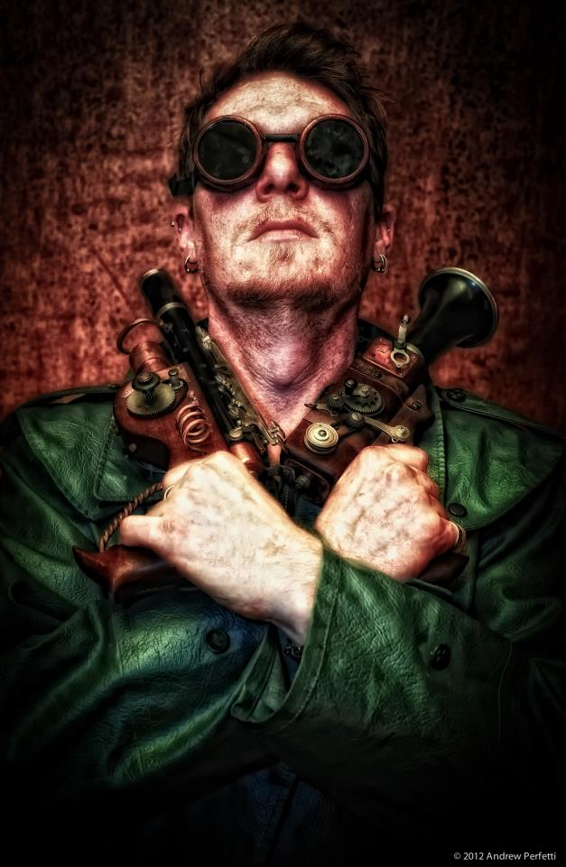

Slide 7
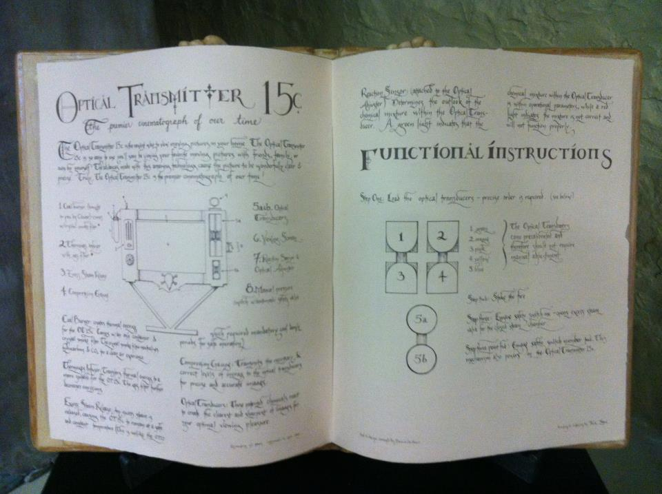

Slide 8
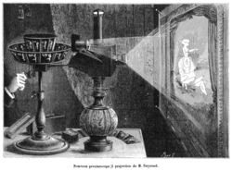

Slide 9
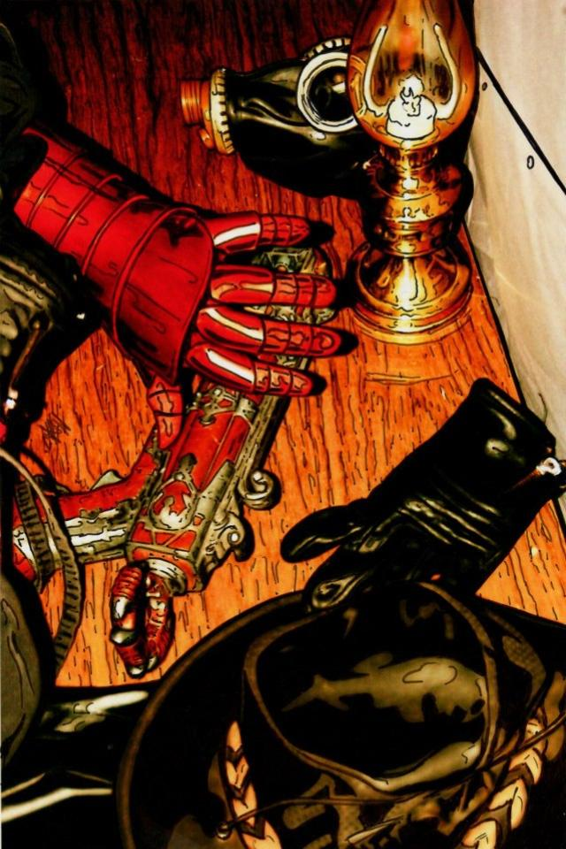
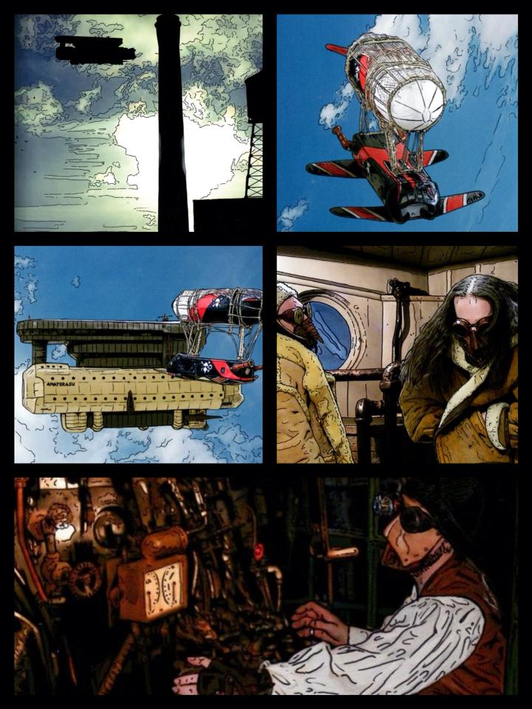

Slide 10
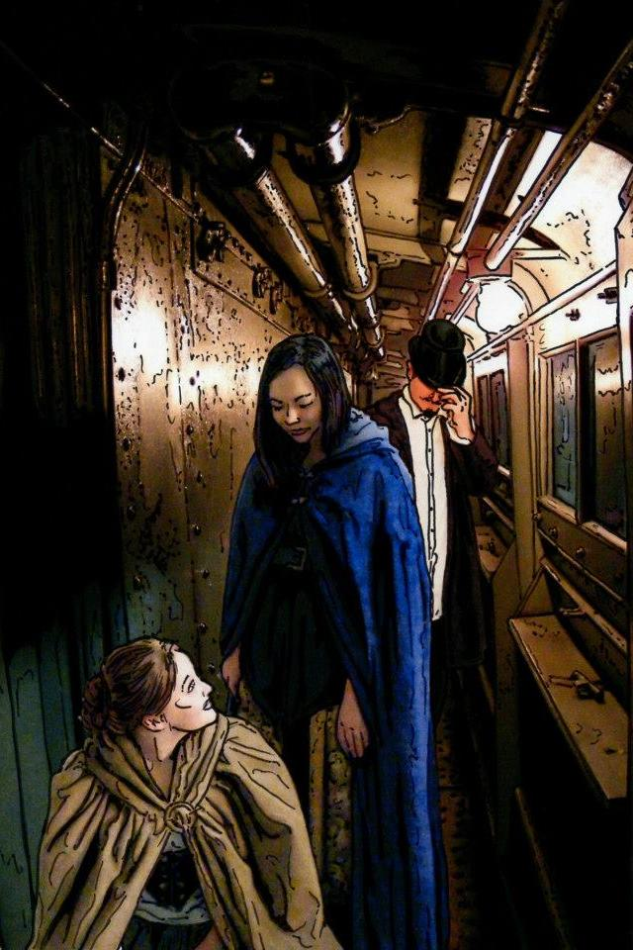
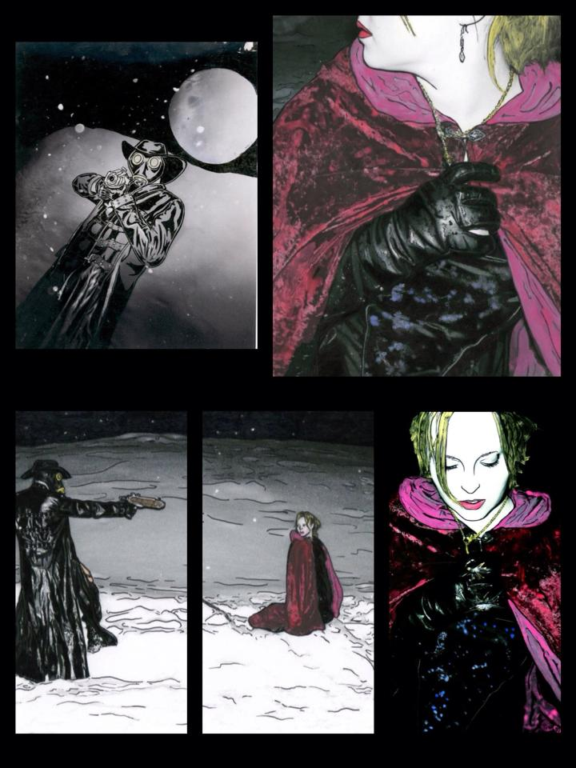

Slide 11
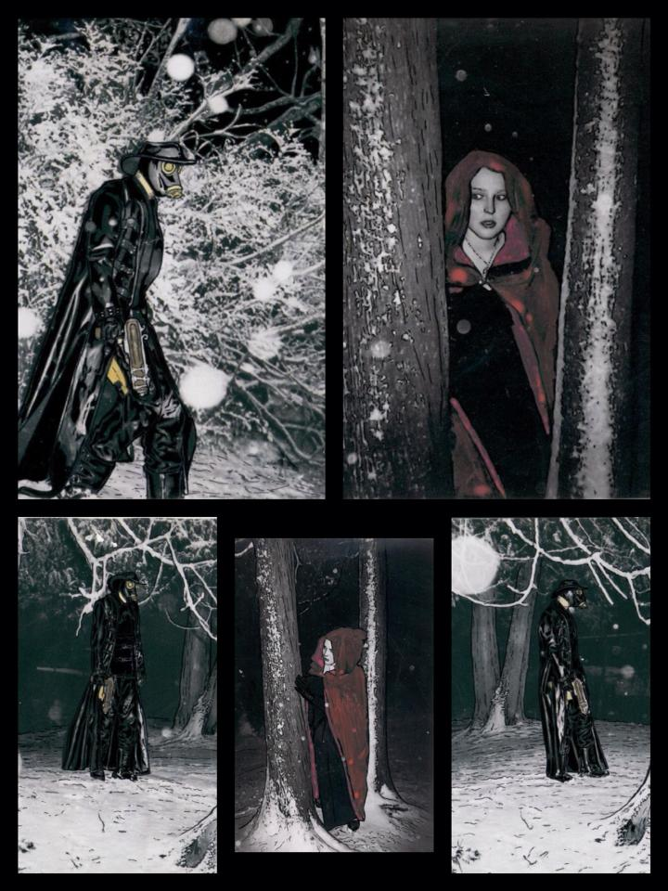
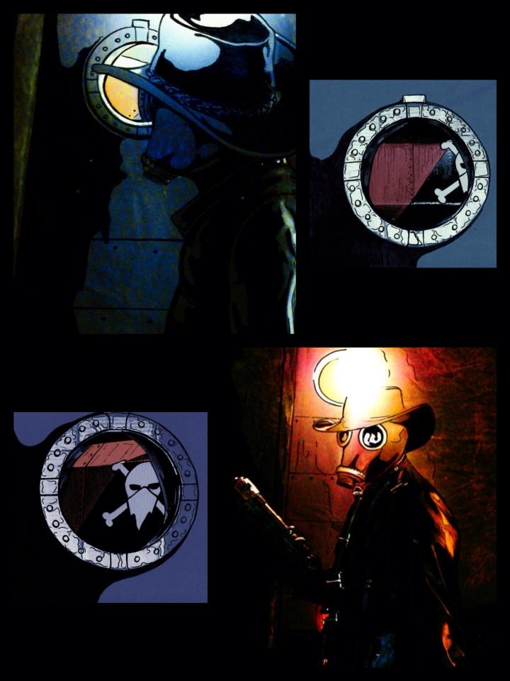

Slide 12
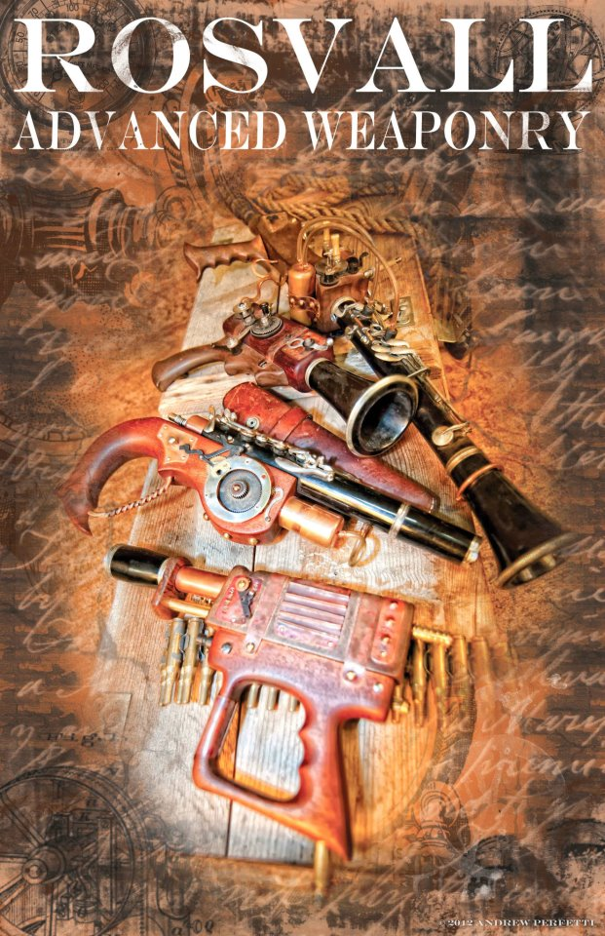

Slide 13
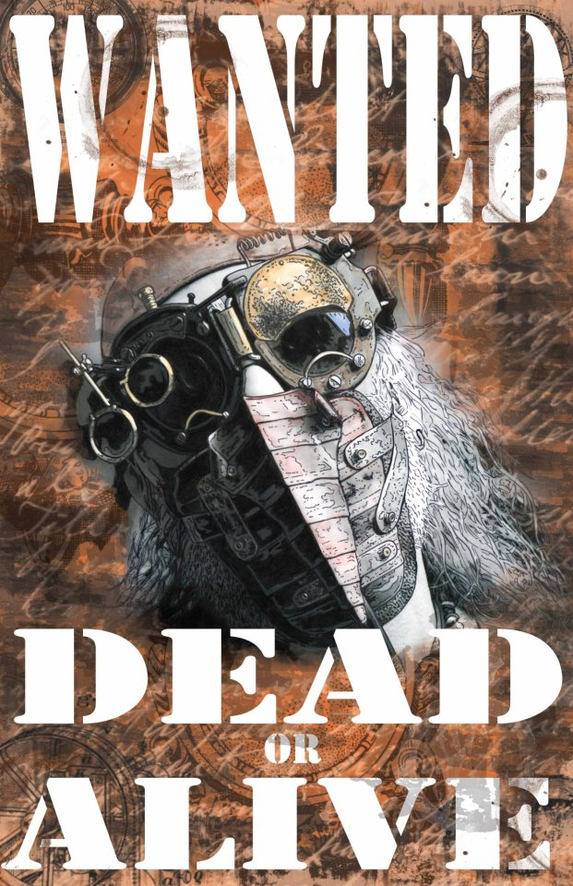

Slide 14
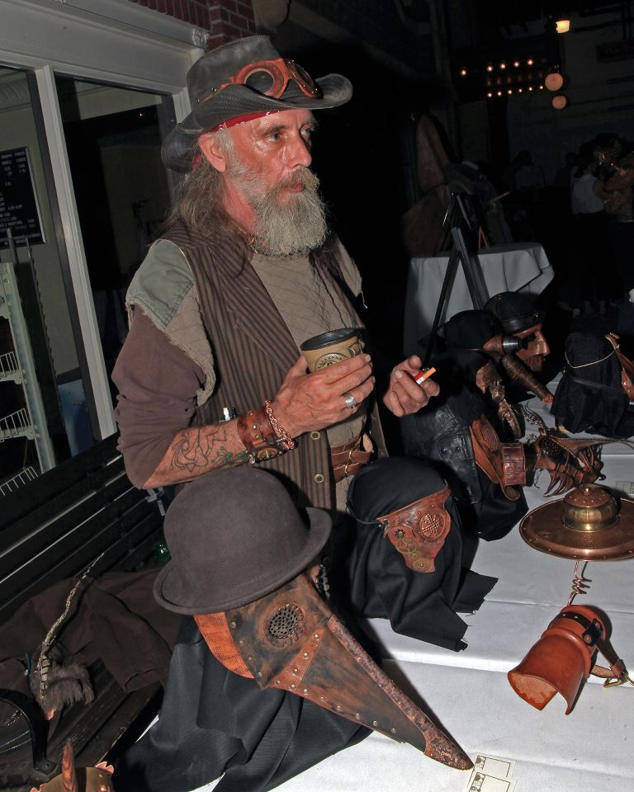

Slide 15
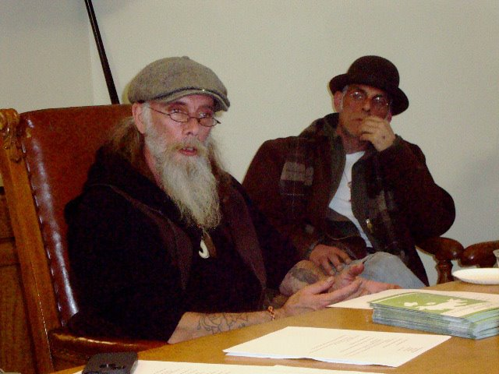

Slide 16
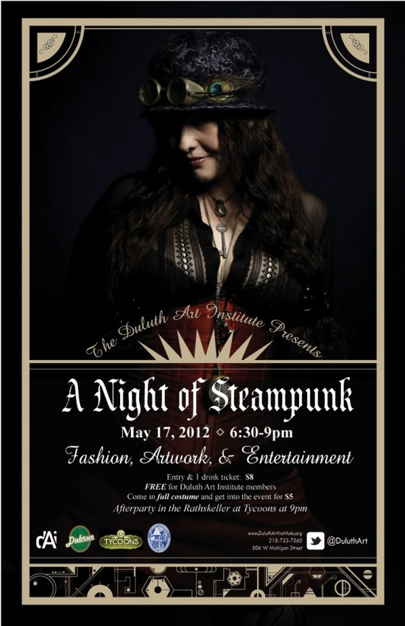

Slide 17
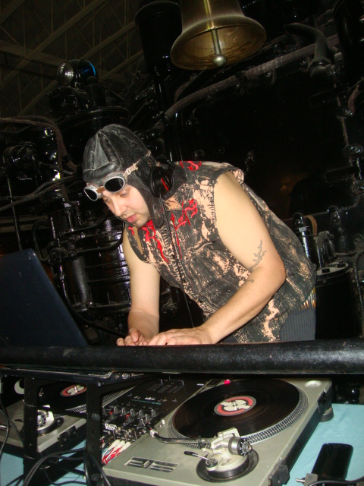

Slide 18
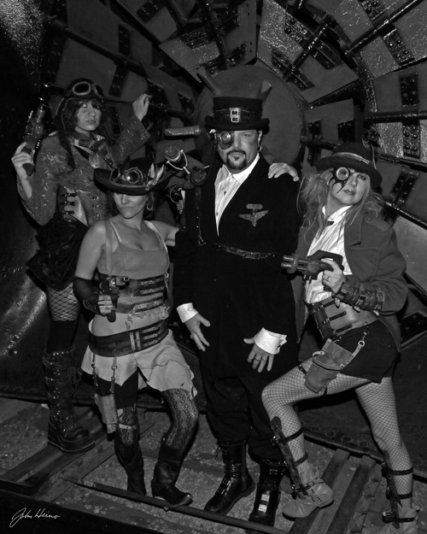

Slide 19
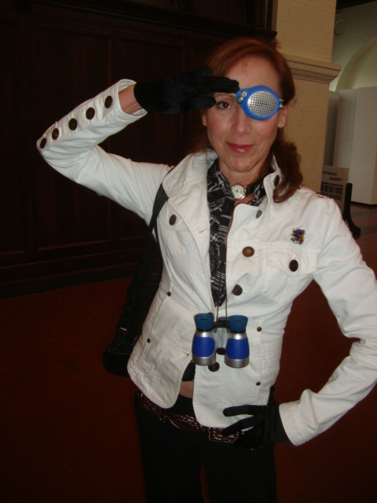
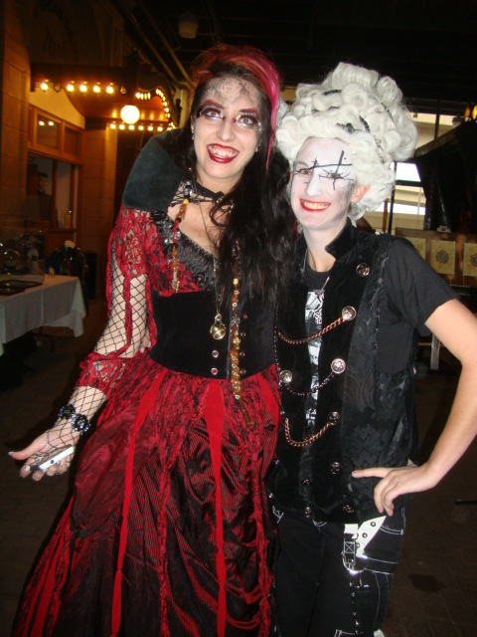

Slide 20
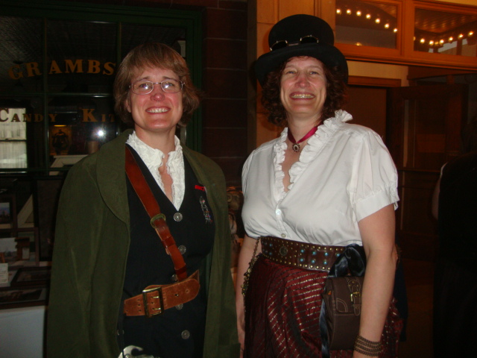

Slide 21
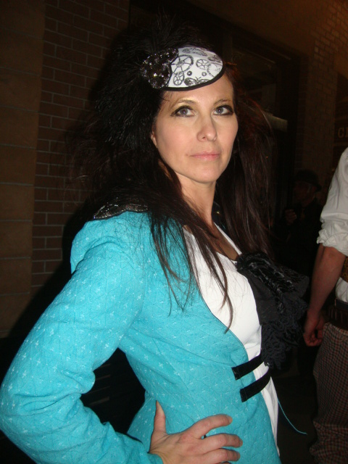
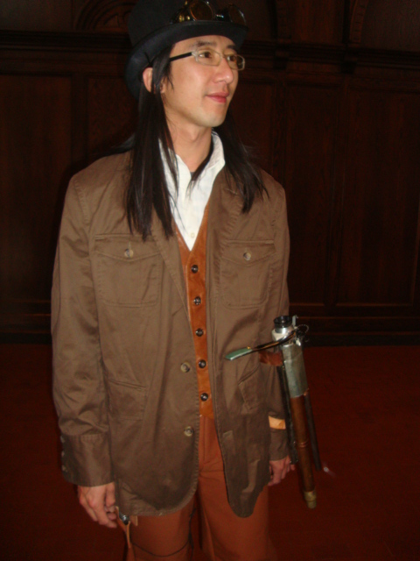

Slide 22
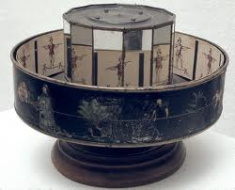
Praxinoscope

Slide 23
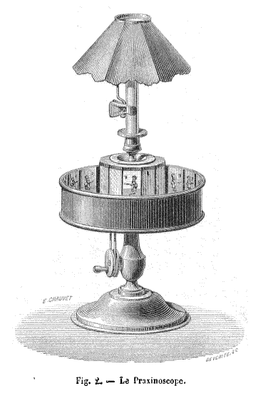

Slide 24
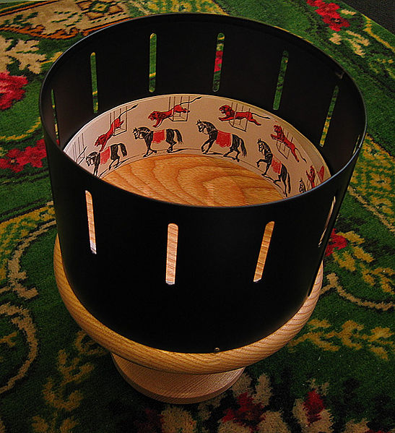
Zoetrope

Slide 25
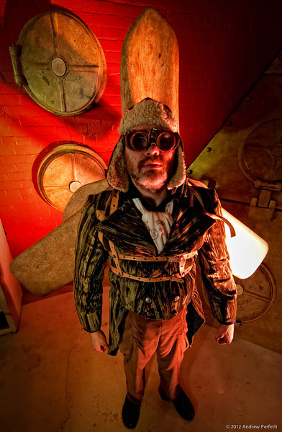

Slide 26
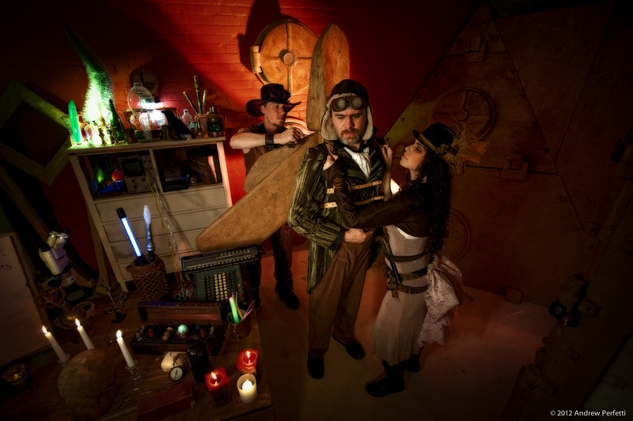

Slide 27
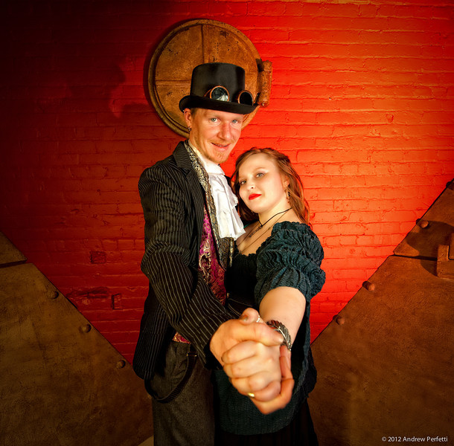
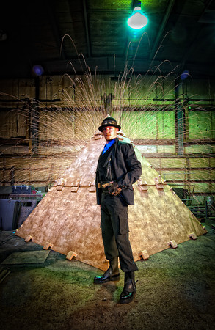

Slide 28
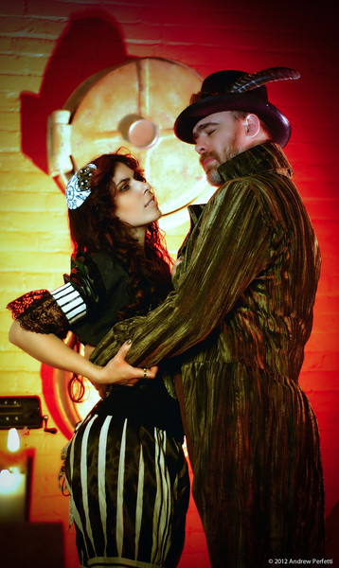
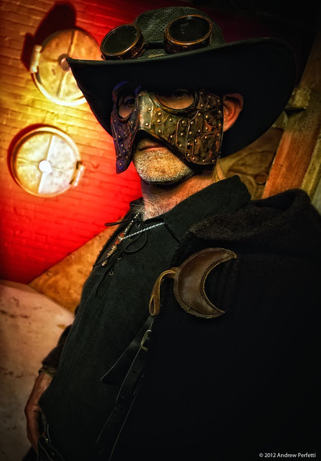

Slide 29
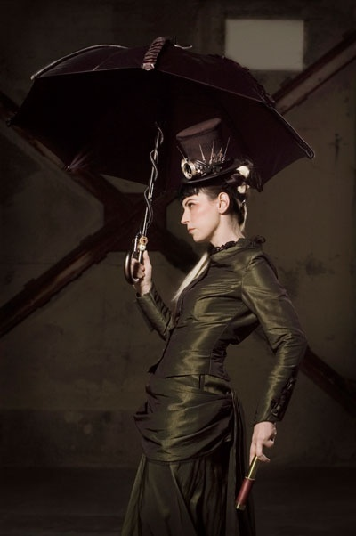

Slide 30
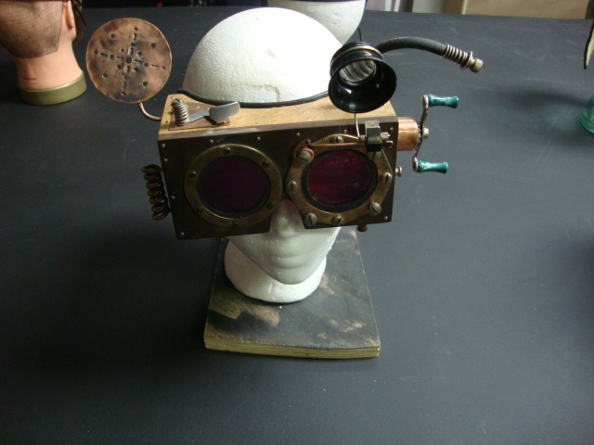
Steampunk Influenced

Slide 31
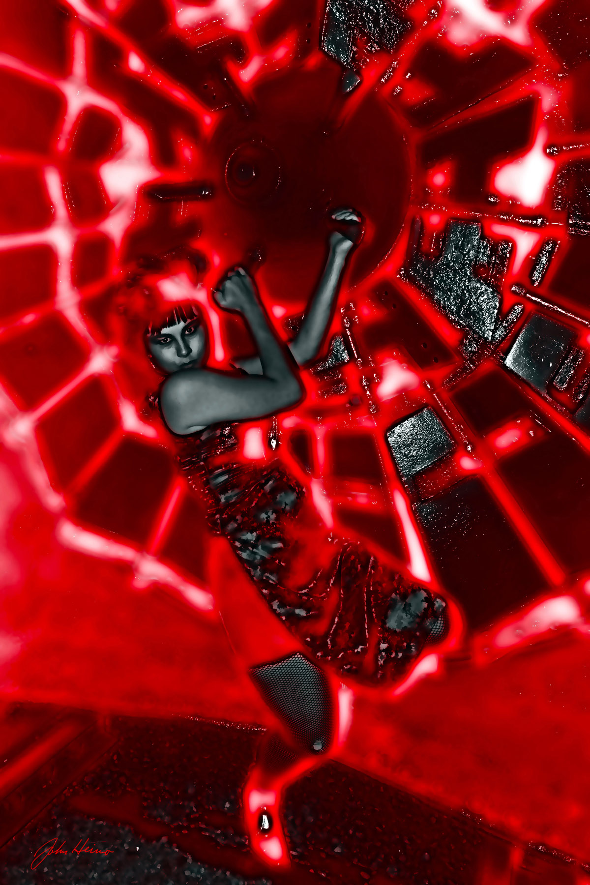
John Heino Photography

Slide 32
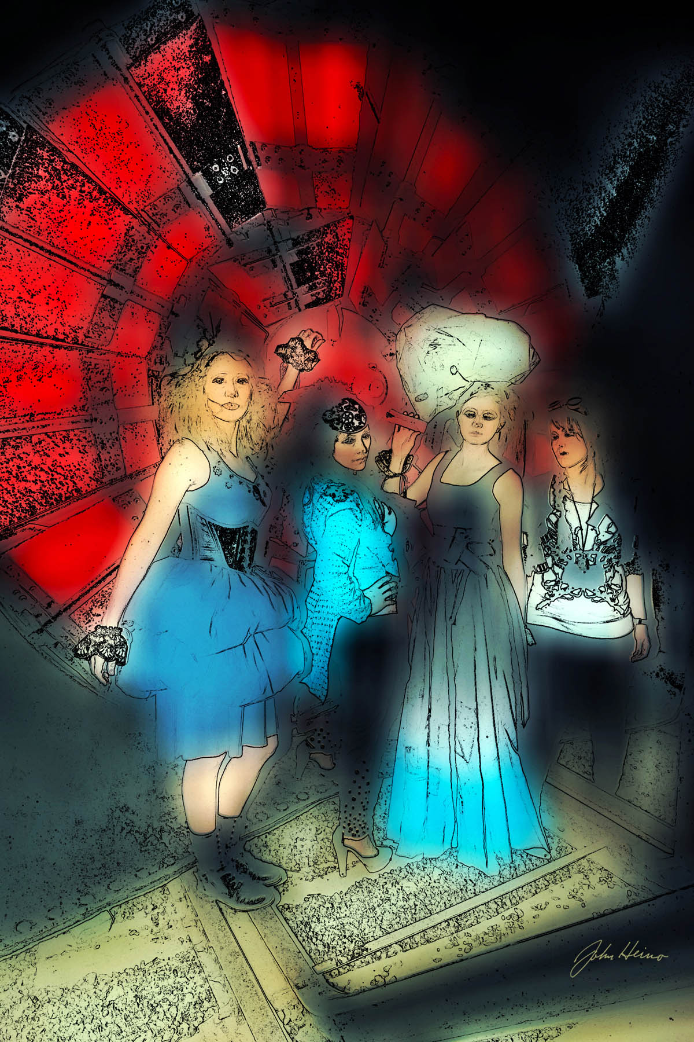

Slide 33
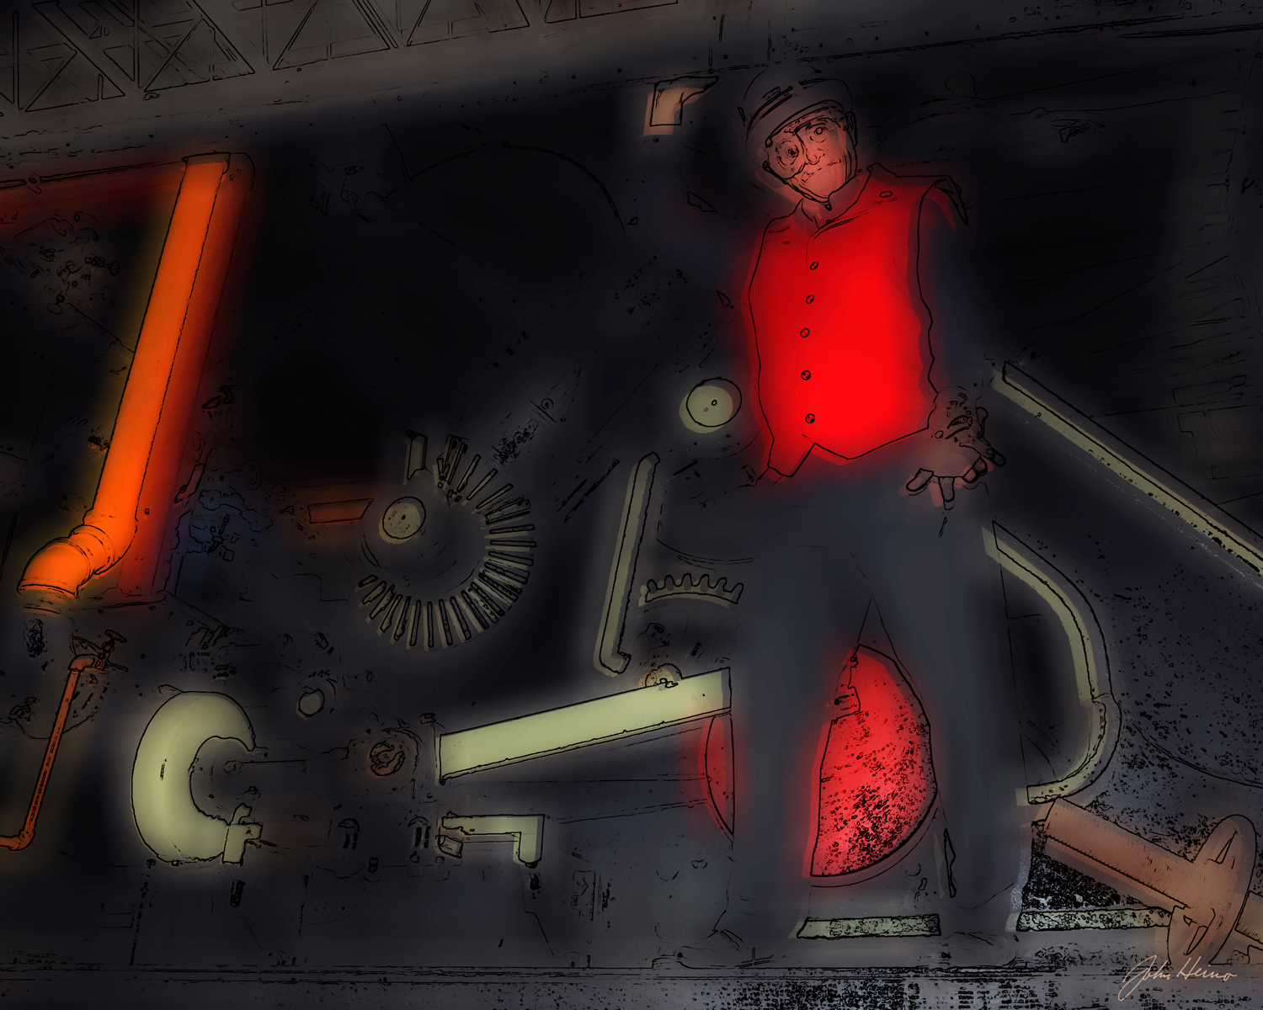

Slide 34
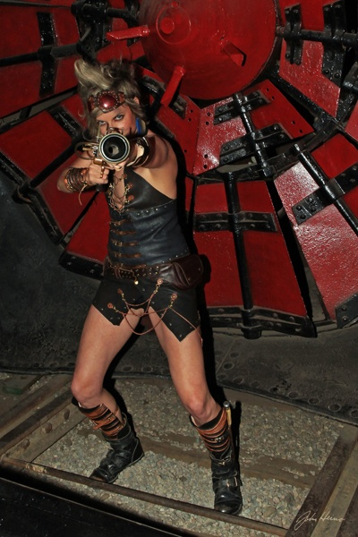
Dead to Rights

Slide 35
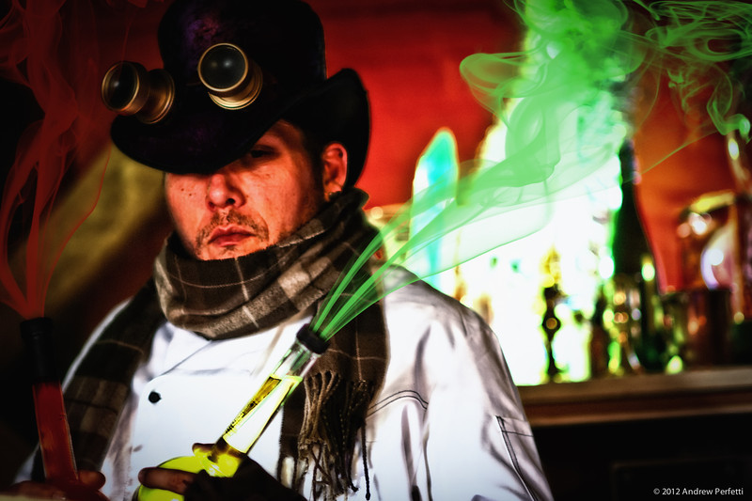
Steampunk & Fantasy Calendar
friendsofindustrystudios@gmail.com

Slide 36
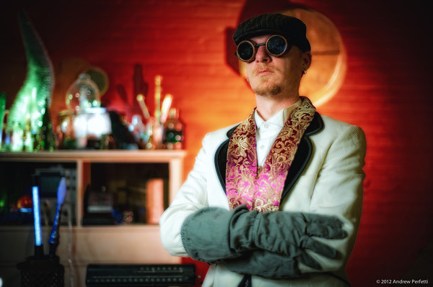

Slide 37
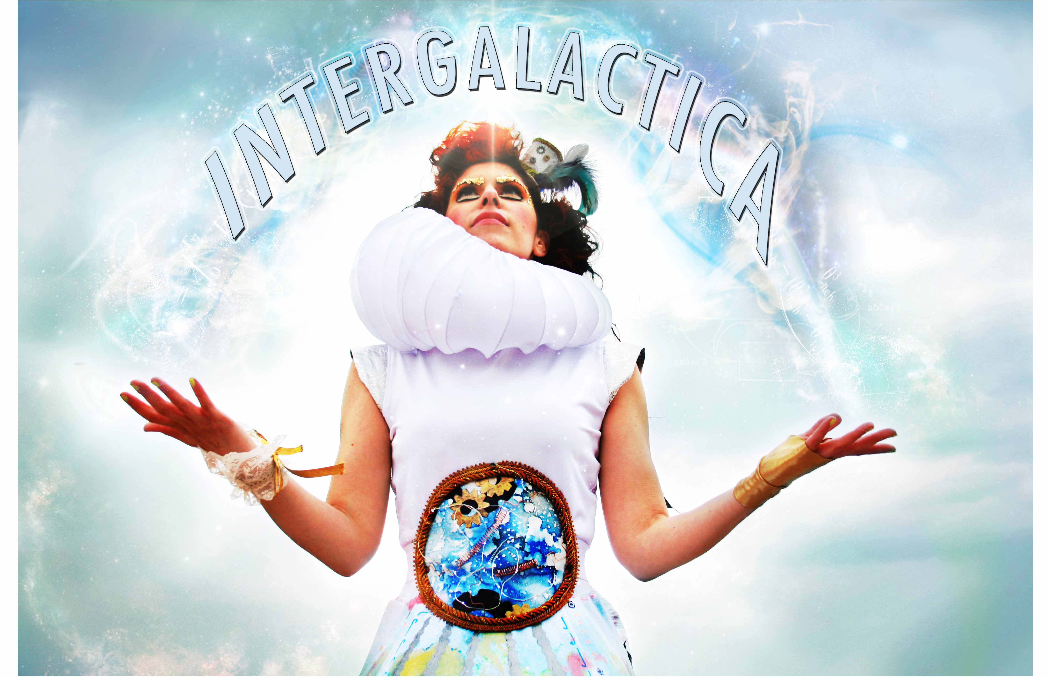
By Kate Dupre, Patricia Mahnke and Ed Newman

Slide 38
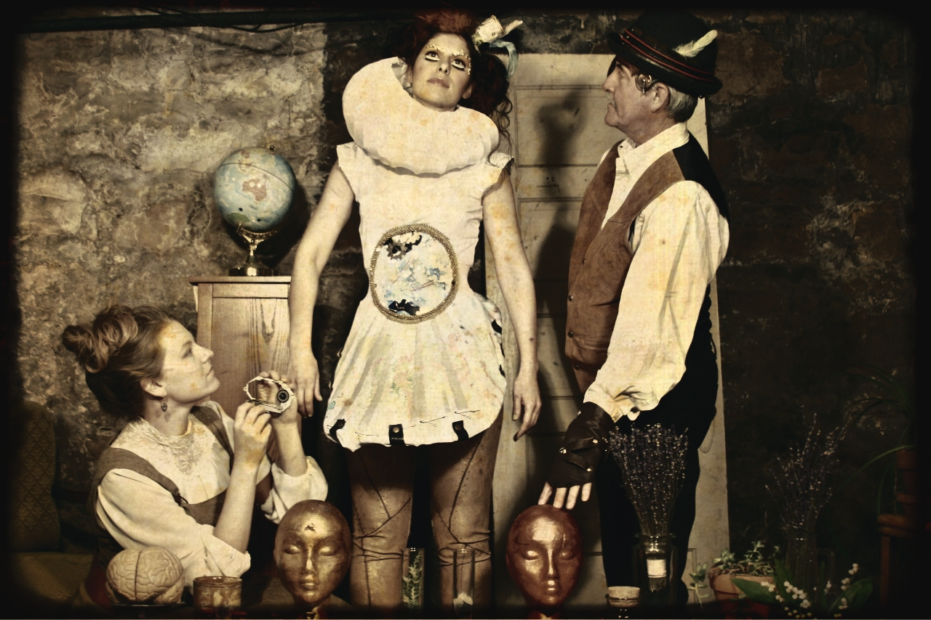
Dr. Jules Langdon Lafón
Professor Minerva Delphina Wonderborn

Slide 39
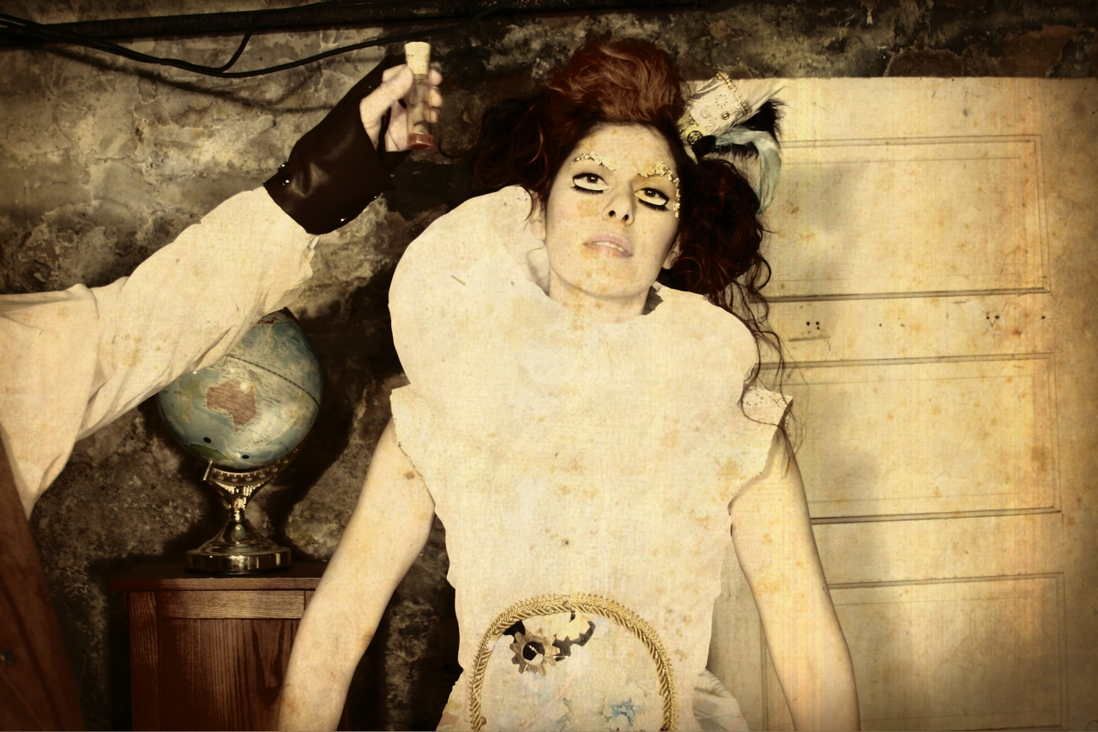
Aurora

Slide 40
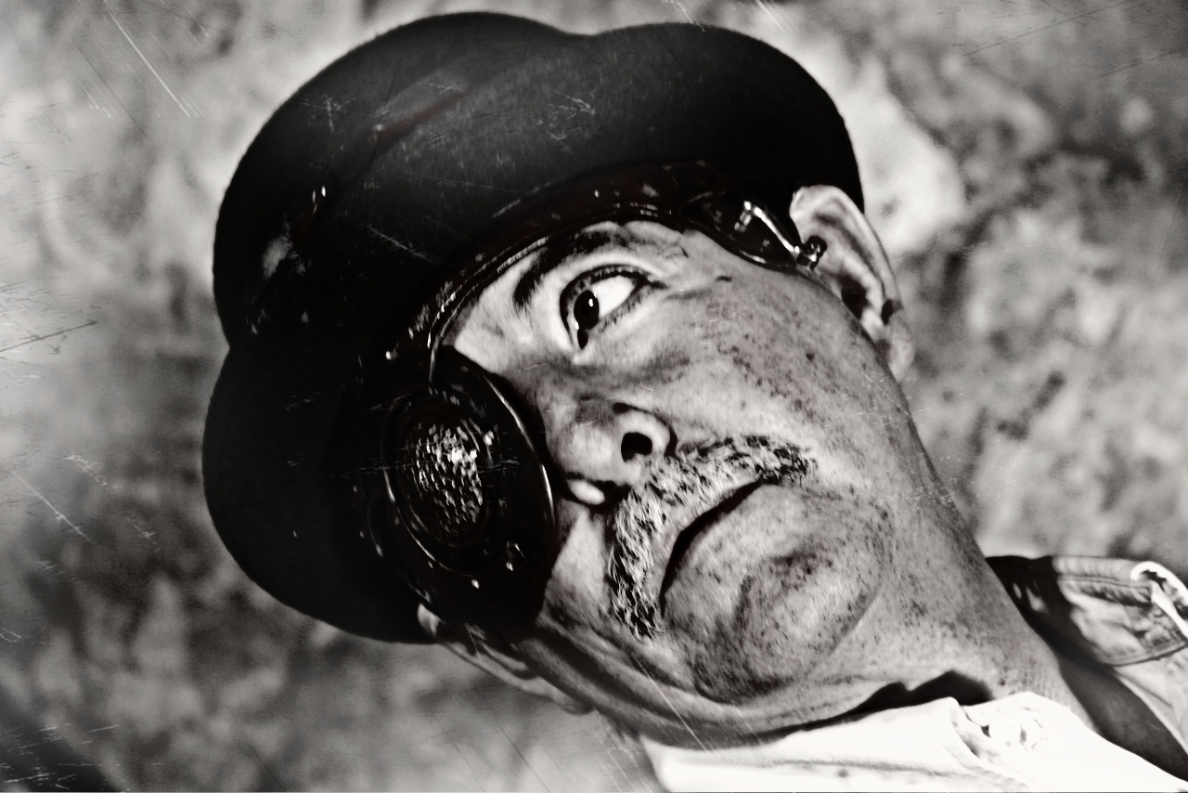

Slide 41
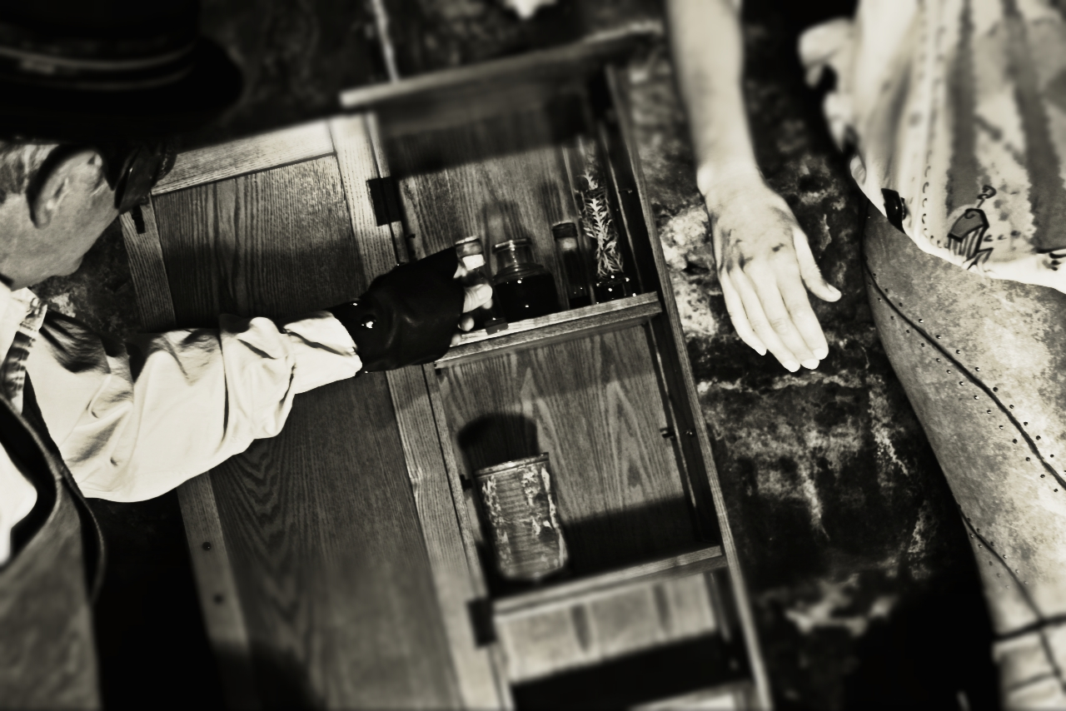

Slide 42
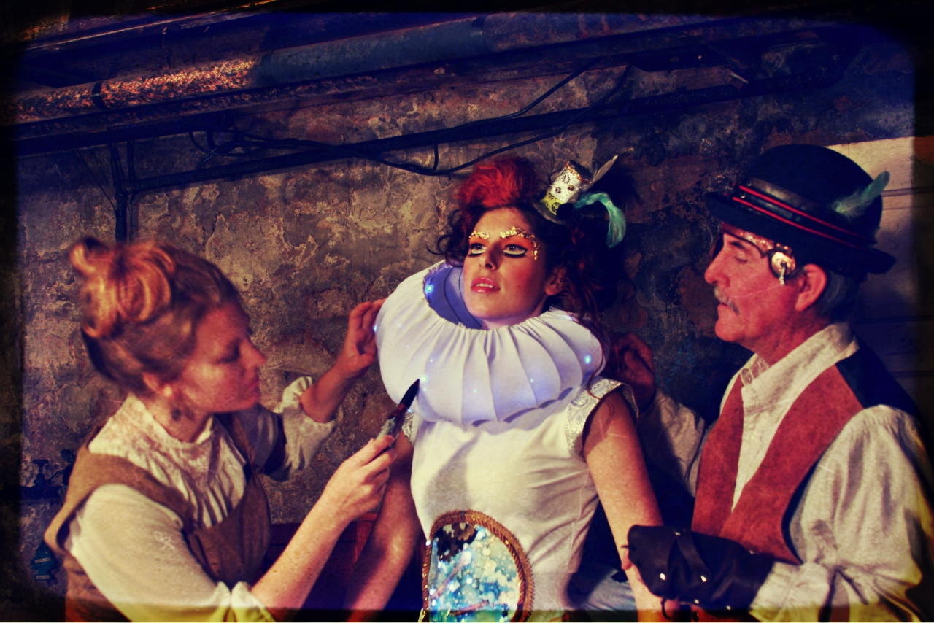

Slide 43
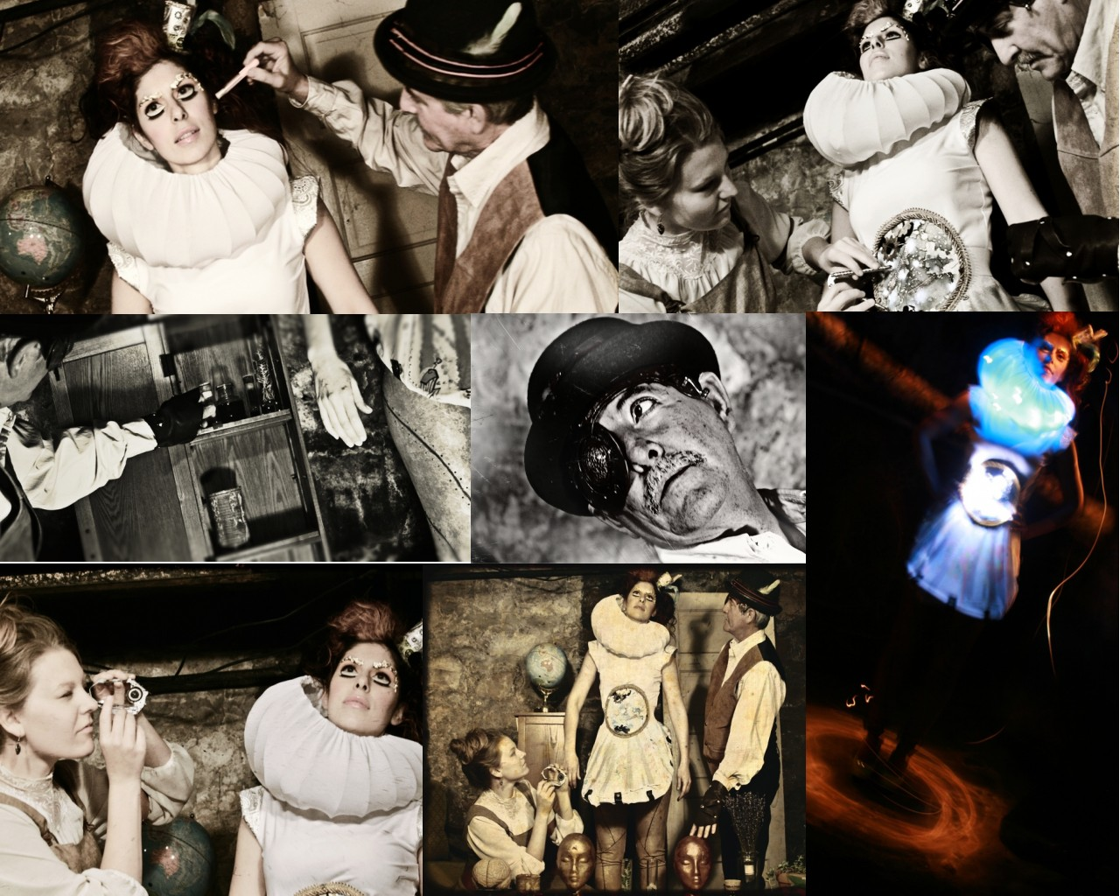

Slide 44
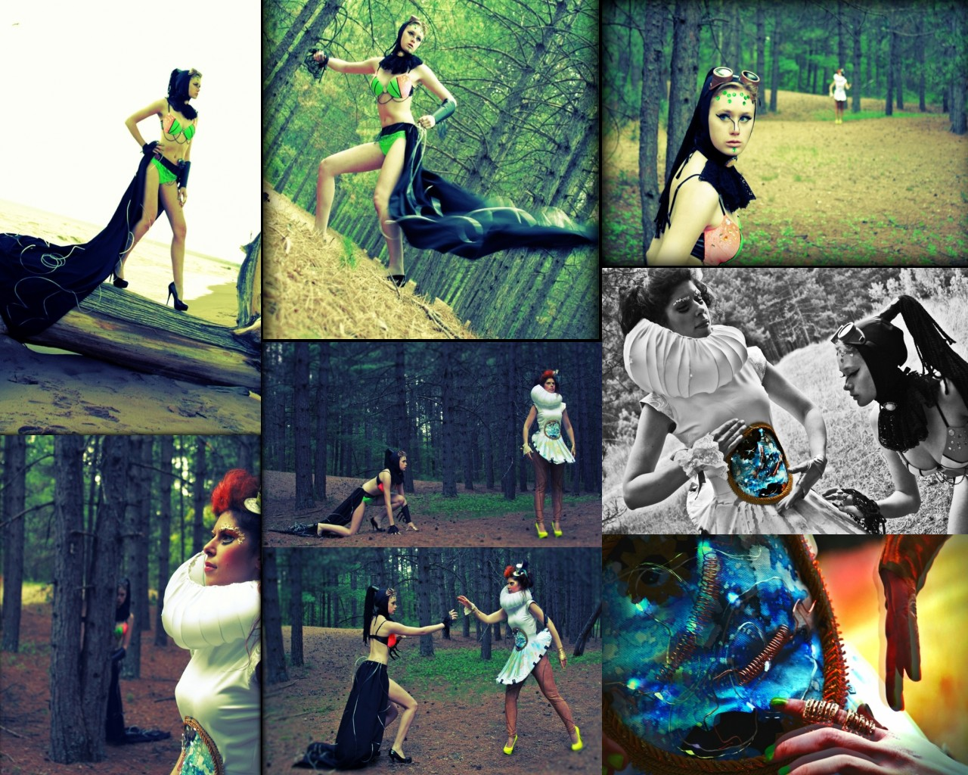

Slide 45
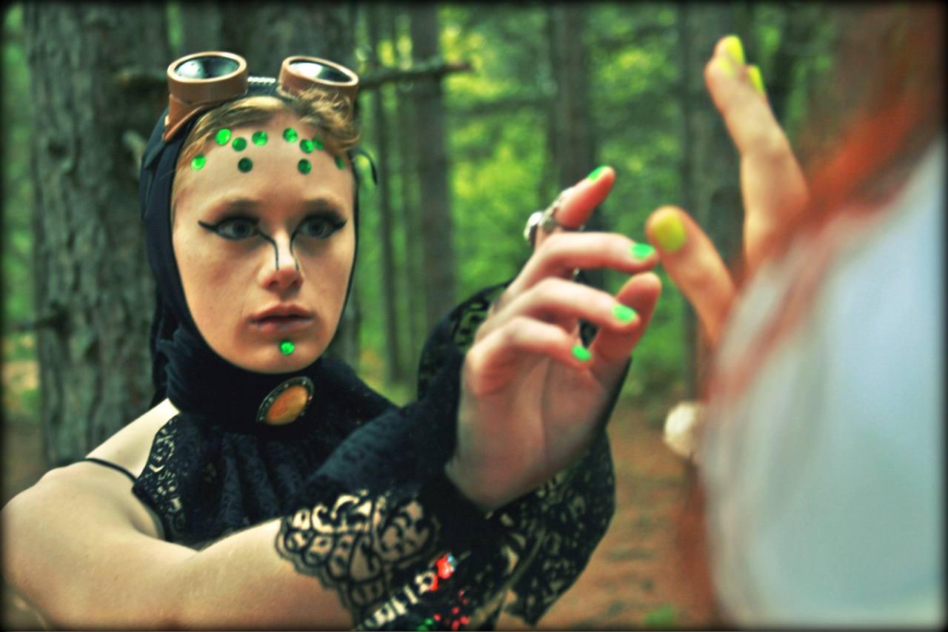
“When worlds collide…”

Slide 46


Slide 47


Slide 48


Slide 49
For MORE INFORMATION
Google “Steampunk Ennyman”
Ennyman’s Territory
Look for Intergalactica online later this year, a production of N&L Publishing.

Slide 51
https://docs.google.com/a/d.umn.edu/presentation/d/1C4Ud6FErDo3NWJIvN-QO51nu3RaBxyQPkPQuAg-pRBg/edit?usp=sharing\

