Slide 1
beyond the tailgate: engaging Alumni as Partners in our Civic Mission
David J. Weerts
Associate Professor and Faculty Director
Jandris Center for Innovative Higher Education (jCENTER)
Department of Organizational Leadership, Policy, and Development
University of Minnesota- Twin Cities

Slide 2
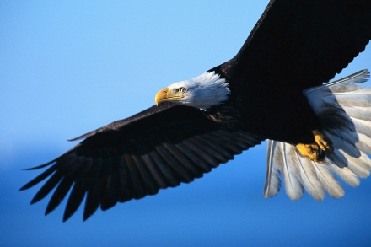
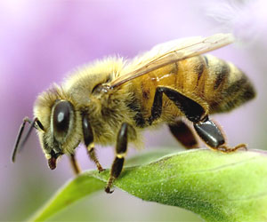
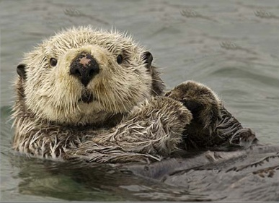

Understanding Civic identity: A Tale of Eagles, Honeybees, Otters, and Koalas
Weerts, D. J., & Cabrera, A. F., (in press). Profiles of civically engaged college students. Journal of College and Character
Weerts, D., J., Cabrera, A. F., & Pérez, P. (2014). Uncovering classes of civically engaged college students: A latent class analysis. Review of Higher Education, 37(2), 141-168.

Slide 3
classes of civically engaged students (now alumni)
Notes:
David’s slide: brief explanation of figure

Slide 4
Profiles of Eagles….
More likely to be…
  Men
  Involved in religious organizations
  Involved in student leadership in high school
  ACT scores not as high as other engagement categories (Honeybee/Otter)

Slide 5
Profiles of Honeybees….
More likely to be…
  Women
  Higher ACT scores than other categories
  Enrolled in conventional majors (accounting, economics) as opposed to investigative/enterprising ones (political science, marketing)

Slide 6
Profiles of otters and koalas….
Otters and Koalas less likely to…
  Report involvement in religious organizations
  Report high school leadership experiences.
  But have slightly higher ACT scores than Eagles…

Slide 7
“Once an Eagle, always an Eagle….”
Civic patterns formed in college hold after graduation (Weerts, Cabrera, Sanford, 2010).
Civic behaviors after college highly correlated with campus volunteerism and philanthropic support (Weerts & Ronca, 2008; 2009)
Notes:
David’s slide

Slide 8
Some Burning Questions Related to Alumni Relations….
Are we engaging our students in meaningful ways given their unique aspirations, talents, worldviews, and civic orientations?
What might alumni relations look like if we engaged alums around their broader civic interests and identities?
How might campus units work together to rethink today’s alumni relations model?
Alumni relations officers as civic professionals? Implications for how we think about our roles…

Slide 9
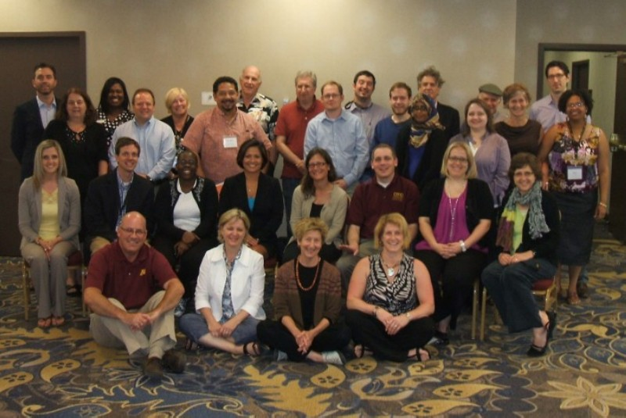
CITIZEN ALUM “Doers, not just donors!”
Citizen Alum Summer Institute, June 11-12, 2013 , University of Minnesota

